Slide 1
NN-accelerator Project
Midterm Presentation

Slide 2
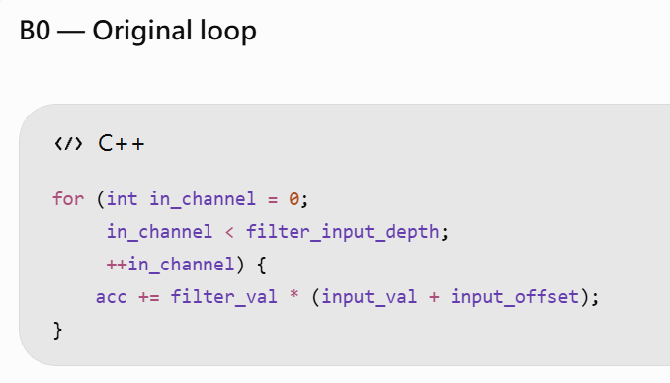
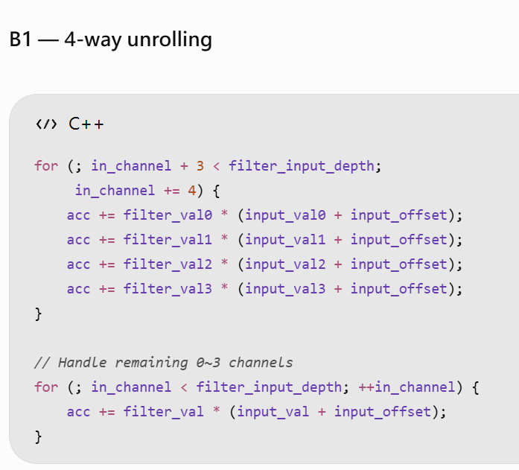
B0 → B1: 4-Way Loop Unrolling
Workload | ResNet-18 INT8
Runtime | TensorFlow Lite Micro
Target ISA | RV64IMC
Compiler | riscv64-unknown-elf-g++
Optimization | -O2
Language | C++17
ABI | lp64
EEI | Spike (+ proxy kernel)
Model / Input | same
Expected:
Reduce loop iteration and branch/control overhead.
Reduce partial loop index update.
Might increase register pressure.
No packed INT8 MAC.

Slide 3
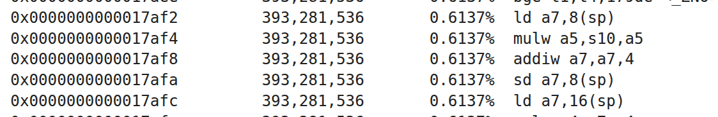
B0 → B1: 4-Way Loop Unrolling (cont.)
Instr | B0 | B1 | Change
bnez | 5.095B | 2.224B | -56.34%
bge | 10.166B | 12.237B | +20.38%
beqz | 8.568B | 10.259B | +19.74%
lw | 13.672B | 4.236B | -69.02%
ld | 0.240B | 3.946B | +1541.93%
sd | 0.173B | 0.938B | +441.69%
mulw | 11.854B | 4.775B | -59.72%
addw | 13.626B | 8.946B | -34.35%
Metric | B0 | B1 | Change
Dynamic instructions | 82.93B | 64.08B | -22.72%
Oberservations:
Branch instruction count decreased by 6.85% overall.
ld / sd increase.
  Possible reason: register spilling
Unexpected mulw reduction
  To be verified.

Slide 4
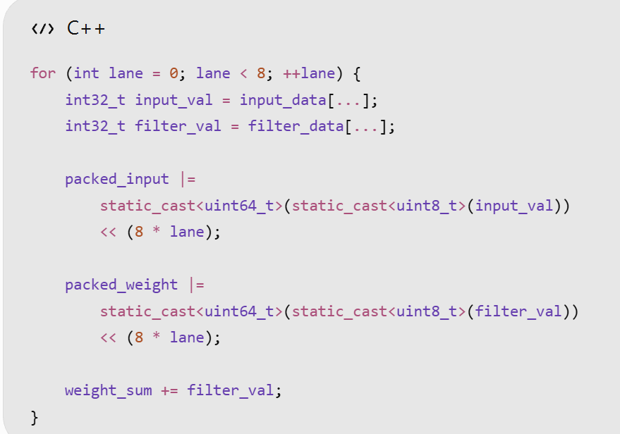
X1.1: xqmac8 (packing loop)
Metric | B1 | X1.1 | Change
Dynamic instructions | 64.08B | 93.52B | +45.93%
Instr | B1 | X1.1 | Change
sll | 4.74M | 3.15B | +66,336%
or | 2.87M | 3.15B | +109,738%
lbu | 1.86M | 1.57B | +84,571%
zext.b | 6K | 1.57B | +25,912,142%
bne | 740.76M | 3.87B | +423%
xqmac8 | 0 | 196.64M | -

Slide 5
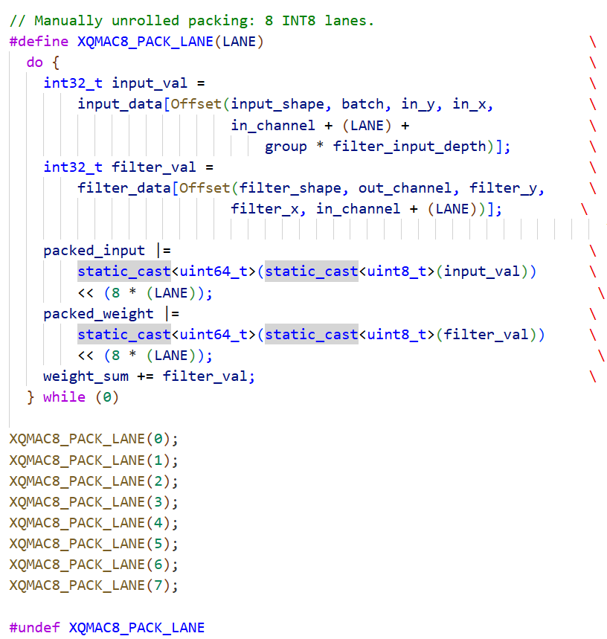
X1.2: xqmac8 (unroll packing loop)
Metric | B1 | X1.2 | Change
Dynamic instructions | 64.08B | 65.08B | +1.55%
Instr | X1.1 | X1.2 | Change
bne | 3.874B | 544.12M | -85.95%
sll | 3.151B | 4.743M | -99.85%
slli | 5.56M | 2.759B | +49,536%
xqmac8 | 196.64M | 196.64M | +0.00%
 | X1.1 | X1.2 | Change
Top Count / PC | 1,573,126,144 | 196,640,768 | -8x

Slide 6
Comparison
Version | MAC impl. | Software optimization | Dynamic Instr. Count | Change
B0 | Scalar MAC | no | 82.93B | -
B1 | Scalar MAC | 4-way | 64.08B | -22.72%
X1.1 | Xqmac8 | no (data packing loop) | 93.52B | +12.77%
X1.2 | Xqmac8 | unroll data packing loop | 65.08B | -21.52%

Slide 7
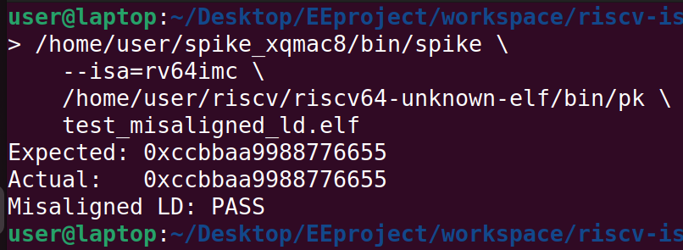
Before X1.3: RISC-V Misaligned Load
RISC-V ISA Spec: Loads and stores whose effective address is not naturally aligned to the referenced datatype (i.e., the effective address is not divisible by the size of the access in bytes) have behavior dependent on the EEI.
Spike Implementation:
riscv/mmu.h:
int is_misaligned_enabled()
{
return proc && proc->extension_enabled(EXT_ZICCLSM);
}
riscv/mmu.cc:
if (!is_misaligned_enabled())
throw trap_load_address_misaligned(...);
Spike ISA | Misaligned Trap | Test Program
rv64imc_zicclsm | No | PASS
rv64imc | Yes | PASS

Slide 8
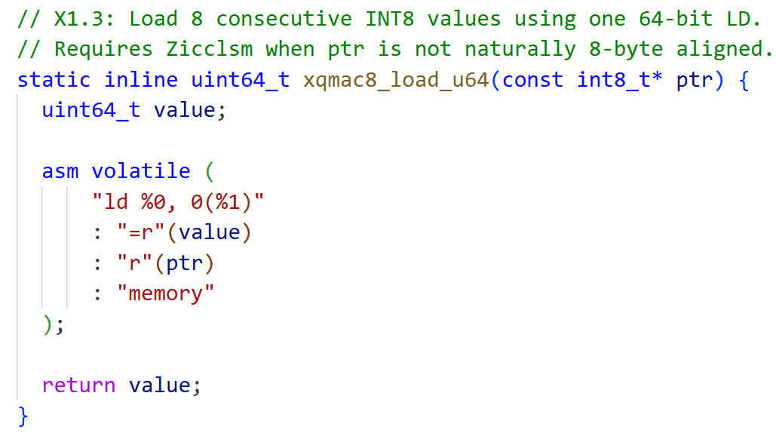
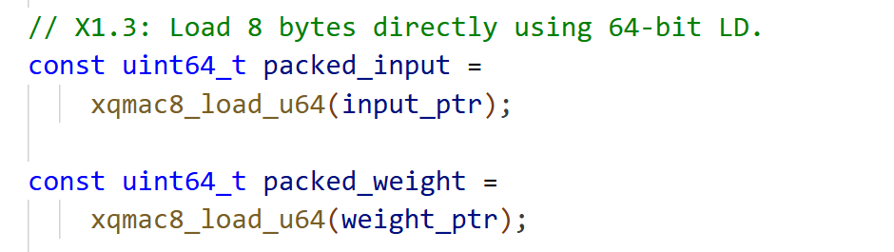
X1.2 → X1.3: 64-bit load

Slide 9
Comparison
Ver. | MAC impl. | Software Optimization | Dynamic Instr. Count |  | Change
 |  |  | RV64IMC | RV64IMC+Zicclsm | RV64IMC | RV64IMC+Zicclsm
B0 | Scalar MAC | no | 82.93B | - | -
B1 | Scalar MAC | 4-way loop unroll | 64.08B | 64.08B | -22.72%
X1.2 | Xqmac8 | unroll data packing loop | 65.08B | 65.08B | -21.52%
X1.3 | Xqmac8 | 64bit load | Need to arrange data layout | 25.64B | - | -69.08%

Slide 10
Thank you

