Slide 1
TDT4265 Project - Group 187 Track 2 – Medical Image Segmentation
Alexander Huhn, Felix Zijie Rong

Slide 2
Agenda?
Data Exploration and Preprocessing -> 1-2 min
Models -> 5 min
Development -> 2 min
Final Model and Results -> 2 min
Runtime Analysis and Carbon Footprint -> <1 min
Discussion and Outlook -> <1 min
Group Member Contribution -> <1 min
14 mins

Slide 3
Preprocessing
Task: Medical image segmentation
Challenges:
Non uniform z-dimensions, Aorta Vessels very small
Small amount of data
Preprocessing: scale intensity to increase contrast, isotropic spacing and padding for z-dimension
Data Augmentation (Crop, Rotate, Flip)
Notes:
Anhand der Data Exploration wurde folgendes Preprocessing abgeleitet
Preprocessing: scale intensity to increase contrast, isotropic spacing and padding for same z-length
Data Augmentation (Crop, Rotate, Flip)

Slide 4
Models
Model A: SegResNet
Model B: DiNTS
Both used in combination with MONAI's Auto3DSeg's solution:
performs data analysis
sets preprocess parameters accordingly

Slide 5
Model A: SegResNet
U-shape architecture
With ResNet-like blocks
DiceCE loss

Slide 6
Model A: SegResNet
Notes:
Encoder?
Decoder?
-> name of parts??
@VAE: input is sampled down to a low dimensional space of 256 and then reconstruted using the same architecture as the encoder (except the interlevel skip connections from the initial input and the different downsample steps)

Slide 7
Model B: DiNTS
"Differentiable Neural Network Topology Search"
Initialized with different architectures from a search space
Dice Focal loss

Slide 8
Model B: DiNTS
Notes:
Each architecture in the search space is parameterized. This means that instead of directly representing architectures as discrete entities, they are represented as continuous variables
Then gradient descent is used in the search process to find the best architecture
Each circle consists of a skip connection
3x3x3 convolution
Or a … [name]

Slide 9
Models:
Model A: SegResNet
U-shape architecture
ResNet-like blocks
DiceCE loss
Model B: DiNTS
Densely-connected lattice-based network
Conv layers
Dice Focal loss

Slide 10
Development
Preprocessing Transforms → crucial
Preprocessing Filters ^{[4]} (Frangi, Hessian) → not successful
Data Augmentation (Crop, Rotate, Flip, Zoom, Gaussian Noise)
Pretraining on ImageCAS ^{[5]} → major improvement (Model A)
Data Postprocessing → minor improvement
Notes:
In order to improve the performance of our model, we took the following steps
- As mentioned before, appropriate preprocessing is the most crucial step to achieve good results in this task
We have tried to include Filters in the preprocessing to highlight tubular structures, however this was not successful
Since the ASOCA dataset only consists of a very limited amount of samples Data Augmentation was important. Common augmentation transforms has been applied using MONAIs framework
To increase the data basis for training, pretraining on the ImageCAS coronary artery segmentation dataset has been used. This brings a major performance increase for Model A
Last but not least we added a simple postprocessing routine to filter out small and unconnected structures, which increases the overall performance a little

Slide 11
Post-Processing
Removing small structures using sk-image ^{[6]}
Notes:
The post-processing has been done using sk image connected component analysis
In the raw prediction you can see that there are quite a lot of small unconnected structures
These will be filtered out and the result looks as follows

Slide 12
Post-Processing and Metrics
Performance increase up to 0.3% Dice and 2.56% HD95
Figures taken from https://doi.org/10.1109/ACCESS.2022.3140378 and https://statisticaloddsandends.wordpress.com/2019/10/02/what-is-hausdorff-distance/
Notes:
With this, the performance increase up to 0.3% DiceScore and 2.6% HausdorffDistance on average
These two are the relevant metrics in this segmentation task
The Dice score measures the overlap between prediction and ground truth relative to their total area as shown here
the Haussdorff metric quantifies the maximum distance between prediction and ground truth, by matching matching the closest points of two datasets and taking the maximum distance.
Like in the literature, the 95% percentile will be taken due to the sensitive to noise and outliers.

Slide 13
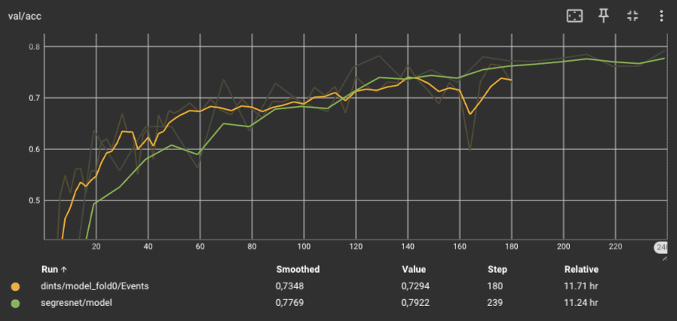
Training Results
(All Models trained for 12 hrs, additional 12 hrs on ImageCAS for pretrained)
Notes:
Our training results can be seen here. We see that Model a has a quite high loss on average, but a good training accuracy.
For Model B, the graphs indicate that more training epochs would be needed for convergence. All models has been trained for 12 hrs, and additional 12 hrs for pretraining.

Slide 14
Results
Model | Epochs | Mean Dice Score | HD95
Model A | 242 | 0.517 | 2.711
Model B | 181 | 0.538 | 2.755
Model A (Pretrained) | 2524 | 0.555 | 2.338
Model B (Pretrained) | 118 | 0.508 | 2.885
(All Models trained for 12 hrs, additional 12 hrs on ImageCAS for pretrained)
Notes:
We tested our models on a 20% split of the data and the results look as follows.

Slide 15
Results
Model | Epochs | Mean Dice Score | HD95
Model A | 242 | 0.517 | 2.711
Model B | 181 | 0.538 | 2.755
Model A (Pretrained) | 2524 | 0.555 | 2.338
Model B (Pretrained) | 118 | 0.508 | 2.885
(All Models trained for 12 hrs, additional 12 hrs on ImageCAS for pretrained)
Notes:
It shows that model A with pretraining has the best Dice and Hausdorff Distance metrics

Slide 16
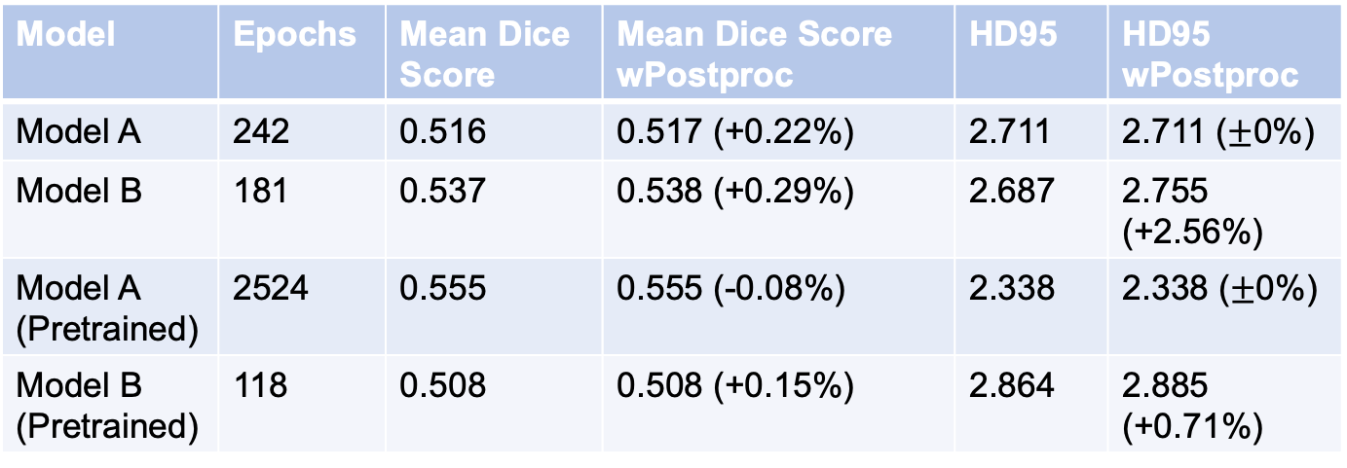
Results
Model | Epochs | Mean Dice Score | Mean Dice Score wPostproc | HD95 | HD95 wPostproc
Model A | 242 | 0.516 | 0.517 (+0.22%) | 2.711 | 2.711 ($±$0%)
Model B | 181 | 0.537 | 0.538 (+0.29%) | 2.687 | 2.755 (+2.56%)
Model A (Pretrained) | 2524 | 0.555 | 0.555 (-0.08%) | 2.338 | 2.338 ($±$0%)
Model B (Pretrained) | 118 | 0.508 | 0.508 (+0.15%) | 2.864 | 2.885 (+0.71%)
All trained 12 hrs
Zum vorstellen nur die Werte mit postproc sofern bei allen eine verbesserung
(For pretraining additional 12 hrs on ImageCAS)
→ Model x is the best
Notes:
Testing our model on 20% split of the data.

Slide 17
Results: ...später...
Quantitative: Loss curves, accuracy (current mean dice) curves
Qualitative: For which datasets is it good and with what does it struggle -> 3D plots
Mean Dice Score and HD95 metric -> Table
Metrics: Dice measures the overlap between the predicted segmentation and the ground truth, HD95: quantifies the maximum discrepancy between the predicted segmentation and the ground truth

Slide 18
Best Model – qualitative results
Overview of architecture → already shown before
...dann schauen welches am besten performed hat und das ist dann einfach das finale
Training: Loss func, data augmentation, pre-proc, time to train it / epochs
show best/worst test result? 3d plot

Slide 19
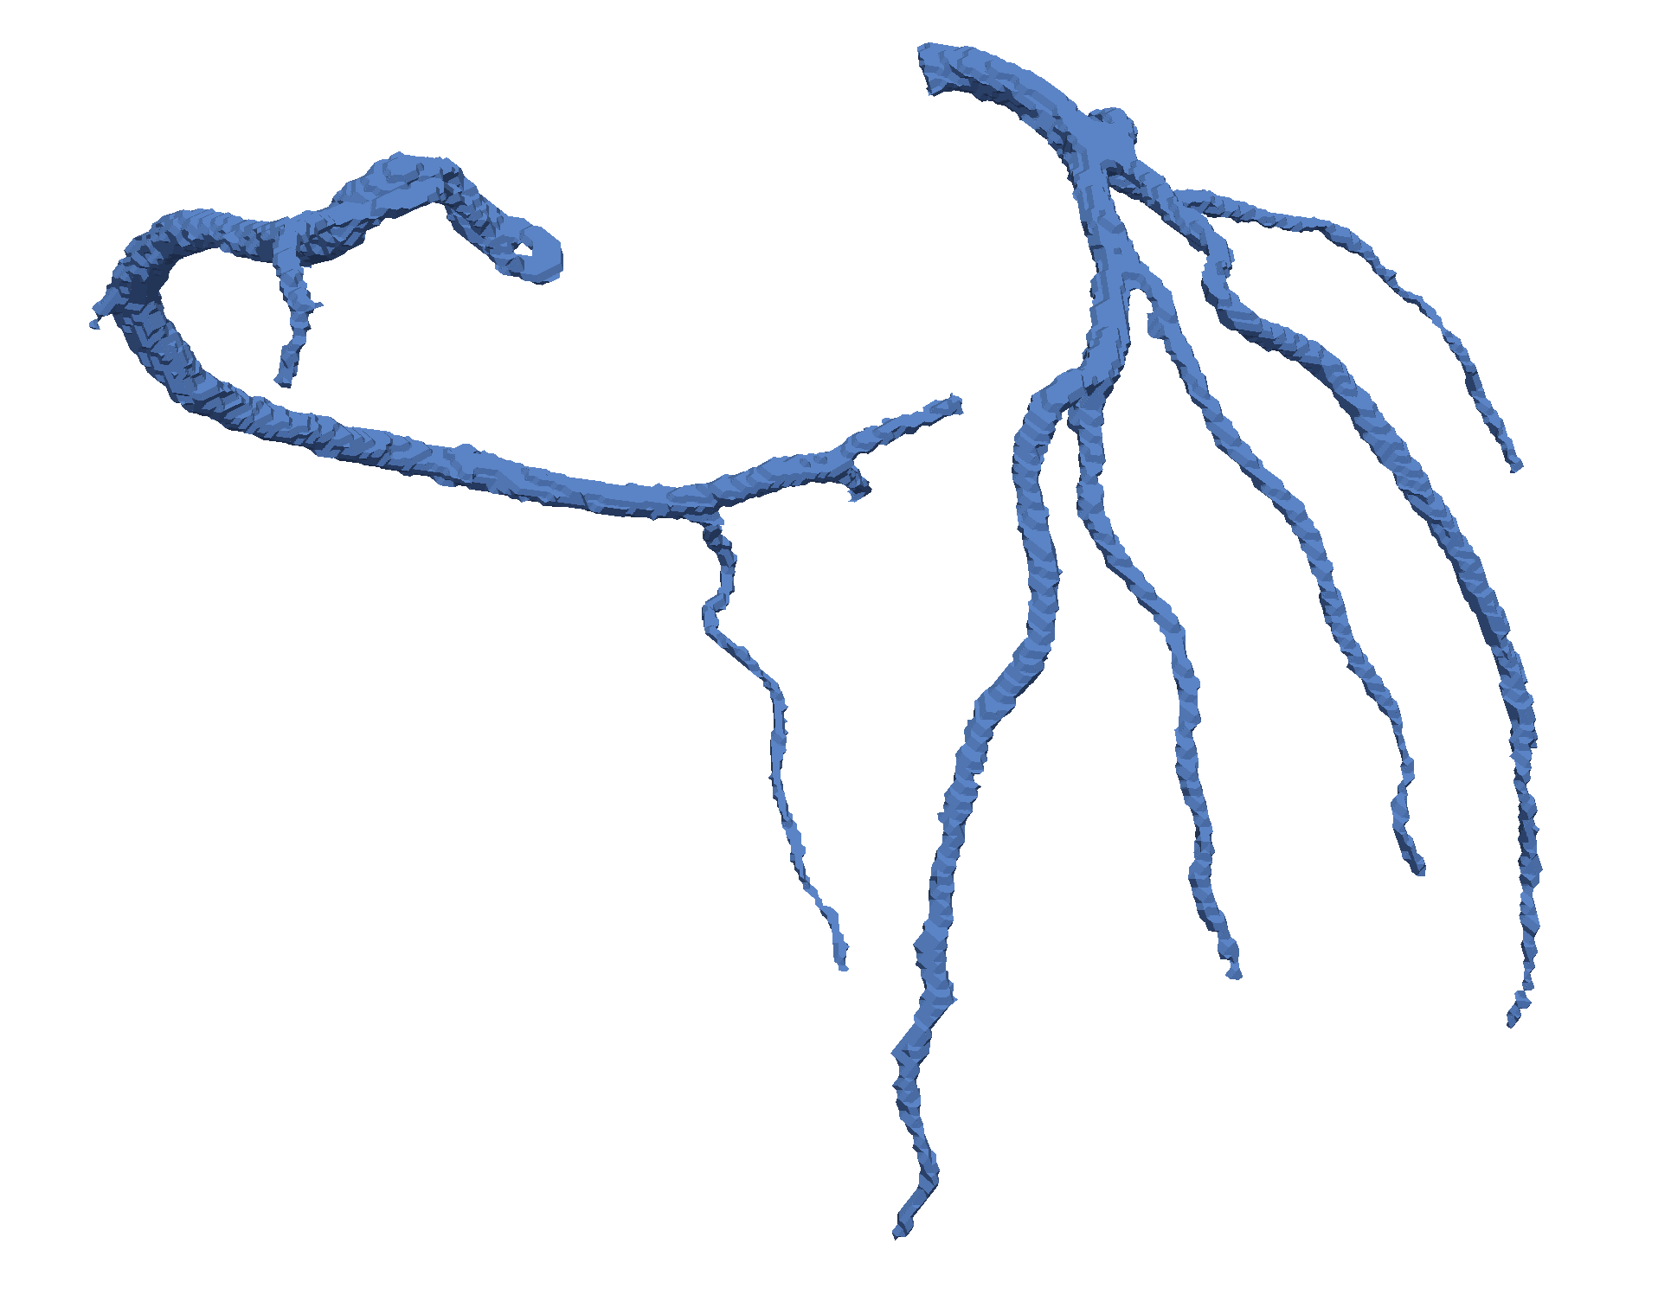
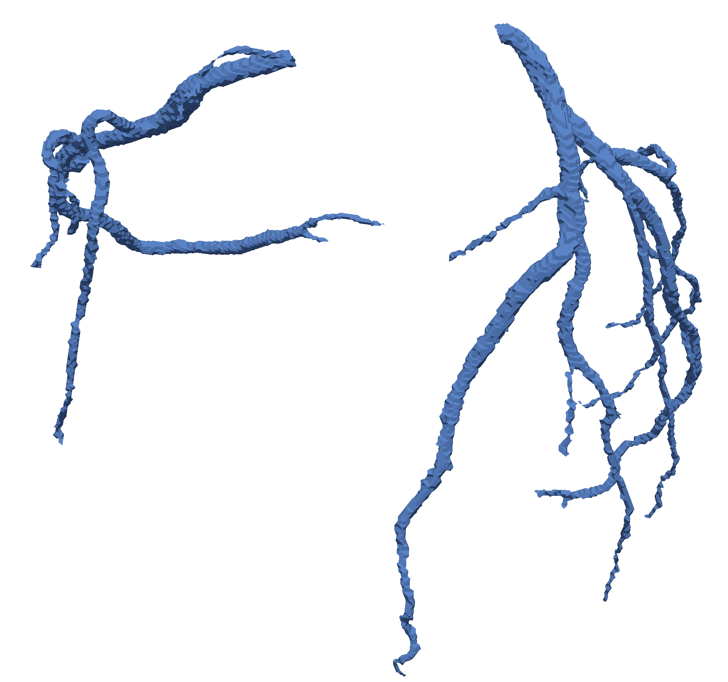
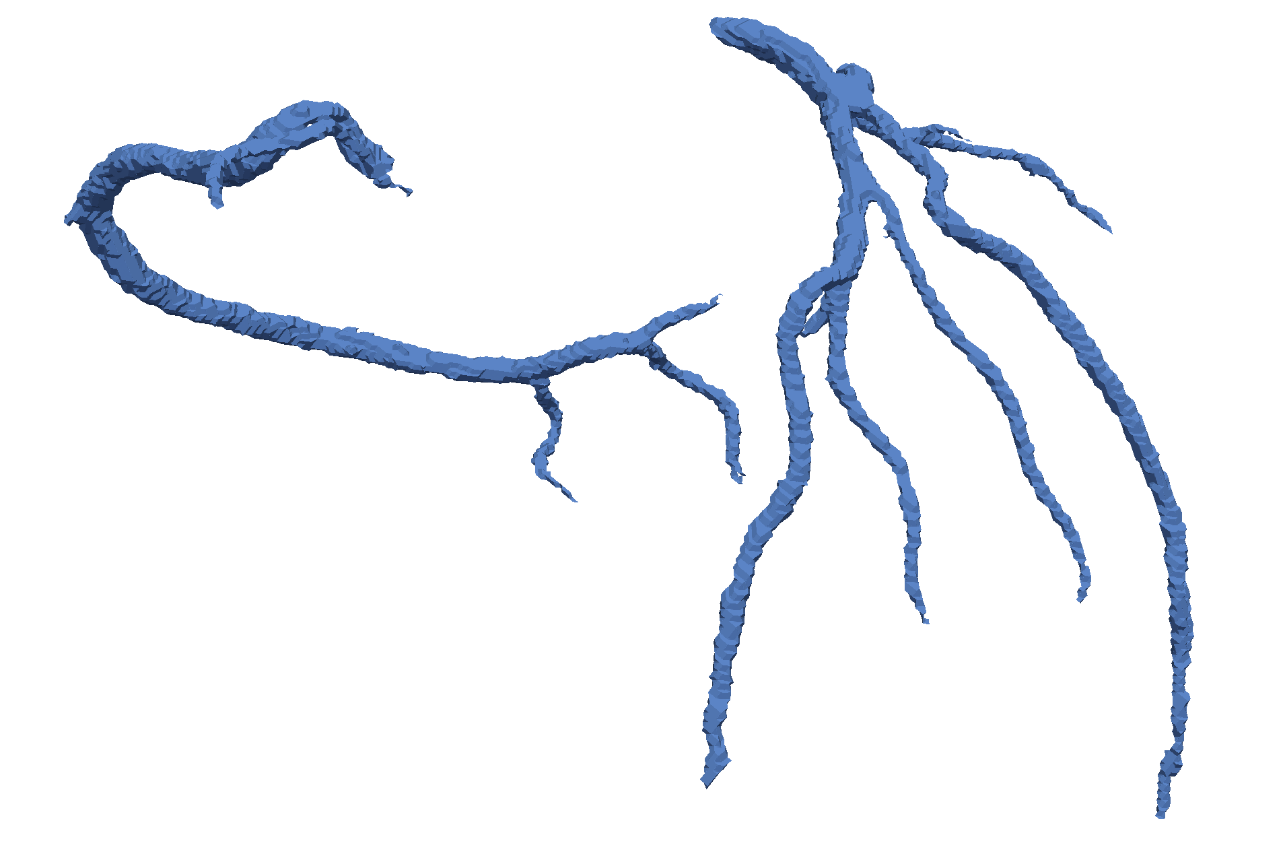
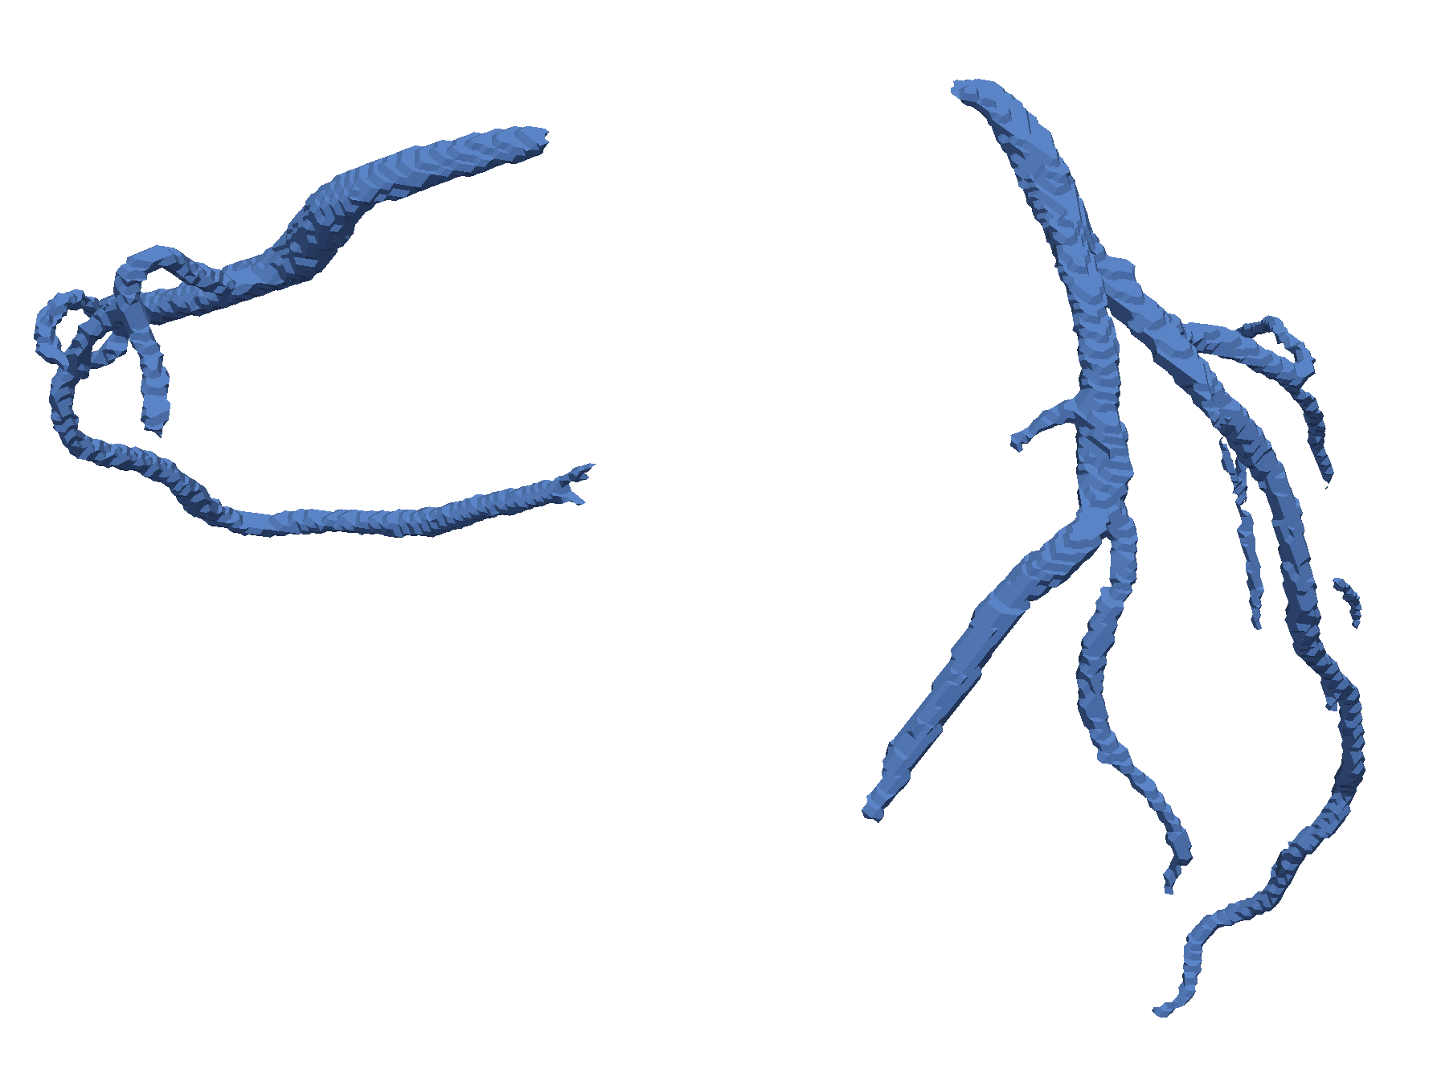
Best Model – Segresnet with pretrain
best performance (Diseased 19, Dice 0.67)
worst performance (Diseased 17, Dice 0.49)
label
prediction
Notes:
When looking at qualitative results, the best performance is shown here on dataset diseased 19. The overall segmentation looks very good. Only small vessels are missing.
The worst performance was on diseased dataset 17, where a lot of fine structure are missing.

Slide 20
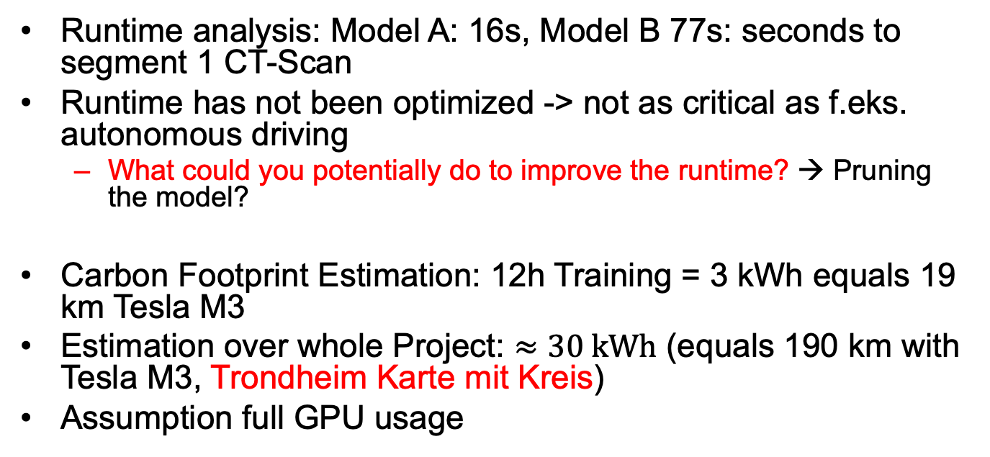
Runtime Analysis and Carbon Footprint → Felix
Runtime analysis: Model A: 16s, Model B 77s: seconds to segment 1 CT-Scan
Runtime has not been optimized -> not as critical as f.eks. autonomous driving
What could you potentially do to improve the runtime? → Pruning the model?
Carbon Footprint Estimation: 12h Training = 3 kWh equals 19 km Tesla M3
Estimation over whole Project: $≈30 kWh$ (equals 190 km with Tesla M3, Trondheim Karte mit Kreis)
Assumption full GPU usage
nvidia a100 40gb -> 250 W
[1] https://www.tesla.com/model3/design#overview
[2] https://www.grafikkarten.com/en/graphics-cards/nvidia/a-series-server/2755/nvidia-a100-40gb-pcie-4.0

Slide 21

Runtime Analysis and Carbon Footprint
190 km
Inference runtime for 1 dataset:
Model A: 16s, Model B: 77s
Inference time has not been optimized
Assumption GPU full load: 250 W (Nvidia a100 40gb) ^{[7]}
$≈30 kWh$ in total, equals 190 km range with Tesla model 3 ^{[8]}
Notes:
The time to segmentate one sample are 16 and 77 seconds For model a and b respectively.
Due to the bigger and complex architecture, its not a surprise that model B has a significantly higher inference time.
The runtime of our model has not been optimized since it is not critical as in autonomous driving for example. It could be optimized by pruning or reducing the model complexity, which however can also worsen the performance.
For the carbon footprint estimation, we assume a full load GPU usage of 250 W.
Over the whole project we estimate a total Power usage of 30 kWh, which equals 190 km range for a Tesla Model 3.
This range is visualized here on the map with Trondheim center

Slide 22
Discussion and Outlook
No significant worse performance on diseased data, unlike in the ASOCA paper ^{[9]}
Approach to create an own model (lightning), but bad results
Applying Preprocessing Filters was not successful
Outlook:
Hyperparameter tuning, cross validation, longer training time (Model B)
Create an ensemble of different models
More extensive pre- and postprocessing, e.g. pretrained networks ^{[9]}
Notes:
Now coming to the discussion of our work.
Interestingly, the test performance on diseased aorta datasets were not significantly worse, unlike in the ASOCA paper
We tried to create an own model from scratch using pytorch lightning, which was performing very badly and couldn’t segment the tubular aorta structures. We could not find out the reason for the poor performance.
As mentioned before, the approach to apply preprocessing filter in order to highlight tubular structures was not successful
For the outlook, hyperparameter tuning and cross validation can be conducted to increase the model performance, and additionally increasing the training time, especially for the dints model
An ensemble of models could be created, since the literature showed that an ensemble of models performs better than the best model alone
In addition, more extensive pre and postprocessing like pretrained networks could be used to improve the segmentation result

Slide 23
Group Member contribution
Preprocessing: Felix
Models: Research and Implementation: Alex
Postprocessing: Felix
Presentation & Report: both
Notes:
The Group member contribution can be summed up as follows.

Slide 24
Sources:
[1] SegResNet: https://arxiv.org/abs/1810.11654
[2] DiNTS: https://arxiv.org/abs/2103.15954
[3] MONAI Auto3DSeg: https://github.com/Project-MONAI/tutorials/tree/main/auto3dseg
[4] https://scikit-image.org/docs/stable/api/skimage.filters.html
[5] https://www.kaggle.com/datasets/xiaoweixumedicalai/imagecas/data
[6] https://scikit-image.org/
[7] https://www.grafikkarten.com/en/graphics-cards/nvidia/a-series-server/2755/nvidia-a100-40gb-pcie-4.0
[8] https://www.tesla.com/model3/design#overview
[9] Gharleghi et al., Automated segmentation of normal and diseased coronary arteries – The ASOCA challenge, 2022
Notes:
You find our sources and references here

Slide 25
Thank you for your attention!
Alexander Huhn: alexahuh@stud.ntnu.no
Felix Zijie Rong: felixzr@stud.ntnu.no
Notes:
Thank you for your interest!

