Slide 2


Nashville 2019 Scooter Trial
March 2023

Slide 3







Data Compliance Disclaimer
We reviewed data from seven companies and check their compliance with Second Substitute Bill BL2018-1202.

Slide 4
Data Compliance Disclaimer
9153 trips across three companies were out of compliance.
661
4,530
3,963

Slide 5
Data Compliance Disclaimer
However, these same companies report the most trips, leaving us with 542,008 trips to investigate.
14,973
2,751
116,459
223,569
34,422
6,410
143,424

Slide 6
Data Compliance Disclaimer
Here’s what we learned:

Slide 7
Company Fleet Size
Each company dropped varying numbers of scooters around the city.

Slide 8
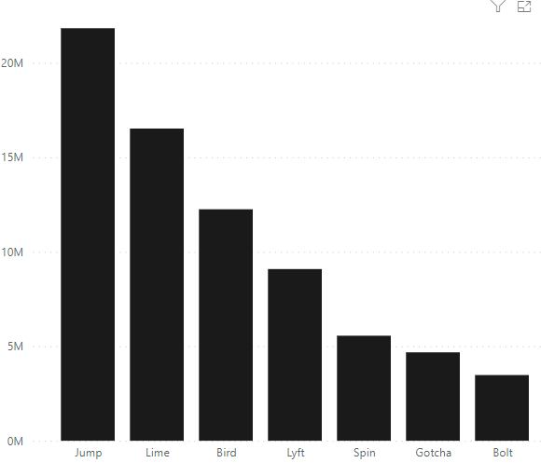
Final Verdict
Scooters are generally meeting the city’s goal for scooter usage.
Company Reach

Slide 9
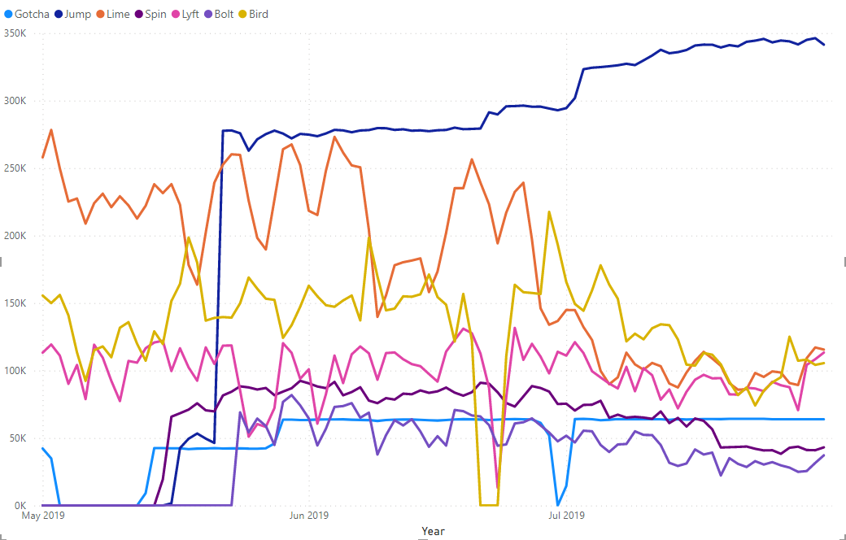
Scooter Availability Over Time
However, the number of available scooters for each company varies throughout the summer.

Slide 10
Final Verdict
Scooters are generally meeting the city’s goal for scooter usage.
Trip Duration Trends
Overall, times ranged from just 1 minute to a full 24 hours (1439 minutes) with a standard deviation of ~2hours (130.6 minutes)
Average Ride: 36.85 minutes

Slide 11
Goal Performance
The goal of Metro Nashville is to have each scooter used a minimum of 3 times per day.

Slide 12
Goal Performance
Let’s see how scooter daily averages varied by company.

Slide 13
Goal Performance
We examined the most and least used scooters from each company:

Slide 14
Goal Performance
Jump has the most noticeable success with five rides above the standard deviation (across ride frequency).
Standard Deviation Across Daily Averages: 3.2

Slide 15
Goal Performance
This trend is could be explained by Jump’s consistent market saturation.

Slide 16
Goal Performance
Alternatively, drops in available scooters may explain why companies stayed within the standard deviation.

Slide 17
Right Place, Right Time
Throughout the summer the observable jumps in scooter use across companies that can inform how we rollout scooters in Nashville.

Slide 18
Hot Spots & Peaks
We suspected the highest counts of scooters are related to tourism and highly-attended events in Downtown Nashville.

Slide 19
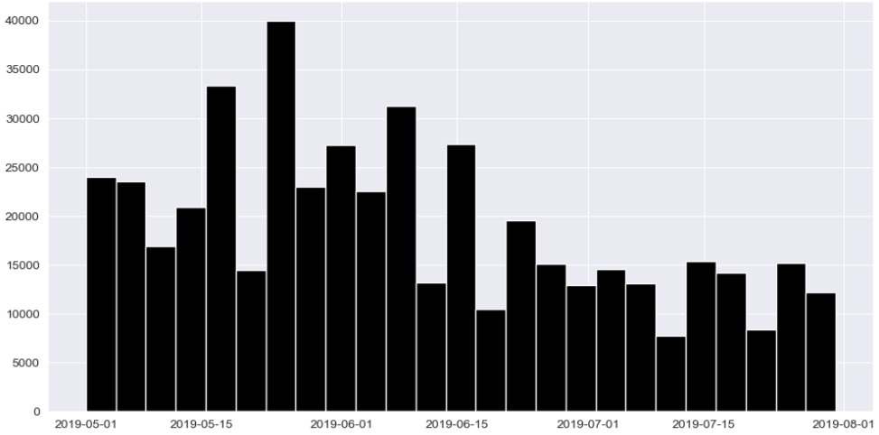
High-Scale Event Factor
We identified large events that lined up with overall peaks in scooter usage.
May Spikes
Deer Tick Concert (17th)
Anderson. Paak Concert (17th)
Harry Potter Concert (25th-26th)
Nashville Sounds Game (25th-26th)

Slide 20
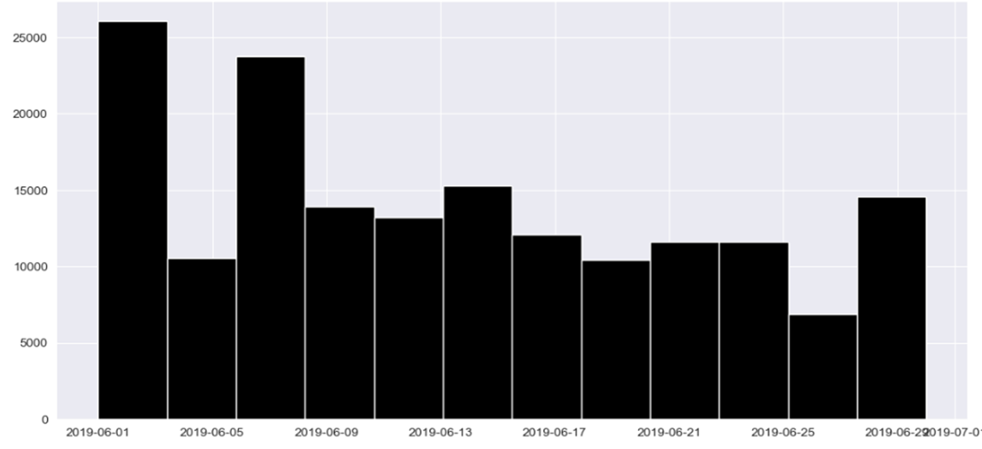
High-Scale Event Factor
We identified large events that lined up with overall peaks in scooter usage.
June Spikes
Taste of Music City (1st)
CMA Fest (6th-9th)

Slide 21
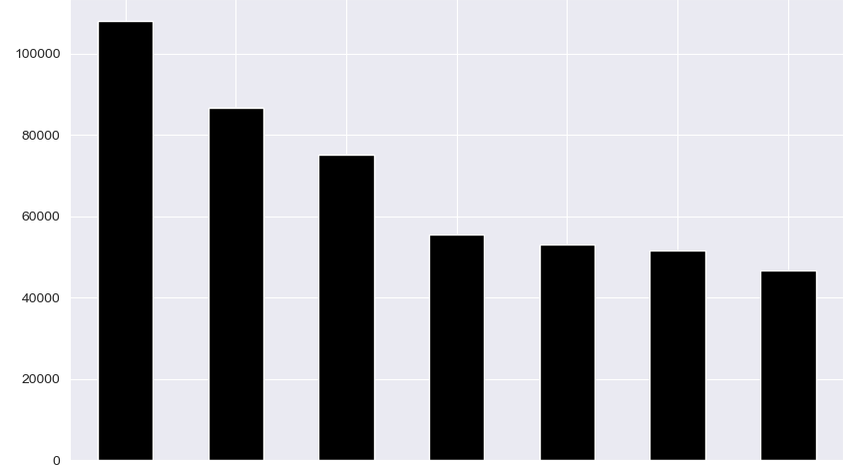
Common Rider Practices
Unsurprisingly, people rented scooters most frequently on Fridays and Saturdays throughout the summer. This trend also aligns with our tourism and events theory.
FRI
SAT
THU
SUN
WED
TUE
MON

Slide 22
Final Verdict
Scooters are generally meeting the city’s goal for scooter usage.

Slide 23
Final Verdict
Scooters are generally meeting the city’s goal for scooter usage.
Use Cases
Temporary fleet increases around tourist seasons and major events
Rides that are too long walk but too short to order a car (~half hour; 7 miles)
Further Work
Explore the locations where rides are initiated
Understand if company preference is tied to neighborhoods

