Slide 1
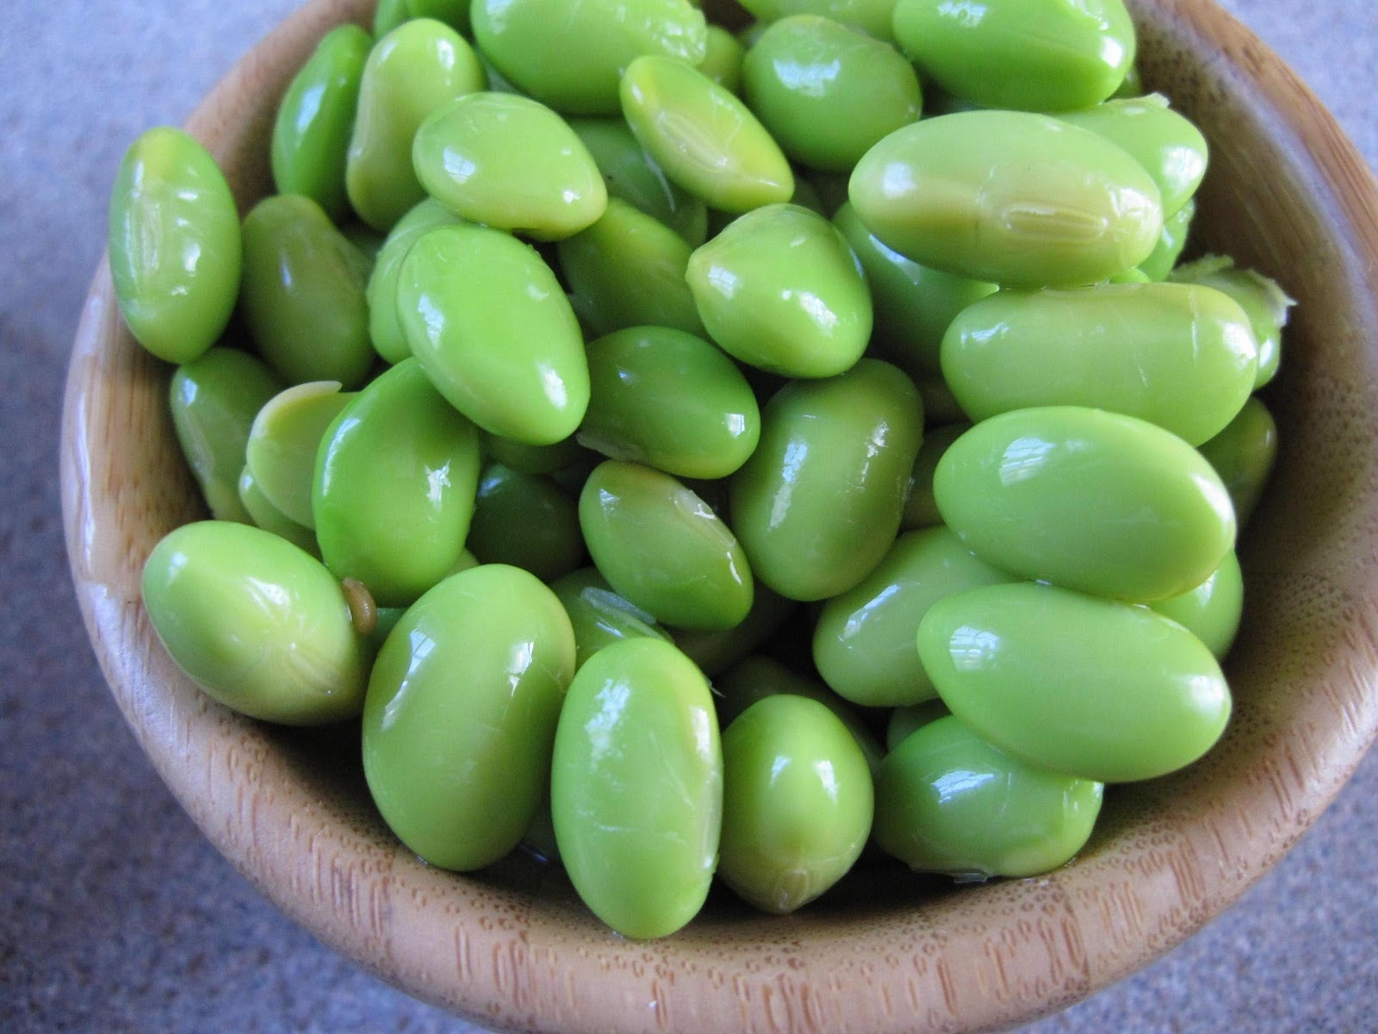
Explorations in Data Analyses for Metagenomic Advances in Microbial Ecology
25 June 2018
Kellogg Biological Station
Michigan State University

Slide 2
Case study: The Productive Post-doc Part #1
A very productive and confident post-doc in the lab, Jane, has performed some analyses on soil samples that were used for a 16S rRNA microbiome survey. She maintains the contextual data in an excel spreadsheet on her laptop, and backed up on the lab’s server. To analyze these data, she routinely copies and pastes the values into a new “clean” tab to try different calculations, but she keeps the original data in the first tab. She also sometimes loads the excel tables into R for other statistical analyses. She keeps her R workflows on a private GitHub repository. In the end, she writes a paper describing her results, including an analysis of the explanatory value of the soil chemistry for microbiome community composition.
Discussion
1. Critique how Jane’s stores and analyzes her data. What aspects of her strategy are reproducible? What aspects of her strategy can be improved?

Slide 3
Case study: The Productive Post-doc Part #2
A student in the lab, John, is a co-author on the paper that Jane is leading. He wants to check her workflow. He cannot access the private workflow on GitHub, and asks for the workflow to be made public. In the mean time, he checks the excel files that are backed up on the lab’s servers and notices that a key sample, Sample1, is missing from all of the tabs in Jane’s file. He also notices that some of the tabs were not copied correctly from the original data, and this has impacted some of the excel results.
Discussion
What should John do?
What aspects of this situation may make it difficult for John to decide what to do?

Slide 4
Case study: The Productive Post-doc Part #3
Jane makes the GitHub repo available to John and he reproduces the R workflow. He notices that the p-values that he generates are off from what Jane has reported in the results section of the paper. In fact, where Jane reports a p-value of 0.031, John generates a p-value of 0.31. John now feels very uncomfortable being an author on the paper.
Discussion
What would you advise John to do?
What steps should be taken before the paper is submitted?
Do you think that Jane’s errors constitute misconduct or negligence? What is the difference?

Slide 5
Case study wrap-up & comparison to wet-bench
Consider the following scenarios:
A lab won’t share their modifications to a DNA extraction protocol that they used to generate a fungal ITS leaf survey
A post-doc takes all of the freezer stocks of her genetic constructs when she moves to her new faculty position.
A graduate student never takes laboratory notes, and instead writes calculations on paper scraps and then discards.

Slide 6
What is a computing workflow?
Exactly what you tell the computer to execute the analysis
Each optimized step in a computing analysis
Verbatim scripts that were executed
Annotated:
Software versions used
Description of what the software is doing/goal of that step
Brief notes on deviations from default options
Workflows can include different software (e.g., mothur to QIIME to R), and should also include all “formatting steps” needed to move between tools – hopefully you don’t need to manually format too much; avoid if possible

Slide 7
Workflows should be mindlessly complete – the computer is a literal beast
The Peanut Butter and Jelly Robot
https://www.youtube.com/watch?v=leBEFaVHllE
https://www.youtube.com/watch?v=Y-UEdr1wofM

Slide 8
Computing Workflows for Biologists
Papers of interest:
Wilson et al. 2014. Best practises for Computing. PLoS Computational Biology
Nobel 2009. Organizing Computational Biology Projects. PLoS Computational Biology
Sandve et al. 2013. Ten simple rules for reproducible computational research. PLoS Computational Biology.
All of these references are posted in our Mendeley group

Slide 9
Our suggestions for an analysis approach
Adopt a systematic, iterative exploration of parameter space.
Include “sanity checks”
Focus on exploring the parameters that matter for your objective/hypothesis
Organize your output and input for someone who isn’t you
Work towards an optimized, seamless workflow. Minimize manual steps.
Implement reproducibility check-points.
Maintain computing notes just as you would experimental notes
Do your part: cultivate a shared responsibility for reproducibility of results and data management

Slide 10
Reproducibility check point

Slide 11
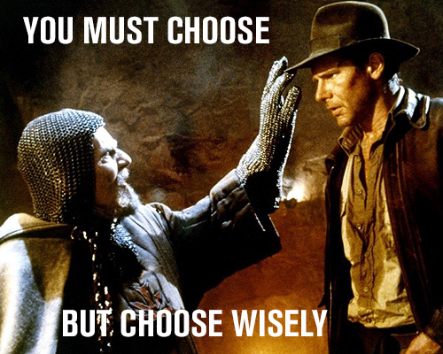
Heartaches: Naming Conventions
Examples of a a good name
20_A_T1_R1 (translation : subject 20, treatment A, timepoint 1, rep1 )
Examples : Bad name
Ashley’s sample
A
Ashley Loves Microbes Pool #1!
Example : kind of bad names
ALS1, ALS2, ALS3….ALS10, ALS11
Improved:
ALS01, ALS02, ALS03…ALS10, ALS11

Slide 12
Our samples, e.g.
C01_05102014_R1_D01
C01 – Centralia core site 1
Date 05102014 – 05 Oct 2014
R1 – core 1 (there were sometimes multiple cores from the same site)
D01 – DNA extraction replicate 1 D01- DNA extraction rep 1
…
F – forward read; R = Reverse read

Slide 13
Subsampling – sometimes required for a large dataset to troubleshoot efficiently through an entire workflow
Check out our tutorial about subsampling:
https://github.com/edamame-course/2015-tutorials/blob/master/final/2015-06-23-QIIME1.md#ampliconsubsampling

Slide 14
Workflow Discussion - Etherpad
Have you ever made a computing workflow? If so, what advice do you have?
Has anyone ever checked your computing or statistical work? In that situation, what went well and what didn’t?
What do you think are the most challenging aspects of making computing workflows?

