Slide 1
Machine Learning in Evolutionary Genetics
Dan Schrider
https://github.com/SchriderLab/evoMLWorkshop2024
UFPR
2024

Slide 2
Outline:
Day 1: A biologically motivated python exercise (writing a simulator)
Day 2: Performing simulations at scale and comparing them to data (detecting positive selection)
Day 3: An introduction to machine learning and deep learning (machine learning exercise)
Day 4: Applications of machine learning to evolutionary genetics (detecting positive selection via deep learning)

Slide 3
Part 1: The Coalescent
Dan Schrider

Slide 4
What do population genetic data look like?
Sequence 1: ACTGTAGTGACAGTACTTCAGTAGGCAC
Sequence 2: ACTGTAGTGACAGTACTTCAGTAGACAC
Sequence 3: ACTGTAGTGACAGTACCTCAGTAGGCAC
Sequence 4: TCTGTAGTGAGAGTACTTCAGTAGGCAC
Sequence 5: TCTGTAGTGAGAGTACTTCAGTAGGCAC
Sequence 6: TCTGTAGTGACAGTACCTCAGTAGGCAC
Sequence 7: ACTGTAGTGACAGTACTTCAGTAGGCAC
Sequence 8: ACTGTAGTGAGAGTACTTCAGTAGGCAC

Slide 5
Phased haplotype data
Example with a sample size of n=8 haploid chromosomes
Sequence 1: ACTGTAGTGACAGTACTTCAGTAGGCAC
Sequence 2: ACTGTAGTGACAGTACTTCAGTAGACAC
Sequence 3: ACTGTAGTGACAGTACCTCAGTAGGCAC
Sequence 4: TCTGTAGTGAGAGTACTTCAGTAGGCAC
Sequence 5: TCTGTAGTGAGAGTACTTCAGTAGGCAC
Sequence 6: TCTGTAGTGACAGTACCTCAGTAGGCAC
Sequence 7: ACTGTAGTGACAGTACTTCAGTAGGCAC
Sequence 8: ACTGTAGTGAGAGTACTTCAGTAGGCAC
Chromosome or haplotype
Our two alleles: A and T
Polymorphisms aka segregating sites
A mono-
morphic site

Slide 6
Ancestral/derived alleles
Example with n=7 haploid chromosomes and known ancestral state
Ancestral seq: ACTGTAGTGAG
Sequence 2: ACTGTAGTGAC
Sequence 3: ACTGTAGTGAC
Sequence 4: TCTGTAGTGAG
Sequence 5: TCTGTAGTGAG
Sequence 6: TCTGTAGTGAC
Sequence 7: ACTGTAGTGAC
Sequence 8: ACTGTAGTGAG
G is ancesetral allele and minor allele (C is derived and major allele)
A is ancesetral allele and major allele (T is derived and minor allele)
Ancestral sequence can often be (imperfectly) inferred (aka polarized) by examining one or more outgroups (i.e. related species)

Slide 7
Now what?
Sequence 1: ACTGTAGTGACAGTACTTCAGTAGGCAC
Sequence 2: ACTGTAGTGACAGTACTTCAGTAGACAC
Sequence 3: ACTGTAGTGACAGTACCTCAGTAGGCAC
Sequence 4: TCTGTAGTGAGAGTACTTCAGTAGGCAC
Sequence 5: TCTGTAGTGAGAGTACTTCAGTAGGCAC
Sequence 6: TCTGTAGTGACAGTACCTCAGTAGGCAC
Sequence 7: ACTGTAGTGACAGTACTTCAGTAGGCAC
Sequence 8: ACTGTAGTGAGAGTACTTCAGTAGGCAC
How do we glean anything about evolutionary history from this?
We need a way to quantify genetic diversity.

Slide 8
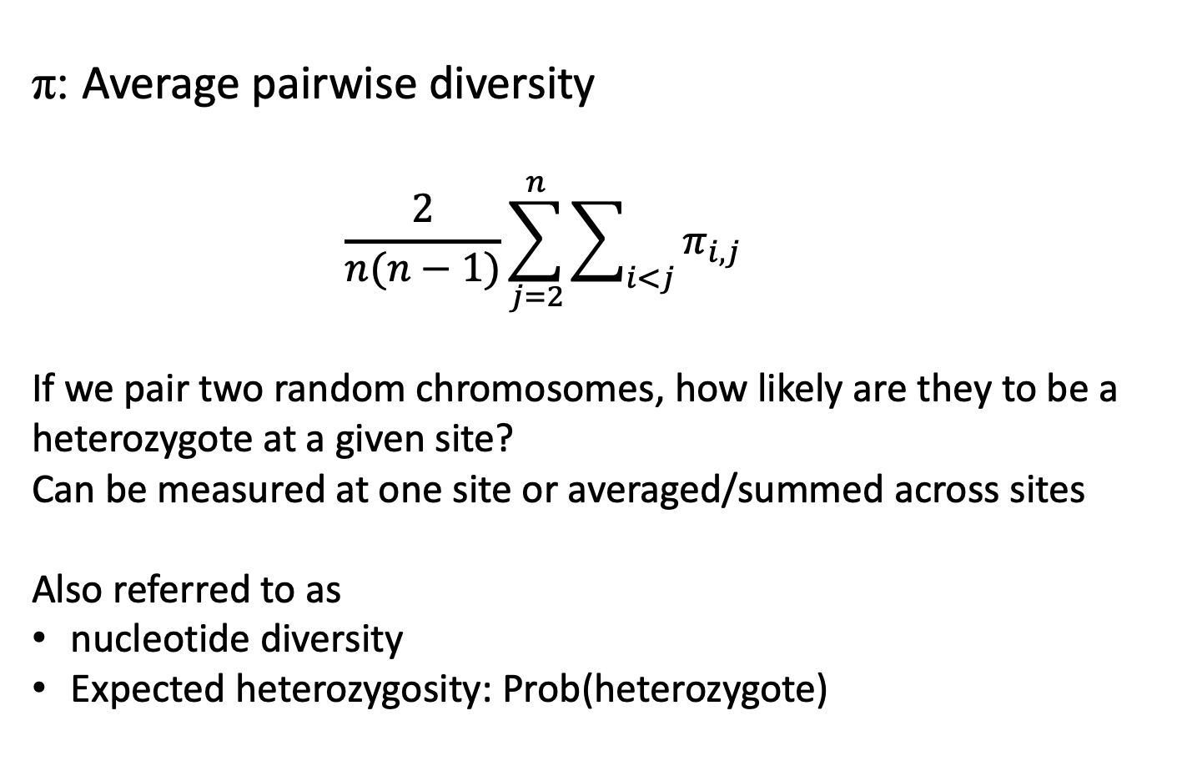
Summary statistics
π: Average pairwise diversity
$$\frac{2}{n(n−1)}\sum_{j=2}^{n}{\sum_{i<j}{π_{i,j}}}$$
If we pair two random chromosomes, how likely are they to be a heterozygote at a given site?
Can be measured at one site or averaged/summed across sites
Also referred to as
nucleotide diversity
Expected heterozygosity: Prob(heterozygote)
where n=sample size
π_{i,j}=the fraction of sites that differ between sequences i and j.
Nei and Li (1979)

Slide 9

Example calculation of π
$$\frac{2}{n(n−1)}\sum_{j=2}^{n}{\sum_{i<j}{π_{i,j}}}$$
Chromosome 1: CCACTGTAGTGACAGTACTTCAGTAGGCAC
Chromosome 2: CCACTGTAGTGACAGTACTTCAGTAGACAC
Chromosome 3: CCACTGTAGTGACAGTACCTCAGTAGGCAC
Chromosome 4: CCTCTGTAGTGAGAGTACTTCAGTAGGCAC
30 sites
n = 4
Number of comparisons:
n(n-1)/2 = 6
 | Chrom 1 | Chrom 2 | Chrom 3 | Chrom 4
Chrom 1 | 1,1 | 1,2 | 1,3 | 1,4
Chrom 2 | 2,1 | 2,2 | 2,3 | 2,4
Chrom 3 | 3,1 | 3,2 | 3,3 | 3,4
Chrom 4 | 4,1 | 4,2 | 4,3 | 4,4

Slide 10
Example calculation of π
$$\frac{2}{n(n−1)}\sum_{j=2}^{n}{\sum_{i<j}{π_{i,j}}}$$
Chromosome 1: CCACTGTAGTGACAGTACTTCAGTAGGCAC
Chromosome 2: CCACTGTAGTGACAGTACTTCAGTAGACAC
Chromosome 3: CCACTGTAGTGACAGTACCTCAGTAGGCAC
Chromosome 4: CCTCTGTAGTGAGAGTACTTCAGTAGGCAC
n = 4
Number of comparisons:
n(n-1)/2 = 6
 | Chrom 1 | Chrom 2 | Chrom 3 | Chrom 4
Chrom 1 | 1,1 | 1,2 | 1,3 | 1,4
Chrom 2 | 2,1: 0.033 | 2,2 | 2,3 | 2,4
Chrom 3 | 3,1 | 3,2 | 3,3 | 3,4
Chrom 4 | 4,1 | 4,2 | 4,3 | 4,4

Slide 11
Example calculation of π
$$\frac{2}{n(n−1)}\sum_{j=2}^{n}{\sum_{i<j}{π_{i,j}}}$$
Chromosome 1: CCACTGTAGTGACAGTACTTCAGTAGGCAC
Chromosome 2: CCACTGTAGTGACAGTACTTCAGTAGACAC
Chromosome 3: CCACTGTAGTGACAGTACCTCAGTAGGCAC
Chromosome 4: CCTCTGTAGTGAGAGTACTTCAGTAGGCAC
n = 4
Number of comparisons:
n(n-1)/2 = 6
 | Chrom 1 | Chrom 2 | Chrom 3 | Chrom 4
Chrom 1 | 1,1 | 1,2 | 1,3 | 1,4
Chrom 2 | 2,1: 0.033 | 2,2 | 2,3 | 2,4
Chrom 3 | 3,1: 0.033 | 3,2 | 3,3 | 3,4
Chrom 4 | 4,1 | 4,2 | 4,3 | 4,4

Slide 12
Example calculation of π
$$\frac{2}{n(n−1)}\sum_{j=2}^{n}{\sum_{i<j}{π_{i,j}}}$$
Chromosome 1: CCACTGTAGTGACAGTACTTCAGTAGGCAC
Chromosome 2: CCACTGTAGTGACAGTACTTCAGTAGACAC
Chromosome 3: CCACTGTAGTGACAGTACCTCAGTAGGCAC
Chromosome 4: CCTCTGTAGTGAGAGTACTTCAGTAGGCAC
n = 4
Number of comparisons:
n(n-1)/2 = 6
 | Chrom 1 | Chrom 2 | Chrom 3 | Chrom 4
Chrom 1 | 1,1 | 1,2 | 1,3 | 1,4
Chrom 2 | 2,1: 0.033 | 2,2 | 2,3 | 2,4
Chrom 3 | 3,1: 0.033 | 3,2: 0.067 | 3,3 | 3,4
Chrom 4 | 4,1 | 4,2 | 4,3 | 4,4

Slide 13
Example calculation of π
$$\frac{2}{n(n−1)}\sum_{j=2}^{n}{\sum_{i<j}{π_{i,j}}}$$
Chromosome 1: CCACTGTAGTGACAGTACTTCAGTAGGCAC
Chromosome 2: CCACTGTAGTGACAGTACTTCAGTAGACAC
Chromosome 3: CCACTGTAGTGACAGTACCTCAGTAGGCAC
Chromosome 4: CCTCTGTAGTGAGAGTACTTCAGTAGGCAC
n = 4
Number of comparisons:
n(n-1)/2 = 6
 | Chrom 1 | Chrom 2 | Chrom 3 | Chrom 4
Chrom 1 | 1,1 | 1,2 | 1,3 | 1,4
Chrom 2 | 2,1: 0.033 | 2,2 | 2,3 | 2,4
Chrom 3 | 3,1: 0.033 | 3,2: 0.067 | 3,3 | 3,4
Chrom 4 | 4,1: 0.067 | 4,2 | 4,3 | 4,4

Slide 14
Example calculation of π
$$\frac{2}{n(n−1)}\sum_{j=2}^{n}{\sum_{i<j}{π_{i,j}}}$$
Chromosome 1: CCACTGTAGTGACAGTACTTCAGTAGGCAC
Chromosome 2: CCACTGTAGTGACAGTACTTCAGTAGACAC
Chromosome 3: CCACTGTAGTGACAGTACCTCAGTAGGCAC
Chromosome 4: CCTCTGTAGTGAGAGTACTTCAGTAGGCAC
n = 4
Number of comparisons:
n(n-1)/2 = 6
 | Chrom 1 | Chrom 2 | Chrom 3 | Chrom 4
Chrom 1 | 1,1 | 1,2 | 1,3 | 1,4
Chrom 2 | 2,1: 0.033 | 2,2 | 2,3 | 2,4
Chrom 3 | 3,1: 0.033 | 3,2: 0.067 | 3,3 | 3,4
Chrom 4 | 4,1: 0.067 | 4,2: 0.1 | 4,3 | 4,4

Slide 15
Example calculation of π
$$\frac{2}{n(n−1)}\sum_{j=2}^{n}{\sum_{i<j}{π_{i,j}}}$$
Chromosome 1: CCACTGTAGTGACAGTACTTCAGTAGGCAC
Chromosome 2: CCACTGTAGTGACAGTACTTCAGTAGACAC
Chromosome 3: CCACTGTAGTGACAGTACCTCAGTAGGCAC
Chromosome 4: CCTCTGTAGTGAGAGTACTTCAGTAGGCAC
n = 4
Number of comparisons:
n(n-1)/2 = 6
 | Chrom 1 | Chrom 2 | Chrom 3 | Chrom 4
Chrom 1 | 1,1 | 1,2 | 1,3 | 1,4
Chrom 2 | 2,1: 0.033 | 2,2 | 2,3 | 2,4
Chrom 3 | 3,1: 0.033 | 3,2: 0.067 | 3,3 | 3,4
Chrom 4 | 4,1: 0.067 | 4,2: 0.1 | 4,3: 0.1 | 4,4

Slide 16
Example calculation of π
$$\frac{2}{n(n−1)}\sum_{j=2}^{n}{\sum_{i<j}{π_{i,j}}}$$
Chromosome 1: CCACTGTAGTGACAGTACTTCAGTAGGCAC
Chromosome 2: CCACTGTAGTGACAGTACTTCAGTAGACAC
Chromosome 3: CCACTGTAGTGACAGTACCTCAGTAGGCAC
Chromosome 4: CCTCTGTAGTGAGAGTACTTCAGTAGGCAC
n = 4
Number of comparisons:
n(n-1)/2 = 6
 | Chrom 1 | Chrom 2 | Chrom 3 | Chrom 4
Chrom 1 | 1,1 | 1,2 | 1,3 | 1,4
Chrom 2 | 2,1: 0.033 | 2,2 | 2,3 | 2,4
Chrom 3 | 3,1: 0.033 | 3,2: 0.067 | 3,3 | 3,4
Chrom 4 | 4,1: 0.067 | 4,2: 0.1 | 4,3: 0.1 | 4,4
(0.033 + 0.033 + 0.067 + 0.067 + 0.1 + 0.1) / 6 = 0.067

Slide 17
π in humans?
Any guesses?
Notes:
< 0.001

Slide 18
More on π
Important factoid: π is an estimator of θ=4Nμ where N = pop size and μ = mutation rate (per haploid genome per bp per generation).
We will derive this soon…

Slide 19
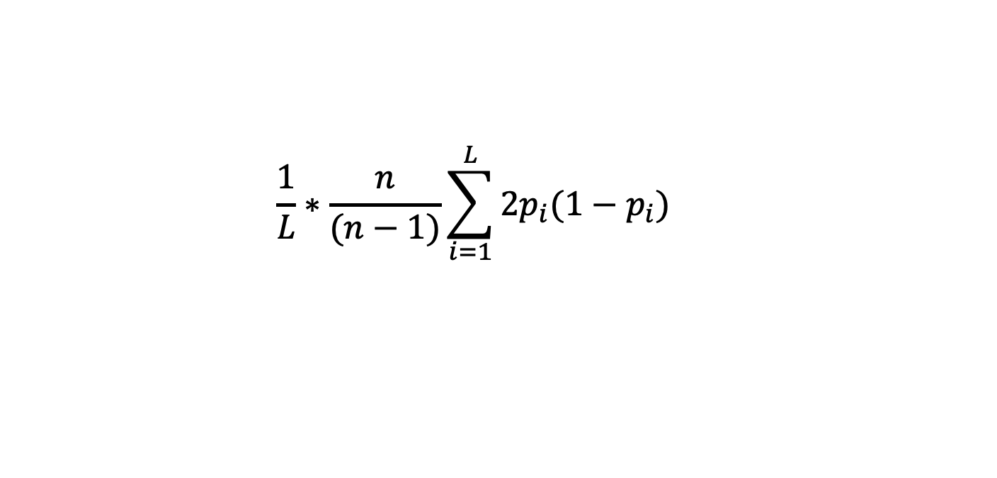
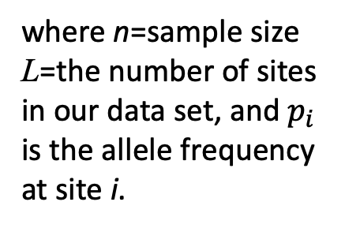
Alternative expression for π
$$\frac{1}{L}∗\frac{n}{(n−1)}\sum_{i=1}^{L}{{2p_{i}(1−p}_{i})}$$
where n=sample size
L=the number of sites in our data set, and $p_{i}$ is the allele frequency at site i.

Slide 20
Site Frequency Spectrum (SFS)

Slide 21
Typical site frequency spectra
Notes:
Note: derived allele frequency—we are assuming that we can polarize mutations.
Versions also exist for when we cannot do this (minor allele frequency).

Slide 22
We can quantify diversity. So what?
Compare observed patterns of diversity to those expected under various evolutionary models/parameterizations
One way to do this: simulation!

Slide 23
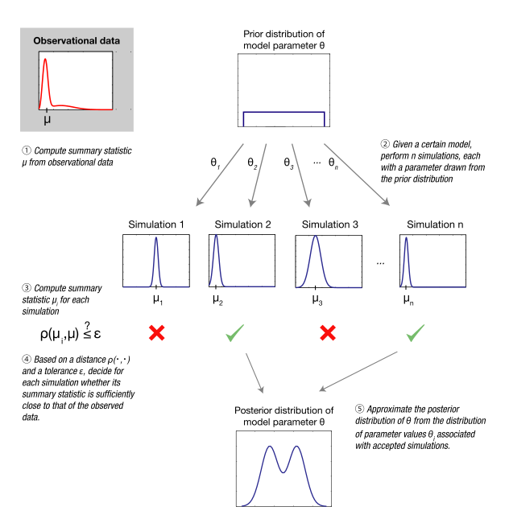
approximate Bayesian computation (ABC)
Simulate under a variety of parameter values
π
Summary statistic from real data set.
Which simulations “look like” our real data?
π
π
π
π
Estimate posterior probability distribution of model params from these “accepted simulations”
Sunnåker et al. (2013)

Slide 24
Problem:
Simulating a population is computationally intensive. Simulating a large population (e.g. N>1 million) is infeasible.
What we can do is simulate our sample’s (a set of n << N genomes) evolutionary history using a trick called coalescent simulation.

Slide 25
Our simple model of neutral evolution:
Diploid population of N individuals (2N chromosomes)
Infinite sites assumption: most sites in the genome have no mutations, so we can assume that any new mutation results in a new segregating site/polymorphism (i.e. no recurrent mutation)
At a polymorphism, we will refer to the ancestral allele as A₁ and the derived (i.e. new) allele as A₂.
Random mating.

Slide 26
Allele frequencies
P(A₁): the probability that a randomly selected allele among our 2N chromosomes is of type A₁.
P(A₁) = p
P(A₂) = (1-p) = q
Example with 8 chromosomes:
A₁ = A
p = 6/8 = 0.75
q = 2/8 = 0.25
Ancestral seq: A
Chromosome 1: A
Chromosome 2: A
Chromosome 3: T
Chromosome 4: T
Chromosome 5: A
Chromosome 6: A
Chromosome 7: A
Chromosome 8: A

Slide 27
Genetic drift
Generation 1
Generation 2
Assumptions:
Constant population size
Non-overlapping generations
Each generation we produce 2N chromosomes by performing 2N random draws from the previous generation
Can also include mutation and recombination (not shown here)
This is a Wright-Fisher model of a population
Can be extended to handle population size changes and natural selection
…
…

Slide 28
Genetic drift
Generation 1
Generation 2
Assumptions:
Constant population size
Non-overlapping generations
Each generation we produce 2N chromosomes by performing 2N random draws from the previous generation
Can also include mutation and recombination (not shown here)
This is a Wright-Fisher model of a population
Can be extended to handle population size changes and natural selection
…
…

Slide 29
Genetic drift
Generation 1
Generation 2
Let’s create our next generation!
For each chromosome: Number of offspring driven by chance
For each offspring chromosome, the probability that any particular chromosome in the previous generation will be the ancestor is 1/2N.
The probability that any chromosome will inherit the A₁ allele (let’s say red, here) is simply p.
For A₂ (blue), the probability is q.
So, on average, the allele frequencies are unchanged.
…
…

Slide 30
Genetic drift
Generation 1
Generation 2
The allele frequencies changed!
The red allele has slightly increased in frequency at the expense of the blue allele.
Huh?
Flip a coin 10 times, the probability of NOT seeing “heads” a total of 5 times is 75.39%
This is just binomial sampling!
…
…

Slide 31
That doesn’t help us simulate a large population quickly
But what if we take this model and think of everything backwards?
This trick is called the coalescent

Slide 32
What is the expected time to the most recent common ancestor of these two individuals?
In other words:
How long, in generations, do we expect to have to wait for the number of lineages to decrease from 2 to 1? (Let’s call this T₁)
T₁

Slide 33
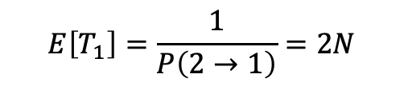
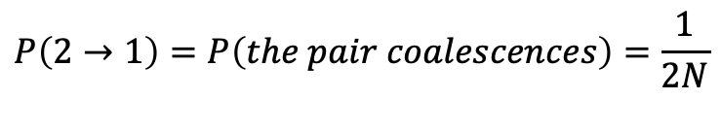
What is the expected time to the most recent common ancestor of these two individuals?
In other words:
How long, in generations, do we expect to have to wait for the number of lineages to decrease from 2 to 1? (Let’s call this T₁)
T₁
$$P\left(2→1\right)=P\left(the pair coalescences\right)=\frac{1}{2N}$$
$$E\left[T_{1}\right]=\frac{1}{P\left(2→1\right)}=2N$$
generations

Slide 34
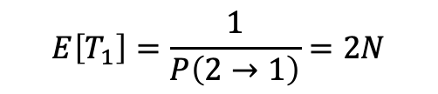
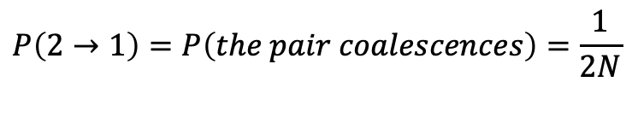
Question: what is the expected number of differences between these two lineages?
We just derived π!
T₁
2*2N*μ
= 4Nμ = θ
$$P\left(2→1\right)=P\left(the pair coalescences\right)=\frac{1}{2N}$$
$$E\left[T_{1}\right]=\frac{1}{P\left(2→1\right)}=2N$$
generations

Slide 35
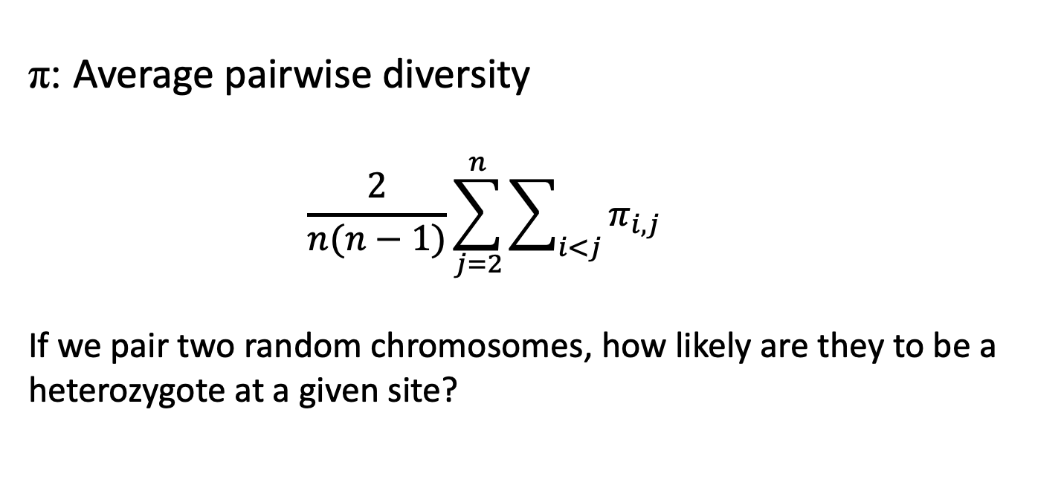
Refresher on π
π: Average pairwise diversity
$$\frac{2}{n(n−1)}\sum_{j=2}^{n}{\sum_{i<j}{π_{i,j}}}$$
If we pair two random chromosomes, how likely are they to be a heterozygote at a given site?
where n=sample size
π_{i,j}=the fraction of sites that differ between sequences i and j.
Nei and Li (1979)

Slide 36
Now let’s try to figure out the expected time to the most recent common ancestor (E[TMRCA]) for a sample of arbitrary size n.

Slide 37
Pop size = N diploids
sample size = n = 4
n << N
P(multiple coalescences in 1 gen) = 0
T₂
T₃
T₄

Slide 38

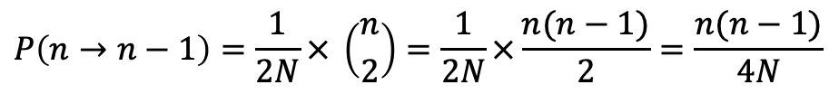
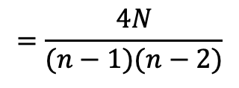

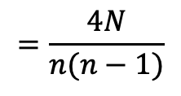

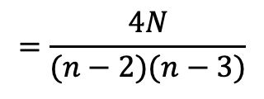
Pop size = N diploids
sample size = n = 4
n << N
P(multiple coalescences in 1 gen) = 0
$$E[T_{2}]=1/P\left(2→1\right)$$
T₂
$$=\frac{4N}{(n−2)(n−3)}$$
$$E[T_{3}]=1/P\left(3→2\right)$$
T₃
$$=\frac{4N}{(n−1)(n−2)}$$
T₄
$$E[T_{4}]=1/P\left(4→3\right)$$
$$=\frac{4N}{n(n−1)}$$
$$P\left(4→3\right)=P\left(a pair coalescences\right) × \# pairs$$
$$P\left(n→n−1\right)=\frac{1}{2N}× \left({n \atop 2}\right)=\frac{1}{2N}×\frac{n(n−1)}{2}=\frac{n(n−1)}{4N}$$

Slide 39

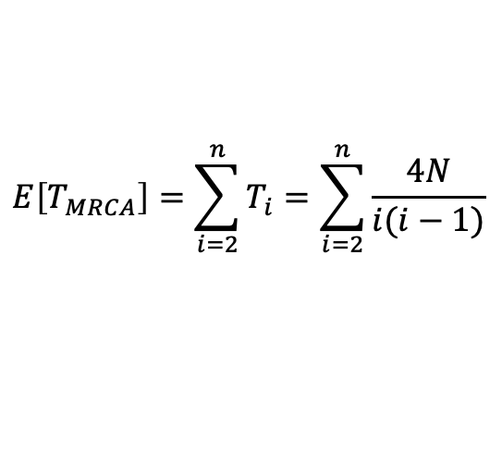
Pop size = N diploids
sample size = n = 4
n << N
P(multiple coalescences in 1 gen) = 0
$$E[T_{2}]=1/P\left(2→1\right)$$
T₂
$$=\frac{4N}{(n−2)(n−3)}$$
We just derived θ_{w}!
$$E[T_{3}]=1/P\left(3→2\right)$$
T₃
$$=\frac{4N}{(n−1)(n−2)}$$
T₄
$$E[T_{4}]=1/P\left(4→3\right)$$
$$=\frac{4N}{n(n−1)}$$
$$E\left[T_{MRCA}\right]=\sum_{i=2}^{n}{T_{i}}=\sum_{i=2}^{n}{\frac{4N}{i(i−1)}}$$
S: total number of polymorphisms
$$E\left[S\right]=μ\sum_{i=2}^{n}{{iT}_{i}}=μ\sum_{i=2}^{n}{\frac{4Ni}{i(i−1)}=4Nμ\sum_{i=2}^{n}{\frac{1}{(i−1)}}=θ\sum_{i=1}^{n−1}{\frac{1}{i}}}$$

Slide 40
Hap1: 100100
Hap2: 101100
Hap3: 000000
Hap4: 010011
Position 5
T₂=?
Position 0
Position 1
T₃=?
Position 3
Position 4
Position 2
T₄=?
We can simulate a sample by randomly drawing T₄, T₃, etc (geometrically distributed)
Then we just drop mutations down on the resulting branches!

Slide 41
Fin

Slide 42
Unphased diploid data
Example with a sample size of n=8 “chromosomes” (4 diploids)
Individual 1: A/G A/A T/T A/C G/G T/A
Individual 2: A/A A/A T/T C/C G/G A/A
Individual 3: A/A A/A T/T C/C C/G A/A
Individual 4: A/G A/A T/T C/C C/G T/T
Polymorphisms aka segregating sites

