Slide 1
WPI
RBE / CS 549
Visual-Inertial Odometry
Learning relative pose from synthetic drone imagery + IMU
Six diagnostic steps → Step S corrected pipeline
Phase 2 checkpoint
ajshah1
May 4, 2026
Notes:
VIO project — Phase 2. Goal: predict relative pose between consecutive frames from a stereo image pair plus an IMU window, on synthetic Blender drone footage. Six diagnostic steps so far, F through K. This talk covers what each step unlocked, and the current Step S retry — the first run where the IMU branch is actually learning.

Slide 2
Architecture — three networks, shared evaluation
Image pair (B, 6, 480, 640)
IMU window (B, 10, 6) acc + gyro
V — Vision
VGG8 CNN backbone, 512-d feature
Heads: R (6-D continuous), t (3-D)
I — Inertial
Bidirectional 2-layer LSTM, 256-d feature
Heads: R (6-D), t (3-D)
VI — Fusion
Residual refiner over (vfeat, ifeat)
R_final = δR · R_v t_final = t_v + δt
V predicts pose from images. I predicts from IMU. VI fuses both.
VIO checkpoint | ajshah1, WPI | 2026-05-04
2 / 10
Notes:
Three branches share the same training and evaluation pipeline. V is a VGG8 CNN over a 6-channel concatenated image pair. I is a bidirectional LSTM over a 10-sample IMU window — that architecture is the Step S rewrite. VI is a residual refiner: take V's prediction, perturb it using the IMU feature. Same loss family across all three.

Slide 3
Approach evolution — what each step unlocked
Approach
Setup
Outcome
metric
1 (F)
100s sinusoid · mixed textures · decomp.
broken — texture confound
V_avg=11.81 m
2 (G)
100s sinusoid · fixed tex_03 · decomp.
texture confound removed
V₃=5.29 m
3 (H)
fixed tex · t-direct prediction
decomp. ambiguity fixed
V₃=3.86 m
5 (J)
30s simple shapes · single speed · 4 trajs
within-family solved
V=0.089 m
6 (K)
speed diversity · 4 shape families
VI < V for the first time
V=0.184 VI=0.173
Step S
speed retune + corrected IMU + bidir I
training in progress
[pending]
Step I (anchored fusion) intentionally omitted — soft-gate variant; not on the throughline.
VIO checkpoint | ajshah1, WPI | 2026-05-04
3 / 10
Notes:
Six steps, one row each. Outcomes go red, amber, green by visual signal. Mixed textures broke V. Fixing the texture removed half the failure. Switching translation prediction from a depth-decomposed form to direct metric removed another bug. Simple slow shapes nailed within-family. Speed diversity in Step K finally let fusion beat vision alone.

Slide 4
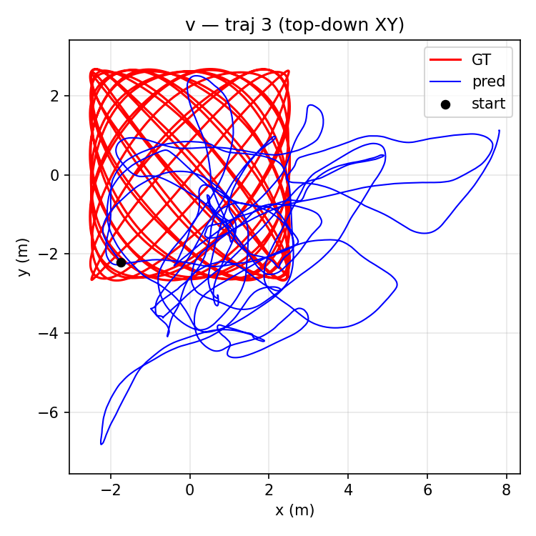
Approach 2 (Step G) — fix the texture confound
V_test on traj 3
11.81 m → 5.29 m
−2.2× ATE on the same held-out 100s sinusoid sequence
• Single texture (tex_03) across train and test
• All other knobs unchanged from Step F
• V is now learnable — but still 5 m off on test
Traj 3 (sinusoid 100s) — V trace, top-down view (Step H eval shown; Step G plots not on disk)
VIO checkpoint | ajshah1, WPI | 2026-05-04
4 / 10
Notes:
Step G — fix the texture confound. Step F trained on different textures than it tested on; the network learned texture features instead of motion. Step G forces a single texture across train and test. V drops from 11.8 m to 5.3 m on the held-out sinusoid — twenty-eight percent of the failure was texture, not motion.

Slide 5
Approach 3 (Step H) — predict translation directly
V_test on traj 3
5.29 m → 3.86 m
−27% ATE by removing the (t/d)·depth ambiguity
• Old head: R, t/d, plane normal → reconstruct t = (t/d)·alt
• New head: R (6-D), t (3-D) metric
• Loss: w_rot · L_rot + w_t · L_t with hover weighting
Step H V — traj 3 top-down (file: step_h_results/eval/plots/v_3_topdown.png)
VIO checkpoint | ajshah1, WPI | 2026-05-04
5 / 10
Notes:
Step H — fix the parameterisation. The old head predicted translation divided by depth, then multiplied at inference. That cascade introduced an ambiguity the network never resolved. Switching to direct metric translation drops V by another 27 percent on the same trajectory. The decomposition wasn't physics, it was a bug.

Slide 6
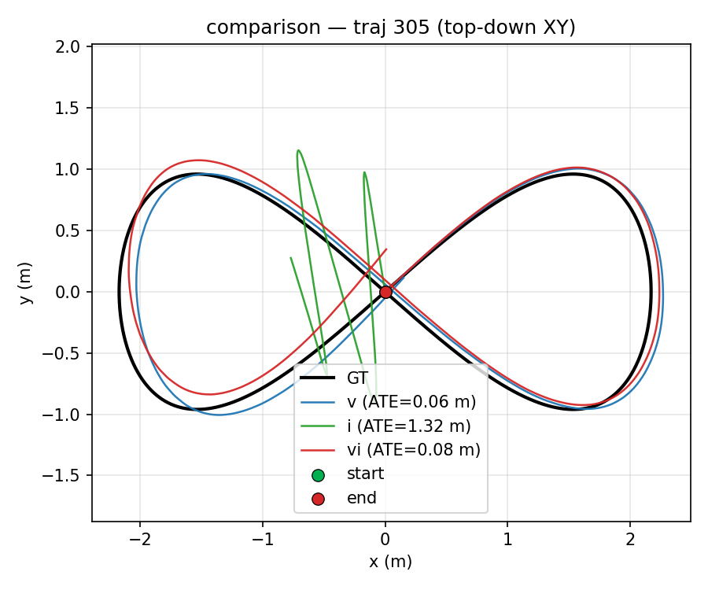
Approach 5 (Step J) — simple shapes, 30 s, within-family
V_test (mean over 4 trajs)
3.86 m → 0.089 m
43× drop on within-family eval (figure-8, circle, ellipse)
• Train: 4 simple-shape trajs, all on tex_03, ~0.4 m/s
• Within-family generalisation finally works
• But cross-family (100 s sinusoid) still 10.85 m
• VI = 0.131 — fusion still trails V alone
Traj 305 (figure-8, val/test) — V/I/VI vs GT, top-down
VIO checkpoint | ajshah1, WPI | 2026-05-04
6 / 10
Notes:
Step J — change the data shape. Drop 100-second aggressive sinusoids; use 30-second simple figure-eights, circles, ellipses at modest speed. V crashes from 3.86 m to 9 cm. Within-family generalisation finally works. Cross-family on the old aggressive trajectories is still 10.85 m, and fusion still trails V alone.

Slide 7
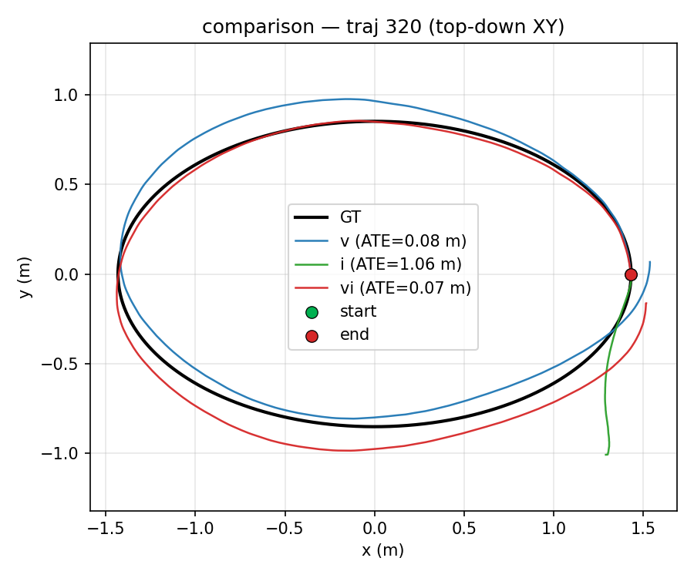
Approach 6 (Step K) — speed diversity unlocks fusion
Within-family test set (5 trajs)
V = 0.184 m
I = 1.242 m
VI = 0.173 m
← VI < V (first time in the project)
• Train: 8 trajs · 4 shape families · 2 speeds each
• VI beats V on 4 of 5 test trajs (-19% to -1%)
• I still hovers near zero — magnitude bias collapse
Traj 320 (ellipse @ 0.3 m/s, held-out shape) — V/I/VI vs GT
VIO checkpoint | ajshah1, WPI | 2026-05-04
7 / 10
Notes:
Step K — speed diversity. Eight trajectories, four shapes, two speeds each. V holds at 18 cm on a held-out test set with shapes never seen at training. Critically, VI beats V for the first time — 17 vs 18 cm — on four of five test trajectories. The IMU branch still collapses to near-zero motion: that's the open problem.

Slide 8
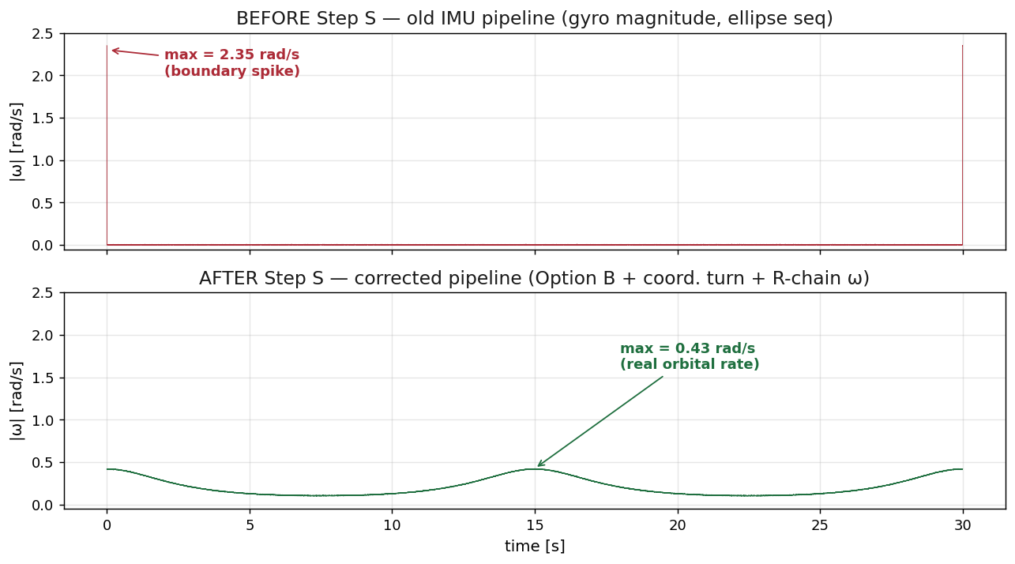
Step S — three coincident fixes; training in progress
Three coincident changes vs Step K
• Speed retune — train spans 0.5 / 0.8 / 1.0 / 1.2 m/s
• IMU pipeline — analytic vel/acc · coordinated turn · R-chain ω
• Network I — bidirectional LSTM · 6-D rot · separate heads
Status — training in progress
V at epoch 11 val_ATE = 1.03 m
I at epoch 10 val_ATE = 0.92 m (was 1.55 → 0.92, monotone)
Final ATE numbers expected tonight.
Gyro |ω| over 30 s — same ellipse trajectory, before vs after pipeline correction
VIO checkpoint | ajshah1, WPI | 2026-05-04
8 / 10
Notes:
Step S bundles three coincident fixes — broader speed range, a rewritten IMU generation pipeline that kills the boundary spike you see top-right, and a bidirectional NetworkI. The right plot is the same ellipse trajectory before and after — the spike of two-point-three radians per second is the bug. Training is live; final numbers tonight.

Slide 9
The IMU branch — diagnosed and addressed
Problem (Steps F → K)
Answer (Step S)
• I_avg never below 1.2 m across F → K
• Data: coordinated-turn yaw + analytic vel/acc + R-chain ω
• Predictions are 10–33 % of GT motion magnitude
• Arch: bidirectional 2-layer LSTM · feat_dim 256 · separate heads
• Two compounding causes — data + architecture
• Loss + window kept identical for clean attribution
data: 10 ms IMU window + boundary-spike artifacts
arch: unidirectional LSTM, single MLP head, axis-angle
First signs of life
Step S NetworkI val_ATE descends monotonically 1.55 → 0.92 over 10 epochs.
Every prior step the same network plateaued at ≥ 1.2 m within the first 5 epochs.
VIO checkpoint | ajshah1, WPI | 2026-05-04
9 / 10
Notes:
The IMU branch was the open problem from F through K — predictions collapsed to a fifth of real motion regardless of training. Step S addresses both halves: the data pipeline that stripped the gyro of signal, and the under-powered encoder. Ten epochs in, val ATE is descending instead of plateauing — first time it's actually learning.

Slide 10
Takeaways
• Texture confound, t-direct, simple shapes — three orthogonal fixes that compounded into 0.18 m within-family V.
• Speed diversity unlocked VI: fusion beats vision-only (0.173 m vs 0.184 m).
• IMU branch was the bottleneck: diagnosed as data + architecture; both fixed in Step S.
• Step S is the first run where V, I, and VI are all learning simultaneously. Final numbers tonight.
github · ajshah1 / vio · WPI RBE/CS 549 · May 2026
Notes:
Three orthogonal fixes — texture, parameterisation, training shapes — compounded V to eighteen centimetres within-family. Speed diversity let fusion beat vision alone for the first time. The IMU branch was the bottleneck across every prior step; Step S addresses it. The punchline: this is the first run where all three branches are simultaneously learning. Final numbers tonight.

