Slide 1
Genotype imputation using GLIMPSE
Github: https://github.com/Schroeder-Group/Inputation-Workshop/tree/main

Slide 2

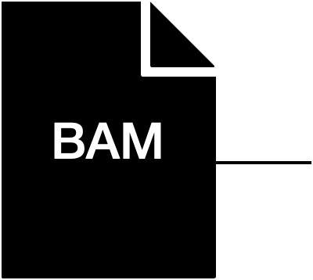
Variant calling (GATK, SAMTOOLS)
i.e.: SNPs, indels...
Not always possible (i.e.: quality, coverage)
Aligned data (filtered)
Genotype likelihoods (ANGSD)
P(D|G): Probability of observing the sequence data at site D given all possible genotypes G
G={AA, AC, AG, AT, CC, CG, CT, GG, GT, TT}
Limiting in what questions we can ask / methods
Imputation (GLIMPSE)
Notes:
Regardless of the approach we use we would end up with aligned data. Let’s assumed that has been processed, we can then use the data to variant call polymorphic sites ( known as SNPS) or indels which is not always possible, for instance, when we work with low coverage data or bad quality, in that case one could compute genotype likelihoods, which estimates the probability of observing the sequence data at each site given all possible genotypes. They still limit the questions we can ask and approaches we can apply. A more recent approach is genotype imputation.

Slide 3
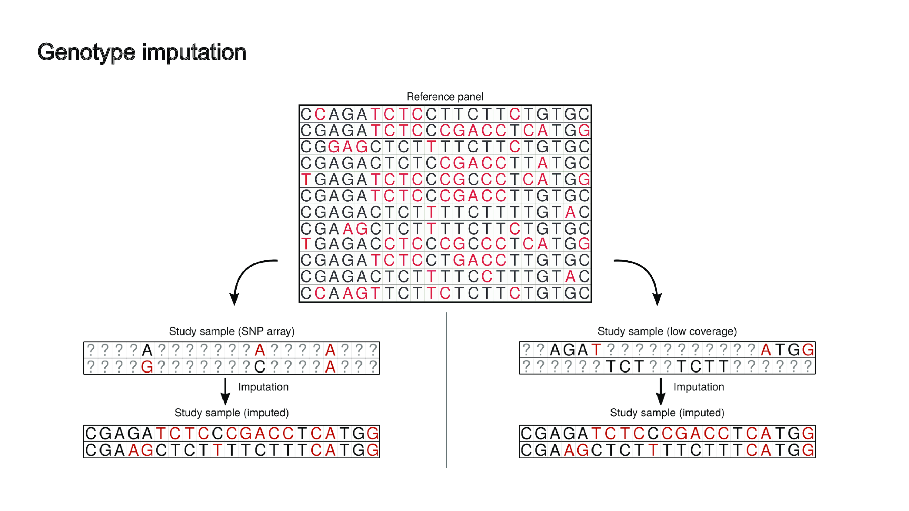
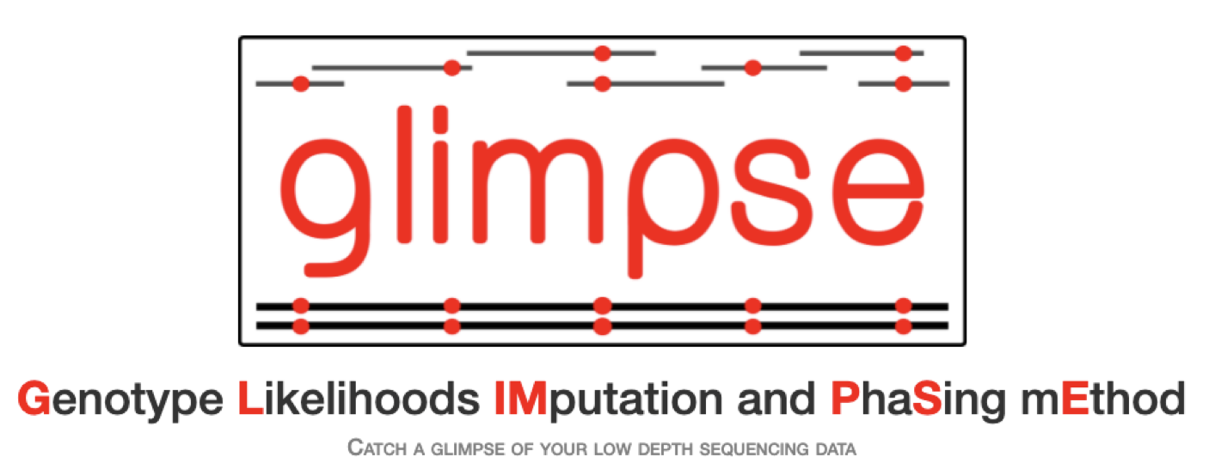
Filling the gaps with genotype imputation
(large)
Haplotypes
?: missing sites
Mota et al., 2023
Erven et al., 2022
Todd et al., 2023
https://odelaneau.github.io/GLIMPSE/glimpse1/overview.html
Notes:
During the process of genotype imputation, missing sites are statistically inferred based on haplotype similarity with individuals present in large reference panels. This method has been applied mainly in snp-array data, where genomes are genotyped at a subset of variant sites and are used to increase sample size for GWAS studies.

Slide 4
Filling the gaps with genotype imputation
Filling the gaps with genotype imputation
Suitable for ancient genomes
Mota et al., 2023
Erven et al., 2022
Todd et al., 2023
https://odelaneau.github.io/GLIMPSE/glimpse1/overview.html
Notes:
It has also been applied in low coverage shotgun data, which makes it suitable for imputing low-coverage ancient genomes.

Slide 5
Aligned data (filtered)
Variant calling, genotype likelihoods or imputation
Population genetic studies:
Population structure (PCAngsd)
Genetic differentiation (Fst, PBS)
Demographic history (dadi, BEAST)
Admixture analyses and gene flow (ADMIXTURE)
Selection studies (GRoSS, PCA-based approaches, CLUES)
Association studies (BOLT-LMM, PLINK…)
Local ancestry inference (Chromopainter, Haplonet)
...
Notes:
Ones we have the genotypes of the individuals, we can do other downstream analyses like inferring population structure, estimating the ancestry proportions from different sources in admixed population (e.g.: Mexican) or looking for genes under adaptive evolution

Slide 6
Are ancient individuals’ ancestries (and their genetic diversity) well captured by reference panels of present-day individuals?
General things to consider:
Reference panel
Common variants (MAF > 0.5%)
Minimum coverage 0.5X
Sample age (>30kya, due to coalescent time) – very low accuracy for rare variants
Genetic distance to the reference panel (underrepresented ancestries, i.e.: African populations)
GP (genotype probabilities) filtering – key for very low coverage samples (0.1X)
Capture data (> 2X): less accurate at rare variants (MAF > 0.5) but better intersection at 1240k and 1000GP
0.1X – can be imputed if ancestry is relatively close to the reference. Filtering:
GP > 0.8
MAF > 0.5
Low coverage == negative effect on downstream analyses (i.e.: admixture analyses)
Notes:
African genetic diversity is not well represented in 1000GP panel. Even though the sample age is expected to affect imputation performance due to the large coalescent times between the reference populations and the ancient individuals. The accuracy is considerably low in very very old samples at rare variants (MAF < 0.2%) . Accurately imputed heterozygous sites in very low coverage samples (0.1X) are removed when applying GP filtering even ig GP > 0.7 and are much more affected than higher coverage samples, however, the GP filter in very low coverage samples still increases the accuracy of the imputation and is important to do. For 0.1X, GP > 0.8

Slide 7
Why Snakemake?
Notes:
Reproductible and scalable pipelines
Analyses require the application of various tools, algorithms and scripts.

Slide 8
Snakemake is an extension of Python with syntax to define rules and workflow specific properties.
Snakemake tutorial slides: https://slides.com/johanneskoester/snakemake-tutorial
The workflow is defined in terms of rules that define how to create output files from input files
rule my_first_rule:
input: “input.txt”
output: “output.txt”
shell: “mycommand {input} {output}”
How to generalize rules? using named wildcards
rule my_first_wildcards:
input: “{dataset}.txt”
output: “{dataset}.png”
shell: “mycommand {input} {output}”
Notes:
One of the text-based workflow systems

Slide 9
Refer to file by name or by index (e.g. input[0])
rule my_second_rule:
input:
file1: “input.txt”
output:
file2: “output.png”
script: myscript.R –i {input.file1} –o {output.file2}
You can use script when running Julia, Python, R, Rust, Bash
Other tips!
You can use python within the rules and even run jupyter notebooks ”notebook”
rule sort:
input: "path/to/{dataset}.txt"
output: "{dataset}.sorted.txt"
run:
with open(output[0], "w") as out:
for l in sorted(open(input[0])):
print(l, file=out)

Slide 10
Target rule to collect results.
Set your target(s) to apply rules:
rule all:
input:
“output.png”
DATASETS=[“D1”,”D2”, “D3”]
rule all:
input:
["{dataset}.sorted.txt".format(dataset=ds) for ds in DATASETS],
expand(“{dataset}.sorted.txt”, dataset=DATASET)

Slide 11
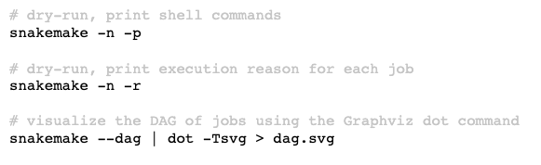
When will snakemake execute a job?
output file is target and does not exist
output file needed by another executed job and does not exist
input file newer than output file
rule has been modified
input file will be updated by other job
execution is enforced (--rerun-)

Slide 12
Thank you!

