Slide 1
Algorithm | Algorithm class | population size | Key idea // how it works | Internal parameters / information
Nelder-Mead | Hill climber | μ > 1 | Initialize simplex of n+1 points Reflect through centroid to find x_{r} Depending on quality of x_{r,} apply contraction, expansion or shrinking operator | Centroid point x₀
BFGS | Hill climber | μ = 1 | quasi-Newton method that approximates Hessian matrix Appr. Hessian is updated through gradient calculations | Hessian appr. matrix B_{k} Step size α_{k}
SANN | Trajectory (exploring) | μ = 1 | Escape local optima through probabilistic selection Probability to accept deteriorations decreases over time ‘temperature’ determines probability, updated with cooling scheme | Current temperature T_{k}
VNS | Trajectory (systematic) | μ = 1 | Apply local search method in the neighbourhood of initial point If no improvement is made, move to further away neighbourhoods | Current neighbourhood index k
Tabu search | Trajectory (systematic) | μ = 1 | Store already made moves in tabu list By prohibiting previously made moves, local optima can be escaped | Tabu list
(H)MLSL | Trajectory (systematic) HMLSL: Hybrid MLSL+DE | μ > 1 | Create a reduced sample with best candidates from randomly sampled points Perform local search for best points in cluster (no better points within critical distance r_{k}) | Critical distance r_{k}
DE | Population (classic) | μ ≥ 4 | Apply mutation and recombination to find new candidates Only accept improvements Step size is controlled by difference calc. in mutation operator | n.a.
PSO | Population (classic) | μ > 1 | Create a swarm of particles that move over solution landscape with velocity particles have access to their all-time best position and the best position found by its neighbours Thereby, momentum, social forces and cognitive forces influence particle movement | Previous best position p_{best,I} at p_{i} Current best global position in N, g_{best,i} at g_{i} Velocity for each particle, v_{i}
CMA-ES | Population (model-based) | μ > 1 | New candidates are samples from multivariate normal distribution Covariance matrix is continuously updated with evolution paths Covariance matrix rotates normal distribution | C: Covariance matrix m: Current centre of mass σ: global step size

Slide 2
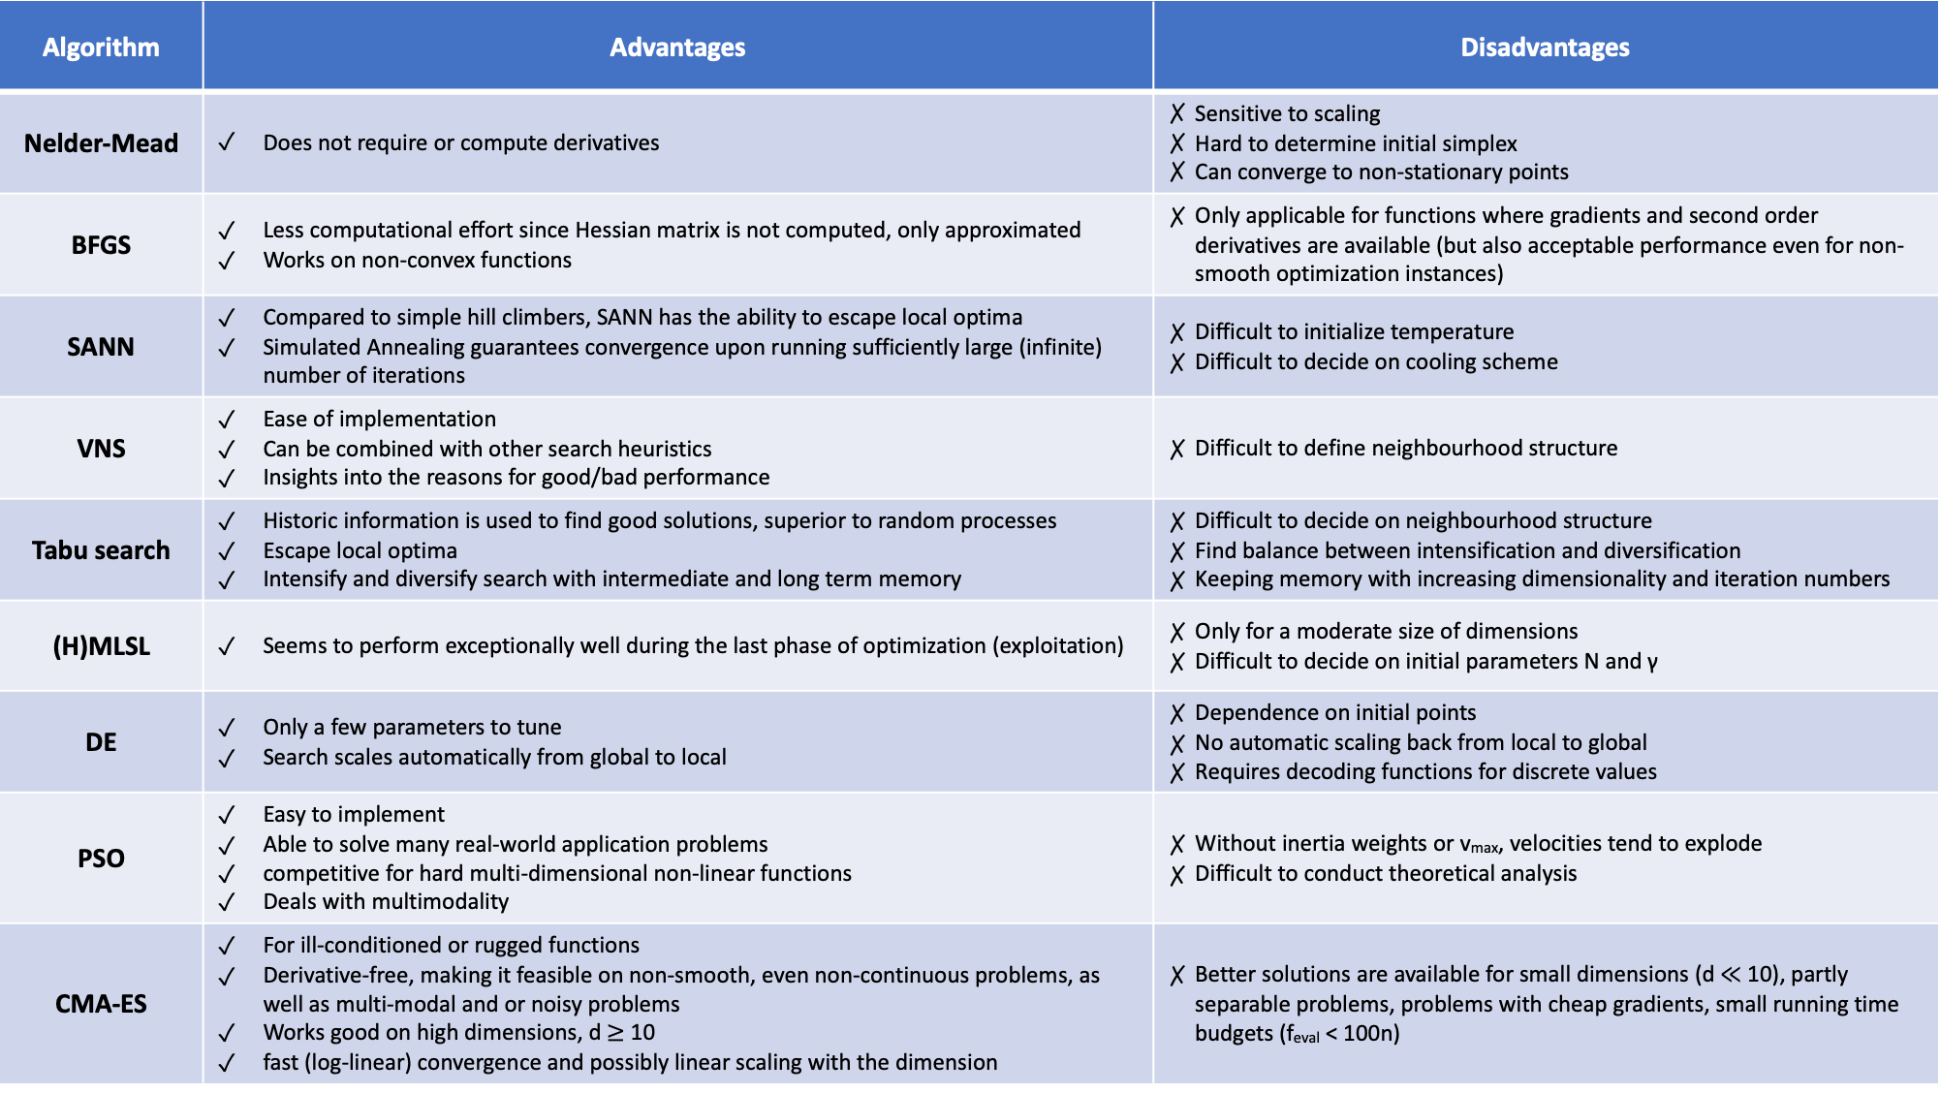
Algorithm | Advantages | Disadvantages
Nelder-Mead | Does not require or compute derivatives | Sensitive to scaling Hard to determine initial simplex Can converge to non-stationary points
BFGS | Less computational effort since Hessian matrix is not computed, only approximated Works on non-convex functions | Only applicable for functions where gradients and second order derivatives are available (but also acceptable performance even for non-smooth optimization instances)
SANN | Compared to simple hill climbers, SANN has the ability to escape local optima Simulated Annealing guarantees convergence upon running sufficiently large (infinite) number of iterations | Difficult to initialize temperature Difficult to decide on cooling scheme
VNS | Ease of implementation Can be combined with other search heuristics Insights into the reasons for good/bad performance | Difficult to define neighbourhood structure
Tabu search | Historic information is used to find good solutions, superior to random processes Escape local optima Intensify and diversify search with intermediate and long term memory | Difficult to decide on neighbourhood structure Find balance between intensification and diversification Keeping memory with increasing dimensionality and iteration numbers
(H)MLSL | Seems to perform exceptionally well during the last phase of optimization (exploitation) | Only for a moderate size of dimensions Difficult to decide on initial parameters N and γ
DE | Only a few parameters to tune Search scales automatically from global to local | Dependence on initial points No automatic scaling back from local to global Requires decoding functions for discrete values
PSO | Easy to implement Able to solve many real-world application problems competitive for hard multi-dimensional non-linear functions Deals with multimodality | Without inertia weights or v_{max}, velocities tend to explode Difficult to conduct theoretical analysis
CMA-ES | For ill-conditioned or rugged functions Derivative-free, making it feasible on non-smooth, even non-continuous problems, as well as multi-modal and or noisy problems Works good on high dimensions, d $≥$ 10 fast (log-linear) convergence and possibly linear scaling with the dimension | Better solutions are available for small dimensions (d $≪$ 10), partly separable problems, problems with cheap gradients, small running time budgets (f_{eval} < 100n)

Slide 3
Algorithm | Tuneable parameters | Number tuneable parameters | Implementation available
Nelder-Mead | Reflection coefficient α Expansion coefficient γ Contraction coefficient ρ Shrink coefficient σ | 4
BFGS | Initial selection of x0 und B0 | 2
SANN | Initial temperature T₀ Cooling scheme / schedule For exponential cooling: factor α | 3
VNS | Neighbourhood structure // distance measure The maximum index of neighbourhoods, k_{max} | 2
Tabu search | Neighbourhood structure // distance measure Tabu list size | 2
(H)MLSL | Number of points per iteration, N Size of reduced sample, given by gamma γ (The budget of function evaluations for local search, in HMLSL: 10%) | 3 | No
DE | Crossover probability Cr Population size Np Scaling factor F | 3
PSO | Acceleration factors φi If applied: Inertia weight ω | 2
CMA-ES | Population size lambda λ; Number of parents mu μ; recombination weights w(i…λ); Initial step size σ; cc, decay rate for the evolution path; c1, learning rate for rank-one update of C ; cμ, learning rate for rank-μ update of C; cσ , decay rate of the evolution path; dσ, damping for σ-change | 9 // 2 | Yes

