Slide 1

Travel Wide
Website by Lindsey Schulz

Slide 2
I chose to do a travel website.
The goal was to allow for users to travel to fictional locations
My inspiration came from other travel websites such as
trivago.com
Trip Advisory.com
Booking.com
The colours were chosen based on pre-sets within the CSS coding file from the class lecture.
I wanted a none intrusive background with muted clours against vibrant pictures to draw users to the products
The site design and navigation was made to be easy to understand and code.

Slide 3
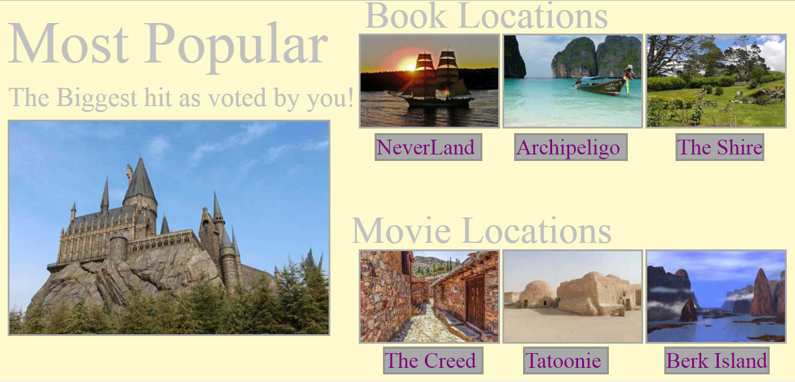

Slide 4

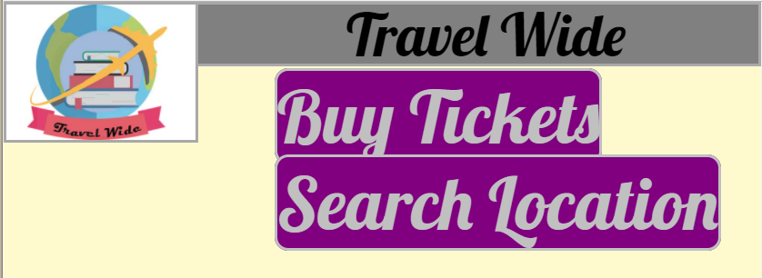
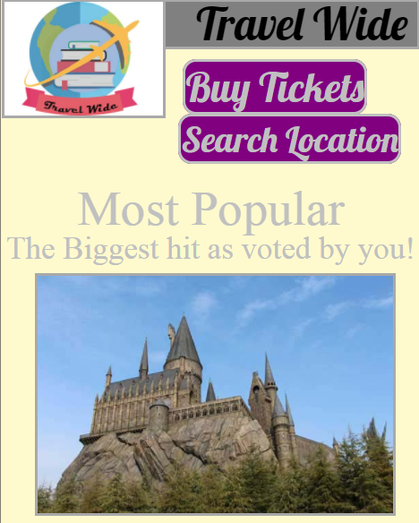

Slide 5
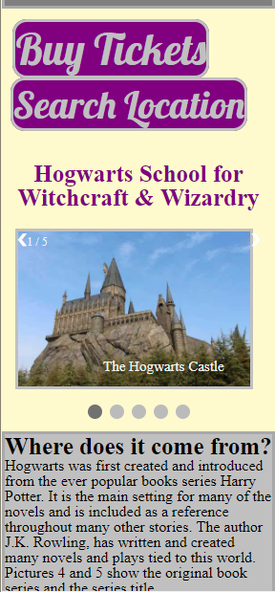
The home page was designed so that the most important information – the content- was the most prominent feature.
all pf the included content is used as links so that the user can easily get information on the travel options available.
The third page was desgided to be dedicated to a specified location
Giving the user information on where this location originated
The traveling packages available & and what each will offer
As well as promotional photos from the location

