Slide 1
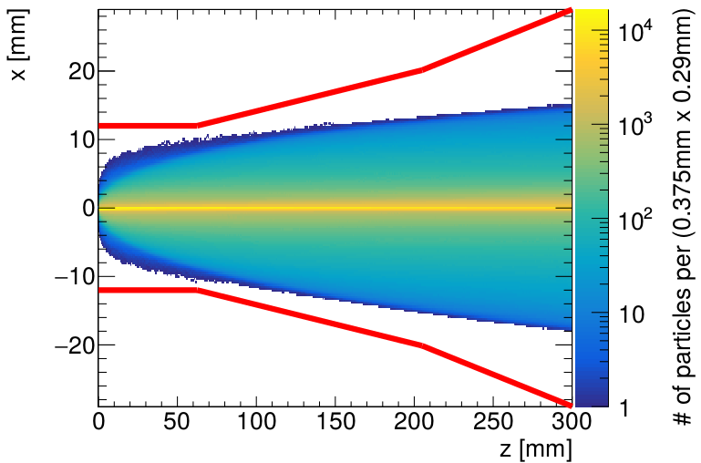
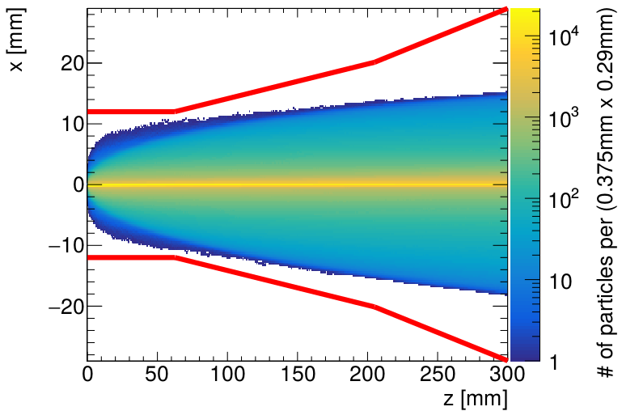
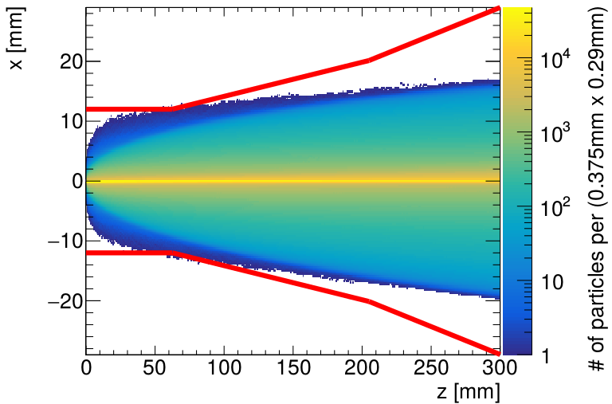
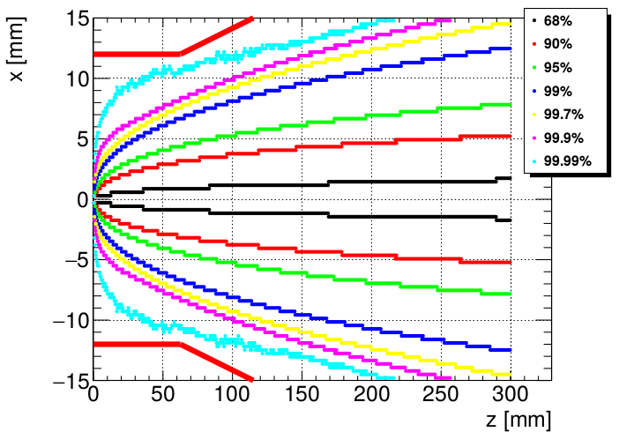
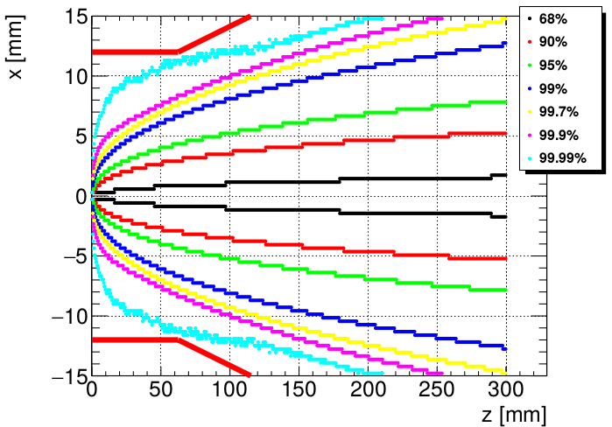
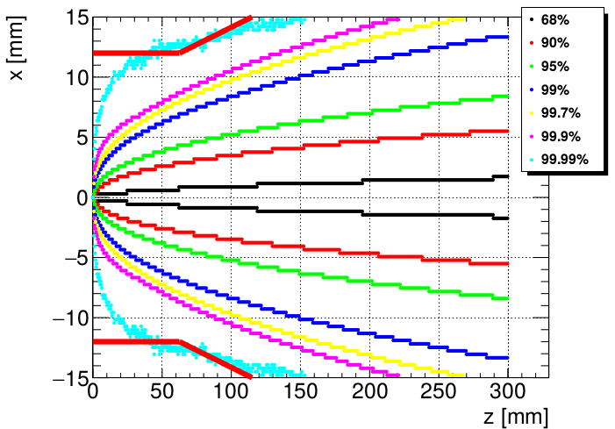
Background from High Cross Section ILC Processes
Pair background envelopes for 250, 350 and 500 GeV
Beam pipe
Helix tracks of e+ e- pairs in the 5T solenoid field of the SiD detector.
250 GeV
350 GeV
500 GeV
At any given point the beam pipe is at least 4 mm away from 99.9% of all pair particle tracks.

Slide 2
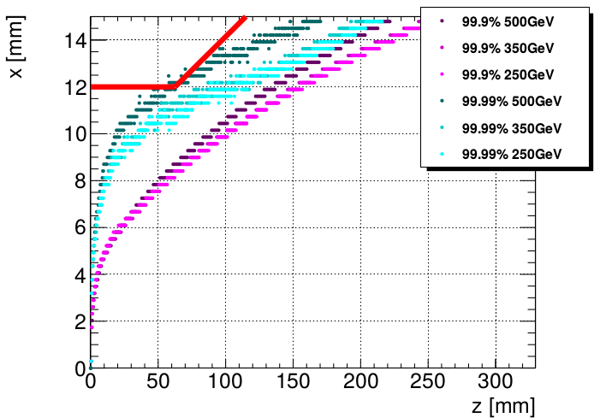
Background from High Cross Section ILC Processes
Pair background envelopes for 250, 350 and 500 GeV
99.9%
99.9%
500 GeV
250/350 GeV
Comparison of the 99.9% and 99.99% envelopes for 250, 350 and 500 GeV suggests the possibility to reduce the beam pipe & VXD radius by ∼2 mm.
Study of possible improvement in physics event reconstruction needed, whilst looking at the increase in the background level at smaller radii.

