Slide 1
MDI Sessions – Overview
Monday morning:
MDI: MDI/BDS/CFS
Helium-Experiment at HERA
ILC main beam dump issues
FLUKA simulation of the
ILC main beam dump
CFS
CFS staging discussion
CLIC CFS study
CFS utility study
Recent geology survey at Kitakami
Tuesday morning:
MDI
Report from KEK Mini-Workshop
Update on Anti-DID studies
Polarisation/Polarimetry
CLIC QD0 stabilisation progress
CLIC background studies

Slide 2
MDI Sessions – Summary
ILC Main Beam Dump
Issues
Simulations
Possible alternatives
Backgrounds
CLIC Background Simulations
ILC Muon Shielding
Update on Anti-DID studies
Helium-Experiment at HERA
KEK Mini-Workshops
ILC surface sites & geological survey

Slide 3
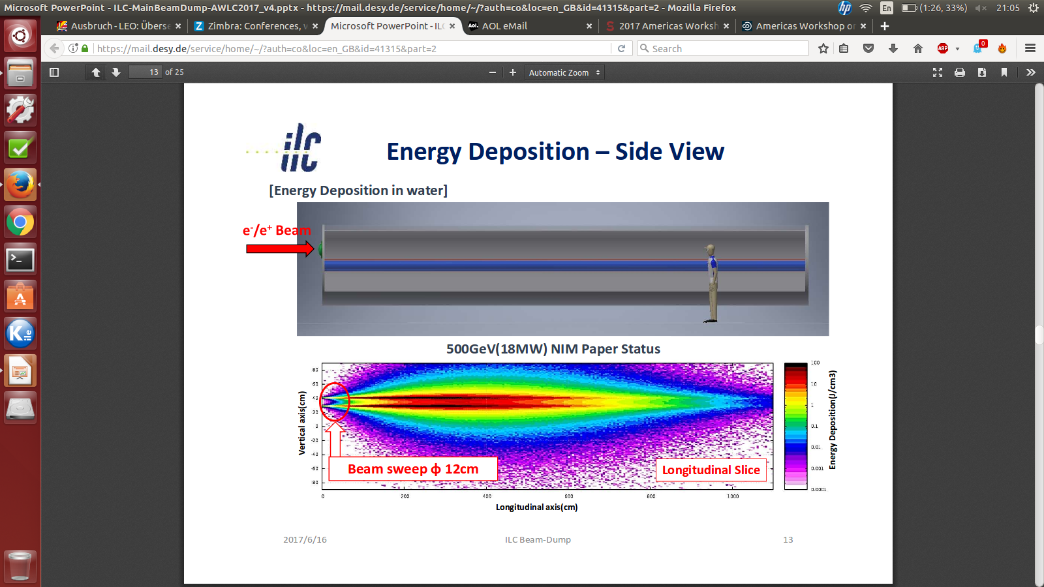
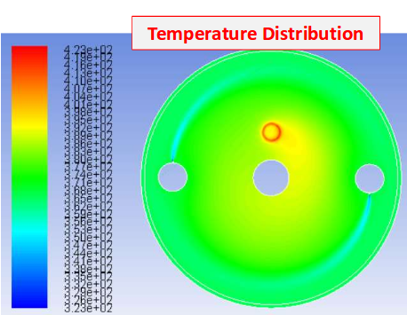
ILC Beam Dump Issues
Yu Morikawa (KEK)
Beam dump design issues:
Beam window durability
Tritium handling
Recombination of Hydrogen
Remote window replacement
Safety
Strong efforts at KEK:
Revisit previous studies
New simulations of the energy deposition and temperature
Evaluation of the possibility of other beam dump designs

Slide 4
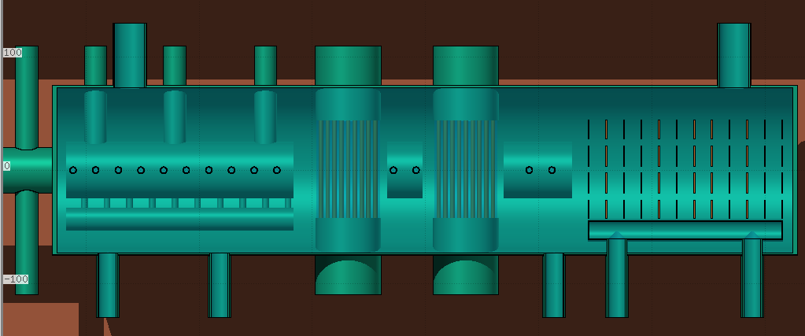
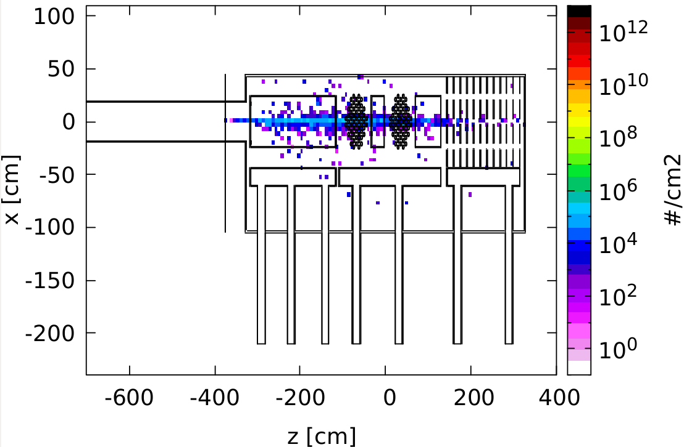
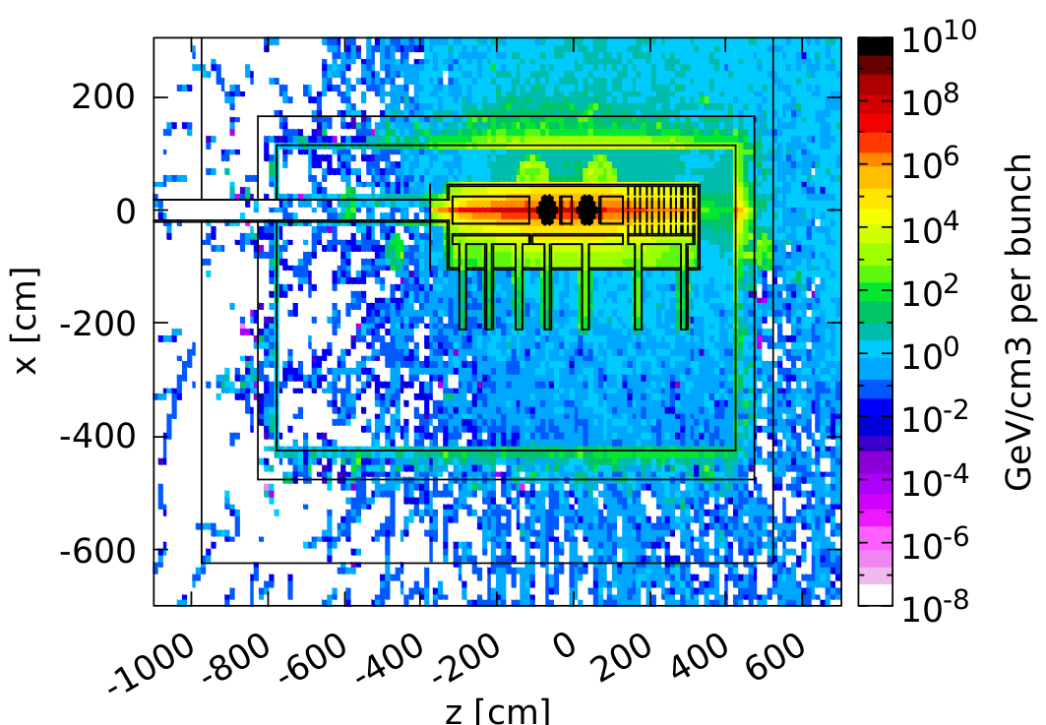
FLUKA simulation of the ILC main beam dump
Anne Schuetz (DESY)
Beam
Implementation of 2 water dump designs (by B. Smith, 2006-2007) in FLUKA
Energy deposition of a 500 GeV beam peaks at 10⁹ GeV/cm³ per bunch inside the water dump.
3
Tritium flux inside the dump ranges around 10⁵/cm³ Tritium atoms per bunch.

Slide 5
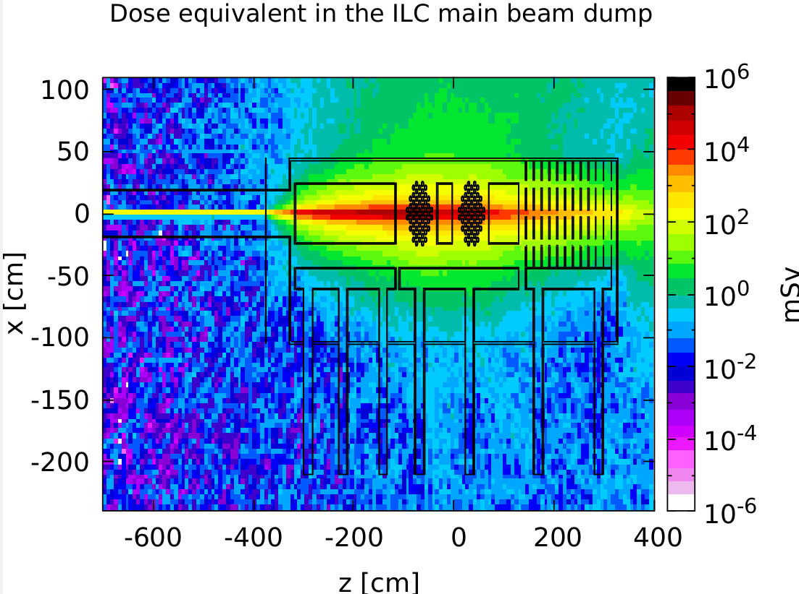
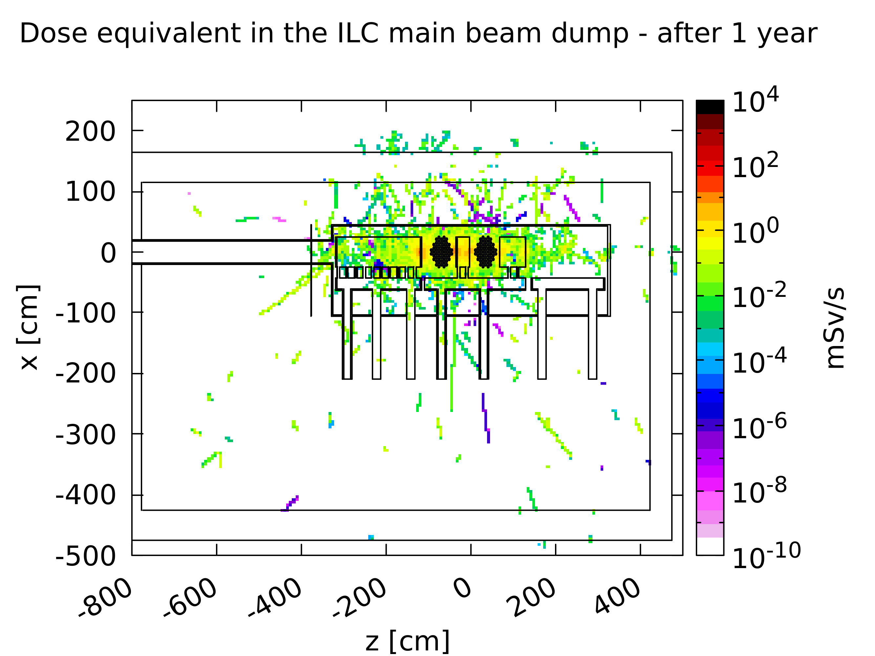
FLUKA simulation of the ILC main beam dump
Anne Schuetz (DESY)
Due to large energy deposition, instantaneous dose equivalent reaches up to 100 Sv per bunch.
The dose rate after 1 month of beam time and
1 year of cooling time still of the order of
0.1 mSv/s in the dump surrounding.
Future studies:
Effect of material composition on residual nuclei, especially Tritium
Simulating the neutrons reaching back to the detectors

Slide 6
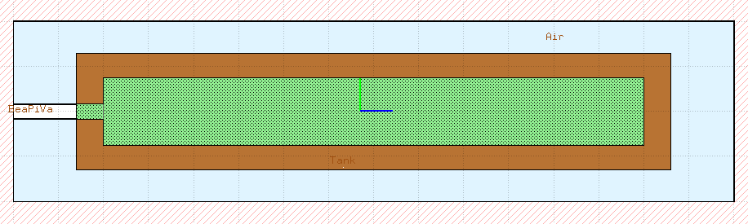
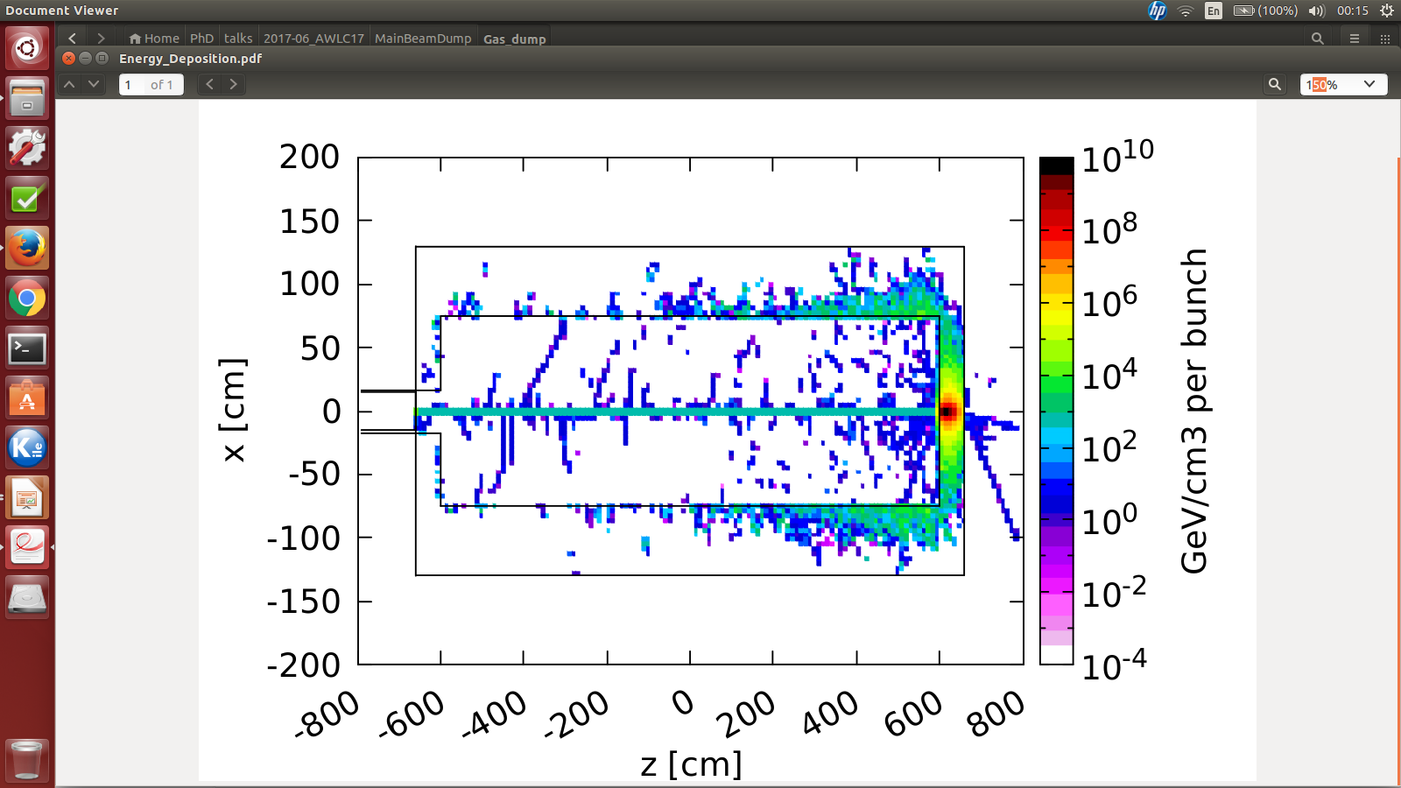
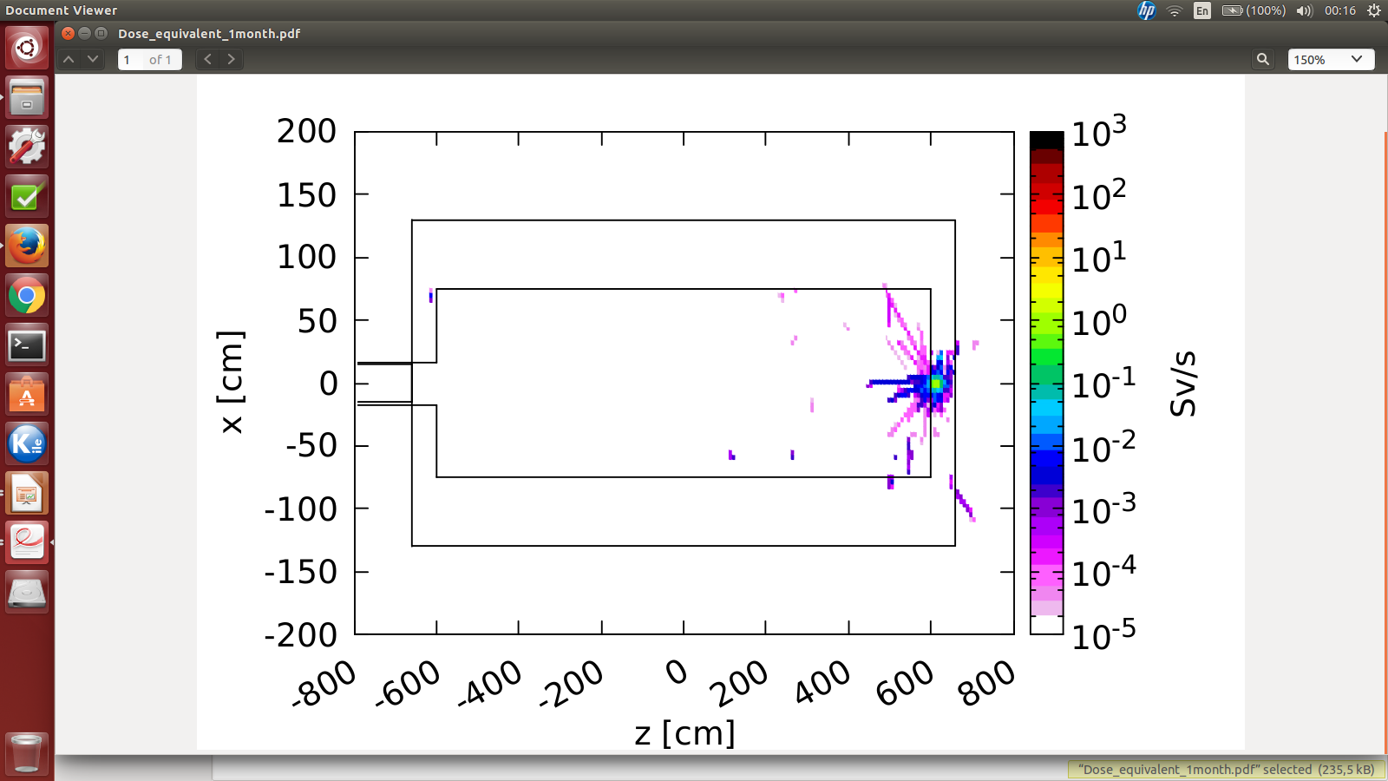
FLUKA simulation of the ILC main beam dump
Anne Schuetz (DESY)
Also alternative options, like a gaseous or solid beam dump, need to be studied.
Quick simulation of a gaseous beam dump
filled with Nitrogen shows:
Energy deposition restricted to the
copper tank
Dose rate after 1 month of cooling time negligible outside the tank

Slide 7
MDI Sessions – Summary
ILC Main Beam Dump
Issues
Simulations
Possible alternatives
Backgrounds
CLIC Background Simulations
ILC Muon Shielding
Update on Anti-DID studies
Helium-Experiment at HERA
KEK Mini-Workshops
ILC surface sites & geological survey

Slide 8
CLIC Background Studies
Dominik Arominski (CERN/WUT)
Ongoing studies of the major backgrounds at 380 GeV and 3 TeV
Incoherent pair background and γγ hadrons the only significant source of direct background
At 3 TeV, trident e+e-
cascades may cause energy
deposition in the forward
region of the detector
380 GeV
3 TeV
Synchrotron radiation at the IP:
For the simulation, only photons from the FF-system were extrapolated to the IP
No synchrotron radiation hits any detector part
380 GeV
3 TeV

Slide 9
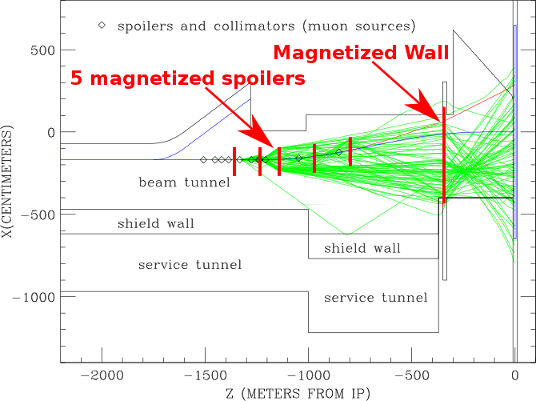
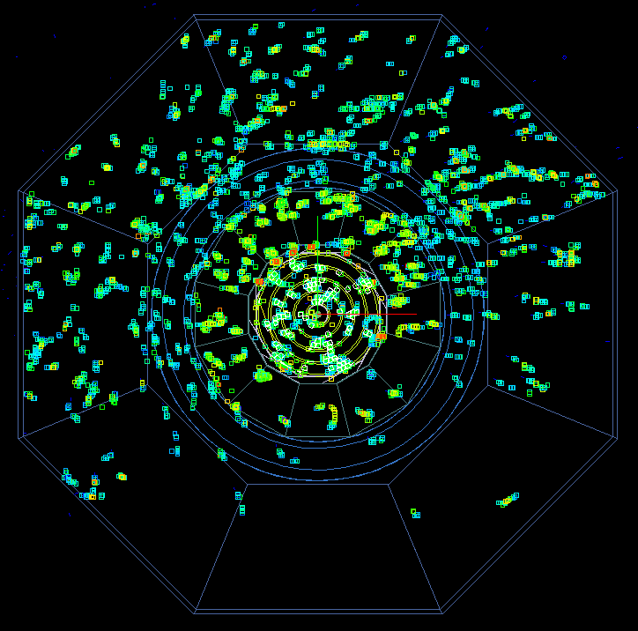
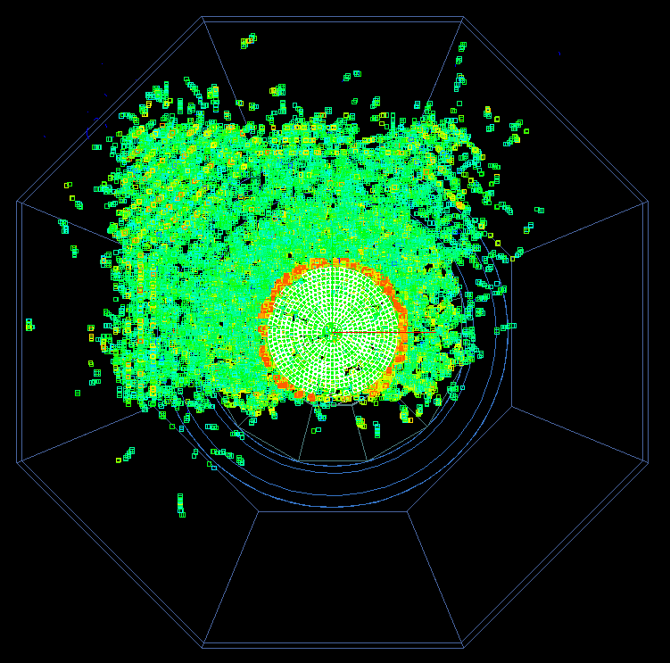
Muons from the ILC Beam Delivery System
Anne Schuetz (DESY)
Discussion about the necessity of a magnetized wall to shield muons that are emitted in the BDS and boosted towards the detectors.
With wall
Without wall
Comparison of SiD detector occupancy of muons with and without the wall:
Magnetized wall is preferable in order to keep the occupancy as low as possible
Wall serves as tertiary containment device
No wall means no access to the detector garage!

Slide 10
MDI Sessions – Summary
ILC Main Beam Dump
Issues
Simulations
Possible alternatives
Backgrounds
CLIC Background Simulations
ILC Muon Shielding
Update on Anti-DID studies
Helium-Experiment at HERA
KEK Mini-Workshops
ILC surface sites & geological survey

Slide 11
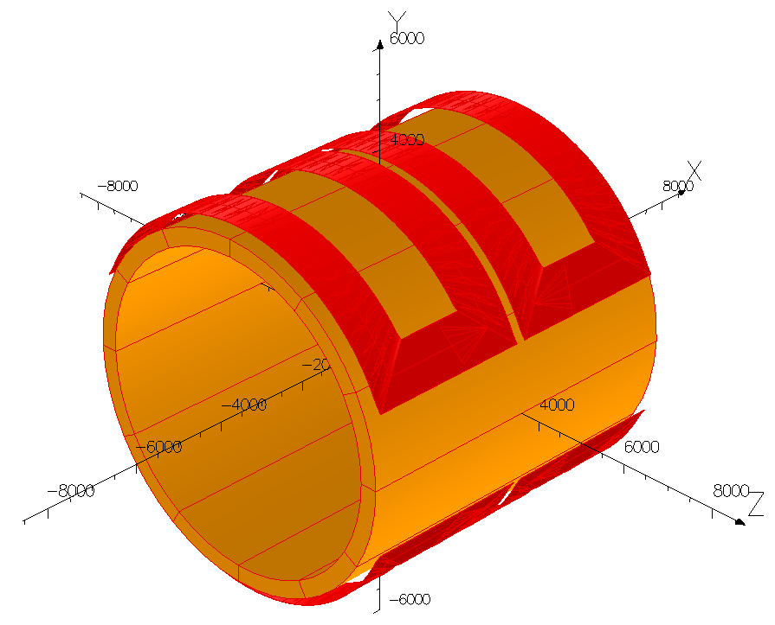
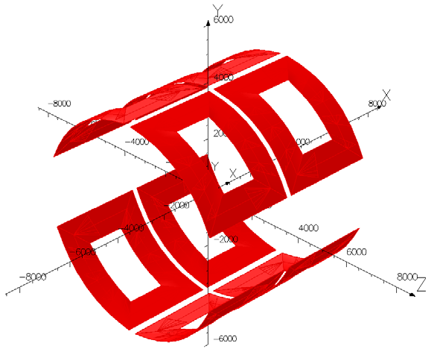
Update on Anti-DID Studies
Uwe Schneekloth (DESY)
Anti-DID field will reduce background
from beamstrahlung pairs
Implementation of such an anti-DID coil
is challenging
New designs needed since L* change
Original anti-DID
Module integrated
anti-DID
Solenoid modules
Two new promising options:
Dipole coils integrated into solenoid modules (B.Parker):
Good behaviour despite thermal stress,
bending forces, quenches
Independent dipole coils (Y. Makida et al. and
Toshiba/Hitachi):
Straight forward production of flat coils
that are bent in shape

Slide 12
MDI Sessions – Summary
ILC Main Beam Dump
Issues
Simulations
Possible alternatives
Backgrounds
CLIC Background Simulations
ILC Muon Shielding
Update on Anti-DID studies
Helium-Experiment at HERA
KEK Mini-Workshops
ILC surface sites & geological survey

Slide 13
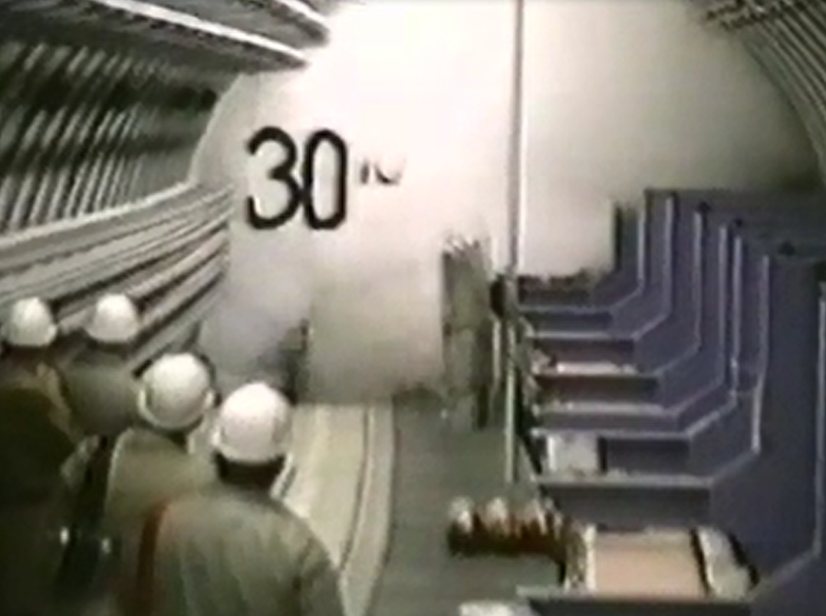
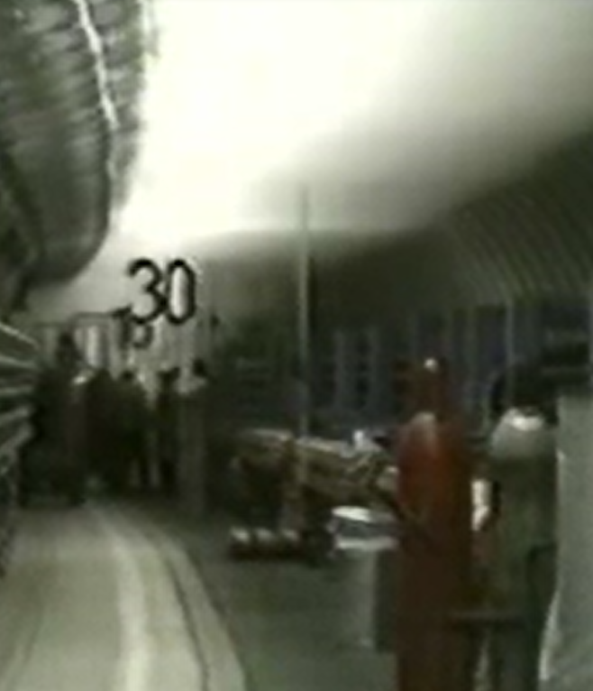
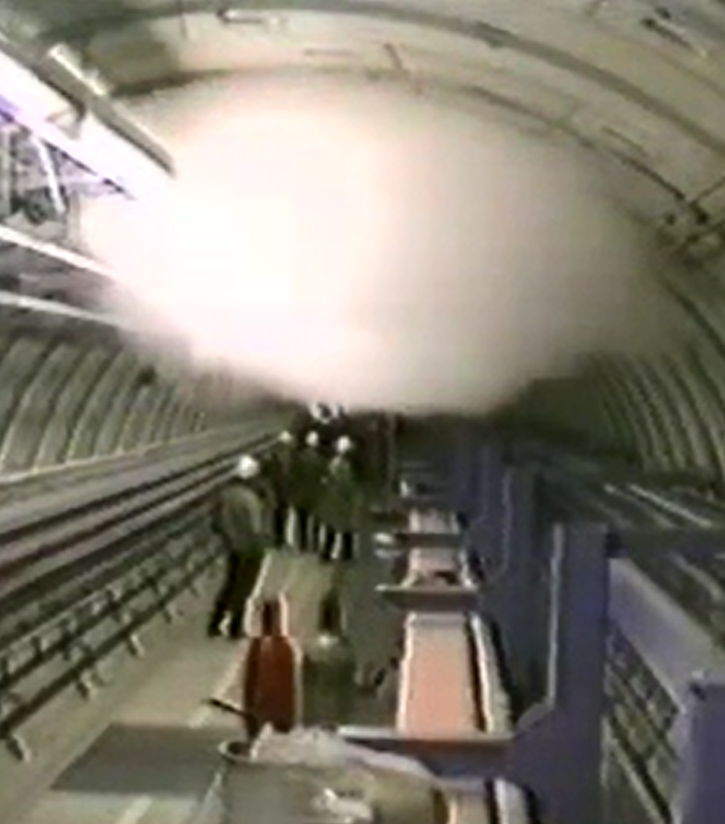
Helium-Experiment in the HERA Tunnel
Klaus Sinram (DESY)
Experiment to assess danger of Helium burst inside the tunnel
1000 l Helium was released into the tunnel
Drop in the Oxygen and temperature levels within only 10 s
Helium separates from air at tunnel
ceiling, and is extracted due to the
tunnel air flow
Danger considered to be small except for direct proximity to Helium burst location
Expensive stationary system for monitoring O2 not necessary at HERA

Slide 14
MDI Sessions – Summary
ILC Main Beam Dump
Issues
Simulations
Possible alternatives
Backgrounds
CLIC Background Simulations
ILC Muon Shielding
Update on Anti-DID studies
Helium-Experiment at HERA
KEK Mini-Workshops
ILC surface sites & geological survey

Slide 15
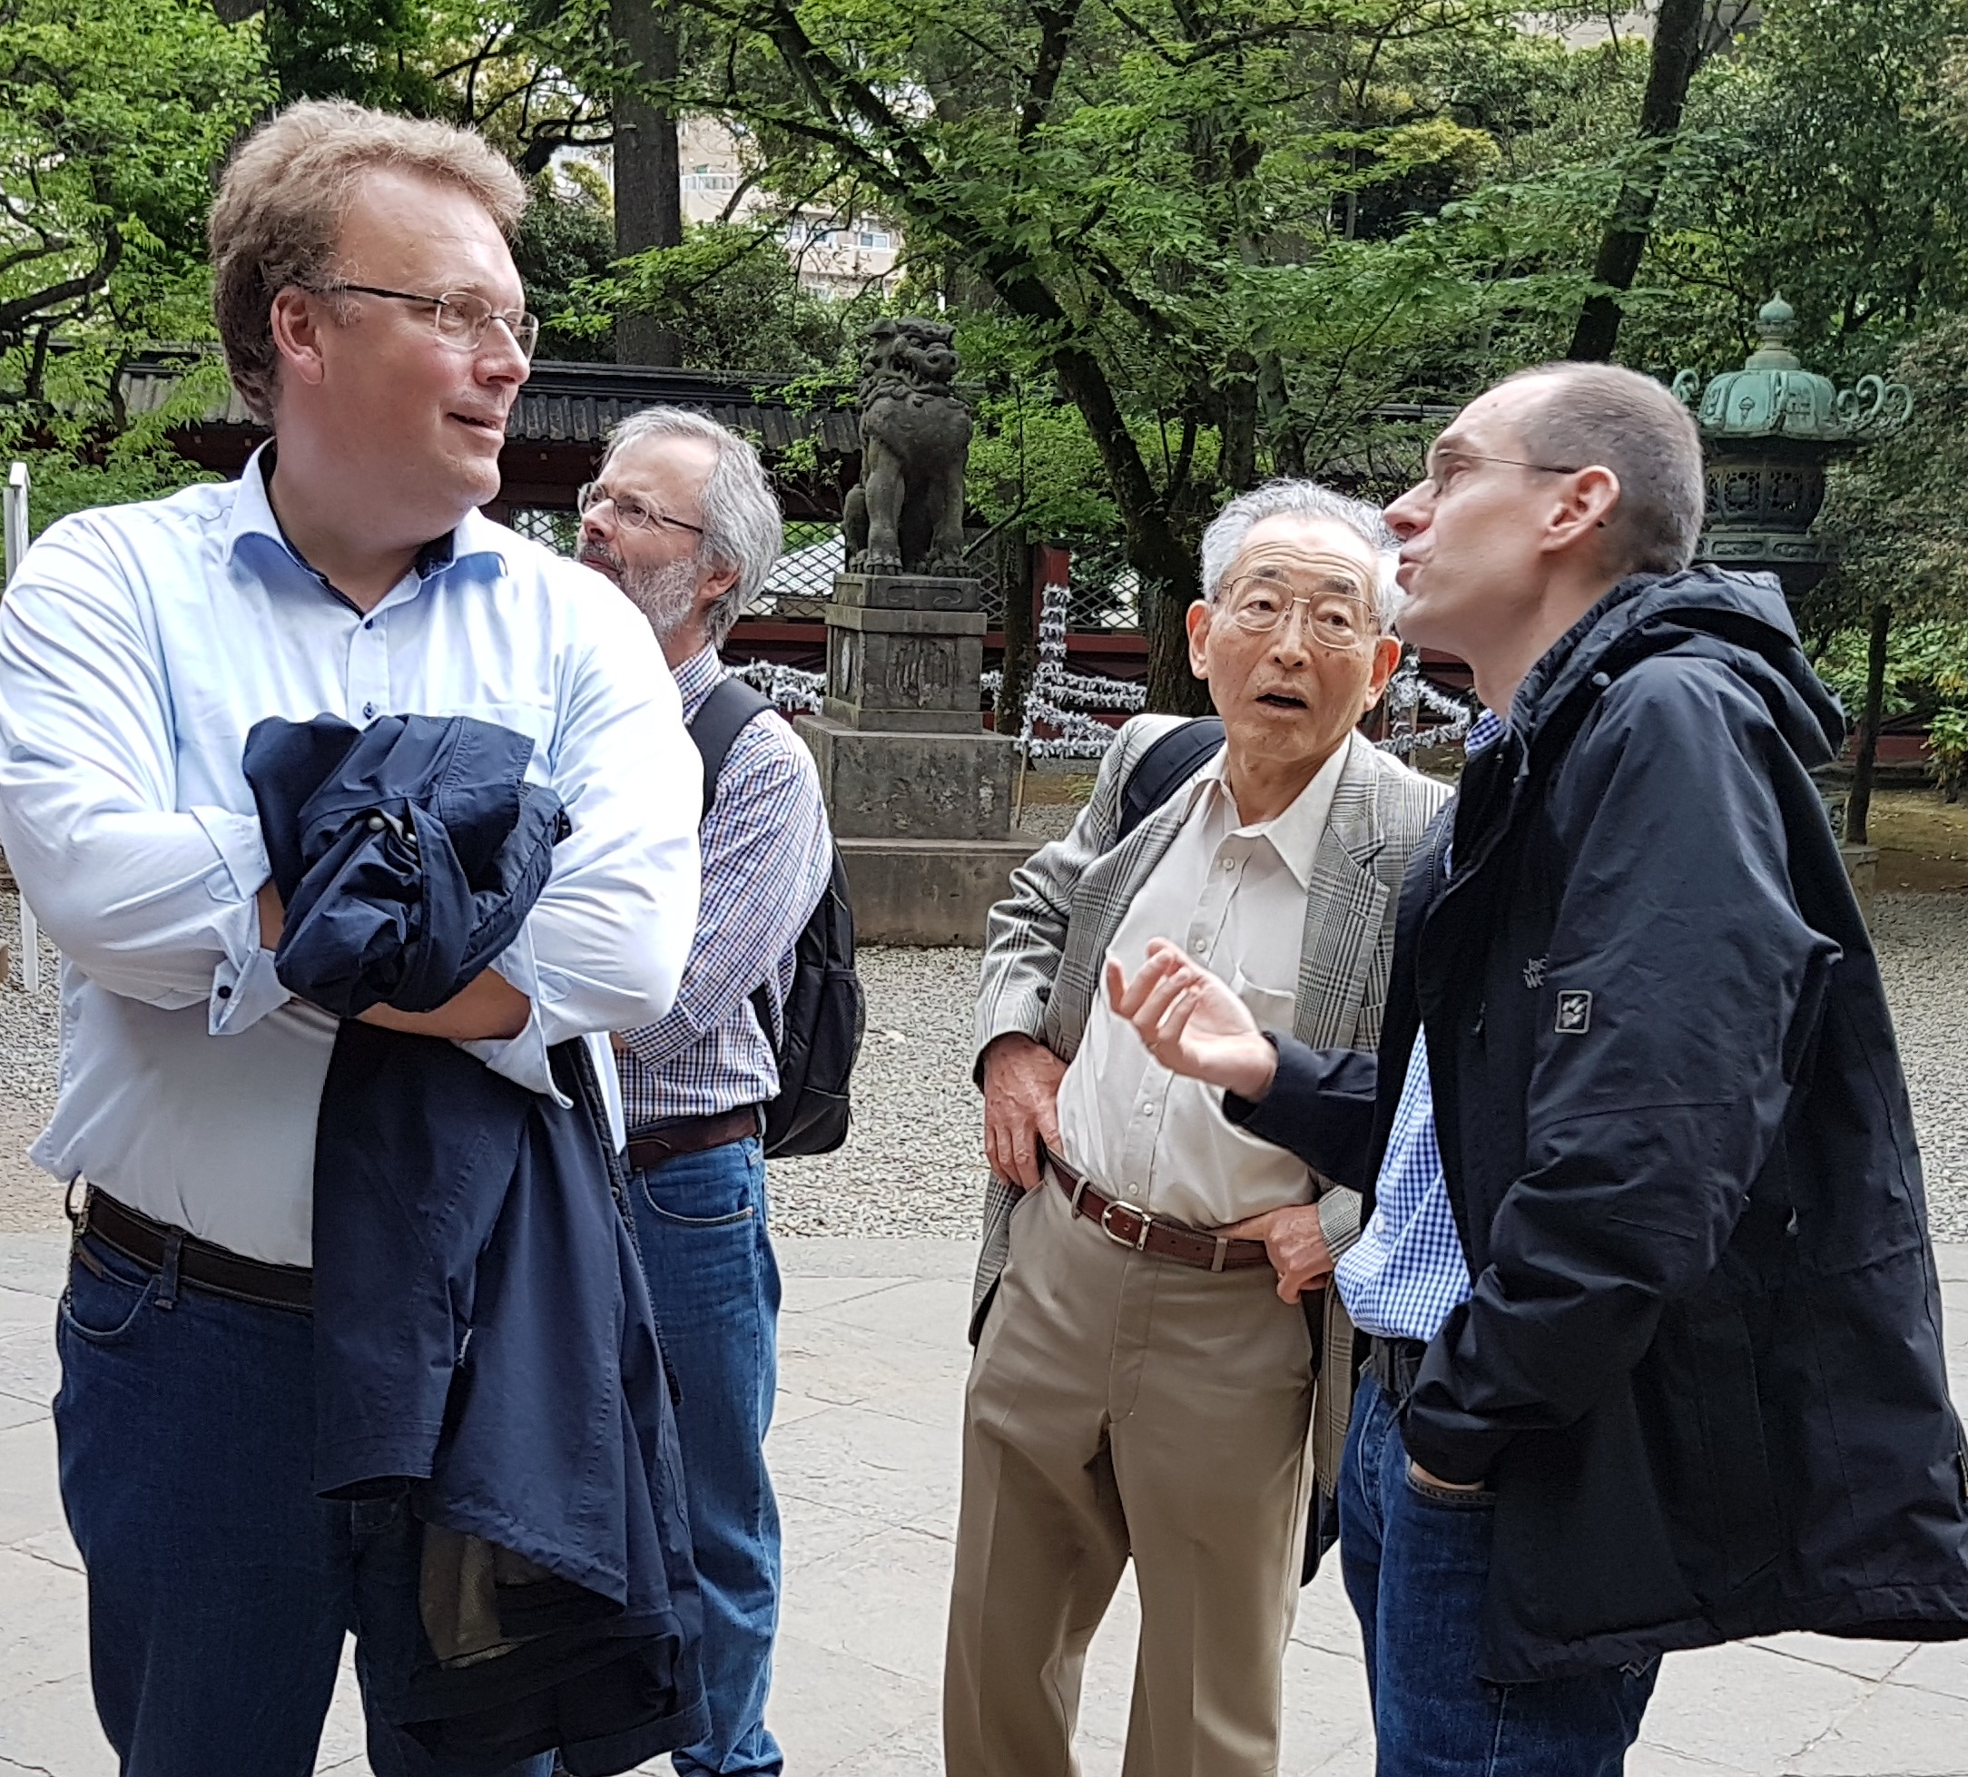
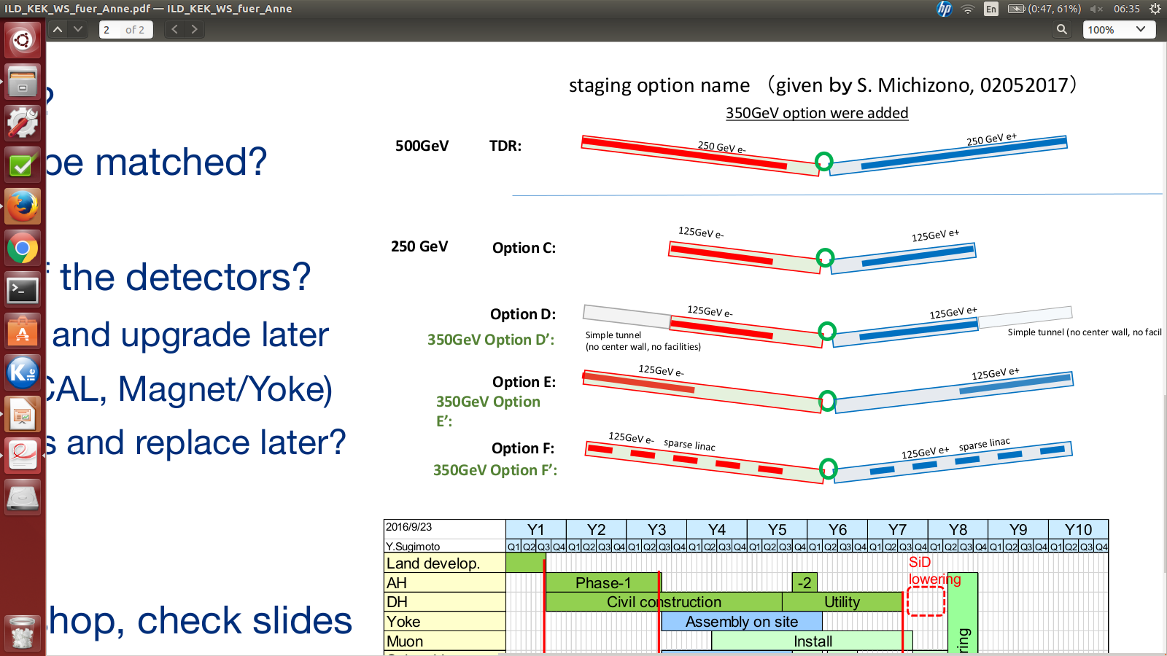
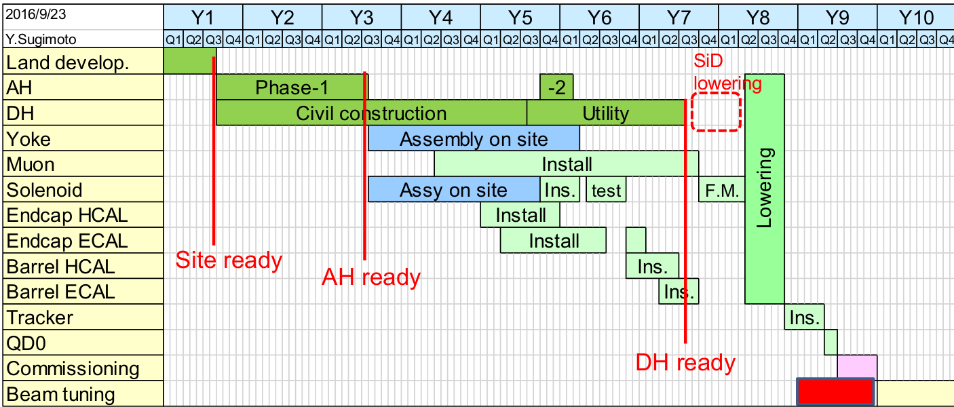
Report from KEK Mini-Workshop on CFS and Infrastructure for Detectors
Karsten Buesser (DESY)
05/16/2017: Fourth workshop of the successful series funded by E-JADE
Topics: Solenoid/Anti-DiD engineering, backgrounds, infrastructure at IP & main campus, detector engineering,
Staging
Impact of staging on the detectors:
Discussion of schedules:
Will a staged machine be ready earlier?
Can the detector assembly schedules be matched?
Staging for detectors:
Reduced detectors for 250 GeV, or dedicated low-energy detectors?
Next workshop: September 28, 2017 !

Slide 16
MDI Sessions – Summary
ILC Main Beam Dump
Issues
Simulations
Possible alternatives
Backgrounds
CLIC Background Simulations
ILC Muon Shielding
Update on Anti-DID studies
Helium-Experiment at HERA
KEK Mini-Workshops
ILC surface sites & geological survey

Slide 17
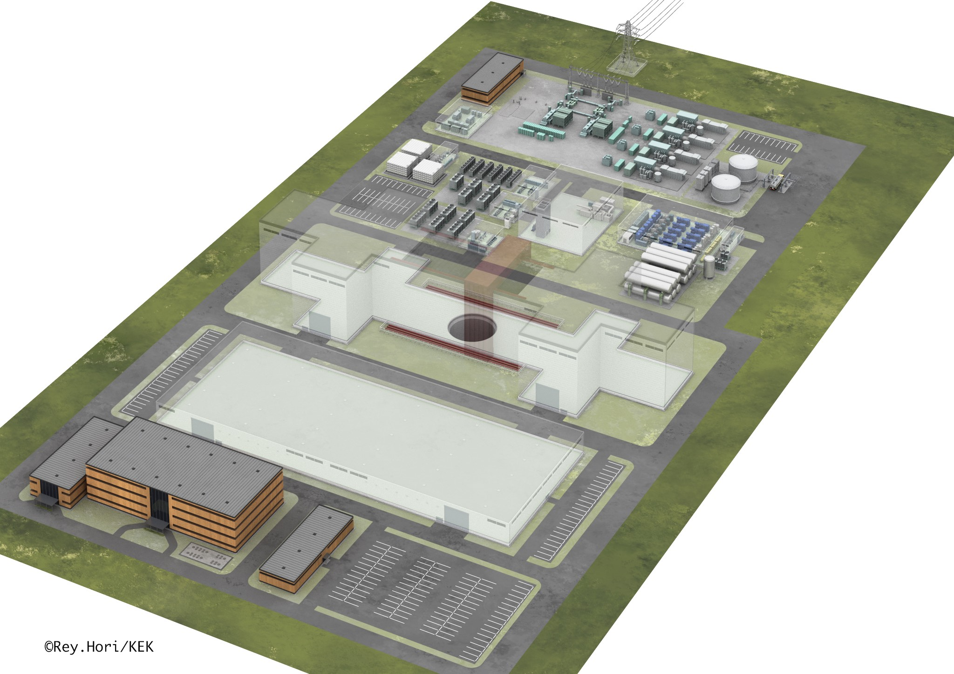
ILC Utility Design Study for the Kitakami-site
Hitoshi Hayano (KEK)
Cooling tower facilities
Detector
assembly hall
SiD/ ILD
workshops
3D model of the Collision Point surface site:
Total area 7.85 ha
Each zone is separable

Slide 18
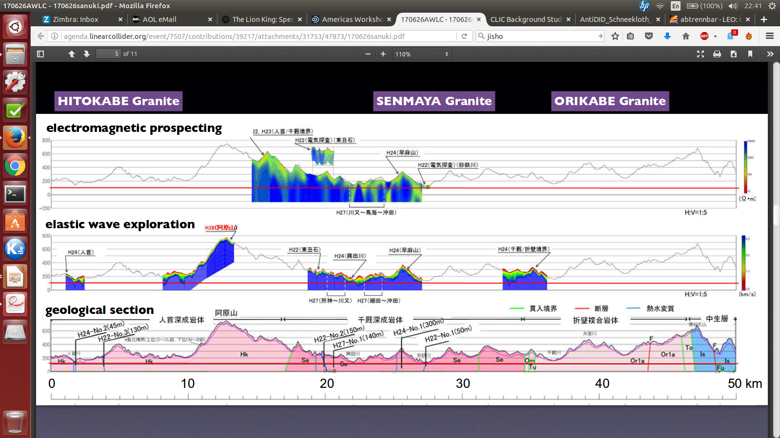
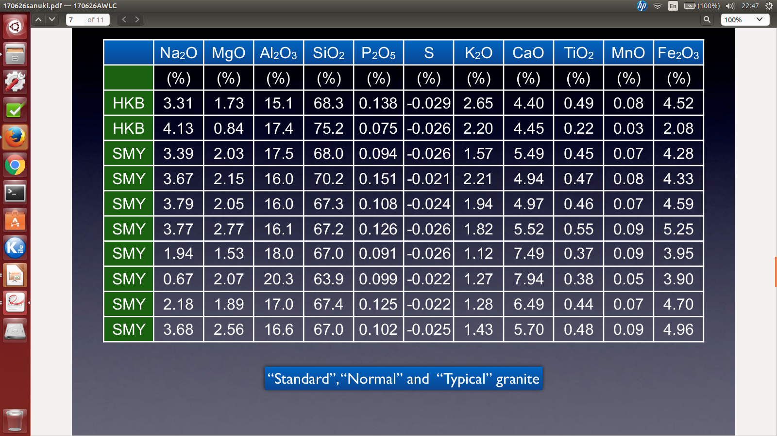
Recent Geological Survey at Kitakami
Tomoyuki Sanuki (Tohoku U./KEK)
Geological survey of the Kitakami site:
Large areas already assessed, especially around the IP area
The more “blue”, the better
X-ray fluorescence analysis:
No heavy metals
Debris from digging can therefore easily be dumped somewhere else
Granite is “standard”, “normal” and “typical”!
All very positive!

Slide 19
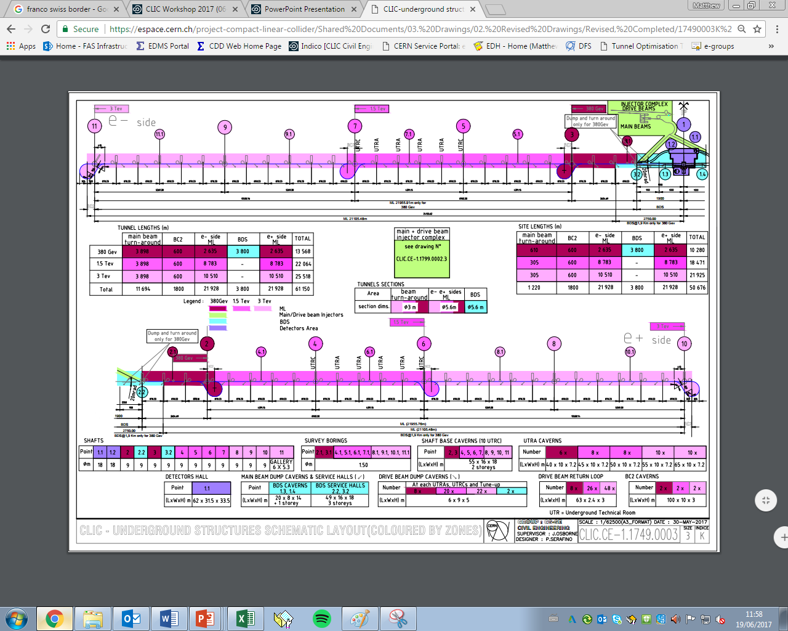
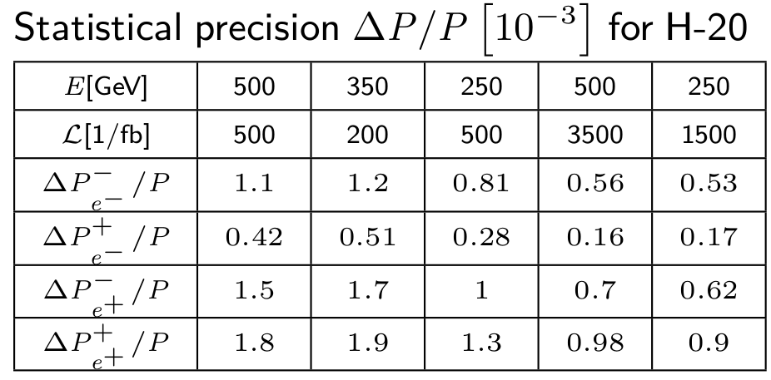
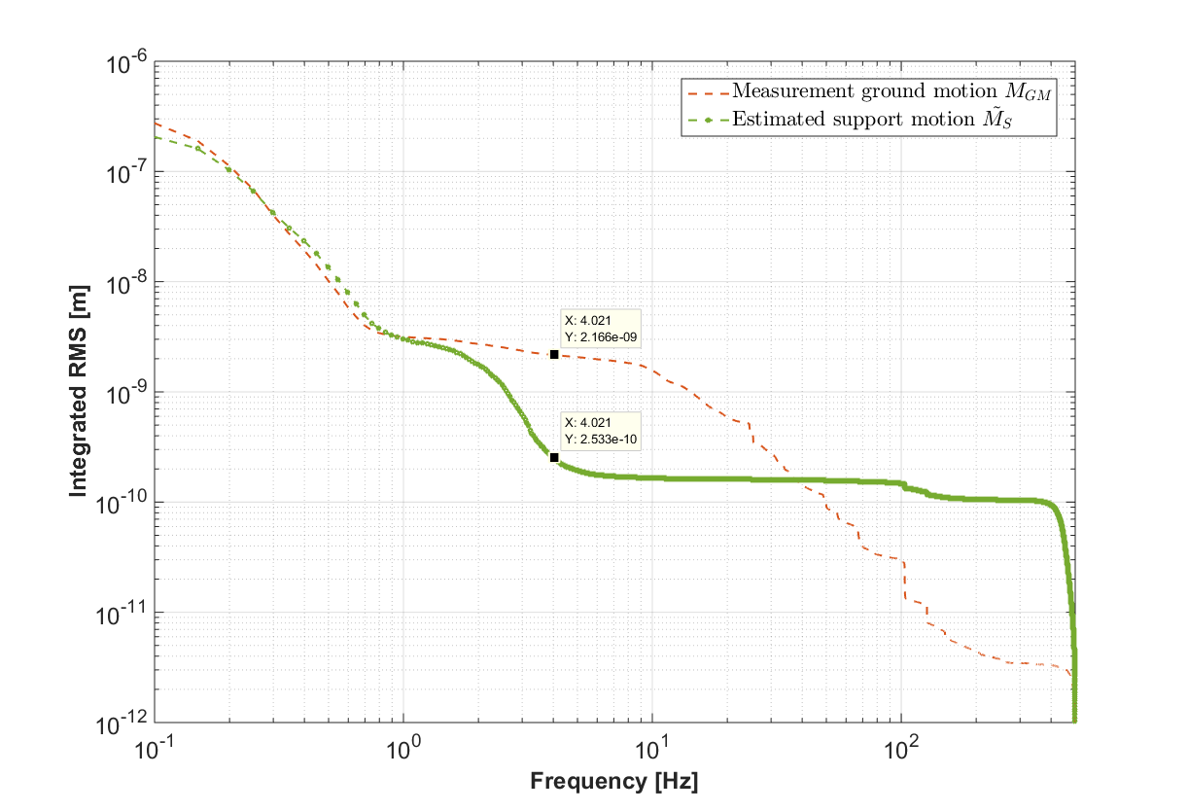
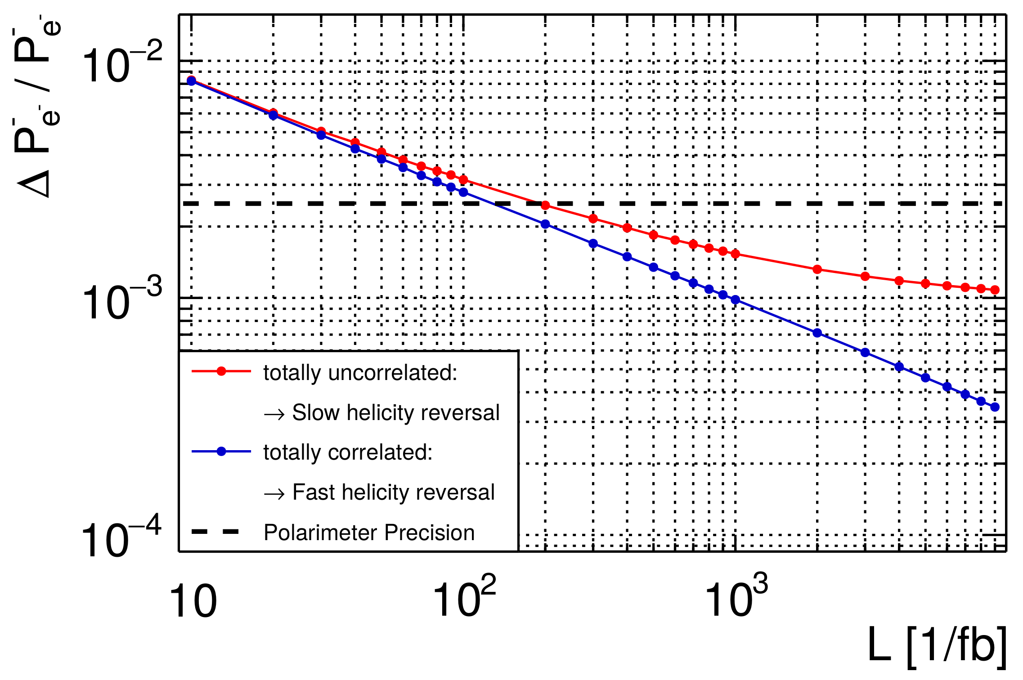
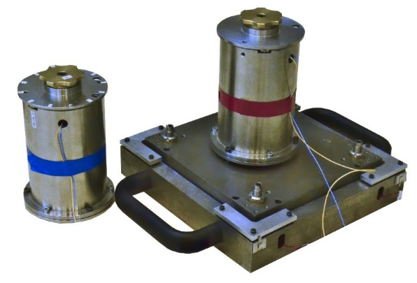
Other contributions - Snapshots
CLIC – Civil Engineering, Infrastructure and Siting Working Group, (CEIS)
Precision Measurement
of the ILC Beam Polarization
CLIC QD0 Stabilisation Progress
0.25 nm

Slide 20
The End
The talks in the MDI & CFS sessions were all great!
Thanks to the speakers for their very nice contributions,
and special thanks to the MDI & CFS session conveners.
For more information, please refer to the slides of the single talks uploaded on the Indico agenda for the sessions:
http://agenda.linearcollider.org/event/7507/sessions/4456/#20170626
http://agenda.linearcollider.org/event/7507/sessions/4460/#20170626

Slide 21
Backup

Slide 22
Precision Measurement of the ILC Beam Polarization
Robert Karl (DESY)
Improving the statistical precision for beam
polarization:
Time-resolved polarization measurements with 2 polarimeters, upstream and downstream of the IP
Luminosity weighted polarization from collision data of well known SM processes
Combining these measurements:
Significant improvement in precision for concurrent measurements (cancellation of sys. uncertainties)

Slide 23

CLIC QD0 Stabilisation Progress
Laurent Brunetti (LAPP)
To reach the CLIC beam offset specifications of 0.2 nm RMS @ 0.1 Hz, the displacement of QD0 has to be below 0.2 nm RMS @ 4Hz
Measurements with prototype of active control system with commercial sensors are promising, but sensors are main limitation
CLIC demonstration of feasibility at
reduced scale with a developed sensor:
LAPP active foot and LAPP vibration
sensor reach
0.25 nm RMS @ 4 Hz
0.25 nm
Future plans:
Improving the sensor by comparing and assessing different technologies for the embedded sensitive part

Slide 24
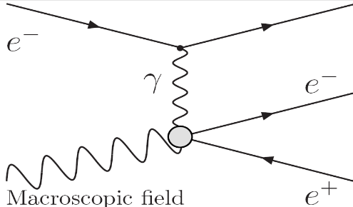
CLIC Background Studies
Dominik Arominski (CERN/WUT)
The cascade trident process:
Only relevant for large ECM
The trident process is mediated by a virtual photon
No accurate single cross section available in literature
Conversion into pair assumes that the photon is unpolarized

