Slide 1




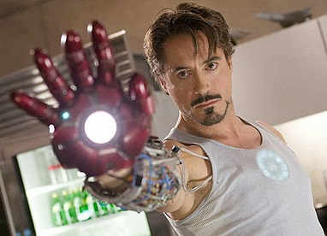


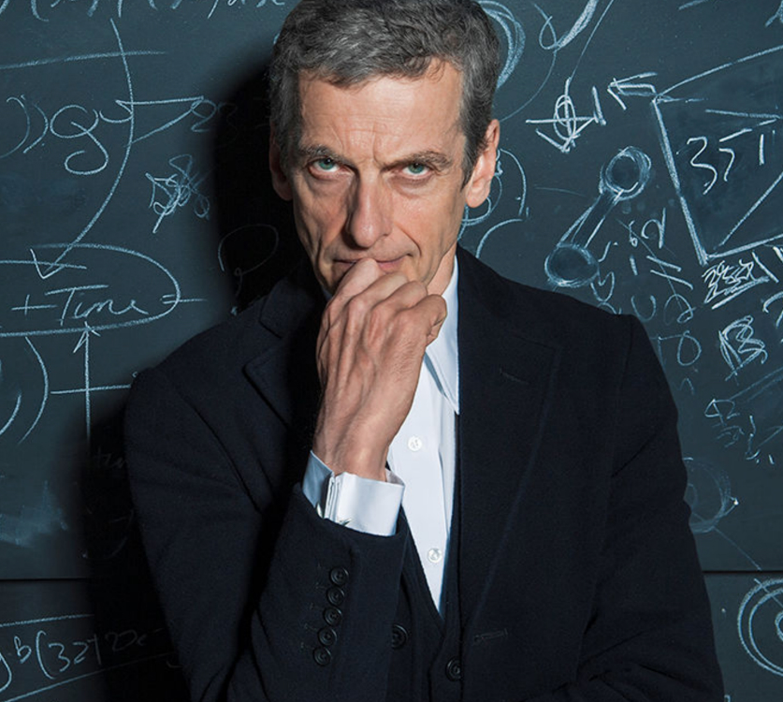

Slide 2


Physicists (all scientists in general) have the advantage of being trained in many different things besides their focus:
Advanced Mathematics
Logical and Critical Thinking
Problem Solving
Programming Skills
Communication
Experience in working in foreign countries and working with people of different nationalities

Slide 3

Research and Academia
  Post-doc, Professorship
  Staff member of an institute
Finance
Industry
  Technical Industry & Engineering & Energy
  Transport & Logistics, Construction
  Programming
Public service and Politics
  Teacher
  Politician
  Law career
Self Employment
Superhero

Slide 4
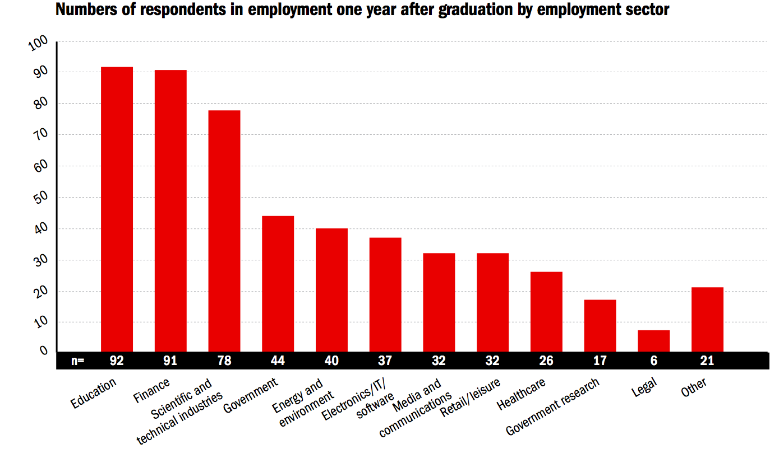
Not research related careers

Slide 5

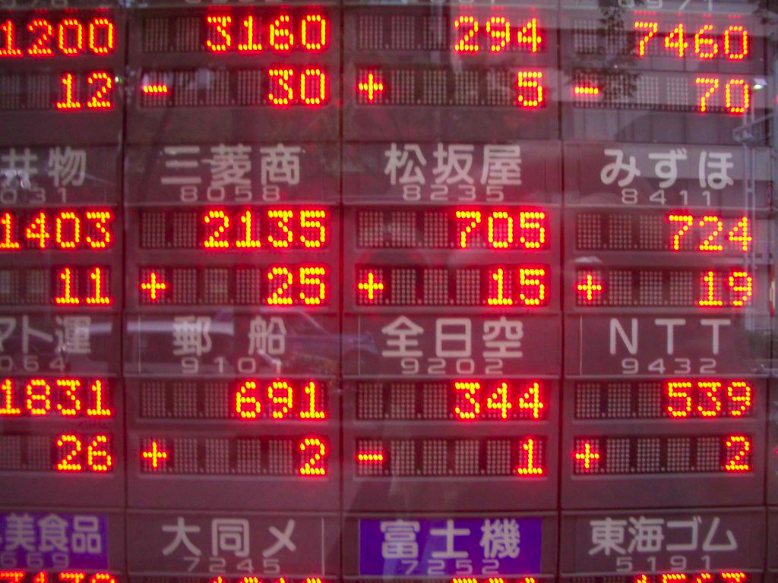


  Broker
  at the stock exchange
  Risk Analyst
  (e.g. for banks or
  insurance companies)

Slide 6



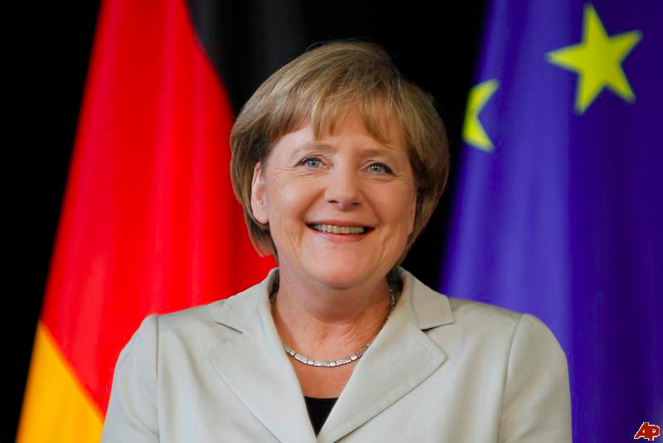
  Law career
  Teacher
  Politician
  (e.g. Bundeskanzlerin (Chancellor)
  Angela Merkel)

Slide 7





  Technical Industry & Engineering
  (e.g. Car Industry)
  Energy
  (e.g. Electrician, Renewables)
  Transport & Logistics
  (e.g. Mechanic, Pilot)
  Construction
  (e.g. Architect)
  Programming & IT
  (e.g. Computer Game Developer)

Slide 8

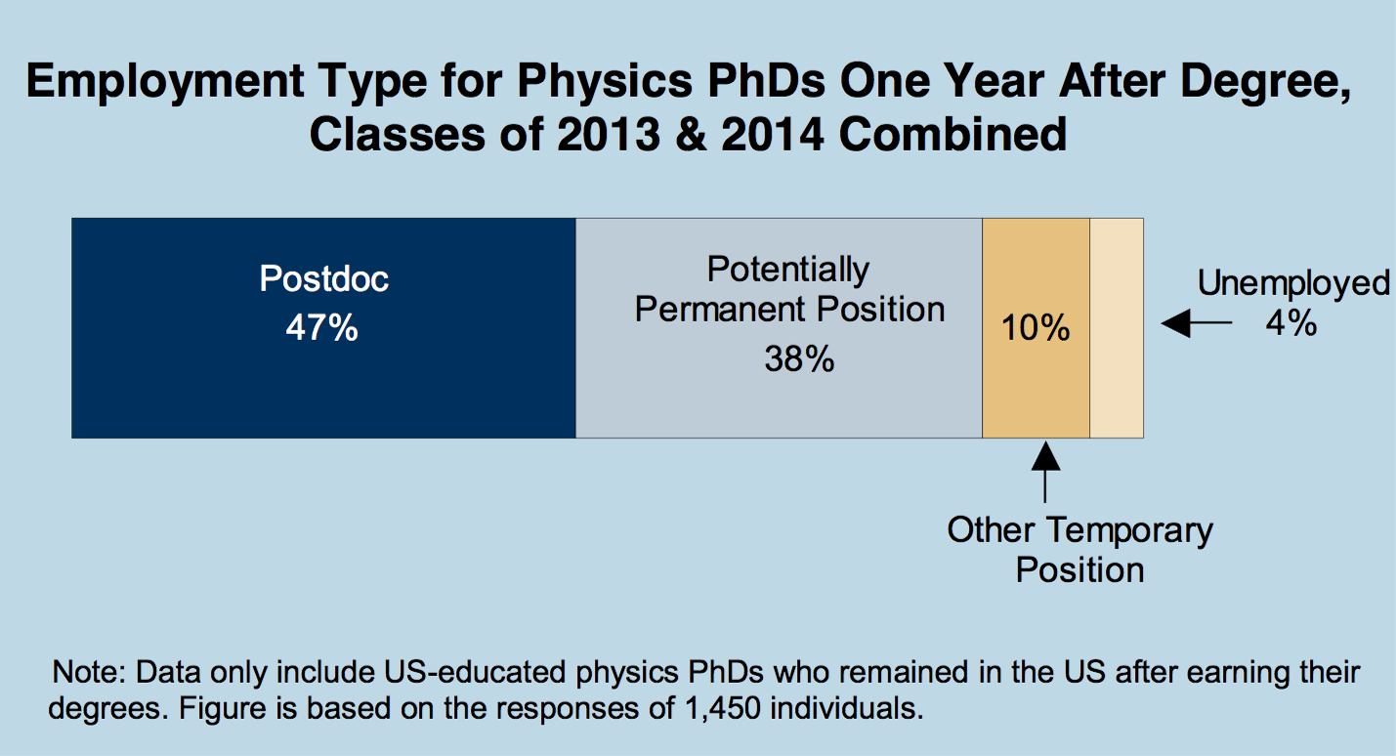

Slide 9
  PhD
  Post-Doc
  (2-3 year position(s) after PhD)
  Professor
  (at an university, have to do teaching, little research)
  Senior researcher
  (research, teaching)

Slide 10

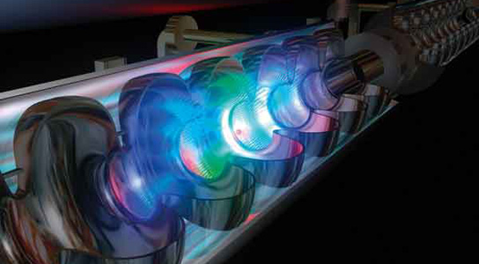
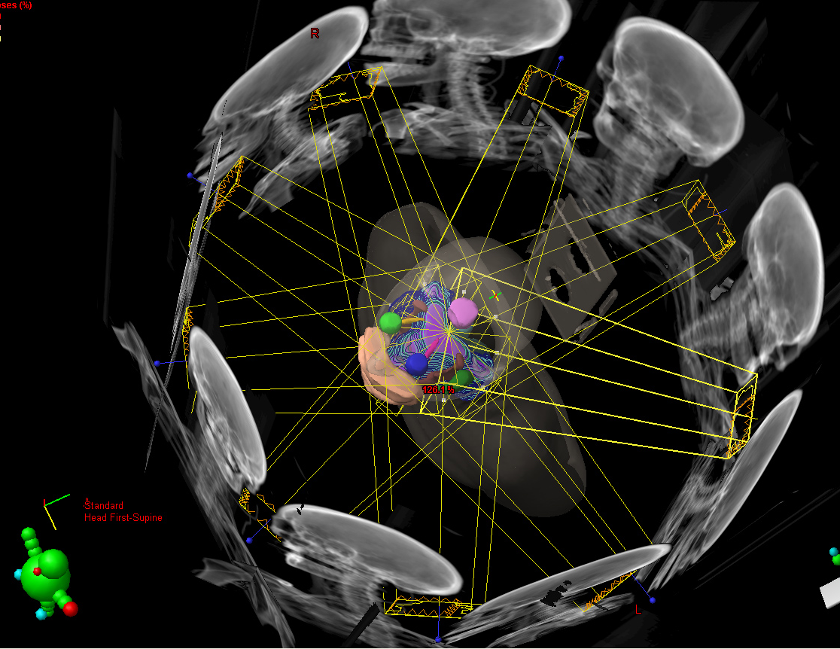
In every science, there are different subfields.
In Physics for example:
Experimental Particle Physics
Theoretical Particle Physics
High Energy Physics
Accelerator Physics
Nuclear Physics
Astrophysics
Plasma Physics
Solid-state Physics
Optics and Acoustics
Biophysics and Chemical Physics
Medical Physics

Slide 11
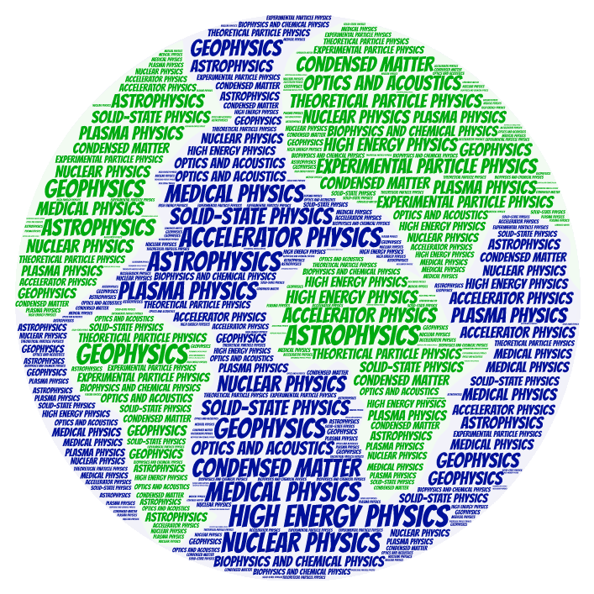
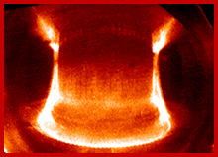
In every science, there are different subfields.
In Physics for example:

Slide 12

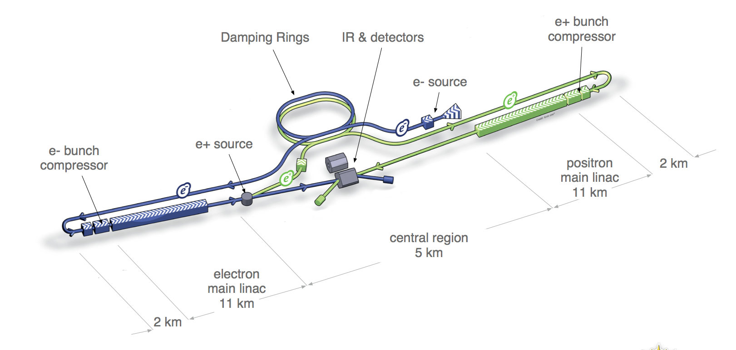




Slide 13
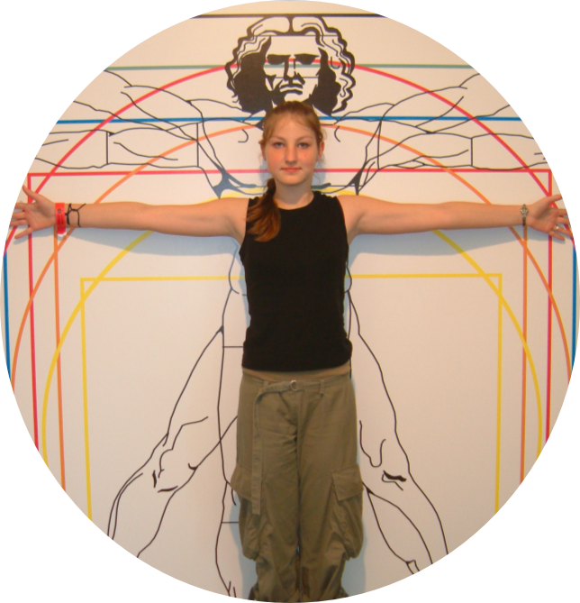
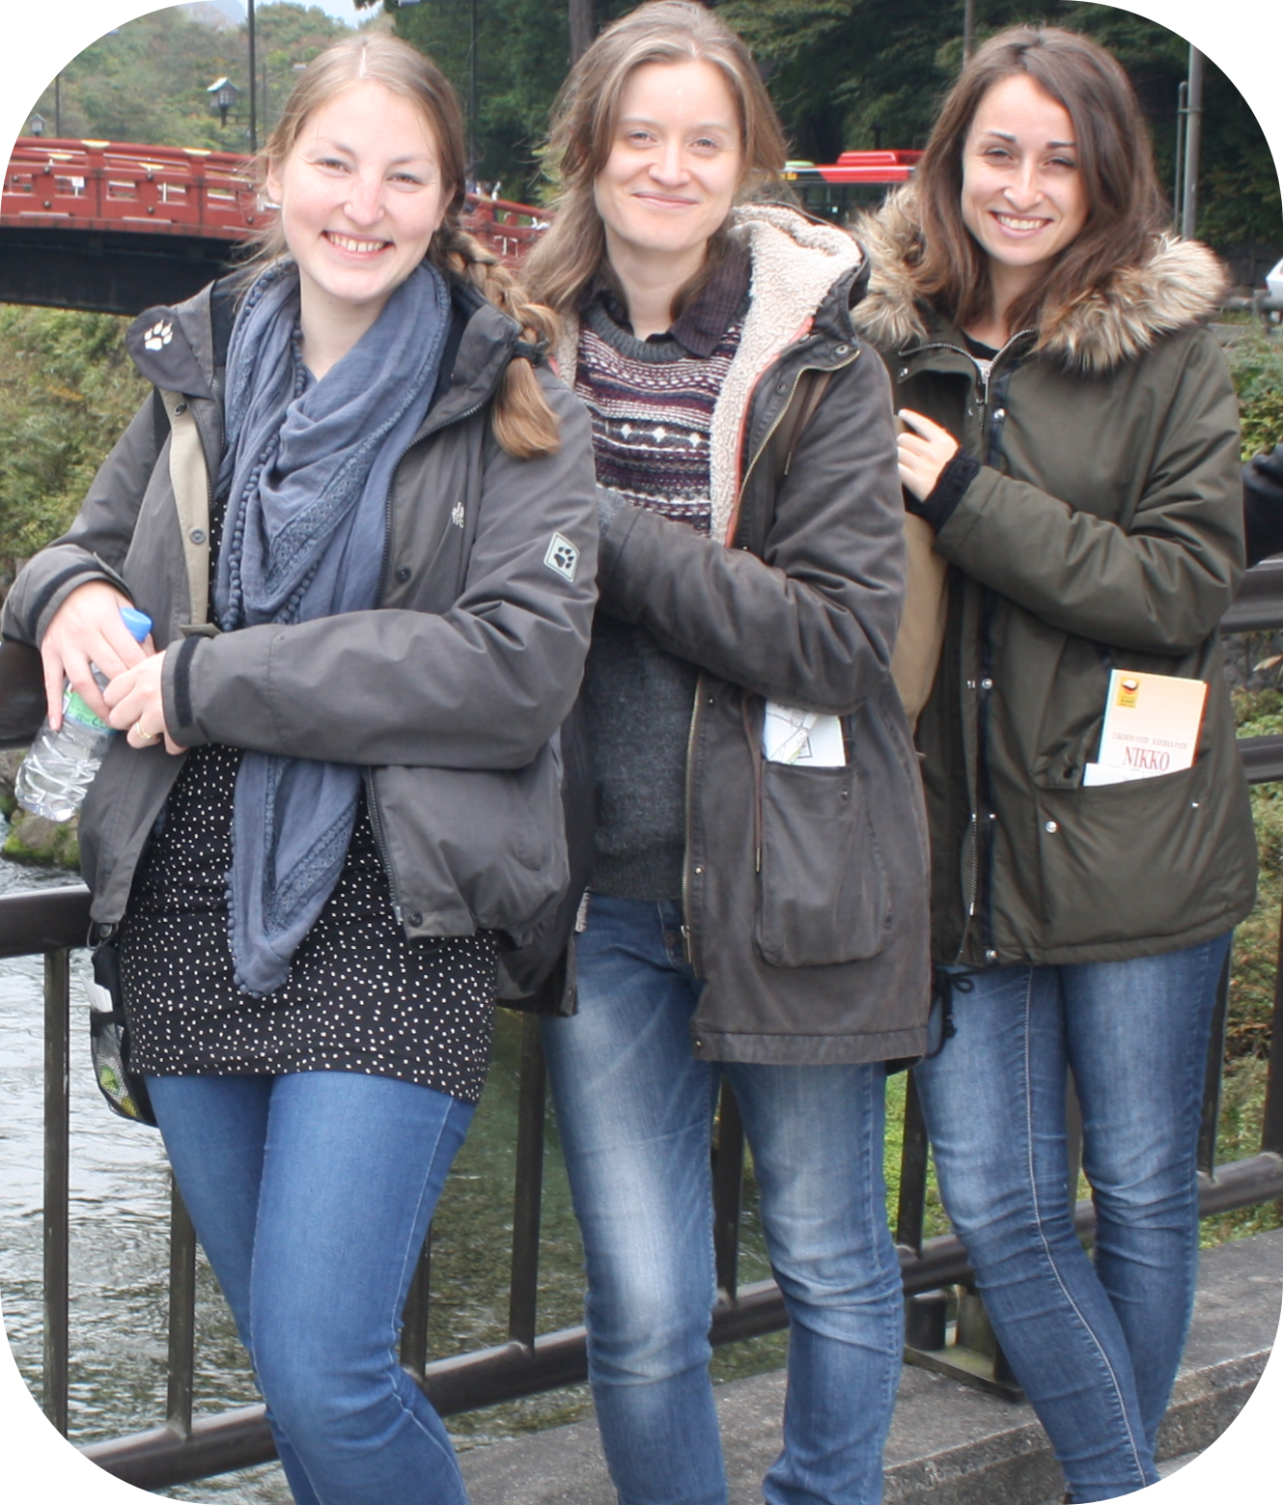



The Path of Three Young Researchers
Past
Present
Future

