Slide 1
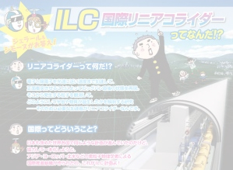


The International Linear Collider -
Background Simulations &
Optimizations of the Final-Focus Region
GK Workshop, Bad Liebenzell
12. October 2017
Anne Schütz
Hadrons vs. Leptons & Circular vs. Linear
The International Linear Collider
Background Simulations
Conclusions

Slide 2
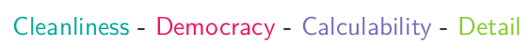
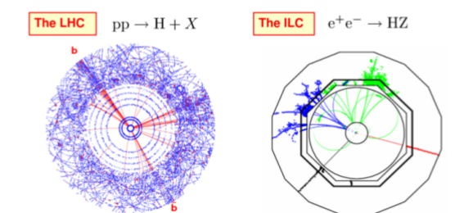
Hadron vs. Lepton Collider
Leptons:
Small background
No out-of-time pileup or underlying events
Small detector occupancy
Tiny background

Slide 3
Hadron vs. Lepton Collider
Leptons:
Small background
No out-of-time pileup or underlying events
Small detector occupancy
Tiny background
e⁺e⁻ annihilation produces pairs of SM and exotics at similar rates
(elementary coupling e of photons is the same for all quarks and leptons)
Model independence
No triggers
Record EVERYTHING!

Slide 4
Hadron vs. Lepton Collider
Leptons:
Small background
No out-of-time pileup or underlying events
Small detector occupancy
Tiny background
e⁺e⁻ annihilation produces pairs of SM and exotics at similar rates
(elementary coupling e of photons is the same for all quarks and leptons)
Model independence
No triggers
Record EVERYTHING!
Point-like elementary particles in initial state
No systematic uncertainties due to PDFs and QCD corrections
Easy to reconstruct

Slide 5
Hadron vs. Lepton Collider
Leptons:
Small background
No out-of-time pileup or underlying events
Small detector occupancy
Tiny background
e⁺e⁻ annihilation produces pairs of SM and exotics at similar rates
(elementary coupling e of photons is the same for all quarks and leptons)
Model independence
No triggers
Record EVERYTHING!
Point-like elementary particles in initial state
No systematic uncertainties due to PDFs and QCD corrections
Easy to reconstruct
Reconstruction of complete events
Due to high energy resolution, particles with small mass difference distinguishable → Peaks are measurable that weren’t measurable before
Find something new

Slide 6
Circular vs. Linear Collider
Circular:
Synchrotron radiation:
Energy loss per turn:
Cost ~ quadratically with E
(B. Richter 1980)
Linear:
Not limited by synchrotron radiation
Cost ~ linear with E + basic costs
(dumping rings etc.)
Circular machine?
→ Leptons:
high E loss due to synchrotron radiation
→ Hadrons:
synchrotron radiation less of a problem
Linear collider?
→ Hadrons:
could reach higher E in circular machines
→ Leptons:
perfect for precision measurements!

Slide 7
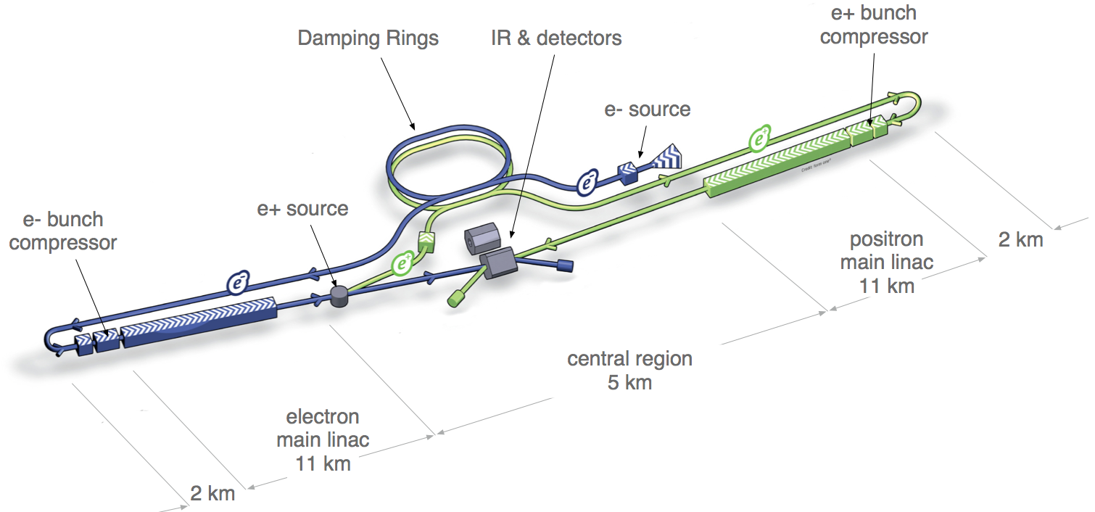
The International Linear Collider
Layout
e⁺ e⁻ linear collider with adjustable center-of-mass energy, and polarized beams

Slide 8


The International Linear Collider
Candidate Site: The Kitakami Mountains

Slide 9
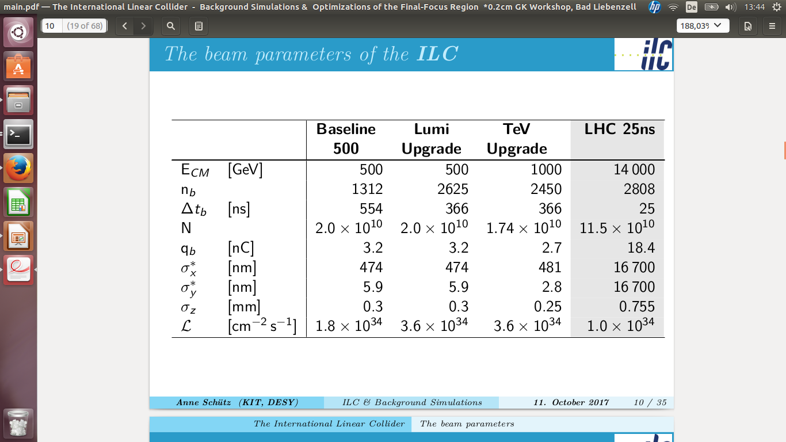
The International Linear Collider
In comparison to LHC
Higher luminosity than LHC Run 2 (25ns bunch spacing) due to the tiny bunch sizes (nano-meters)!

Slide 10
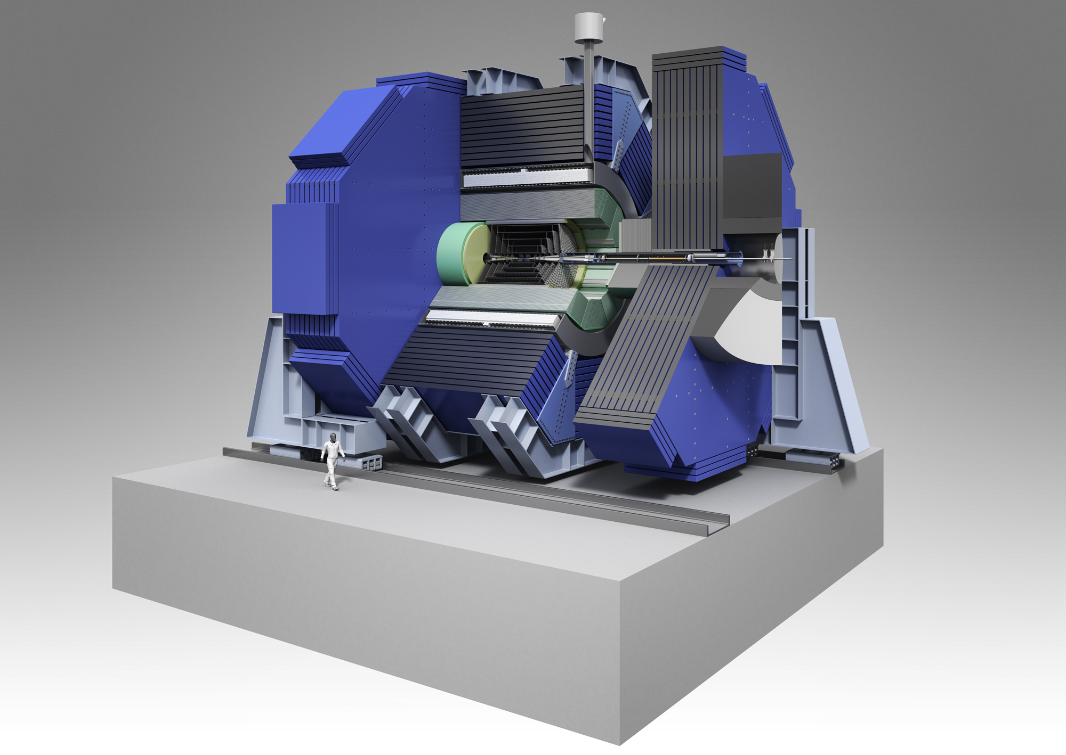
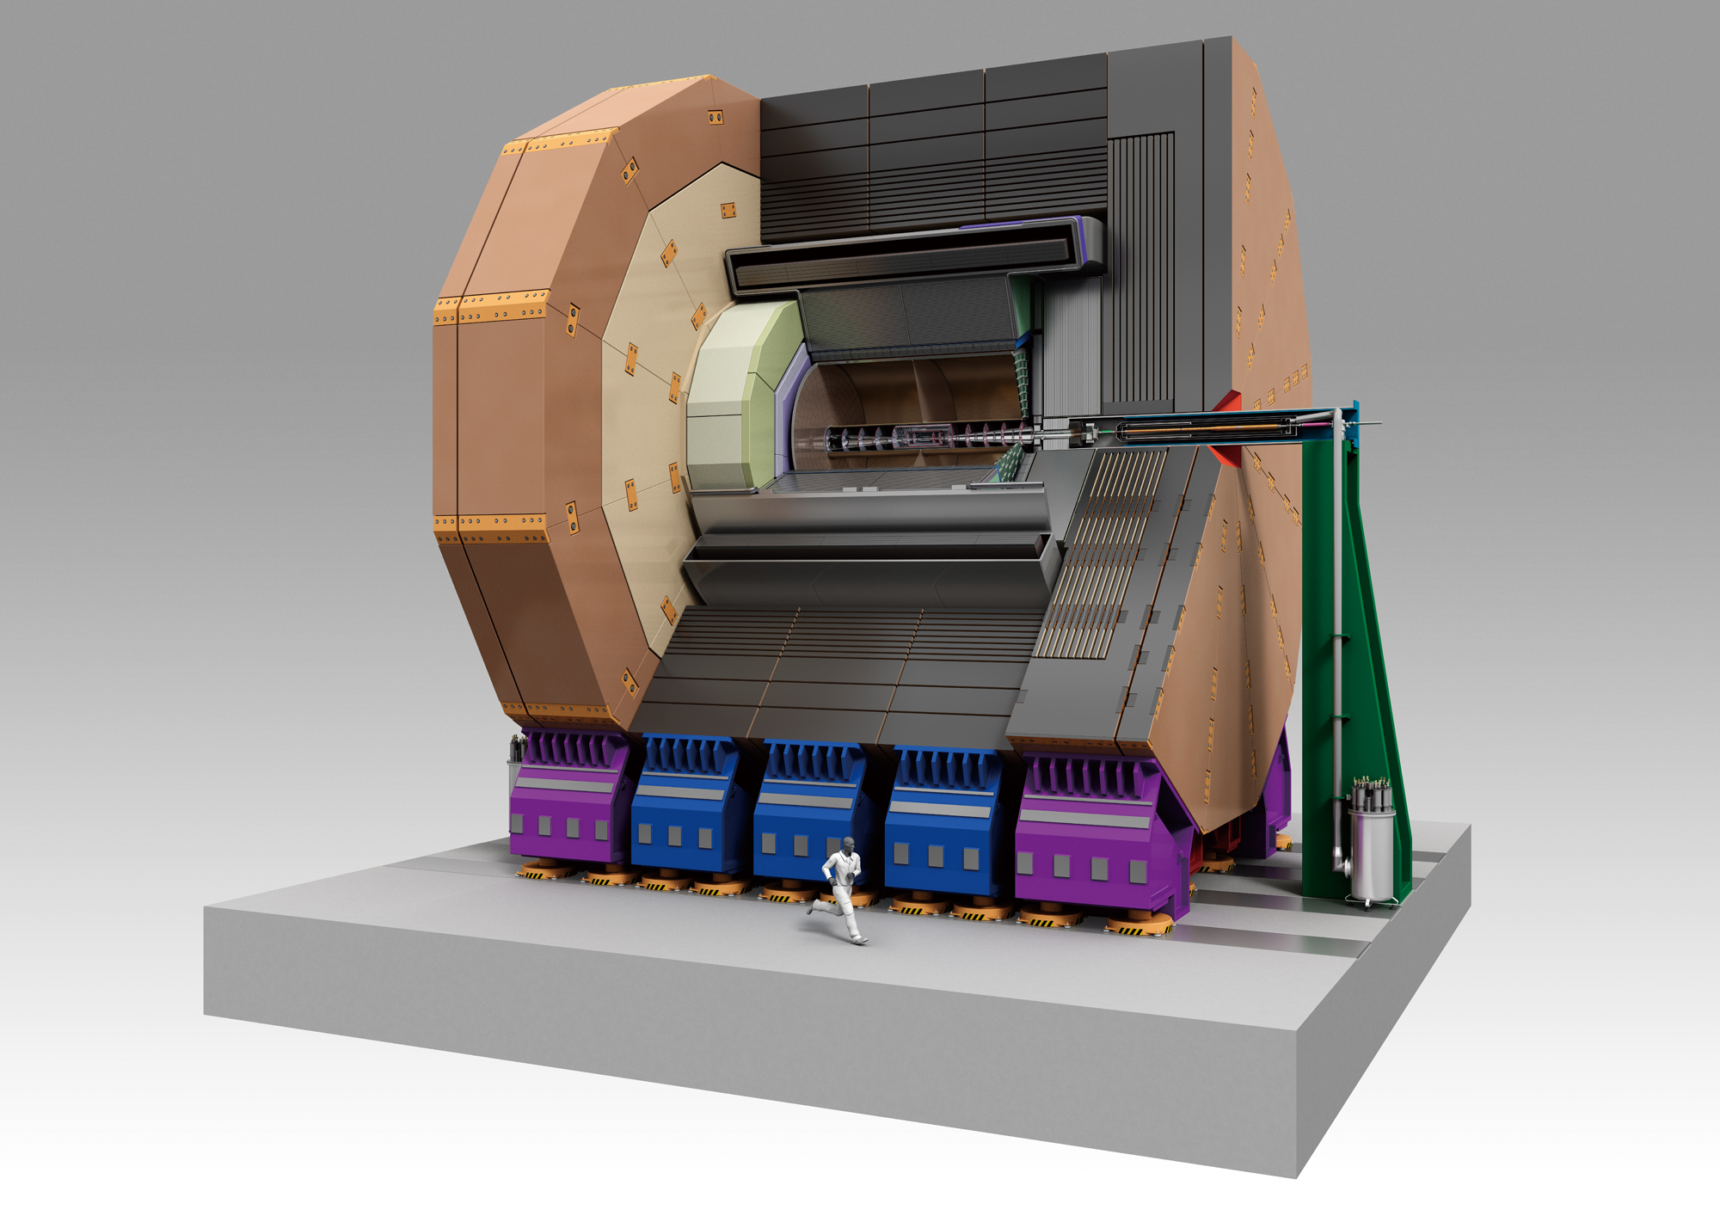
The International Linear Collider
The Detectors
Only one IP but two detectors → push-pull system!
SiD – Silicon Detector
Full silicon vertex & tracker detector system
ILD – International Large Detector
TPC as a tracker system
SiD and ILD are multi-purpose detectors,
but what’s the difference to the LHC detectors, such as CMS and ATLAS?
The technology is much more advanced!

Slide 11
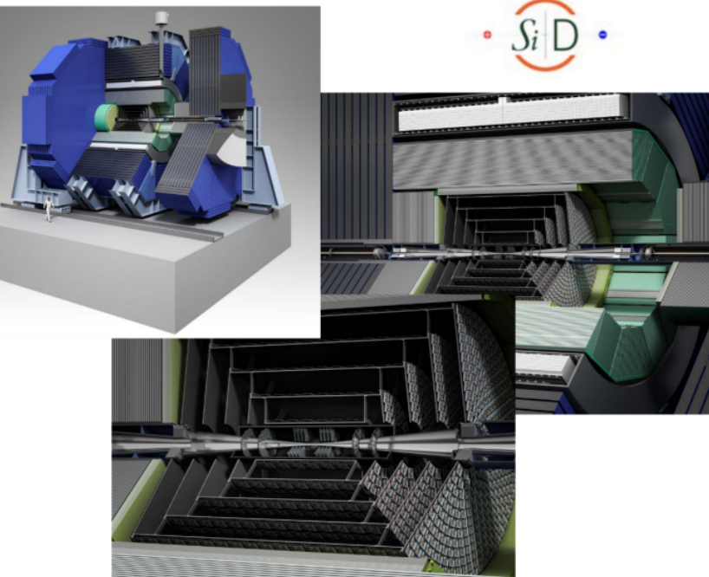
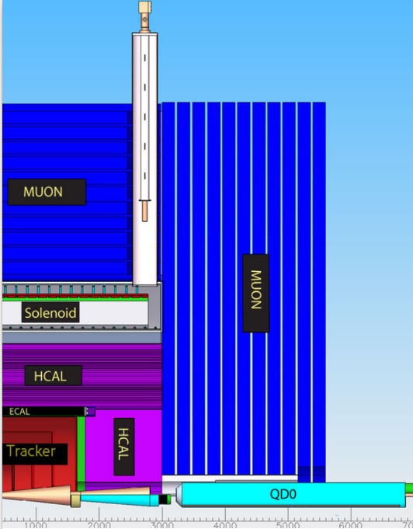
The International Linear Collider
The SiD Detector
Convincing design:
Robust and compact
Full silicon vertex detector and tracker
5T solenoid field
Vertex detector:
Spatial resolution:
< 3 μm
Momentum resolution:
∼ 2-5 × 10 ⁻⁵ GeV
∼ 0.1 % X0 per layer
Calorimeters:
highly granular, optimized for
Particle Flow
Jet energy resolution: 3-4 %

Slide 12
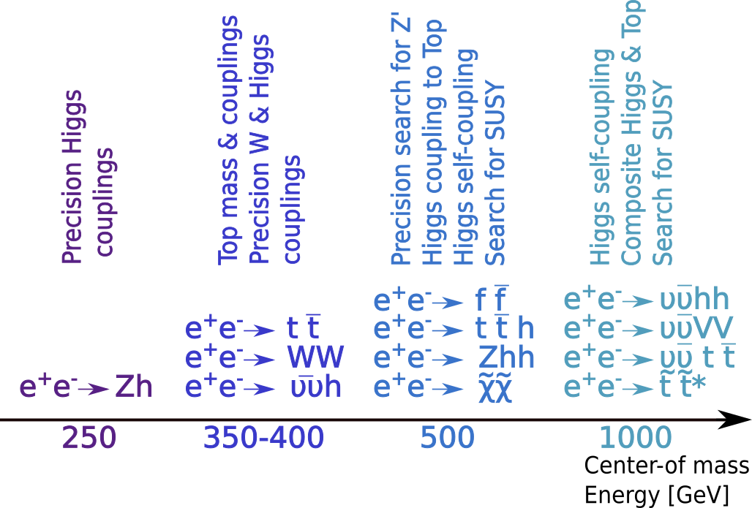
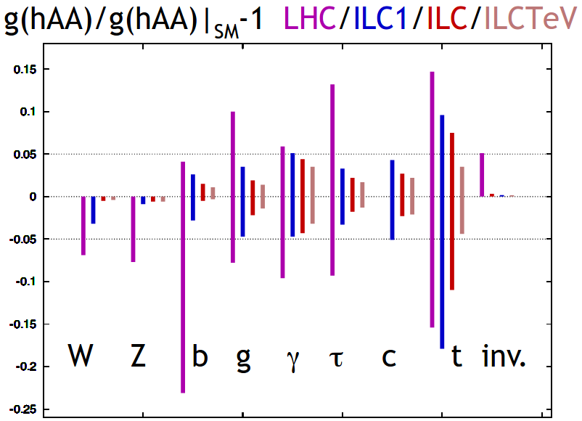
The International Linear Collider
Key Physics Goals
The Japanese government asks for a
significant cost reduction!
To achieve such a dramatic reduction, the full machine needs to be staged:
“ILC250” instead of the ILC with 500 GeV c.o.m energy
Precision Measurements:
ILC: Each Higgs coupling will be measured to a percent accuracy, direct measurement of the global width of the Higgs
LHC: Global fit to all Higgs signals (plus using theoretical assumptions of the width) → Higgs couplings can never be as precise as at the ILC

Slide 13
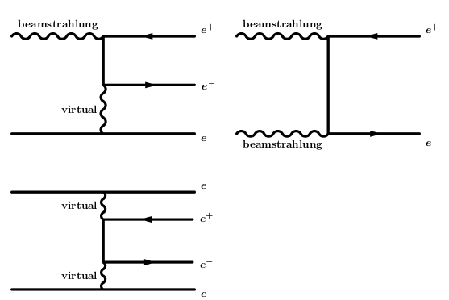
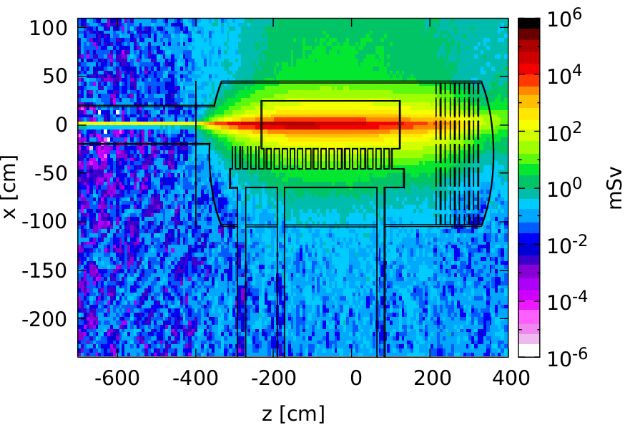
The International Linear Collider Background Sources & Simulation Tools
The main sources of background:
Beam-beam interactions
  Pair background
  Bhabha scattering
  → hadrons
Machine background
  Muons from the Beam Delivery System
  Background from the Final-Focus System (beam halo collimators)
  Neutrons from the Main Beam Dumps
→ GuineaPig
→ Whizard
→ Mucarlo
→ BDSIM
→ FLUKA
The generated background events are then input to a Geant4 full detector simulation of SiD.

Slide 14
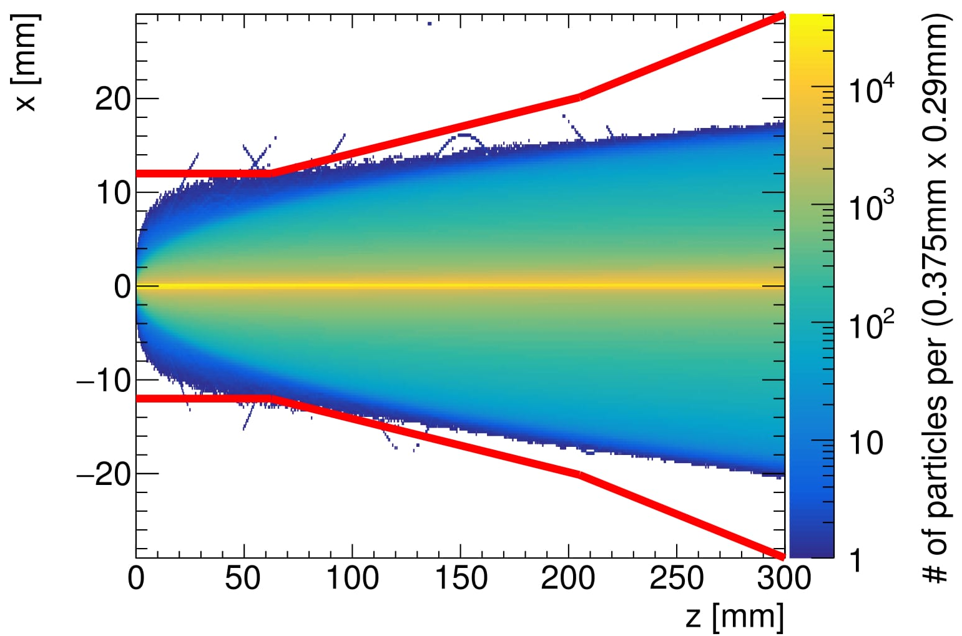
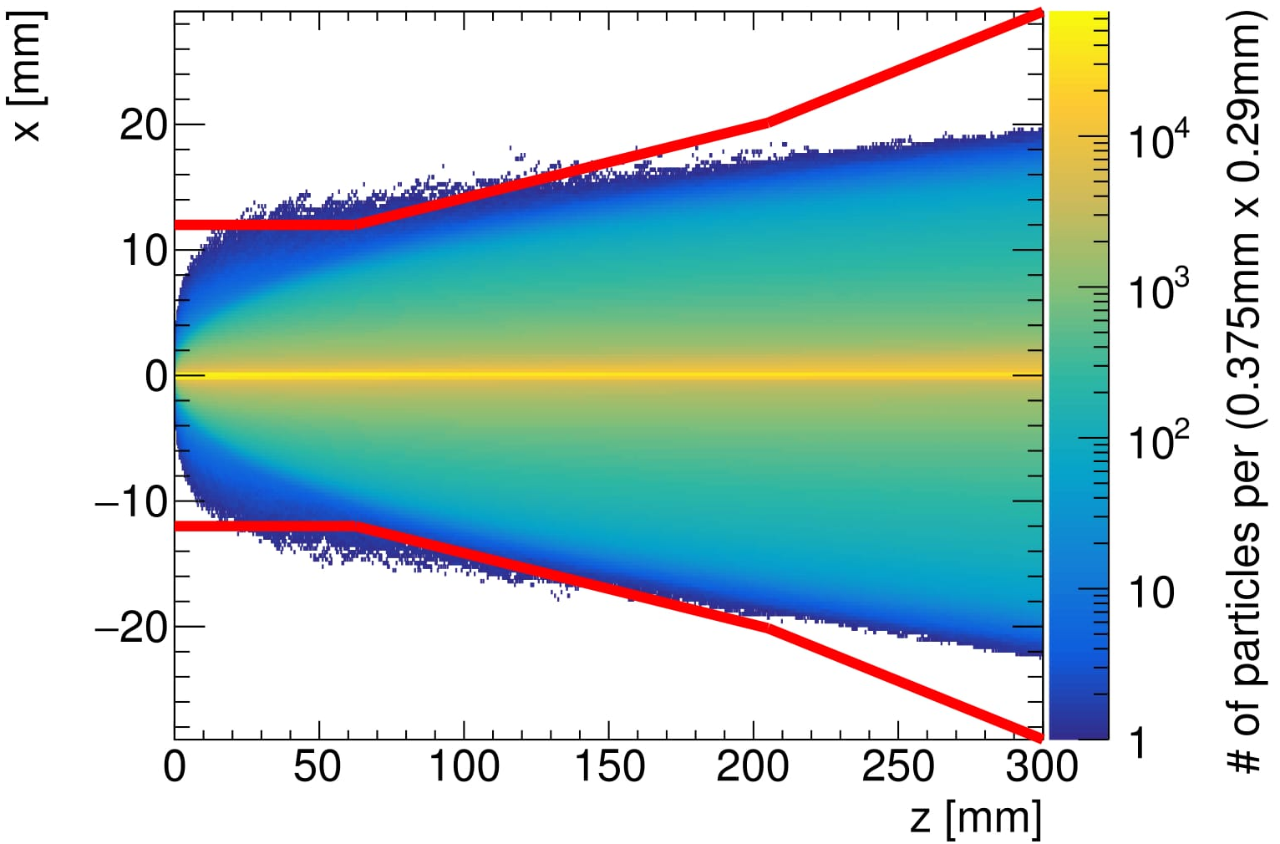
The International Linear Collider
Pair background studies for the ILC250
New beam parameter sets: Increasing the lumi by reducing the beam emittance →
Stronger beam-beam interactions, more background!
Pair background density in a 5T solenoid field
The pair background particles spiral in the magnetic field, and have a characteristic envelope.
The broader the envelope, the more particles reach the inner most layers of the detector
ILC250 TDR Baseline parameters
New ILC250 parameters
(reduced emittance)

Slide 15
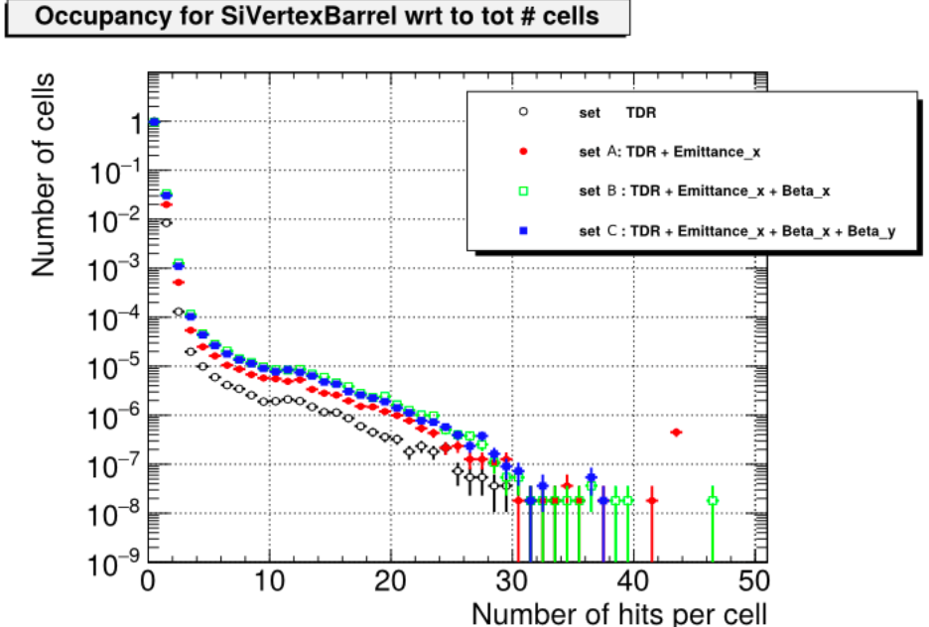
The International Linear Collider
Pair background studies for the ILC250
SiD Vertex Detector Occupancy
Number of cells containing a certain amount of hits, normalized by the total number of cells of the vertex detector.
SiD is confident that the occupancy can be accommodated in the design of the pixel detector.
→ Green light for changes of the machine parameters!

Slide 16
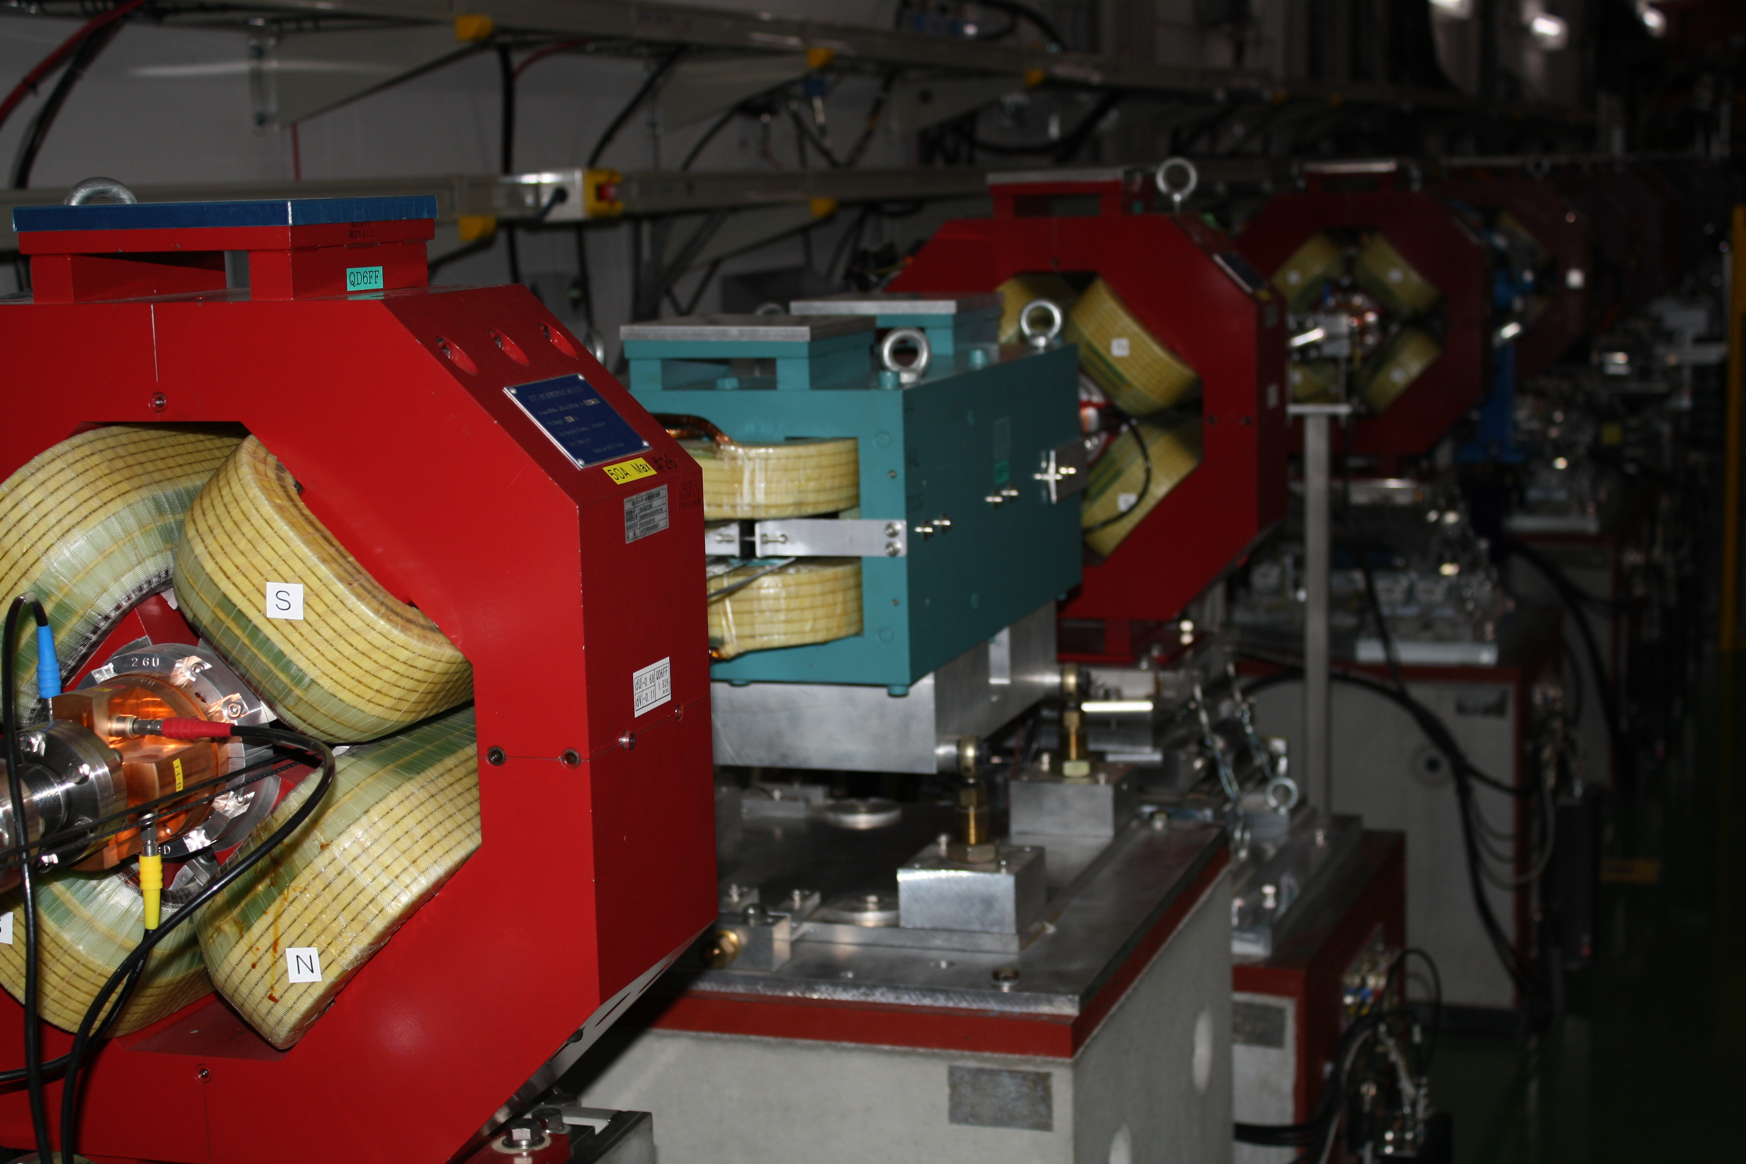
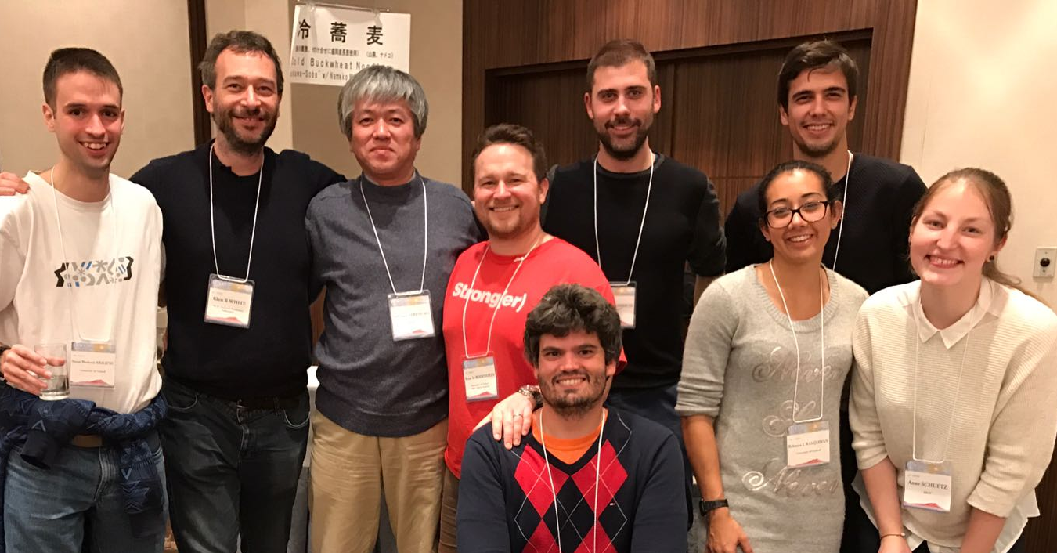

Conclusion
Realizing a new particle accelerator does not only mean unfathomable CPU time of calculations and simulations, but also hands-on work at prototypes of accelerator machines and detector components!
The ILC is ready to go!
Young scientists are needed to make it happen, and then to do great physics at the ILC. :)

Slide 17
Backup
ILC beam parameters
ILC250 stage
ILC Main Beam Dump simulations

Slide 18
The International Linear Collider
In comparison to LHC

Slide 19
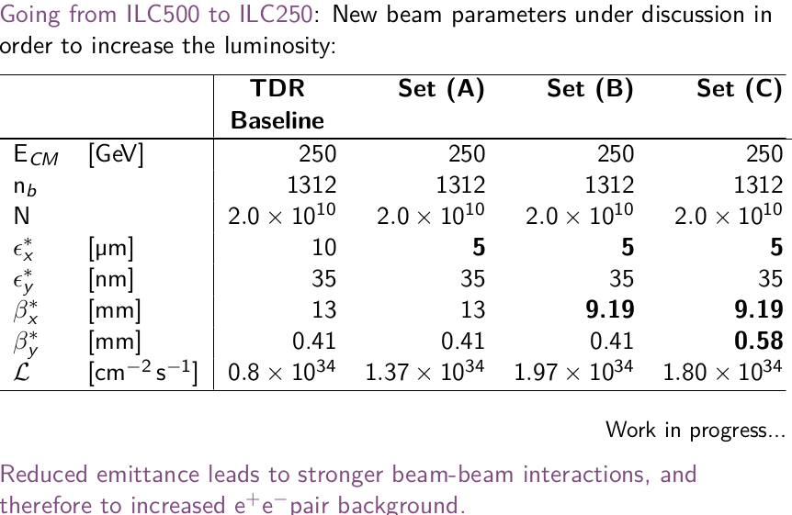
The International Linear Collider
ILC250 beam parameter sets

Slide 20
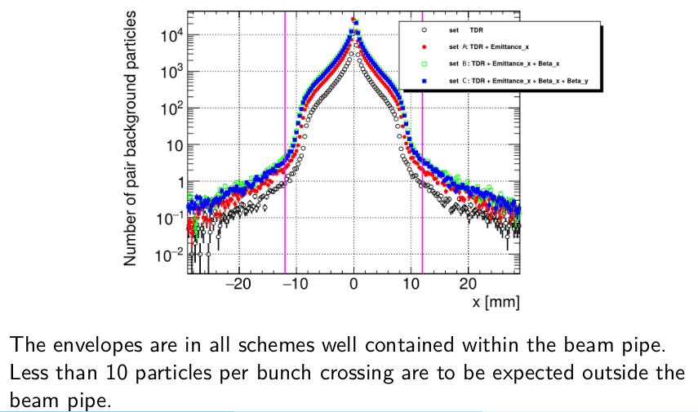
The International Linear Collider
ILC250 beam parameter sets

Slide 21
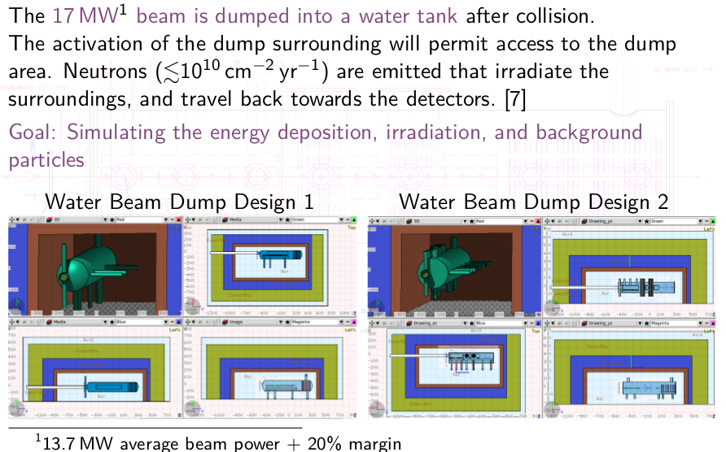
Simulation of the ILC
Main Beam Dumps

Slide 22
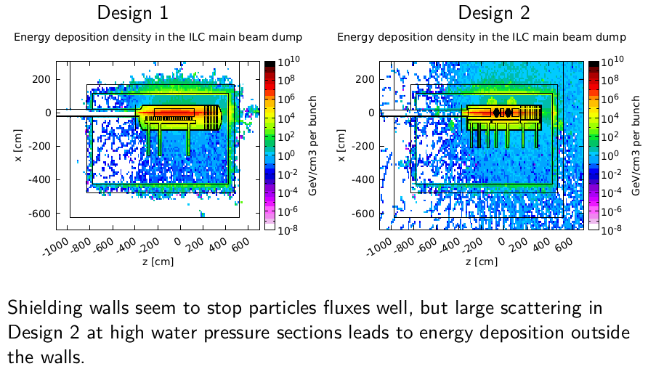
Simulation of the ILC
Main Beam Dumps

Slide 23
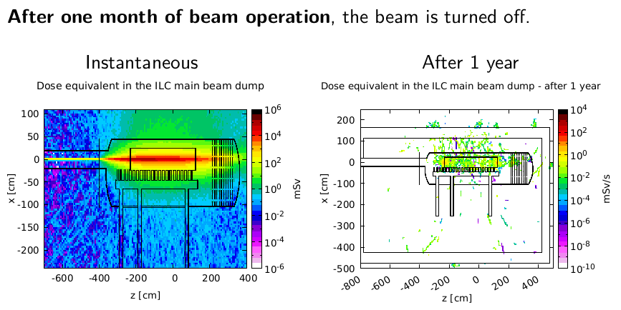
Simulation of the ILC
Main Beam Dumps

Slide 24
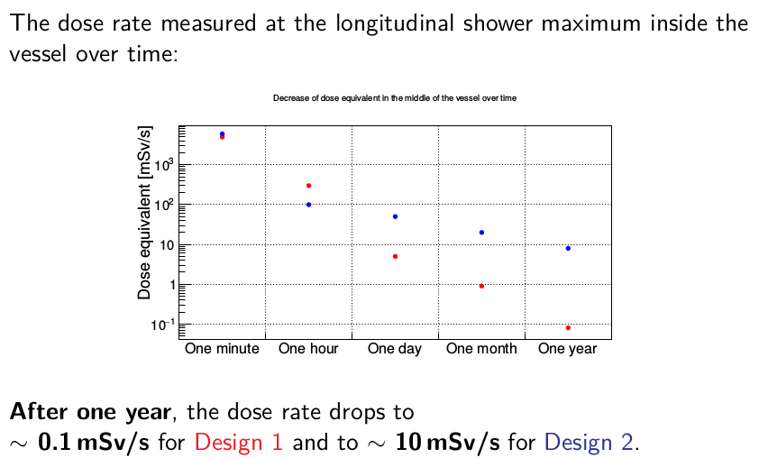
Simulation of the ILC
Main Beam Dumps

