Slide 1


TCMB – CR-0016
SiD Occupancy Studies for the ILC250 beam parameters
LCWS2017, Strasbourg
26. October 2017
Anne Schütz
on behalf of the SiD Optimization Group
Pair Background Density
SiD Occupancy
Conclusion

Slide 2
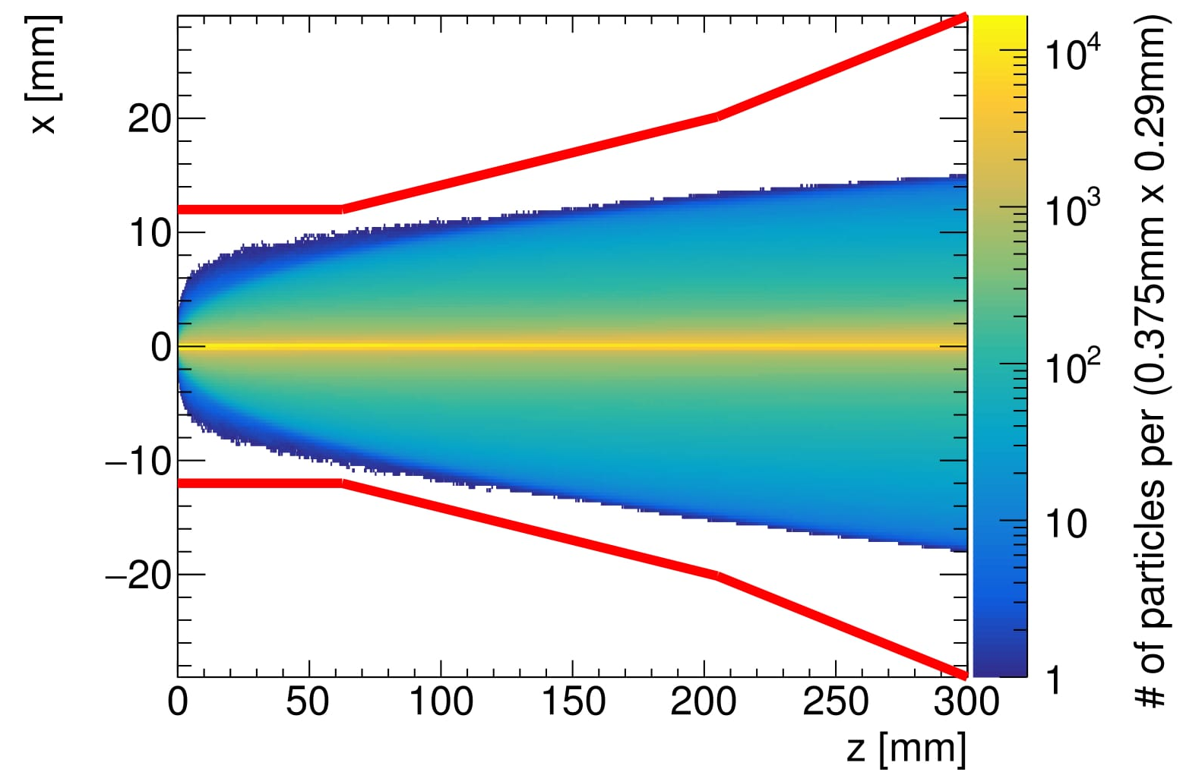
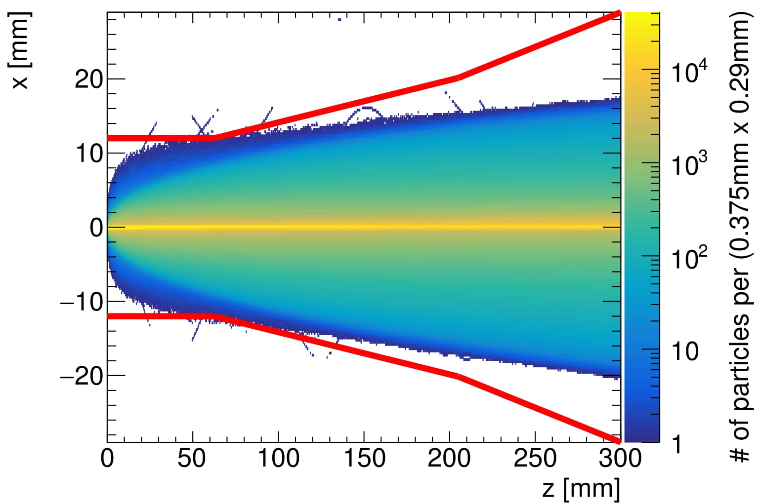
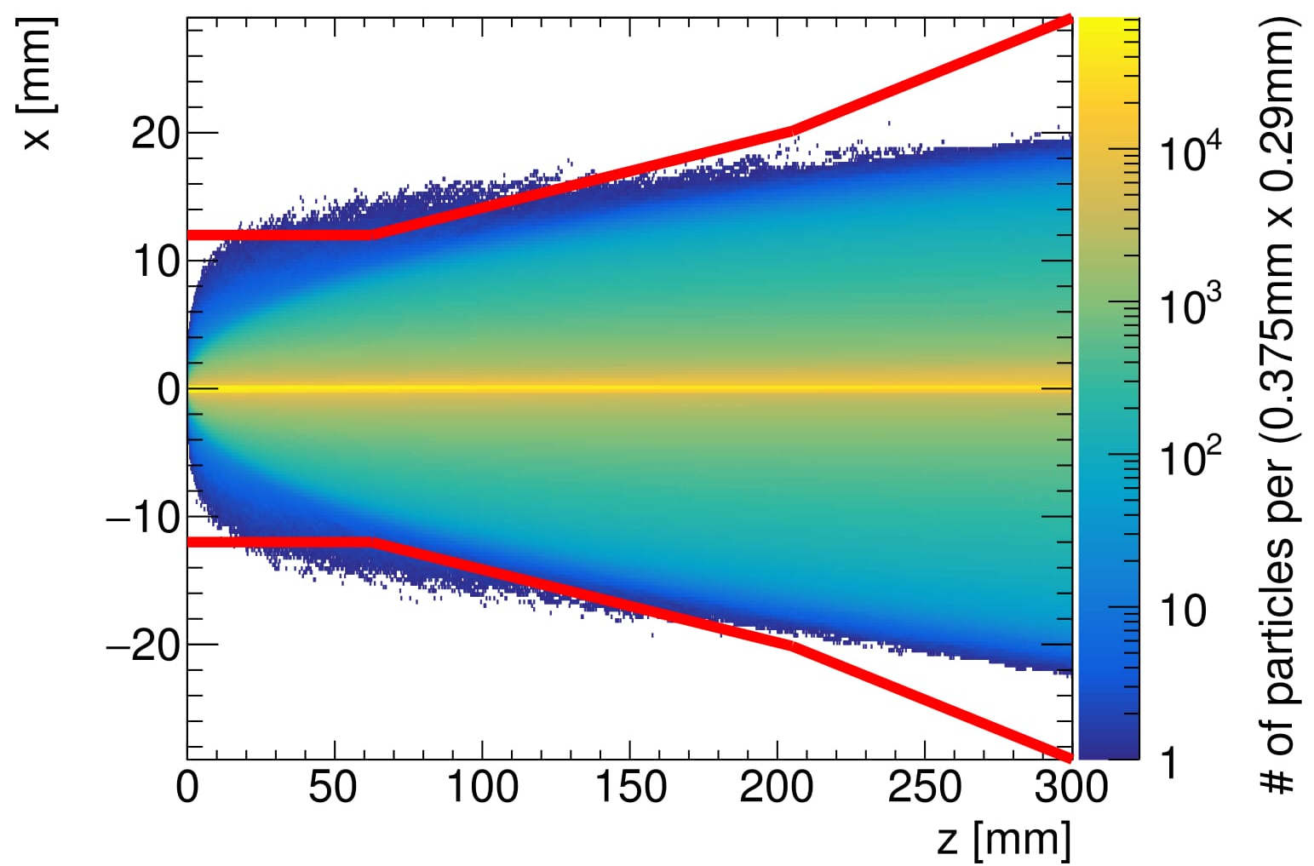
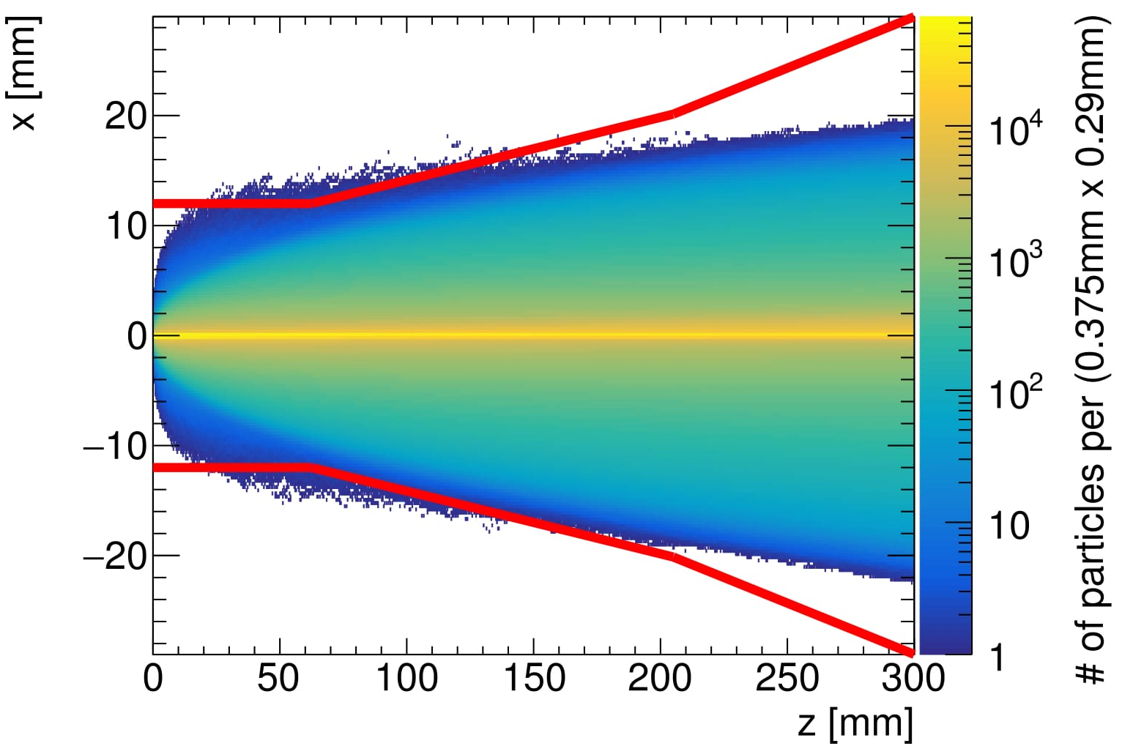
Pair Background Density in the 5T solenoid field
Beam pipe
ILC250 TDR
ILC250 Set A
ILC250 Set B
ILC250 Set C
The broader the envelope, the more particles reach the inner most layers of the detector.

Slide 3
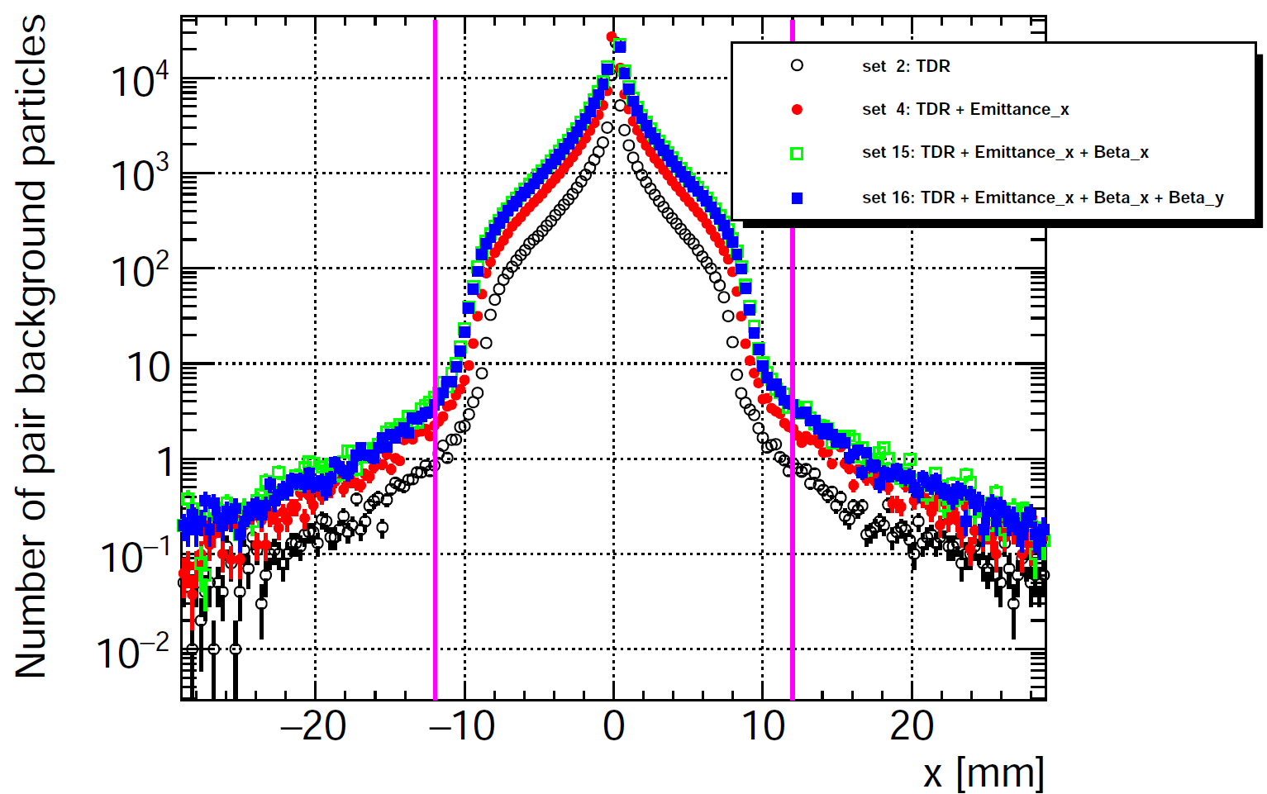
Pair Background Density in the 5T solenoid field
A
B
C
Beam pipe
The number of pairs is increased by a factor of ~4-6 wrt the TDR scheme.
The so-called 'pair edge' is well contained within the beam pipe.
Less than 10 particles can be found outside the beam pipe at any given location.

Slide 4
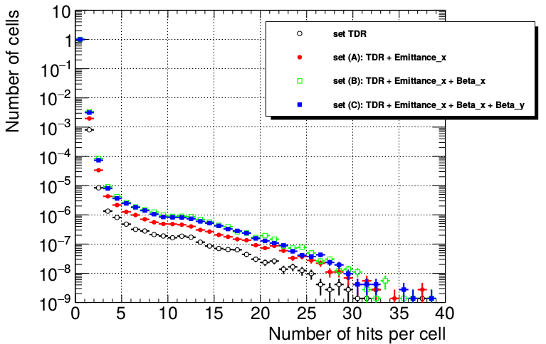
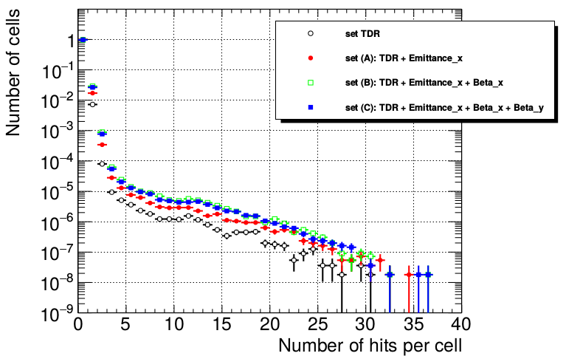
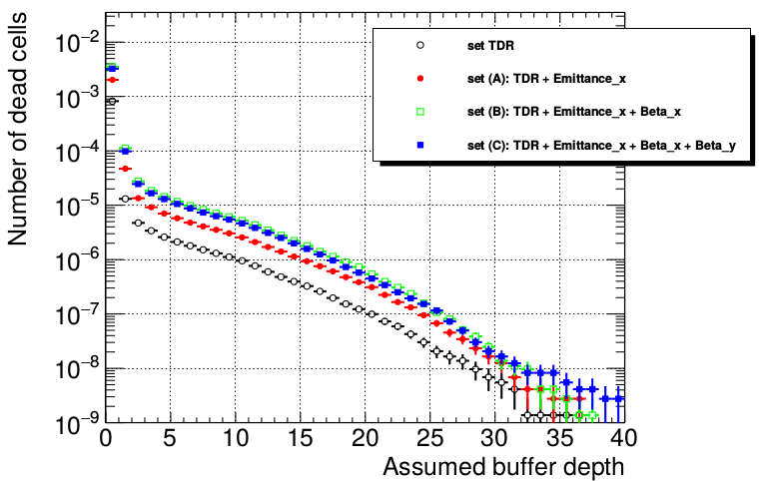
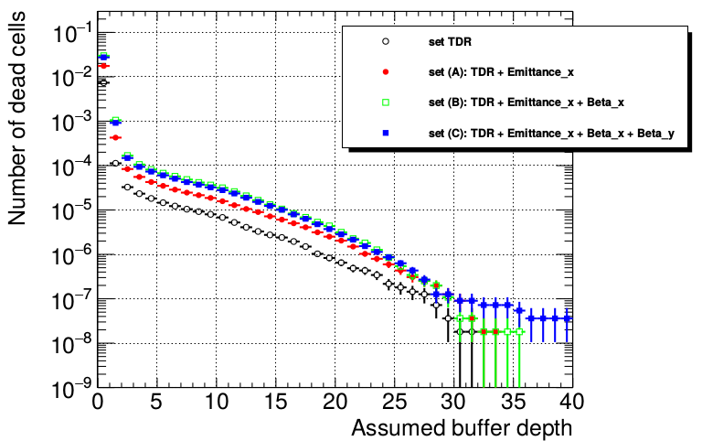
SiD Vertex Detector Occupancy
L* = 4.1 m, with antiDiD
Norm. Occupancy,
All layers
Norm. Occupancy,
Layer 0
Norm. # dead cells,
All layers
Norm. # dead cells,
Layer 0
SiD is confident that the occupancy can be accommodated in the design of the pixel detector.

Slide 5
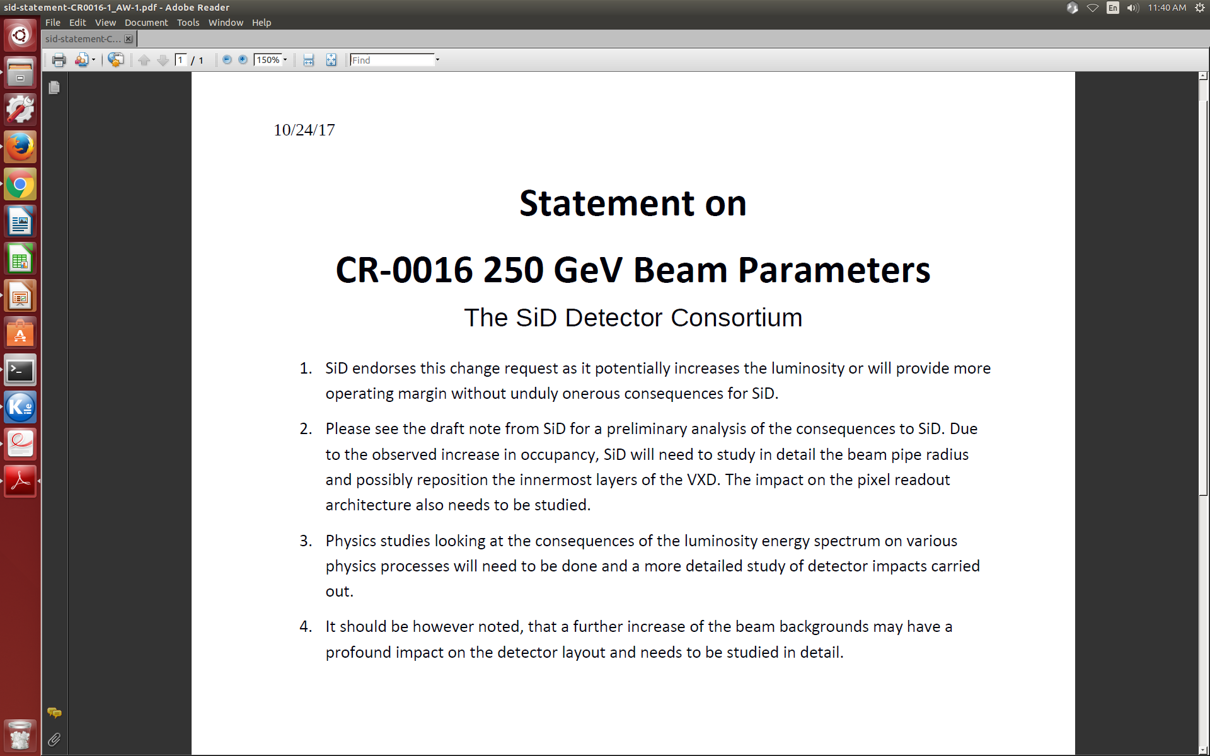
Conclusion
The SiD Optimization Group gives green light for the CR-0016,
and welcomes the efforts on increasing the luminosity for the ILC250 stage.
Nevertheless further studies ongoing:
Increased beam pipe and VXD radius
Smaller VXD pixel size
Effects on various physics processes
https://www.overleaf.com/11200510zzjwfmzthhwp#/42243207/

Slide 6
Backup
ILC beam parameters

Slide 7
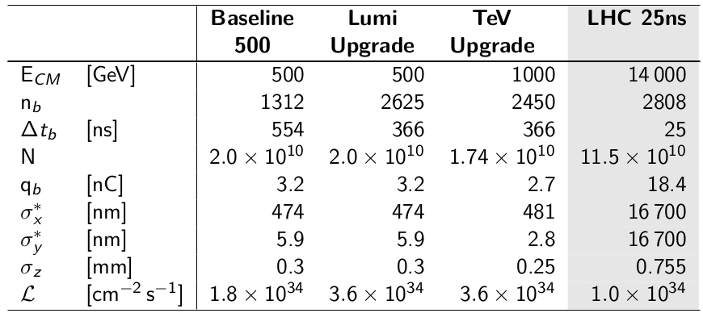
The International Linear Collider
In comparison to LHC

Slide 8
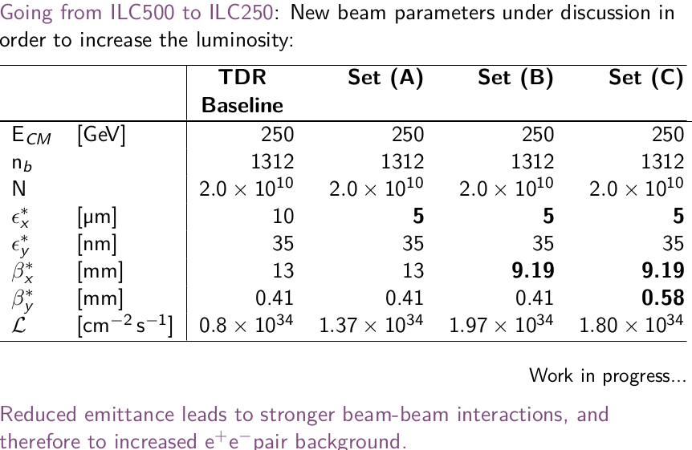
The International Linear Collider
ILC250 beam parameter sets

