Slide 1
ILC250 parameter sets -
Comparison GuineaPig - CAIN
ILC250 machine was discussed in more detail at AWLC2017 at SLAC
Different parameter sets are under discussion to increase the luminosity
CAIN simulation was done by Daniel Jeans to look at the luminosity, and the pair background envelopes
See talks by Kaoru Yokaya and Daniel Jeans
https://agenda.linearcollider.org/event/7507/contributions/39290/attachments/31821/47993/HigherLumi250GeV-AWLC2017-Yokoya.pdf
https://agenda.linearcollider.org/event/7507/contributions/39291/attachments/31828/48012/mdi-beamparams-awlc-2017.pdf

Slide 2
ILC250 parameter sets
From talk by Yokoya
Set 2: TDR
Set 4: TDR + εx

Slide 3
ILC250 parameter sets
Variations of the new ILC250 parameters
"set 2": TDR ("baseline 250" from p11 of Yokoya's talk @ AWLC)
"set 4": normalised εx reduced from 10 to 5 μm ("New Param" in Yokoya's table)
"set 15": set 4, but with βx reduced from 13.0 to 9.19 mm
"set 16": set 15, but with βy increased from 0.41 to 0.58 mm
Waist shift of 240 μm in x and y
→ Bunches are smaller in the x-direction:
more luminosity
more beamstrahlung
→ larger energy spread of collisions, more detector backgrounds

Slide 4
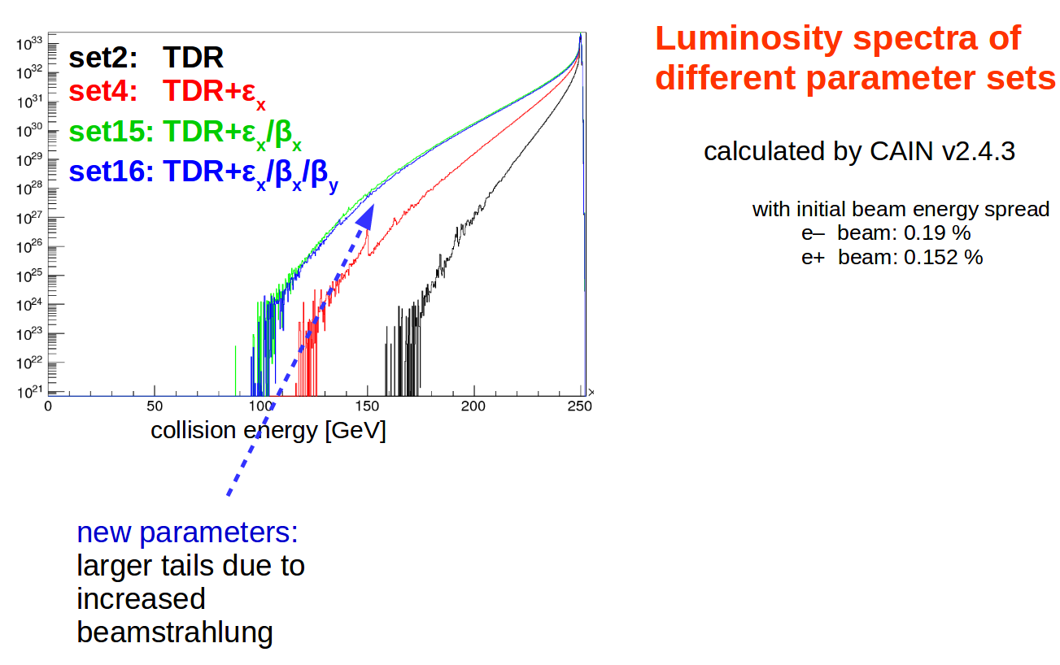
ILC250 parameter sets – Luminosity (CAIN)
From talk by Daniel

Slide 5
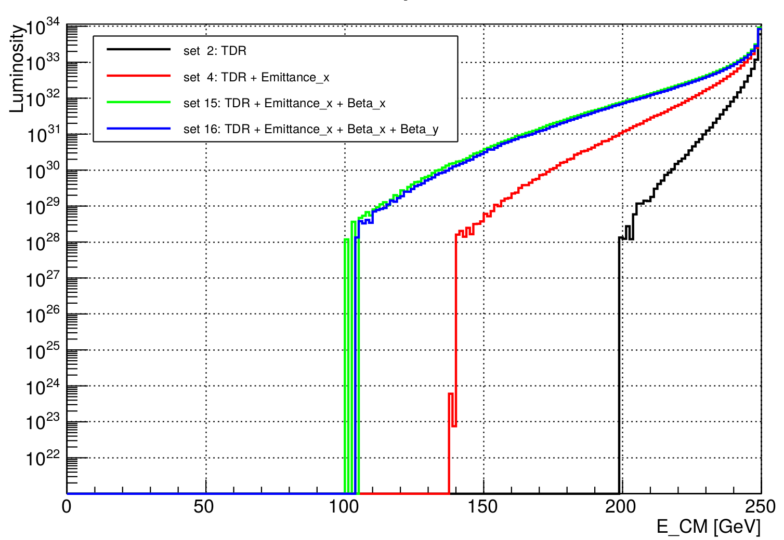
ILC250 parameter sets – Luminosity (GuineaPig)
Similar at first glance
Lumi_ee histogram values given in main output of GuineaPig
Less information given by GuineaPig
Numbers given in 200 bins
    Not detailed enough for peak at 250 GeV
No information for below 10²⁸ cm⁻² s⁻¹
New plan:
Plot luminosity from lumi_ee.dat file
Up to 8 * 10³³ cm⁻² s⁻¹, maybe because of binning

Slide 6
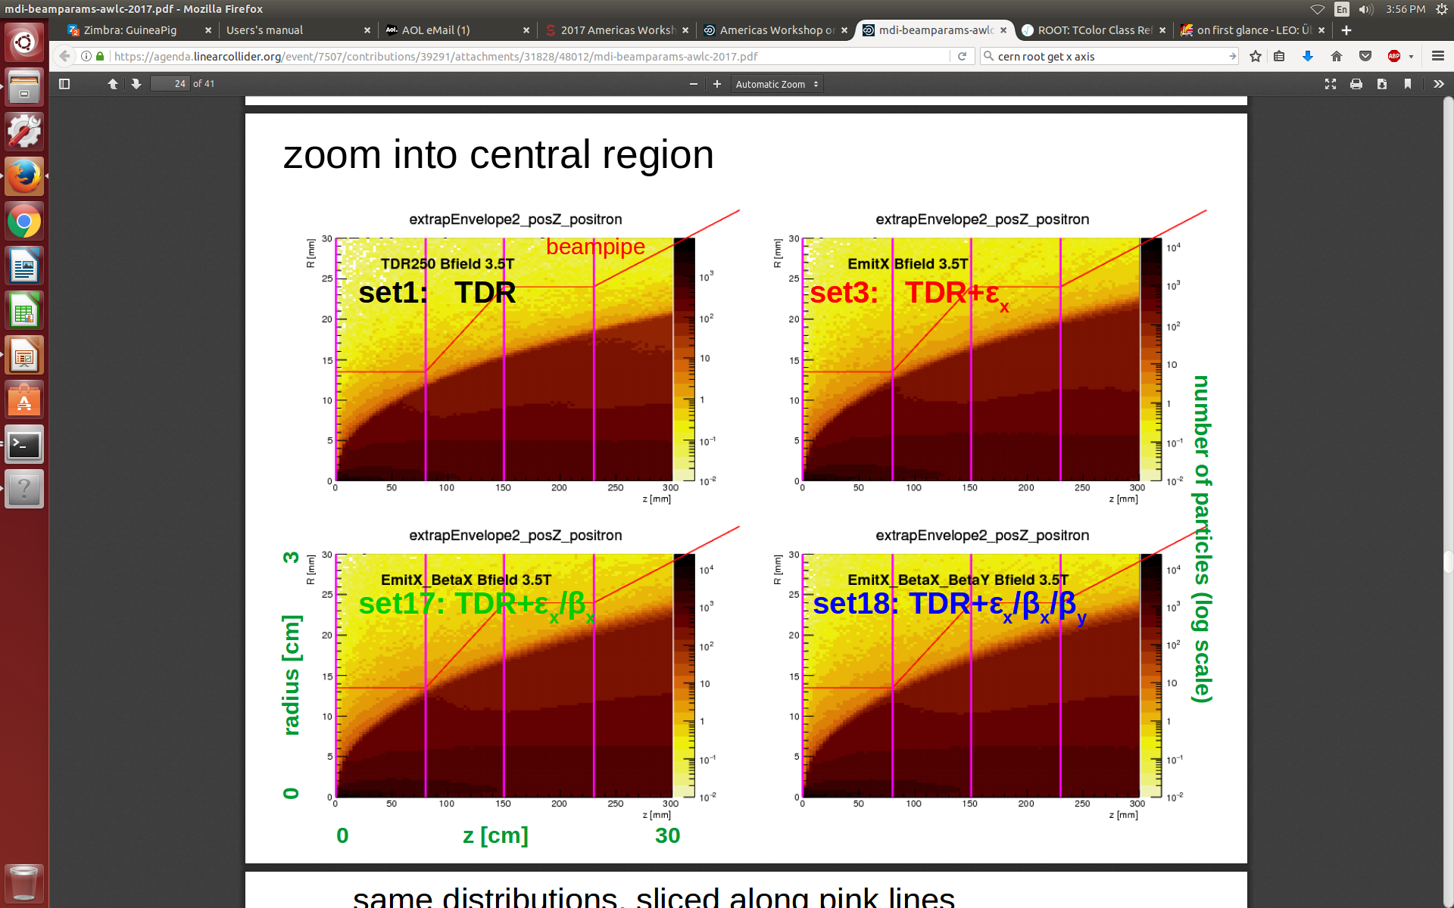
ILC250 parameter sets –
Pair Envelopes (CAIN)
3.5 T
ILD
From talk by Daniel

Slide 7
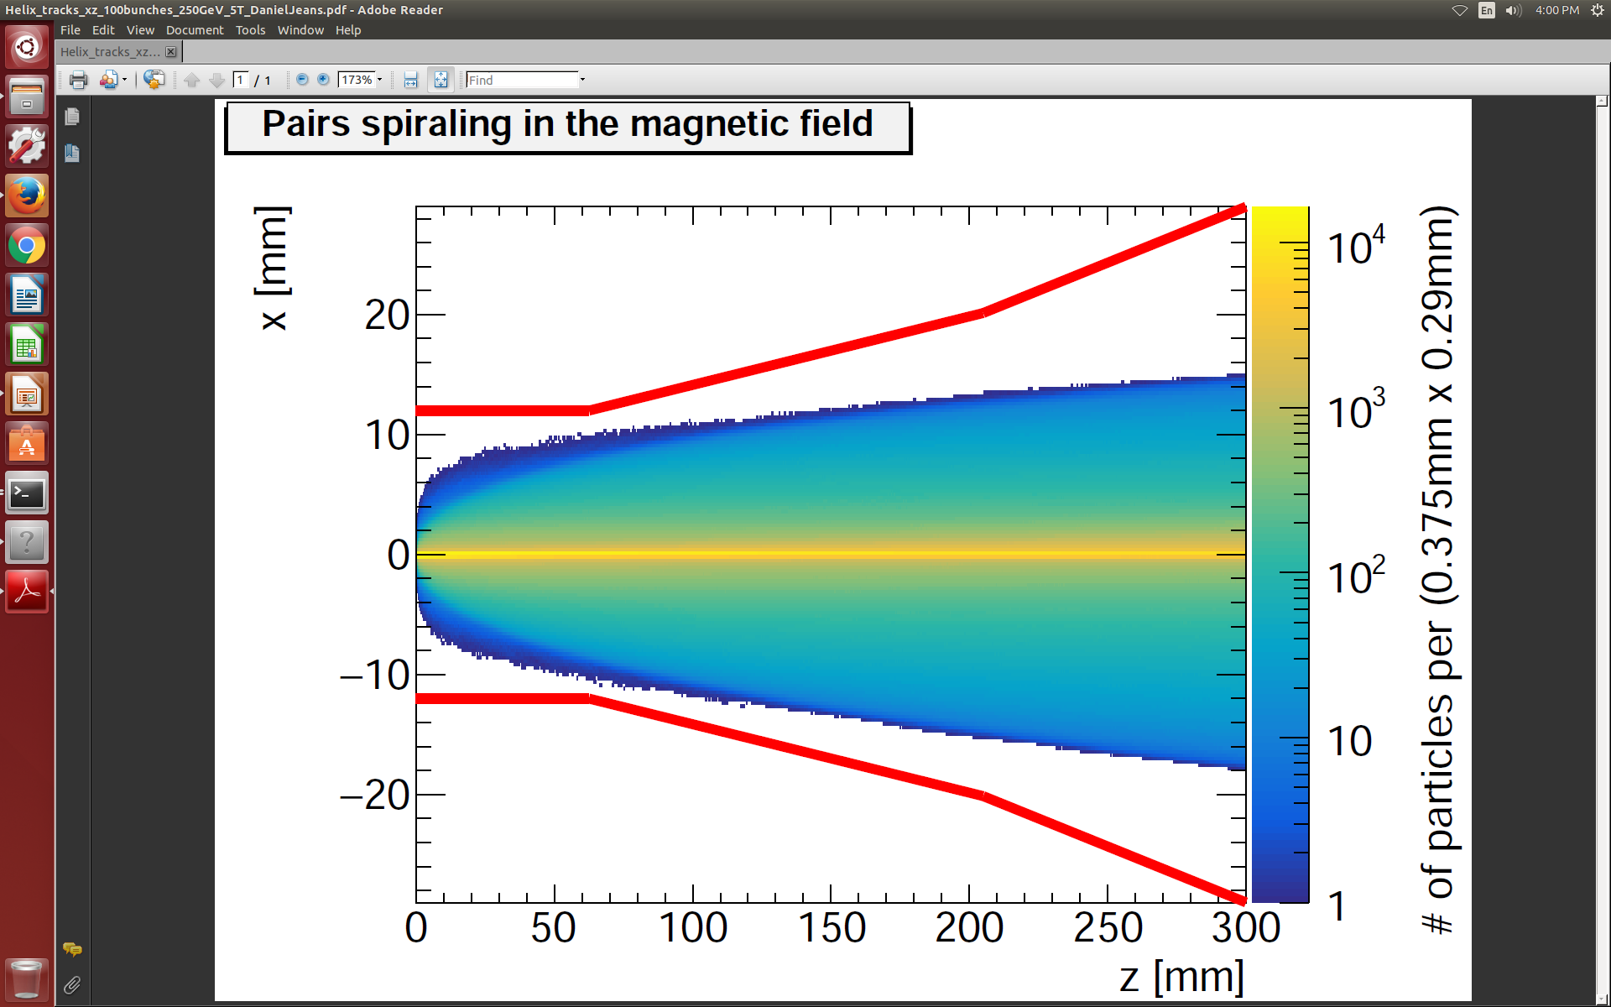
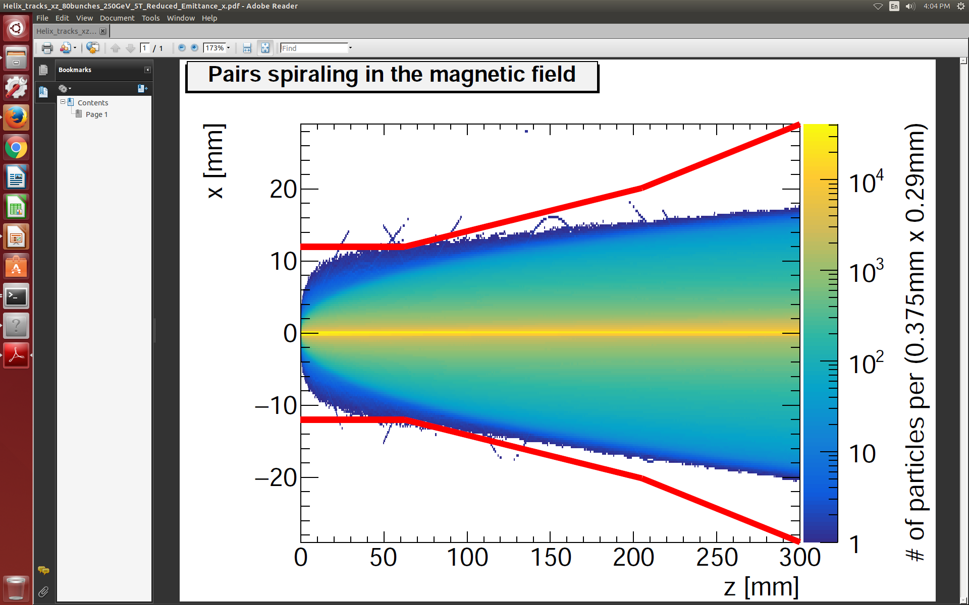
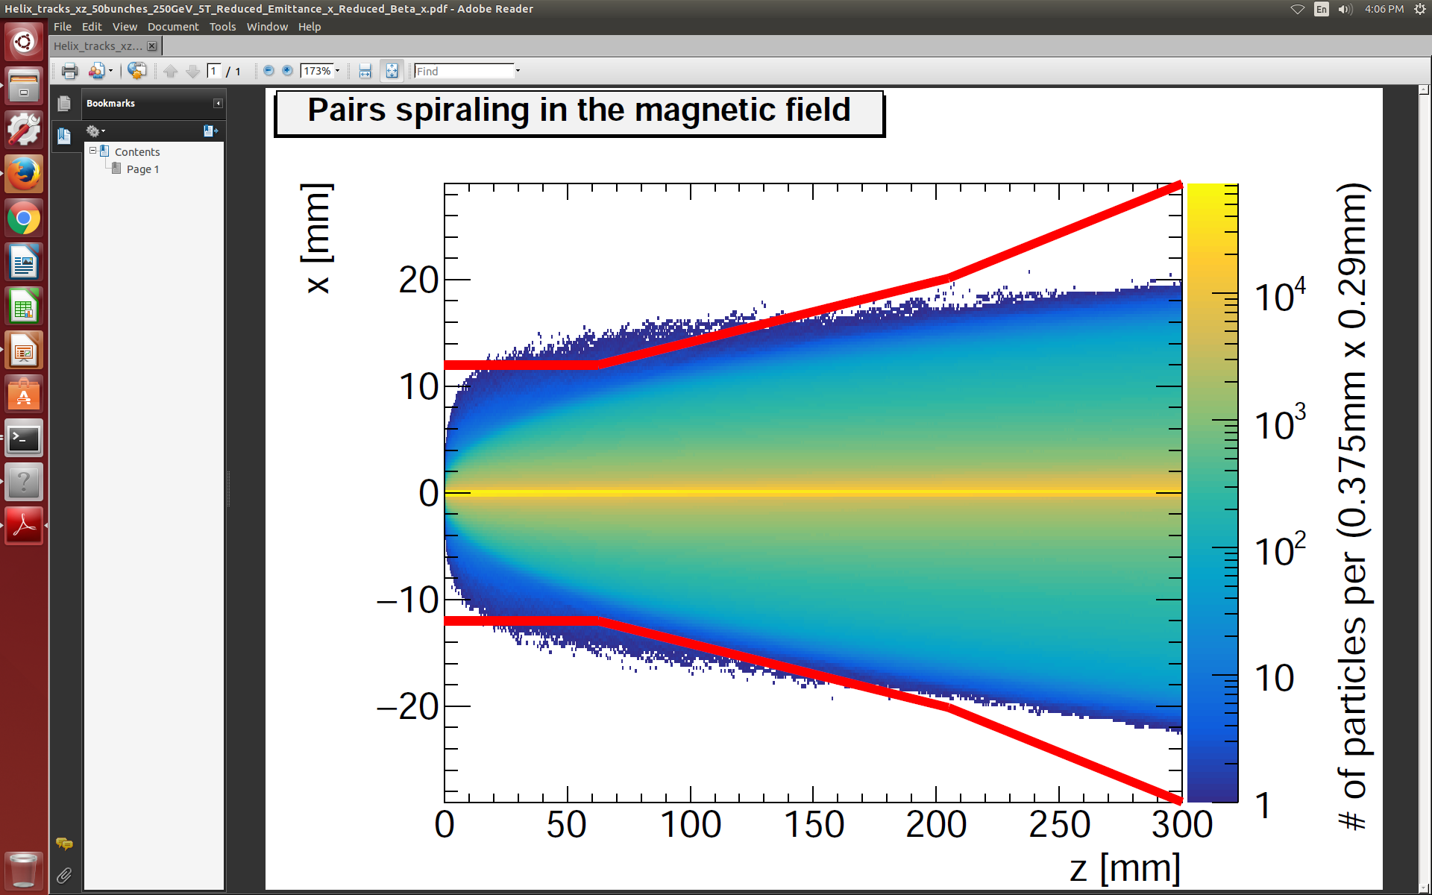
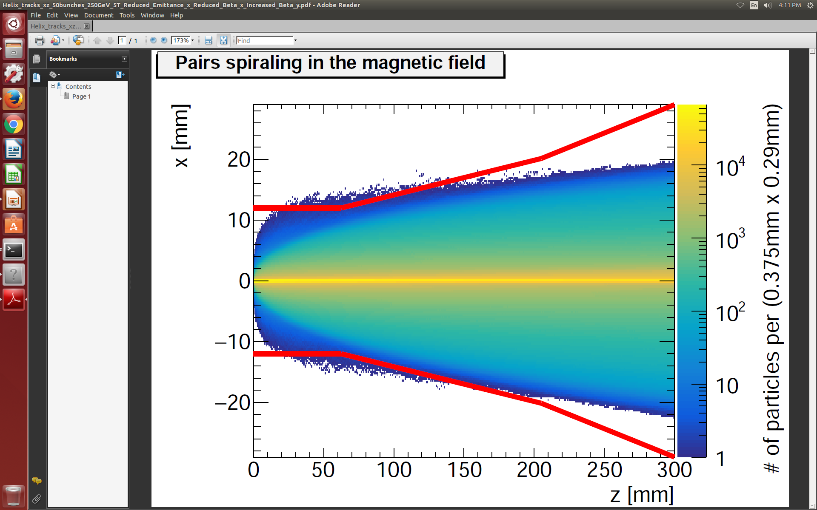
ILC250 parameter sets –
Pair Envelopes (GuineaPig)
5 T
SiD
Set 1: TDR
Set 4: TDR + εx
Set 15: TDR +
εx + βx
Set 16: TDR +
εx + βx + βy

Slide 8
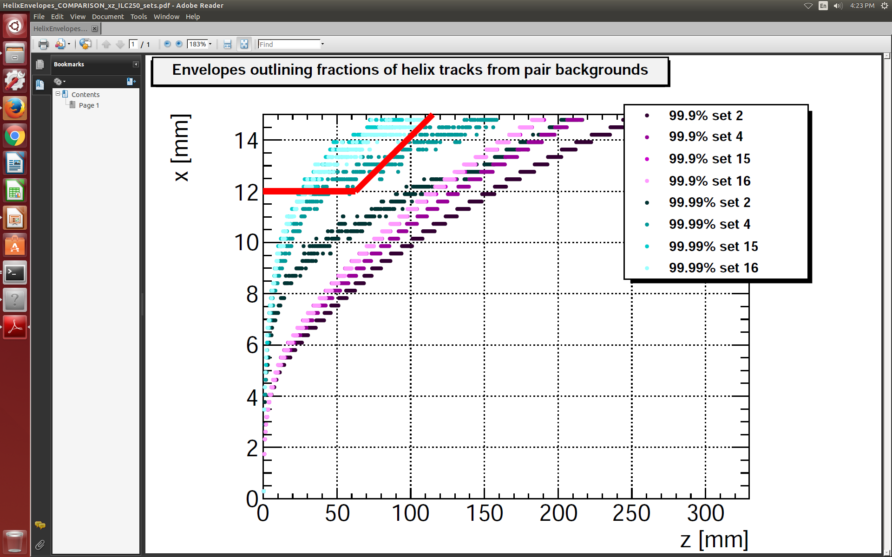
ILC250 parameter sets –
Pair Envelopes (GuineaPig)
5 T
SiD
Set 16: TDR +
εx + βx + βy
Set 15: TDR +
εx + βx
Set 4: TDR + εx
Set 1: TDR

Slide 9
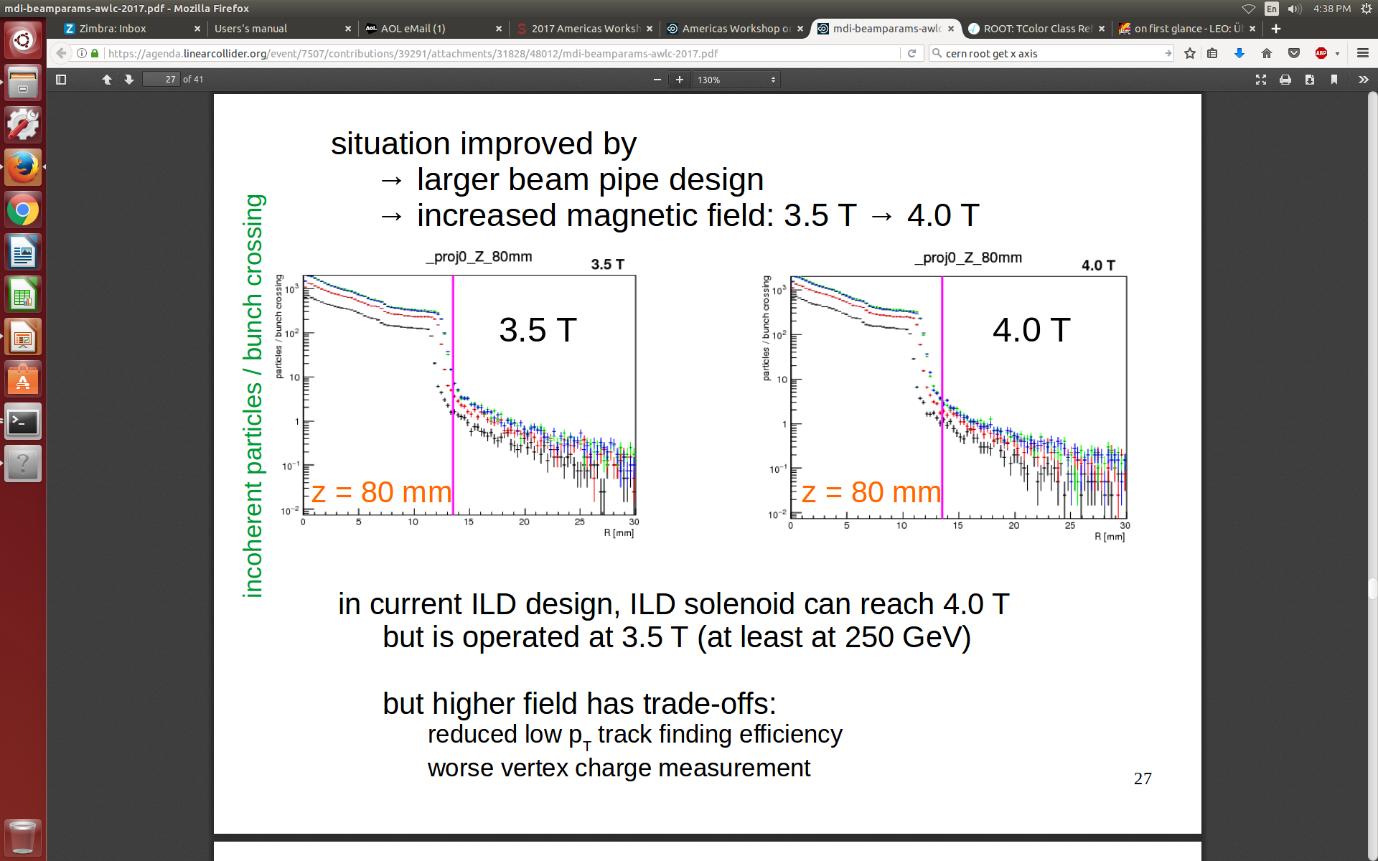
ILC250 parameter sets –
Pair Envelopes (CAIN)
From talk by Daniel

Slide 10
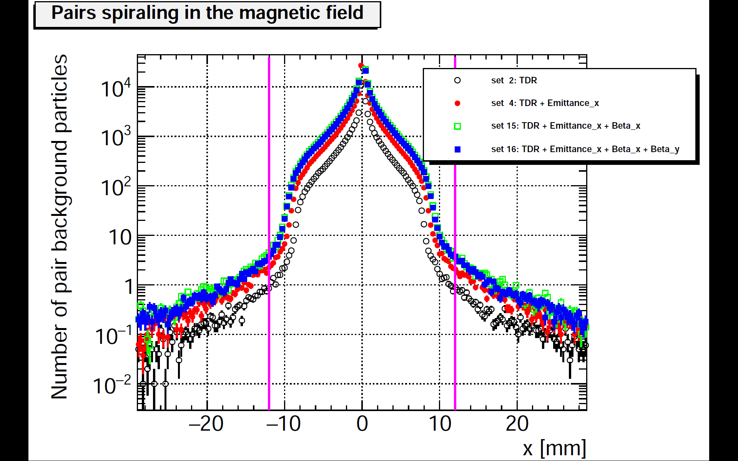
ILC250 parameter sets –
Pair Envelopes (GuineaPig)
SiD seems to do better! :)
At first beam pipe kink
(z = 62.5 mm), edge at comfortable distance
Magnetic field strength
(5 T) higher than for ILD
z = 62.5 mm

Slide 11
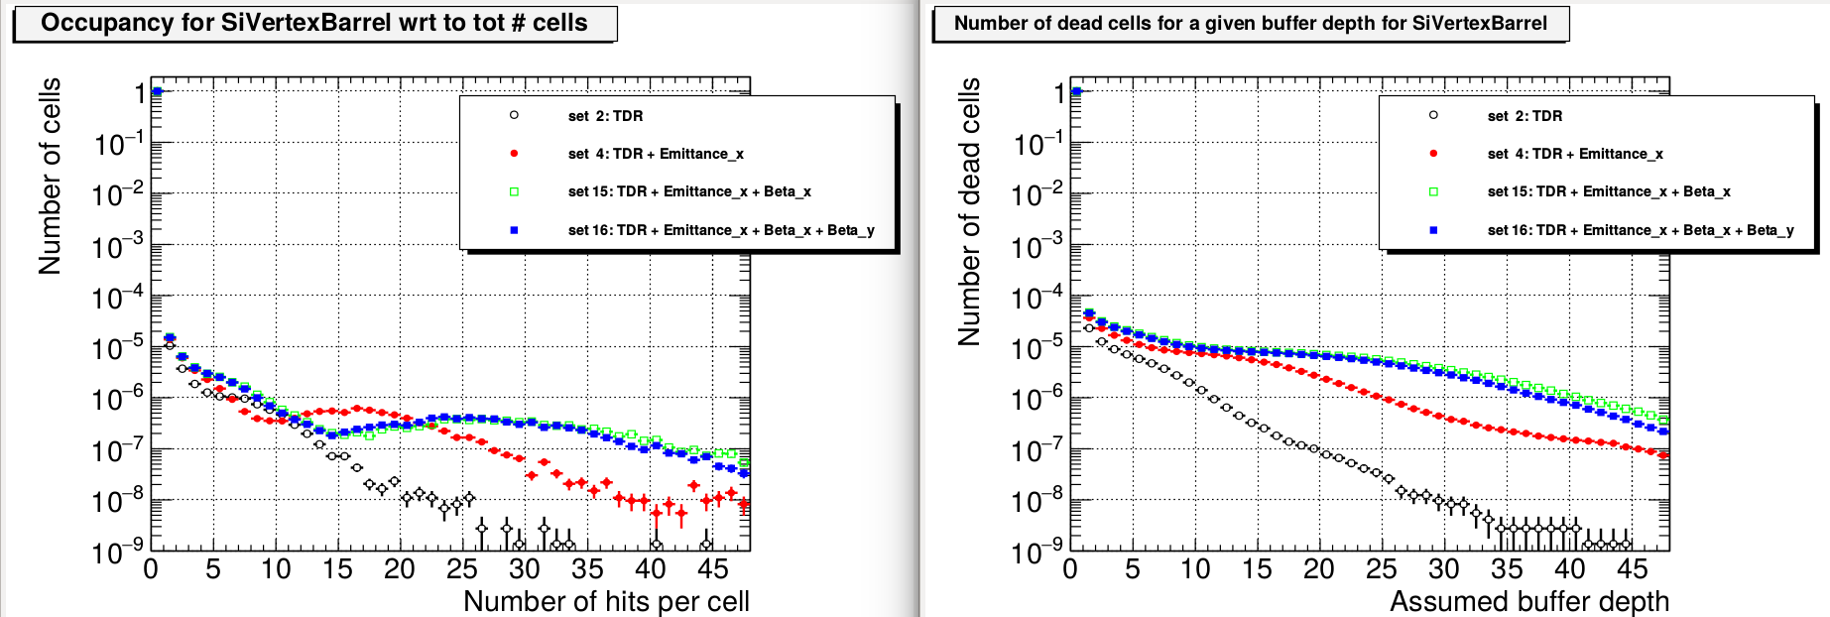
ILC250 parameter sets –
Vertex Detector Occupancy
All layers
For all vertex detector layers combined
For a bufferdepth of 4, new sets (4, 15, 16) do worse by a factor of 2-3
Set 15 and 16 are pretty much equivalent

Slide 12
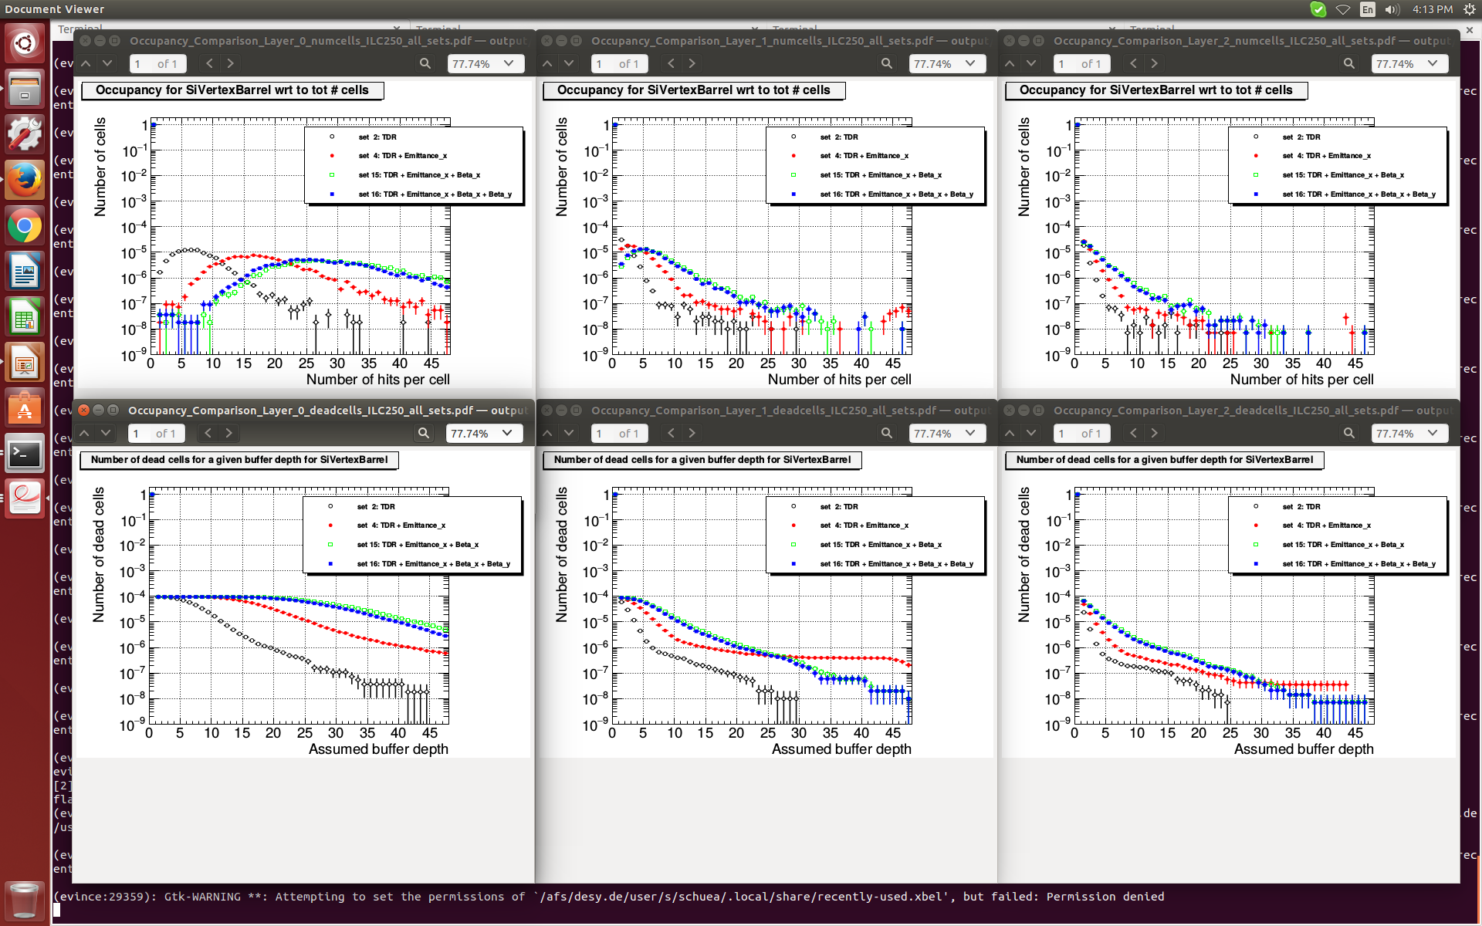
ILC250 parameter sets –
Vertex Detector Occupancy
Layer 0
Layer 1
Layer 2
Layer 0 is worrying: constant plateau of 10⁻⁴ of all cells that are dead

Slide 13
ILC250 parameter sets -
Conclusion
Conclusion by Daniel Jeans
In current ILD design with 3.5 T, “beam pipe rather close to envelope”
ILD solenoid can reach 4.0 T, but higher field has trade-offs:
reduced low pT track finding efficiency, worse vertex charge measurement
Larger beam pipe, or higher B-field to be considered
Conclusion for SiD
Even in current design, pair envelope edge far away from the beam pipe
Vertex detector occupancies show a significant difference between the new sets. Especially layer 0 is worrying: even with TDR set, plateau of 10⁻⁴ in “dead cells plot”

