Slide 1
ILC background studies at ATF & the University of Tokyo
March – April 2016
Anne Schütz / WP 2, 3

Slide 2

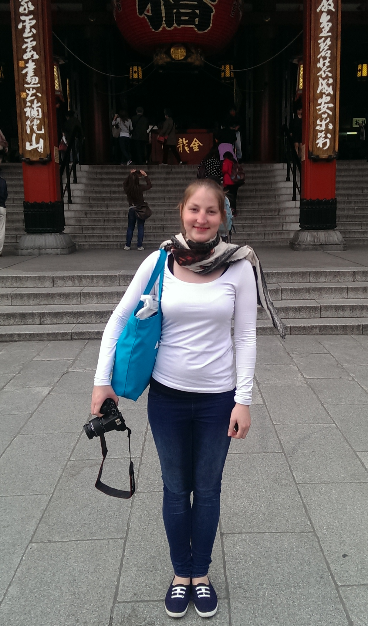

My Ph.D.
Ph.D. at Desy, Hamburg
Associated with KIT, Karlsruhe
Ph.D. topic:
“Optimizing the Final-Focus Region of
the Interntional Linear Collider”
Simulations of the ILC machine background wrt a possible optimization of the final-focus region
Practical experience at KEK in Japan:
3 ∕ weeks at KEK to join the ATF beam time in March
5 weeks at the University of Tokyo
8 ∕ weeks of fun in Japan!

Slide 3
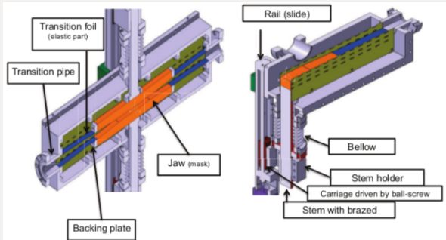
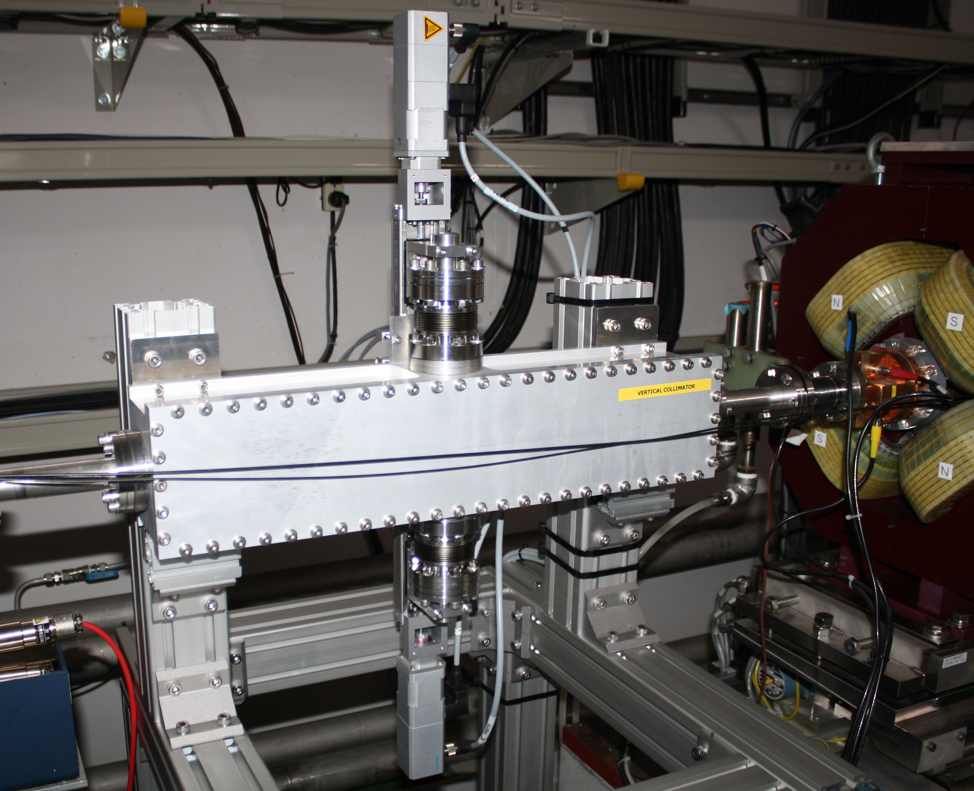
Project at ATF2
Testing the performance of a recently installed vertical beam halo collimator [Nuria Fuster Martinez (IFIC) et al.]:
Participation in the ATF2 beam operation time, operation of the ATF beam
Measuring the background production/overall-reduction in dependency of the collimator apertures
Analysing the data whilst being in the working group around Sachio Komamiya-san in the Particle Physics Department of the University of Tokyo

Slide 4
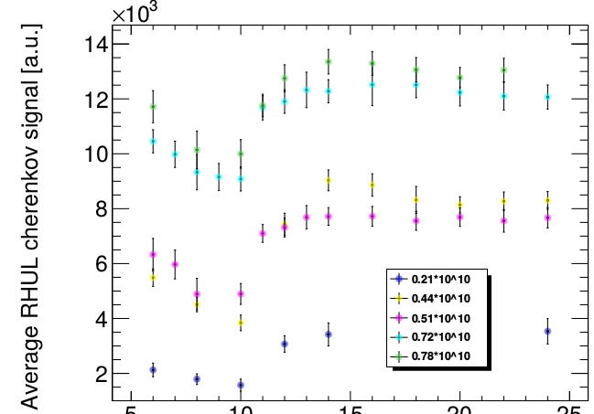
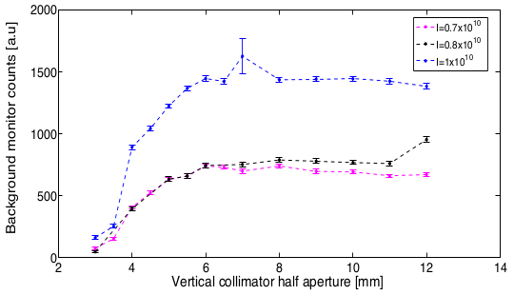
Project at ATF2 – Results and goals
Cherenkov detector close to collimator
Background monitor at IP
5
10
15
20
25
8
12
16
20
24
Collimator aperture [mm]
Goals:
Simulation of ATF2 and the effect of the beam halo collimator with BDSIM [RHUL]
Paper about the vertical beam halo collimator with results from beam time at ATF

Slide 5
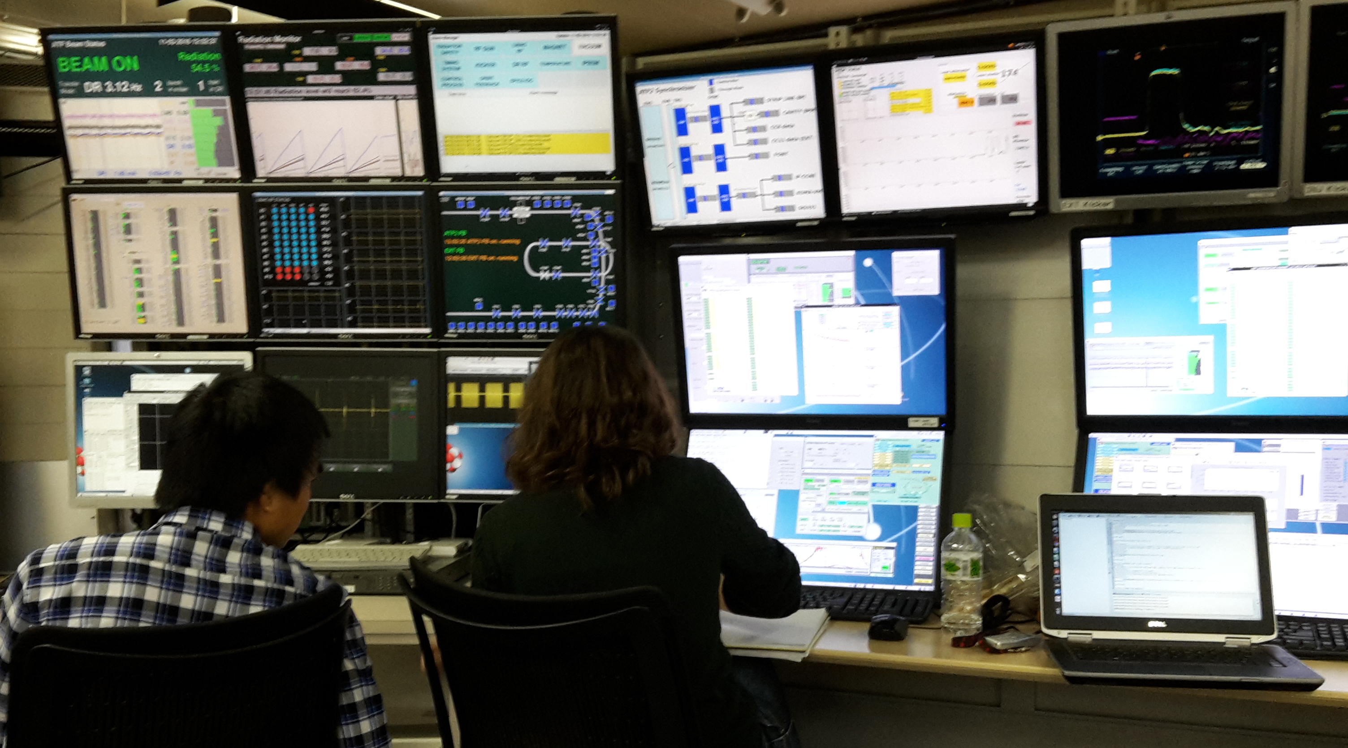
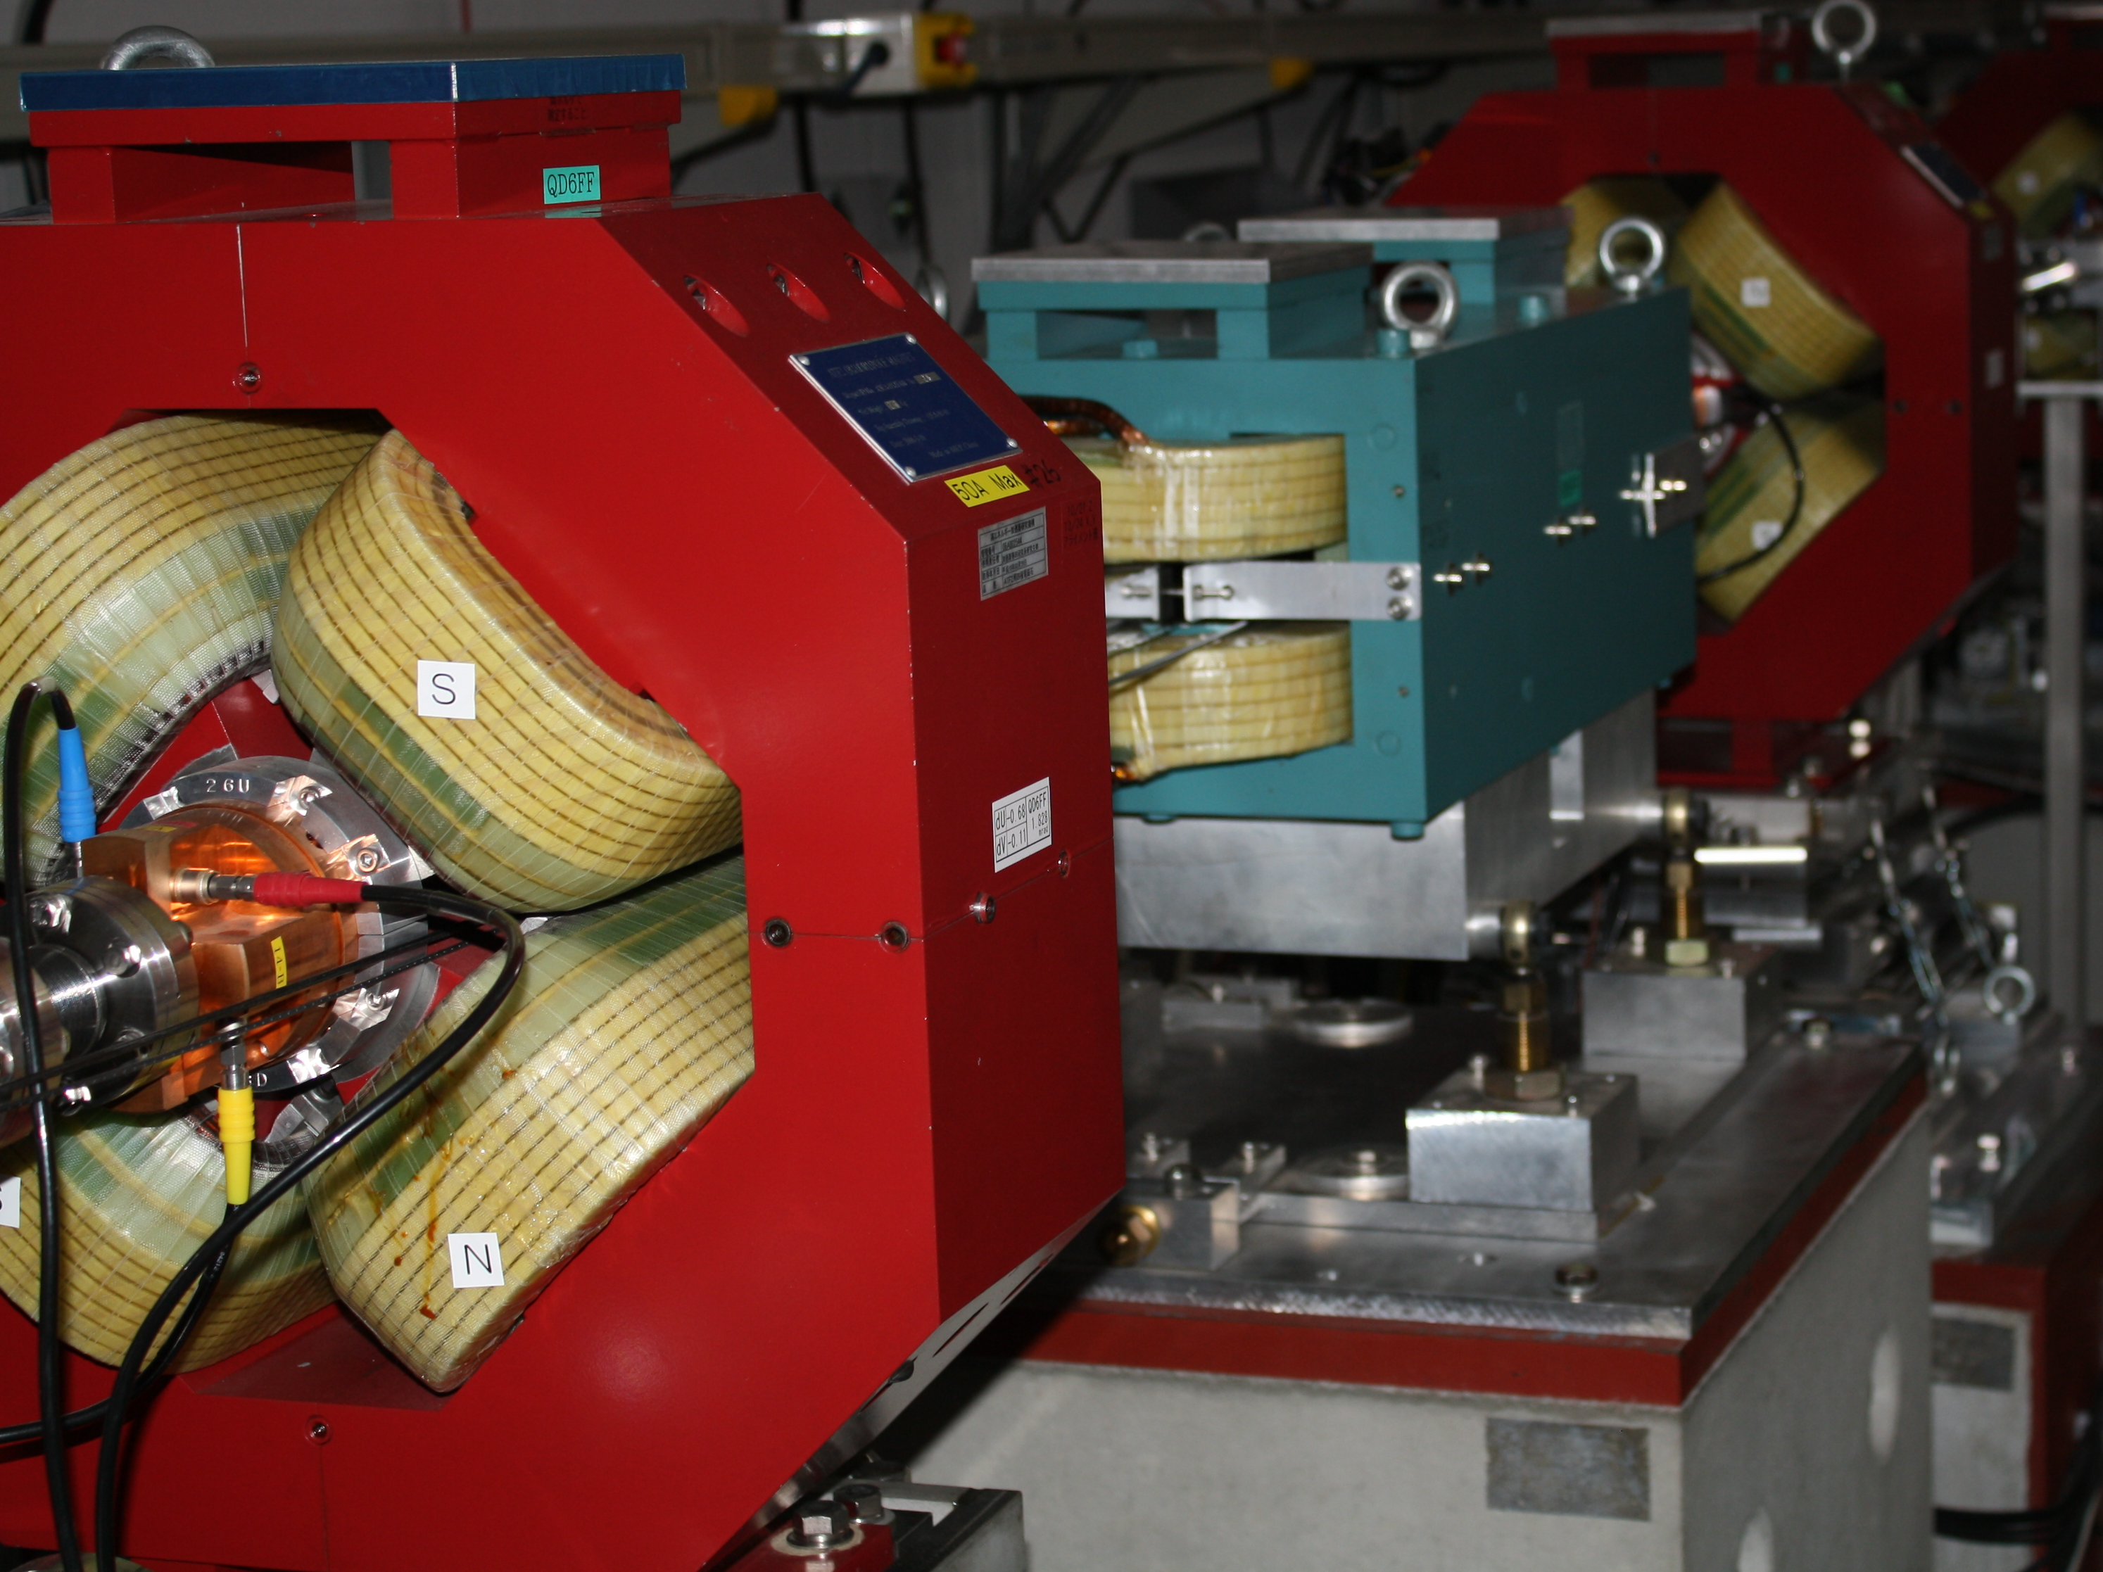
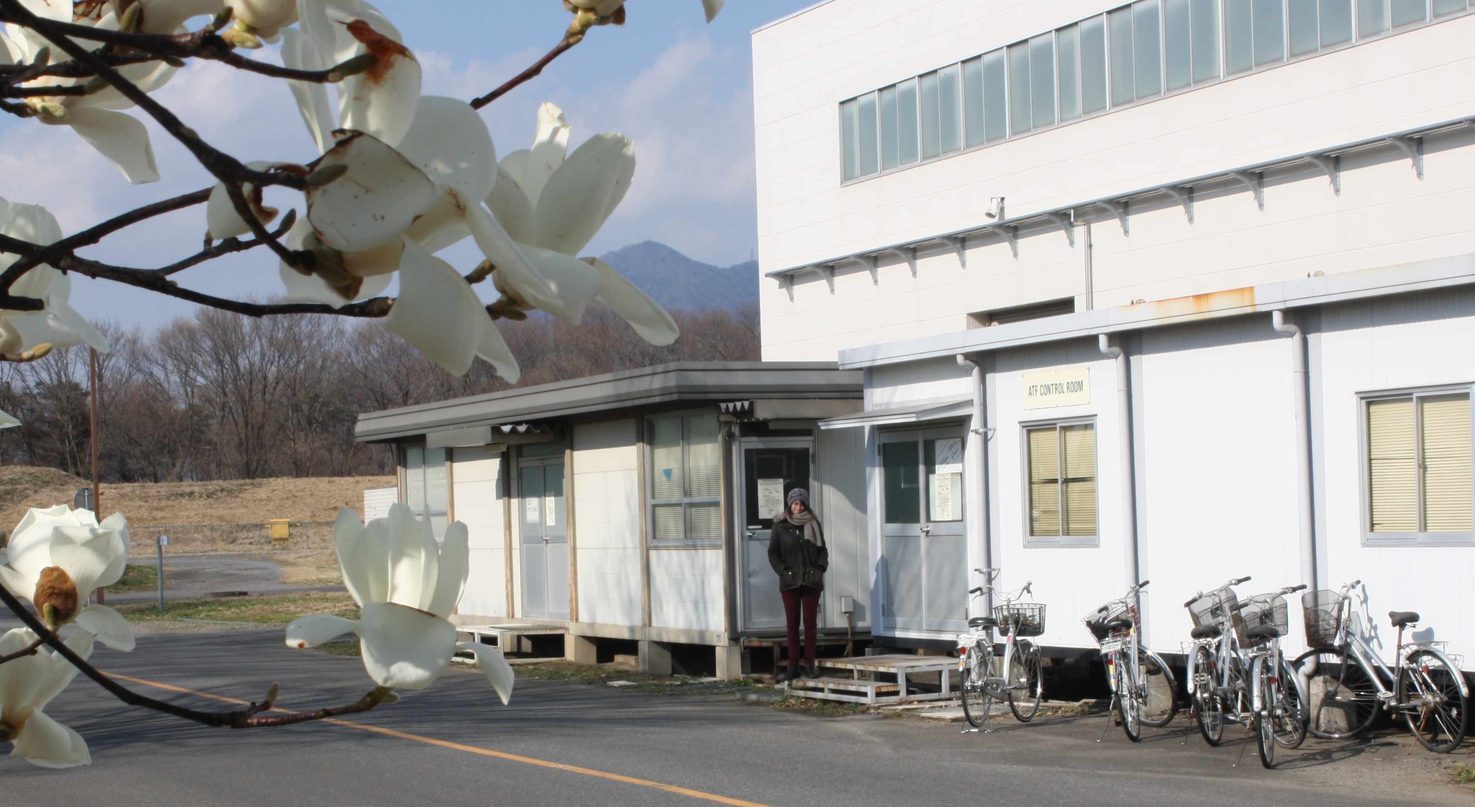
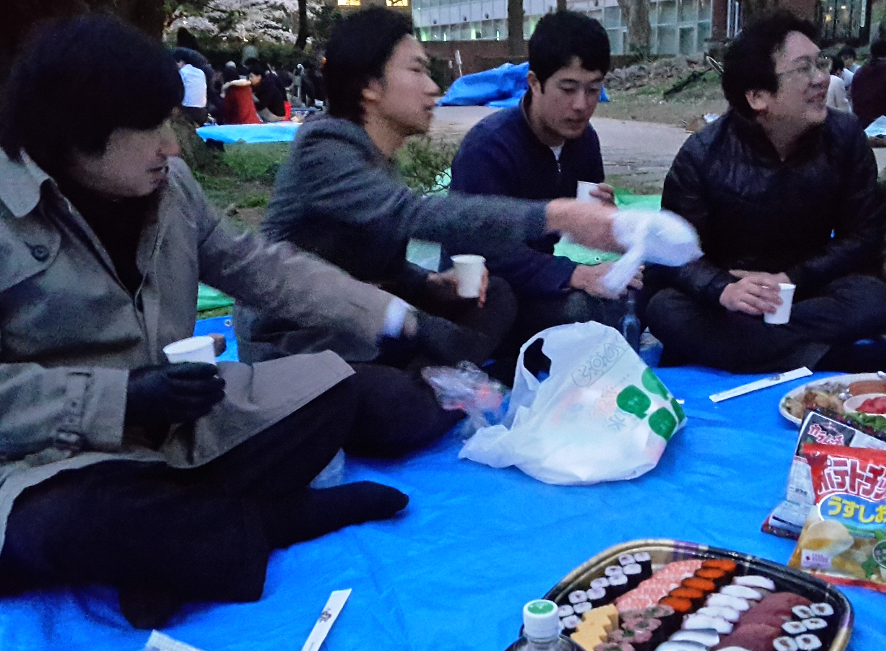
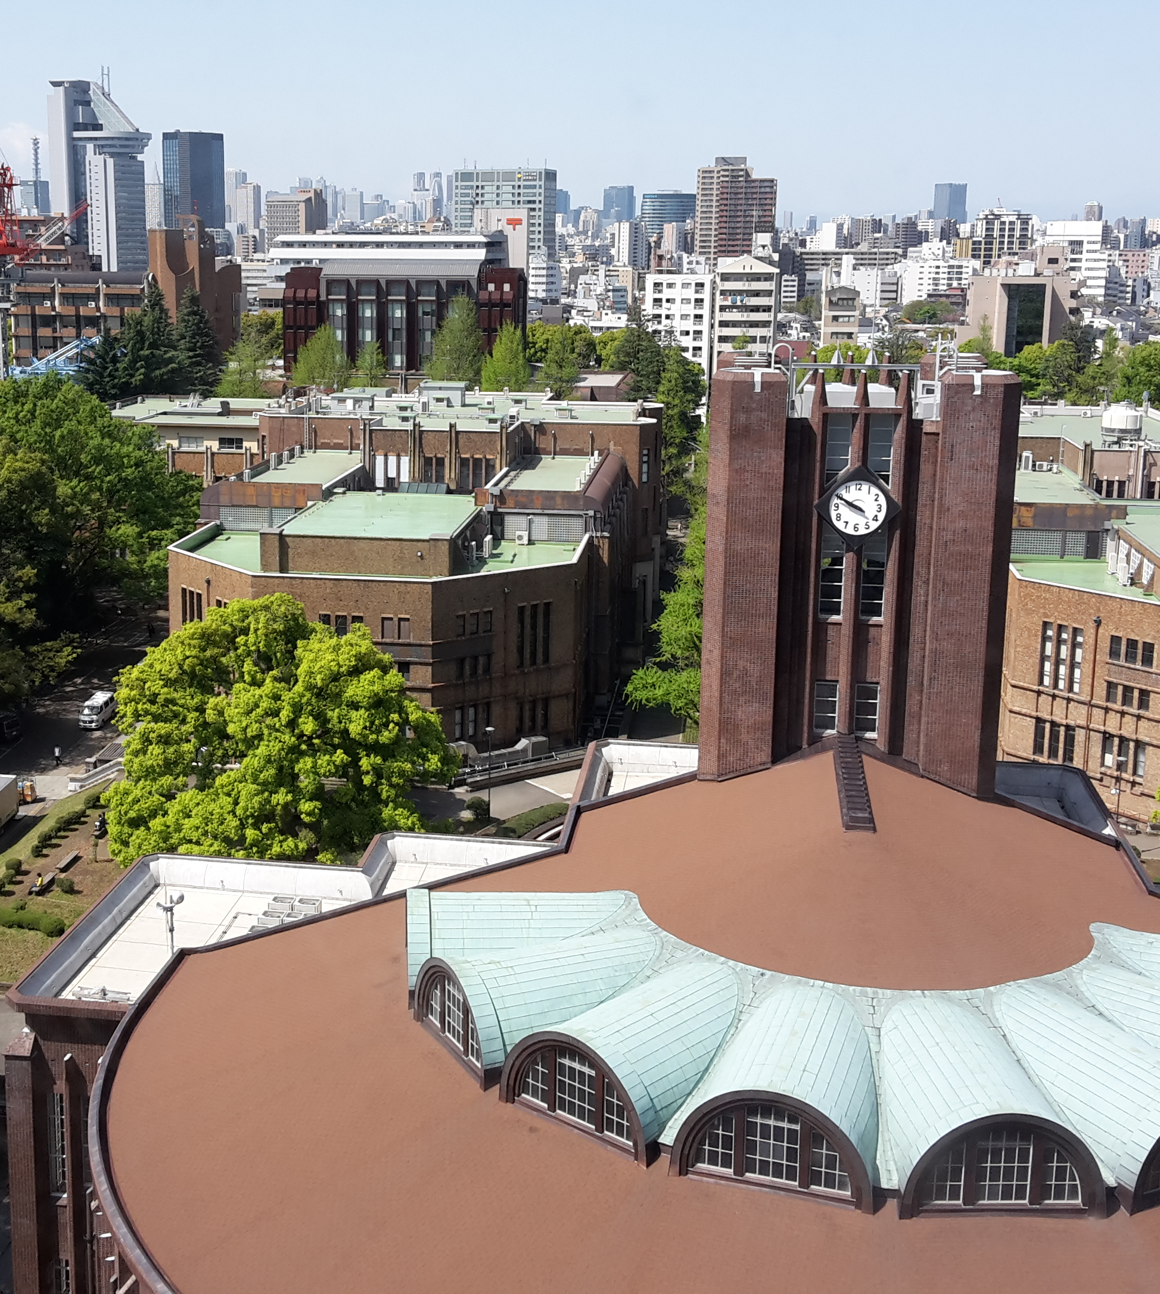
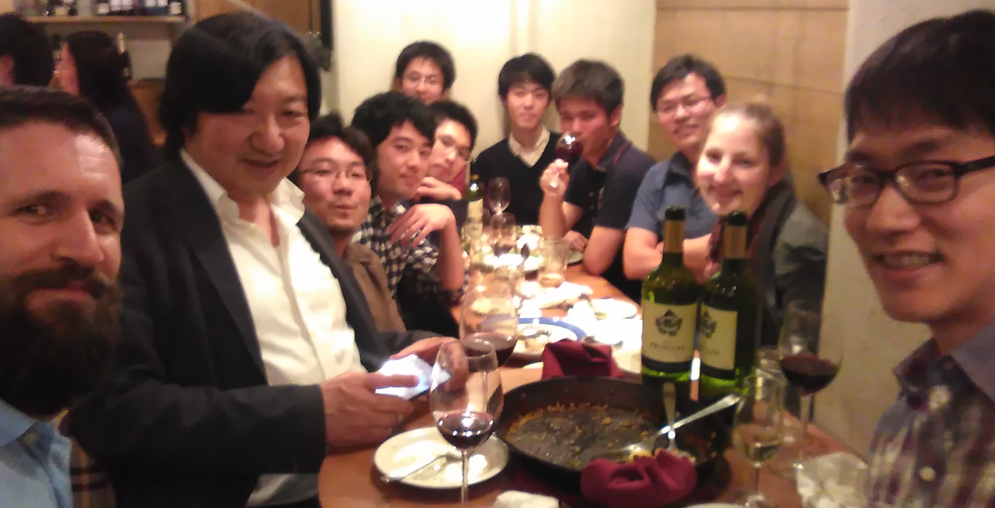
Gained experience and new friends
ATF is an international collaboration:
people from Japan, America, UK, Spain, France, China, …
Working group around Komamiya-san (University of Tokyo):
Master and Ph.D. students from Japan, post-docs and researchers from Japan, China and Europe

Slide 6
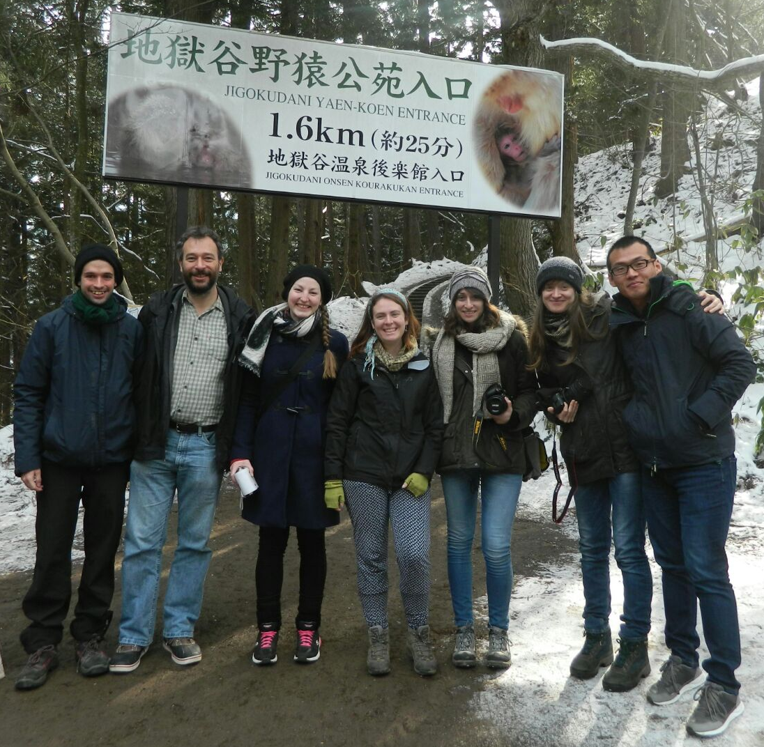
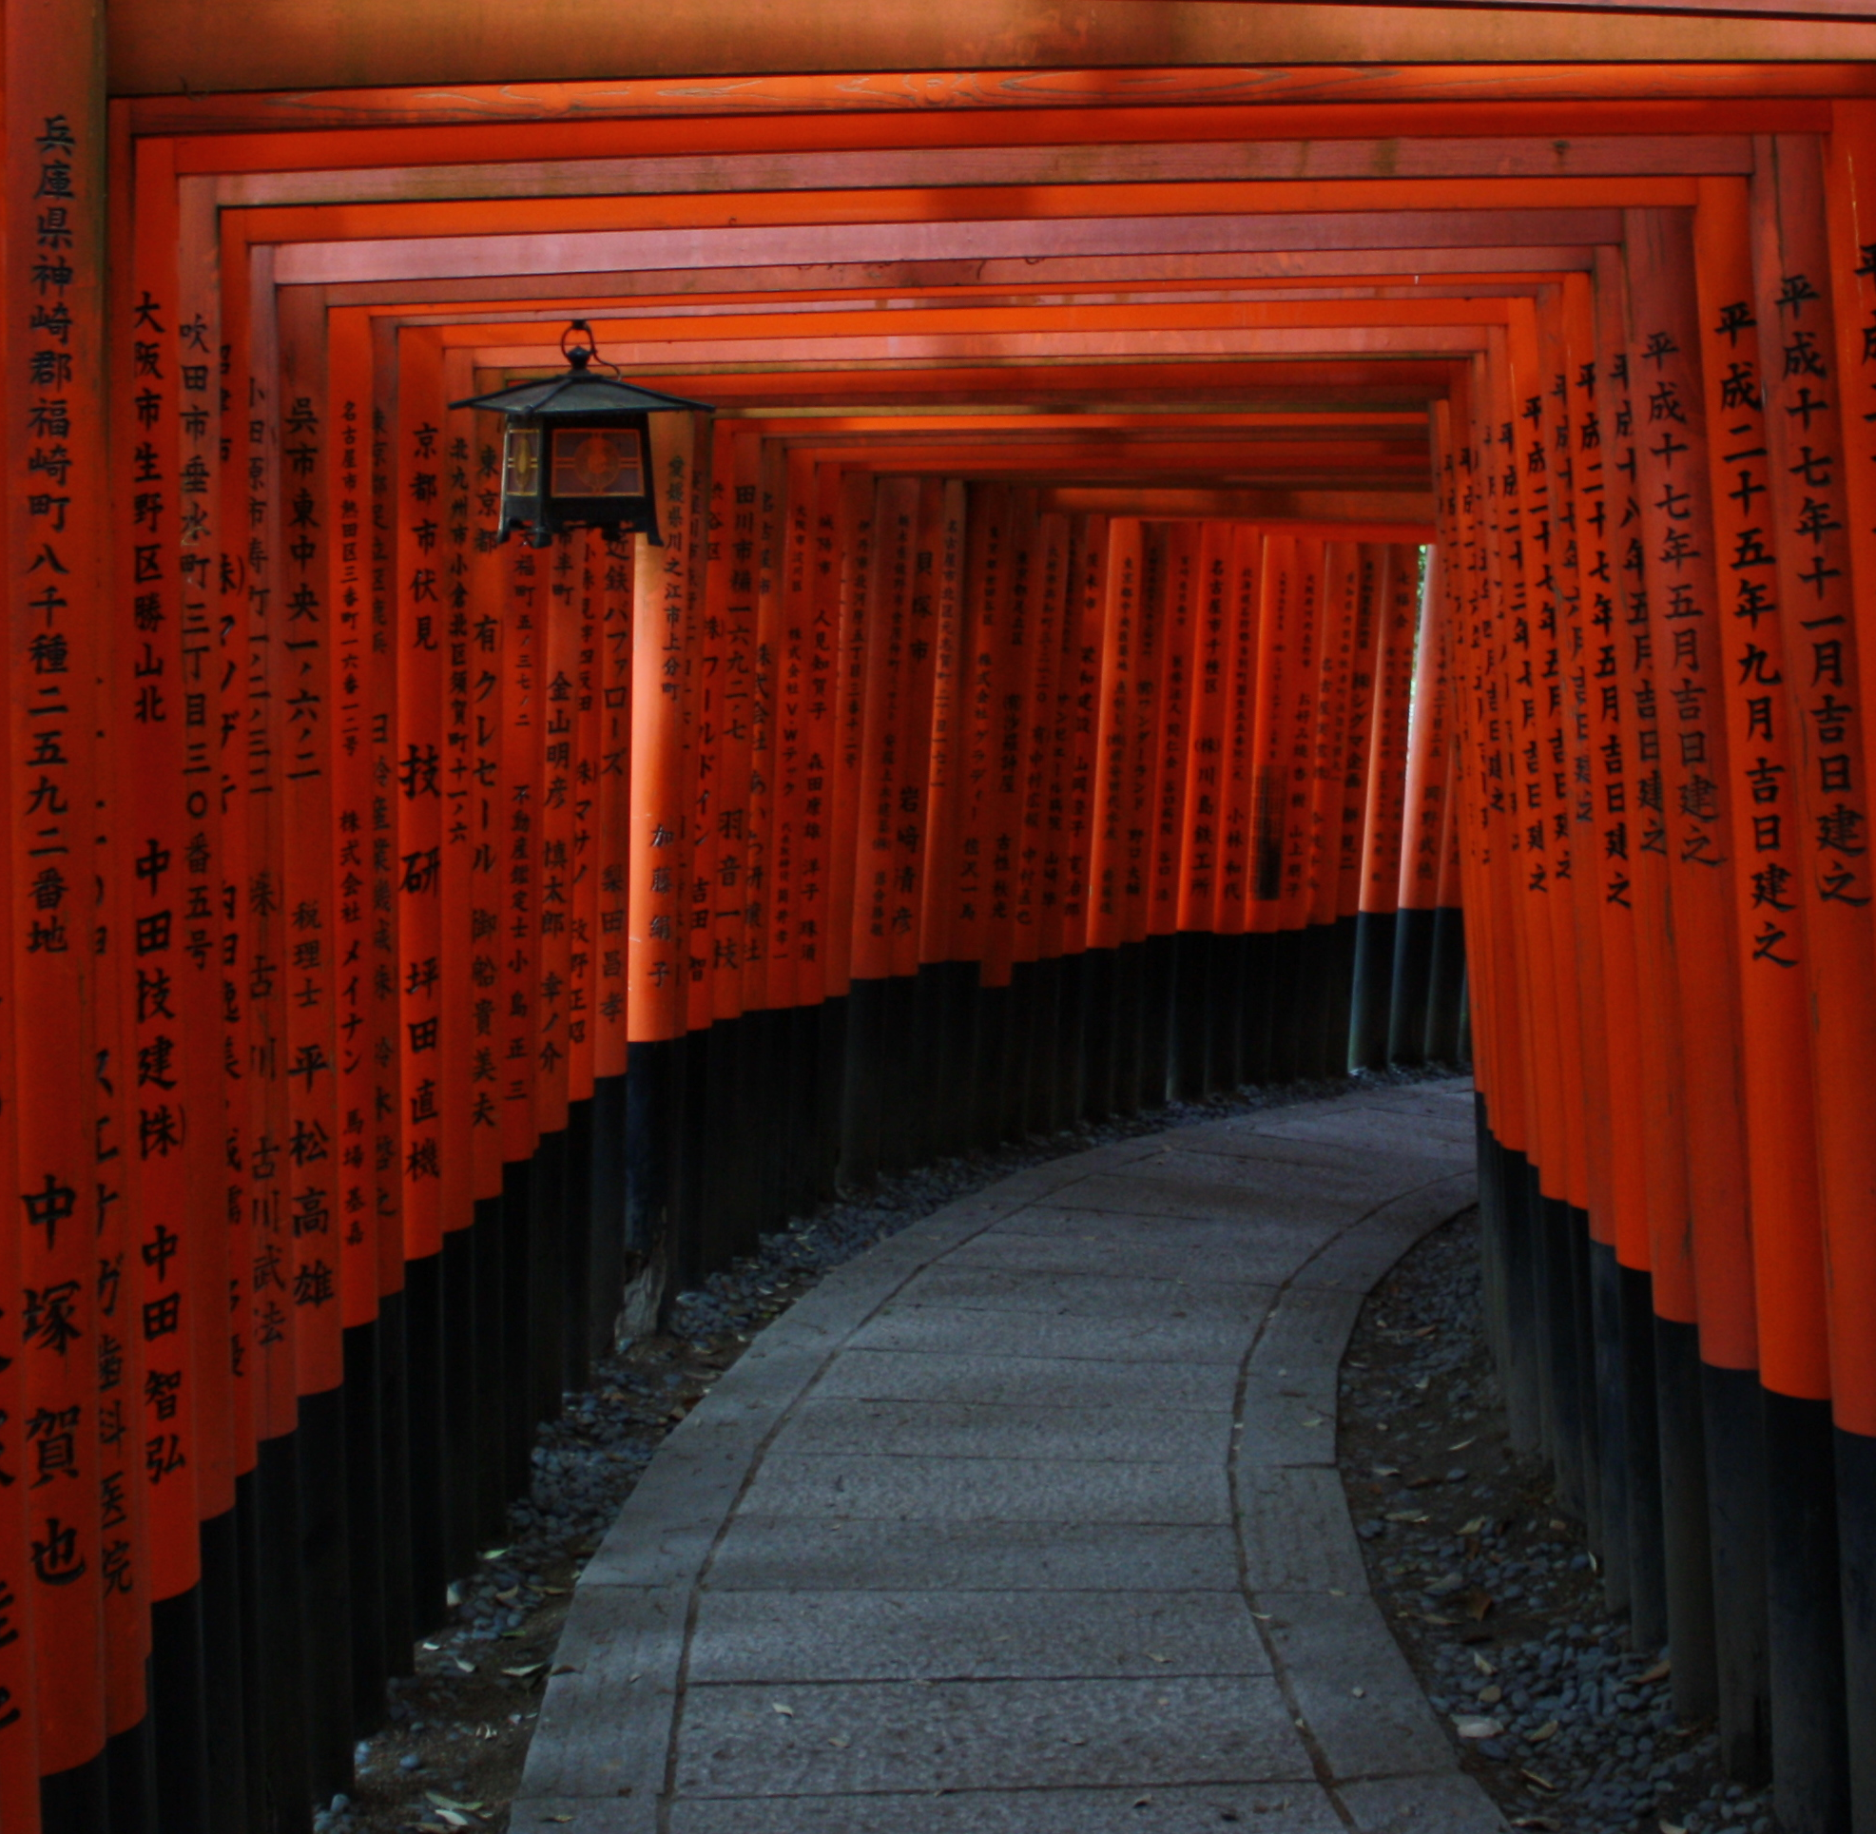
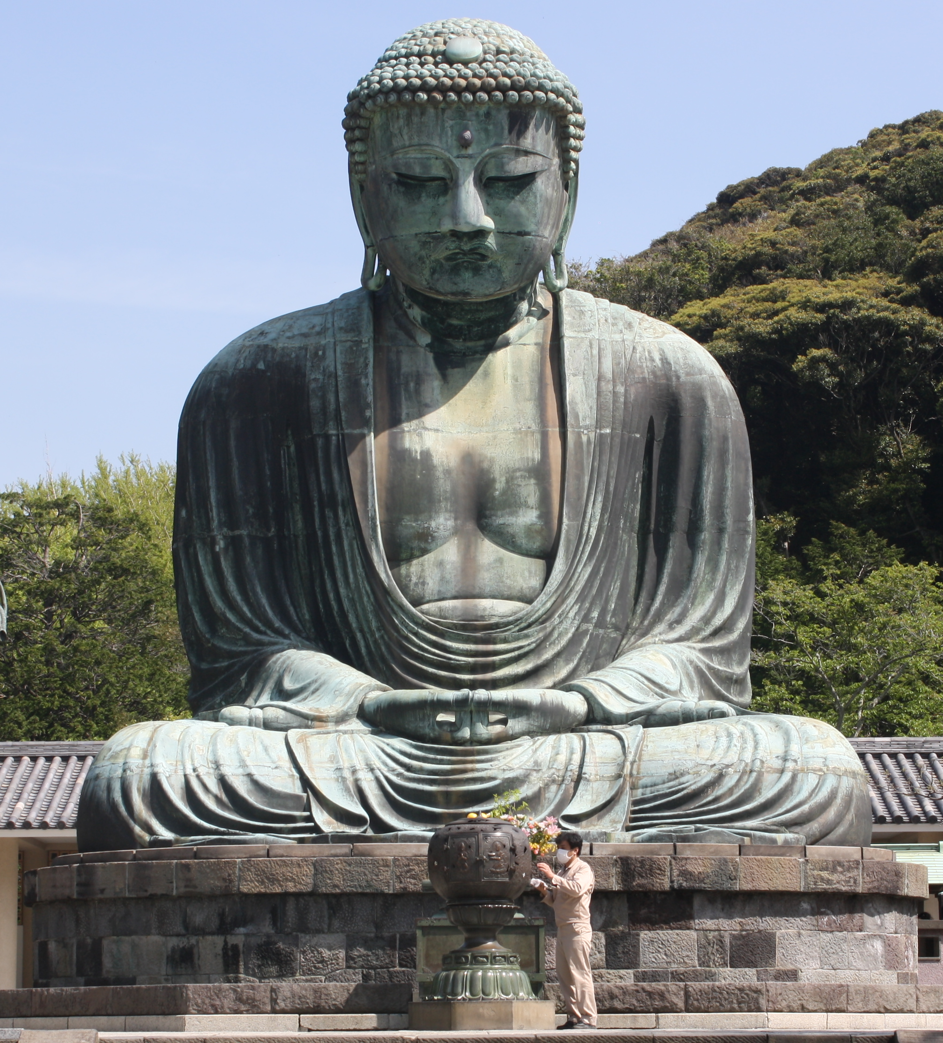
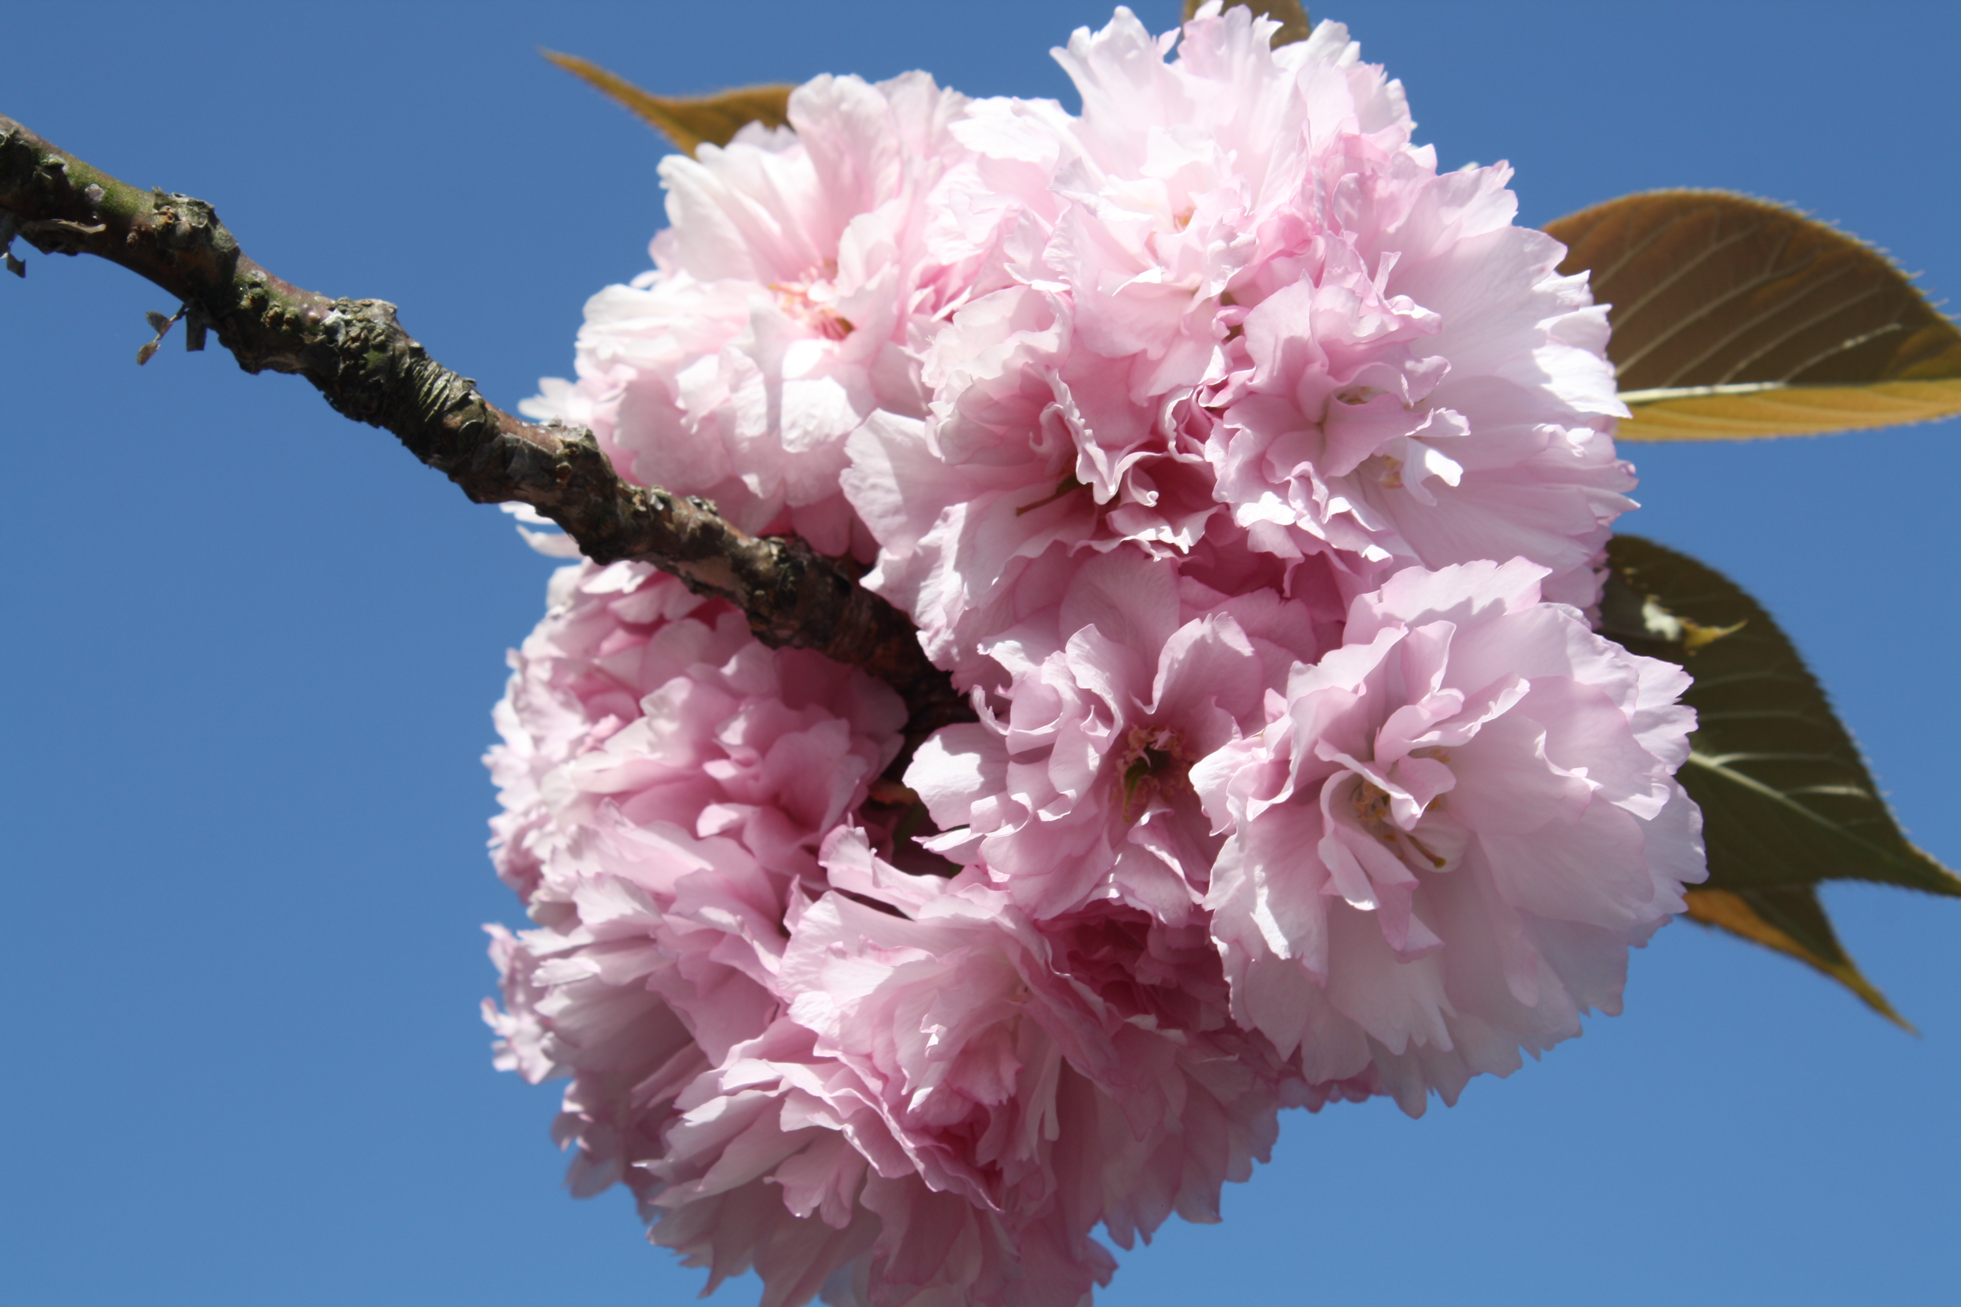
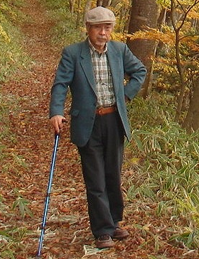
Gained experience and new friends
Japanese language courses: VHS in Hamburg and COTO language academy in Tokyo
Trips to several places:
Pen pal:
Yuichiro Tabaru
met on the train to
Nikko
Snow Monkey
Park, Nagano
Fushimi inari
Kyoto
Great Buddha
Kamakura
Ueno park
Tokyo

Slide 7
Backup

Slide 8
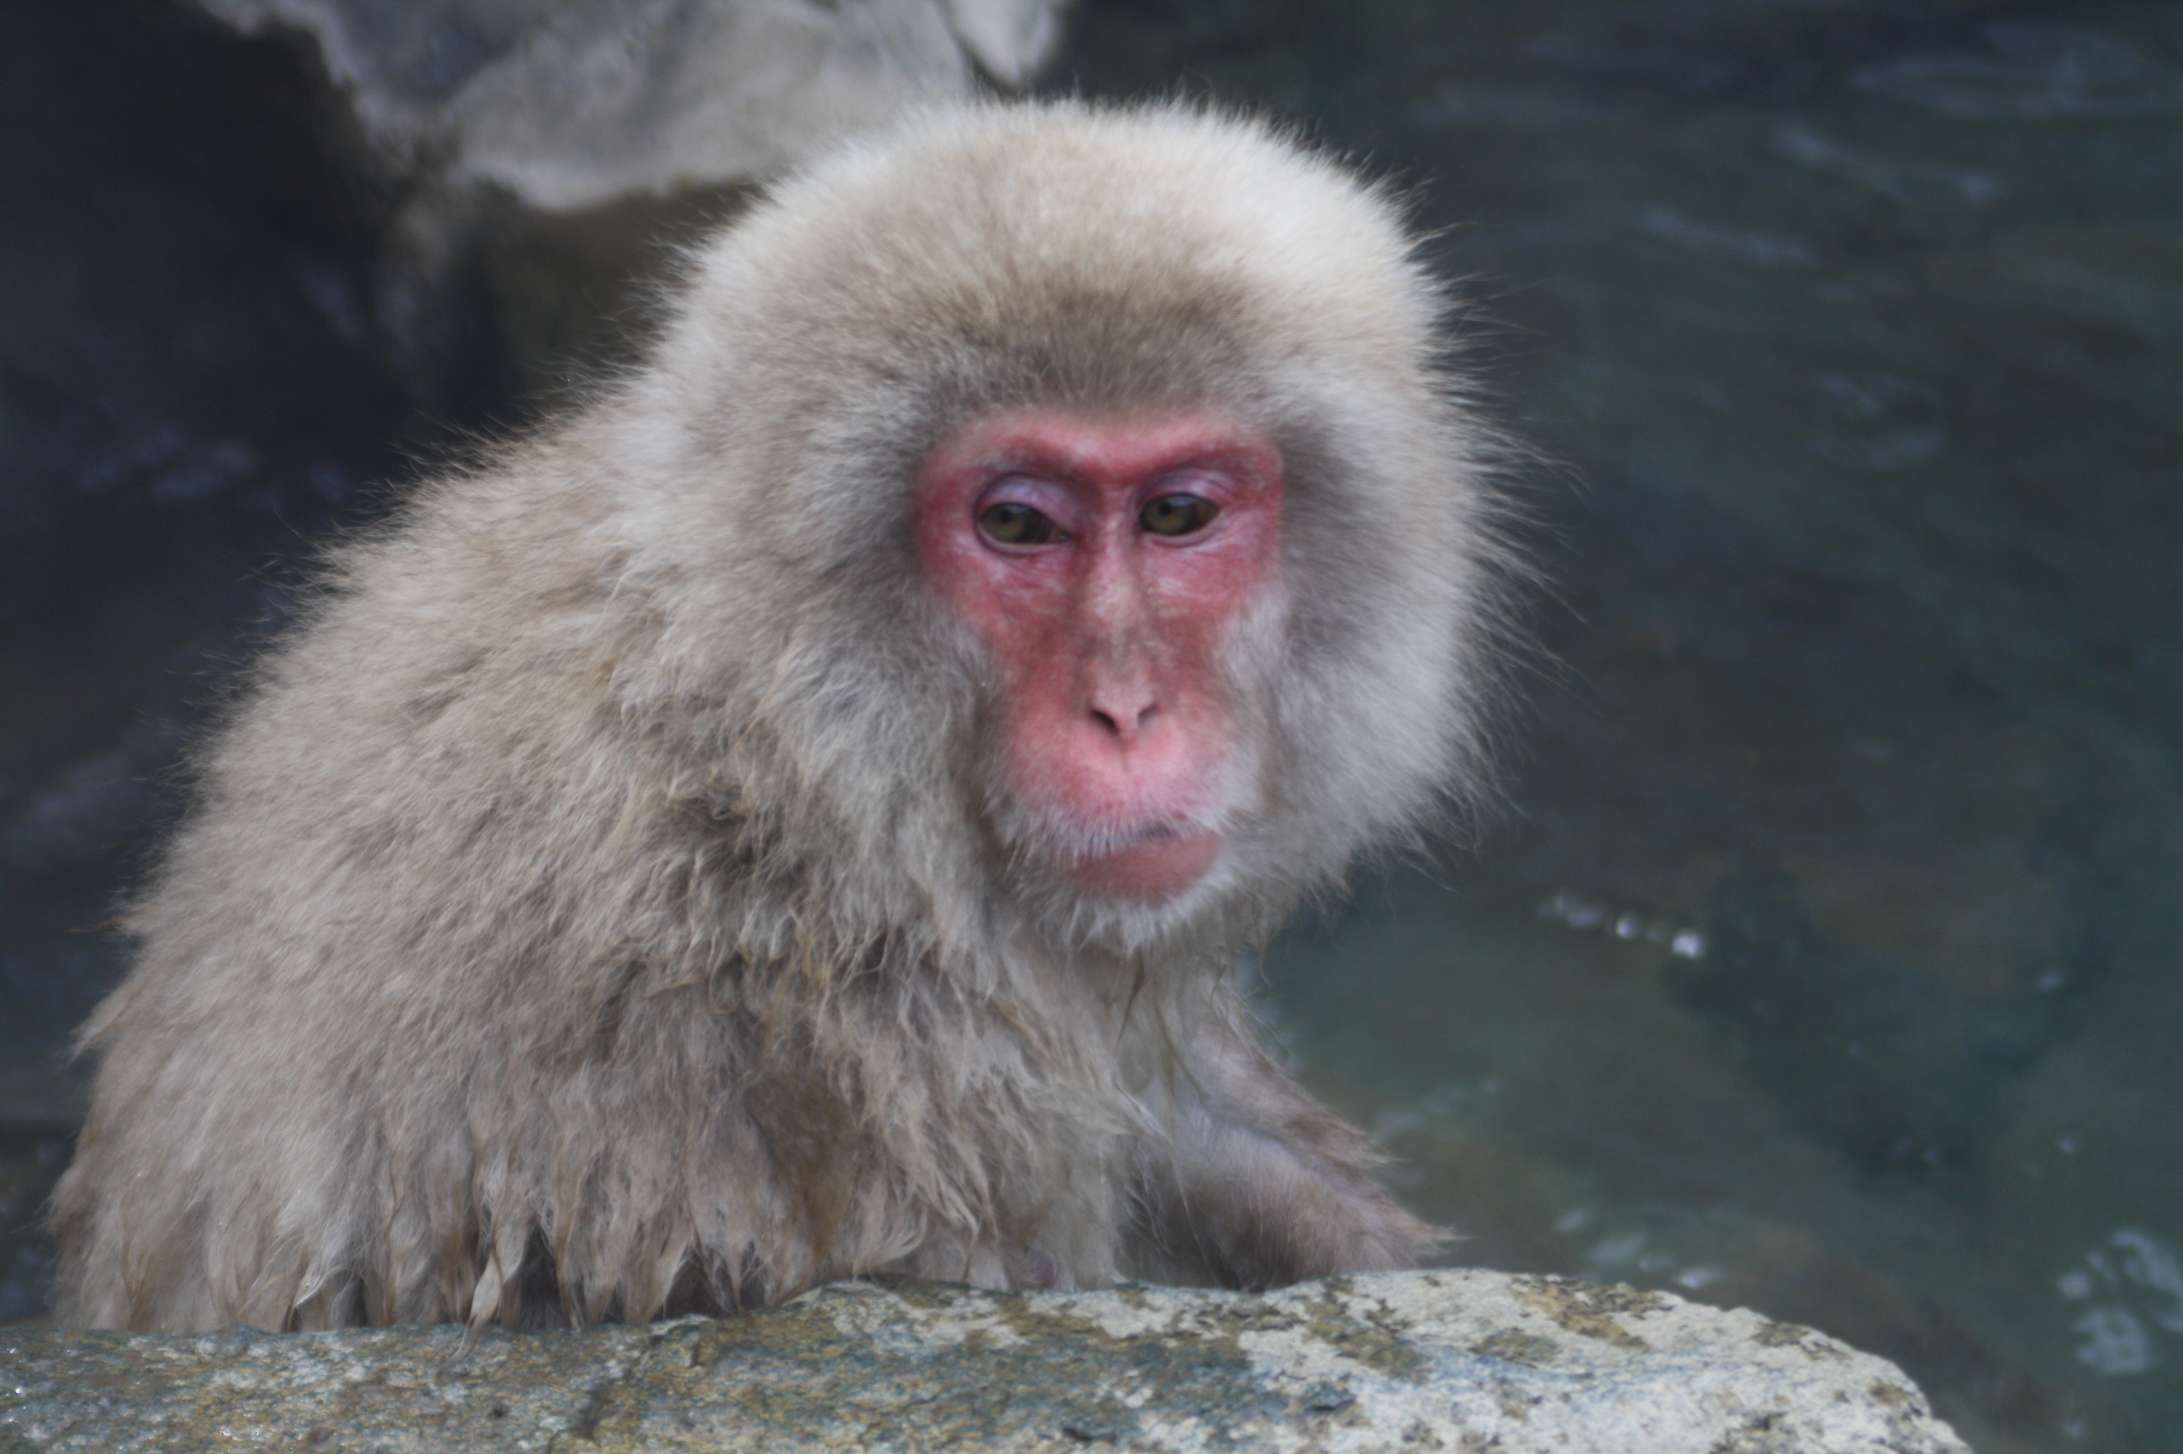
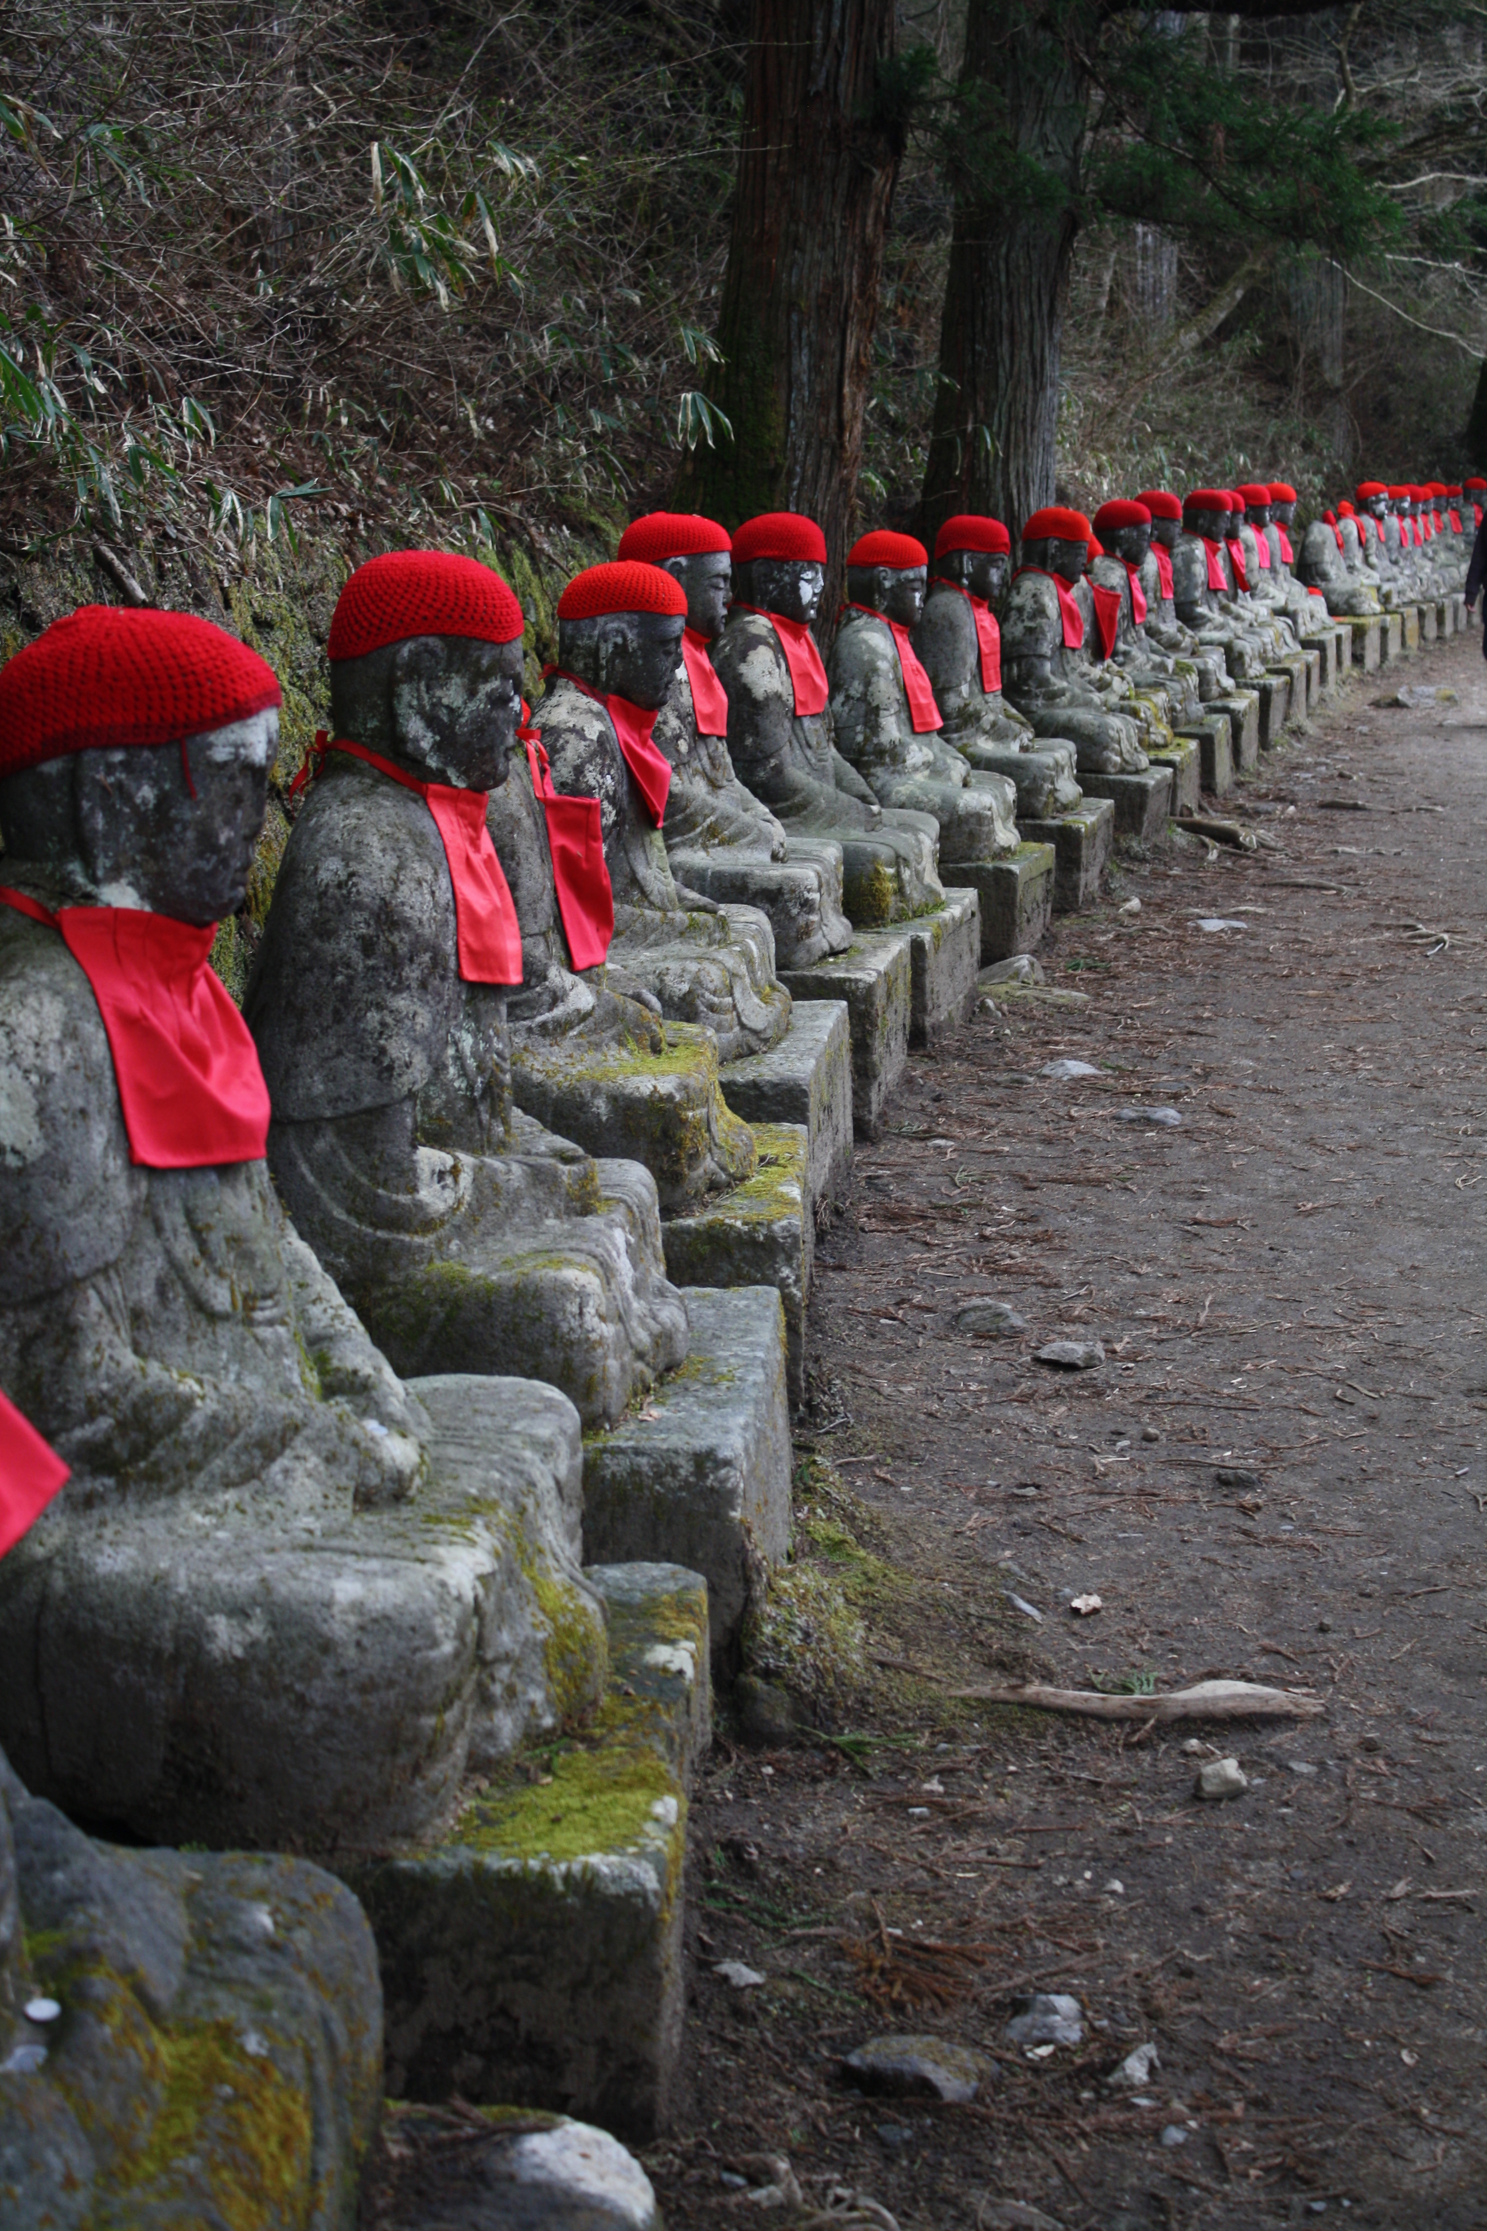
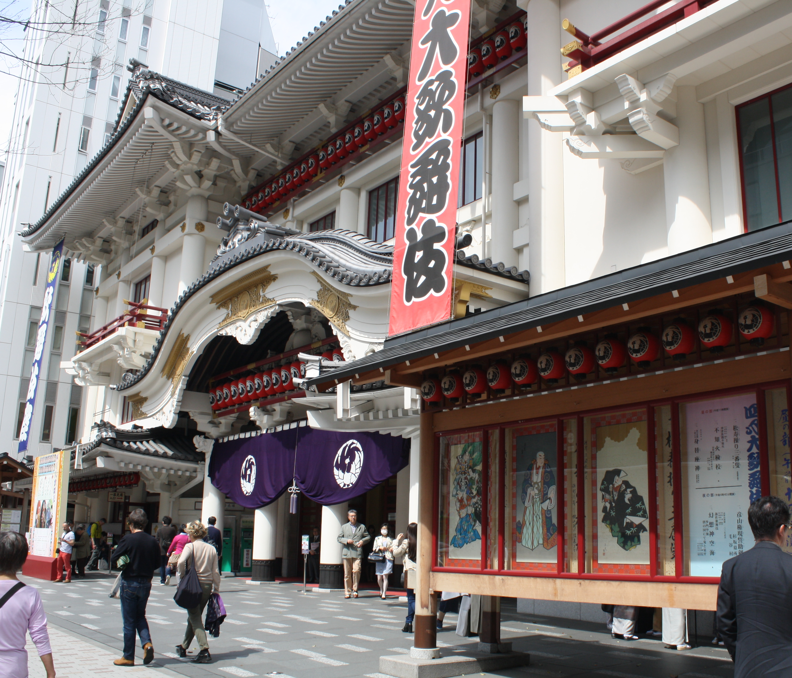
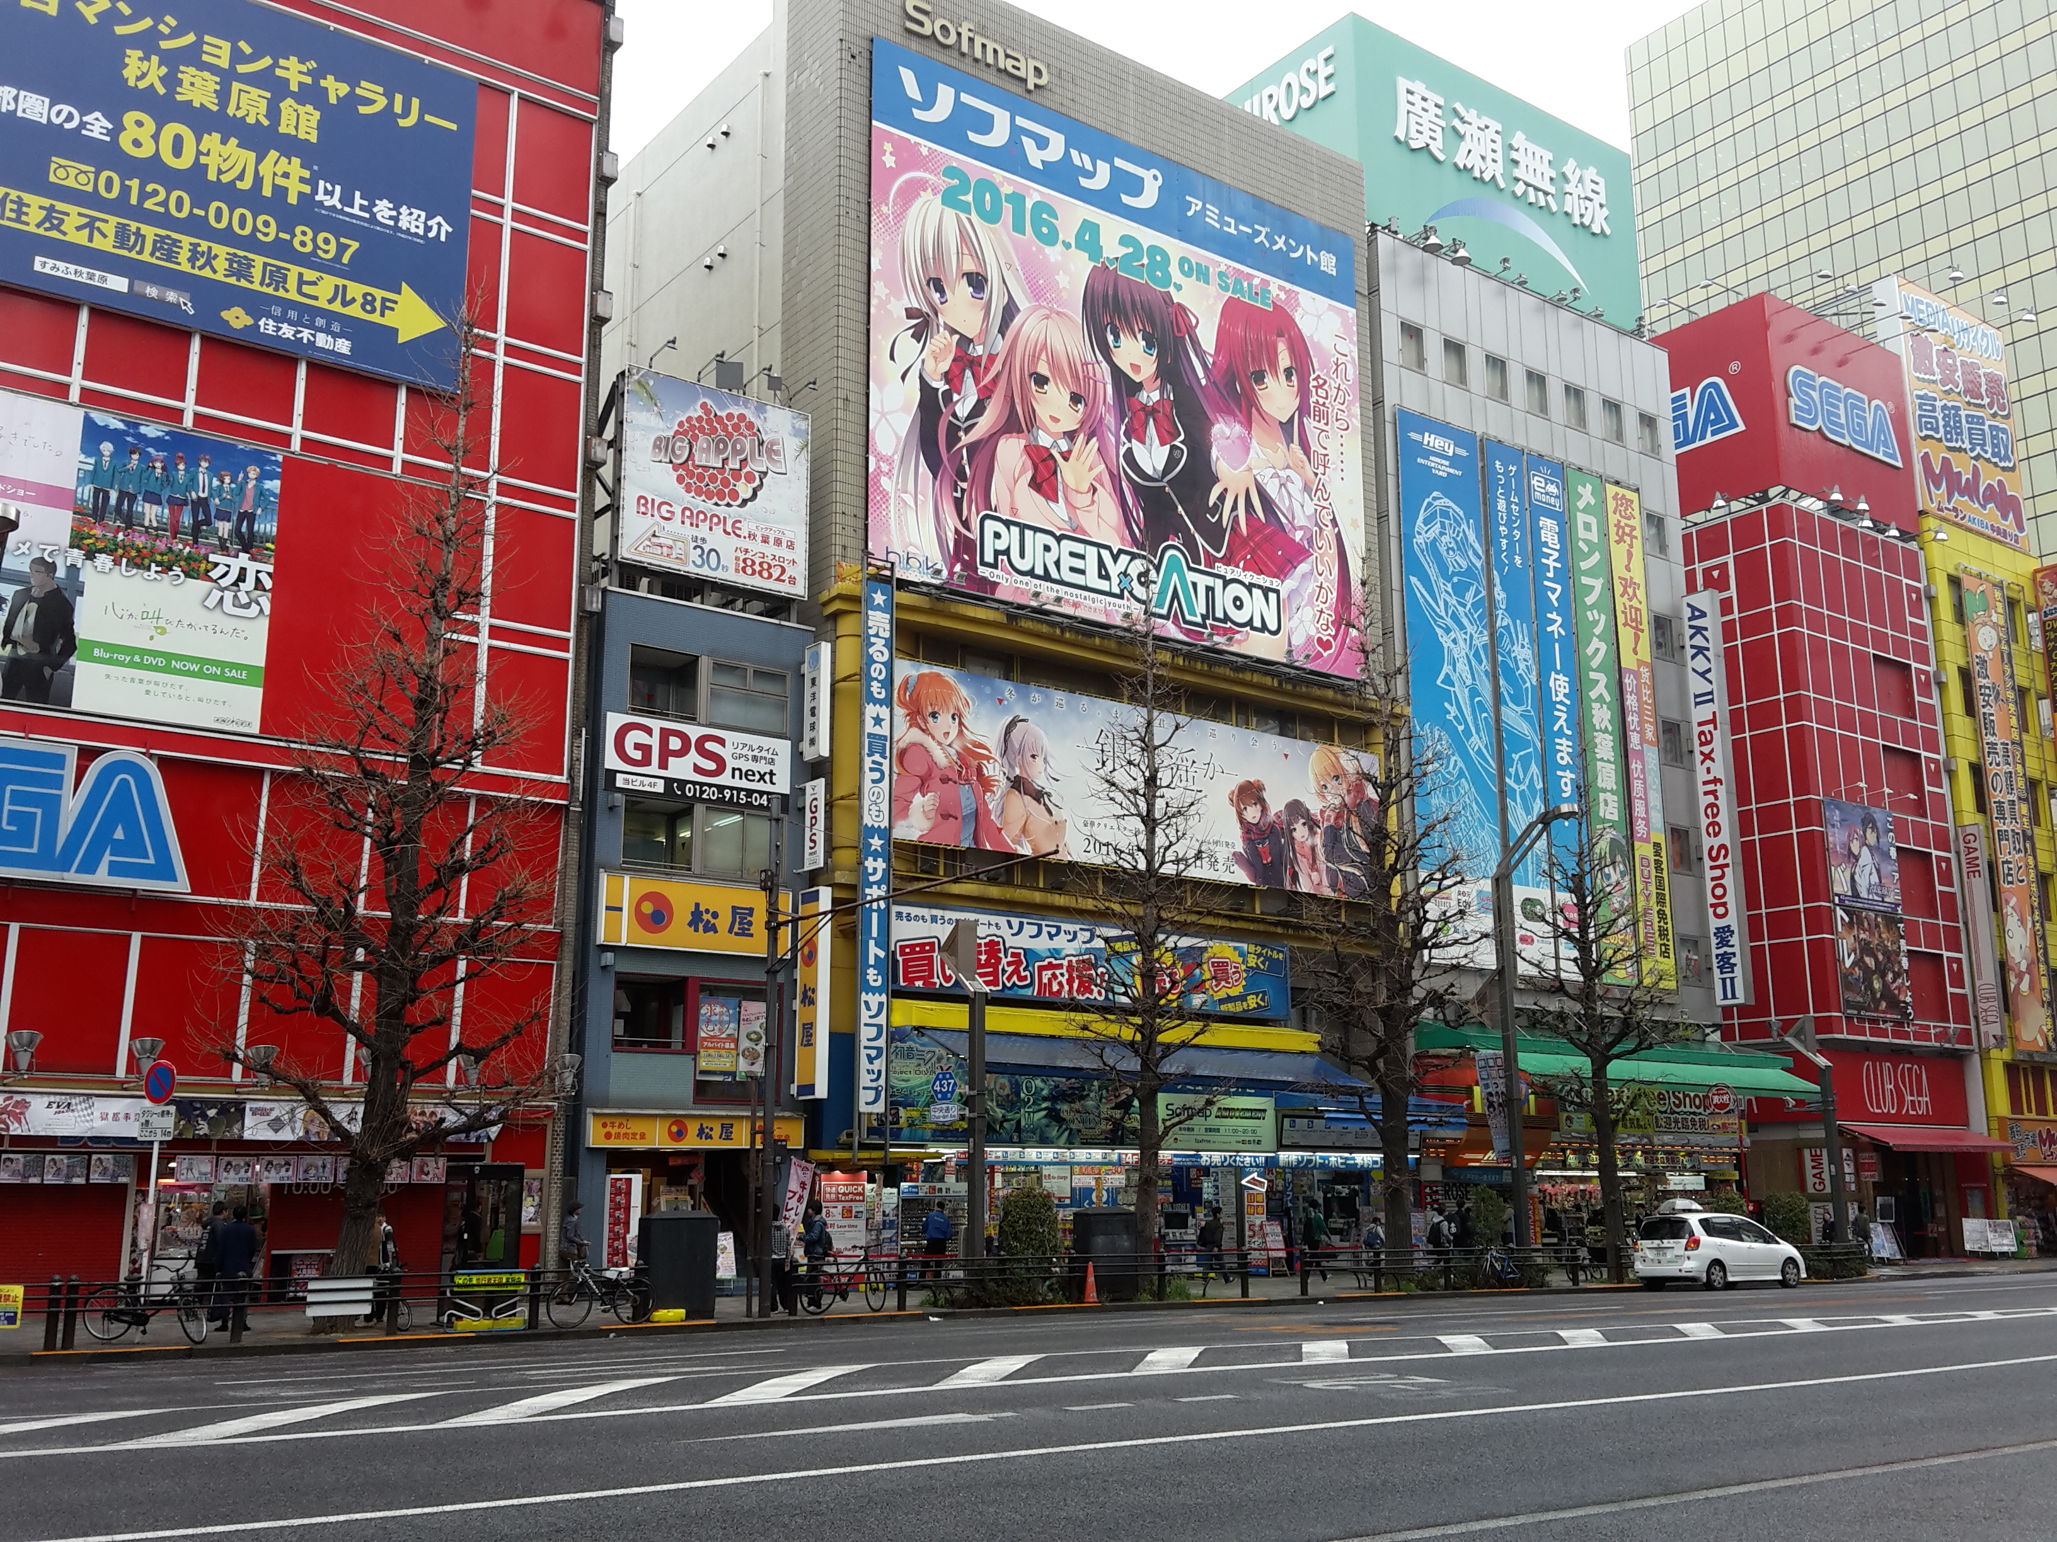
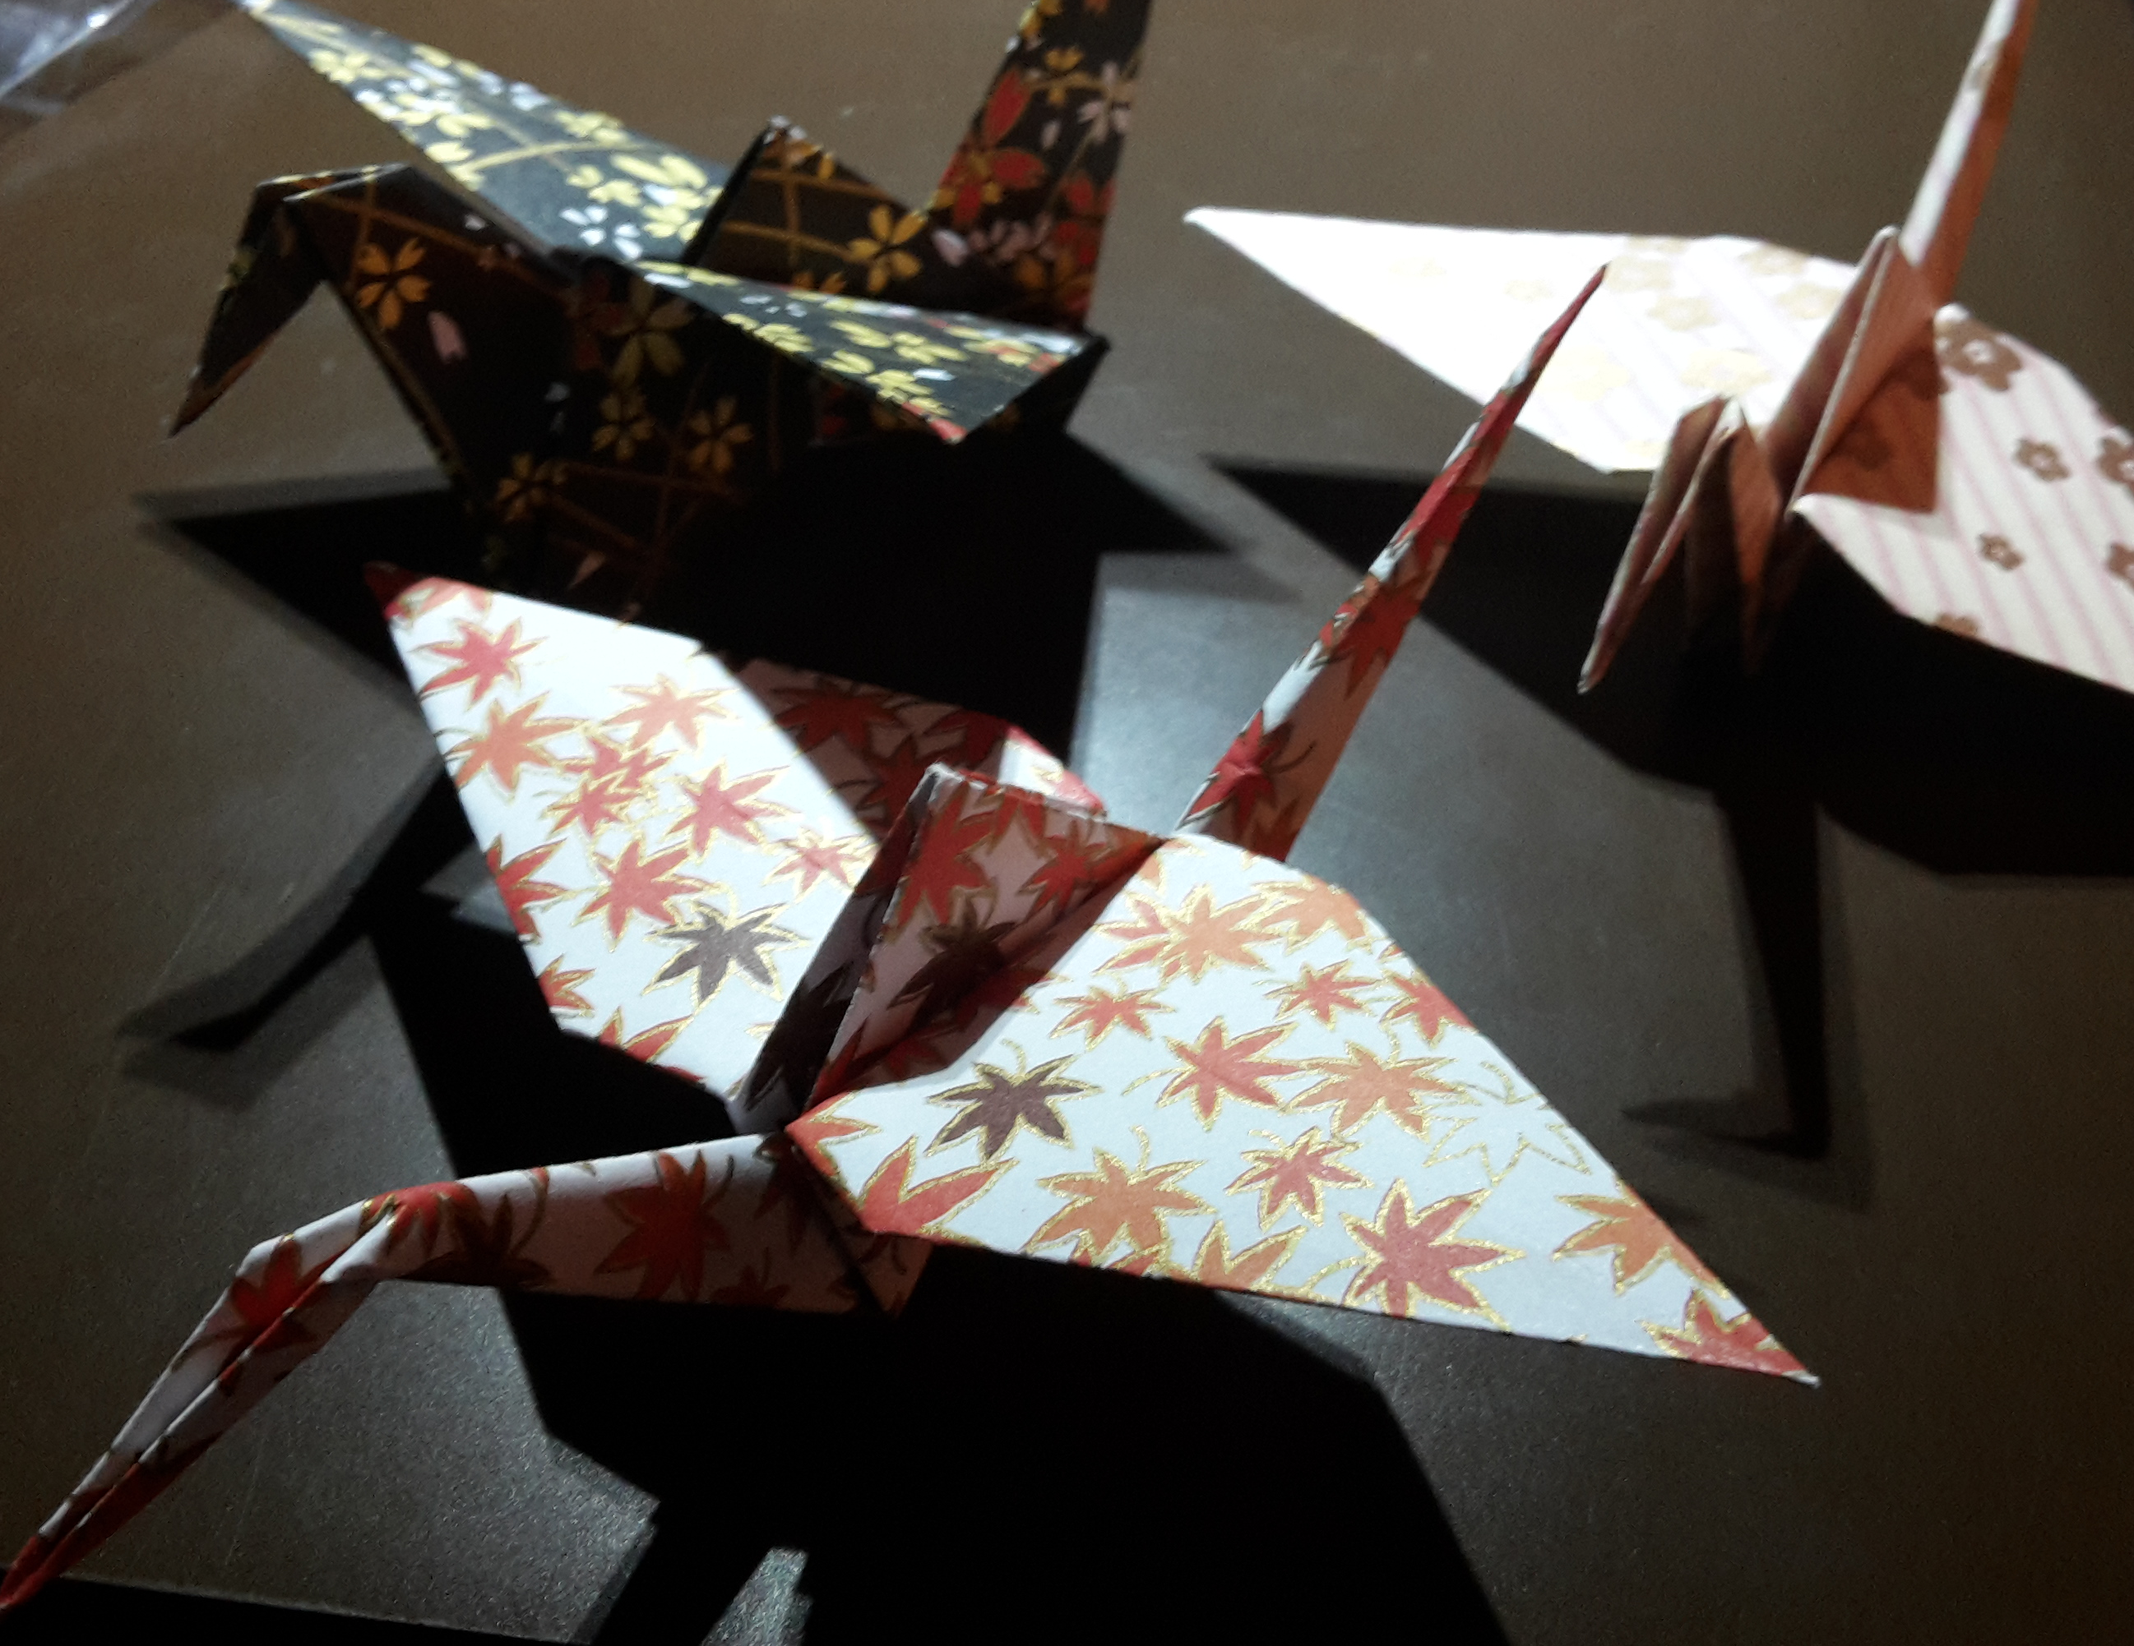
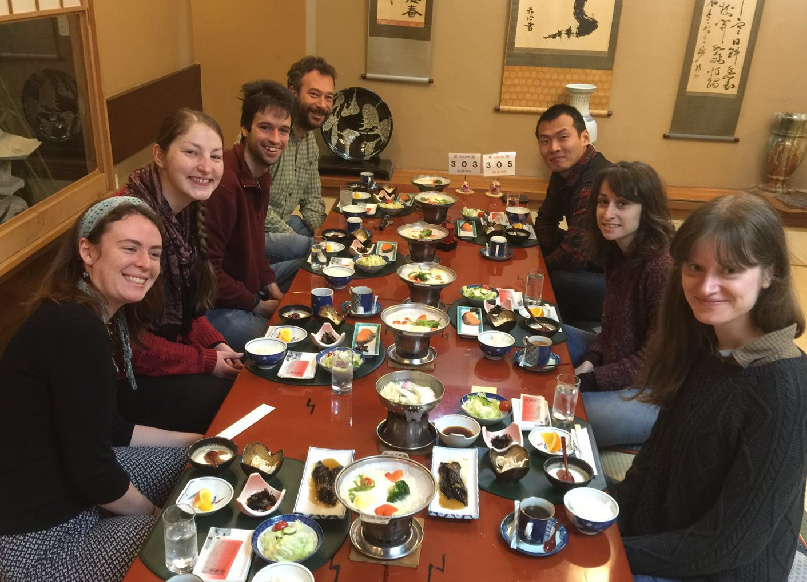
Gained experience and new friends

Slide 9
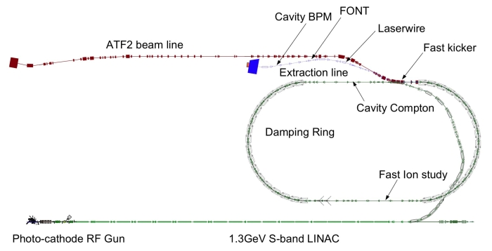
Project at ATF2
The vertical beam halo collimator is installed in the ATF2 extraction line:

Slide 10
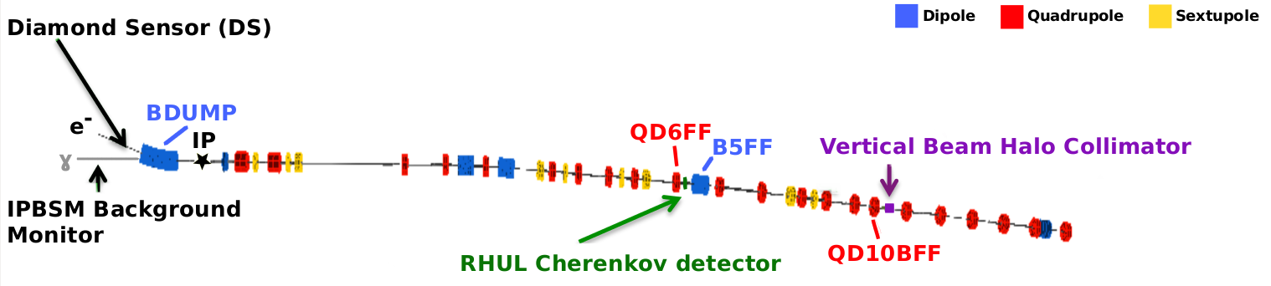
Project at ATF2
The vertical beam halo collimator is installed in the ATF2 extraction line:

