Slide 1
Backup
ILC beam parameters
ILC250 stage
BDS muon study
ATF2 machine background study
ILC Main Beam Dump simulations

Slide 2
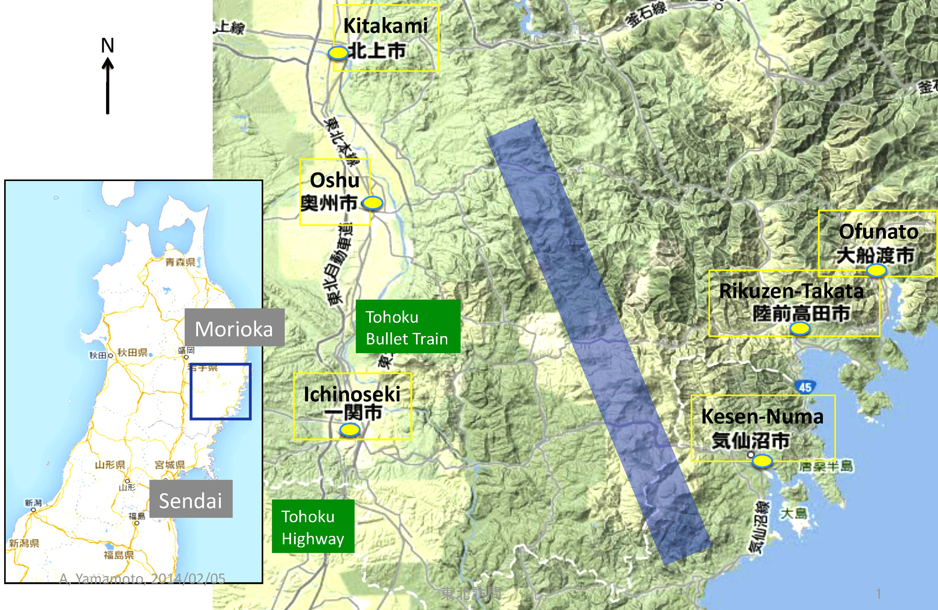
The International Linear Collider
Candidate Site: The Kitakami Mountains
~31 km
B. Warmbein, “The road to Kitakami”, in “LC Newsline - The Newsletter of the Linear Collider Community”, 2014 http://newsline.linearcollider.org/2014/02/20/the-road-to-kitakami/

Slide 3
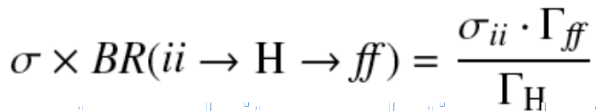
The International Linear Collider
Key Physics Goals
Higgs coupling precisions at the LHC:
Only the products σxBR are measured, there is no model-independent way to determine cross section and branching ratio separately
Measured yield can be parametrized in terms of coupling strength scaling factors
κ = g/gSM
Some parametrizations make no assumptions on the total width, allowing only measurements of ratios of coupling scale factors
In SM all μ's and κ's are equal to 1
Loop scaling factors (κg,κγ) can be:
  expressed in terms SM coupling scaling factors (no BSM in loops assumed)
  treated as free parameters → effective couplings sensitive on BSM
Global width ΓH requires assumptions (κH=κH(κW,κZ,...)) because of inaccessible decays
Global fit to all Higgs signals (plus using theoretical assumptions of the width)
→ Higgs couplings can never be as precise as at the ILC

Slide 4
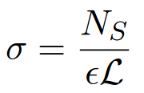
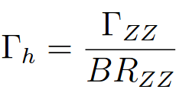
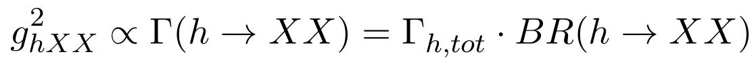
The International Linear Collider
Key Physics Goals
Higgs coupling precisions at the ILC:
Each Higgs coupling will be measured to a percent accuracy:
Through recoil method: σ(e⁺e⁻→ Zh) measured to a 1% precision
Branching ratio: BRchannel = Nchannel/σ(e⁺e⁻→ Zh)
Total Higgs width: for h→ ZZ* (direct measurement of the global width)
Higgs couplings:

Slide 5
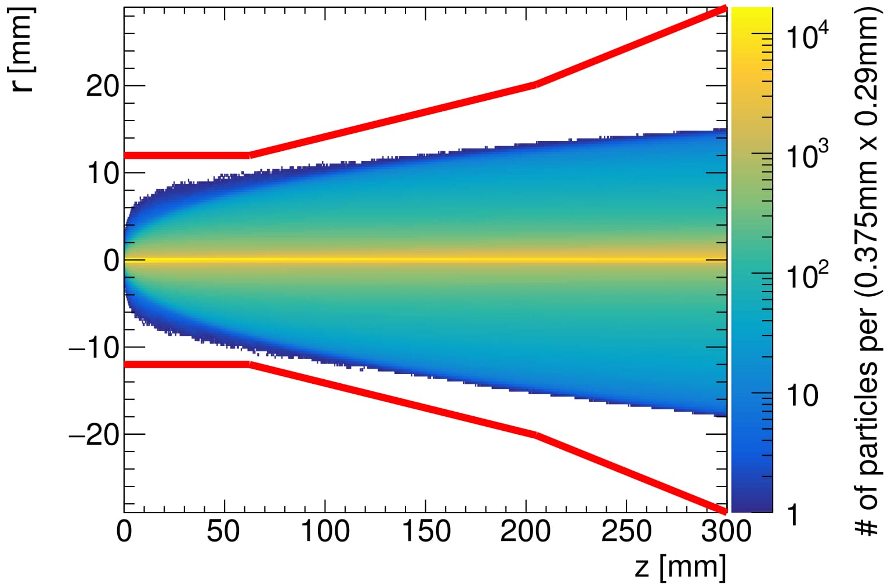
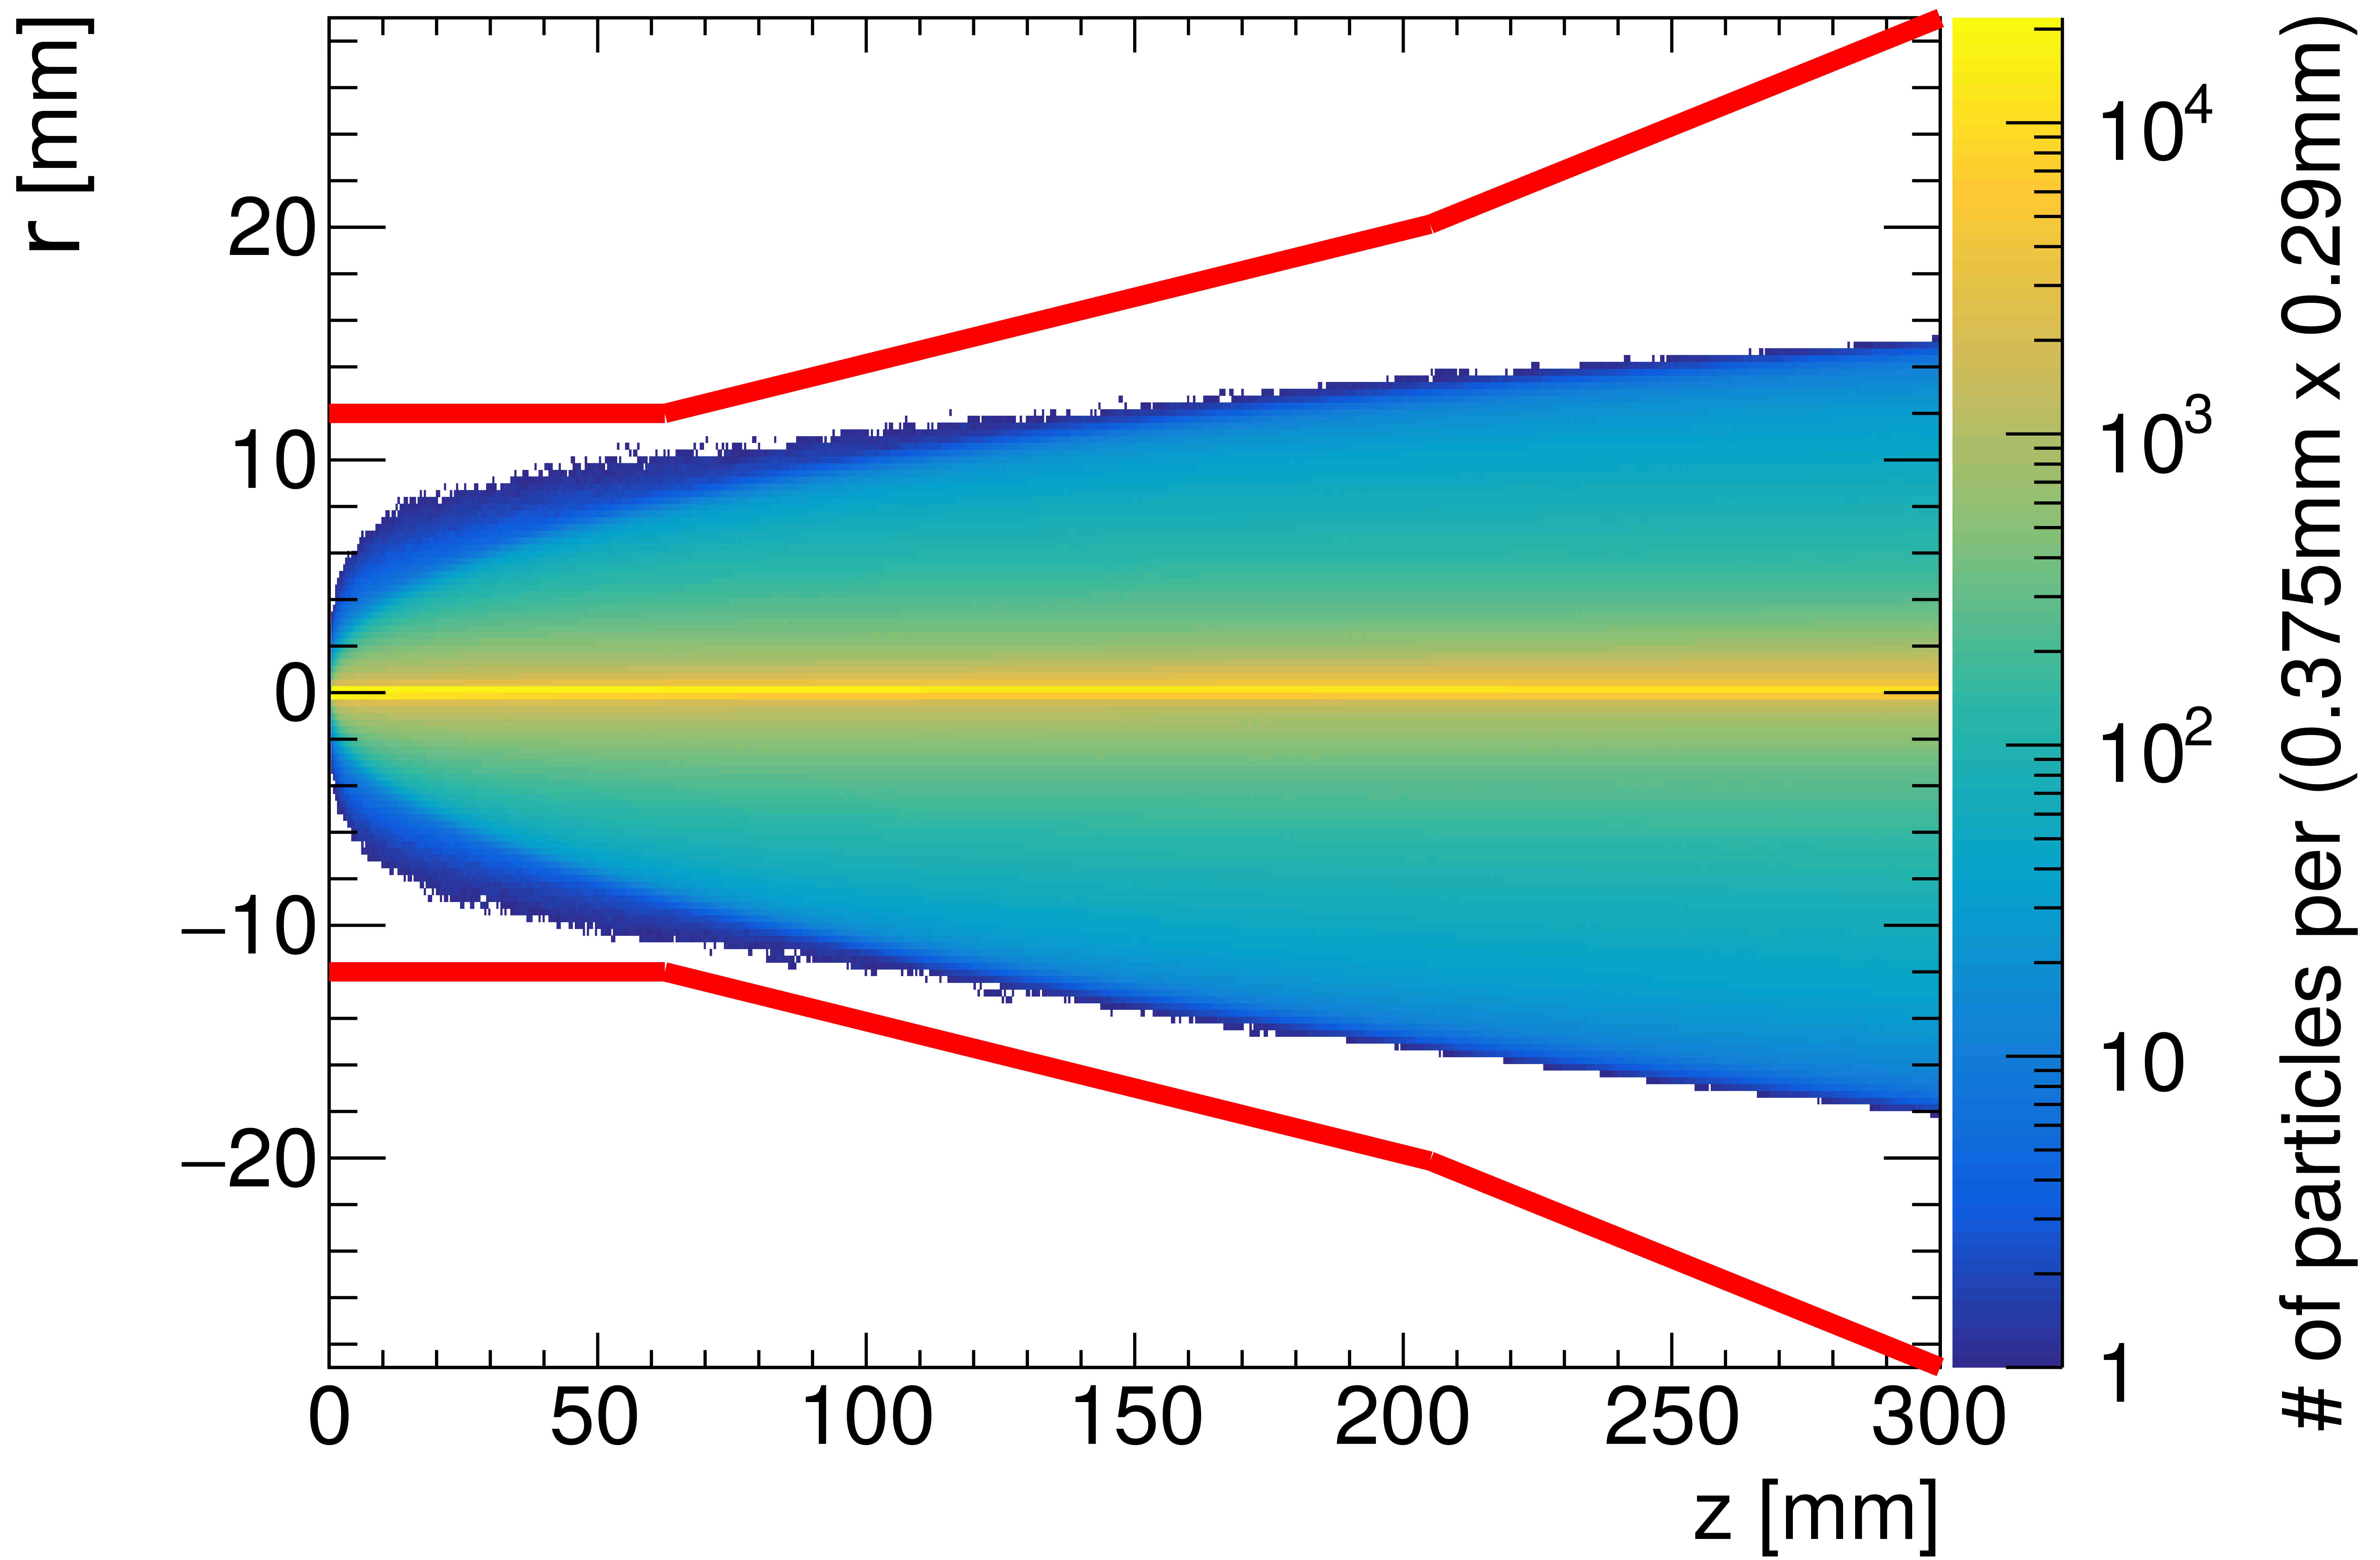
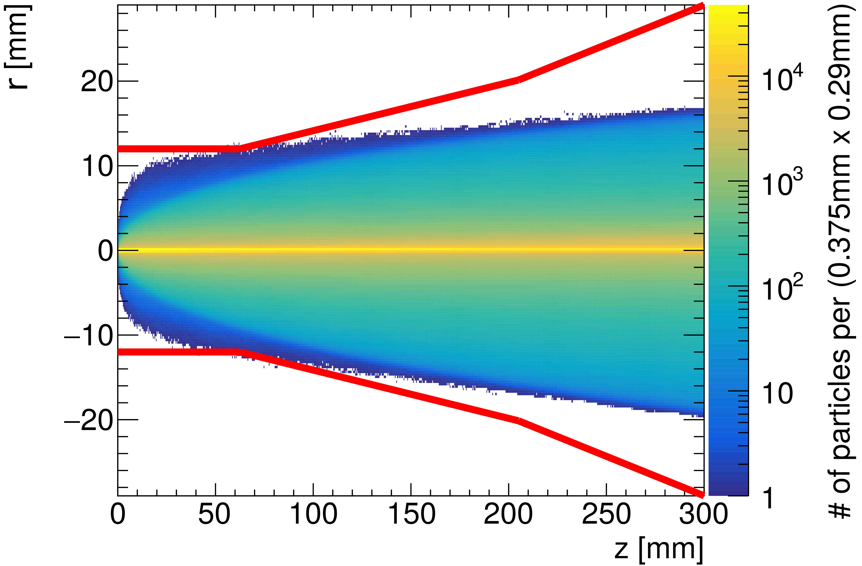
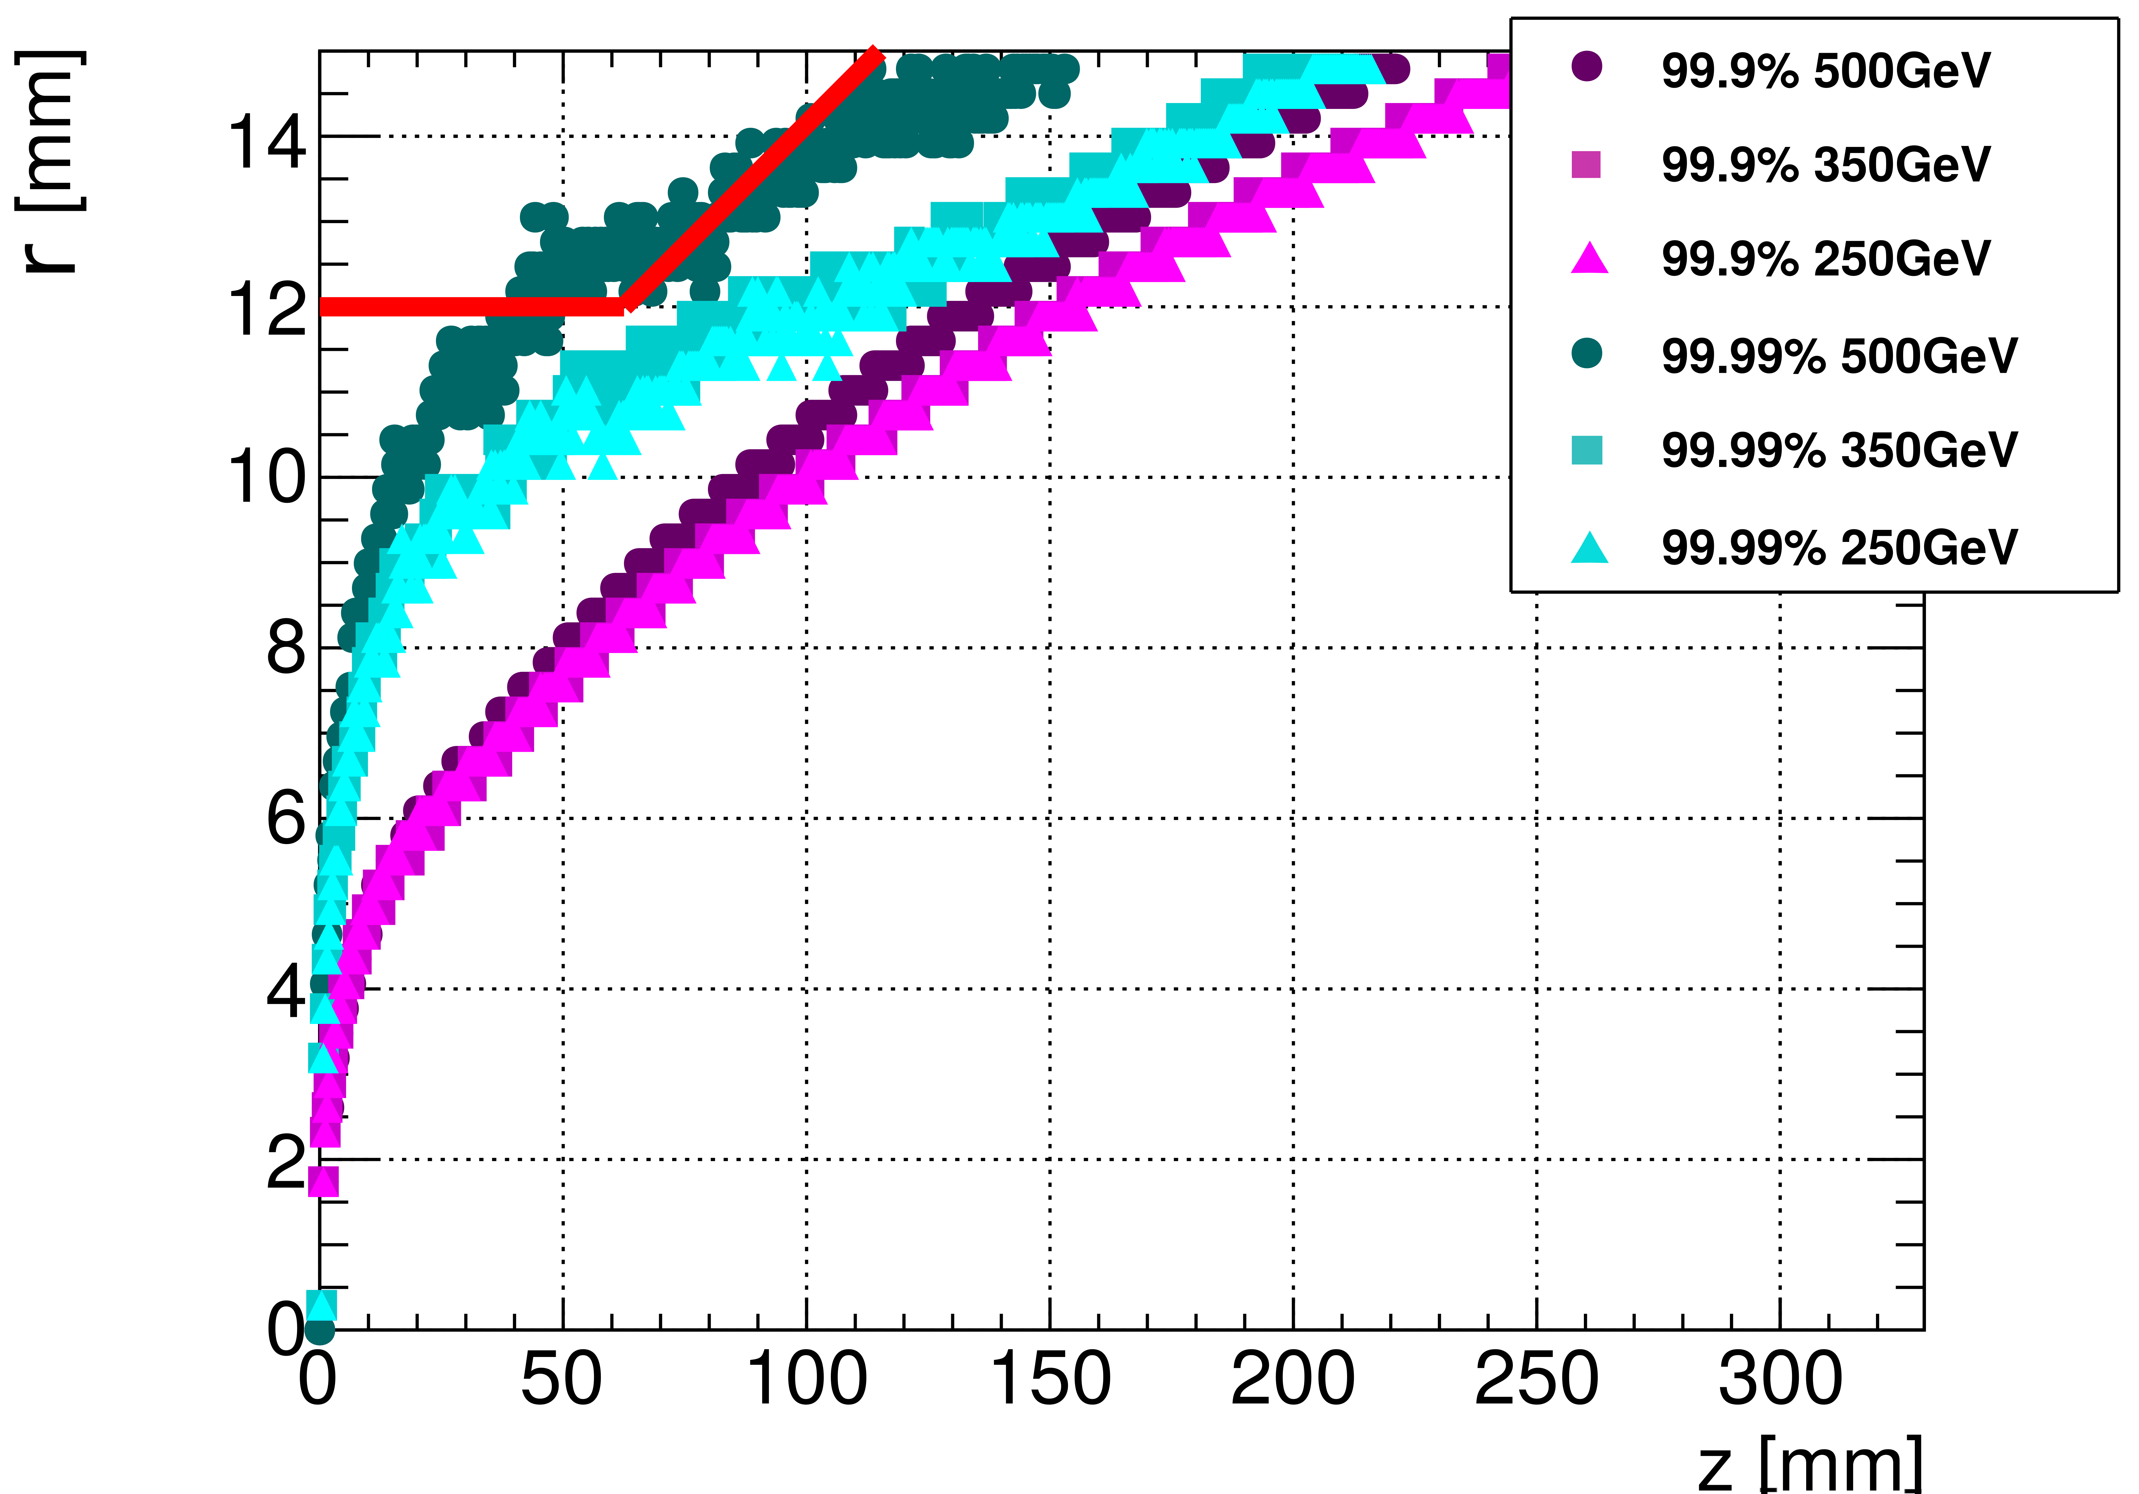
The International Linear Collider e⁺e⁻ pair background
Testing the dependency on the center-of-mass energy
250 GeV
350 GeV
500 GeV
→ The higher the center-of-mass energy, the broader the pair background envelopes

Slide 6
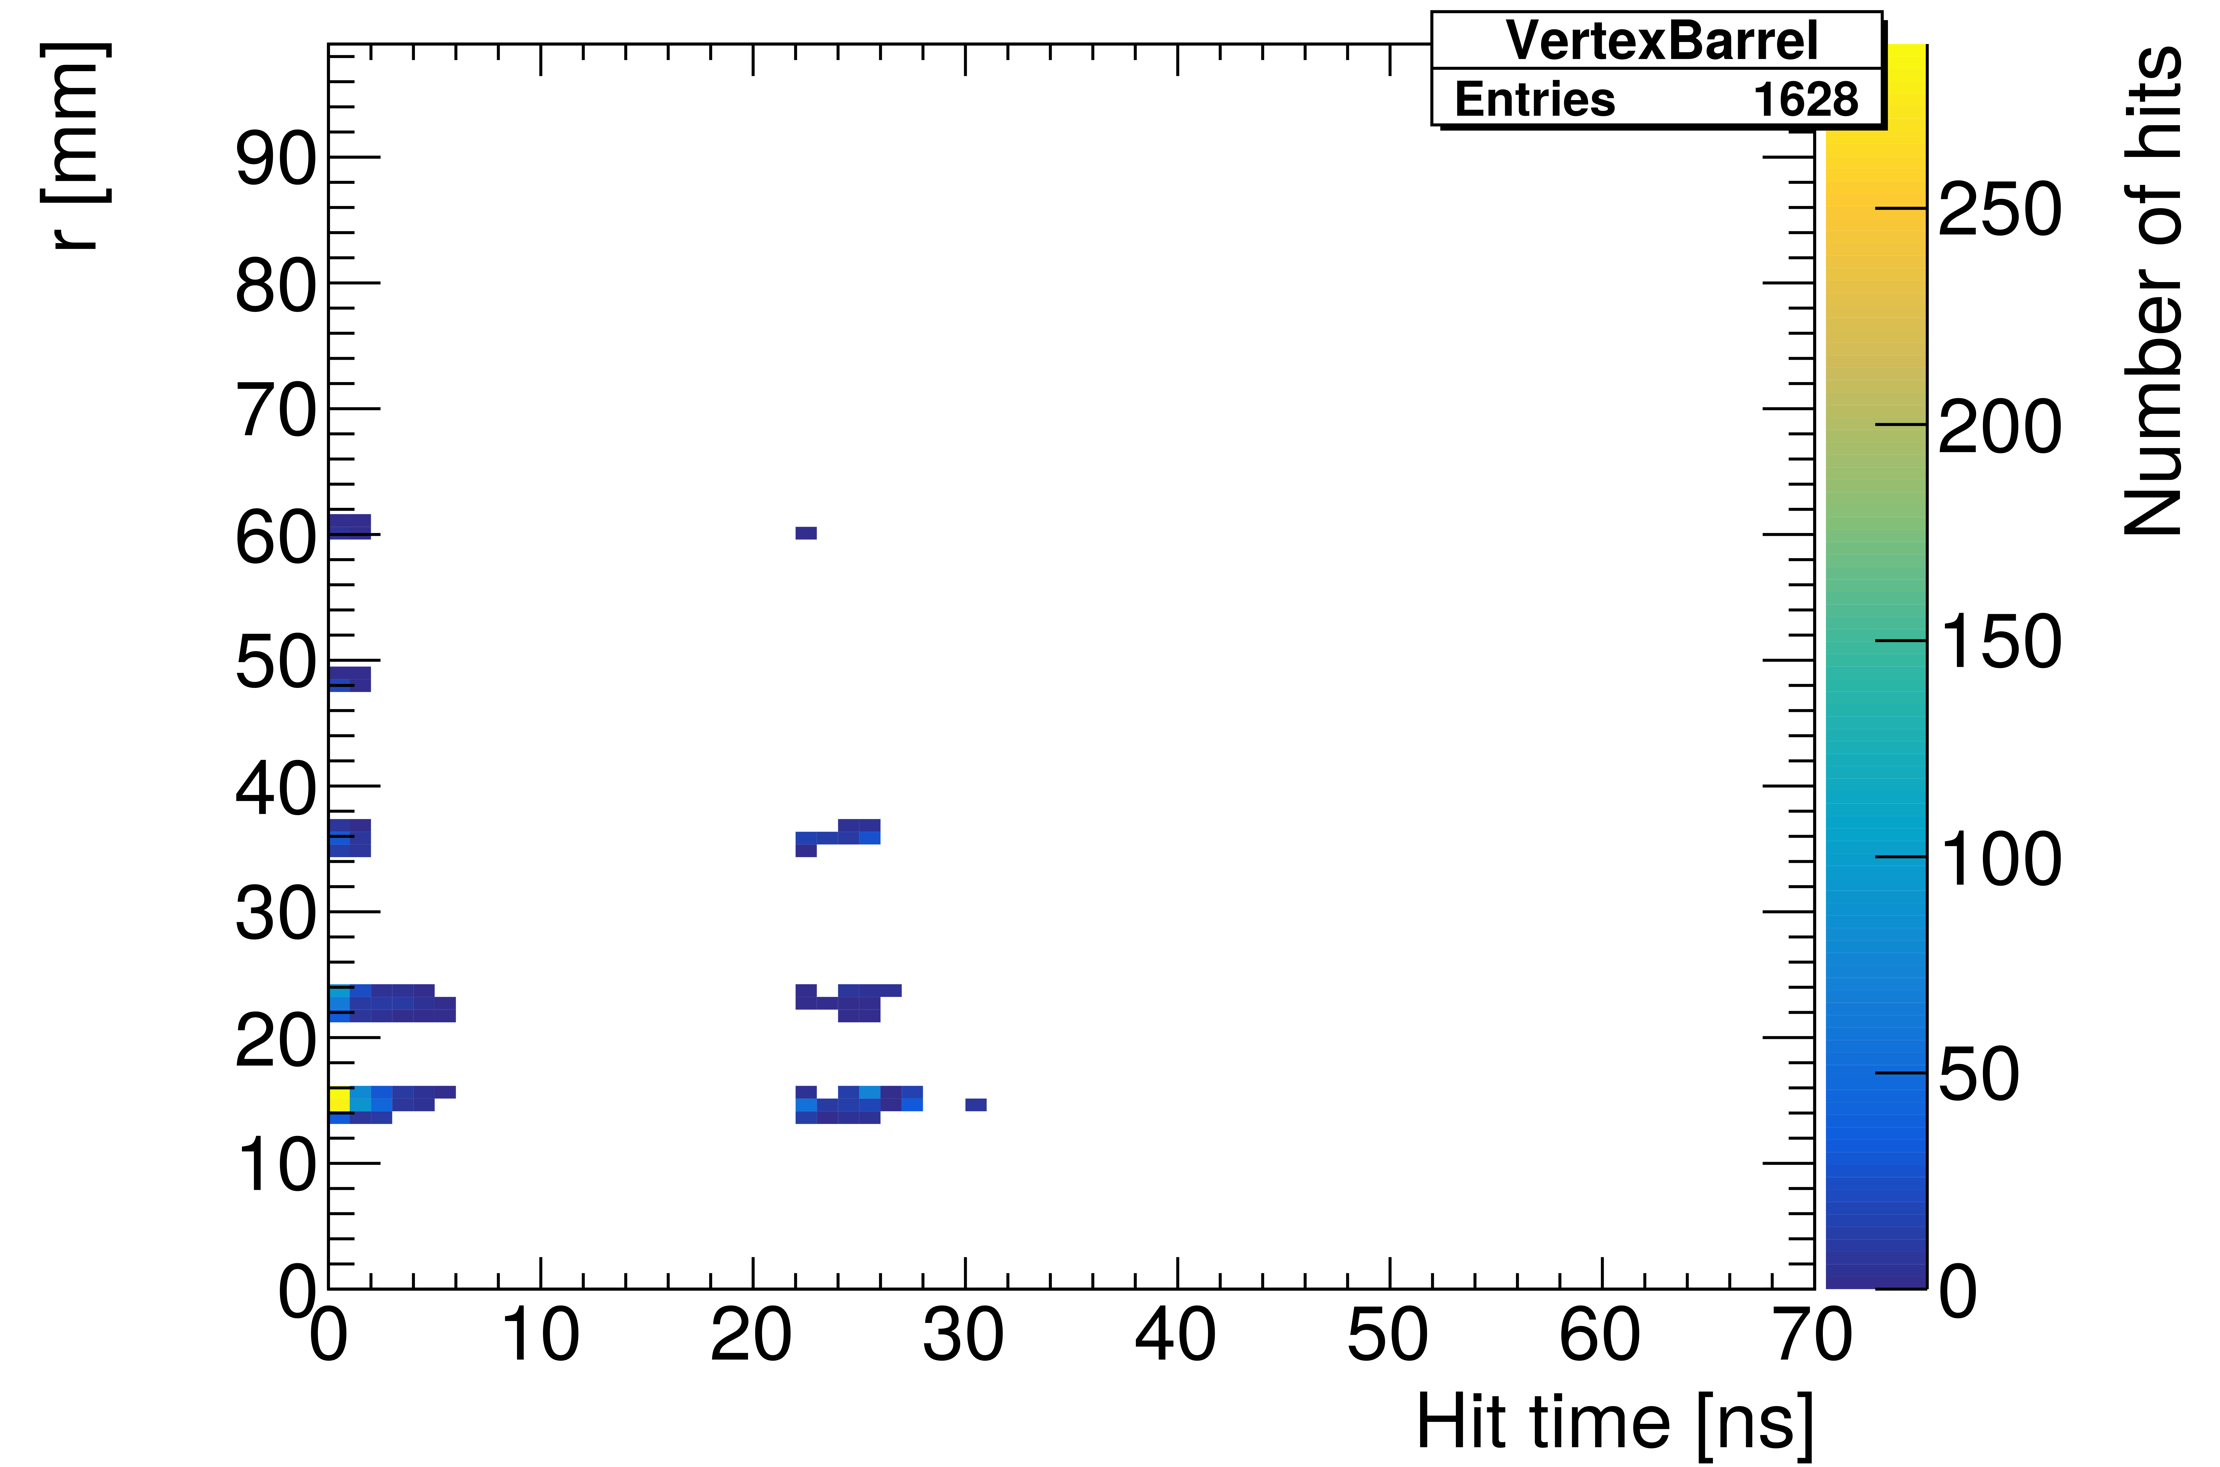
The International Linear Collider e⁺e⁻ pair background
From the pair background timing study:
Pair background particles originate from the IP & backscatter off the forward detectors
→ Backscatter particles arrive later
→ Time gate: reject all hits later than 10 ns after the bunch crossing!

