Slide 1

Aiolos – A multi-purpose RHD code
M. Schulik & R. Booth

Slide 2
Aiolos – A multi-purpose RHD code
Why another code?
Why hydrodynamic: Complex, multi-species physics with radiation might give static methods challenges to find solutions
Why finite volumes: Supersonic phenomena can lead to trouble with finite differences
Why well-balancing: Deep gravity wells can be stabilized, intermediate-mass planets (MNeptunes / SEarths) have their atmospheres accelerated deep in their potentials, need to get this region right
M. Schulik & R. Booth

Slide 3
Aiolos – A multi-purpose RHD code
Why dynamic? → Shooting/relaxation methods might have trouble with a lot of physics added
Not limited to Wind problems: Find static temperature solution, let a giant planet accrete gas, ...

Slide 4
Physics included
Multi-species hydrodynamics: A separate set of Euler equations per species, solved with FV method, HLLC solver for gas, DUST for dust
Gravity well-balanced with FV pressure gradients
Species coupled via friction
Multi-band radiation transport
Photochemistry
Dust growth

Slide 5
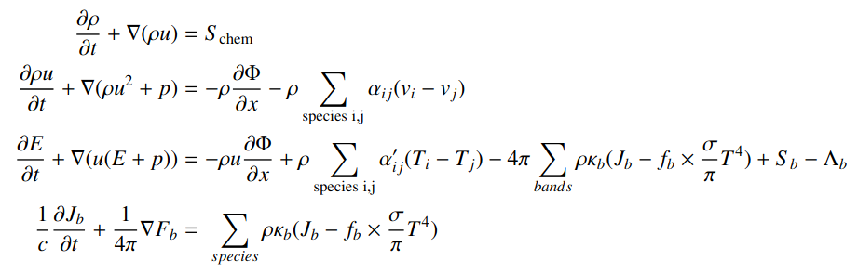
Physics included
Equations to be solved:
i.e. Standard Euler equations, augmented with
(some) photochemistry, gravity, friction and radiation transport.

Slide 6
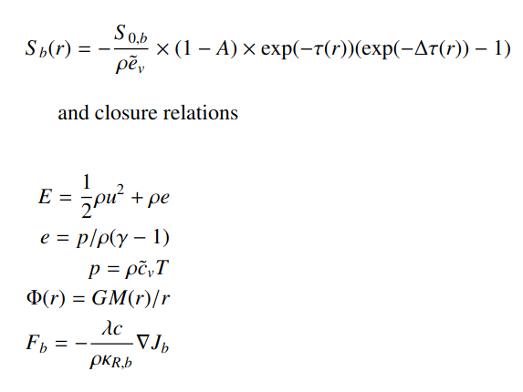
Physics included
Equations to be solved:
Standard relations for closure:

Slide 7
Physics included
Equations to be solved:
Potential overlap in cooling functions between Λ and J-S term?

Slide 8
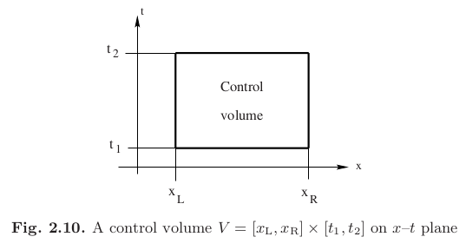

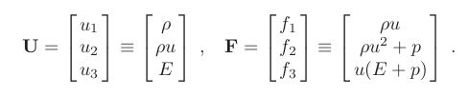
Finite Volumes
Operator-split for advection vs. sources.
Conservation equations can be solved in a Finite Volume framework, giving exact conservation to machine precision and vastly improved stability@shocks (still has to obey CFL though)
(Many equations and images from Toro, Riemann solvers and numerical methods for Fluid Dynamics)

Slide 9
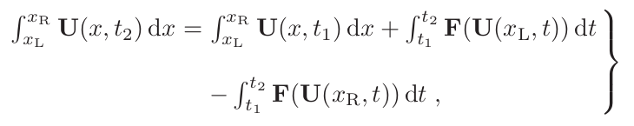
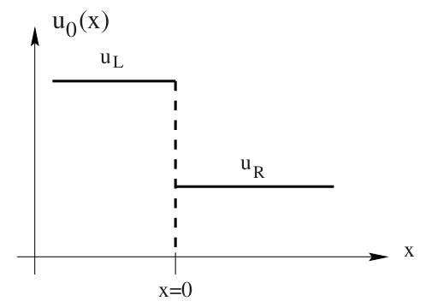
Finite Volumes
Steps to construct a FV scheme, a.k.a ‘Godunov’s method’:
1. Define dx-integral as new FV variable
2. Find intermediate state between uL and uR, usually done in Eigenspace
3. \int dt F = Δt F^{N}(uL,uR,t0)
4. Find ‘good’ approximation F^{N}(uL,uR,t)
5. Godunov says: F^{N}(uL,uR,t) = F^{analytic}(u*,t)

Slide 10
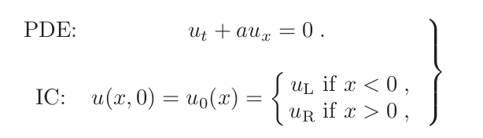
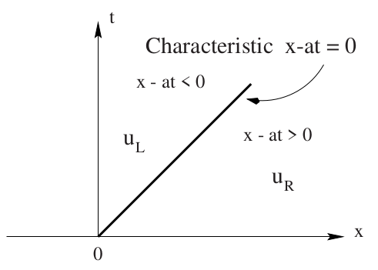
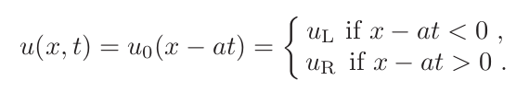
Finite Volumes – Characteristics
The simple system
Has an analytic solution
No intermediate state as only one characteristic exists

Slide 11
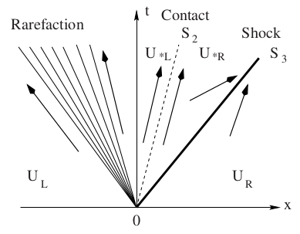
Finite Volumes – Charachteristics
With more complex systems, such as the Euler equations...

Slide 12
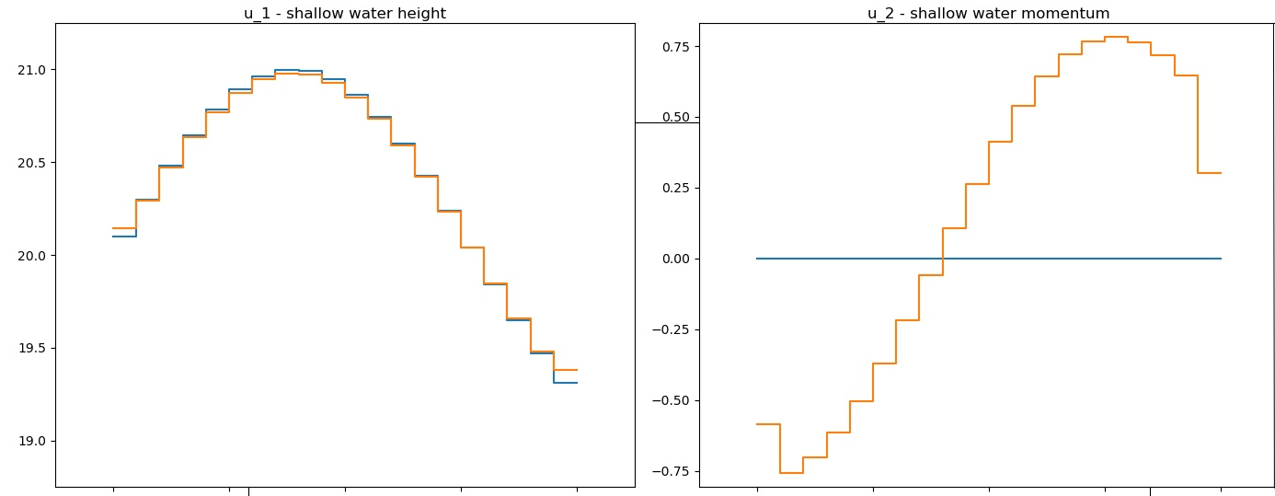
Hydrodynamics – Finite Volumes
Finite Volumes: Weak solutions but powerful method
Instead of fighting with discontinuities – make everything a discontinuity
Two ingredients: A Riemann solver and Godunov’s method
All variables co-located at cell centers, only fluxes at cell edges

Slide 13

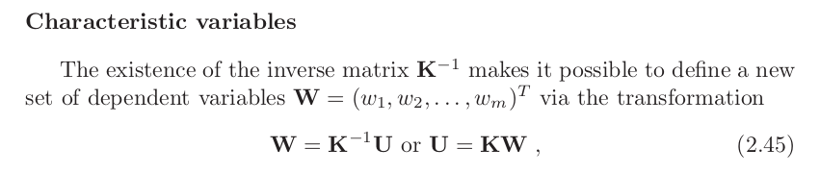
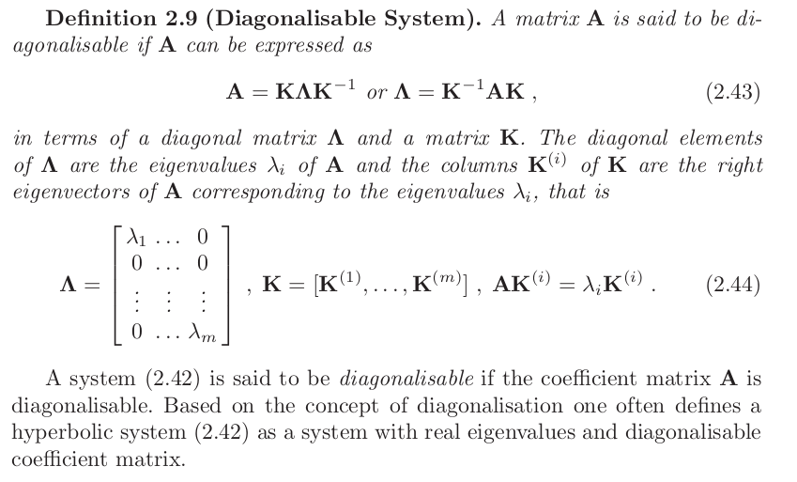
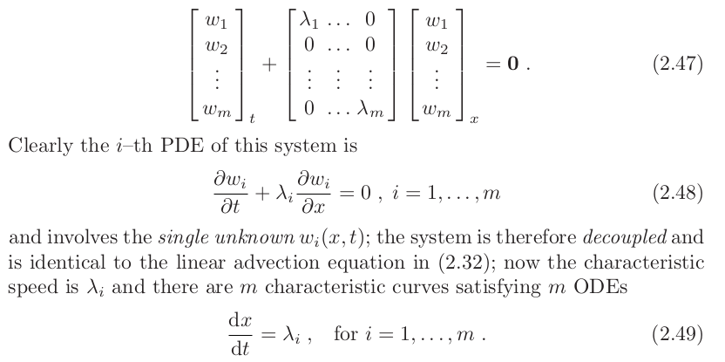
Finite Volumes - extended

Slide 14
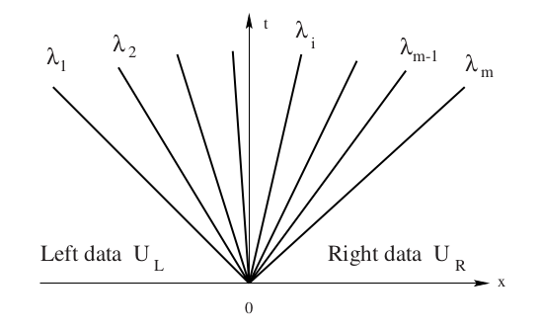
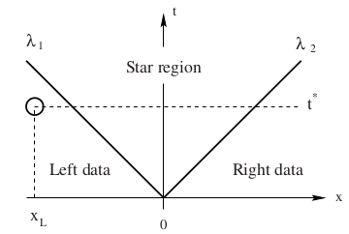

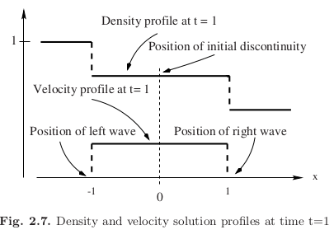
Finite Volumes – Extended

Slide 15
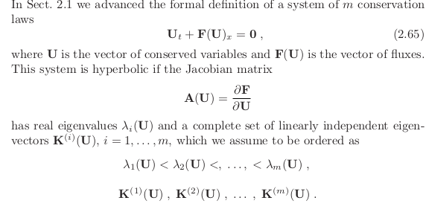
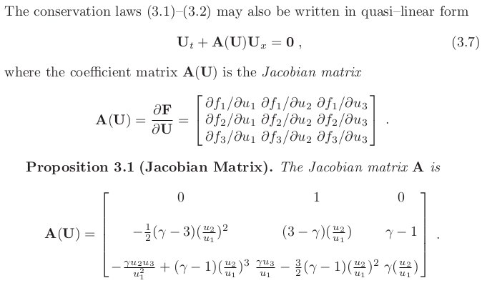
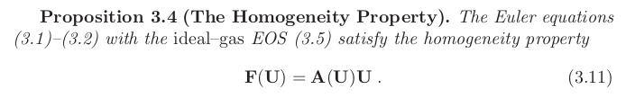
Finite Volumes – The Euler equations

Slide 16
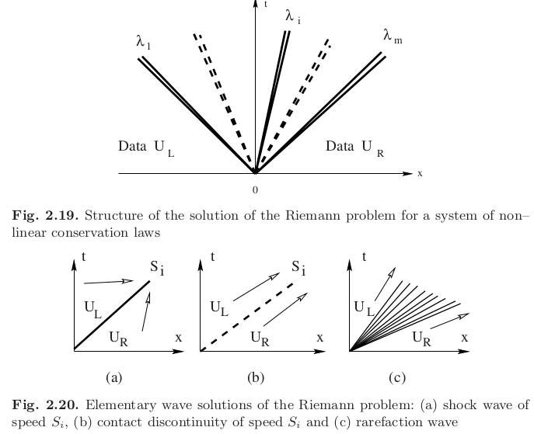
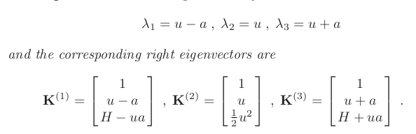
Finite Volumes – The Euler system

Slide 17
Hydrodynamics – Finite Volumes
Euler system: 3 fundamental solutions to discontinuities:
Shock, rarefaction, contact wave
Their correct representation by the Riemann-solver is important for several physical phenomena we are interested in:
* Hydrodynamic escape: Sonic rarefaction
* Hydrostatic atmosphere: Contact waves
...

Slide 18
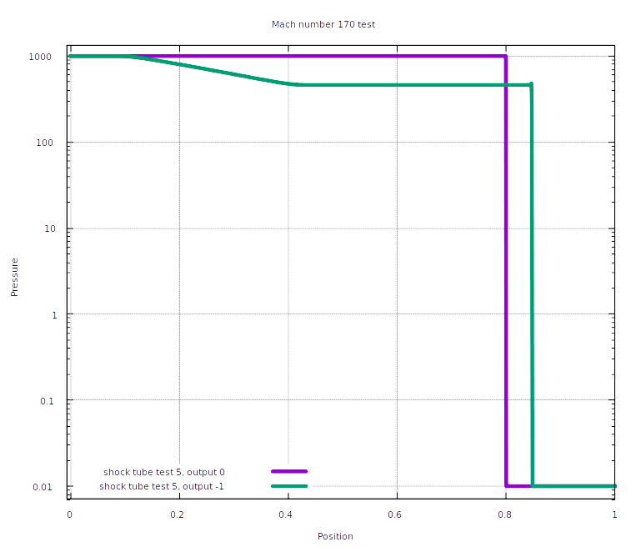
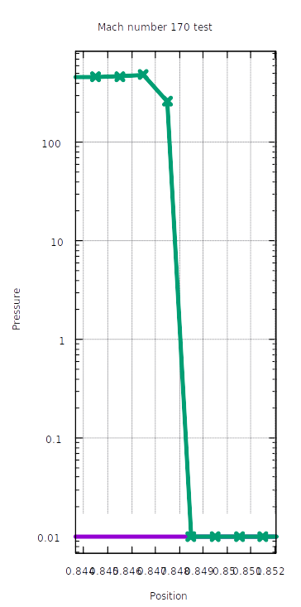
Hydrodynamics – HLLC Shock test
Strong shock ‘surface’ preserved at high Mach number in our shock tube

Slide 19
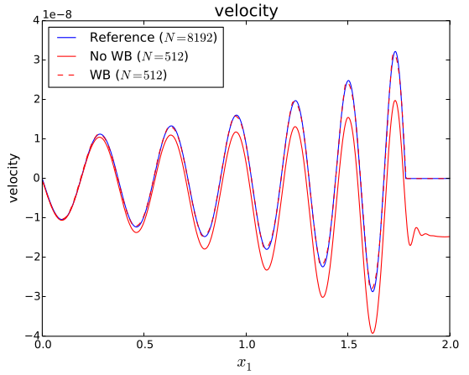
Well-balancing: Motivation
* Generally, letting a hydrodynamic simulation return to a previous hydrostatic state is nontrivial
* Particularly operator-splits are vulnerable to this
From Käppeli&Mishra(2016):
Without well-balancing a passing wave in a G-field leaves a non-zero background state

Slide 20
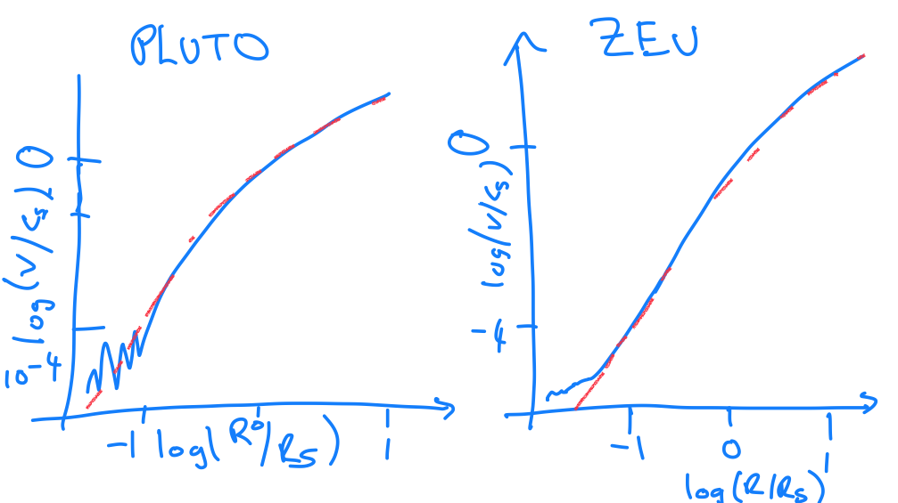
Well-balancing: Motivation
(c) J. Owen

Slide 21



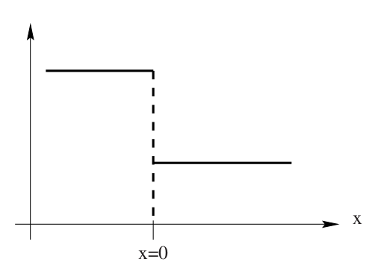
Well-balancing gravity
Assure numerical flux function can correctly solve stationary contact waves, i.e.
Step 1:
FV update with source
Numerical flux function
pL
pR

Slide 22
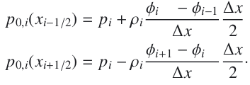
Well-balancing gravity
Step 2:
Choose an adequate extrapolation for an interface-pressure
And hand it to the Riemann solver
pL
And a standard 2nd order gravitational source function
pi-1(+)
pi(-)
pR

Slide 23
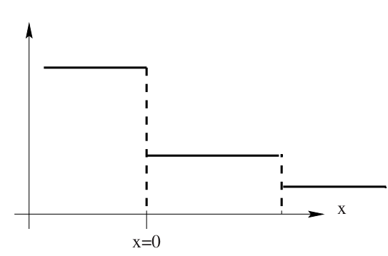
Well-balancing gravity
Step 3:
For pi that fulfill the hydrostatic condition, now dF+S=0
pi-1
Doing this via the contact wave is smart, pi are not changed, extrapolation merely ‘informs’ solver when it’s supposed to be hydrostatic.
pi
pi+1
pi(-)

Slide 24
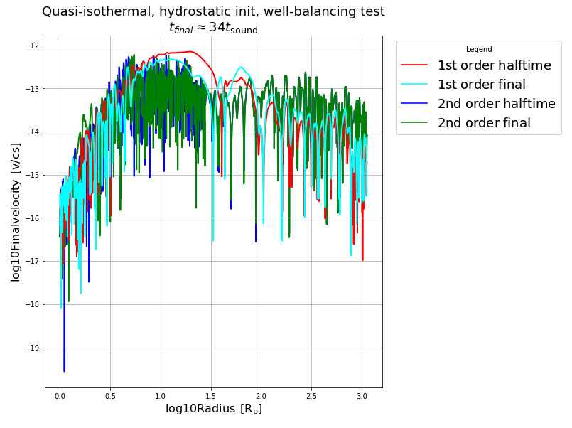
Remaining hydrostatic
* Initializing a hydrostatic density profile for T=const=10.000 K, γad=1.01
and v=0 everywhere
* Check if well-balancing keeps velocity small

Slide 25
Well-balanced winds
* Now, after checking the v=0 preservation, we can try to launch winds via several methods:
1.) A step function in density (clearly not hydrostatic)
2.) A tidal potential
3.) Irradiation

Slide 26
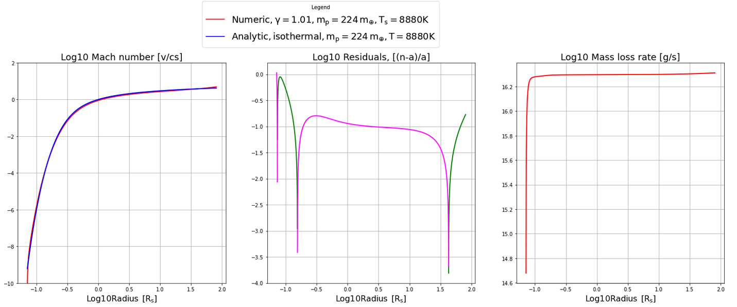
Winds – Launch via step function

Slide 27
Winds – Launch via step function
Residuals originate in imperfect isothermality
T_init = 10000 K
T_sonic = 8880 K

Slide 28
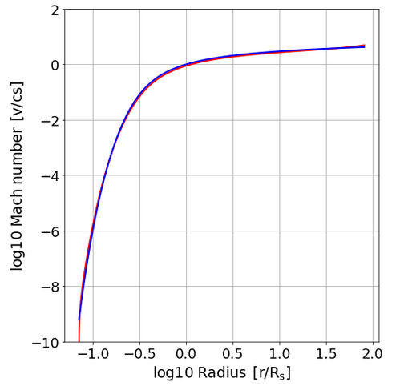
Well-balancing gravity
AIOLOS

Slide 29
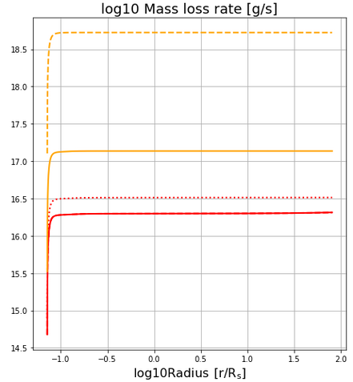
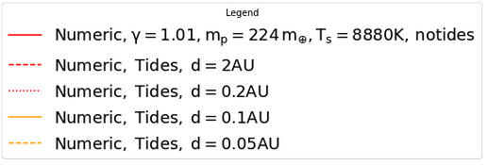
Tides and boil-off
* Quasi-isothermal atmospheres connected to their parent discs have enormous escape rates
* Might be an issue of compactifying them first, before they reach close-in distances to the star

Slide 30
Beyond prescribed isothermality
* Using γad=1.01 mimicks an isothermal gas
* Real gases have γad= 1.1 – 1.67
* Need solar thermal/XUV heating + radiation transport to compensate adiabatic cooling
Two example scenarios of physical interest for γad>1 :
* Compact, evolved atmospheres, deep in their potentials → can launch wind
* Protoplanet, shrouded with gas, difficult to jumpstart wind

Slide 31
Atmospheric temperature structures
Generic I: Guillot, influence of y on temperature inversion

Slide 32
Atmospheric temperature structures
Generic I: Guillot, influence of y on temperature inversion
Physically: (Show freedman+2014 plots) kp(Tsolar) is not the same as kR(Tgas)
This is how we physically get y > 1, otherwise no temperature inversion

Slide 33
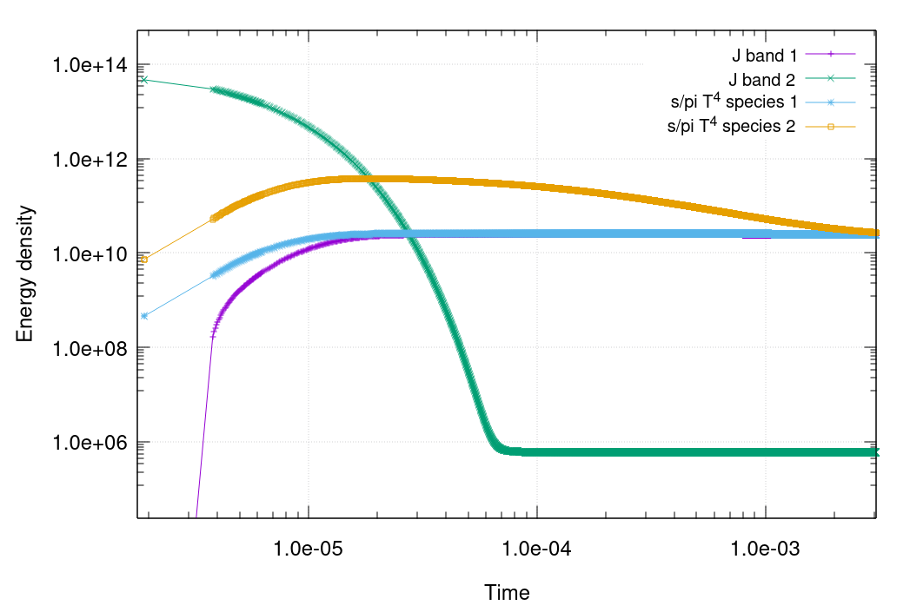
Radiation transport
Implicit schemes by Commercon+(2011) and Bitsch+(2013) with some inspiration by Vaytet+(2011) used to solve for multi-Temperatures and multi-bands.
Flux limiter for system closure.
Example 2-species, 2-band hydrostatic atmosphere attaining thermodynamic equilibrium

Slide 34
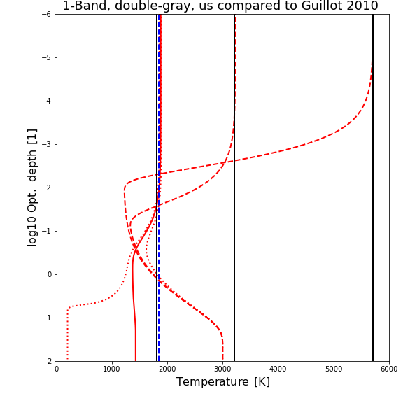
Atmospheric temperature structures
Resulting first static atmospheric structures (static because hydro module switched off):
Temperature achieved comes from
Tthermo = Trad x (κP(Tgas) / κP(Tstar))^{1/4} ,
like a dust particle

Slide 35
Atmospheric temperature structures
Temperature achieved comes from k_p(Tgas)/k_p(T_star)
But is this temperature actually sensible / the temperature of real atmospheres?
Fake Venus: A 1-band Double-gray Venus with Albedo =0.75

Slide 36
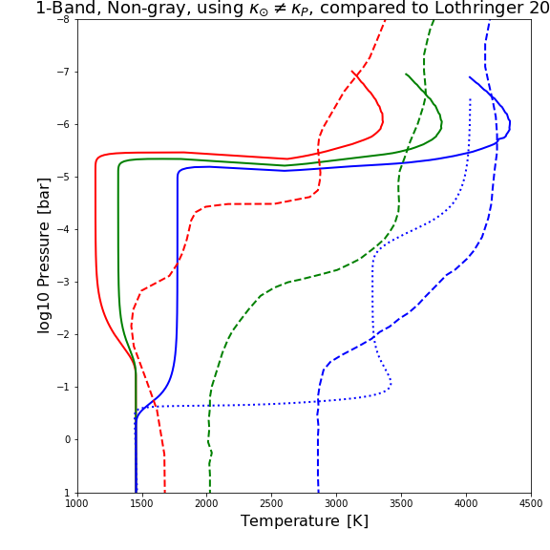
Atmospheric temperature structures
Lothringer+(2018) Irradiated HJ, full spectrum, i.e. the real deal
vs. our atmosphere with complex, tabulated opacities Malygin+(2014) and Freedman+(2014)
Improve plot!

Slide 37
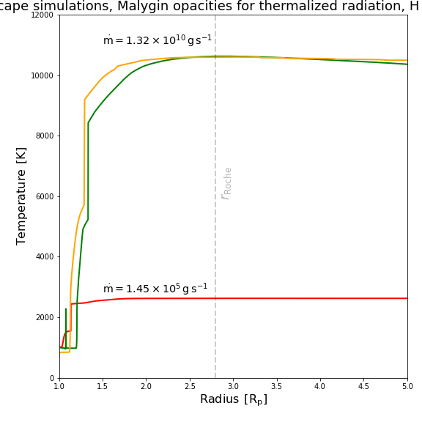
(Nearly) Full winds
Steady-state solutions with 3 bands, but no photochemistry or high-energy cooling
FUV = 10⁴ erg/cm²/s @ y=10⁵, FX= 10⁴ erg/cm²/s @ y=10⁷
Comparable result to Murray-Clay+(2009) although missing physics
is no suprise, as there, pdV cooling dominates, as it does here

Slide 38
Multi-species: Friction coupling
Using Benitez-Llambay(2019) scheme:
Implicit solution of coupled friction, with total momentum conservation (default) and total energy conservation (Work by from Richard)

Slide 39
2-species winds
First: Adiabatic only case

Slide 40
2-species winds
Second: Full case (you have to think about what radiative parameters to give to the other species...)

Slide 41
Photochemistry
Full photochemical model

Slide 42
Caveats
Dust-free atmospheres so far...

Slide 43
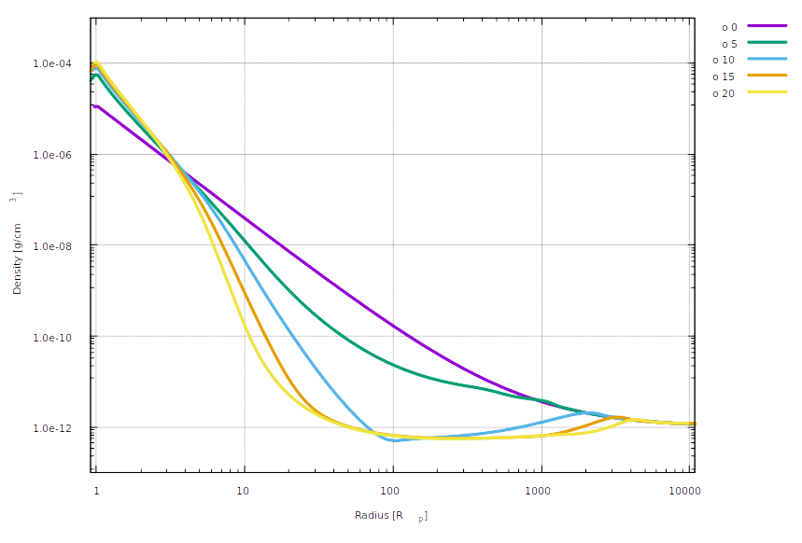
Failed winds
* Accreting solutions
* Contracting planet
* Evaporating a part of the upper atmosphere
Example of a low-mass atmosphere (10^-10 m_e at 0.1 m_e core)

