Slide 1
Oakland university Hockey Database
CSI 3450 Final Project

Slide 2
Problem Statement
We need to keep track of the Oakland University (OU) Ice Hockey teams overall record, as well as individual player records. We would like to know statistics and information about each skater, goalie, and staff. We also want to track and manage regular season record, playoff record, sponsors, and arena locations.

Slide 3
Use Case
We are developing this database for the athletes, fans, and family to keep track of the statistics for the Oakland Hockey team.
We have identified a need for this application since there is not a current solution for this.
Our solution allows admins to create and modify entries to keep up with the current stats of the teams, while allowing the users to view the information in an organized and intuitive way.

Slide 4
System Requirements
The scope of this system is the 2019-20 OU hockey team. This system will keep track of statistics for the team as well as the individual players. This system will not keep stats on other teams in the league, for this is only for OU use.
This system will be designed for administrators to be able add/edit/delete the stats of any player, as well as the overall team stats. It is also designed for regular users to view these stats. This project has the capability of expanding into years past and present. However, with no accurate data from Oakland University or the American Collegiate Hockey Association (ACHA), we were only able to do the most recent season in 2019-20.

Slide 5
System Capabilities
The architecture of our application is a web-based database for Oakland’s D1 ACHA Hockey Team. We want our end users to be able to find information of the 2019-20 OU hockey team and view the statistics of the team and individuals that made up that year’s roster. We also want users to be able to create/read/update/delete information on the database by using the website.
The GUI of the application is web based. A big home button on the top, a navbar below, a page header below that, the data for the page below that, and the create/edit/delete links below that. After successfully using a create/edit/delete link, user will have to return to the original page and refresh to see the results in the table.

Slide 6
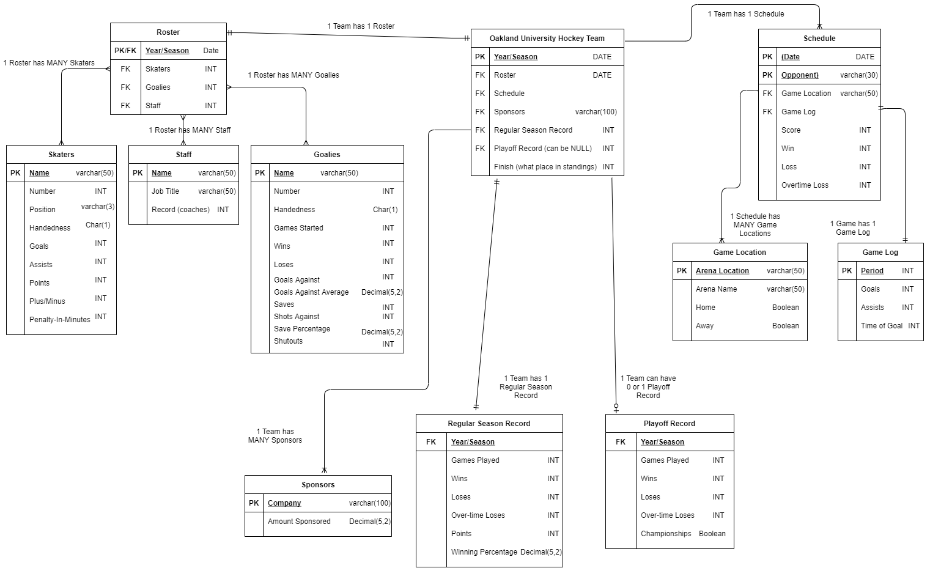
Entity-RelationShip Diagram

Slide 7
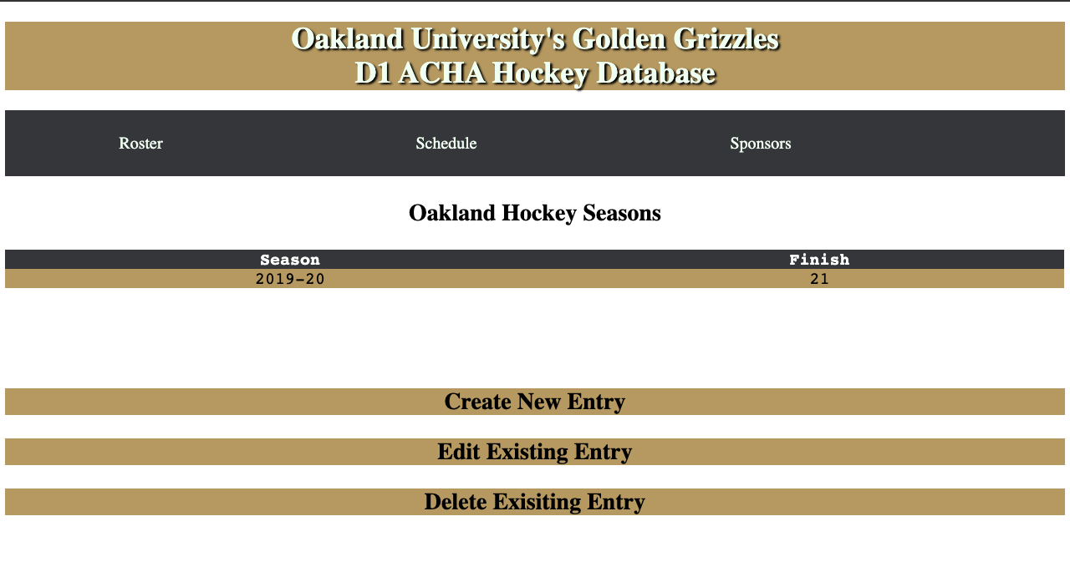
Main index

Slide 8
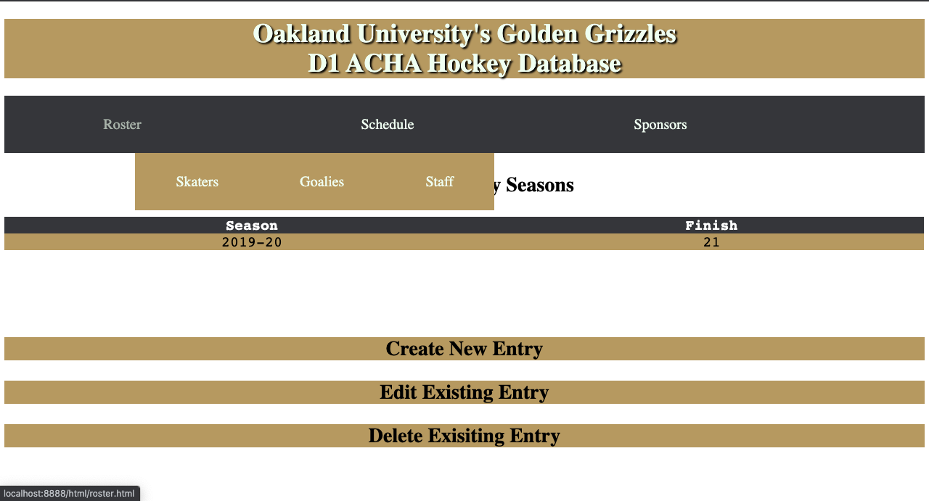
roster submenu

Slide 9
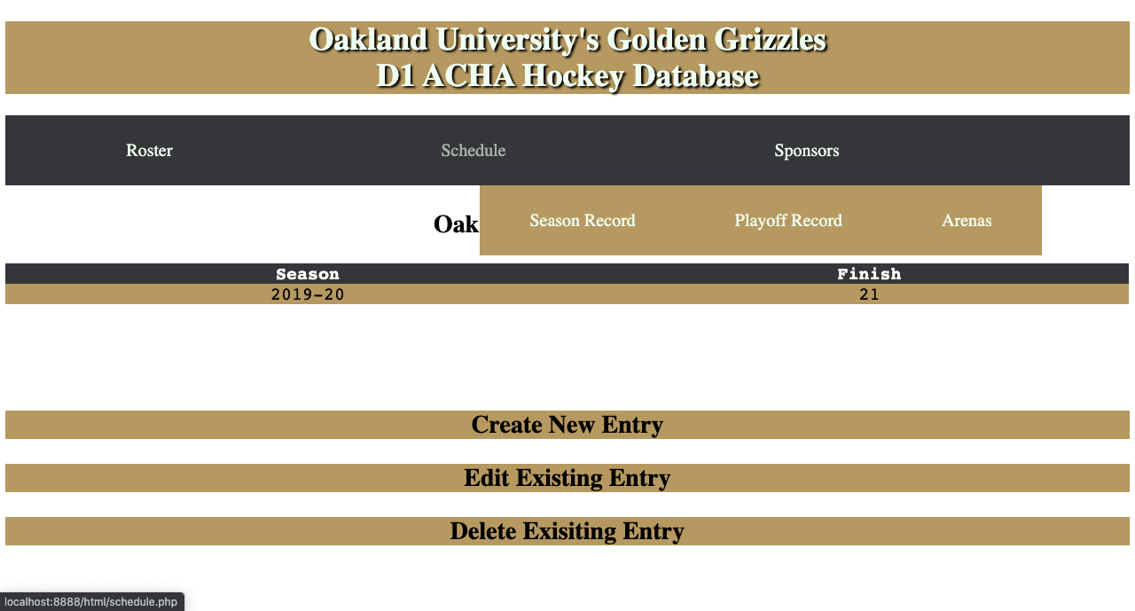
Schedule submenu

Slide 10
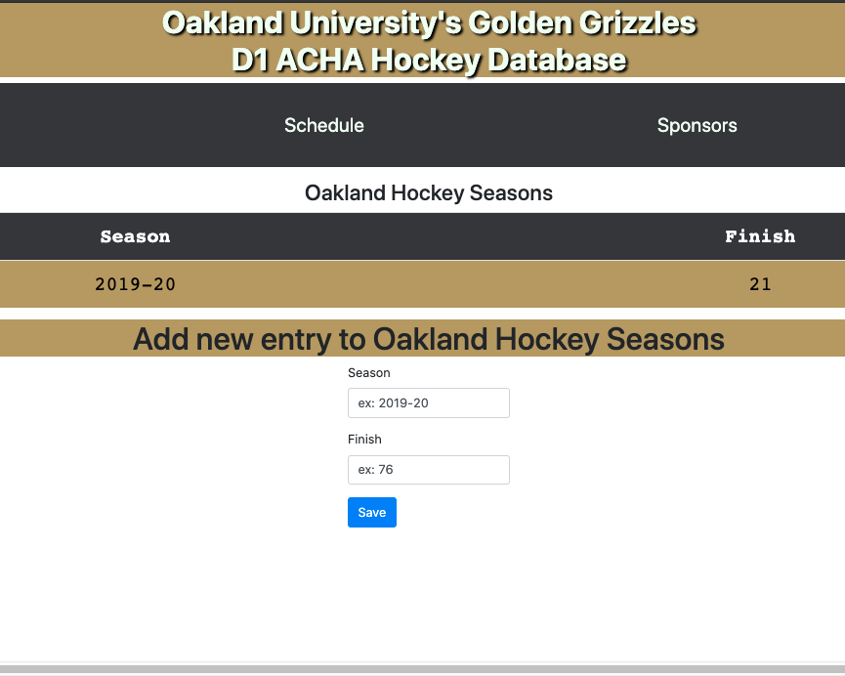
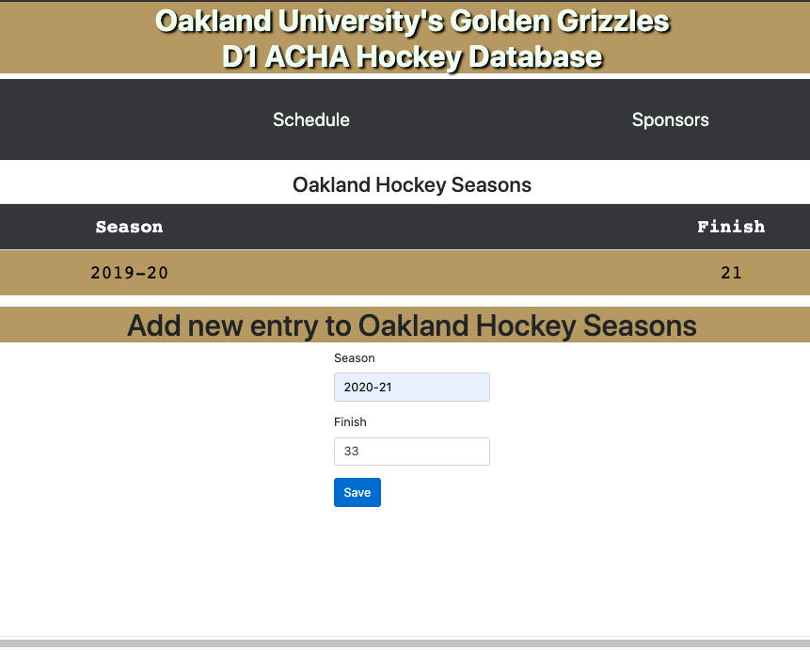
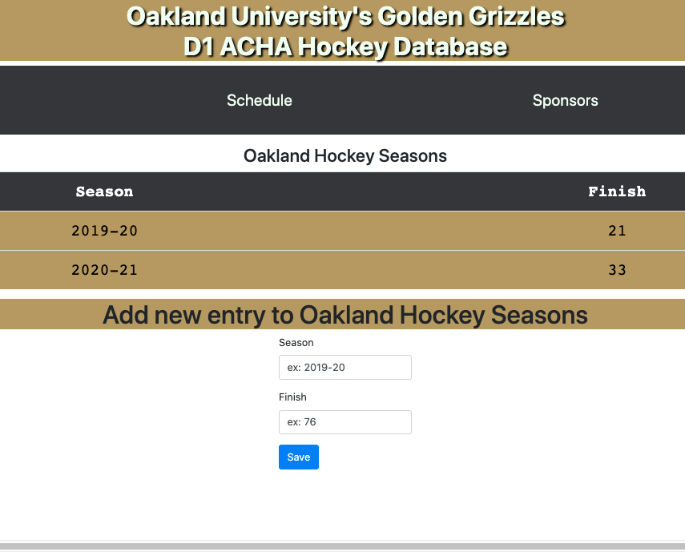
Entry Creation

Slide 11
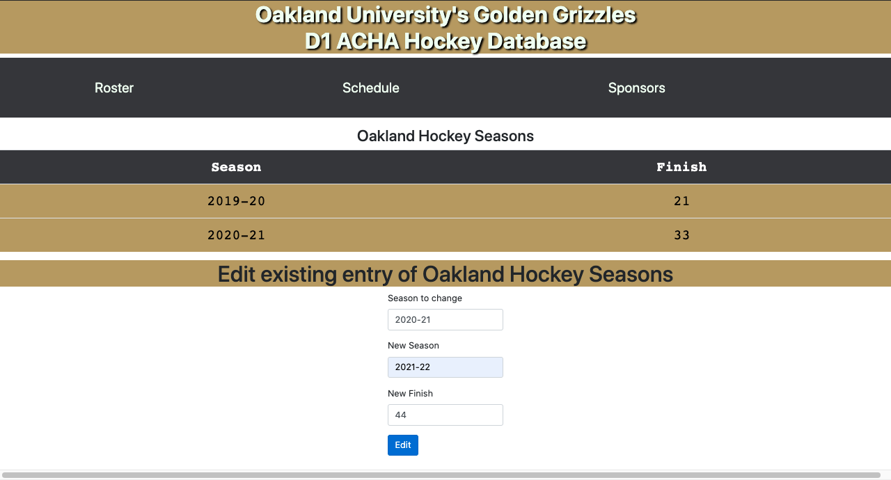


Entry Manipulation

Slide 12
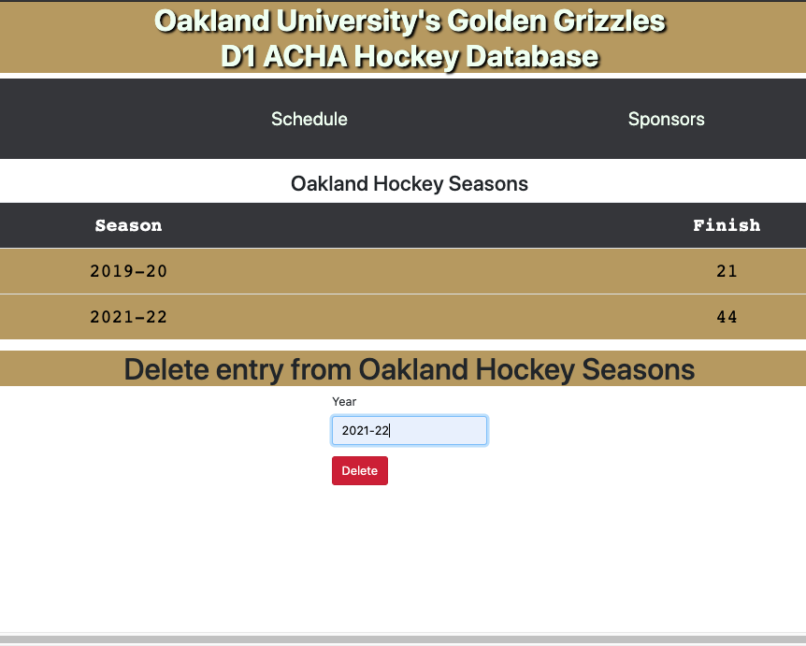
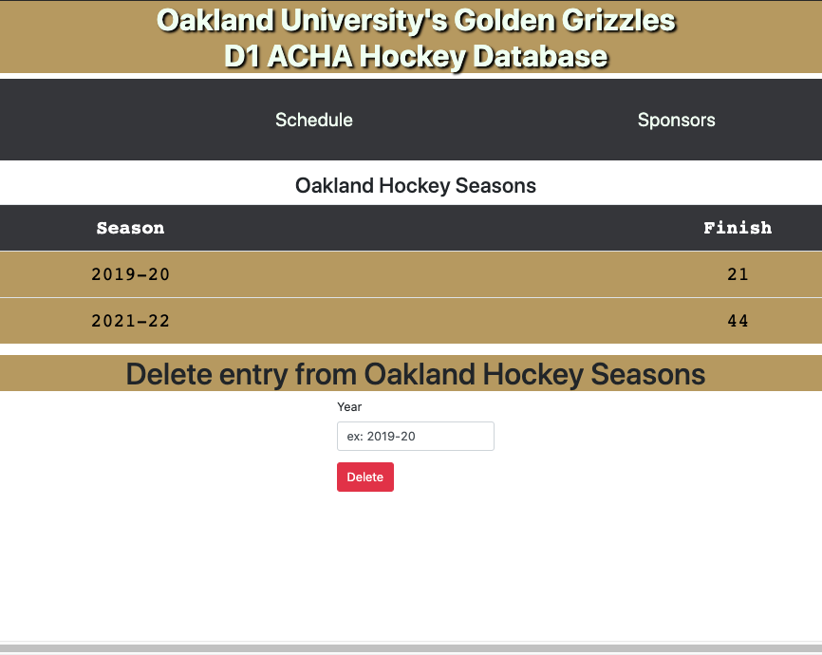
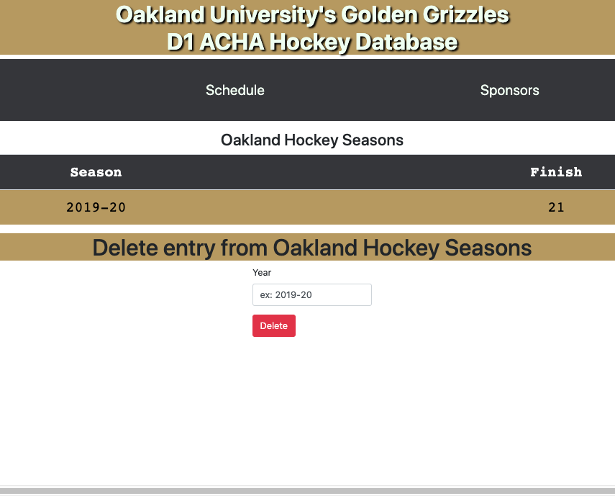
Entry Deletion

Slide 13
Design & Architecture
Half of our application is utilizing MySQL to host the information in a structure that is easy to manage and pull from.
The other half of our application is split between HTML and PHP to hand the front end. We decided to HTML and PHP to provide a user-friendly experience without having to download anything or go through any unnecessary steps to get the information that they are looking for.
We are also using MacOS Apache MySQL & PHP (MAMP) to host this locally.

Slide 14
What we learned
Throughout this project we learned how to integrate MySQL on an Apache webserver through PHP, as well as executing SQL commands through PHP code which built most of our UI and utilizes the initiation of the SQL database to present the tables in a more readable and organized fashion.
We also learned how to utilize HTML forms to take user input and translate it to PHP scripts that executed our SQL commands. We used this in features such as our Create, Edit, and Delete functions shown in the images and demo.

Slide 15
Demo & conclusion
We have created this to set a new standard for OU to use and build off in the future.
We hope that this is something that can be implemented in the future to help both the athletes and fans keep track of all the statistics associated with the club.
We are open to questions for the next 2 minutes.

