Slide 1


Project Title :Full Stack Development (E-Commerce Platform)
 | Nitte Meenakshi Institute of Technology (AN AUTONOMOUS INSTITUTION AFFILIATED TO VISVESVARAYA TECHNOLOGICAL UNIVERSITY, BELGAUM) PB No. 6429, Yelahanka, Bangalore 560-064, Karnataka Telephone: 080- 22167800, 22167860, Fax: 080 - 22167805
Department of Computer Science and Engineering
Presentation By:
Sudeep H M
1NT21CS178
Company Name : Cognizant

Slide 2
Introduction
This presentation outlines the Low-Level Design (LLD) for an E-Commerce Platform that allows users to browse products, manage shopping carts, make payments, and track orders. The platform includes an admin interface to manage products, orders, users, and analytics.

Slide 3
Background
The e-commerce industry has seen exponential growth in recent years, driven by the convenience of online shopping and advancements in technology. This project aims to develop a robust e-commerce platform that caters to the needs of both customers and administrators.

Slide 4
Problem Statement
The current e-commerce solutions often lack comprehensive features for product management, order tracking, and user authentication. There is a need for a platform that integrates these functionalities seamlessly while providing a user-friendly interface.

Slide 5
Scope of the Work
The scope of this project includes the development of modules for product management, shopping cart, order management, user authentication and profile management, and an admin dashboard. The platform will be built using ASP.NET Core for backend development and Angular or React for frontend development.

Slide 6
Objectives of the Work
The main objectives of this project are:
1. To develop a user-friendly e-commerce platform.
2. To implement secure user authentication and profile management.
3. To provide comprehensive product management features.
4. To enable efficient shopping cart and order management.
5. To create an admin dashboard for managing users, products, and viewing analytics.

Slide 7
System Requirements
The system requirements for this project include:
1. Frontend: Angular or React
2. Backend: ASP.NET Core
3. Database: MySQL/PostgreSQL/SQL Server
4. Development Environment: Visual Studio
5. Hosting: IIS or Azure

Slide 8
Design
The design of the e-commerce platform includes the following modules:
1. Product Management
2. Shopping Cart
3. Order Management
4. User Authentication and Profile Management
5. Admin Dashboard
Each module will have its own set of features and data flow.

Slide 9
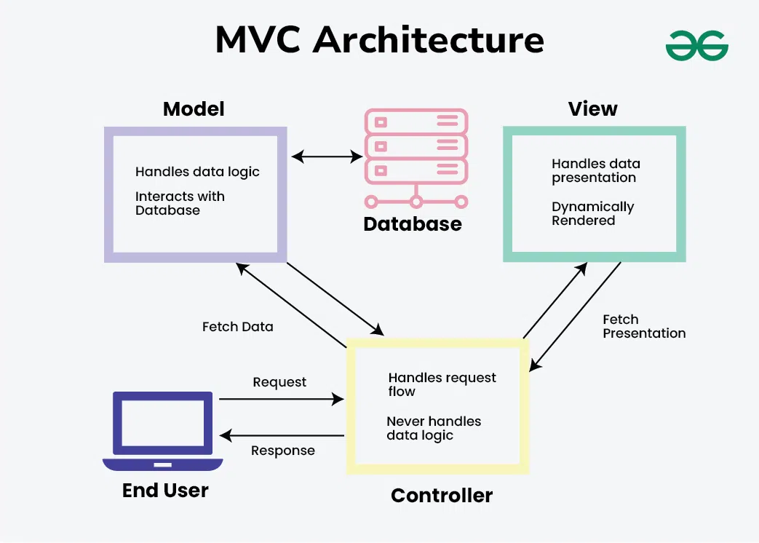
Design
The design of the e-commerce platform includes the following modules:
1. Product Management
2. Shopping Cart
3. Order Management
4. User Authentication and Profile Management
5. Admin Dashboard
Each module will have its own set of features and data flow.

Slide 10
Implementation
The implementation of the e-commerce platform will be carried out in phases:
1. Setting up the development environment.
2. Developing the backend using ASP.NET Core.
3. Creating the frontend using Angular or React.
4. Integrating the modules and testing.
5. Deploying the platform on IIS or Azure.

Slide 11
References
1. ASP.NET Core Documentation
2. Angular Documentation
3. React Documentation
4. MySQL Documentation
5. PostgreSQL Documentation
6. SQL Server Documentation

