Slide 1

CPT204 Final Project
Ataxx
Group 64
Yuyi Yang, Yilin Yang, Yilin Cao

Slide 2
Catalogue
OOP
AI algorithm
GUI

Slide 3
OOP
Object-Oriented Programming

Slide 4
Part A.1.1 - getColorNums()
Good data hiding and encapsulation :
PieceState[] ataxxBoard
Call method:
PieceState getContent()

Slide 5
Part A.1.2 – setBlock()
Good data hiding and encapsulation :
private void announce()
Control structure：
switch case

Slide 6
Part A.1.3 – isClone() & isJump()
High Indepedence
Can be called in private method move()

Slide 7
Part A.1.4 – getWinner()
Call method:
boolean couldMove()
getColorNums()
getConsecJumpNums()

Slide 8
AI algorithm
Min-max Algorithm
α-β Pruning

Slide 9
Part A.2.1
Good Data Hiding and Encapsulation :
private Move lastFoundMove
Many variavles and methods called contained in enumeration :
PieceState

Slide 10
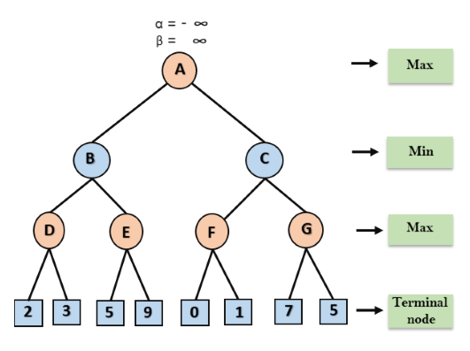
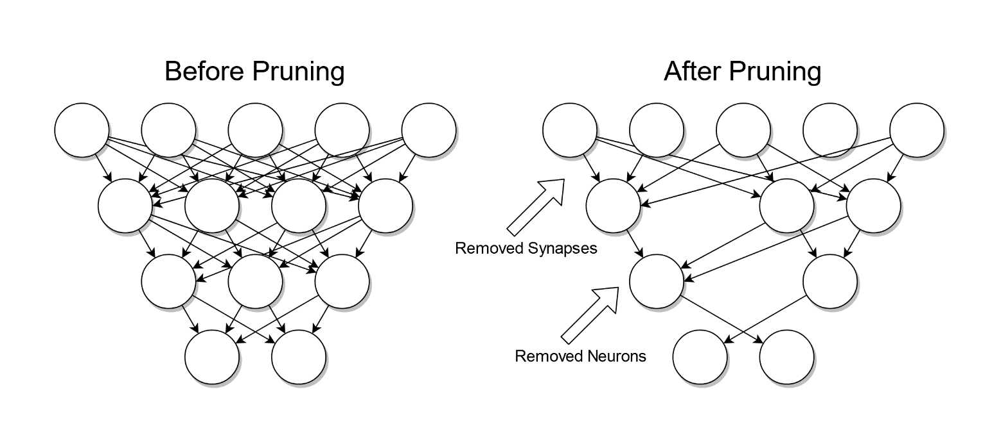
Part A.2.2
This part aims to introduce the min-max algorithm for the AI players in the game.
Create a method called minMax().
We use AlphaBeta pruning algorithm to optimize min-max by reducing useless calculating.

Slide 11
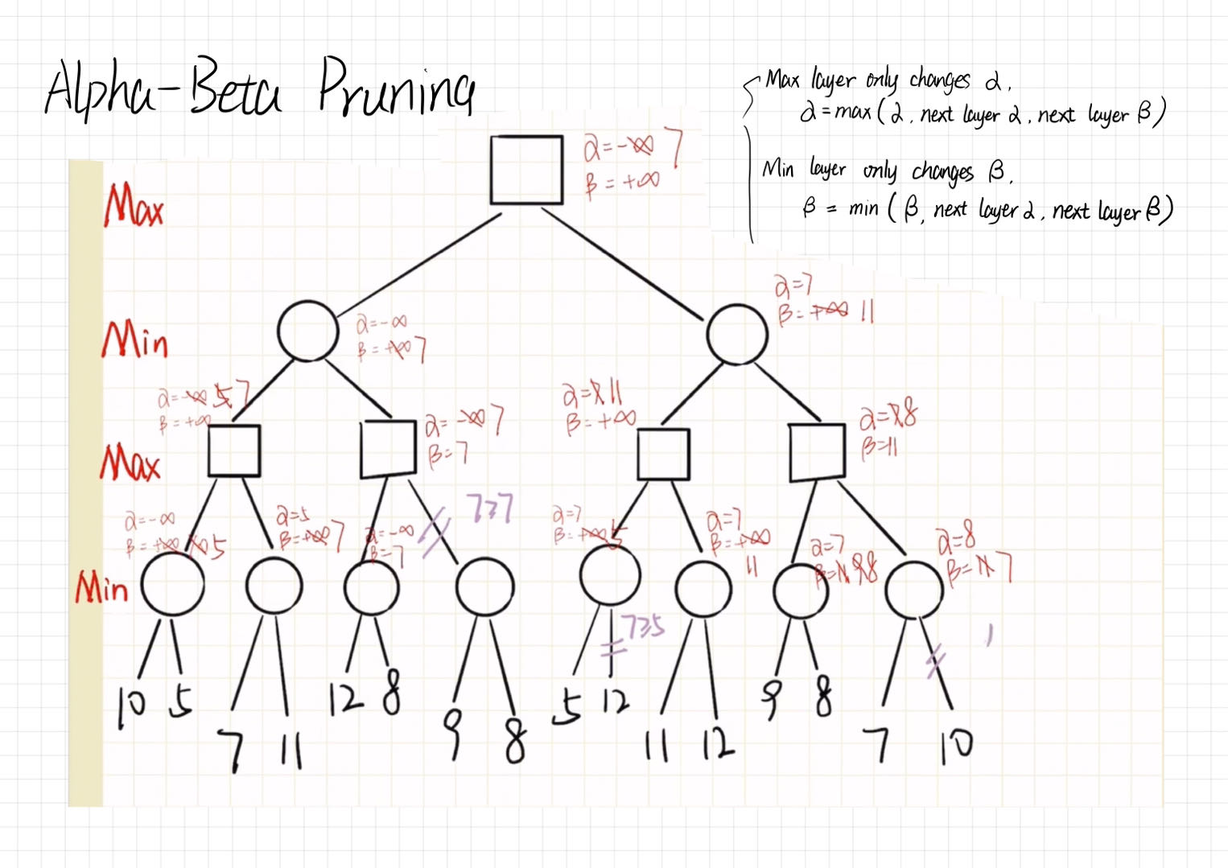
Part A.2.2
Alpha-Beta Pruning algorithm optimizes the min-max algorithm by deleting branches for which results have been determined :
Based on the previous best case.
Reduce unnecessary calculations to improve search efficiency.

Slide 12
Part A.2.2
AlphaBeta pruning algorithm optimizes the min-max algorithm by deleting branches for which results have been determined :
Based on the previous best case.
Reduce unnecessary calculations to improve search efficiency.

Slide 14
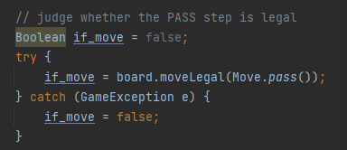
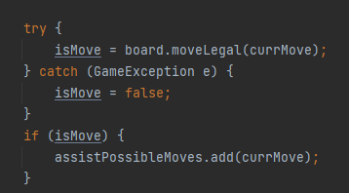
Part A.2.3
Extra error handling in method :
assistPossibleMoves()
Use try-catch to avoid infinite loop of error of “Could not move”

Slide 15
Let’s see the Ataxx

