Slide 1

Generative Pre-Training LM Ver. 1 & 2
https://zhuanlan.zhihu.com/p/350017443

Slide 2
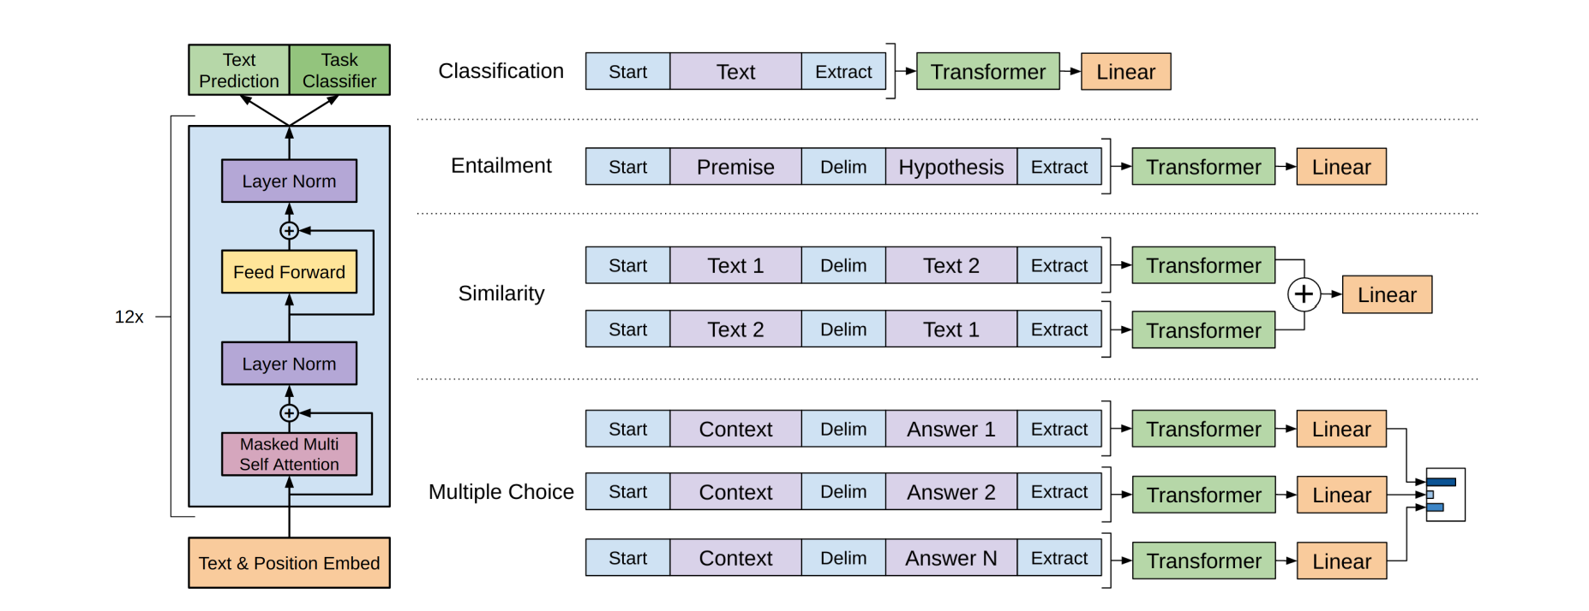
GPT-1: Overview
Phase 1: Unsupervised pre-training
Phase 2: Supervised fine-tuning

Slide 3
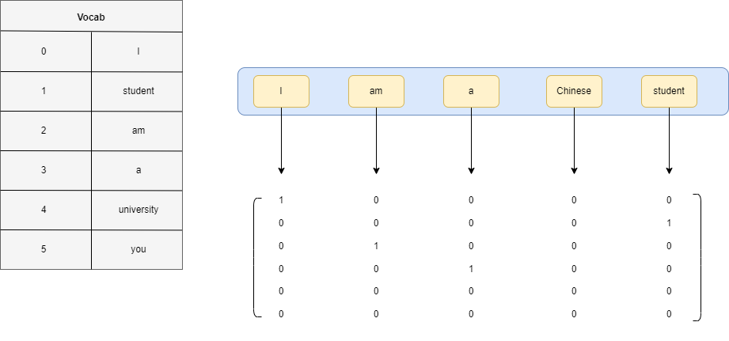
GPT-1: Unsupervised Pre-training
Transformer Encoder
Embedding Layer: Sparse Text Embed(e.g. Bag of Words)

Slide 4
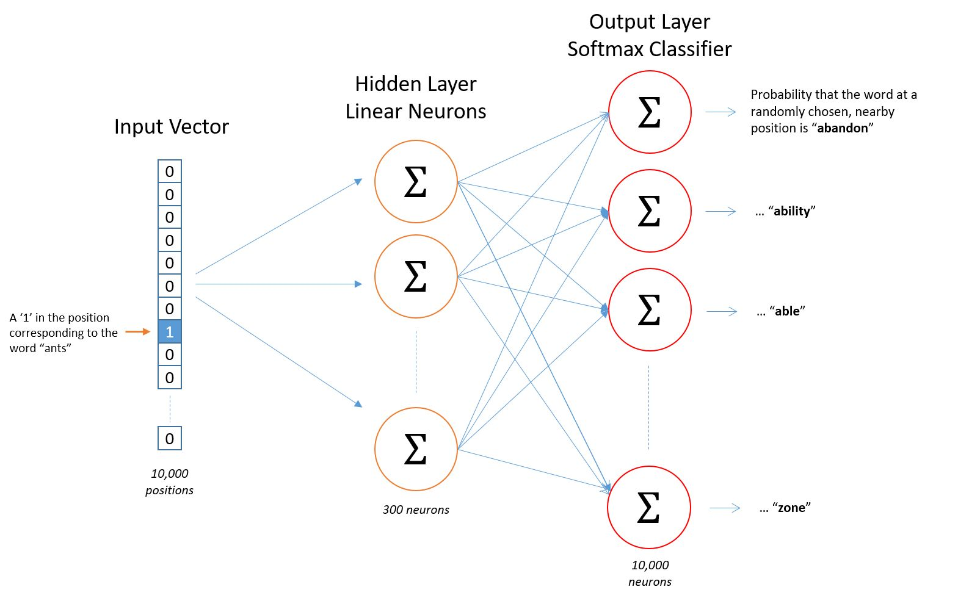
GPT-1: Unsupervised Pre-training
https://zhuanlan.zhihu.com/p/27234078
Transformer Encoder
Embedding Layer: Dense Text Embed
(e.g. word2vec: skip-gram)

Slide 5
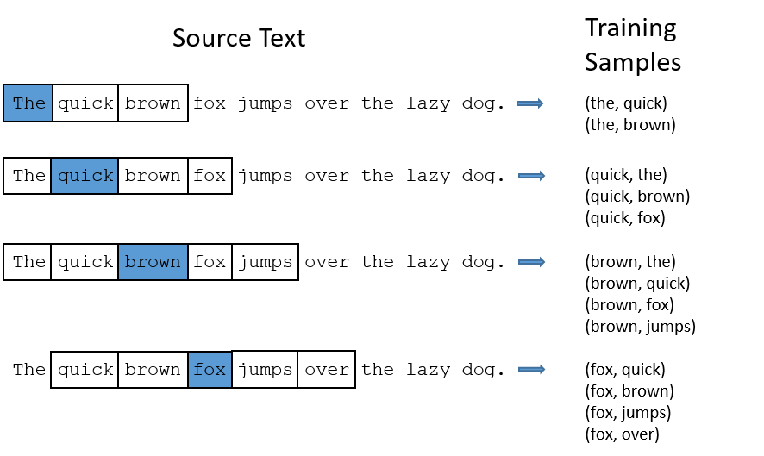
GPT-1: Unsupervised Pre-training
https://zhuanlan.zhihu.com/p/27234078
Transformer Encoder
Embedding Layer: Dense Text Embed
(e.g. word2vec: skip-gram)

Slide 6
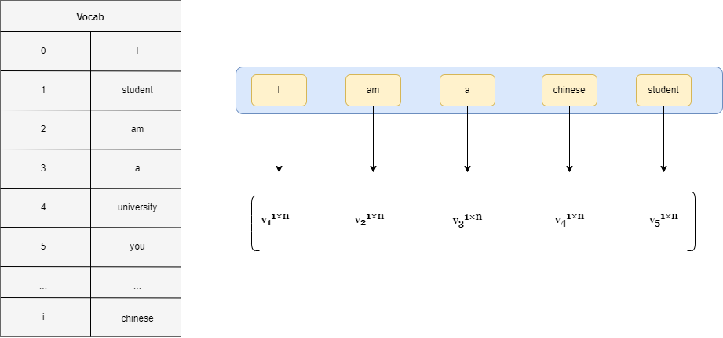
GPT-1: Unsupervised Pre-training
https://zhuanlan.zhihu.com/p/27234078
Transformer Encoder
Embedding Layer: Dense Text Embed
(e.g. word2vec: skip-gram)

Slide 7
GPT-1: Unsupervised Pre-training
https://zhuanlan.zhihu.com/p/424631681
Transformer Encoder
Embedding Layer: Byte Pair Embed
Morphologically studies the words:
e.g. taller = tall + er
tallest = tall + est

Slide 8
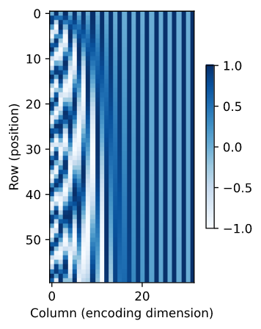
GPT-1: Unsupervised Pre-training
https://zhuanlan.zhihu.com/p/106644634
Transformer Encoder
Embedding Layer: Positional Embed
Encodes the absolute positional information of a word in a sentence
Encodes the relative positional information of a word in a sentence

Slide 9
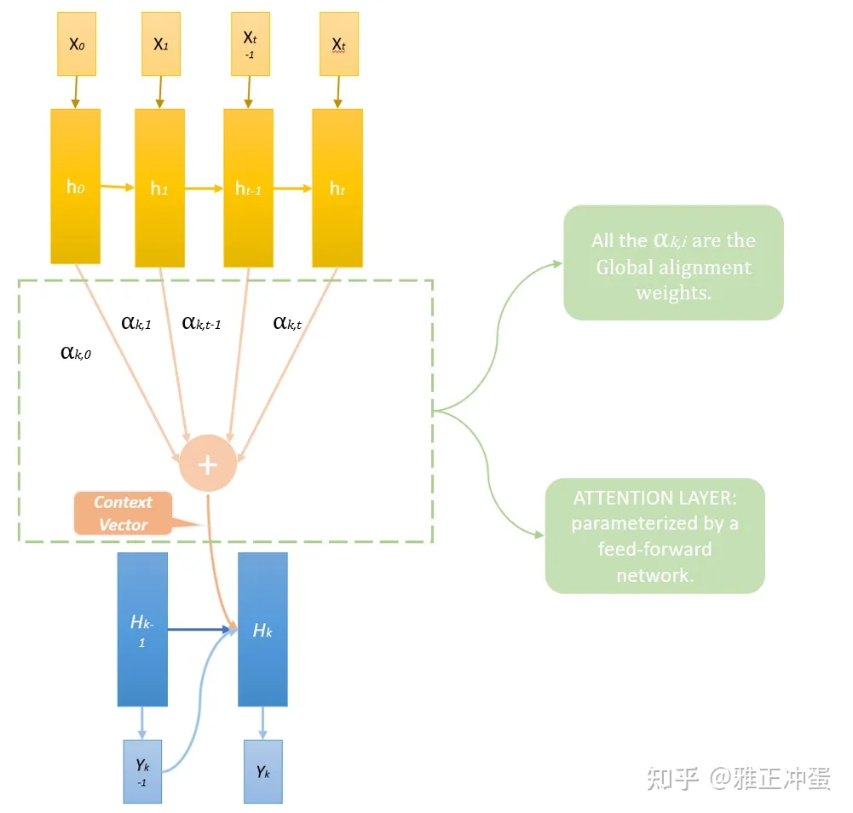
GPT-1: Unsupervised Pre-training
https://zhuanlan.zhihu.com/p/380892265
Transformer Encoder
Attention

Slide 10
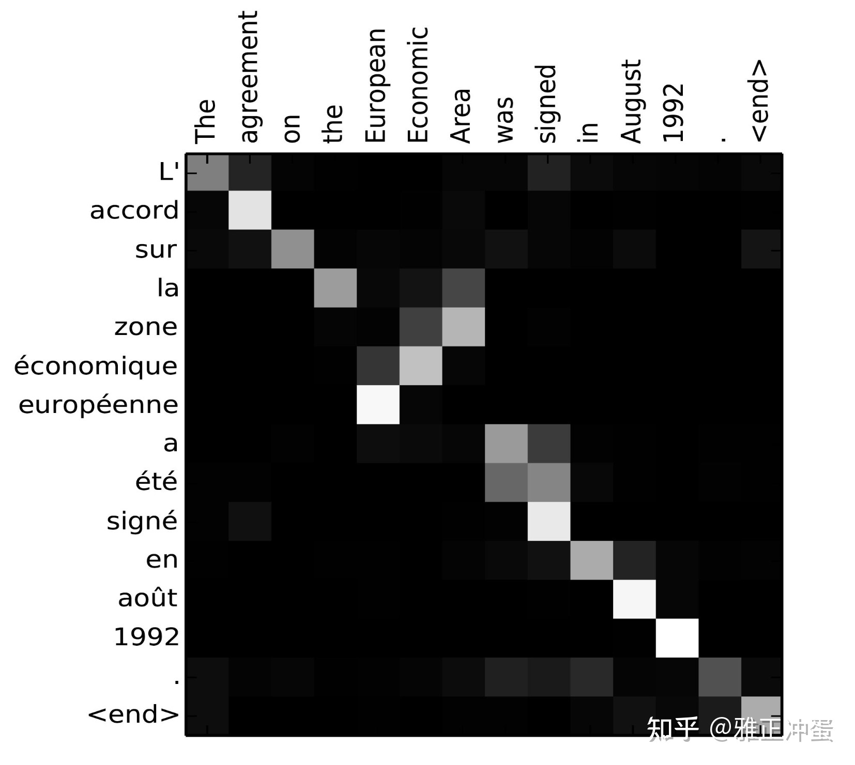
GPT-1: Unsupervised Pre-training
https://zhuanlan.zhihu.com/p/380892265
Transformer Encoder
Attention

Slide 11
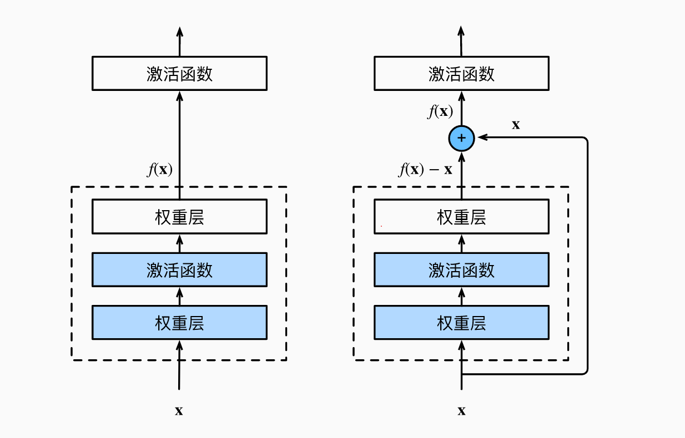
GPT-1: Unsupervised Pre-training
Transformer Encoder
Residual & Layer Normalization
Residual

Slide 12
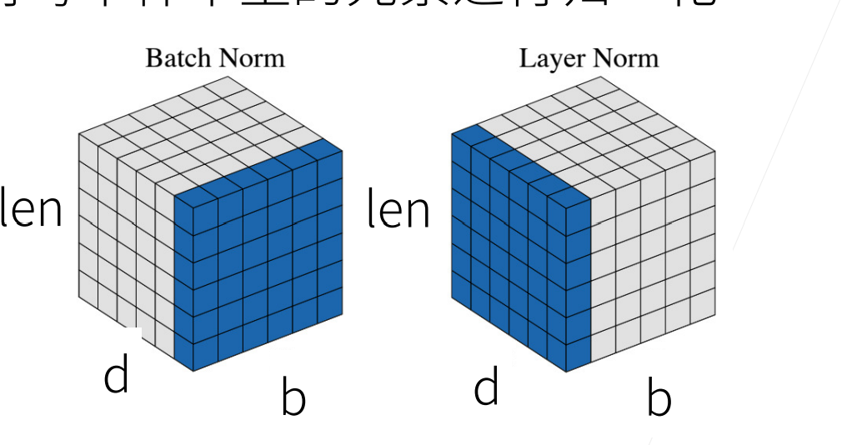
GPT-1: Unsupervised Pre-training
Transformer Encoder
Layer Normalization vs. Batch Normalization

Slide 13
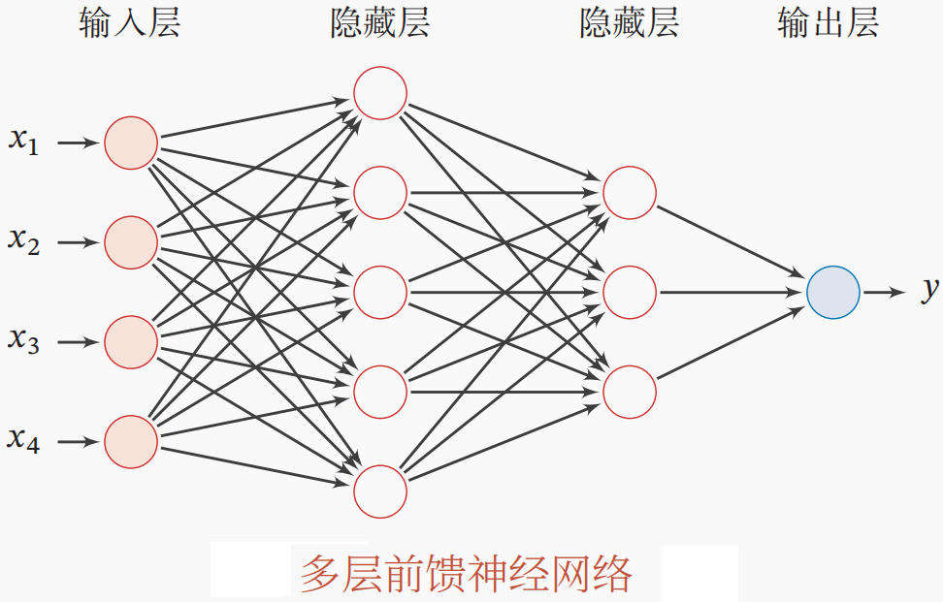
GPT-1: Unsupervised Pre-training
Transformer Encoder
Feed Forward Network(FFN)

Slide 14
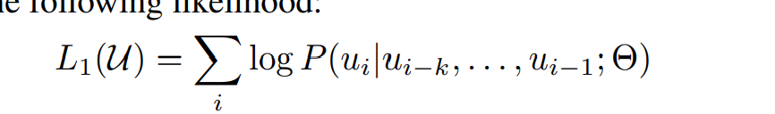
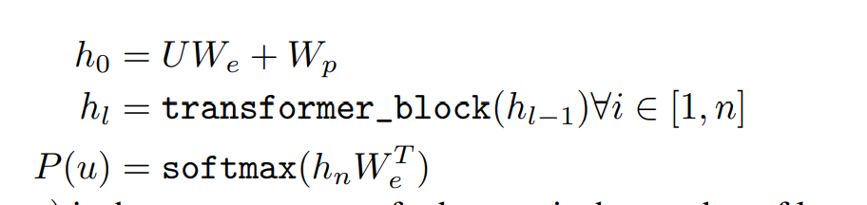
GPT-1: Unsupervised Pre-training
Optimization

Slide 15
GPT-1: Supervised Fine-tuning
Tasks & Preprocessing methods

Slide 16
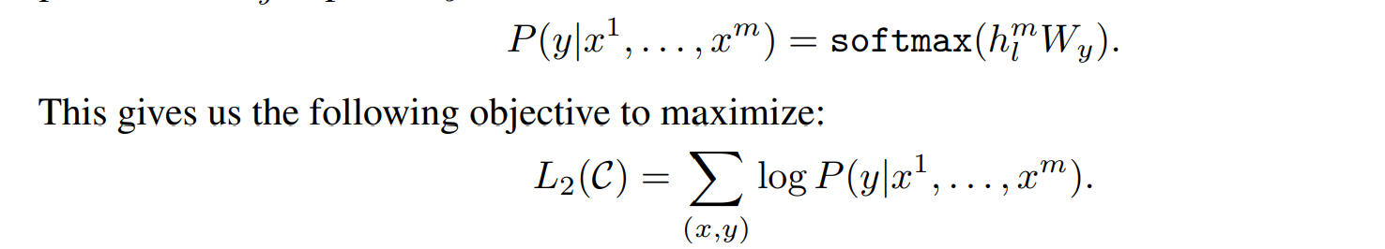
GPT-1: Supervised Fine-tuning
Optimization

Slide 17
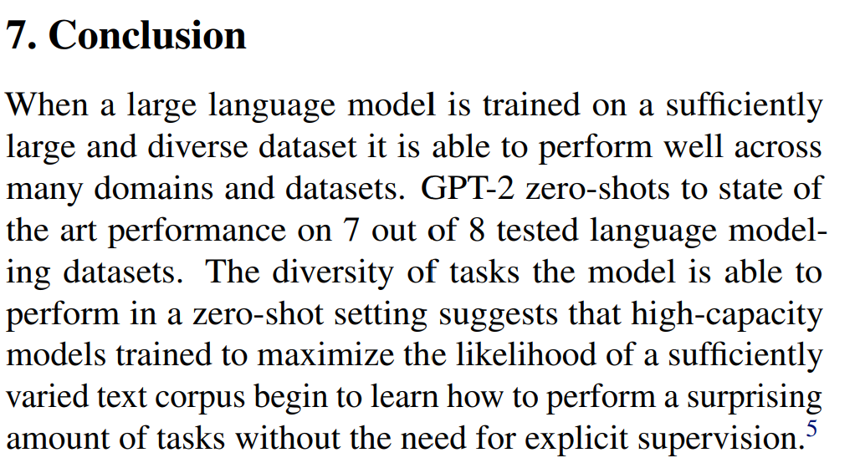

GPT-2: Bigger dataset, bigger model

Slide 18
Online courses recommendation
Stanford cs229 Machine Learning
Dive into Deep Learning
Stanford cs231n DL for CV
Stanford cs224n NLP with DL

