Slide 1
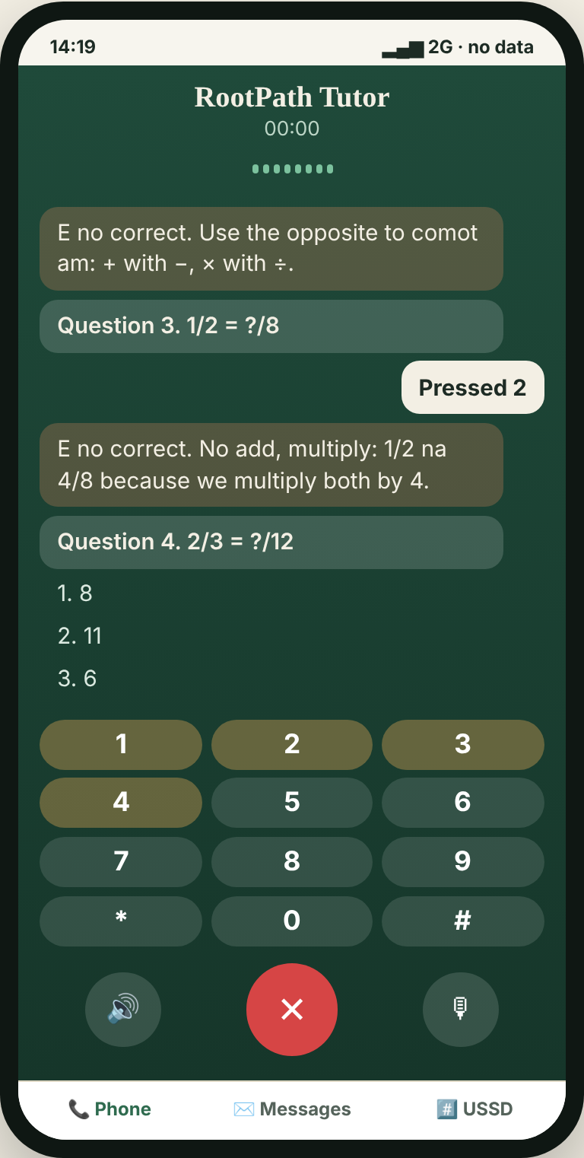
RootPath
Call a tutor from any phone. No data. No smartphone.
Wale Lab NextGen AI Hackathon 2026 · Track 1: AI for Zero-Bandwidth & Localized Learning
Muiz Adeyemi (Schwoz) · University of Lagos
Try the live demo: edumesh-eta.vercel.app
Notes:
Hook: A child dials a toll-free number from any phone. An AI tutor talks with them in their language, finds the real reason they are stuck, and keeps teaching them all week by SMS. No data, no smartphone.

Slide 2
A JSS1 failure with a Primary 5 cause
Tunde cannot solve x + 1/2 = 3/4.
Re-teaching equations does not help. His missing skill is equivalent fractions, from Primary 5. Teachers rarely see it, and learners cannot name it.
ROOT GAP
ON THE PATH
WHERE TUNDE FAILS
Equivalent fractions
Adding fractions, different bottoms
Equations with fractions
And most help needs what Tunde does not have: data, a smartphone, or a teacher with time for one child.
Notes:
Tunde fails in JSS1, but the cause is from Primary 5. Re-teaching equations will not fix it. And the usual fixes need data, a smartphone, or a teacher with time for one child: the three things most of our learners do not have.

Slide 3
What works: a call, at the child’s level, then SMS
Calls + SMS, taught at each child’s level
RootPath is that tutor, automated.
Large learning gains in randomised trials across six countries.
SMS alone
An AI that answers the phone, finds the child’s level by voice, then follows up by SMS and calls back. Any phone, any network, no data.
Had little effect on its own.
Low cost
About $12 per child, delivered by phone.
Source: J-PAL / Youth Impact, phone-based targeted instruction trials (human tutors).
Notes:
We did not guess the format. Randomised trials by J-PAL and Youth Impact in six countries found that a short phone call plus SMS, teaching each child at their level, produced large learning gains for about twelve dollars per child, while SMS alone did little. Those trials used human tutors. RootPath automates that tutor so it can reach every child.

Slide 4
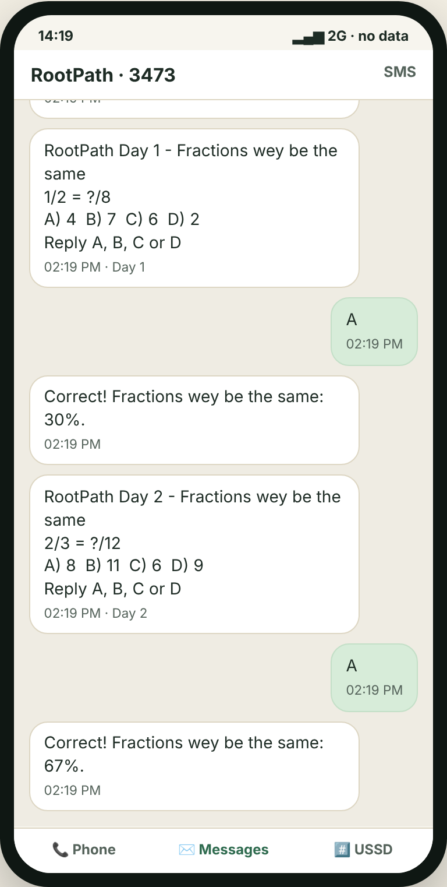
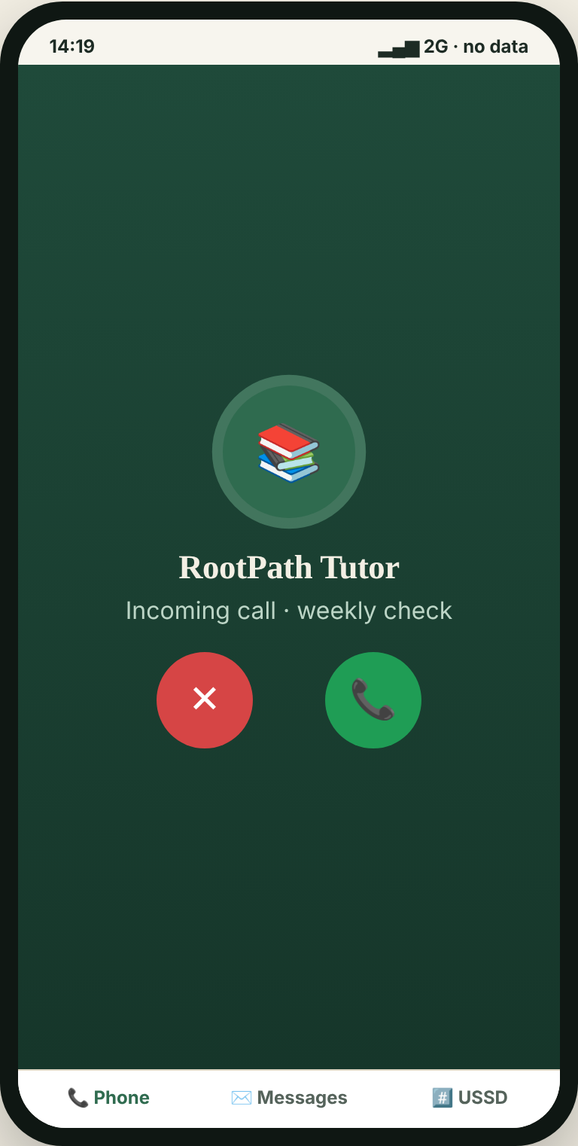
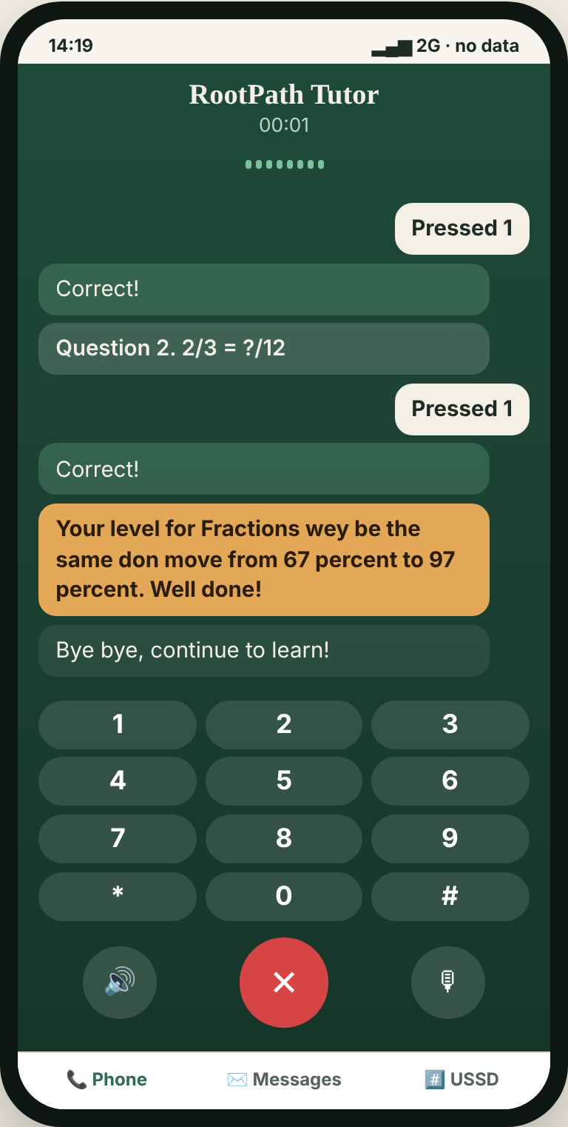
How it works: one child, one week
MONDAY
TUE – FRI
SATURDAY
SUNDAY
Tunde calls
Daily practice SMS
RootPath calls back
Progress, shared
The tutor asks questions by voice in Pidgin and explains each mistake.
One question a day on his root gap. He replies A–D and gets instant feedback.
A short check-in call practises the gap and measures progress.
The call reports his level rising; parent and teacher get it by SMS.
Notes:
Here is the whole loop. Monday, Tunde dials the free number and the tutor talks with him in Pidgin. Tuesday to Friday, one practice SMS a day on his root gap; he replies A to D. Saturday, RootPath calls him back for a short check. Sunday, his parent and teacher get the progress by SMS. Nothing here needs data or a smartphone.

Slide 5
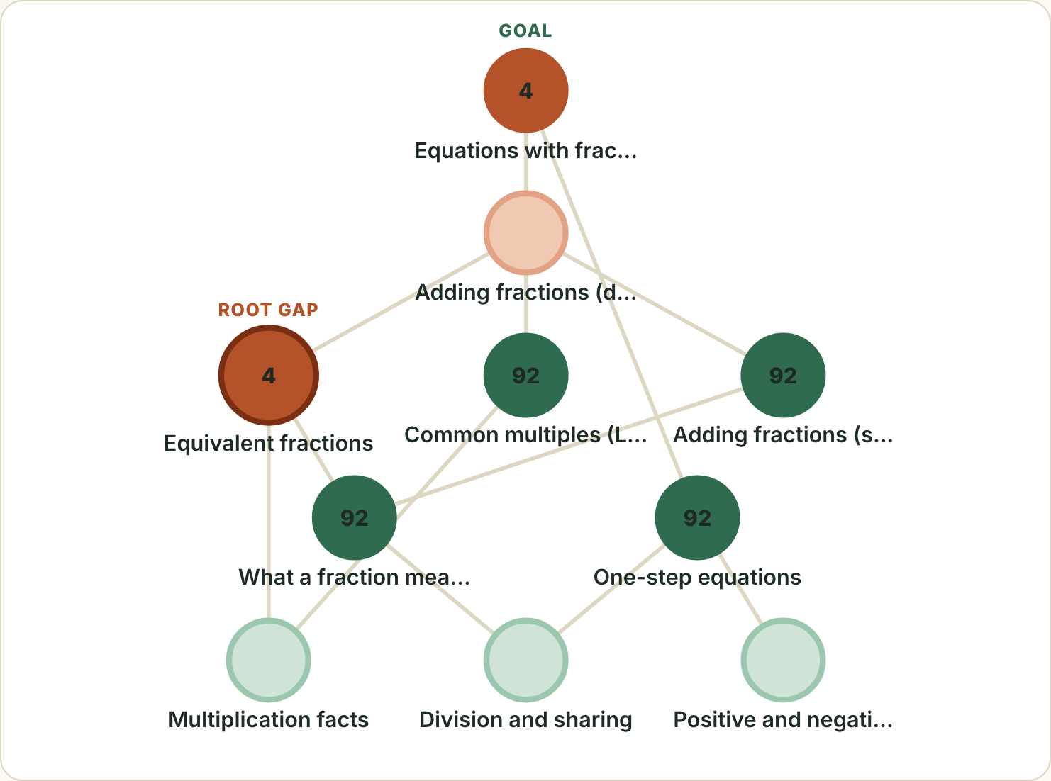
The AI finds the root, and shows its reasoning
1
A model of what the child knows
Every key press updates a mastery probability for that skill (Bayesian Knowledge Tracing), allowing for lucky guesses and slips.
2
A search down the skill map
Weak skills send it to earlier skills, choosing the question that rules out the most. Tunde’s root was found in 12 questions.
3
Safe by design
No free chat near children. Generative AI drafts local-language lessons before release; humans approve them.
Notes:
This is the AI, live in the demo. Each answer updates a probability of mastery for that skill using Bayesian Knowledge Tracing. Weak skills send the search down the skill map, picking the question that rules out the most. For Tunde it found equivalent fractions in twelve questions. Green is mastered, orange is a gap, and the ring marks the root. Teachers can see every step. Generative AI is only used before release to draft local-language lessons, which humans approve.

Slide 6
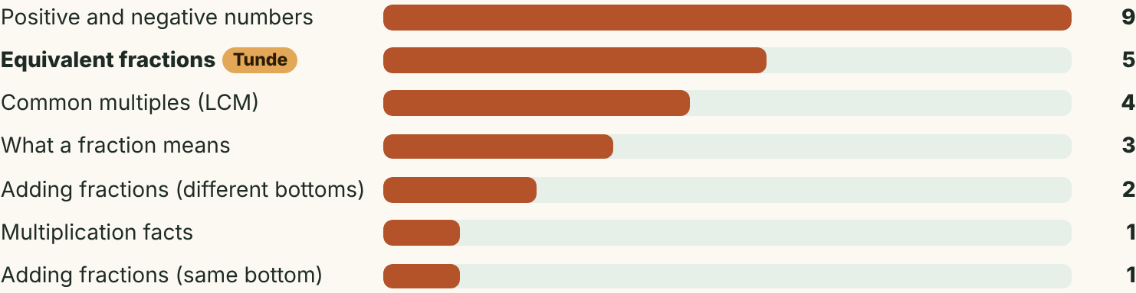
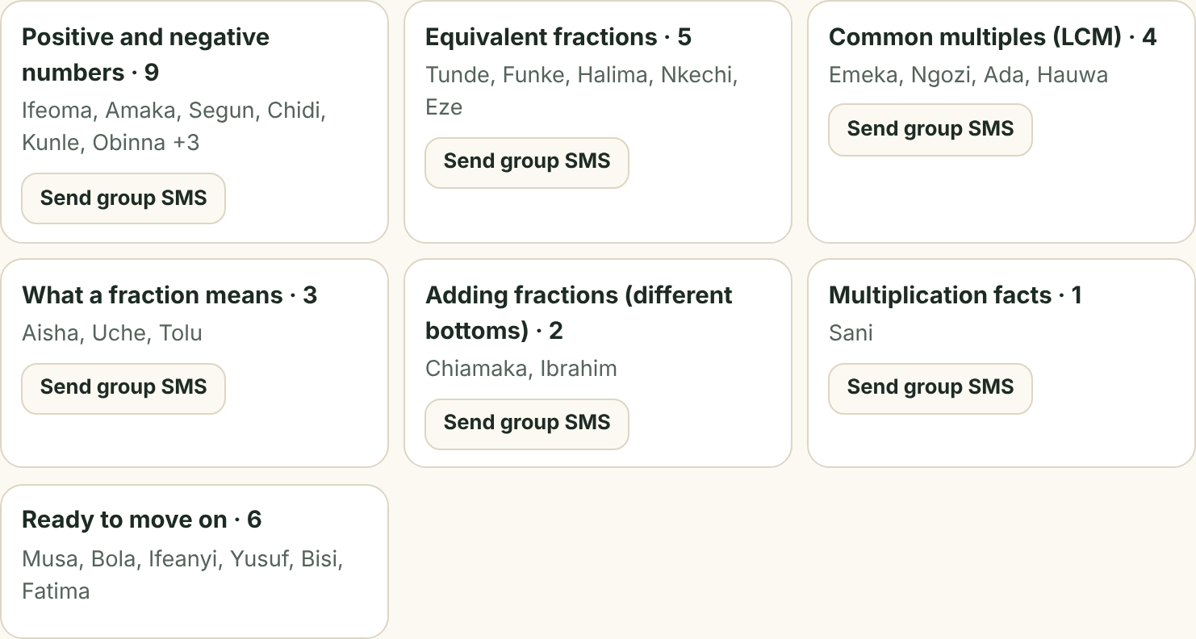
One teacher, a whole class, every gap
Teach at the right level
Every call places the child on the class map.
Groups by root gap, not by age or class.
One tap sends each group its practice SMS.
Add any learner from their SMS progress code.
Demo class: 30 simulated learners diagnosed by the real engine, plus Tunde’s real call.
Notes:
Now scale it to a class. Every call places the child on the class map, grouped by root gap rather than by age, which is the teach-at-the-right-level method from the trials. One tap sends each group its practice SMS. Be clear that the demo class is simulated by the real engine; Tunde is the real call.

Slide 7
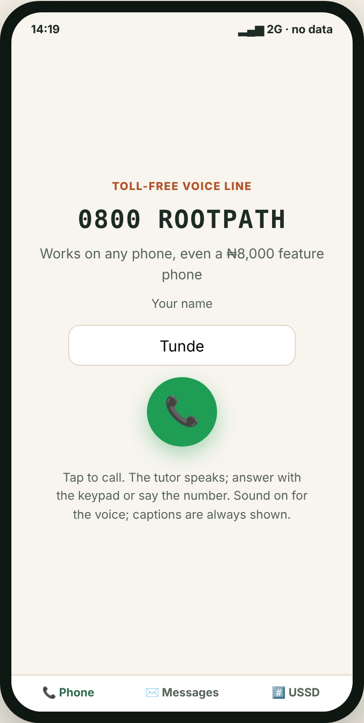
Any phone, zero data, five languages
Voice call
SMS
Toll-free line: the tutor speaks, the child answers by keypad or voice.
Daily practice and reports. Plain text that fits basic phones.
USSD
Offline app
The same diagnosis as text menus, on any phone.
Installable web app for smartphones; works in airplane mode.
English
Pidgin
Yorùbá
Igbo
Hausa
Voice prompts are full in English and Pidgin; Yorùbá, Igbo and Hausa greet in their language and are in native-speaker review.
Notes:
RootPath meets the child on whatever phone the family has: a toll-free voice call, SMS, USSD menus, or the offline app on a smartphone. English and Pidgin voice prompts are complete; Yoruba, Igbo and Hausa are in native-speaker review, and we say so.

Slide 8
Built, tested and ready for a real phone line
60
26
78
automated tests, all passing
skills across maths, physics and English
questions, each wrong answer tagged with a misconception
Real phone calls: an Africa’s Talking voice adapter serves the same tutor to a live number. It is built and tested; going live needs a number.
Every simulated single-gap learner is traced to the exact root skill, including a physics speed problem traced back to a Primary 3 division gap.
Notes:
Everything you saw is real code, with 60 automated tests. The same tutor can answer a real phone line today through an Africa’s Talking voice adapter we built and tested; going live only needs a number. Be honest: the accuracy results are from simulated learners, which is why the next slide is the field test.

Slide 9
Field test: does RootPath agree with the teacher?
[__]%
+[__] pts
of learners where RootPath named the same gap as their teacher
average mastery gain on the root skill after practice
1
[N] learners
2
Teacher check
3
One command
[school or community], [date]
The teacher records their view of each child’s gap.
npm run report computes both numbers from the results.
Notes:
Fill this slide with real numbers before submitting. Run 5 to 10 learners through the offline app (app.html) so the Teacher check is recorded, export the field-test JSON, then run: npm run report -- rootpath-field-test.json. If you have only a few learners, say the number plainly; small and real beats large and simulated. If you cannot run a test in time, delete this slide rather than leave placeholders.

Slide 10
Free for the child, ready to scale
1
2
3
Now
Pilot
Scale
Built
Prove it
Reach more
Voice-call tutor + SMS
Live AI skill map
Teacher class view
USSD and offline app
Live toll-free number
5–10 classes, one term
Compare with teachers
Native-speaker review
Partner-sponsored lines
Full JSS maths and science
More Nigerian languages
Telco and state partners
Free to the child: the toll-free line and SMS are sponsored by partners such as state education boards, NGOs and telcos.
Notes:
It is free for the child. Partners such as state education boards, NGOs and telcos sponsor the toll-free line and SMS. Next is a one-term pilot with a live number in a few classes, comparing RootPath with teachers, then scaling through partners.

Slide 11

Thank you
Find the root. Walk the path.
Try it now: call the tutor in your browser
edumesh-eta.vercel.app
Scan to call the tutor
Muiz Adeyemi (Schwoz) · adeyemimuiz033@gmail.com · github.com/Schwoz17
Notes:
A child should not need data or a smartphone to get a tutor. With RootPath, they need any phone. Scan the code and try the call yourself. Thank you.

