Slide 1



Moving to Tokens: IRIS and WLCG
Migrating to Token-Based AuthN and AuthZ
Internet2 TechEx 2022
Tom Dack
Notes:
The abstract pattern can be removed or repositioned if required. Be careful to ‘Send to Back’ so that it does not obscure any important information.

Slide 2
IRIS
WLCG
eInfrastructure for Research and Innovation for STFC
A coordinating body for the provision of STFC eInfrastructure
Common elements are required for IRIS resources to function as a coherent infrastructure
  Policy and Trust Framework
  Identity Management
  Resource Accounting
  Monitoring
Worldwide LHC Computing Grid
Replacing existing X509 + VOMS system with token flows
Working towards token support across the full WLCG stack
Notes:
STFC supports a diverse set of science activites, and many of these require substantial eInfrastructure to support them – both physical infrastructure and software.
The infrastructure is provided by several provider entities, including STFC’s own computing departments and partners such as GridPP.
But what about IRIS?
First and foremost Iris is a self-formed coordination body, bringing together these science activities and provider entities, which together are referred to as the IRIS partners.
IRIS was not mandated from above – rather formed from the bottom up by the partners as it was felt to be the sensible decision to make.
Things IRIS can do:
Coordinate approaches to physical infrastructure
Coordinate approaches to software where it makes sense to do so
Engender sharing of existing resources and expertise between members on a best efforts basis
Compile and aggregate the eInfrastructure requirements of its partners and relay this information to STFC.
IRIS also provides physical resource, through its capital funding.
IRIS cannot run eInfrastructure directly, however its partners can commission the deployment of resources to be made available to all science activities. But not that IRIS is *only* able to commission the resource – IRIS has no staff effort funded and there fore no capability to provide software infrastructure – the software needed to exploit the resources IRIS can provide is the responsibility of the end user.
IRIS does have some allowance for the creation of digital assets – pieces of software built with the intention of enabling users of the National facilities to exploit data mote quickly and efficiently.

Slide 3
Motivations for Migration
There is a landscape shift away from X.509 user certificates
  Not user friendly
  Mobility issues – moving certificates around
  Interoperability issues with the broader federated infrastructure landscape
Shift towards OAuth2 and OpenID Connect (Tokens)
  Tokens widely accepted
  Easy to implement – used by major industry players
  Links directly to home institutions

Slide 4
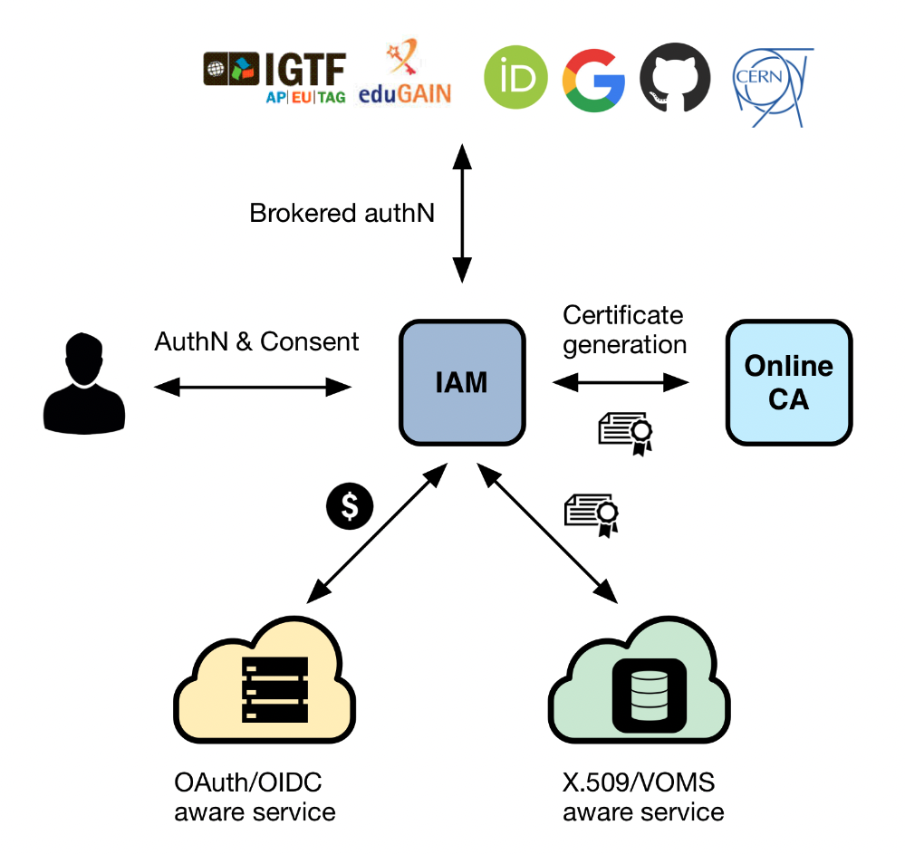
WLCG & IRIS use INDIGO IAM
An authentication and authorization application that
supports multiple authentication mechanisms
provides users with a persistent, organization
scoped identifier
exposes identity information, attributes and capabilities to services via JSON Web Tokens and standard OAuth & OpenID Connect protocols
can integrate existing VOMS-aware services
supports Web and non-Web access, delegation and token renewal

Slide 5
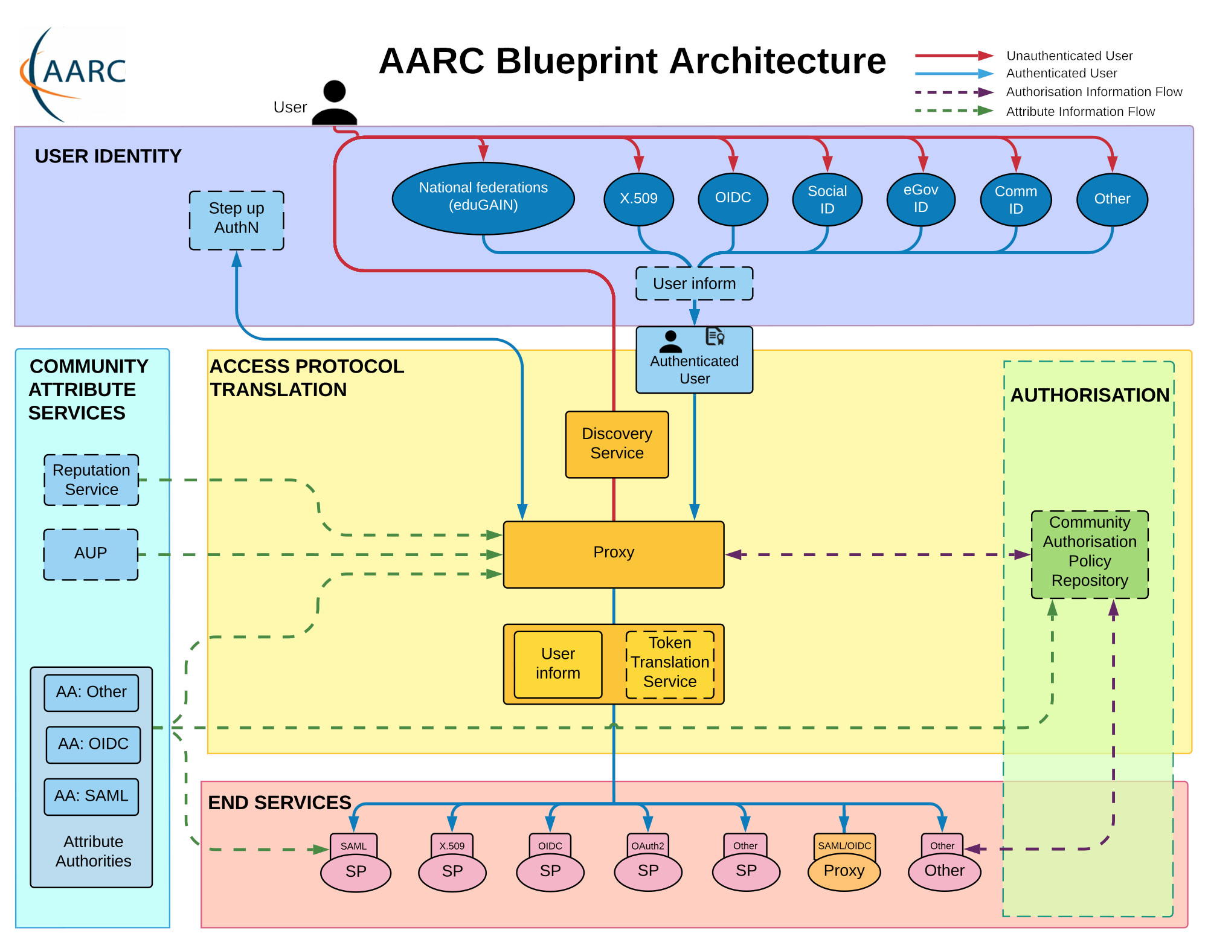
INDIGO IAM and the AARC Blueprint Architecture for Infrastructures
Authentication and Authorisation for Research and Collaboration (AARC)

Slide 6
WLCG Token Schema
Common Claims
ID Tokens
Access Tokens
iss+sub used to uniquely identify a user, e.g. for blocking
  sub
  exp
  iss
  acr
  aud
  iat
  nbf
  jti
  eduperson_assurance (REFEDS)
  wlcg.ver (WLCG)
  wlcg.groups (WLCG)
  auth_time
  general OIDC Claims
  scope (RFC8693)
Access tokens should include at least scope (capabilities) or group for authorization
wlcg prefix added to avoid collisions with other schemas
Note: Where unspecified, the origin is RFC7519 or OpenID Connect core

Slide 7
Token Status:
IRIS
WLCG
Multi-tenancy Identity Management Platform, serving multiple IRIS communities
IRIS IAM is a production service, providing AuthN/Z to IRIS and STFC communities
Primary authentication to IRIS services, including Accounting Portals, IRIS DynaFed (Storage), MISP Security Portal and OpenStack Clouds
IAM is in production for the four LHC experiments
  Contents are automatically replicated from VOMS-Admin
IAM VOMS endpoints can be used alongside the legacy VOMS services
  In production for ATLAS and CMS
  TBD for ALICE and LHCb
ATLAS, CMS and SAM ETF can use tokens to submit jobs to HTCondor Ces
  CEs on OSG, which only support tokens since May
  Those jobs still use X509 VOMS proxies for data management etc.
Notes:
STFC supports a diverse set of science activites, and many of these require substantial eInfrastructure to support them – both physical infrastructure and software.
The infrastructure is provided by several provider entities, including STFC’s own computing departments and partners such as GridPP.
But what about IRIS?
First and foremost Iris is a self-formed coordination body, bringing together these science activities and provider entities, which together are referred to as the IRIS partners.
IRIS was not mandated from above – rather formed from the bottom up by the partners as it was felt to be the sensible decision to make.
Things IRIS can do:
Coordinate approaches to physical infrastructure
Coordinate approaches to software where it makes sense to do so
Engender sharing of existing resources and expertise between members on a best efforts basis
Compile and aggregate the eInfrastructure requirements of its partners and relay this information to STFC.
IRIS also provides physical resource, through its capital funding.
IRIS cannot run eInfrastructure directly, however its partners can commission the deployment of resources to be made available to all science activities. But not that IRIS is *only* able to commission the resource – IRIS has no staff effort funded and there fore no capability to provide software infrastructure – the software needed to exploit the resources IRIS can provide is the responsibility of the end user.
IRIS does have some allowance for the creation of digital assets – pieces of software built with the intention of enabling users of the National facilities to exploit data mote quickly and efficiently.

Slide 8
The Big Challenges
Token Lifetimes
  Token lifetime is typically short for security reasons – what happens with a job longer than the token
  Current WLCG Pilot job submission token lifetimes are a few days
    Allows times to resolve service incidents transparently
    Only used in security handshakes with Ces
  Refresh Tokens – potential security concerns
High Availability Operations
Interoperability
  Following AARC guidelines where possible

Slide 9
Challenges - IRIS
How to provide access to services which operate only over command line
  OAuth Device Code PAM with Group Authorization
  https://github.com/stfc/pam_oauth2_device
Assurance for users who do not have an eduGAIN IdP
  Using the AAI platform as an Identity-Provider-of-last-resort
  ”Community” IAM instances with local credentials acting as IdPs

Slide 10
Challenges - WLCG
Support Level
  Staff availability and service reliability has caused issues here
Phasing out VOMS-Admin
  User, group, and role management needs to migrate to IAM
  Transition phase will require supporting both in tandem

Slide 11

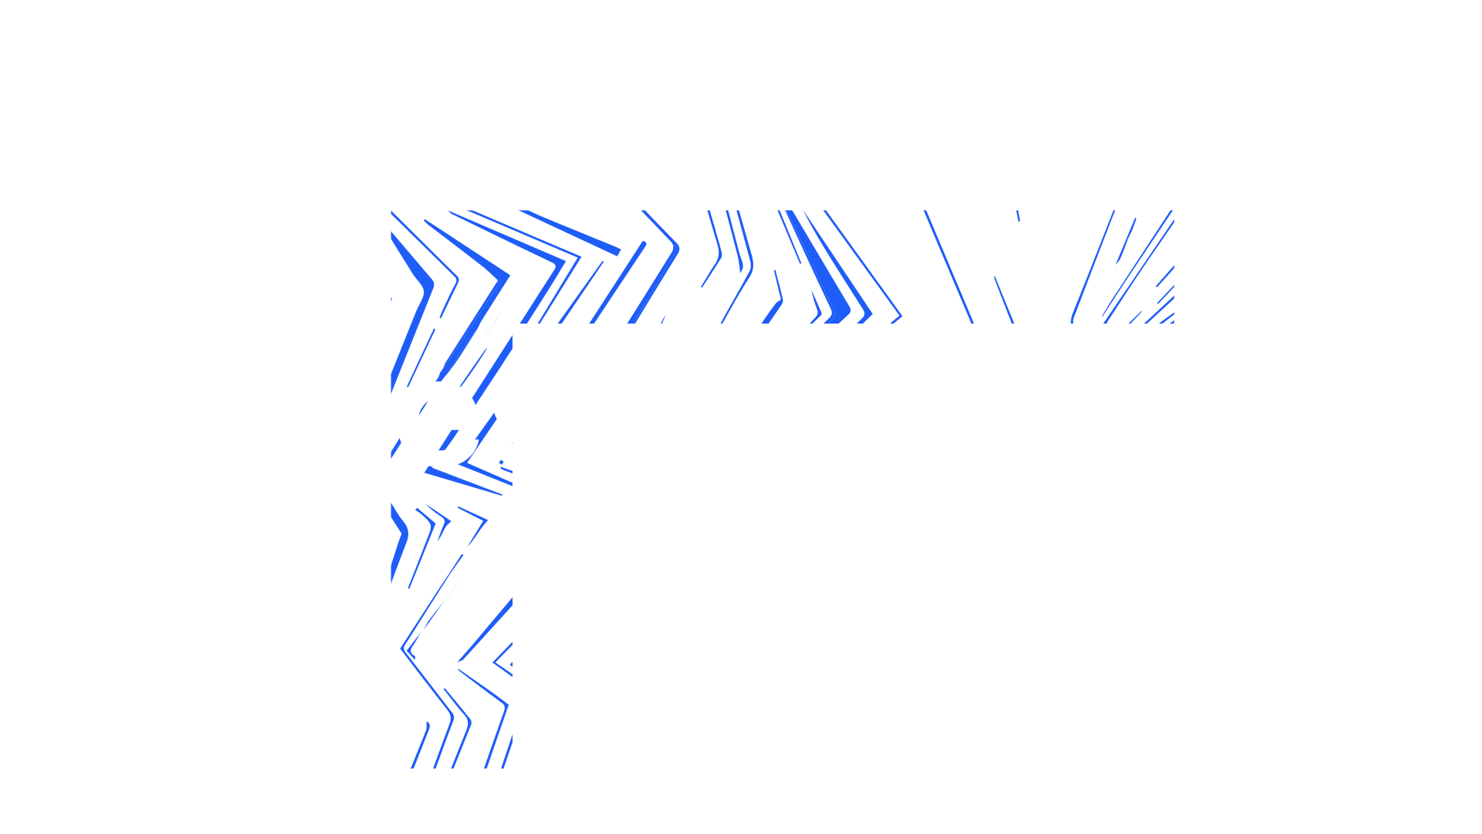

Notes:
The abstract pattern can be removed or repositioned if required. Be careful to ‘Send to Back’ so that it does not obscure any important information.

Slide 12






Science and Technology Facilities Council
@STFC_matters
Science and Technology Facilities Council
Notes:
The abstract pattern can be removed or repositioned if required. Be careful to ‘Send to Back’ so that it does not obscure any important information.

