Slide 1
A Lightweight
End-to-End Capability-Based
Authorization Environment for
Scientific Computing

Slide 2
Acknowledgements
This work is a collaboration between:
Brian Aydemir - Morgridge Institute for Research
Jim Basney - National Center for Supercomputing Applications, University of Illinois
Brian Bockelman - Morgridge Institute for Research
Jeff Gaynor - National Center for Supercomputing Applications, University of Illinois
Derek Weitzel - University of Nebraska-Lincoln
This material is based upon work supported by the National Science Foundation under Grant No. 2114989. Any opinions, findings, and conclusions or recommendations expressed in this material are those of the author(s) and do not necessarily reflect the views of the National Science Foundation.

Slide 3
Background: SciTokens
Capability-based authorization system
Based on OAuth and JSON Web Tokens (JWTs)
Used by many software components and the Open Science Grid
{ "scope": "ssh:vt20" , "aud": "martok.ncsa.Illinois.edu", "iss": "https://demo.scitokens.org",
"exp": 1583855836, "iat": 1583855236, "jti": "073ac358−4f07−4090−ae5f−b5c5be273269"
}
Notes:
SciTokens is a *distributed* authorization scheme: the entity issuing the token might be different from the entity consuming the token.
In practice, this can make it difficult to see how all the pieces of the system need to be configured in order to work together.

Slide 4
The SciAuth Lightweight End-to-End Environment
Goal: To provide an environment for experimenting with SciTokens
Key features:
Lightweight: Runs on a single host using Docker Compose
End-to-End: Allows users to go through an entire workflow
Incorporates well-known software (CILogon, GitHub, HTCondor, Jupyter)
Novel components: Lightweight authorization server, JupyterHub service for tokens
(Almost) Just works out-of-the-box
Notes:
(Almost) Just works out-of-the-box: You need to create your own an OIDC Client with CILogon, GitHub, and (future) other external services.

Slide 5
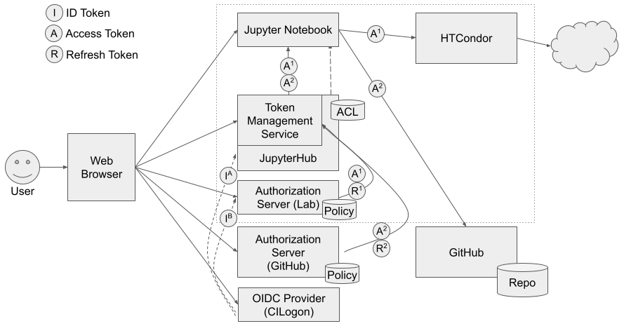
Architecture of the Lightweight Environment

Slide 6
Architecture of the Lightweight Environment
Notes:
Initial OAuth log-in flow for JupyterHub.

Slide 7
Architecture of the Lightweight Environment
Notes:
Now, the user wants to use the token management service to obtain tokens to use with a service provider, say, an HTCondor pool.

Slide 8
JupyterHub Token Management Service
Provides a mechanism for users to obtain tokens:
Allows JupyterHub to act as on OAuth client on behalf of users
Provides a basic web page where users can authorize the service to fetch tokens
Provides a simple API for retrieving tokens from the service
Notes:
The service eliminates the need for the user to create their own OIDC Client with service providers.
The service provides a means for obtaining tokens for services that don’t use the same authorization provider as JupyterHub itself.
The service can handle refreshing tokens.

Slide 9
Architecture of the Lightweight Environment
Notes:
At this point, the token management service sends the user to the lightweight authorization server.

Slide 10
Lightweight Authorization Server
Issues tokens according to some policy:
Runs as a single Docker container
Authenticates users with CILogon
Policy configuration is a map from users to their authorizations:
{
"http://cilogon.org/serverA/users/123456": {
"eduPersonEntitlement": ["condor:READ"],
"audience": "htcondor.local"
}
}

Slide 11
Architecture of the Lightweight Environment
Notes:
In turn, the lightweight authorization server has the user authenticate themselves with CILogon, after which it issues a token according to its configured policy.

Slide 12
Architecture of the Lightweight Environment
Notes:
The user can now use that token to interact with the HTCondor pool.

Slide 13
Looking Ahead
Download the end-to-end environment:
1.0 release by the end of the week
https://github.com/SciAuth/sciauth-lightweight-environment
Learn more about the SciAuth Project:
https://sciauth.org/
Encourage students to apply to the SciAuth student fellows program:
https://sciauth.org/fellows
Currently accepting applications for Fall 2022
Projects are related to authentication and authorization for scientific collaborations

