Slide 1

IRIS/DiRAC TBAn&Az trial
Combining HPC with federated identity management
Jens Jensen (UKRI)
Co-conspirators:
José Caballero Bejar (UKRI)
Matt Rásó-Barnett ((then) Univ of Cambridge)
NSF CyberSecurity Summit 2022, WoTBAn&Az workshop

Slide 2
Dramatis Personae
UK Research and Innovation (UKRI, www.ukri.org) funds, supports and conducts research on behalf of the UK gov’t
STFC, one of 9 councils in UKRI, supports large facilities (synchrotrons, lasers, etc), cosmology, astronomy, particle physics, space science, and much more
IRIS (www.iris.ac.uk) supports computing for STFC-funded research (incl. LIGO, SKA, DUNE, V Rubin Telescope,…)
DiRAC (www.dirac.ac.uk) is a network of HPC and supercomputing sites supporting computational cosmology – now part of IRIS (not to be confused with other things called DIRAC)

Slide 3
IRIS compute overview: current
X.509 user cert
federated or password
ssh key
GridPP
(particle physics)
IRIS community cloud
DiRAC HPC
HTC
cloud
HPC

Slide 4
IRIS compute overview: desired
IRIS community cloud
federated
GridPP
(particle physics)
DiRAC HPC
VO mgmt

Slide 5
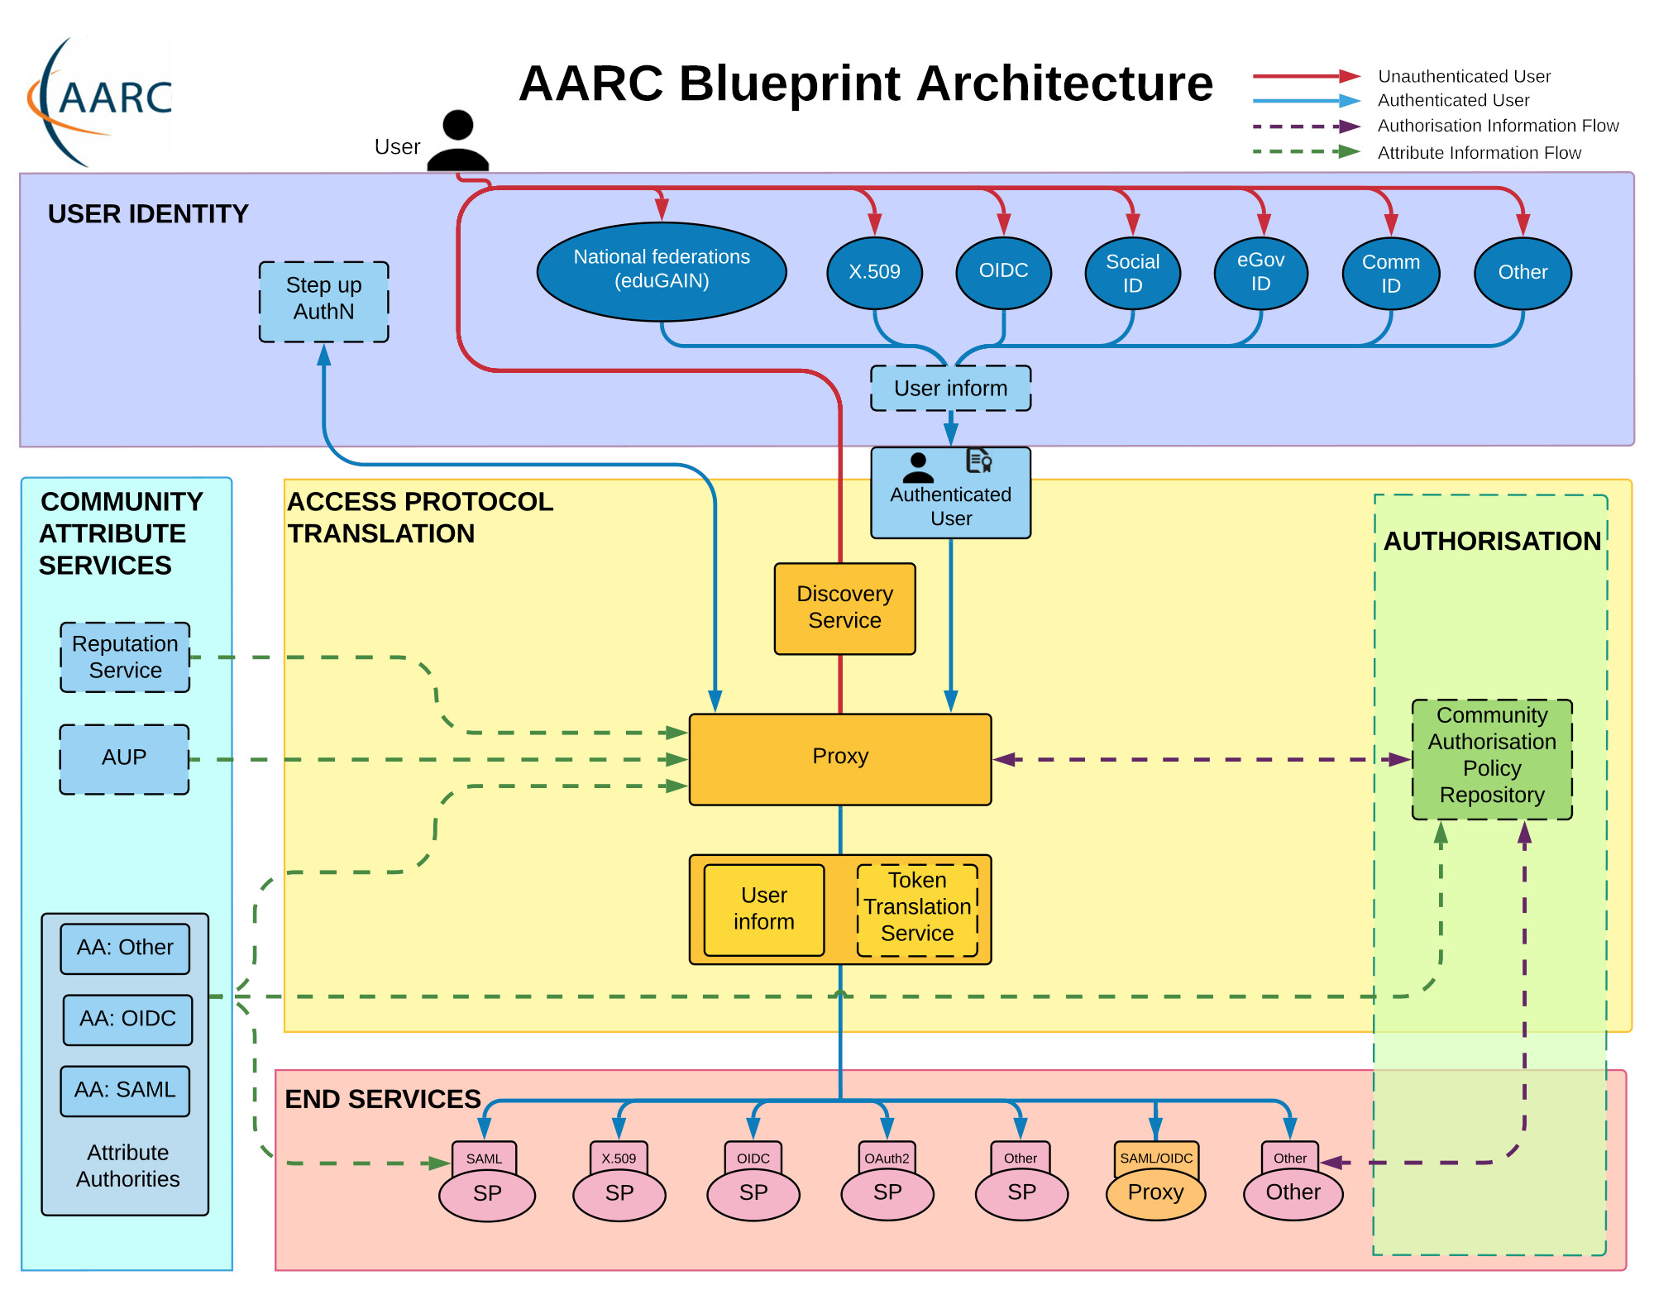
AARChitecture
IRIS runs a BPA proxy connected to eduGAIN
The IRIS BPA proxy is Indigo IAM
(There is a parallel setup for SKA UKSRC, globally accessible)

Slide 6
IRIS IAM
Adding SAFE as “Community Identity Provider” to the proxy
DiRAC resources as service providers
SAFE users
Not-SAFE users
In practice, SAFE access is used in prod’n
Federated access needs rollout across DiRAC
“legacy” access
(ssh keys)
IAM
DiRAC services
Not-DiRAC services
“legacy” access
(X.509 cert)

Slide 7
UserInfo and Authorisation
UserInfo (depends on scopes etc)
Mail
Name (sn, givenName)
preferred_username
Group memberships
Authorisation (individually selectable)
Individual local mapping
LDAP query successful
Group membership
“Project,” fetch list of groups belonging to project from proxy’s server

Slide 8
PAM module for ssh login
SAFE
DiRAC test of PAM module for federated ssh access
Code is forked from Mazarykova Univerzita
Durham and Cambridge were volunteered to test this…
SAFE added as Community IdP to IRIS IAM
Spent most of August ‘21 refactoring and hardening the code
Advantages
No need for ssh keys
Harmonise user mgmt. between DiRAC and IRIS\DiRAC
Future proofing
Still does accounting via SAFE
Full UserInfo available to authorisation
No change to ssh client. No change to ssh server.
Disadvantages
Extra levels of indirection for current ssh key users
IAM
ssh

Slide 9
Single ssh, single PAM stack
auth required pam_sepermit.so
auth sufficient pam_oauth2_device.so auth include passwd # or whatever
Bypass for named users or LDAP lookup
Non-bypassed users go through federation login
pam_oauth2 must come first, or everyone gets asked about the fallback login

Slide 10
LDAP
No LDAP
No bypass
Bypass
LDAP bypass query
PAM module looks up local (PAM) username and compares the remote (IAM) username with an LDAP attribute
Added local username LDAP query as alternative
Query just has to be successful
Bypass checks which supports local users through fall-through to password
The account name (local Unix) may be different again
Tested at Cambridge and RAL
LDAP auz qry on local username
LDAP auz qry on remote username
authorised

Slide 11
Fork from ICS-MUNI.CZ work
Goodish bit of refactoring done (next slide)
Stayed with upstream decisions for now
C++11
Config in JSON
Build with make
Using modern C++ features for code correctness
Albeit limited to C++11, see above
conventional commits
www.conventionalcommits.org

Slide 12
Main UK changes since fork
Improved certificate checking
Debug mode
curl refactored, support for NSS clients
Improved logging
Including syslog
Config file can be split into sections
E.g. keeping secrets or usermaps in separate files
Bypass mode x2 (LDAP or config file or both)
External contrib: HTTP BASIC auth (Brian Bockelman)
Additional authorisations (Will Furnell)
Including local suffix for (say) pool accounts
Exception handling
Worked on unit tests but they still need more work

Slide 13
Main upstream changes since fork
(According to the commit messages)
Multiple LDAP servers
syslog
REFEDS MFA support
Exception handling

Slide 14
Initial feedback from SKA
No ssh client state: need to authenticate every time
No modifications to ssh client
In contrast, KIT’s oidc-agent would obviously cache user side creds
No delegated token on ssh server
à la MEG (MyProxy-enhanced GSISSH)
Would need some thought
Federation infrastructure (BPA proxy) needs HA setup

Slide 15
Other module considerations
Sharing code
Working with other groups (Mazarykova, Karlsruhe, EOSC, OSG, …)
Evolving/emerging standards
Communities from AARC projects’ extended collaborations (appint, OIDCre, voPerson, REFEDS groups, FIM4R, GEANT …)
User communities
The PAM module is quite large…
Config is JSON: slightly temperamental and no comments
Need to validate every config file after change
PAM module includes JSON parser => larger code

Slide 16
Other considerations - Authorisation
No user manageable attributes (à la VOMS)
Except users specify the (local) username through ssh
Authorisation extended to meet community needs
Is it doing the Right Thing™? Some choices seem a bit exotic
Need for more sophisticated authorisation?
E.g. (optional) callout to external decision process?
Indigo IAM not G069 (née G002) compliant
Though subgroup ⊆ parent
Meaning IAM will send for example,
"groups": { "skao", "skao/uksrc", "skao/uksrc/purple" }
Using a hypothetical RFC6453 subspace, G069 would say,
entitlement: { "urn:ogf:aaops:skao:group:uksrc:purple" }

Slide 17
Deployment: account management
local
remote
user1
user2
user3
user3
ssh user3@remote
user4
user5
Users must know their remote username
Human administrators must have approved the account creation
Usernames (preferred_username) not necessarily consistent across sites
Accounting must be tied to federated account (or group(s))

Slide 18
Deployment: account management
Either consistently use preferred_username across all sites
Or look up local username in LDAP/usermap (site specific config)
Users would ssh @remote, à la Moonshot
Or use mapping tools, à la LCMAPS/GUMS (remember those?)
Option to allocate from pool accounts?
Synchronise accounts with proxy
SCIM or some (other) LDAP schema

Slide 19
Next steps (modulo effort available)
Production rollout across DiRAC
Testing with SKA
Support for G069 attributes
Merge upstream support for MFA?
Indigo IAM will get MFA support “in due course”
Investigate caching sessions?
Acks: this work was funded by UKRI-STFC through IRIS and DiRAC

Slide 20

Thank you
https://github.com/stfc/pam_oauth2_device
scd.stfc.ac.uk
@SciComp_STFC

