Slide 1
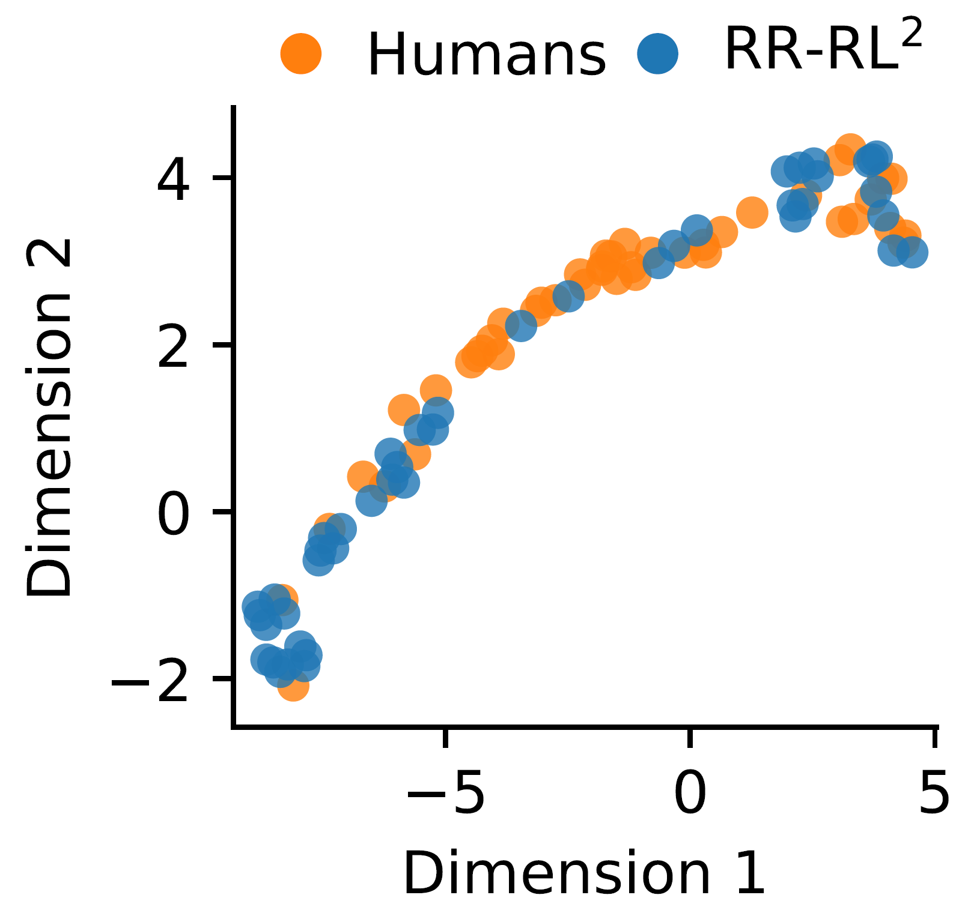
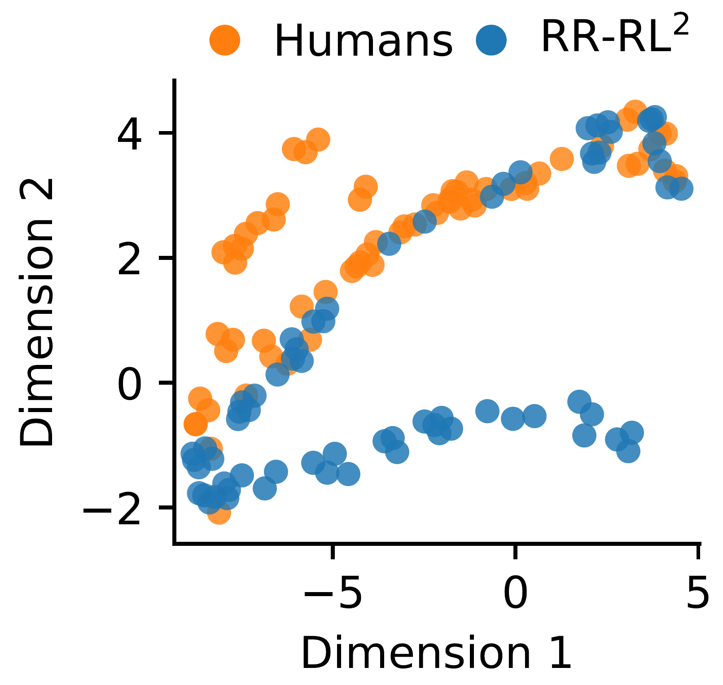
Claim
Evidence
Context
Label
The figure reveals a set of diverse exploration strategies within the human population and confirms that RR-RL 2 captures the overall variability in human exploration appropriately.
Finally, we compared the probit regression coefficients of human participants to the ones of RR-RL2. Figure 1 (b) shows a two-dimensional UMAP embedding (McInnes et al., 2018) of these coefficients.
Supported
The figure reveals a set of diverse exploration strategies within the human population and confirms that RR-RL 2 captures the overall variability in human exploration appropriately.
Finally, we compared the probit regression coefficients of human participants to the ones of RR-RL2. Figure 1 (b) shows a two-dimensional UMAP embedding (McInnes et al., 2018) of these coefficients.
Refuted

