Slide 1
SQL In Data management
Anni Liu
Population health sciences, Weill Cornell Medicine
Nov 4, 2022

Slide 2
What is SQL?
SQL stands for Structured Query Language.
SQL is the language that you use to communicate with a database.
A database can contain many different datasets, or tables, that can be interrelated in some way.

Slide 3
Why use SQL?
You need to be able to communicate with the databases that many companies use to store their data.
You can reuse a SQL query to update your dataset whenever the database itself is updated.
Databases are more secure than localized datasets, and multiple people can read from the same database without any worry that someone is using a different version.

Slide 4
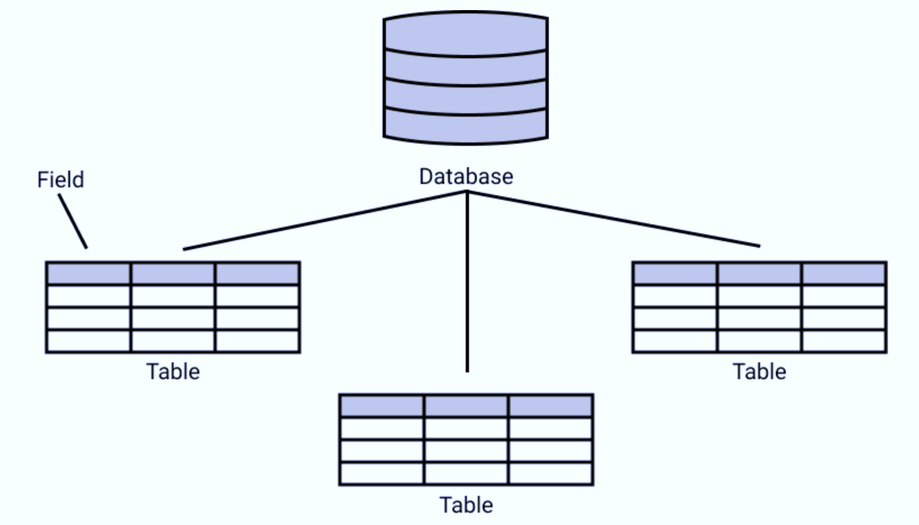
SQL Terminology
A database can contain one or multiple tables. Each tables have columns associated with them, which we refer to as fields.

Slide 5
SQL in R/Python Case study: Data management of Gene & Lipid expression

Slide 6
Q & A

