Slide 1
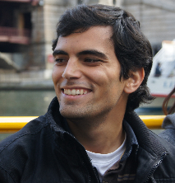
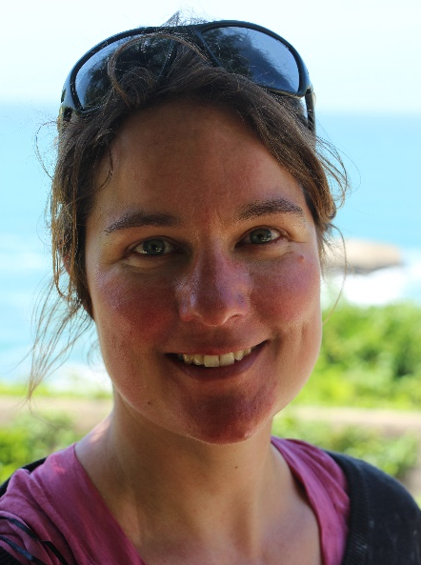
Second Workshop on Capturing Scientific Knowledge
Martine de Vos
Daniel Garijo
http://sciknow.github.io/sciknow2017
#sciKnow2017

Slide 2
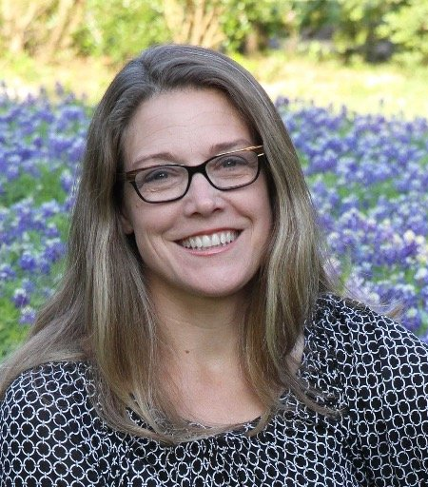
Schedule
Keynote by Suzanne Pierce (TACC): Science-based decision support: From case studies to design patterns en route to achieving implementation for water resources management
9:30-10:30
Session 1: Capturing knowledge from specific scientific domains
11:00-12:15
Panel: The future of scientific knowledge capture
Gully Burns, Mauro Vallati, Francesco Osborne, Takahiro Kawamura, Pablo Calleja, Kemele M. Endris.
12:15-13:00
Session 2: Reproducibility and reusability
14:00-15:30
Session 3: Automated support of scientific processes
16:00-17:30

