Slide 1


Learning Embeddings from Scientific Corpora using Lexical, Grammatical and Semantic Information
Andres Garcia-Silva, Ronald Denaux, Jose Manuel Gomez-Perez
Sciknow 2019
Marina del Rey, California, USA. November 19th, 2019

Slide 2






Scholarly Communications in 2019
Several initiatives to gain better visibility, reuse capabilities and to foster a broader data accessibility. Focus on data and software
Digital Object Identifiers
Data Citation principles
Software Citation principles
Fair Principles
Research Objects
Academic Search Engines
Scientific knowledge graphs

Slide 3
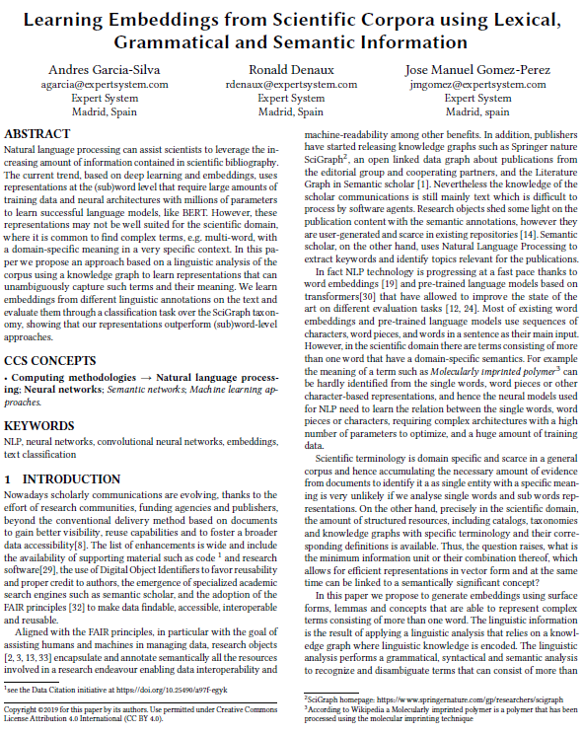
Most of the knowledge is still Text
Content annotations, e.g., in research objects, shed some light on the content
  These annotations are user-generated and scarce
Scientific knowledge graphs assign categories to papers
  SciGraph uses a taxonomy with 22 1st level categories
Natural Language Processing to generate metadata describing the content of the papers
  Semantic scholar extracts keywords and identify topics in publications

Slide 4
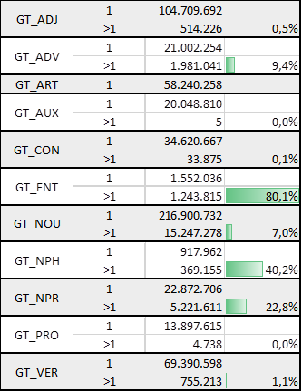
Natural language processing
Continuous improvements (GLUE benchmark)
  Context-free (word2vec, Glove, fastText) and contextual word embeddings (ELMo)
  Deep learning architectures: CNN, [Bi]LSTM, Transformers
  Sequence-to-sequence and neural language models
  Fine-tuning pre-trained language models (ULMFit, OpenAI GPT, BERT, XLNet)
(Sub)word representations: words (GloVe), characters (ELMo), subwords (GPT, BERT), ngrams (fastText)
Nevertheless, scientific literature is rich in multi-word expressions with domain-specific semantics
  “Molecularly imprinted polymer”
  “Cosmic Microwave Background Radiation”…
  …

Slide 5

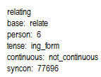
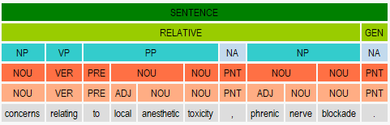

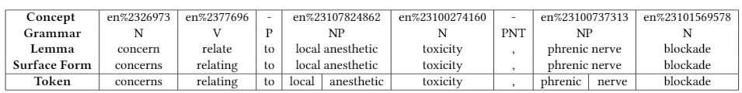
Linguistic rich representations

Slide 6
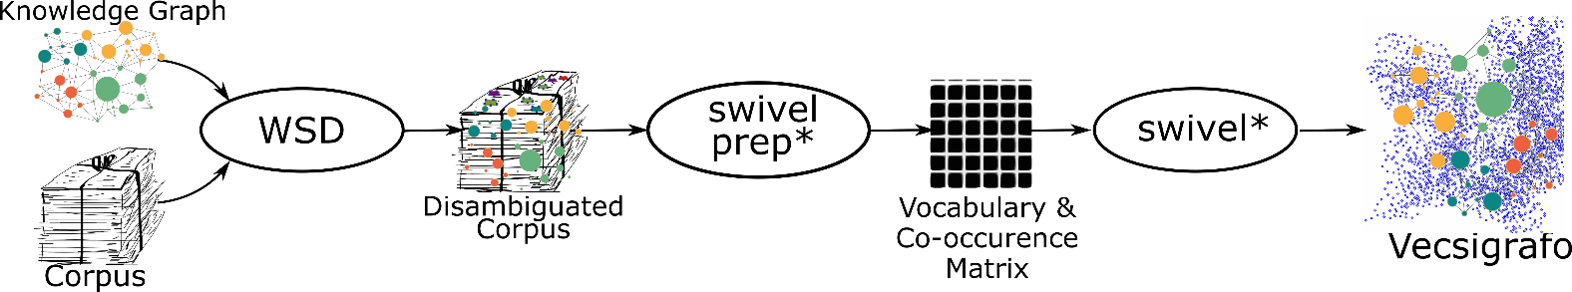

Capturing MWE embeddings with Vecsigrafo
Vecsigrafo jointly learns word and concept embeddings (as opposed to word, sense or knowledge graph embeddings)
Combines corpus-based and graph-based approaches
Extends Swivel to consider both lexical and semantic entries as part of the vocabulary
  The corpus is lemmatized following different tokenization strategies, disambiguated and expanded
  Word, lemma and concept embeddings are then jointly learnt
Vecsigrafo: Corpus-based Word-Concept Embeddings

Slide 7

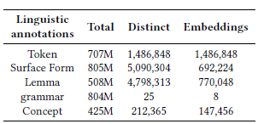
Experimental work
Dataset
Springer Nature SciGraph
Articles and book chapters (2001 to 2017): 3.2 million publications
Titles and Abstracts: 700M tokens, and 1.4M distinct tokens
Linguistic annotations
Cogito, Expert System NLP suite
Word, lemma and concept embeddings
Vecsigrafo

Slide 8
Evaluation task
A multilabel classification task to predict first level categories assigned to publications in SN SciGraph
  E.g., Mathematical Sciences, Engineering or Medical and Health Sciences
Neural architecture: Convolutional neural networks (CNN) for text classification
  Kim’s work (2014) improved the state of the art on different text classification tasks and benchmarks
  Convolutions allow the network to learn features
  Stacking several convolutions enables feature composition

Slide 9

Evaluation task
We used an off-the-shelf CNN implementation available in Keras
3 Convolutional layers, 128 filters and a 5-element window size
As dataset we use publications published in 2011: 187795 papers
To evaluate the classifier we used 10-fold cross validation
Baseline and upper bound classifiers
Random embeddings
Learned by the CNN

Slide 10
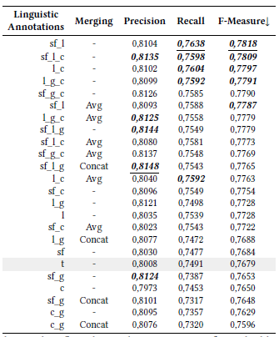

Evaluation results
Single embeddings
  Lemmas > surface forms > tokens > concepts
  Conflating morphological variations (sf and tokens) into lemmas improves learning
  The smaller volume of concept vocabulary affects learning negatively due to OOV
More than one embedding type
  Lemmas and surface forms learn the best classifier
  Precision: Grammar information (PoS) along with either lemmas or surface forms yields the most precise classifiers
  Recall: Lemmas and surface forms best recall. Concept embeddings provide an additional boost
FastText (token & n-grams) ranks 12 compared to above
Notes:
the classifier learning process benefits from the conflation of different term and word variations (sf, t) into a base form (l). However, grouping raw tokens into terms (sf ) only generates a slight improvement in the classifier performance with respect to using only tokens (t).
precision-wise the part-of-speech information in combination with surface forms and lemmas is very relevant
- The recall analysis shows a different picture since the grammar information (g) does not seem to have a decisive role on the classifier performance. Surface forms and lemmas generates the classifier with highest recall. Nevertheless, in this analysis concepts (c) gain more relevance always in combination with either sf
or l. The combination of l and c seems to benefit recall since it is presented in 3 of the top 5 classifiers. In contrast, when concepts are combined with sf the recall is lower

Slide 11
Conclusions
Natural language processing can assist scientists to manage and get insights out of the huge amount of scholarly communications available.
We have shown, in a multilabel classification task, that in the scientific domain embeddings generated on linguistic annotations outperform word and character n-gram representations.
  The conflation of several words in one base form lemma is the best single representation
  Combined, lemma and surface form embeddings get best results overall. Representing both the base form and the morphological variation
  Grammar information impacts positively in the precision of the classifier
  Concepts combined with others improve recall

Slide 12
Future work
Evaluate the linguistic annotation embeddings on other evaluation tasks different from text classification where understanding the glossary can have more impact like entailment and question and answering
Learn a transformers-based language model using linguistic annotations
Test on multiword benchmarks
Research on neural models for compositional semantics:
  Principle of compositionality overall meaning is based not only on the individual meaning but also on syntactic composition
Notes:
MWE datasets
https://github.com/nert-nlp/streusle; a corpus of online reviews hand-annotated for comprehensive multiword expressions and for noun, verb, and preposition supersenses
http://www.cs.cmu.edu/~ark/LexSem/
http://multiword.sourceforge.net/PHITE.php%3Fsitesig%3DFILES%26page%3DFILES_20_Data_Sets
https://www.aclweb.org/anthology/W15-0904/

Slide 13
Jose Manuel Gomez-Perez
R&D Director
jmgomez@expertsystem.com

Slide 14
Evaluation Results
Words and subwords
We use FastText to generate the embeddings because vecsigrafo does not work with character subwords
Token embeddings are better than using token and character-ngram embeddings
Although not directly comparable with vecsigrafo results, we can see that 11 results of vecsigrafo embeddings are better than using FastText character-ngrams embeddings
Notes:
On the other hand, results in table 4 and 5 are not directly comparable
since the embeddings are generated with a different algorithms
(FastText vs Vecsigrafo). For example FastText token embeddings
generate a better classifier than using Vecisgrafo token
embeddings, and remarkably FastText embeddings in both cases
reach the highest precision of all the tested embeddings. Nevertheless,
we can see that the f-measure of the classifier that uses
FastText character-ngram embeddings is lesser than the first 11
results reported in table 4, including the classifier that uses only
lemmas.

