Slide 1
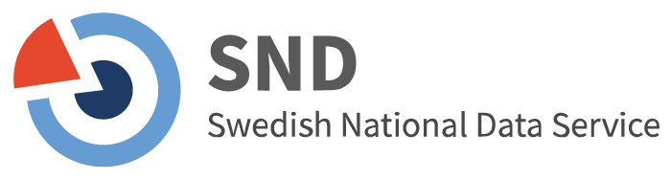
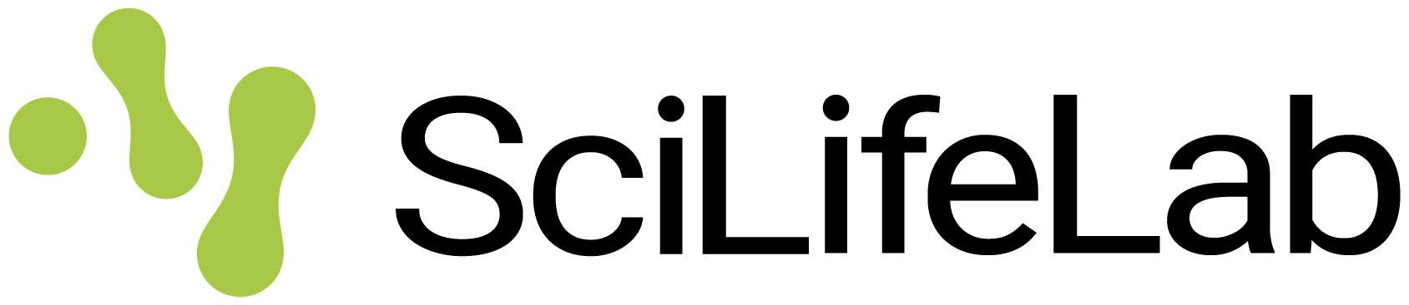
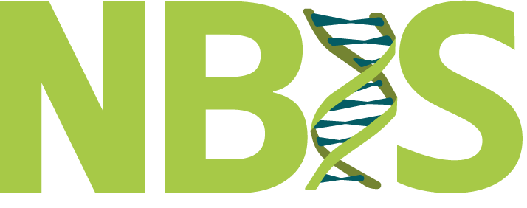

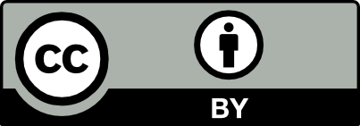
The state of Open Science in Sweden
04/05/2026
SciLifeLab Training Hub
Ineke Luijten, PhD
Notes:
Title: "The state of Open Science in Sweden"
Slides author:
name: "Ineke Luijten"
ORCID: 0000-0001-5768-275X
email: ineke.luijten@scilifelab.se
Part of: Open Science in the Swedish Context, SciLifeLab / NBIS / SND
Url: https://scilifelab-training.github.io/open-science/2605/day1.html
duration: 45 min

Slide 2
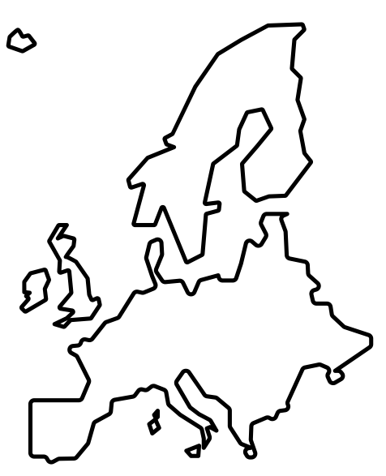
The state of Open Science in Europe
Image europe by Olguioo Noun Project CC-BY 3.0
Notes:
We can now see if there is a discrepancy between what you have already engaged with and what will be expected of you going forward. To do this, we have to look at progression of OS implementation worldwide/in EU/Sweden.
Open Science has been an important policy priority for several years. This has been expressed both in efforts to create common knowledge and understanding, and in conditions for research funding and infrastructural support for open science. Since 2021, open science has been a regulatory obligation within the EU's research and innovation programs.

Slide 3
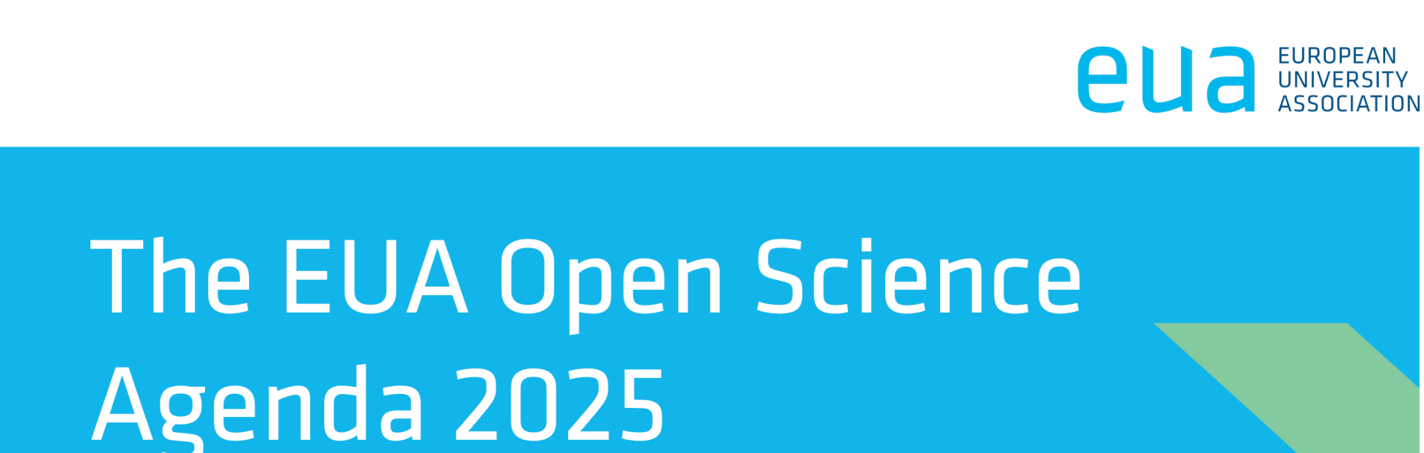


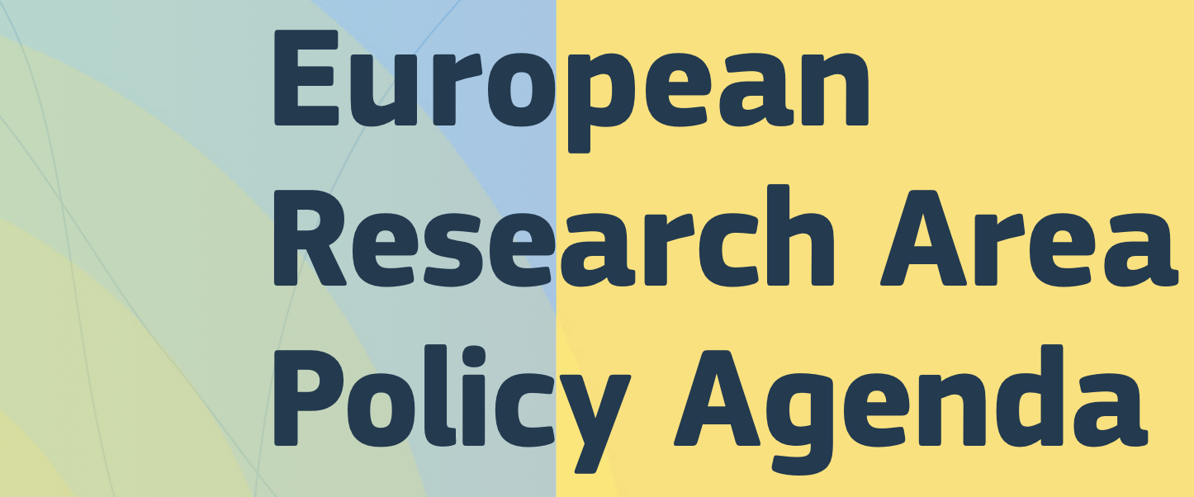
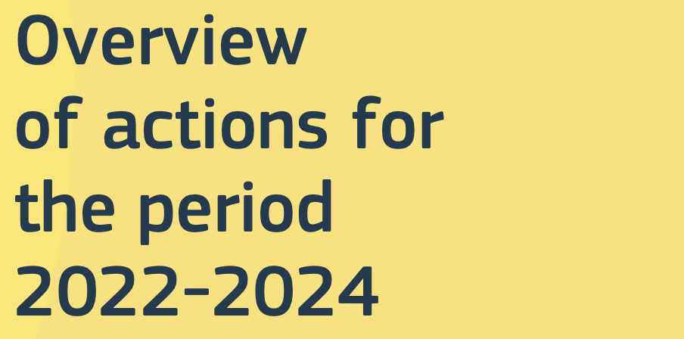


The state of OS policy in Europe
European University Association
Open Access to scholarly outputs, in a just scholarly publishing ecosystem.
Findable, Accessible, Interoperable and Reusable (FAIR) research data.
Institutional approaches to research assessment.
European Commission - European Research Area
Action 1: Enable the open sharing of knowledge and the re-use of research outputs, including through the development of the European Open Science Cloud (EOSC)
Science Europe
the promotion and support of Open Science will contribute to all three strategic priority areas: shape European research policy, contribute to the evolution of research culture, strengthening science in tackling societal challenges
European University Association (2022) EUA Open Science Agenda 2025 https://www.eua.eu/images/eua_os_agenda.pdf CC BY-NC
European Commission (2021) ERA Policy agenda doi:10.2777/52110 CC BY
Science Europe (2021) Strategy plan 2021-2026 doi:10.5281/ZENODO.4911426 CC BY
Notes:
EUA: The European University Association (EUA) is the representative organisation of universities and national rectors’ conferences in 48 European countries. The EUA Open Science Agenda 2025. It defines the association’s priorities in this field, and describes the current context, challenges, developments envisaged for 2025, and the actions EUA will take to drive this Agenda forward. Open Science goes hand in hand with good scientific practices for all aspects of research, as it builds on and contributes to the quality of research and of scholarly outputs. EUA has supported universities in the transition to Open Science for more than a decade.
EC - ERA: The implementation of the EOSC is based on a long-term process of alignment and coordination pursued by the European Commission (EC) since 2015 with diverse stakeholders of the European research landscape. In the initial phase of implementation (2018-2020), the EC invested around EUR 250 million to prototype components of the EOSC through calls for projects under Horizon 2020. The EC also launched an interim EOSC Governance to prepare the strategic orientations for the EOSC implementation post-2020. The current phase of implementation (2021-2030), is taking place in the context of the EOSC European co-programmed partnership and according to a Strategic Research and Innovation Agenda (SRIA), which is co-developed with the entire EOSC community.
Science Europe is the organisation representing major public organisations that fund or perform excellent, ground-breaking research in Europe. It brings together the expertise of some of the largest and most respected European research organisations to jointly push the frontiers of how scientific research is produced and delivers benefits to society. Forte, Formas, VR are a member. Science Europe will meet these priorities through numerous activities. Some activities, such as the promotion and support of Open Science, ERA developments and work related to the EU Framework Programmes for Research and Innovation, will contribute to all three strategic priority areas.

Slide 4


The state of OS infrastructure in Europe
The European Open Science Cloud
Provide researchers and innovators in Europe with an open and trusted multi-disciplinary environment where they can publish, find and reuse data, tools and services for research and innovation.
OpenAIRE
a non-profit organization operating a European e-infrastructure offering a diverse set of public services to accelerate the adoption of Open Science
Notes:
EOSC: The objective of the European Open Science Cloud (EOSC) is to provide researchers and innovators in Europe with an open and trusted multi-disciplinary environment where they can publish, find and reuse data, tools and services for research and innovation. Through this environment, EOSC aims to mobilise, align and scale resources across Europe to accelerate open science, higher productivity and increased reproducibility and trust in research.
EOSC ultimately aims to contribute to a 'web of FAIR (Findable, Accessible, Interoperable and Reuseable) data and services' for science in Europe, upon which a wide range of value-added services can be built.
EOSC is recognised by the Council of the European Union among the priority actions of the policy agenda of the European Research Area (ERA) with the objective to deepen open science practices in Europe. It is also recognised as the common European research and innovation data space, articulated with the other sectoral data spaces defined in the European strategy for data.
OpenAIRE: OpenAIRE (Open Access Infrastructure for Research in Europe) is a non-profit European infrastructure, established in 2018, that provides comprehensive services to support open science, enabling the discovery, management, and monitoring of European research outputs. It is a key provider for the European Open Science Cloud (EOSC). the European network of open repositories and the main infrastructure connecting European research outputs to EOSC. OpenAIRE Explore (explore.openaire.eu) is where Horizon Europe-funded publications and datasets are expected to be findable.

Slide 5

The state of Open Science in Sweden
Image Financial institution by WiStudio Noun Project CC-BY 3.0

Slide 6
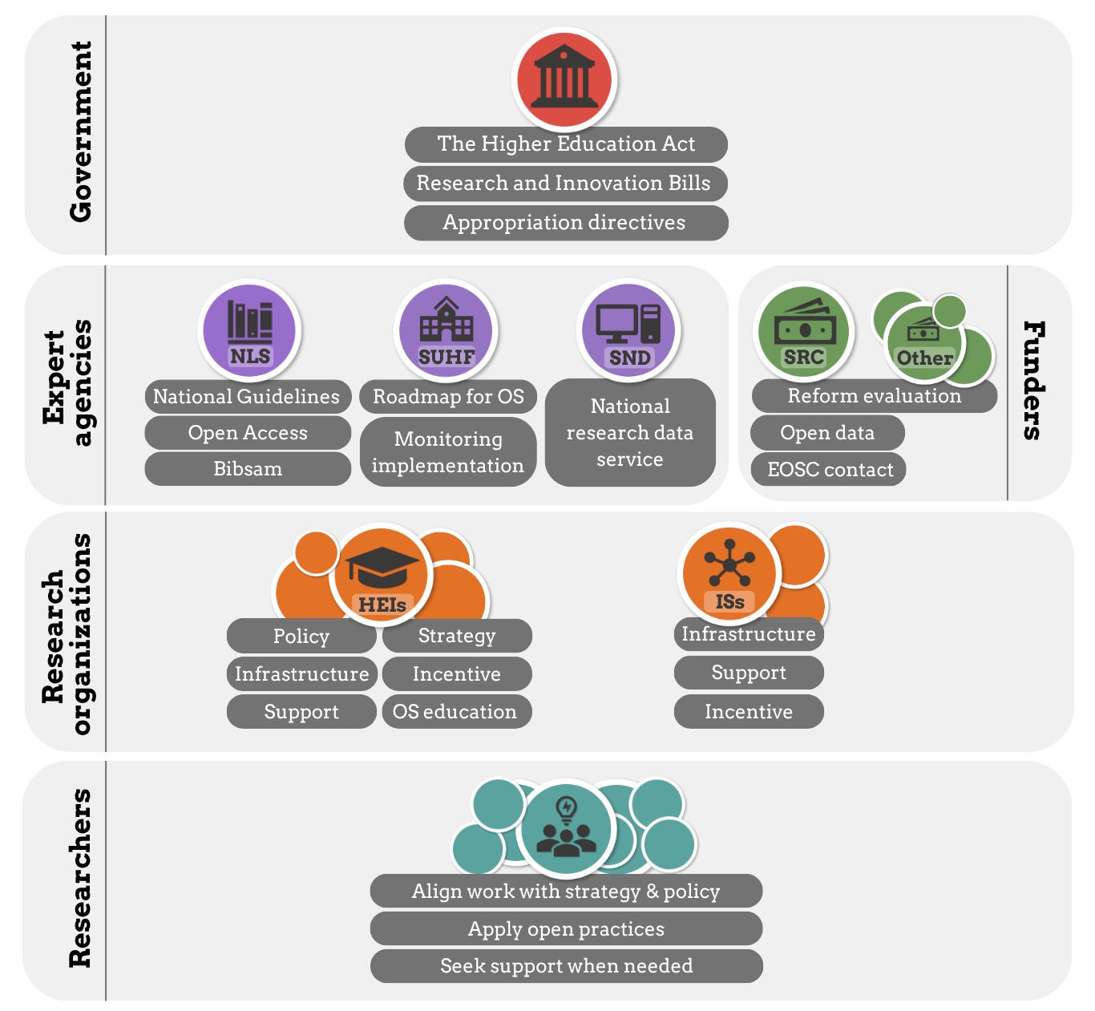
The state of Open Science in Sweden
Image Financial institution by WiStudio Noun Project CC-BY 3.0

Slide 7
The state of Open Science in Sweden
The Swedish government embeds a baseline of openness into the Swedish academic system
Image Financial institution by WiStudio Noun Project CC-BY 3.0
Notes:
Between national policy and university-level decision-making, there are some core principles in Swedish academia that apply to all Swedish universities. These rules are the same everywhere and are not optional, they are built into law and long-standing academic practice. Even though they are not labelled as “Open Science”, they set clear expectations around transparency, access, and responsibility in research. This means there is a shared baseline for how research in Sweden should be carried out, documented, and shared, regardless of where you are enrolled.

Slide 8
The state of Open Science in Sweden
Academic freedom: All researchers have the right to choose and refine their research questions, develop and apply appropriate methods, communicate, publish, and discuss their results
Allmän handling: The public has a constitutional right to access allmänna handlingar (official public documents) held by public authorities
Lärarundantag: teachers and researchers generally retain the rights to materials they create in the course of their academic work
Text: https://scilifelab-training.github.io/open-science/2603/Assignment1.html
Image Financial institution by WiStudio Noun Project CC-BY 3.0
Notes:
Academic freedom
The first foundational principle is academic freedom, which is protected in the Higher Education Act. In Sweden, universities are legally required to safeguard academic freedom as a core condition for research and education. In practice, this means that all researchers — including you as a PhD student — have the right to:
choose and refine their research questions
develop and apply appropriate methods
communicate, publish, and discuss their results
Universities have to not only respect your academic freedom, but also actively protect and promote it by providing appropriate working conditions, supervision, and safeguards. At the same time, academic freedom is not unlimited. It comes with clear responsibilities. The Higher Education Act emphasises academic integrity and good research practice, meaning that you are expected to conduct your research ethically, transparently, and responsibly. To better understand the ethical principles, regulations, and responsibilities that apply to your research, see Good Research Practice 2024, a report published by the Swedish Research Council.
The principle of public access (‘Allmän handling’)
The second foundational principle is transparency in research. In Sweden, this is not only a scientific ideal but a legal requirement. Under the Freedom of the Press Ordinance (Tryckfrihetsförordningen, 1949:105), the public (“allmänheten”) has a constitutional right to access allmänna handlingar (official public documents) held by public authorities. Because public universities are classified as public authorities, many documents created or held within universities fall under this principle.
In practice, this means:
A wide range of material connected to your PhD work may be considered public, e.g. meeting minutes, project documentation (i.e. lab journal), email correspondence, research protocols, and in some cases databases or research records can be requested by anyone.
A person requesting access does not need to explain why, and they may remain anonymous.
If a university refuses to release a document, the decision must be legally justified and can be challenged in the Court of Appeal (‘Hovrätt’).
Transparency also applies over time. Under the Archives Act (Arkivlagen, 1990:782), public authorities (including universities) are required to preserve and manage your research documentation for legal, scientific, and historical purposes. This means that research records connected to your PhD may not only be accessible during your studies, but may also be stored and retrievable long after your project has ended.
As seen above, public access is not unlimited and universities can refuse to release a document. The Public Access and Secrecy Act (Offentlighets- och sekretesslagen, 2009:400) defines what information must be kept confidential, for example to ensure:
Confidentiality: Protecting personal data and sensitive research topics
Legal compliance: Following ethical guidelines and applicable laws
Risk mitigation: Balancing transparency with security
Ethical approvals, data protection legislation (GDPR), and secrecy rules can therefore restrict what may be disclosed, even if a document does exist.
From an Open Science perspective, the principle of public access sets transparency as the default in publicly funded research in Sweden. Openness is assumed unless there are clear legal or ethical reasons not to share. This is why careful documentation, traceability, and responsible data management are central to Swedish research governance and Open Science, and why these practices matter directly in your everyday work.
The teacher’s exemption (‘Lärarundantaget’)
The third foundational legal principle that is applied in Swedish academia is the lärarundantaget (teacher’s exemption). Unlike in many other countries, this means that teachers and researchers generally retain the rights to materials they create in the course of their academic work, rather than these rights automatically transferring to the university as the employer. This give you a comparatively strong position when it comes to ownership of your academic work.
For researchers, lärarundantaget primarily affects intellectual property, such as novel methods, software, algorithms, materials, or therapeutics. If your project develops any of these, you typically have significant influence over how your work is used, shared, or further developed, including whether, when, and how it is made openly available. Some data and materials in projects involving intellectual property might be legitimately exempt from open access requirements, including:
Data protected under intellectual property laws, such as Patent Law (1967:837), where early openness could conflict with innovation, commercialisation, or patentability.
Data that is owned by third parties and protected by Copyright Law (1960:729) that limits redistribution or reuse.
From an Open Science perspective, lärarundantaget can be seen as a double-edged sword. On one hand, retaining rights to your own work gives you the freedom to share materials, add licences that support openness and reuse, and contribute to a transparent research culture. On the other hand, not all outputs can or should be shared immediately. If your work involves innovation, methods, or data that could be patented or are subject to commercial or third-party rights, immediate openness may conflict with patentability, licensing agreements, or intellectual property protections.
This means that you carry the responsibility to make informed decisions about what, when, and how to share your work. Understanding these boundaries early helps you balance openness with ethical, legal, and strategic considerations, ensuring that your research is both responsible and maximally reusable whenever possible.

Slide 9
The state of Open Science in Sweden
Swedish government: Research policy bill 2021-2024
“results of research funded with public funds to be published with immediate open access starting in 2021, and for the transition regarding open access to research data to be fully implemented by 2026 at the latest”
“universities and research funders also have a responsibility to design clear incentives that promote open science.”
Swedish government: Research policy bill 2025-2028
“The transition to an open science system contributes to the efficiency, quality and competitiveness of research by making high-quality research useful for different scientific disciplines, companies and other actors.”
“That research results, and as far as possible digital objects in the research process, meet the FAIR principles and can be reused by everyone (...), is a prerequisite for being able to meet societal challenges.”
Image Financial institution by WiStudio Noun Project CC-BY 3.0
Utbildningsdepartmentet (2020) Prop 2020/21:60 Forskning, frihet, framtid – kunskap och innovation för Sverige. URL
Utbildningsdepartmentet (2024) Prop 2024/25:60 Forskning och innovation för framtid, nyfikenhet och nytta. URL
Notes:
On top of baseline openness, the Swedish government also sets the overall direction for research and Open Science. This is done through research bills and national strategies.
Government 2020
The national direction for open science has been established in the research policy bill from 2020 (Prop. 2020/21:60). The stated goal is for results of research funded with public funds to be published with immediate open access starting in 2021, and for the transition regarding open access to research data to be fully implemented by 2026 at the latest. It is also emphasized that it is a shared responsibility for all actors in the research system, such as universities and research funders, to work to ensure that the goals are met.
From bill 2020/21:60: In 2017, the government commissioned the Swedish Research Council and the Royal Library to develop criteria to assess the extent to which scientific publications and research data that were produced in whole or in part with public funding meet the FAIR principles. The Swedish Research Council represents Sweden on the EOSC Governance Board, where there are delegates from the EU member states. A focus area in the Swedish Research Council's coordination work for open access to research data is the need for data management plans. National coordination on data management plans and requirements in calls for proposals for data management plans has been a first step in promoting good data management.In recent years, the Government has given the Swedish Research Council and the Royal Library a number of assignments regarding open access to research results. Taken together, the assignments provide a clear picture of the Government's focus on open science. Since 2017, the Swedish Research Council and the Royal Library have been tasked with nationally coordinating work on open research data and openly accessible scientific publications, respectively. The Royal Library also has the government's mandate to compile the total expenditure on scientific publishing for universities and colleges.
In 2019, the Royal Library reported a compilation of the total expenditure on scientific publishing, which showed that the costs for 2018 were at least SEK 491 million. In 2019, the Royal Library was also tasked with establishing and managing a national digital platform for openly accessible Swedish scientific journals. Universities and research funders also have a responsibility to design clear incentives that promote open science.
From bill 2024/25:60: The Swedish Research Council is tasked with coordinating and promoting Swedish involvement in EOSC. The Swedish Research Council and the Royal Library have existing coordination assignments on open access (U2019/04423 and U2019/03436 respectively). The authorities' target is that the transition to open access to research results, including scientific publications, artistic works and research data, shall be completed by 2026. For publications, the government has stated that scientific publications that are a result of research financed with public funds shall be openly available with effect from 2021. Universities and higher education institutions are tasked with developing the work on open science and contributing with data to the respective tasks of the Swedish Research Council and the Royal Library to coordinate, follow up and promote collaboration in the work on open access to research data and scientific publications. The implementation of the national guiding and supporting guidelines for open science that have been presented by the Royal Library The library should be monitored regularly and in a coordinated manner to promote a holistic view and increase efficiency in order to achieve the national target.

Slide 10
The state of Open Science in Sweden
Image Financial institution by WiStudio Noun Project CC-BY 3.0
Notes:
Through annual appropriation directives, the government also gives specific tasks to governmental agencies (e.g.the National Library of Sweden and the Swedish Research Council) related to Open Science. These agencies then translate political goals into more concrete actions and guidelines.

Slide 11



The state of Open Science in Sweden
The Royal Library (Kungliga Biblioteket, KB)
Coordinates national work on openly accessible scientific publications
Coordinates the BIBSAM consortium that negotiates agreements with publishers
Compiles the total expenditure on scientific publishing for universities and colleges
Manages Publicera (Swedish OA journals) and SwePub (portal for Swedish research)
Published The National Guidelines for Open Science in 2024
Association of Swedish Higher Education Institutions
Developed the Roadmap for Open Science to provide a road for implementation of OS practices for higher education institutions
Runs an annual survey to track implementation of the Roadmap
Involved in developing incentives that promote open science (CoARA national chapter)
Runs OpenScience.se, a national information and collaboration platform
SND - Swedish National Data Service
Runs the national portal for research data: Researchdata.se and DORIS
Support the accessibility, preservation and reuse of research data and related material.
SUHF (2025) Roadmap for Open Science (revised). Dnr SU-850-005-17
Image Financial institution by WiStudio Noun Project CC-BY 3.0
Notes:
National Library of Sweden (NLS): The government has tasked NLS with coordinating Sweden’s work on open access to publications. They do this mainly through the Bibsam consortium, which negotiates agreements with publishers on behalf of all Swedish universities. Every year, KB publishes a report on its government assignment (see e.g. (12)), showing how many articles and books were openly published in Sweden and the costs of academic publishing. They also manage Publicera, the national digital platform for Swedish open-access journals, and SwePub, a national portal for research that has been published by researchers active in Sweden. In 2024, NLS published the National Guidelines for Open Science, which will be central for your group work in this assignment
Association of Swedish Higher Education Institutions (SUHF): SUHF is a collaboration body for Swedish universities. They developed the Roadmap for Open Science, which provides practical advice for universities on how to implement Open Science. Each year, SUHF also runs a survey to track how universities across Sweden are putting Open Science into practice (see e.g. (13)).
Swedish National Data Service (SND): SND is a national research infrastructure that supports research data management, sharing, and long-term preservation. You can turn to them for guidance on creating data management plans, adding proper metadata, and publishing data according to FAIR principles. Tools like DORIS allow you to describe and publish your research data on the national portal Researchdata.se, making it findable and reusable by others.

Slide 12
The state of Open Science in Sweden
Image Financial institution by WiStudio Noun Project CC-BY 3.0
Notes:
Universities and research funders also have a responsibility to design clear incentives that promote open science.
Universities and higher education institutions are tasked with developing the work on open science and contributing with data to the respective tasks of the Swedish Research Council and the Royal Library to coordinate, follow up and promote collaboration in the work on open access to research data and scientific publications.

Slide 13




The state of Open Science in Sweden
Swedish Research Council (Vetenskapsrådet)
Nationally coordinates work on open research data
Compiles an annual report on progress in open data
Provides guidance and templates for e.g. data management plans
Represents Sweden in the European Open Science Cloud (EOSC)
Formas
Collaborates to develop the European publishing platform ORE
Collaborates to develop infrastructure and capacity for diamond OA
Signed DORA and CoARA
Launched two new grants that will make use of a new, narrative CV-format
Image Financial institution by WiStudio Noun Project CC-BY 3.0
https://formas.se/om-formas/vad-vi-gor/oppen-vetenskap.html#h-Formasarbetemedoppenvetenskap
Notes:
Funders play a key role in driving Open Science because they can require and reward open practices. In Sweden, several funders now explicitly encourage or reward Open Science practices in this way, so your grant applications are not just about the research itself, but also how openly and responsibly you plan to share your outputs. In general, funding requirements include things like:
Publishing your work open access (see e.g. SRC requirements)
FAIR data sharing (see e.g. SRC, and sharpened requirements in 2026)
Data management plans (see e.g. SRC requirements)
Highlighting Open Science contributions in funding applications (e.g. through narrative CVs or special sections in proposals, see e.g. Formas Career grant for ECRs and Formas Explore)
The Swedish Research Council (SRC) is the largest national research funder. SRC has a government mandate to coordinate work on open access to research data. Every year, they publish a report on progress (see e.g. (14)), and they provide guidance, examples, and templates for things like data management plans to help you comply with Open Science expectations.
Formas: Formas participates in the Swedish collaboration node for diamond open access, Diamond OA Sweden. The node brings together representatives from university libraries, the Royal Library and SUHF. The purpose of the collaboration is to promote non-commercial, researcher-led publishing without author fees (APC), so-called diamond open access. The node coordinates support, resources and funding to increase the quality and dissemination of scientific journals and books in Sweden.
Formas, Forte and the Royal Library have also initiated collaboration on a pilot project to develop infrastructure and capacity for diamond open access.
During 2023–2024, we developed two new annually recurring calls, Career Support and Explore. As part of the development work, we have looked at how the applicants' qualifications can be described in a more appropriate way, in line with our commitment within Coara. This resulted in a new CV format, Academic Profile, which has been tested in both Career Support and Explore. The academic profile allows the applicant to describe their experiences and skills in a more narrative form – and how they are relevant to the project in question.

Slide 14
The state of Open Science in Sweden
Image Financial institution by WiStudio Noun Project CC-BY 3.0
Notes:
Higher education institutions are responsible for providing the support and tools that make open practices possible. This includes:
Repositories for publications and research data
Support from the library (publishing guidance) and data stewards (data management advice)
Local Open Science policies and guidance
Training in Open Science practices

Slide 15

The state of Open Science in Sweden
Kungliga Tekniska Högskola
Policy for scientific publishing https://www.kth.se/biblioteket/publicera-analysera/vagledning-for-publicering/kth-s-policy-for-publicering-1.854744
Strategy for working with research data https://intra.kth.se/polopoly_fs/1.1037530.1714460492!/Riktlinje-om-hantering-av-forskningsdata.pdf
Joined CoARA in 2023 https://intra.kth.se/styrning/kvalitetsarbete/forskning/coara-1.1403812
Infrastructure: KTH data repository https://datarepository.kth.se/
Guidance around several topics: sensitive data https://www.kth.se/biblioteket/publicera-analysera/hantera-forskningsdata/planera-och-dokument/rekommendationer-vid-arbete-med-kansliga-data-1.1125398
Data management plans https://dmp.kth.se/?perform_check=false
Support for questions around publications and research data: researchdata@kth.se
Course: Open Science and research data management https://canvas.kth.se/courses/29371
Image Financial institution by WiStudio Noun Project CC-BY 3.0
Notes:
As an example of institutional responsibilities, here is an overview of (a part of) KTH’s policies, support, and guidance for Open Science.

Slide 16
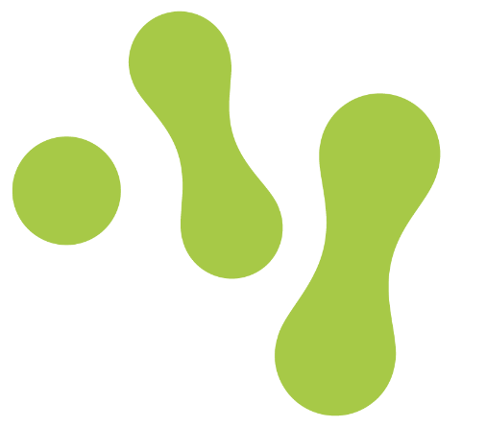
The state of Open Science in Sweden
SciLifeLab
the Data Stewardship Wizard for planning and managing data
the SciLifeLab data repository to deposit datasets
the SciLifeLab Data Platform for guidance and resources
SciLifeLab Training Hub for courses and open educational resources
Joined CoARA in 2024 https://www.scilifelab.se/news/scilifelab-joins-the-coalition-for-advancing-research-assessment/
Image Financial institution by WiStudio Noun Project CC-BY 3.0
Notes:
On top of that, national research infrastructures provide advanced facilities and technologies across universities, including high-performance computing, sequencing, imaging, and other specialized research platforms.
SciLifeLab is one such infrastructure in life sciences. It offers platforms, training, and support for data-intensive research. For Open Science, SciLifeLab provides:
the Data Stewardship Wizard for planning and managing data
the SciLifeLab data repository to deposit datasets
the SciLifeLab Data Platform for guidance and resources
SciLifeLab Training Hub for courses and open educational resources

Slide 17
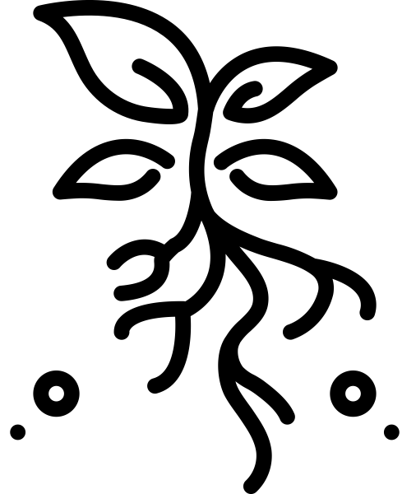
The state of Open Science in Sweden
Image Grass roots by Webtechops LLP Noun Project CC-BY 3.0
Notes:
Researchers (including you)
Open Science ultimately happens in everyday research practice. As a PhD student, this is where theory meets reality: you are the one putting policies and tools into action. This doesn’t mean you do it alone, but it does mean you have a role in implementing open practices. Some ways you might engage with Open Science include (but are not limited to):
Open access publishing: choosing journals or platforms that make your papers freely available. Tools like Publicera or your university’s repository help you comply with requirements.
Data management and sharing: writing and following a data management plan, adding metadata, and depositing data in repositories such as Researchdata.se or SciLifeLab’s repository.
Transparent methods and code: documenting your protocols, code, or lab workflows in a clear way so others can understand and reuse them; GitHub, Zenodo, and Jupyter notebooks are popular tools.
Preprints and early sharing: posting your manuscript on preprint servers (like bioRxiv, arXiv, or medRxiv) to get faster feedback and increase visibility.
Science communication and engagement: sharing your results with non-academic audiences through blogs, social media, open educational resources, or citizen science projects.
Responsible research practices: maintaining research integrity, preregistering studies when appropriate, and carefully considering ethical or legal constraints on openness.

Slide 18
The state of Open Science in Sweden
SUHF: The Roadmap for Open Science
“Academic freedom, good research practice, and open access to research results are all necessary for research to be reproducible and reusable, which in turn promotes new knowledge”
“Open science will become a natural part of a researcher’s daily work. It is the responsibility of each researcher to understand and embrace the requirements and opportunities that the new scientific system entails.”
KB : The National Guidelines for Open Science
“A transition to open science needs to occur in the everyday research practices involving research data, in scholarly publishing, and throughout the research process. Researchers have a responsibility to continuously work towards open science in their daily practices by developing approaches themselves and by applying the approaches and routines developed by relevant organisations and within specific fields.”
Image Grass roots by Webtechops LLP Noun Project CC-BY 3.0
SUHF (2025) Roadmap for Open Science (revised). Dnr SU-850-005-17
Kungliga Biblioteket (2024) National guidelines for Open Science. Dnr KB-2024-42
Notes:
From the guidelines: The purpose of the work on open science is to contribute to improving both the quality of science and the interaction between research and the surrounding society. Through open science, a foundation for future research is laid, built on transparency, reproducibility, and increased opportunities to benefit from scientific information. Open science fosters knowledge growth, innovation, competitiveness, and more efficient use of resources.
The guidelines serve as a link between, on the one hand, international efforts and recommendations, and on the other hand, the ongoing work at the national level that needs to be developed primarily within research performing and research funding organisations. While the national guidelines focus specifically on the direction for open science in Sweden The national work for open access to scholarly publications monitored by KB The national work for open access to research data monitored by VR policies and strategies evaluated and monitored by HEIs
The guidelines cover the following six areas, in which development is ongoing and which therefore are prioritised and crucial to fully develop in Sweden: Open access to scholarly publications Open access to research data Open research methods Open educational resources Public engagement in science Infrastructures supporting open science

Slide 19
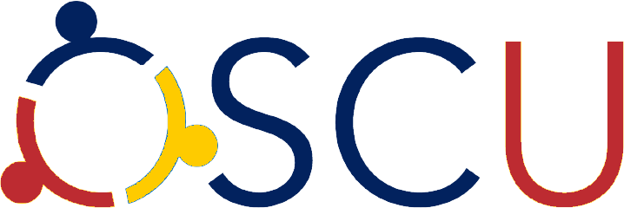

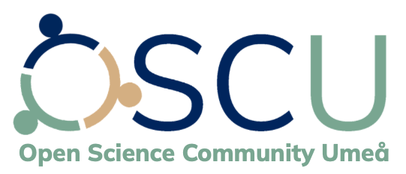
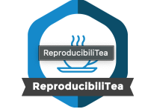

The state of Open Science in Sweden
Open Science Communities: hubs where academics learn from their peers how to make their workflows more open
Open Science Community Uppsala
ReproducibiliTea: grassroots journal club initiative that helps researchers create local Open Science journal clubs at their universities to discuss diverse issues, papers and ideas about improving science, reproducibility and the Open Science movement
The Swedish Reproducibility Network: a peer-led network of researchers with the goal to make research results more reliable.
Image Grass roots by Webtechops LLP Noun Project CC-BY 3.0
Open Science Community Sweden URL. Open Science Community Uppsala URL. Open Science Community Umeå URL. ReproducibiliTeaURL
Notes:
Open science community Lund started in 2025
Can also be involved at european level, OpenAire, EOSC, webinars etc

Slide 20
Open Science: from policy to practice

Slide 21
Open Science: from policy to practice
Policy
Make it required
Incentive
Make it rewarding
Community
Make it normative
User Interface/Experience
Make it easy
Infrastructure
Make it possible
Adjusted from: Brian Nosek - The Center for Open Science (2019) Strategy for culture change.
Notes:
To bring about culture change, several practices have to be aligned.
In summary, over the last decade, we've seen a growing number of national and international policies advocating for open access, open data, and research transparency. Think of the UNESCO Open Science Recommendation, the Horizon Europe open science mandates, and national strategies like Sweden’s Open Science roadmap.
But the big challenge with open science is the implementation. What does it actually look like to practice open science? It involves using repositories for sharing data and code, choosing open licenses, making training materials FAIR, involving citizens in research, and publishing in open access formats—even when the incentives aren’t fully aligned yet.

Slide 22

Open Science: from policy to practice
For your own institution, reflect on the following:
Are there policies in place (OA/data sharing/other)?
Is there incentive/reward?
Is there an OS community?
Is there infrastructure in place?
Is OS infrastructure easy to use?
Notes:
To bring about culture change, several practices have to be aligned.
In summary, over the last decade, we've seen a growing number of national and international policies advocating for open access, open data, and research transparency. Think of the UNESCO Open Science Recommendation, the Horizon Europe open science mandates, and national strategies like Sweden’s Open Science roadmap.
But the big challenge with open science is the implementation. What does it actually look like to practice open science? It involves using repositories for sharing data and code, choosing open licenses, making training materials FAIR, involving citizens in research, and publishing in open access formats—even when the incentives aren’t fully aligned yet.
https://miro.com/app/board/uXjVHaz88z8=/?share_link_id=501085818387
Board password OpenScience

Slide 23
How to implement Open Science
Notes:
Post exercise: How can researchers practically incorporate open science practices into their research workflow

Slide 24


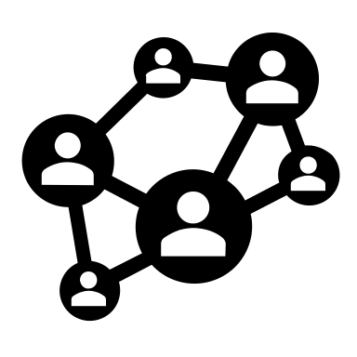
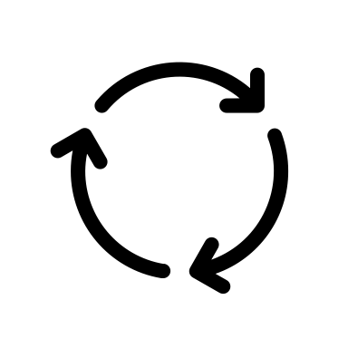








How to implement Open Science
The Open Science workflow
Plan &
Design
Collect &
Analyse
Publish &
Spread
Access &
Reuse
Evaluate &
Build
Communicate & Involve
Evaluate IP potential
Determine research type
Choose transparent practices
Write a DMP
Reuse data from data repositories
Use open-source software for method documentation & data analysis
Publish preprints
Publish Open Access
Publish all research outputs
Practice Open peer review
Deposit all outputs in open repositories
Use open licensing
Attach persistent identifiers
Add rich metadata
Use responsible research metrics
Adopt qualitative research assessment
Track Open Science contributions
Share key insights through (social) media
Encourage Citizen Science
Turn research into MOOCs or OERs
Notes:
Plan & Design:
Consider participatory or citizen science approaches to involve diverse stakeholders early.
Pre-register study protocols (e.g., on OSF, AsPredicted, or ClinicalTrials.gov) to reduce bias and improve reproducibility: ensure study design is peer-reviewed before data collection.
Plan for crowdsource feedback on study design: Engage with the scientific community via preprint servers, discussion forums (e.g., ResearchGate, Twitter/X, Mastodon), workshops, or share hypothesis through open lab notebooks.
Predefine analysis workflows & pipelines to avoid "p-hacking" and questionable research practices.
Create a data management plan DMP including the following:
structured plan for data collection, storage, sharing, and long-term preservation (aligning with FAIR principles).
GDPR, informed consent, and anonymization strategies for open data sharing.
allocation of funding for open-access publishing, data repositories, and open-source tool development.
Collect & Analyze:
Select interoperable file formats (CSV, JSON, XML) to ensure future reuse.
Document methods in a transparent, reusable way by using open tools (e.g., Jupyter Notebooks, RMarkdown, Protocols.io).
Analyse data using open-source software & tools (R, Python, JASP, OpenRefine, OpenSesame, etc)
Share data in real-time using electronic lab notebooks (ELNs) or Open platforms like eLabFTW, Jupyter Notebooks, OpenLabArchives, OSF or GitHub.
Use version control systems for data & code to track changes in scripts and datasets, e.g. GitHub, GitLab, or OSF.
Automate analyses for reproducibility by using workflow management tools (e.g., Snakemake, Nextflow)
Share & publish:
Write collaboratively on open, version-controlled platforms like Overleaf (LaTeX), Google Docs, or Manubot.
Manage references and bibliographies openly with tools like Zotero and OpenCitations.
Post early manuscript versions on preprint servers (e.g., bioRxiv, arXiv, PsyArXiv) to get feedback before peer review.
Openly share all outputs:
avoid publication bias by publishing negative/null results
supplementary materials: include extended datasets, protocols, and additional figures in repositories like Zenodo or OSF.
publish scripts/code/computational workflows in repositories like Zenodo, GitHub, or Software Heritage with clear documentation.
Publish in fully open-access journals (e.g., PLOS, eLife) or use institutional agreements for APC-free publishing and deposit accepted manuscripts in institutional or subject repositories (e.g., Europe PMC, arXiv, HAL).
Opt for open peer review: choose journals that allow reviews to be published alongside articles (e.g., PeerJ, F1000Research, eLife).
Engage in post-publication review by using platforms like PubPeer.
Cite and credit open peer reviewers when reviews are public.
Access & reuse:
Deposit all research outputs (raw data) in open-access repositories (e.g., Zenodo, Dryad, Figshare) and/or share on collaborative platforms (e.g., GitHub, OSF, Wikidata).
Ensure others can easily understand and reuse your work:
Annotate with rich metadata using community standards (e.g., Dublin Core, DDI, or BioSchemas).
Attach open licenses to all research outputs: Creative Commons (CC-BY) for publications and datasets, open-source licenses (MIT, GPL) for software.
Obtain persistent identifiers (PIDs) for all research outputs: link publications, datasets, software, and methods using DOIs (via ORCID).
Include README files
Include usage guidelines (e.g. license details, preferred citation).
Encourage reuse through Open Science communities by sharing findings in The Turing Way, ResearchGate, or discipline-specific forums.
Evaluate & build:
Avoid over-reliance on impact factors when evaluating research; use responsible research metrics like Altmetrics, citation networks, and software citations.
Ensure visibility and proper attribution by linking all research outputs to ORCID & institutional profiles.
Track reuse, mentions, citations, and discussions of research outputs through Altmetric, PlumX, OpenCitations.
Cite non-traditional research outputs (datasets, software, protocols, and educational materials) using appropriate citation formats.
Adopt narrative CVs & qualitative assessments which highlight a broad range of contributions (data, code, teaching, policy impact) beyond just publications.
Communicate & reach out:
Involve non-scientists in research projects (e.g., Zooniverse, Foldit) through public outreach and citizen science
Write easy-to-understand summaries for the general public (e.g., blogs, news articles, Wikipedia).
Share key insights on social media & online platforms Twitter/X, LinkedIn, Mastodon, ResearchGate.
Summarize research for policymakers and stakeholders in policy briefs or white papers.
Work with institutional PR teams or freelance science writers to encourage media coverage & science journalism
Turn research findings into open educational resources (OERs) or Massive Open Online Courses (MOOCs, e.g. via OpenLearn, MIT OpenCourseWare).

Slide 25
How to implement Open Science
Reflect on how you can integrate OS into your own workflow!
Plan &
Design
Collect &
Analyse
Publish &
Spread
Access &
Reuse
Evaluate &
Build
Communicate & Involve
Evaluate IP potential
Determine research type
Choose transparent practices
Write a DMP
Reuse data from data repositories
Use open-source software for method documentation & data analysis
Publish preprints
Publish Open Access
Publish all research outputs
Practice Open peer review
Deposit all outputs in open repositories
Use open licensing
Attach persistent identifiers
Add rich metadata
Use responsible research metrics
Adopt qualitative research assessment
Track Open Science contributions
Share key insights through (social) media
Encourage Citizen Science
Turn research into MOOCs or OERs
Notes:
Plan & Design:
Consider participatory or citizen science approaches to involve diverse stakeholders early.
Pre-register study protocols (e.g., on OSF, AsPredicted, or ClinicalTrials.gov) to reduce bias and improve reproducibility: ensure study design is peer-reviewed before data collection.
Plan for crowdsource feedback on study design: Engage with the scientific community via preprint servers, discussion forums (e.g., ResearchGate, Twitter/X, Mastodon), workshops, or share hypothesis through open lab notebooks.
Predefine analysis workflows & pipelines to avoid "p-hacking" and questionable research practices.
Create a data management plan DMP including the following:
structured plan for data collection, storage, sharing, and long-term preservation (aligning with FAIR principles).
GDPR, informed consent, and anonymization strategies for open data sharing.
allocation of funding for open-access publishing, data repositories, and open-source tool development.
Collect & Analyze:
Select interoperable file formats (CSV, JSON, XML) to ensure future reuse.
Document methods in a transparent, reusable way by using open tools (e.g., Jupyter Notebooks, RMarkdown, Protocols.io).
Analyse data using open-source software & tools (R, Python, JASP, OpenRefine, OpenSesame, etc)
Share data in real-time using electronic lab notebooks (ELNs) or Open platforms like eLabFTW, Jupyter Notebooks, OpenLabArchives, OSF or GitHub.
Use version control systems for data & code to track changes in scripts and datasets, e.g. GitHub, GitLab, or OSF.
Automate analyses for reproducibility by using workflow management tools (e.g., Snakemake, Nextflow)
Share & publish:
Write collaboratively on open, version-controlled platforms like Overleaf (LaTeX), Google Docs, or Manubot.
Manage references and bibliographies openly with tools like Zotero and OpenCitations.
Post early manuscript versions on preprint servers (e.g., bioRxiv, arXiv, PsyArXiv) to get feedback before peer review.
Openly share all outputs:
avoid publication bias by publishing negative/null results
supplementary materials: include extended datasets, protocols, and additional figures in repositories like Zenodo or OSF.
publish scripts/code/computational workflows in repositories like Zenodo, GitHub, or Software Heritage with clear documentation.
Publish in fully open-access journals (e.g., PLOS, eLife) or use institutional agreements for APC-free publishing and deposit accepted manuscripts in institutional or subject repositories (e.g., Europe PMC, arXiv, HAL).
Opt for open peer review: choose journals that allow reviews to be published alongside articles (e.g., PeerJ, F1000Research, eLife).
Engage in post-publication review by using platforms like PubPeer.
Cite and credit open peer reviewers when reviews are public.
Access & reuse:
Deposit all research outputs (raw data) in open-access repositories (e.g., Zenodo, Dryad, Figshare) and/or share on collaborative platforms (e.g., GitHub, OSF, Wikidata).
Ensure others can easily understand and reuse your work:
Annotate with rich metadata using community standards (e.g., Dublin Core, DDI, or BioSchemas).
Attach open licenses to all research outputs: Creative Commons (CC-BY) for publications and datasets, open-source licenses (MIT, GPL) for software.
Obtain persistent identifiers (PIDs) for all research outputs: link publications, datasets, software, and methods using DOIs (via ORCID).
Include README files
Include usage guidelines (e.g. license details, preferred citation).
Encourage reuse through Open Science communities by sharing findings in The Turing Way, ResearchGate, or discipline-specific forums.
Evaluate & build:
Avoid over-reliance on impact factors when evaluating research; use responsible research metrics like Altmetrics, citation networks, and software citations.
Ensure visibility and proper attribution by linking all research outputs to ORCID & institutional profiles.
Track reuse, mentions, citations, and discussions of research outputs through Altmetric, PlumX, OpenCitations.
Cite non-traditional research outputs (datasets, software, protocols, and educational materials) using appropriate citation formats.
Adopt narrative CVs & qualitative assessments which highlight a broad range of contributions (data, code, teaching, policy impact) beyond just publications.
Communicate & reach out:
Involve non-scientists in research projects (e.g., Zooniverse, Foldit) through public outreach and citizen science
Write easy-to-understand summaries for the general public (e.g., blogs, news articles, Wikipedia).
Share key insights on social media & online platforms Twitter/X, LinkedIn, Mastodon, ResearchGate.
Summarize research for policymakers and stakeholders in policy briefs or white papers.
Work with institutional PR teams or freelance science writers to encourage media coverage & science journalism
Turn research findings into open educational resources (OERs) or Massive Open Online Courses (MOOCs, e.g. via OpenLearn, MIT OpenCourseWare).

Slide 26

Coffee break!
Next topic at 15:00

