Slide 1

Data Management Plans
and research integrity tools
Stephan Nylinder
Notes:
title: "Data Management Plans"
author:
name: "Elin Kronander"
orcid: 0000-0003-0280-6318
email: elin.kronander@nbis.se
Part of: Open Science in the Swedish context 2025-05-05 – 09 Url: https://scilifelab-training.github.io/open-science/2505/
duration: 75 minutes

Slide 2
Research integrity
What is meant by research integrity?
Ensures results are trustworthy, verifiable, and reproducible
Data is handled correctly
Logic behind study stays honest
DMP
Pre-registration
Research Data Management
Notes:
https://www.mentimeter.com/app/presentation/alarjznwtik51ypcw2gn1h7safswyjsv/edit?question=iw2r9ervu3b2
https://www.menti.com/aloedrho39o6

Slide 3


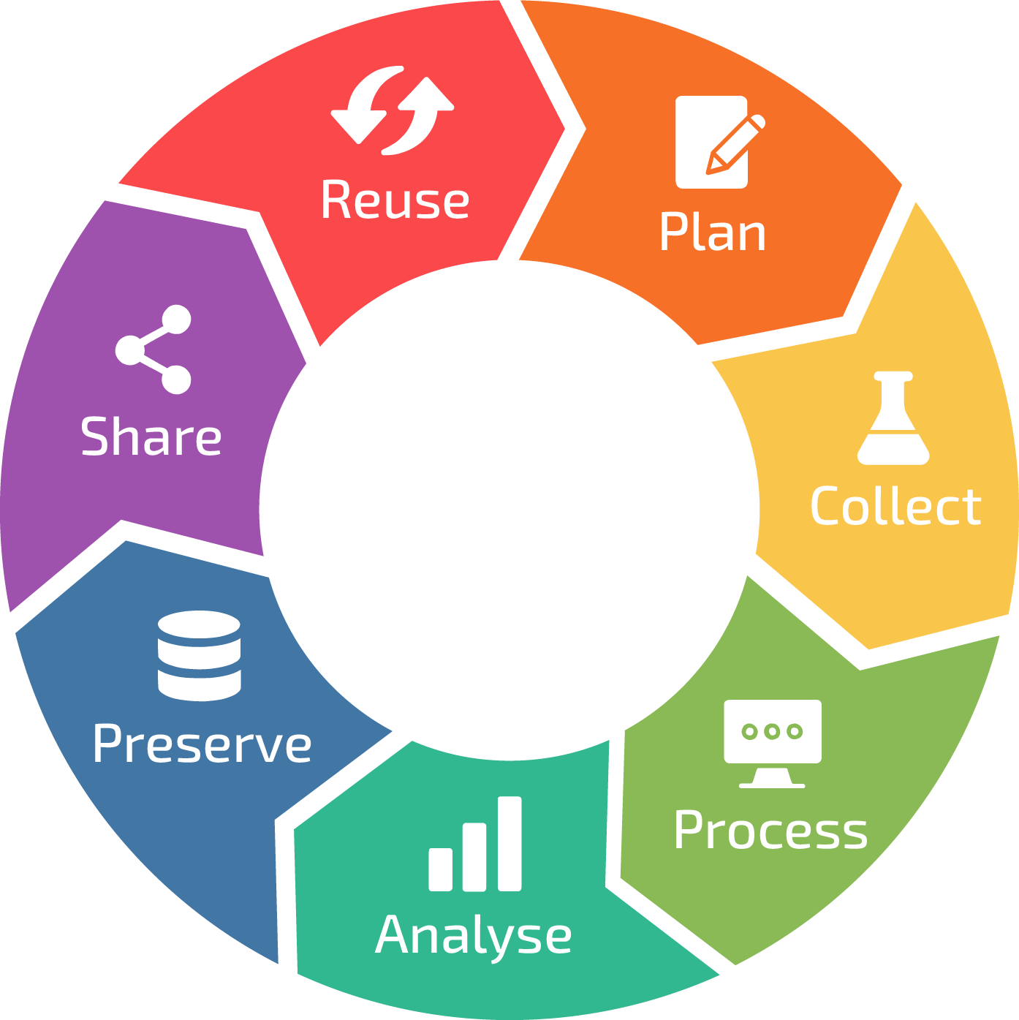








Research data management
Raw data
Processed data
Data about data (metadata)
…
Note! Not all data is digital!
Data Life Cycle by RDMkit used under CC-BY
Notes:
DM is an umbrella term covering topics for dealing with data and other research outputs both on a day to day basis (organizing it, structuring it, choosing appropriate software or other technologies to manage it with, storing it, backing it up, and so forth)
as well as long term solutions like (sharing and preservation, for example). And not to forget, ethical and legal considerations. Data management in needed throuhgout the data life cycle, but the needs will differ.
It all boils down to being transparent and conducting trustworthy and high quality research and to make the most out of the data by reuse by yourself and others. You are all managing data and applying data management strategies in one or several ways already but to make your project more efficient and your life easier it can be very useful to adhere to best practices.

Slide 4

“To promote the usability of research data that is made openly accessible, the data management should follow the FAIR principles.”
The report compiles the Swedish Research Council’s recommendations for
open access to research data
marking and licences when making research data openly accessible
criteria for FAIR data management
data management plans.
ISBN 978-91-89845-28-2
Notes:
The Swedish Research Council's recommendations describe the initiatives needed to achieve a full transition to open access to FAIR research data.
The report gathers together the Swedish Research Council's recommendations on:
open access to research data
marking and licences when making research data openly accessible
criteria for FAIR data management
data management plans
The recommendations are primarily aimed at the managements of research performing bodies and research funding bodies. They can also be used by other actors to increase the understanding and knowledge of what the transition to open access to research data entails, and how it is achieved.
https://www.vr.se/english/analysis/reports/our-reports/2025-03-24-the-swedish-research-councils-recommendations-for-research-data-fair-and-open-access.html

Slide 5
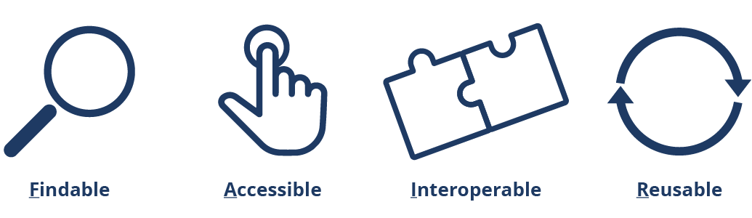
The FAIR principles
FAIR principles illustration. SND/Svensk nationell datatjänst. CC-BY 4.0
Notes:
The FAIR principles are a fundamental part of open science, and describe some of the central guidelines to good data management and open access to research data.
that data should be easily accessed, understood, exchanged and reused
FAIR research data shall be Findable, Accessible, Interoperable, and Reusable.

Slide 6
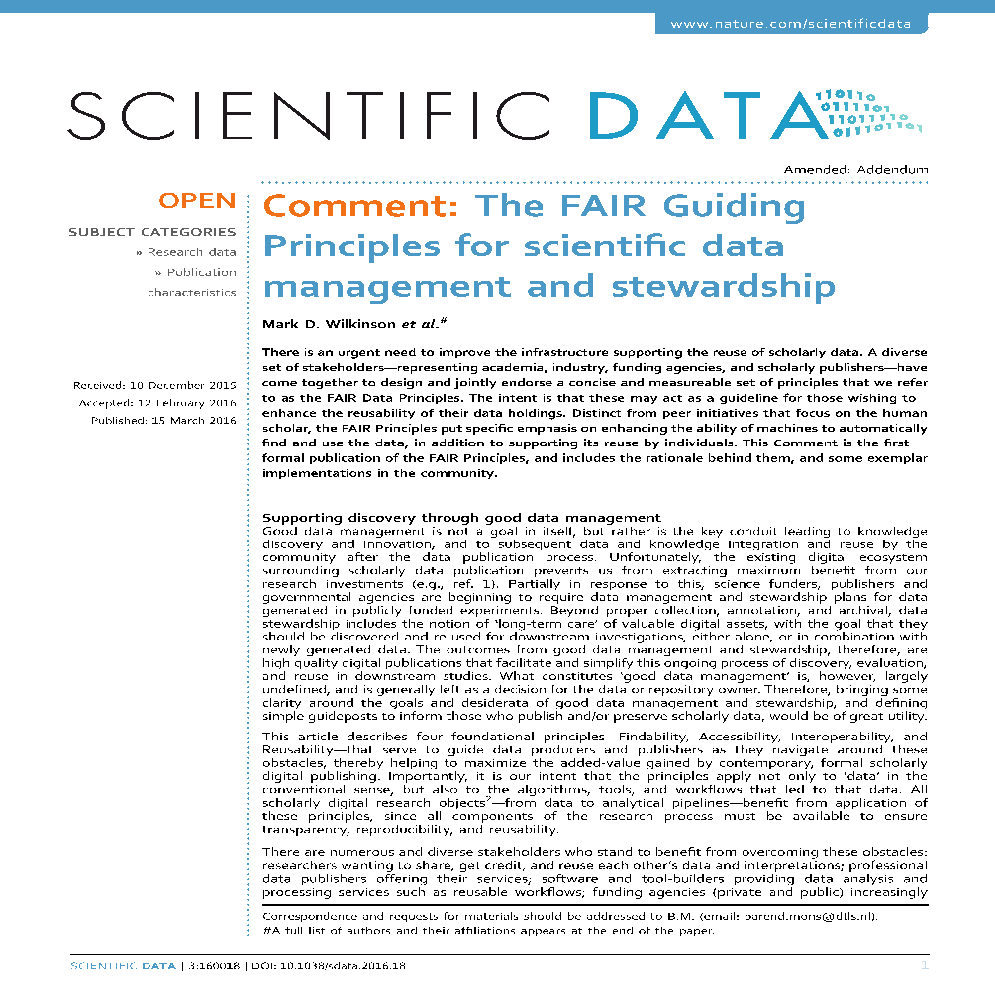
The FAIR principles
Promote efficient data discovery and reuse by providing guidelines to make digital resources
Findable
Accessible
Interoperable
Reusable
Address aspects enabling software and infrastructure to automatically find and use research data
Wilkinson et al. (2016). The FAIR Guiding Principles for scientific data management and stewardship. Scientific Data, 3(1), 160018. doi:10.1038/sdata.2016.18
Notes:
FAIR in short
The FAIR data principles were first published in 2016. 15 FAIR principles - applied to research in all scientific disciplines. Since then, they have received worldwide recognition been adopted by for instance the European Comission and a large number of research funding organisations, universities, and research infrastructures.
Concept has broadened FAIR software, FAIR training material, FAIR research

Slide 7
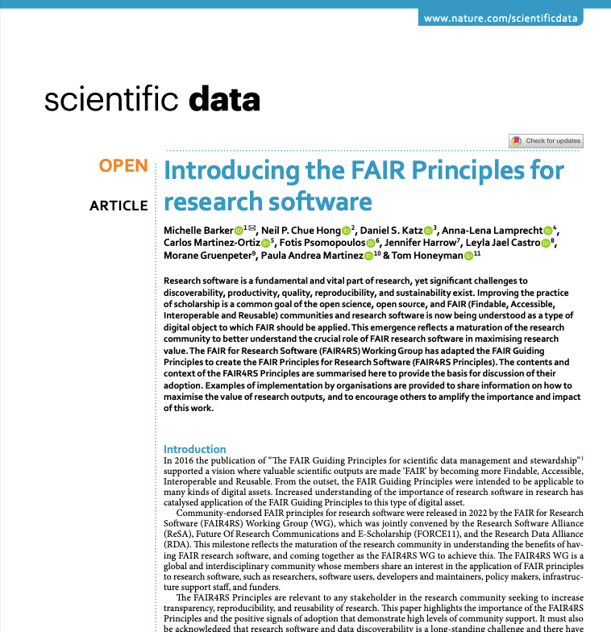
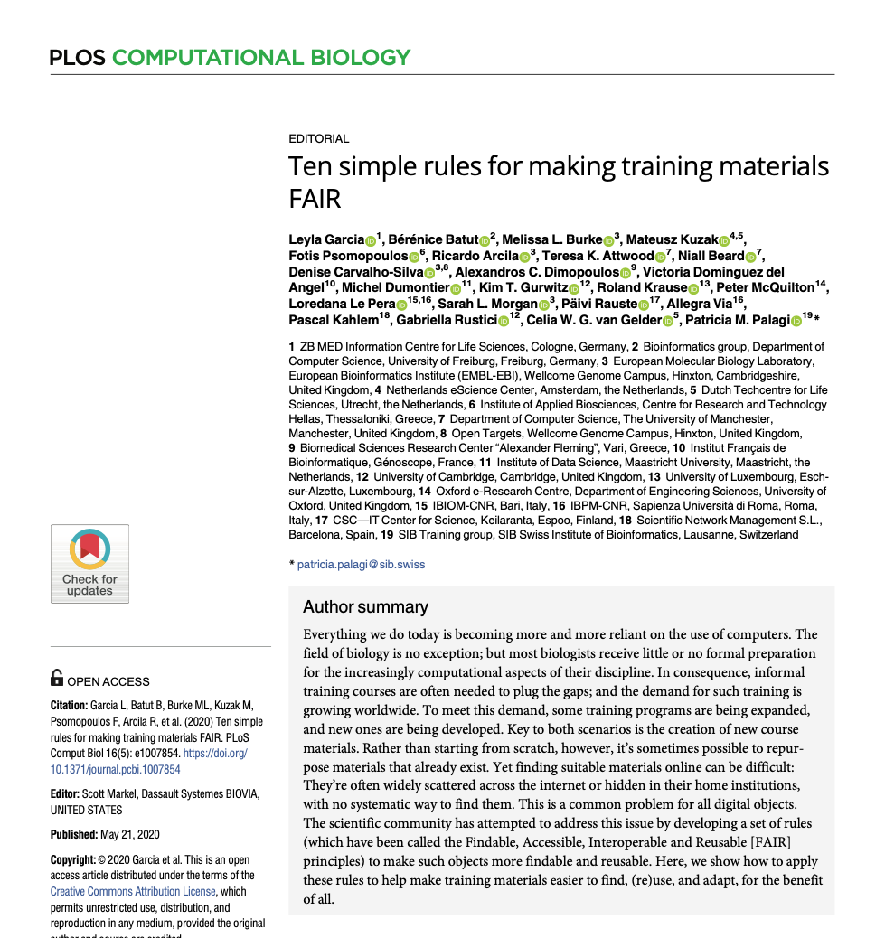
Barker, M., Chue Hong, N.P., Katz, D.S. et al. Introducing the FAIR Principles for research software. Sci Data 9, 622 (2022). https://doi.org/10.1038/s41597-022-01710-x
Garcia L, Batut B, Burke ML, Kuzak M, Psomopoulos F, Arcila R, et al. (2020) Ten simple rules for making training materials FAIR. PLoS Comput Biol 16(5): e1007854. https://doi.org/10.1371/journal.pcbi.1007854

Slide 8
Data Management Recipients
People I collaborate with must understand what I do with the data
Colleagues
Scientific community
Society
Yourself
Scientists wanting to reuse or review my data can find and understand the data
The society funding my research have a right to know what happens to the data
Your future You will not always remember what Your present You decided today
Notes:
First, let me ask you, who are the recipients of Data Managemenet practices, who will benefit from you adhering to these good data management practices?

Slide 9
“Your primary collaborator is yourself six months from now, and your past self doesn’t answer e-mails,”
-Rachael Ainsworth
Notes:
Rachael Ainsworth,
Astrophysicist at the University of Manchester, UK.
‹#›

Slide 10
Data Management - DMP (Data management plan)
Data organisation
Information security
Documentation
Publish Data
Workflow
Data Dictionary
GDPR
Storage
FAIR
Ontologies
Versioning
DOI
Data Life Cycle
File naming
Open Science
Metadata
Repositories
File format
License
Archiving
Ethics
DMP
Notes:
Data management is a crucial aspect of any research or project involving data. (In Data Management we talk about data organization, metadata, dictionaries, making data FAIR etc,)
But how can we assure that we meet all these aspects? How can we ensure that our data is handled effectively and consistently throughout its life cycle?
The short answer is to write a data management plan.

Slide 11
Data Management - Pre-registration
Hypothesis
Statistical model
Power analysis
Methodology
Outlier rules
Secondary outcomes
Blinding
Masking
Variables
P-hacking
DOI
Stopping rules
Exclusion criteria
Expectations
Metadata
Sample sizes
Samples
Harking
Primary outcome
Archiving
Pre-registration
Notes:
Data management is a crucial aspect of any research or project involving data. (In Data Management we talk about data organization, metadata, dictionaries, making data FAIR etc,)
But how can we assure that we meet all these aspects? How can we ensure that our data is handled effectively and consistently throughout its life cycle?
The short answer is to write a data management plan.

Slide 12
What is a DMP?
A document addressing requirements and practices for managing the project’s data, code and documentation throughout the data life cycle.
Outlines the data management strategies, and how the data is:
collected
documented
organised
preserved
Data Life Cycle by RDMkit used under CC-BY
Notes:
A data management plan (DMP) is a document addressing requirements and practices for managing the project’s data, code and documentation, throughout the data life cycle, i.e from the initial planning until the project ends and beyond.
It outlines the data management strategies in a project.
Making plans for how you will collect, document, organize, and preserve your data are all part of the data management strategy.

Slide 13
Why should you write a DMP?
Identify data management gaps
Define responsibilities
Estimate costs
Facilitate collaboration by setting project wide standards (e.g. data organisation, naming conventions, metadata standards, vocabulary)
Data Life Cycle by RDMkit used under CC-BY
Notes:
There are several reasons why writing a data management plan is a very good idea:
Think of the DMP as a checklist, and going through the checklist allows you to identify gaps in current data management strategies. Identifying the gaps early on saves a lot of headache and time spent later. Going through the process of planning is more important than the actual plan itself.
In a project with several members, it is important to decide on standards that all collaborators should adhere to, e.g. regarding how to organise the data, how to name it, which metadata standards to use, what vocabularies to use, etc.
Writing a DMP also enables you to estimate costs with regards to data production, storage, data management, etc.
It is also a good way to clarify responsibilities regarding the data and the data management, e.g. who is responsible for the execution of the DMP.
By planning how the data will be managed, there’s greater chance that the research data will be well-managed (no guarantee, since you still need to have good strategies and actually implement them for this to happen). Of course there are many benefits with well-managed data but the main ones are:
reproducibility, so that the results can be verified
reusability, so that this data can be used for answering other scientific questions, thus reducing redundancy
A DMP is the first step towards being FAIR in your project.
If the reasons above don’t persuade you, the last argument is that it is more and more a requirement by funders and other stakeholders:
For transparency and openness: publicly funded research data must be discoverable, accessible, and reusable to the public
Return on investment: well planned data maximizes the research potential of the data and provides greater returns on public investments and research

Slide 14
Why should you write a DMP?
Obtain well-managed research data (which enables reproducibility and reusability)
First step towards FAIRness
Requirement from funders and other stakeholders for reasons of transparency, openness and return on investment
Data Life Cycle by RDMkit used under CC-BY
Notes:
There are several reasons why writing a data management plan is a very good idea:
Think of the DMP as a checklist, and going through the checklist allows you to identify gaps in current data management strategies. Identifying the gaps early on saves a lot of headache and time spent later. Going through the process of planning is more important than the actual plan itself.
In a project with several members, it is important to decide on standards that all collaborators should adhere to, e.g. regarding how to organise the data, how to name it, which metadata standards to use, what vocabularies to use, etc.
Writing a DMP also enables you to estimate costs with regards to data production, storage, data management, etc.
It is also a good way to clarify responsibilities regarding the data and the data management, e.g. who is responsible for the execution of the DMP.
By planning how the data will be managed, there’s greater chance that the research data will be well-managed (no guarantee, since you still need to have good strategies and actually implement them for this to happen). Of course there are many benefits with well-managed data but the main ones are:
reproducibility, so that the results can be verified
reusability, so that this data can be used for answering other scientific questions, thus reducing redundancy
A DMP is the first step towards being FAIR in your project.
If the reasons above don’t persuade you, the last argument is that it is more and more a requirement by funders and other stakeholders:
For transparency and openness: publicly funded research data must be discoverable, accessible, and reusable to the public
Return on investment: well planned data maximizes the research potential of the data and provides greater returns on public investments and research

Slide 15
The main parts of a DMP
Description of data
What types of data will be created and/or collected?
Formats
Amount/volume of data
Instrument
Equipment
Documentation
How will the material be documented and described?
ELN & LIMS
Collection method
Metadata standards
Versioning
Notes:
Description of data
This includes identifying the types of data you will create or collect—whether it’s quantitative, qualitative, images, or any other formats.
You’ll also outline the format of this data as well as the estimated amount or volume.
Documentation
Documentation is key to making your data understandable and usable. This section is all about creating clear and consistent documentation about the data.
For example, how was it collected, what does each variable mean, and what methodologies were used?
Metadata plays a vital role here—it describes the content, structure, and meaning of your data, ensuring others can interpret it correctly.

Slide 16
The main parts of a DMP
Storage and backup
How is data security, storage and backup handled?
Organization
Naming convention
Backup strategy
Security
Legal and ethical aspects
How is data handled? Any legal requirements?
Sensitive data
GDPR
Intellectual property rights
Nagoya
Notes:
3. Storage and backup
Data storage and backup are fundamental for safeguarding your work during the research process.
In this section you outline where the data will be stored, and ensure that storage complies with any institutional or legal requirements.
Backups are equally important, as they provide a safety net in case of loss or damage.
4. Legal and ethical
We need to ensure compliance with legal and ethical requirements.
This includes detailing how sensitive or non-sensitive personal data will be handled to meet regulations like GDPR, Nagoya protocol and IP rights

Slide 17
The main parts of a DMP
Accessibility and long-term storage
How, when, and where will research data and metadata be made accessible?
Repositories
Raw data
Code & Software
Type of storage
Responsibility and resources
Who are the responsible persons for data management?
Resources
Labour estimate
Notes:
5. Accessibility and long-term storage
Here, we address how, when and where your data—or metadata—will be shared, such as in public repositories and institutional archives.
It’s also important to specify any conditions for access, especially if the data contains sensitive information.
Additionally, long-term storage ensures that your data remains usable years after the project ends.
6. Responsibility and resources
Finally, we define who is responsible for managing the data and identify the resources needed throughout the project.
Proper planning here prevents gaps and ensures the project runs smoothly
It can seem a bit overwhelming to write a DMP, but there are templates and tools to help you!

Slide 18
When do you write a DMP?
A DMP is a living document that will develop throughout the project
Project planning: Outline the strategies to be able to estimate the resources needed, so this can be included in the proposal for funding.
Project start: Complete with details e.g. about documentation, data quality measures, file and folder strategies, etc.
Project end: Update with e.g. links to published data and details about archiving (what data and where).
Notes:
A DMP is a living document, the initial version is written the same time as a new project idea is emerging, and then successively updated as the project continues and new decisions are made:
Project planning: The DMP should outline the strategies for data management in sufficient detail to be able to estimate the resources needed to implement the DMP, so that this can be included in the proposal for funding (e.g. data production, data analysis, storage during and after project, costs related to publishing of data).
Project start: The DMP is completed with more details e.g. about documentation, data quality measures, file and folder strategies, etc.
Project end: The DMP is updated a final time with e.g. links to published data and details about archiving (what data and where), so that this document enables future re-use of the project (by yourself or others).

Slide 19


How write a DMP?
DMP templates:
Provided by funding agencies, e.g. Swedish Research Council and Science Europe
High-level questions, with no guidance on how to answer
Use MS Word?
DMP tools:
DMPOnline - Good guidance but not Life Science specific; Free text answer type;
Data Stewardship Wizard - Provided by SciLifeLab; Life Science specific guidance; Many questions with answer options
Notes:
Standard DMP templates can typically be found at funder agencies, e.g. Swedish Research Council and Science Europe, and it is of course possible to write in your favorite text editor.
However, the questions in these templates are quite high-level, with little or no guidance on how to answer them.
Luckily, there are tools to assist you:
DMPOnline
The tool most universities have chosen to offer (check with your institute)
Good guidance but typically generic and not Life Science specific
Most often free text answers
Data Stewardship wizard
Provided by ScilifeLab
Gives Life Science specific guidance
Less free text answers, instead many questions with answer options

Slide 20
Key Points
A data management plan (DMP) is a document that describes the data produced in the course of a research project.
A DMP allows for well-managed data, and funding agencies often requires a DMP for transparency and return on investment.
A DMP is a living document, the first version is written during project planning, and is then updated as the project proceeds.
There are standard templates available e.g. at funder agencies, and tools to assist when writing.

Slide 21
What is a Pre-registration?
A pre-registration is a kind of documentation that declares intention and scope of the research.
A pre-registration allows for clear goals and explicit strategies in order to handle unexpected situations.
A pre-registration is a time-stamped document that is (almost) never updated, made before data collection.
There are no set standards, but templates are available to assist when writing (e.g. Open Science Foundation, AsPredicted).

Slide 22
When not to apply Pre-registration?
For research where no statistical inference testing is conducted.
For research where hypothesis testing is done using pre-existing data.
Field studies
…

Slide 23
Why do we need Pre-registrations?
“To produce a false finding, you must be a morally bad
or incompetent researcher. Our field is not full of
morally bad or incompetent researchers. Therefore,
our field is not full of false findings.”
Simmons et. al. 2021. Pre-registration: Why and How. JCP 31:1 151-162.

Slide 24
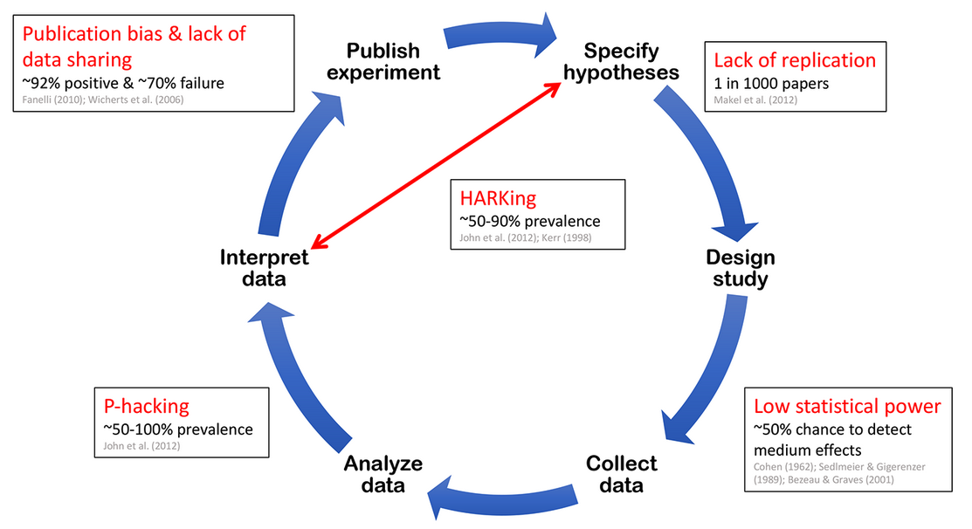
Why do we need Pre-registrations?

Slide 25
Pre-registration resources
Open Science Foundation (OSF) - https://osf.io/
A portal for pre-registrations, with plenty of documentation and advice for all.
Several collected templates. Easy for users to select.
Publication system, with possibility to browse registrations
Online lectures and learning resources

Slide 26
Lets try this out!
Notes:
Now you will get to try writing a Data Management Plan. There are 2 set of exercises to choose from. The first one will mainly be for those of you who are life scientist. You can try out the tool from SciLifeLab and either create a DMP for a pre-defined scenario in the material or create a DMP for your own project.
The second one is good for everyone so life scientists might also choose that one. It has 2 parts. First, find out if your organisation/institution has a DMP tool or template. Search your intranet, ask your support function or library if you have one etc. Then, use the DMP checklist from SND and reflect over the questions in the checklist. Would they be applicable to you/your project or not.

Slide 27
Exercise on Data Management Planning
Create a Data Management Plan (DMP) using Data Stewardship Wizard (DSW).
Work on own project or pre-written scenario
Work alone or in pairs
Instructions exercise - Data Management Planning
Create a Pre-registration using the OSF portal
Work exploratory, alone or in pairs
https://osf.io/
Notes:
Recommend this for Life Science participants

Slide 28
Exercise on Data Management Planning for everyone
Exercise 1: Find out if your organisation provides a DMP tool or template
Exercise 2:
1. Download the checklist for data management plan from SND https://zenodo.org/records/6424769
2. Start at p.5 and go through the questions to see which ones are relevant to your project/situation.
3. Start answering the relevant questions

Slide 29
Discuss your experience
What is the biggest challenge you foresee in implementing a data management plan, or creating a study pre-registration?
When do you estimate a DMP or pre-registration will be useful in your own research?

Slide 30
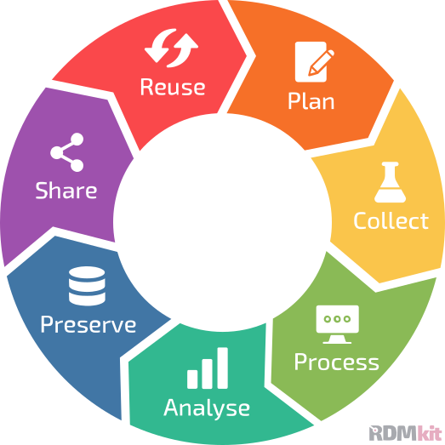


Data management services for you!
Support with:
Writing a data management plan.
Describing data with proper metadata for documentation and publishing.
Data transfer, organisation, backup, and security procedures.
Identifying a suitable repository for data publication.
Submission process when publishing your data and code.
Handling of sensitive human data.
Contact us!
data-management@scilifelab.se
https://nbis.se/services/data-management-support/apply
Notes:
NBIS and DC together aims to provide support throughout the data life cycle and we can provide advice around all phases but for our our hands-on support we put an extra emphasis on Planning and Sharing/reuse.
The data stewards at NBIS can give you guidance regarding various data management aspects such as how to collect, document, organize, and preserve the research data. We can e.g.:
Support with:
Writing a data management plan.
Describing data with proper metadata for documentation and publishing.
Data transfer, organisation, backup, and security procedures.
Identifying a suitable repository for data publication.
Submission process when publishing your data and code.
Handling of sensitive human data.

Slide 31
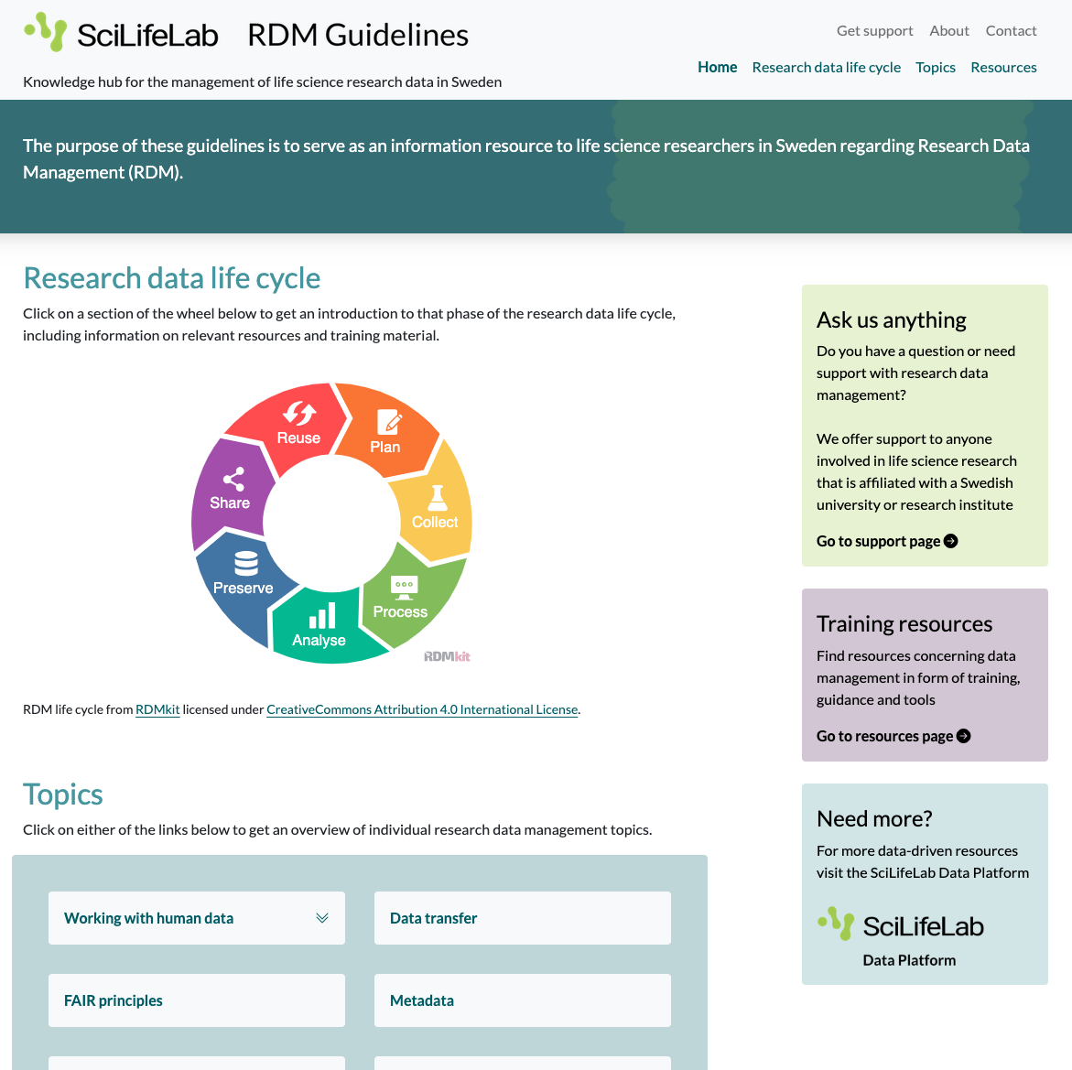
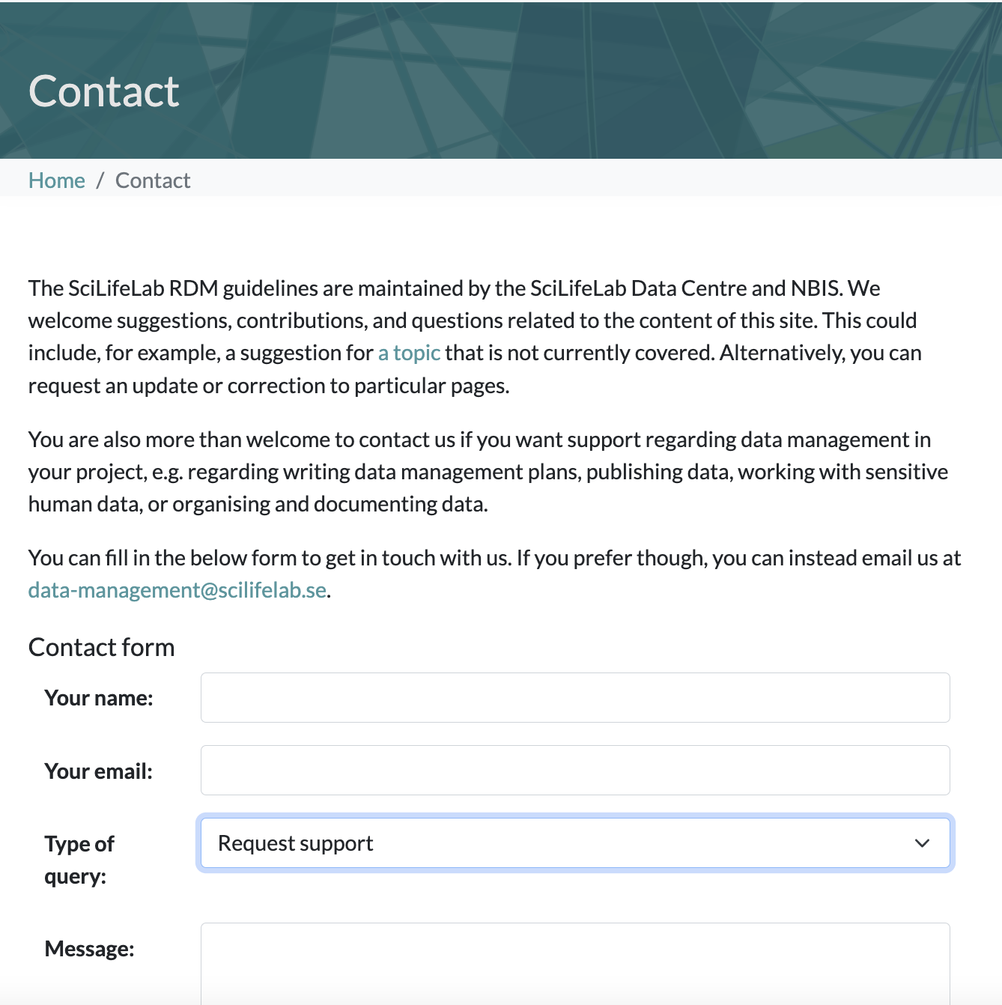
SciLifeLab Research Data Management (RDM) Guidelines
Knowledge hub for the management of life science research data in Sweden.
data-guidelines.scilifelab.se
data-management@scilifelab.se
Notes:
SciLifeLab RDM Guidelines is a knowledge hub for the management of life science research data in Sweden. The purpose of this portal is to serve as an information resource for each phase of the data life cycle and related topics. We also aim to collect training materials and other RDM resources provided by universities and research infrastructures in Sweden.

Slide 32

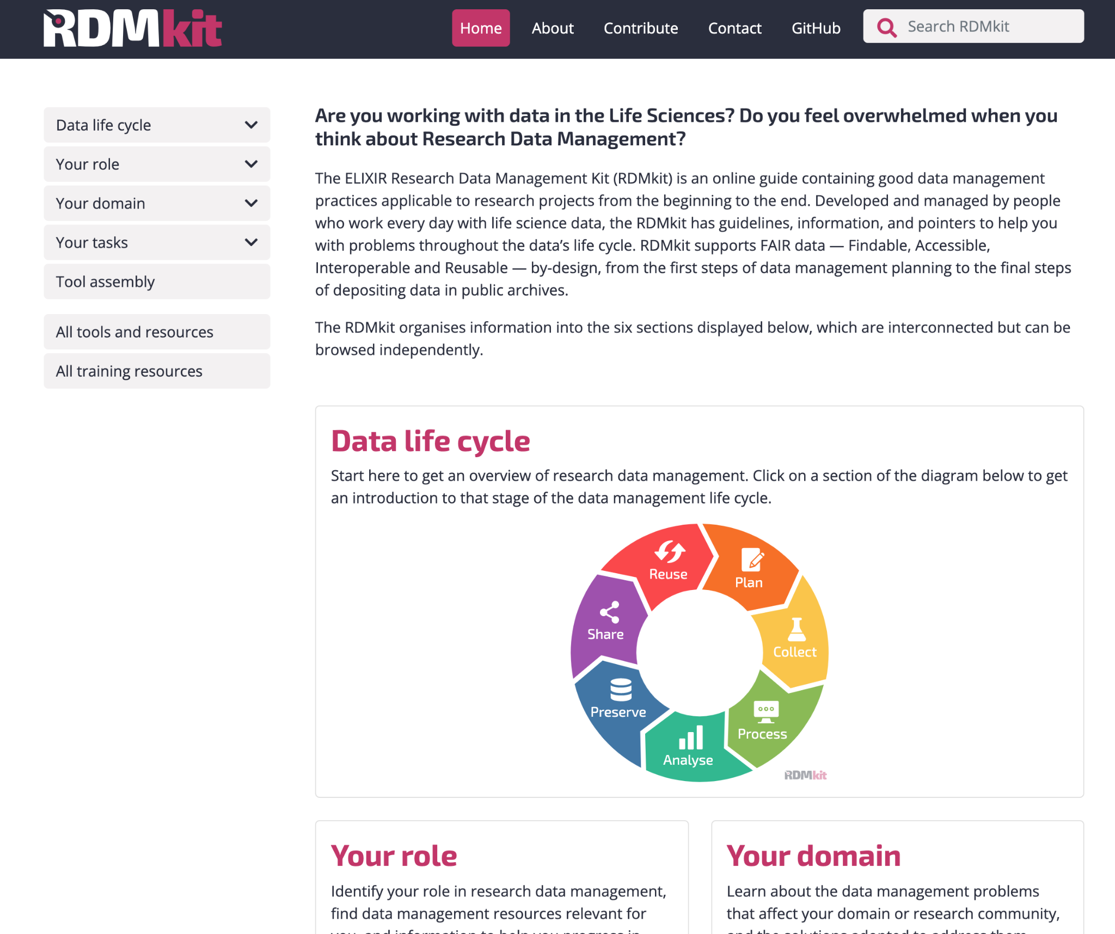

The Research Data Management
toolkit for Life Sciences
RDM best practices and guidelines.
Links to tools/resources and training material given in specific DM context.
Examples of combination of tools for RDM.
https://rdmkit.elixir-europe.org/

Slide 33
References
These slides and exercises are based on previous training material from:
NBIS workshop module: Data Management Plans
Materials from SciLifeLab Research Data Management Roadshow in Lund 2024. Uppsala University. Educational resource. https://doi.org/10.17044/scilifelab.28016054.v1
NBIS workshop: Introduction To Bioinformatics Using NGS Data

