Slide 1
Knowledge assets and intellectual property
CAMILLA PETTERSSON, RESEARCH AND INNOVATION SERVICES AT THE UNIVERSITY OF GOTHENBURG
Notes:
Hello!

Slide 2
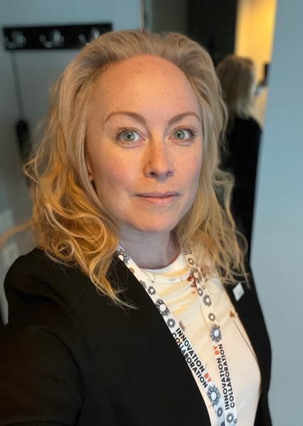
Camilla, University of Gothenburg
MSc in Molecular biology
University diploma in Journalism
PhD in Medicine (lipoproteins in the Metabolic syndrome)
Innovation advisor since 2011 (within science and medicine)
Team leader since 2019 (university-wide support, group of 9 innovation advisors)
Notes:
This is me…

Slide 3
Research- and Innovation Services
Our mission: To enable excellent and socially relevant research and its impact in academia and society
Impact
Utilization
The Innovation Office supports utilization for impact
Knowledge
Notes:
I am part of…

Slide 4
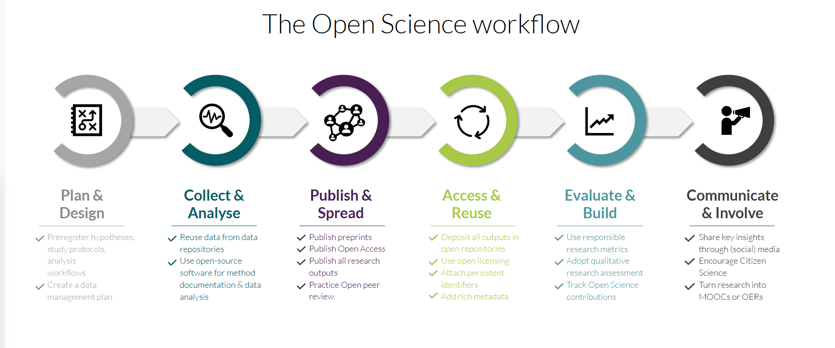
+
Manage & Protect
Notes:
I would like to add a cheeky extra phase called Manage & protect, in between Collect & Analyse and Publish & Spread.
I believe this session was tagged with the phase Plan & Design, and it is important to keep in mind the immaterial rights-perspective also in that phase, but it is most important to implement the Manage & Protect toolbox after the research data and results have been produced, but before any of it is spread or utilized any further, expecially crossing the invivible lines of the university.

Slide 5
Plan & design
Notes:
The Innovation office’s best tool for the Plan and design phase of a research project is the Impact pathway canvas.

Slide 6
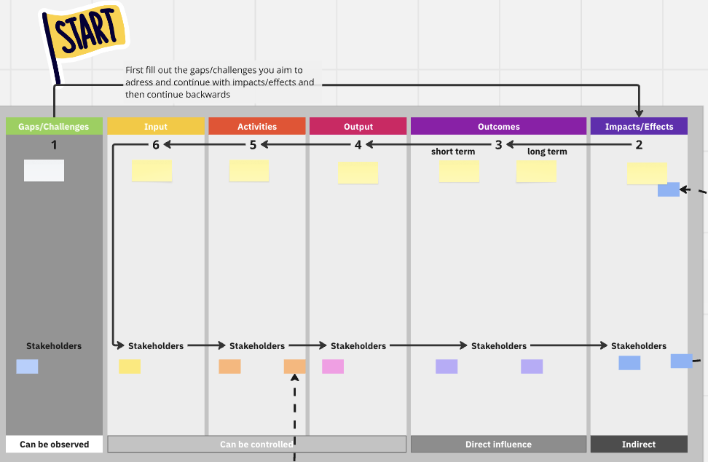
Planning for your impact always starts from the end
- What outputs do you need to put into the hands of your outcome-stakeholders to enable them to contribute to your
desired effect?
- How do you then design your research project to achieve those outputs?
Notes:
In this canvas, you start by defining what impact, or effect, often outside the university, i.e. in society, that you want to see. And then you work your way backwards, answering questions like:
- What outputs do you need to put into the hands of your outcome-stakeholders to enable them to contribute to yourdesired effect? and
- How do you then design your research project to achieve those outputs?
Research results that can be described as outputs and that can be transferred in some way to another actor, or another research- or collaboration project, can also be called ”knowledge assets” or ”intellectual assets”.

Slide 7

WHAT DO WE MEAN BY IMPACT?
Impact is defined as any effect on, change or benefit to the…
economy
society
culture
public policy or services
health
the environment
or quality of life
…beyond academia
Ref. The UK Research Excellence Framework (REF)
Ref. The UK Research Excellence Framework (REF)
Notes:
Societal impact – the effects that the university has outside of academia
Changes to make the world better
Beneficial for e.g. citizens, organizations, patients, practitioners, companies, ecosystems
What the taxpayers get back from funding research

Slide 8

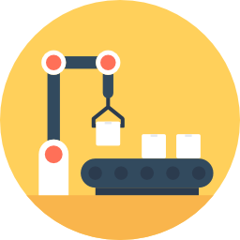
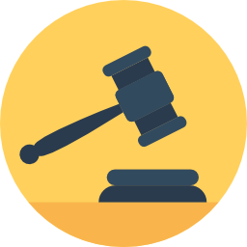

How societal impact is achieved
Changed attitudes and culture; in the public, in a target group, in an industry
Changed practices; private persons, organizational practices, business practices
New products or services
New or changed processes in industry
Changed policy, standards or laws
Often a combination of above
17 SDG
Notes:
Here are some examples of how impact is achieved in various sectors in society – all of them require some kind of transfer of knowledge and subsequent developing new ways of how to do things.
And the more proactive you as a researcher are in how you package your knowledge and enable uptake and implementation by the intended users, the more certain it is that the change you want to see actually can happen.
---
Consider your own research: What changes in society do you hope it will lead to in the long run?
Who else, outside academia, will need to be involved in making those changes?
What reality and situations are they operating in? How do changes to their environment usually come about?
And how can you package and convey your research so that it fits into that reality, those users or organisations, and their needs?

Slide 9
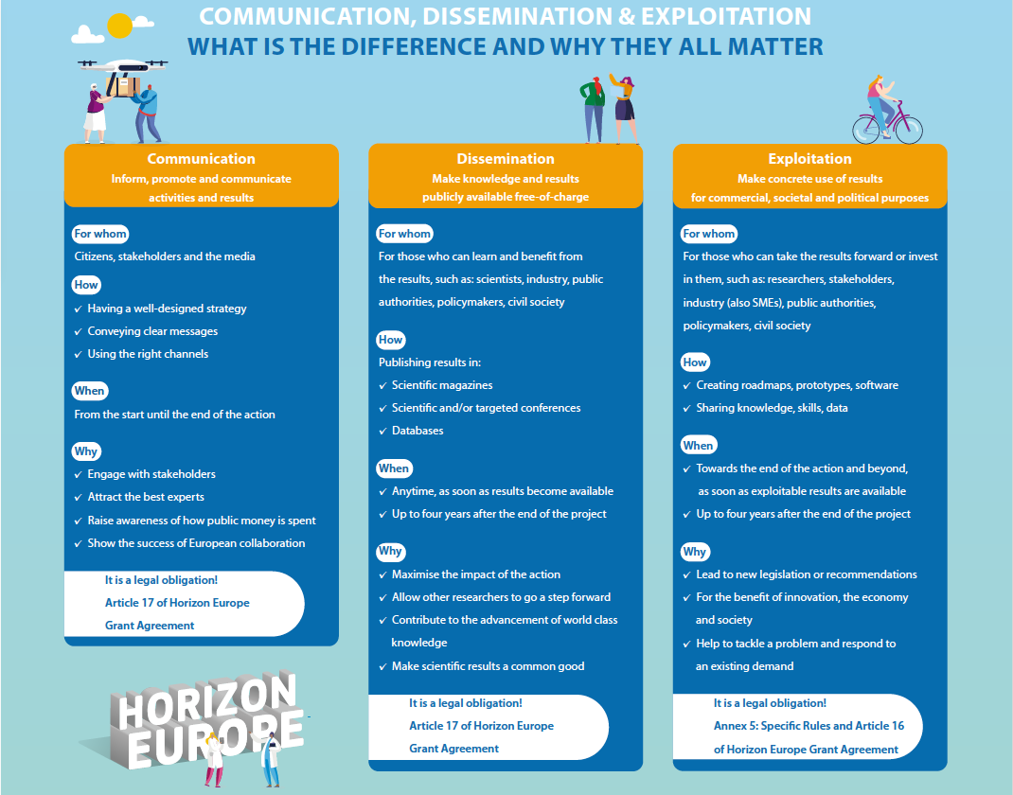
Notes:
You are probably familiar with this, as in order to get funding from Horizon Europe, you:
Must perform activities to increase the impact of project results
Must share research results with the scientific community, commercial players, civil society and policymakers (‘dissemination’).
Must take action to use their project results for commercial purposes, to tackle societal problems or in policymaking (‘exploitation’).
In which of these three boxes you spend most of your time is a choice depending on your ambition and which types of channels/pathways are most relevant for creating impact from your project.

Slide 10
Högskolelag (1992:1434)
1 kap.
2§ I högskolornas uppgift ska det ingå att samverka med det omgivande samhället för ömsesidigt utbyte och verka för att den kunskap och kompetens som finns vid högskolan kommer samhället till nytta.
5 § Högskolorna ska i sin verksamhet främja en hållbar utveckling som innebär att nuvarande och kommande generationer tillförsäkras en hälsosam och god miljö, ekonomisk och social välfärd och rättvisa.

Slide 11
‘Knowledge assets’ or ‘intellectual assets’ – transferable results of research (outputs)
Distinct to you
Communicable or documented
Transferable
An intangible asset
that is also …
Ideas
Creative thoughts
Know-how
Data
…
Notes:
When we define knowledge assets, or intellectual assets, we say that they are intangible, i.e. things without physical form. As opposed to material assets, like computers, pens or instruments.
Intangible assets can be ideas, creative thoughts, know-how, data etc.
If those assets are also:
distinct, or unique, to you,
communicable or documented - you should be able to explain them to others,
and transferable - you should be able to give them to someone else without them needing you in order to use them.

Slide 12
Collect & Analyse
Notes:
The Innovation office’s best tool for the Plan and design phase of a research project is the Impact pathway canvas.

Slide 13
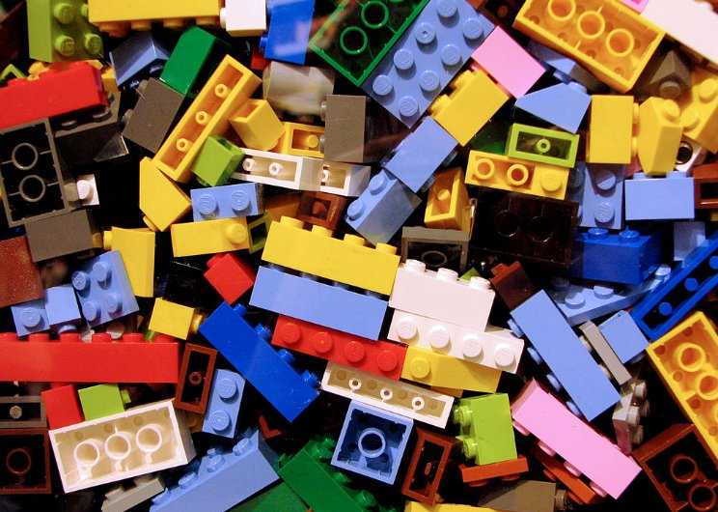
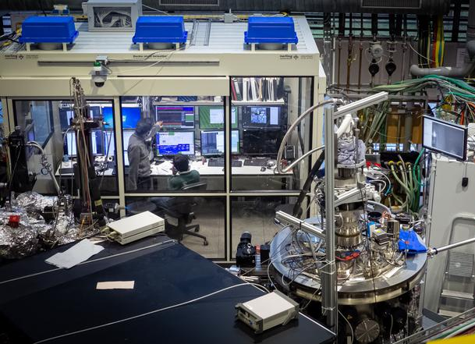
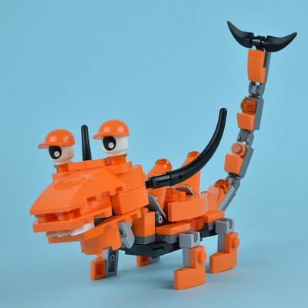
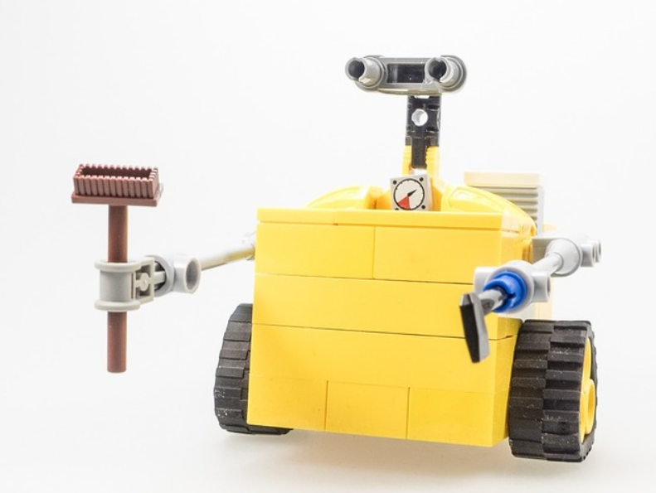
‘Knowledge assets’ or ‘intellectual assets’ – transferable results of research (outputs)
Method
Model
Visualization
Creation
Design
Software
Doug Coldwell CC-BY SA
Database
Flexers Max CC-BY
Technical solution
Image: C. Schüßler-Langeheine / HZB CC BY-SA
picryl
Notes:
Here are some examples of knowledge assets that can be found within a research project:
We sometimes depict knowledge assets as lego pieces, as they are destinct individual things, that were created as part of one project, but that can be distributed and rearranged to create new projects, collaborations, and solutions to somebody else’s problems – by which you can create an impact for those people.

Slide 14
Research data or knowledge asset / research result?
Research data
Data gathered through research
Could possibly have copyright protection, but unusual
Not subject to teachers’ exemption; no exclusivity; publicly owned; open access
Results / knowledge assets
Outputs of research that have reached the ”threshold of originality”
Could be protected by various types of intellectual property protection (laws)
Subject to the Teachers’ exemption / university IP policy
Ownership and exclusivity of which can be regulated in agreements
Notes:
So, what is the difference between resarch data and knowledge assets, and how do you identify an asset?
Research data in itself is rarely seen as a knowledge asset, as it is usually not covered by any of the immaterial rights (such as e.g. patent, pattern protection, copyright, trademark, etc.) and because it should be shared and made available freely.
While an asset is a resource with economic value, that can be owned or controlled by somone, and used to provide future benefits.
This transition happens when a research result has reached the ”threshold of originality”, making it unique and potentially valuable due to the intellectual input made by the creator (thus, ”intellectual assets”).
---
Forskningsdata kan sammanfattas som all data som samlas in i ett forskningsprojekt. Det är information som kan vara mer eller mindre strukturerad och som ha form av bild, numeriska värden, prover osv. osv.
Typiskt sett omfattas inte forskningsdata av någon av de rättsliga immaterialrätterna, vilket innebär att det inte går att ha ensamrätt till forskningsdata.
Det kan på sin höjd finnas möjligheter att utöva kontroll över datan genom att begränsa vem som har tillgång till den, men här finns lagstiftning kring allmänna handlingar, sekretess och öppen data som styr hur GU och de enskilda forskarna får begränsa eller dela informationen med andra.
Utöver forskningsdata så kan ett forskningsprojekt även leda till att andra typer av resultat skapas. Dessa resultat utmärker sig genom att det har skett ett intellektuellt skapande och en nivå av förfining. Vi använder ibland ordet verkshöjd för benämna detta.
Det kan t.ex. vara metoder, uppfinningar, visualiseringar eller texter.
När det finns verkshöjd finns det vanligtvis möjlighet att använda sig av immaterialrättsligt skydd för att utöva kontroll och ensamrätt över resultatet. T.ex. kan det sökas patent för en uppfinning eller bli automatisk upphovsrätt till en visualisering.
Forskningsresultat omfattas av lärarundantag i lagstiftning vad gäller uppfinningar, och ett utökat lärarundantag genom GU:s policys.

Slide 15
What knowledge assets have you created?

Slide 16
Manage & Protect

Slide 17
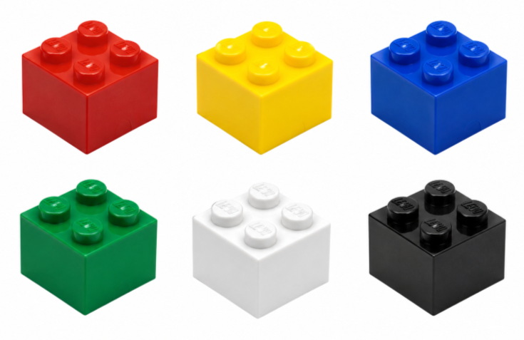


Identify and manage your knowledge assets strategically
Dissemination and exploitation plan
Publish
License
+
Patent
Your knowledge asset portfolio
Publish
Knowledge assets
Use in an academic collaboration project
The results of research
Use in an external collaboration
rawpixel
Data, databases, observations, theoretical frameworks, (technical) solutions, visualizations, instructions, computer programs, narratives, creations, etc.
Package for easy use by practicioners
Position (patent? secret?)
Set up a consultancy or startup
Notes:
1.[GÅ IGENOM SLIDE:N]
2.
As a researcher who is interested in utilising your research to achieve some kind of impact, it’s very useful to try and identify which of the knowledge assets that you have created through your research that can either constitute a part of the a solution that can be utilized, or that can be essential for developing a solution.
When you identify such assets, an analysis should be made to understand if it would be worth it (for you or for someone else) to develop a solution using them, and if so – they probably need to be protected in some way.
That is exemplified here by patenting them before publishing, so that you can for instance license them to an external collaboration partner, or bt setting up a consultancy or startup around
You also need to make sure that you have the rights to the vital knowledge assets, and perhaps even exclusive access, which helps you (or the one you license or sell them to) to get a head start on potential competitors, so that no one else can copy you and beat you to it.
---
Identifying and managing your knowledge assets is about understanding what defines a ’result’ or a ’knowledge asset’, which ones are valuable for you and what you can do with it, which can be are valuable for others or what they could could use it for. And sometimes in which order you need to do things in order not to trip yourself up.
A knowledge asset is a result of the research process that you have created, that can be described according to function and use. And that can be defined as a unit that is separable from other units, in a document such as an agreement.
Examples of knowledge assets are: A database, a method or instruction, a technical solution, or a vizualisation.
---
I’m sure you all know that if you want to, or if you want someone else to be able to, exploit a key result in a commercial way – for instance to develop a new drug or to improve the efficiency of long-distance heating – companies that will get engaged in a collaboration to develop such solutions will want to have exclusivity of the solution (or else it will be too much of a risk for them to put a lot of money and people into that development), and that means that you will have to allow patenting of the solution before you publish any details about it.
When going into a new collaboration, with academic or external partners, you will draw up a collaboration agreement, where you define the partners rights to any ’background’ – i.e. knowledge assets from earlier performed research – that each partner brings into the project, and to any ’foreground’ – i.e. the knowledge asstes that will be created during the project. At this stage, you need to know what you are doing if you so that you don’t break any other agreements made, with e.g. funders of earlier research projects, so that you protect your rights to continue doing research and to publish, and so that you have control of foreseen and unforseen possibilities to create the impacts that you want with your research.

Slide 18



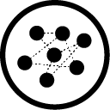
VAR FINNS STÖDET FÖR OLIKA SORTERS NYTTIGGÖRANDE AV FORSKNINGSRESULTAT OCH KUNSKAP(STILLGÅNGAR)?
INSTITUTION / FAKULTET / CENTRUMBILDNING
INNOVATIONSKONTORET
CENTRUM-BILDNING
ALLMÄNT TILLGÄNGLIGT
TILLÄMPBART
FÖR SPECIFIKA
ANVÄNDARE
INNOVATIONS-PROCESSER
KONTRAKTUELLA NÄTVERK
Utbildning
Populärvet.
föreläsningar
Uppdrags-
utbildning
Forsknings-
samarbeten
Produkt-
innovation
Patent
Öppen
källkod
Gemensamma
plattformar
Publikationer
Mötesplatser
Uppdrags-
forskning
Professions-
utbildning
Tjänste-
innovation
Forsknings-
företag
Creative
commons
Crowd-
sourcing
GU VENTURES
(Inkubator och holdingbolag)

Slide 19
Researchers have the right to utilize their results!
Teachers’ exemption (lärarundantaget)
Swedish law (1949:345) (LAU)
An exemption from the principle of the employer’s right to employee inventions.
Patentable inventions belong to the employed teacher/s who created them, even if they were produced within the scope of their work at the university.
Almost unique to Sweden’s universities
Not the case for hospitals/healthcare organisations
University of Gothenburg IP Policy
Includes also non-teacher employees who perform independent research and take part in the creation of an invention (e.g. PhD students)
Grants the creator/s the rights to spread, commercialize or in other ways utilize (nyttiggöra) their intellectual property rights (IPR) (not just patents)
Notes:
So, often the first important step in managing your knowledge assets is to understand who has what rights to them.
The basic principle, covered by law, states that researchers have the right to utilize their results.
---
Purpose of the IP Policy:
Clarify GU’s stance on intellectual property rights
Ensure compliance with legal frameworks
Developed in concert with other Swedish universities
Outlines procedures to balance an ensure the interests of the university & its employees, academic openness, and the continued development and dissemination of knowledge

Slide 20

Relevant definitions, regulations and policies for research results
The University of Gothenburg’s rules for how to manage research data
The University of Gothenburg’s policy for rights of use to copyright protected material
The University of Gothenburg’s policy for intellectual property rights
rawpixel
Notes:
--
Upphovsrättspolicyn tillkom för att säkra undervisningen och universitetes verksamhet

Slide 21
Limitations within the GU IP policy to researchers’ rights
GU has a free right to use IPR-protected knowledge assets for continued research and education
GU owns physical material carrying IPR created within employment scope
Regulations like GDPR and ethics permits may limit use of research data or -results
Research data is official document (allmän handling) ​
Exception: researcher may have rights to images or text according to copyright and catalogue protection; also GU may have rights according to catalogue protection if a substantial investment has been made
External collaborations or financiers can limit the creator’s rights to intellectual property or other knowledge assets through agreements
Grant agreements, collaboration agreements, and commission agreements can (should) regulate ownership, access and use rights – if not, it can get messy once you start realizing something you created is valuable

Slide 22
GU’s Policy for intellectual property rights
Extends the scope from patentable inventions to all categories of immaterial rights:
patents (technical solutions and applications)
copyright (threshold of originality / verkshöjd) incl. software
trademarks (except for those created within GU operations)
and design protection / mönsterskydd (incl. circuit patterns)
Notes:
Moving on to Protect, intellectual property rights are not all patents, but come in various forms for various types of knowledge assets, inventions or creations.
--
Datorprogram som skapats inom forskning ägs av forskaren
Om GU gjort en väsentlig investering i databaser har GU parallell upphovsrätt och ansvar för databaserna (bl.a. för att upprätthålla externa krav som GDPR eller bevarande- eller tillgängliggörande-ansvar) – då kan forskaren ta en kopia för att nyttiggöra databasen (som kanske begränsas av GDPR och etikprövning).
Även

Slide 23
Why protect / patent my knowledge assets?
Patents provide you with the right to exclude others from (in a particular jurisdiction): Manufacturing, using, marketing, selling
If you want (someone) to commercialize your research results, protecting your intellectual assets is a strategic, often necessary, move to hinder others from:
copying and out-competing you with a faster route to market
patenting something similar themselves and hindering your freedom to operate to market your solution
IPR enables you (or someone of your choosing) to take the risk, including spending lots of money and time, to develop the solution and market it without competition
Investors often demand IPR, especially from universities who are subject to the principle of public access to information (offentlighetsprincipen)
Notes:
Moving on to Protect, intellectual property rights are not all patents, but come in various forms for various types of knowledge assets, inventions or creations.
--
Datorprogram som skapats inom forskning ägs av forskaren
Om GU gjort en väsentlig investering i databaser har GU parallell upphovsrätt och ansvar för databaserna (bl.a. för att upprätthålla externa krav som GDPR eller bevarande- eller tillgängliggörande-ansvar) – då kan forskaren ta en kopia för att nyttiggöra databasen (som kanske begränsas av GDPR och etikprövning).
Även

Slide 24
What kind of knowledge assets can be patented?
Physical products, devices and systems
Chemical substances and pharmaceuticals
Processes, methods and uses
Notes:
---
Patent – What cant be protected
Business methods
A method for surgical or therapeutic treatment
Plant or animal varieties.
Inventions that are contrary to ordre public or morality.
Biotechnological exceptionsProcesses for cloning human beings.
Processes for modifying the germ line genetic identity of human beings.
Uses of human embryos for industrial or commercial purposes.
Processes for modifying the genetic identity of animals which are likely to cause them suffering without any substantial medical benefit to man or animal, and also animals resulting from such processes.

Slide 25
What is a patentable invention?
Be novel – not be previously published, disclosed or publicly available prior to your first patent filing date (prior art)
Conference presentations, applications for funding, pre-prints, Youtube-clips, discussions in articles…
Either protect first-publish after, or redact they patentable details from your publications
Have an inventive step – being more than just a combination of known features leading to an expected result; not obvious to someone skilled in that technical field, in view of the prior art
Be industrially applicable – useful in some practical, tangible, technical sense; not abstract. Inventions must solve technical problems
https://www.prv.se/en/patents/basic-patentguide/what-is-a-patent/
Notes:
To be patentable, an invention must fulfil these three criteria:

Slide 26
Often confused: The different roles relating to a patent
Inventor / co-inventors: Individual/s who have contributed to the claimed invention
Assignee: Organization/s and individual/s that have ownership interest in the legal rights a patent offers
There may or may not be an assignee. An assignee can also change at a later date
Applicant: Organization or individual that files the patent application
This could be the inventor or the assignee
https://www.prv.se/en/patents/basic-patentguide/what-is-a-patent/
Notes:
It is also very important to understand the different roles that occur in a patent, and that being the inventor, or very often inventors, is not the same as being the one that will develop the invention into a solution and being the one making money off of it.
When applying for a patent it’s important to list all of the inventors who have contibuted to the actual invention (which is described in the patent claims) – if you don’t do that, an inventor could later refute the patent and make it invalid.
It’s also different from authorship on academic publications, where any collaboration and role can be listed – it is the intellectual contribution (not the financial) to the invention that grants you a place as an inventor.
The matter of who will actually develop it forward, or make money of it, is something you regulate in an agreement, in a parallel or subsequent process.
We often come across researchers who do not know or understand:
what the IP policy says about all independently researching staff’s rights to their results
that inventorship on a patent does not equal necessity to share income from the patent
that if there is nothing else written in a collaboration agreement, all creators of an intellectual asset need to agree about hiw to utilise it
that often, there is one or maybe two of the creators/inventors who are interested in developing the solution, and the rest are only interested in getting their fair share
that a research-based intellectual asset is worth less to begin with than what they think, and the development bit that comes after that is worth more
that almost everything can be regulated in a collaboration agreement

Slide 27
The reality
We often come across researchers who do not know or have understood:
what the IP policy says about all independently researching staff’s rights to their results
that co-inventorship on a patent does not equal necessity to share income from the patent equally
that if there is nothing else written in a collaboration agreement, all creators of an intellectual asset need to agree about how to utilise it
that often, only one or maybe two of the creators/inventors are interested in developing the solution, and the rest are only interested in getting their fair share
that a research-based intellectual asset is worth less to begin with than what they think, and the development bit that comes after that is worth more
that almost everything can be regulated in a collaboration agreement
that the awkwardness of suggesting an agreement beats the conflict that can occur in the absence of one, when opportunities arise

Slide 28
What experiences do you have of IPR or collaboration around knowledge assets / IP?

Slide 29
+
Manage & Protect
Utilize
Notes:
I would like to end with adding yet another arrow, from the Manage & Protect your knowledge assets-phase, which is: Utilize.
And in order to utilize your reserach results, there is so much more to it than just patenting them…

Slide 30

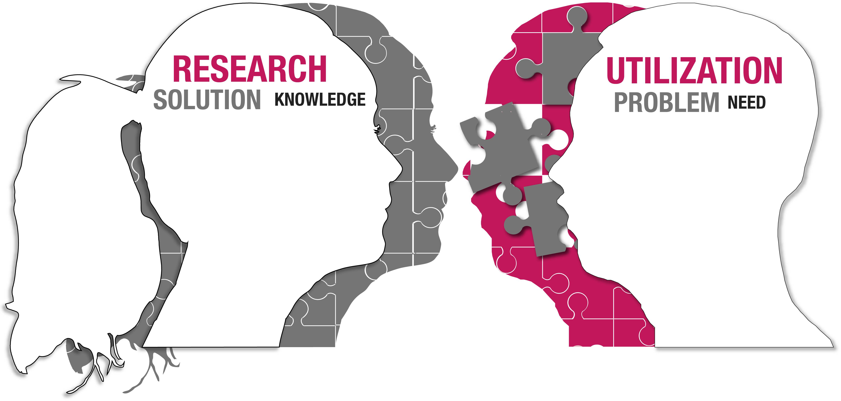





Advice & coaching
Seed funding & project support
Is my idea worth developing?
Ask VFT – verification for implementation!
Objective external analyses
What is the problem, actually?
Who are in need of the solution?
Risks and potential
Does it work like intended?
Is the idea economically feasible?
Is it sustainable?
Collaboration and partners
Should it be protected?
What’s the next step, the next taker?

