Slide 1

Open Science - access & reuse Repositories, Metadata, DOIs and Licensing
Elin Kronander
Notes:
title: "Open Science in the project lifecycle - access & reuse
"
author:
name: "Elin Kronander"
orcid: 0000-0003-0280-6318
email: elin.kronander@nbis.se
Part of: Open Science in the Swedish context 2025-05-05 – 09 Url: https://scilifelab-training.github.io/open-science/2505/
duration: 90 minutes
Repositories 1 10’
Metadata Exercise 1 15’
Metadata in depth 10 ’
DOI’s 10’
Licenses 15’

Slide 2
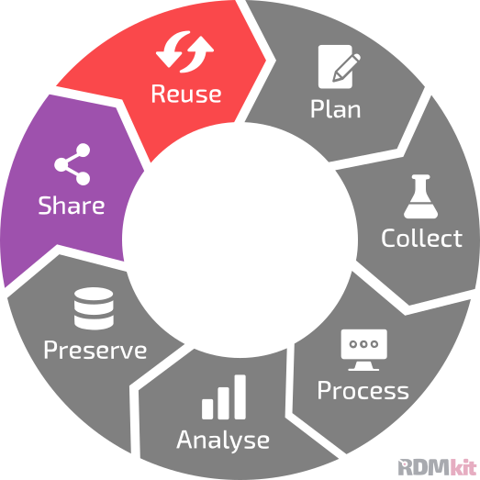
Repositories are key for share and reuse
Re-colored data Life Cycle by RDMkit used under CC-BY

Slide 3
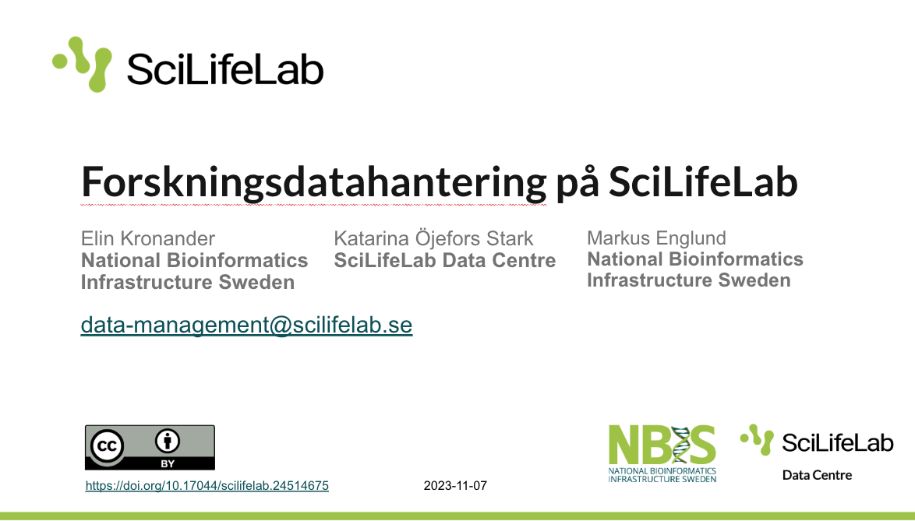

Reuse - open is not enough
Notes:
Open is not enough. If open is defined as freely available on the web for anyone to use it would mean that I can just put this presentation on my private GDrive with the access “Anyone with the link” but it would be very unlikely that anyone would find that presentation via the link unless I shared it. And this would probably also be true if I shared it on a private website or lab-website etc. So let’s brainstorm together, what would we need in order to reuse a research output.

Slide 4
Reuse - open is not enough
What do we need in order to be able to reuse a research output?
Notes:
[let the audience brainstorm ideas - write down on a board if possible]

Slide 5
Reuse - open is not enough
What do we need in order to be able to reuse a research output?
That the object exists/where to look for it
Detailed information about the object
How the object can be accessed
How the object could/should be used
Who and how has the right to use it
…
Notes:
Here are some suggestions

Slide 6
Reuse - open is not enough
What do we need in order to be able to reuse a research output?
That the object exists/where to look for it - Repositories
Detailed information about the object - Metadata
How the object can be accessed - Persistent Identifiers
How the object could/should be used - Metadata
Who and how has the right to use it - Licenses
…
Notes:
and some tools or solutions to help us enable reuse of the outputs we produce.
So what do we mean?

Slide 7
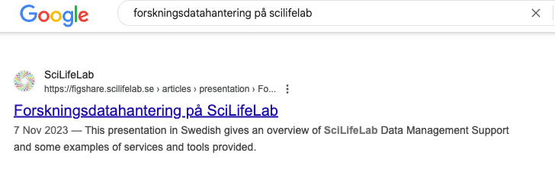
Reuse - open is not enough
What do we need in order to be able to reuse a research output?
Notes:
Instead of only making this presentation “available for anyone with the link” we used the SciLifeLab Data repository to make it openly available. Let’s see what that looks like. [Click on the presentation to reach the record]
And the repository allows us to provide detailed information about the file. Also in this example, the record is indexed on google by the repository and makes it findable when googling.
So let’s talk a bit more about repositories:

Slide 8
Types of repositories
Domain/type-specific:
Best choice - long-term plan, typically free, maximum reach
E.g. European Nucleotide Archive, European Genome Phenome Archive, ArrayExpress, PRIDE
General purpose:
Second best - long-term plan, might cost (now or in future), good reach but less specific in metadata → more difficult for future users to judge if a dataset will be useful
E.g. Zenodo, (SciLifeLab) Figshare, SND Doris, Dryad
In-house/institutional
For archive/backup purpose mainly, might cost, limited reach unless also published in a data catalogue
Domain-specific
General purpose
In-house
Notes:
There are different types of repositories:
Domain specific repositories:
These are repositories dedicated to specific scientific domains (e.g., genomics, physics, ecology).
Best choice if there is a suitable one for your data type. They have long-term plan for sustainability, they are typically free of charge, and has maximum reach in your research community.
E.g. European Nucleotide Archive, ArrayExpress
General purpose repositories:
These repositories are designed to accept datasets from any field of research. They are more generalized, meaning they accept a broader range of data types.
If there is no domain specific repository, a general purpose repository is the best choice. They also have long-term plan for sustainability, but might cost (now or in future), and they do have good reach. However, the metadata is less specific which means it is more difficult for future users to judge if a dataset will be useful to them or not.
E.g. Zenodo, Figshare, Dryad
Some general purpose repositories have metadata profiles
In house/institutional repositories:
These are repositories that are run by specific institutions (universities, research centers) primarily for archiving and backup purposes
This type of repository is for archive/backup purpose mainly, since it has limited reach outside the institution, they are typically not ‘googlable’, unless also published in a public (indexed) data catalogue. Also, it might be associated with a cost.
Domain-specific repositories
This type of repository focuses on specific data types and is typically the best choice if you can find one that is suitable for your research data. It will reach your research community, so that others working in your field can find and reuse your data, and incorporates metadata standards in order to make the data as widely useful as possible. The repositories usually have long-term sustainability plan, i.e. they will be available for a long time, and are typically free of charge.
European Nucleotide Archive (ENA) - for genomic sequence data (non-human)
European Genome Phenome Archive (EGA) - for human genomic sequence data
ArrayExpress - for gene expression data
PRIDE - for proteomics data
It could also be a repository for a specific output such as
General purpose repositories
From time to time you will most likely come across situations when there is no suitable domain-specific repository for your data type, for example if you have a new data type. Another situation you might find yourself in is that you have done registry-based research with human data, and you are not allowed to share this data but still want to publish the methodology openly. Making a metadata record in a general purpose repository will then allow others to easily find it, without violating the agreements with the registry holders.
General purpose repositories usually accepts anything and everything related to research, i.e. they are also useful for other purposes, besides publishing research data, e.g. posters and presentations can be made publicly available and obtain a persistent identifier (DOI).
This type of repository is typically indexed, so you can find its content via search engines, and thus it has good reach. However, since the repository accepts many data types, the metadata will be less specific (no or very high level metadata standards), with the result that is more difficult for future users to judge if a dataset will be useful for them. The repositories usually have long-term sustainability plan, i.e. they will be available for a long time, but might cost (now or in future).
Zenodo
Figshare
SciLifeLab Data Repository (Figshare)
Dryad
In-house/institutional repositories
Many institutions offer local repositories, and might even require that affiliated researchers put their research outputs there. However, unless the repository is indexed (so that search engines can find its content) this type of repository is for archive/backup purpose mainly.
You can also choose to create and host an in-house repository yourself, but that put a lot of responsibility on your shoulders. For how long will you be able to sustain it? It also requires considerable labour in order to make the repository FAIR, and without that the repository will have limited reach unless you also publish in a data catalogue.

Slide 9
Data catalogues and registries
Data repositories
FAIRsharing.org/databases - catalogue of many repositories, with possibility to filter on e.g. domain
Scientific Data Repository Guidance - publisher’s recommendation
re3data.org - registry of research data repositories
Swedish data
researchdata.se - a national web portal where you can find, share, and reuse research data from a wide range of disciplines
dataportalen.se - a national web portal where you can find, share, and reuse data beyond research data
Output specific registries
WorkflowHub - a registry for describing, sharing and publishing scientific computational workflows
Protocols.io a platform for organising, describing and sharing methods
ELIXIR TeSS - a registry for training materials
Notes:
Apart from searching directly in repositories where data typically is shared there are data catalogues where you can search and discover published outputs. Note that datasets might have been collected for completely different purposes and still serve your goals.
Visit the Swedish Pathogens Portal list of available data in order to find publications about COVID-19/SARS-CoV-2 that
Search in the Registry of Research Data Repositories re3data to find discipline-specific repositories for your field.
2 national web portals The Swedish National Data Service (SND) research data catalogue on Researchdata.se can also be used to search for data from a variety of research disciplines.

Slide 10
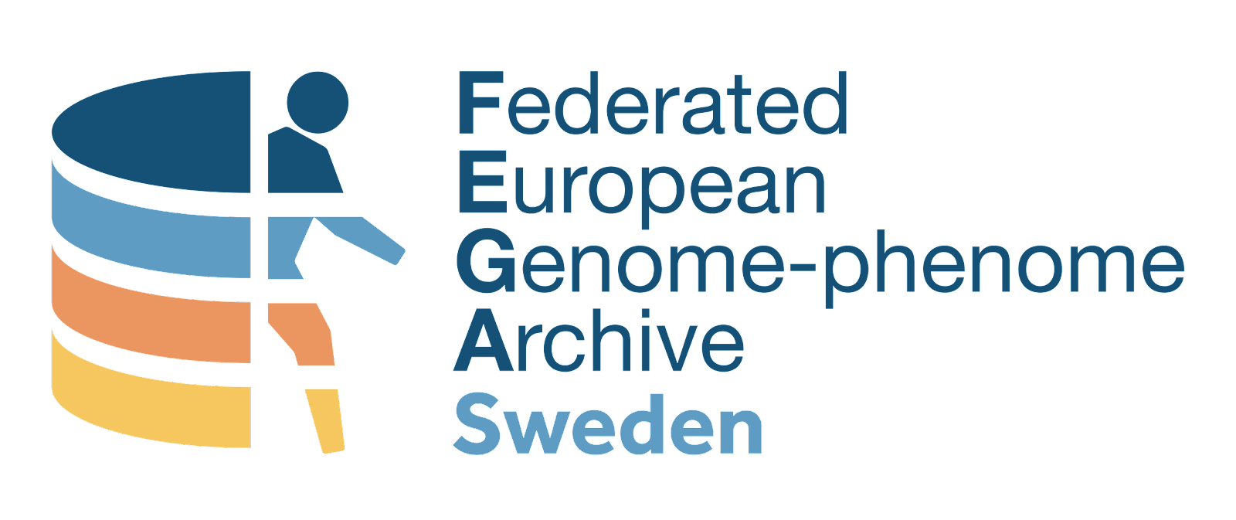
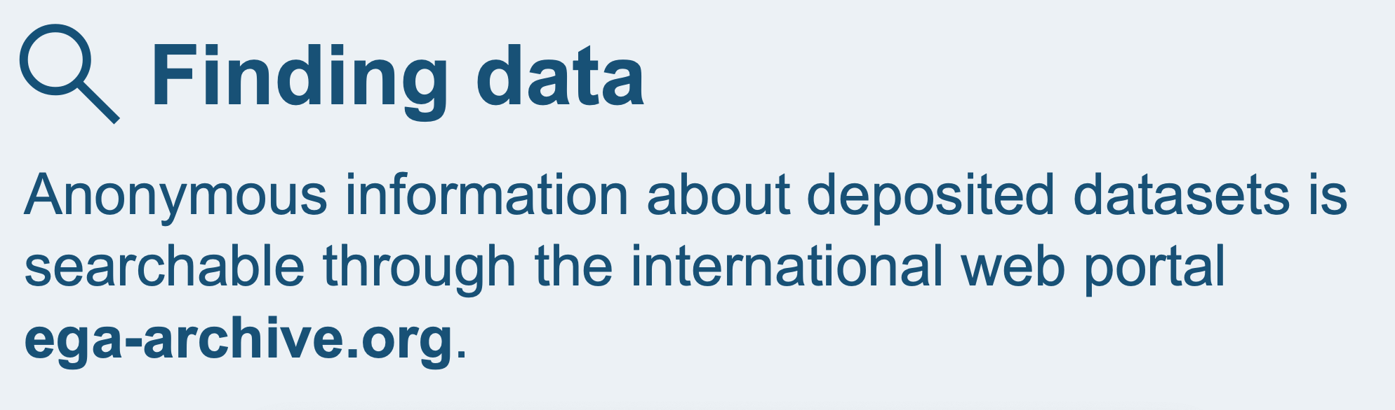
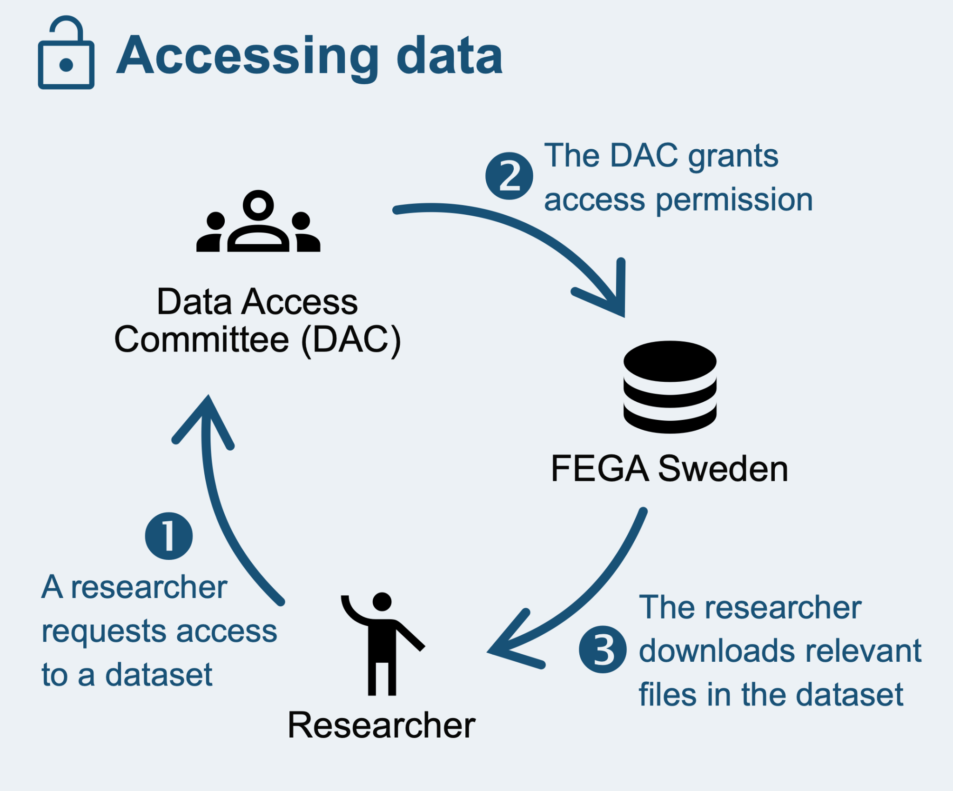
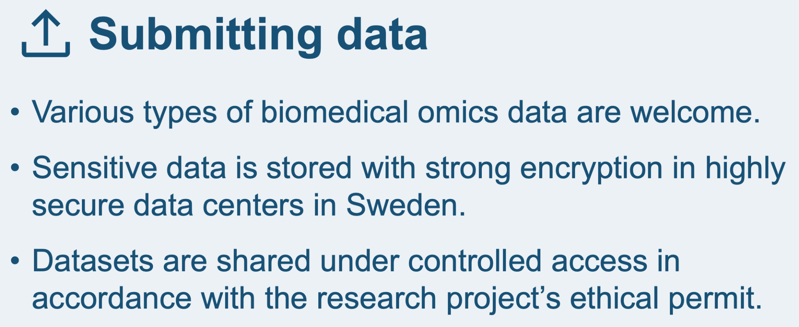

Restricted access repository: FEGA Sweden
National repository for storing and sharing personally identifiable information from Swedish biomedical research projects.
fega.nbis.se
Notes:
A national repository for storing and sharing personally identifiable information from Swedish biomedical research projects
One of several national nodes in FEGA, i.e. the Federated European Genome-phenome Archive
Why a national repository?
Easier for researchers to meet GDPR requirements when sharing their data, which means that more data can be shared.
Support and services that are better adapted to researchers’ needs.

Slide 11
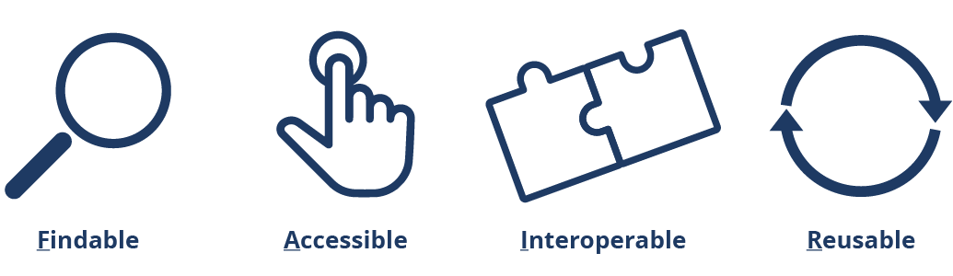
FAIR principles
FAIR principles illustration. SND/Svensk nationell datatjänst. CC-BY 4.0
Notes:
Let’s revisit the FAIR principles.

Slide 12
The FAIR data guiding principles
To be Findable:
F1. (meta)data are assigned a globally unique and persistent identifier
F2. data are described with rich metadata (defined by R1 below)
F3. metadata clearly and explicitly include the identifier of the data it describes
F4. (meta)data are registered or indexed in a searchable resource
To be Accessible:
A1. (meta)data are retrievable by their identifier using a standardized communications protocol
A1.1 the protocol is open, free, and universally implementable
A1.2 the protocol allows for an authentication and authorization procedure, where necessary
A2. metadata are accessible, even when the data are no longer available
To be Interoperable:
I1. (meta)data use a formal, accessible, shared, and broadly applicable language for knowledge representation.
I2. (meta)data use vocabularies that follow FAIR principles
I3. (meta)data include qualified references to other (meta)data
To be Reusable:
R1. meta(data) are richly described with a plurality of accurate and relevant attributes
R1.1. (meta)data are released with a clear and accessible data usage license
R1.2. (meta)data are associated with detailed provenance
R1.3. (meta)data meet domain-relevant community standards

Slide 13
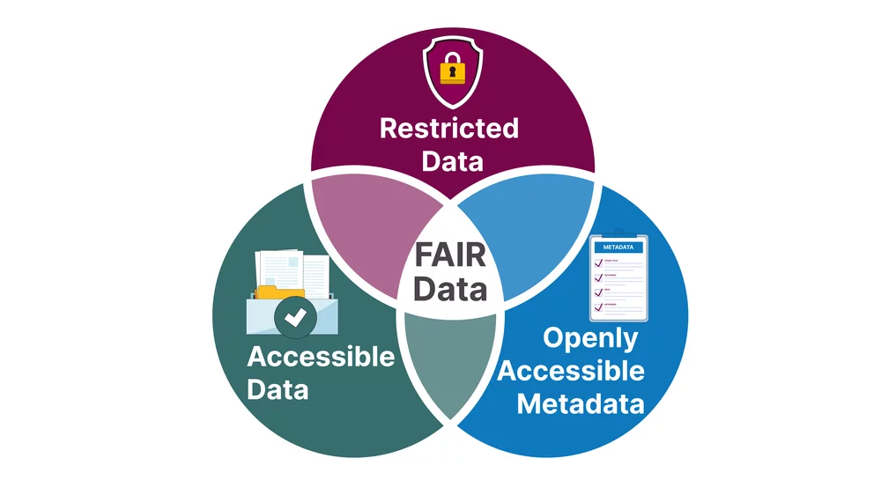
FAIR does not mean open
FAIR and OPEN image from CESSDA Data Archiving Guide version 4.0. CESSDA Training Team (2025). CC-BY 4.0
Notes:
https://dag.cessda.eu/Chapter-5/1-Introduction-to-FAIR CESSDA Training Team (2025). CESSDA Data Archiving Guide version 4.0. Bergen, Norway: CESSDA ERIC.
FAIR and Open
A common misconception is that FAIR data must be open. While data can be both open and FAIR, the FAIR principles do not stipulate that data must be open in order to be FAIR-compliant. The concept of Accessibility means that data access conditions should be well-defined. Data can have any access category, and the data can be considered Accessible as long as this is clearly communicated in a data usage licence. Another way to be FAIR when you cannot be open is to accompany a restricted data file with openly accessible metadata.

Slide 14
Metadata
Open Science in the project lifecycle - access & reuse

Slide 15
Metadata
The data about the data (or anything really)
“One person’s metadata, is another person’s data”
Notes:
This - “the data about the data (or anything really)” - is what we call metadata.
However, it might not always be straightforward to draw a line between data and metadata. It depends on the particular research interest and focus of the person looking at the data and metadata.
“One person's metadata, is another person's data”

Slide 16
Impactful metadata
Human readable
Standardised
Machine readable

Slide 17
Exercise instructions
In groups:
Examine the packaging of the food item
List the information you find
Think broadly
Consider why each piece of information is included in the packaging
Notes:
Divide participants into small groups (2-3 people).
Distribute a food item (or similar item) to each group.
Instruct each group to examine the packaging and list the information they find.
Encourage them to think broadly: ingredients, nutritional information, weight, dates, manufacturer, etc.
Ask groups to consider why each piece of information is included on the packaging.

Slide 18
Exercise reflection
Share 1-2 interesting pieces of information you found on the packaging
How would these elements relate to research metadata?
Going back to the previous slide, could you identify something that could be described as standardised metadata or machine readable metadata?
Notes:
Ask 2-3 groups to quickly share one or two interesting pieces of information they found.
Briefly discuss how these elements relate to research metadata

Slide 19
Elements relating to research metadata
Product Name → Research Title
Ingredients → Methods/Materials
Best Before Date → Creation Date/Version
Manufacturer → Author/Affiliation
Notes:
Some examples: Product Name → Research Title
Ingredients → Methods/Materials
Best Before Date → Creation Date/Version
Manufacturer → Author/Affiliation

Slide 20
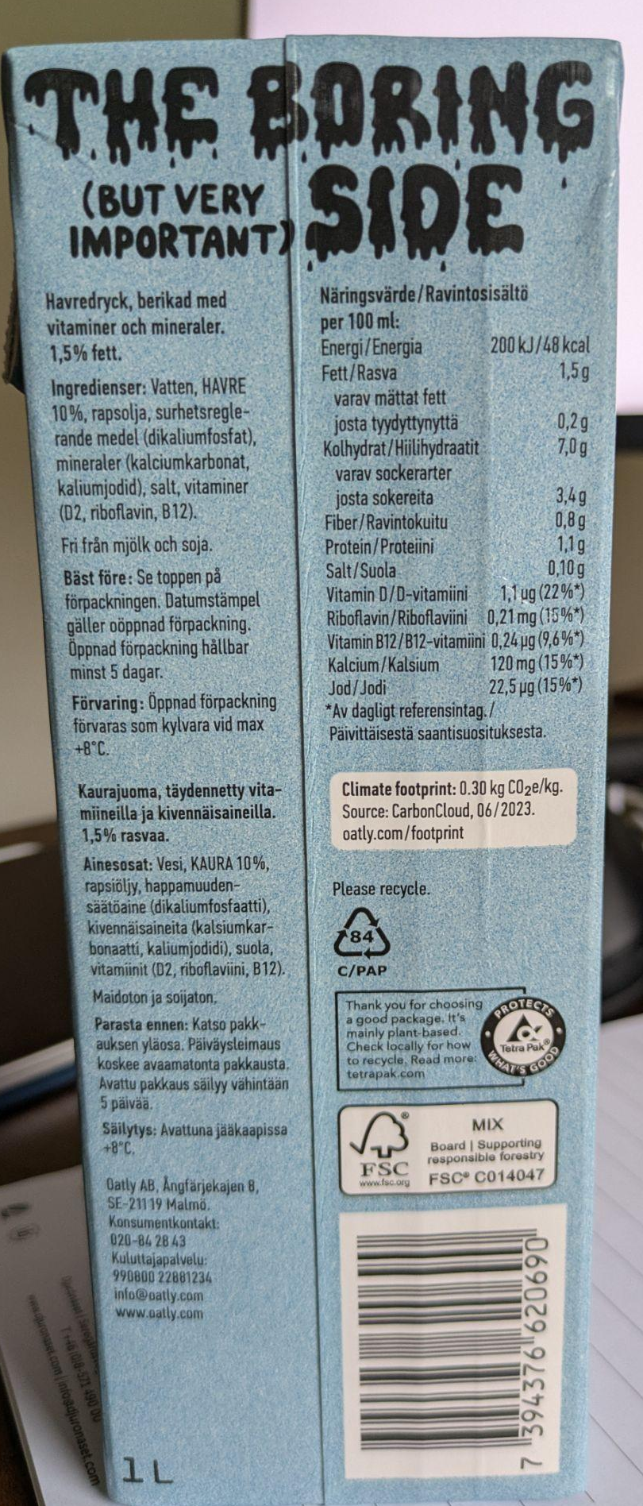
Standardised
Human readable
Machine readable
Notes:
Most of the metadata is human readable
Some example of standardised metadata is the table with nutrition declaration per 100ml or 100g from the EU, also the barcode. Barcode is machine readable. Instead of printing the price, they print a barcode that is unique and linked in the have a database where the price can differ between time points and shops etc.
Ok so let’s go back to the research setting.

Slide 21
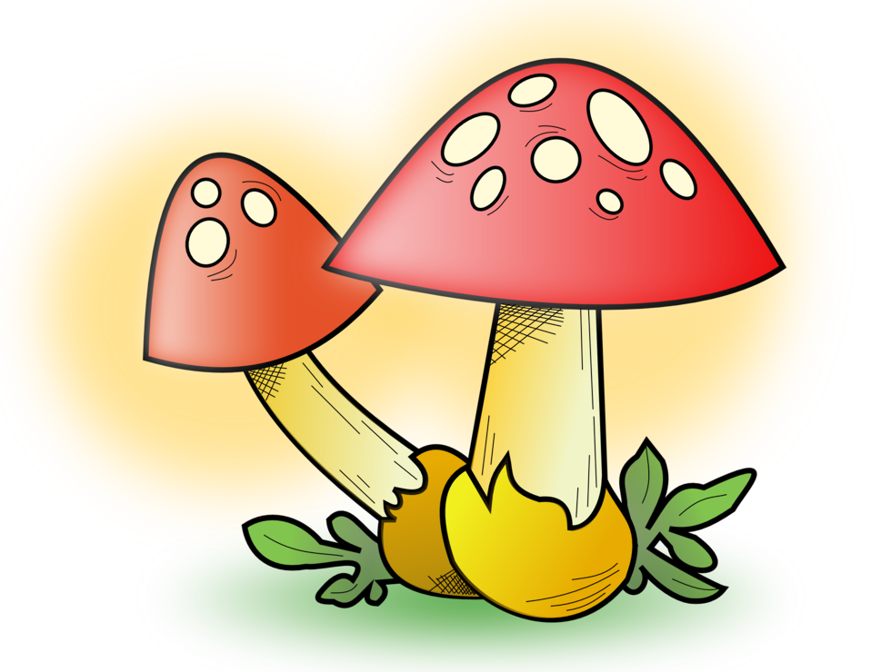
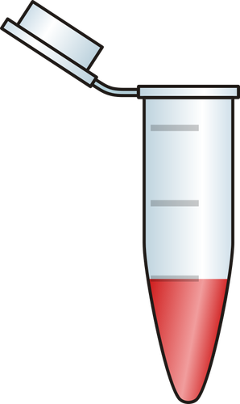
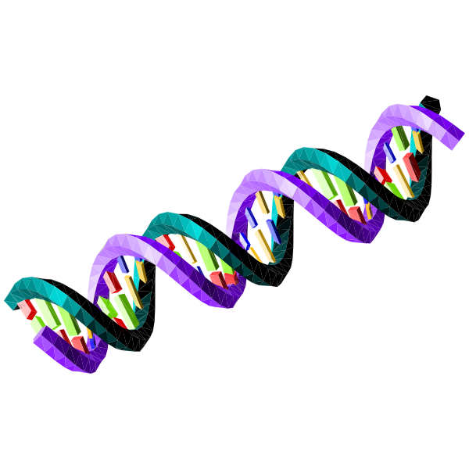

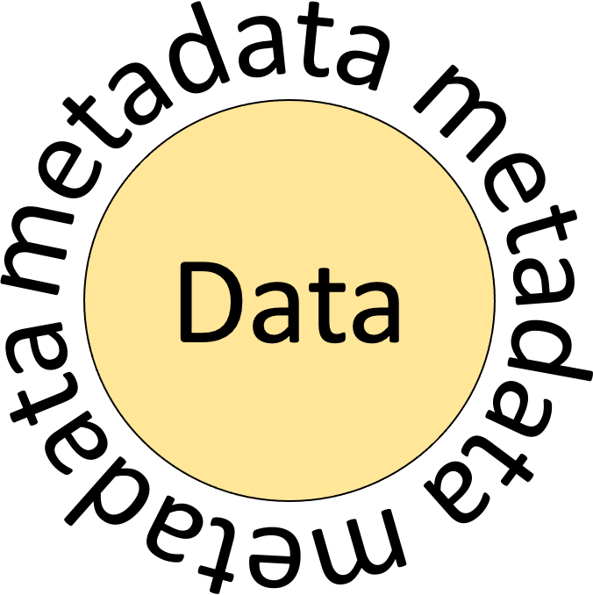
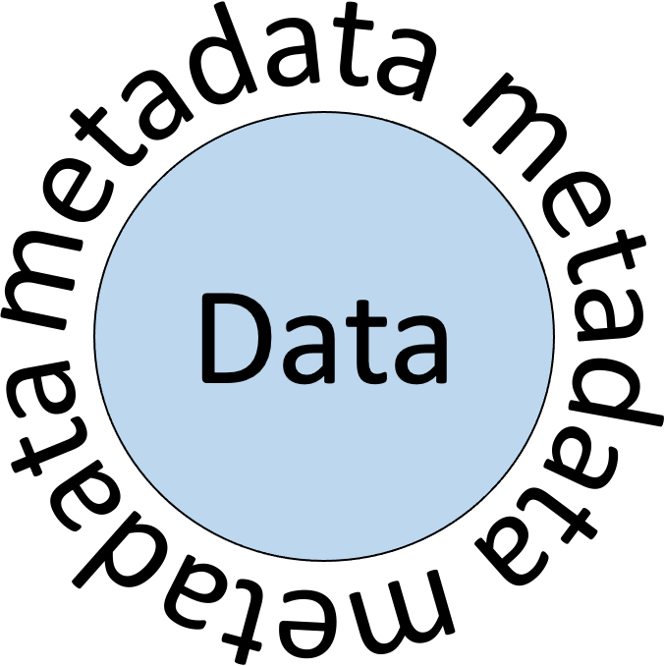
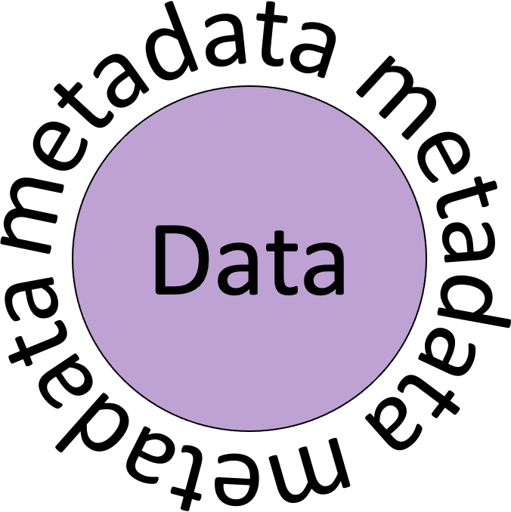
Metadata at different levels
?
?
?
.fastq
Source: Openclipart
Source: Openclipart
Source: Openclipart
Source: Publicdomainpictures
This slide, including all images, are in the public domain and free to reuse.
Notes:
So, what counts as metadata in a research setting?
Well, imagine this scenario:
[ click 1 ] You have your favourite organism that you want to study
[ click 2 ] You collect samples from it
[ click 3 ] You need to document how the samples were collected, from which source, and during which conditions
[ click 4 ] Say that you want to obtain DNA sequences from your samples
[ click 5 ] How the samples were prepared and what instrument was used needs to be documented
[ click 6 ] Then, you have the sequence files and do bioinformatic analysis to answer your research questions
[ click 7 ] How this analysis was done needs to be documented
Think of metadata as descriptions of the data at certain steps of your project, a record of how something was produced.

Slide 22
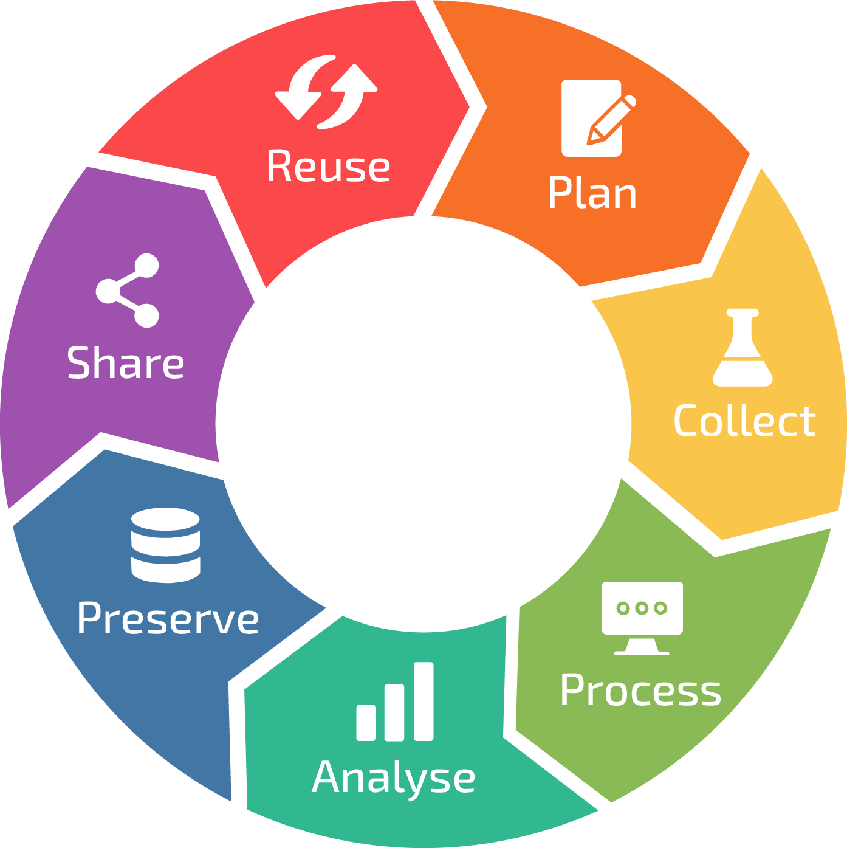
Why & when does it matter?
Discovery, integration and validation metadata
Administrative and Legal metadata
Contextual metadata
Discovery metadata
Technical and Provenance metadata
RDM life cycle, by ELIXIR RDMkit
Notes:
Metadata touches all of the stages of the data lifecycle
At the start of the project the metadata is about governance and traceability
Registration & Project IDs: These are often Persistent Identifiers (PIDs) for the study itself. Examples include a Grant ID from a funding agency (e.g., VR or Horizon Europe) or a ClinicalTrials.gov identifier.
Ethical Permits & Personal Data: If the project involves humans or animals, the Ethical Review Authority (Etikprövningsmyndigheten) ID is a critical piece of metadata. This links the resulting data to the specific legal permissions granted.
Data Management Plan (DMP) Metadata: The DMP itself is a "metadata document." It outlines which Metadata Standards (like Dublin Core or MIAME) will be used and how the Data Dictionary will be structured to define variables.
As you move into the lab or field, metadata captures the "who, what, where, and when." This is where you move from abstract plans to concrete observations.
Apply discipline-specific ways of describing your collected materials: samples, geographical coordinates, collection dates
Use Controlled Vocabularies & Ontologies: Instead of writing "Mouse" or "House mouse," researchers use a standardized term from an ontology (e.g., Mus musculus with a link to the NCBI Taxonomy). This ensures that a computer (and other researchers) can aggregate your data with others.
Metadata in process & analyse phases describes the "how" - the transformation of raw samples into digital data. This is vital for Reproducibility.
Extraction & Library Protocols: Metadata includes specific kit names (e.g., "Chromium Single Cell 3’ kit"), incubation times, and reagents. This allows another researcher to see if a result was due to biology or a specific lab technique.
Instrument Metadata: For sequencing or imaging, the machine model (e.g., "NovaSeq 6000"), flowcell type, and software versions are recorded.
Bioinformatics Metadata: Recording the exact version of the code, parameters used in a pipeline, and the environment (e.g., Docker container or Conda environment) used to process the data.
In the final stage, metadata is what makes your data Findable and Reusable. This is the information that goes into a repository like the ENA, Scilifelab Data Repository, or FEGA Sweden.
Licensing: Specifying a license (e.g., CC-BY 4.0) tells others exactly how they are allowed to reuse your work.
Access Categories: Metadata must state if the data is "Open Access," "Embargoed," or "Restricted" (common for sensitive human data).
Linkage: Linking the Data PID to the Publication PID. This creates a web of information where the paper describes the "why," and the metadata describes the "what" and "how."
In the Reuse Phase, metadata shifts from being a record of "what was done" to a tool for discovery, integration, and validation. At this stage, a different researcher (or your "future self") needs to evaluate if your data is compatible with their own project.
Discovery & Citation Metadata: This metadata ensures the data can be found in global databases and that the original creator receives proper credit.
Persistent Identifiers (PIDs): Not just for the paper, but a Data DOI (from a repository like Zenodo or Figshare) or an Accession Number (e.g., ENA's PRJEBXXXXX).
Creator/ORCID: Metadata identifying the researchers using their unique ORCID iDs to ensure correct attribution.
Related Identifiers: Metadata that "links" the data to other objects, such as IsSupplementTo [Journal Article DOI] or IsDerivedFrom [Original Dataset DOI].

Slide 23

The beauty of formalised metadata
Ok, but what is that?
Describe the same thing! (i.e. Contextual terms)
Use the same words! (i.e. Recommended terminologies)
With good levels of detail! (i.e. Metadata templates)
Source: Openclipart
Repositories are your friends!
This slide, including all images, are in the public domain and free to reuse.
Notes:
The answer is formalised metadata, to apply universal standards to your descriptions making it understandable to everyone, everywhere
[ click ] By using standard ways of describing how the samples were collected, and how the experiments were conducted, we can make sure that we all:
Describe the same thing - by using contextual terms that are universally recognised and specific for your field of research
Use the same words - by using terminologies that are agreed upon within the research community
Supply good levels of detail - by using metadata templates that ensure a rich level of information
And how can you get access to these community standards, you might ask?
The answer is [click] by using repositories!
Repositories that are tailored to specific data types, such as sequence data, have implemented appropriate standards on how the data should be described

Slide 24
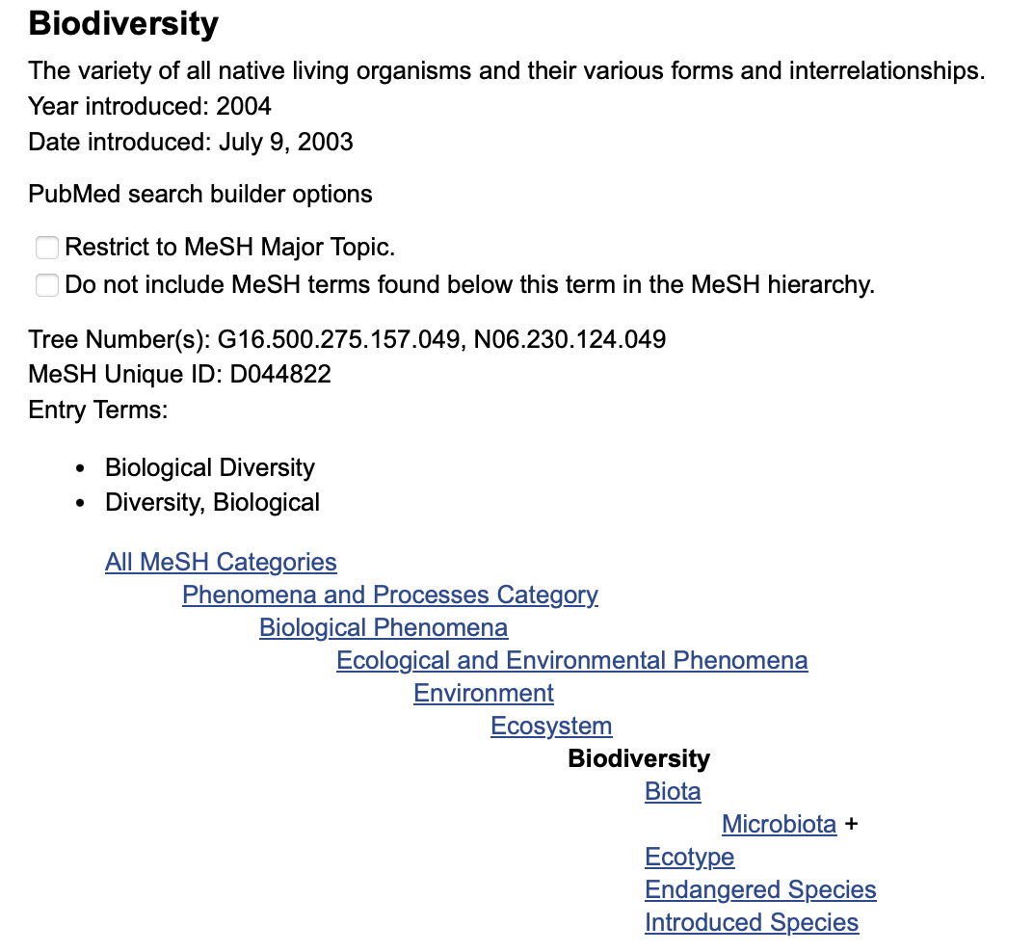
Controlled Vocabularies & Ontologies
Controlled Vocabularies
A predefined, organised list of authorised terms
Ensures consistency in data description
Examples: Species taxonomies, Medical Subject Headings (MESH)
Ontologies
A structured framework showing relationships between concepts/terms
Supports complex data integration and interoperability
Benefits as Metadata Descriptors
Improved Data Consistency: Reduces ambiguity and enhances searchability
Enhanced Interoperability: Facilitates data sharing across systems
Efficient Data Management: Streamlines classification and retrieval processes
This slide, including all images, are in the public domain and free to reuse.
Notes:
Controlled vocabularies:
You decide which terms are allowed for which field
Ontologies - adds on relationships between terms

Slide 25
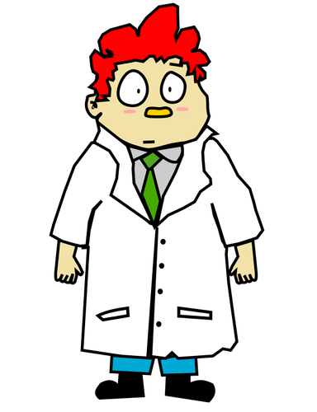
Metadata transformation
A simple example:
One location
=
One metadata value
 | Place
 | Strängnäs
Does anyone need to know more?
This slide, including all images, are in the public domain and free to reuse.
Notes:
Is that it then? Will repositories save the day, and save you the work, like some super hero?
No, sorry, YOU still need to transform what you have into the more formalised way of describing things.
[ click ] Let’s go through a simple example:
As a researcher you know that you collected your samples in a field in an area, so you name a column in your sample spreadsheet ‘Place’ and add the location
[ click ] Seems sufficient, right? One location equals one metadata value. Everyone in the world should know what “Strängnäs” is.
[ click ] Does anyone need to know more about the location?

Slide 26
Metadata transformation
Yes!
More detail let others (and your future self) know what you have done
 | Geographic location (country and/or sea) | Geographic location (region and locality) | Geographic location (latitude) | Geographic location (longitude)
 | Sweden | Strängnäs | 59.29 | 17.12
Rich metadata is the key to scientific reliability!
This slide, including all images, are in the public domain and free to reuse.
Notes:
In short, yes!
[ click ] In order for this to make sense to someone else, a someone who has no idea what “Strängnäs” even is, a repository will ask you
to transform your column called ‘Place’ into four columns, and
to use specific column headings and
give more detail about country, local region, plus latitude and longitude in universal decimal grades
[ click ] This transformation is necessary and requires manual labour, but rich metadata really IS the key to scientific reliability

Slide 27
Persistent Identifiers
Open Science in the project lifecycle - access & reuse
This presentation originates from session 8 of the The ELIXIR FAIR training material by Design course. DOI:10.5281/zenodo.13773159

Slide 28





What is a unique persistent identifier (PID)
Identify
Verify
Locate
Notes:
So to start with, what is a persistant identifer?
A persistent identifier (PID) is a long-lasting reference that uniquely tags a resource, for example a dataset, and provides the information required to reliably identify, verify and locate your resource eliminating many misunderstandings. (A PID may also be connected to a set of metadata which describes a digital or non-digital resource rather than to the item itself.) A PID ensures that access to the digital object is persistent. PIDs avoid broken links and difficulties locating a digital object (e.g. a dataset, a publication), even if its web address (URL) changes. A central registry ensures that following the PID will point you to the digital object’s current location.
In order to make this a bit more concrete I’ll give you an example.

Slide 29






Unique identifiers: How it works
Globally unique
Comply with controlled syntax
Persistent
Its maintained for long period of time
Resolvable
Should enable humans and machine
JANE DOE, MILL RD 1 SWEDEN
JANE
JANE DOE, HIGH ST 5
NORWAY
JANE SMITH, CASHEW WAY
GERMANY
Notes:
Let’s imagine that you are going to be invited to a high school reunion in the hometown of your youth. However, you've moved several times in your life. With each move, your physical address changes. You might also have changed your name at some point in your life. When the organising committee wants to send you the invitation, they need your current name and address but since you both changed your name and moved your invite will be lost. But what if there was a magical mailbox that stayed the same no matter where you moved? You could give out this "magical mailbox" address once, and anyone could send you letters to that address, which would then automatically find its way to wherever you live now. Even if you move across the globe, your mail reaches you through this magical, never-changing mailbox.
A Persistent Identifier (PID) acts like this magical mailbox for digital information. Let's say there's a specific research paper online. It gets a PID, a unique digital "address" that never changes, even if the paper moves to different locations on the internet (like from one database to another). No matter how the internet changes or where the document goes, you can use this PID to find the paper, just like how your letter finds you through your unchanging, magical mailbox.
The primary purpose of the PID is to provide the information required to reliably identify, verify and locate the resource it is connected with. In order to do so, the PIDs must comply with a few rules:
Globally unique:
To enable global uniqueness, a PID should comply with a controlled syntax to avoid clashes, for instance, by having namespaces that are governed by clearly defined authorities, ensuring that there are no two identical identifiers that point to different digital objects
Persistent:
The identifier, and the object to which it points, should be maintained for a long period of time. The syntax used for the identifier should be also persistent. A PID ensures that access to the digital object is persistent. PIDs avoid broken links and difficulties locating a digital object (e.g. a dataset, a publication), even if its web address (URL) changes. A central registry ensures that following the PID will point you to the digital object’s current location. Resolvable: The identifier allows both human and machine users to access the resource or information

Slide 30
Are you familiar with some persistent identifiers?
Notes:
Ask the audience if they know any PIDs and listen to the responses

Slide 31

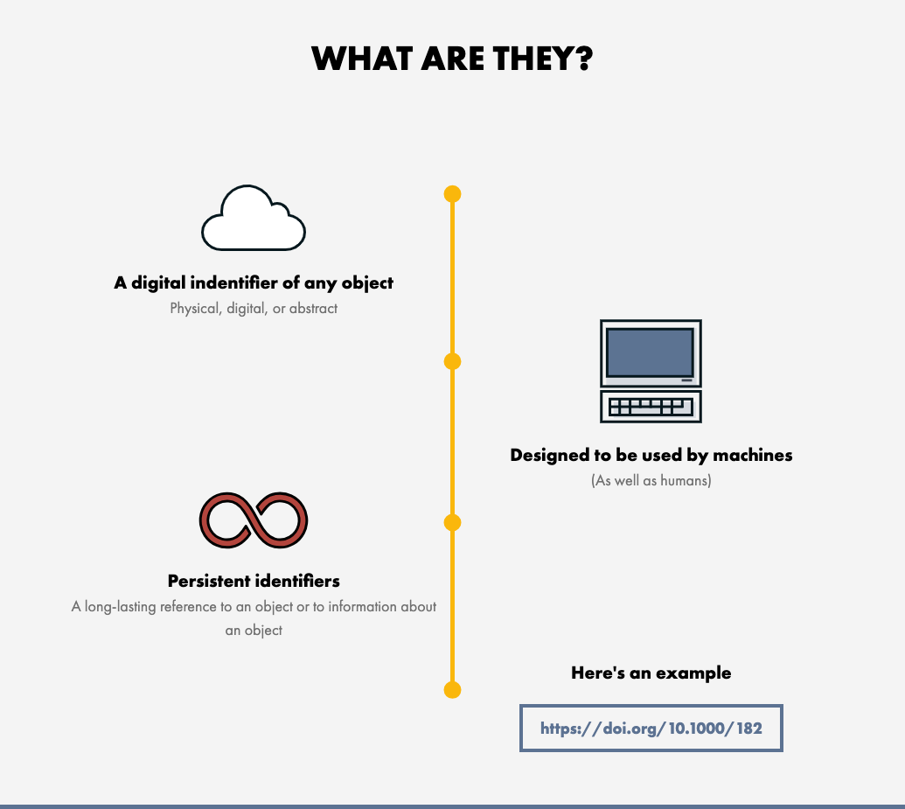
Digital Object Identifier - DOI
Illustration from the DOI Foundations website https://www.doi.org/the-identifier/what-is-a-doi/
Notes:
An example of a persistent identifier that you might be familiar with is the DOI Digital Object Identifier (DOI) (doi.org) It is one of the most common PIDs used by public repositories. A DOI, like any other PID, is a long-lasting reference that uniquely tags a resource. While the identifier itself is digital the object it is identifying can be of any kind, Physical, digital or abstract. DOIs are and are actionable, meaning that you can resolve it using the web browser and be taken to a web page with the listed digital object and its metadata. Actual access to the digital object from this page might be restricted since a PID may be connected to a set of metadata describing an item rather than to the item itself. DOIs are coupled with metadata that can be modified over time and to keep track of the locations and characteristics of the objects they identify.
Designed to be used by humans as well as machines, DOIs identify objects persistently. They allow things to be uniquely identified and accessed reliably. You know what you have, where it is, and others can track it too. A DOI is a unique number made up of a prefix and a suffix separated by a forward slash. This is an example of one: 10.1000/182. It is resolvable using our proxy server by displaying it as a link: https://doi.org/10.1000/182. Foundation and RAs The DOI Foundation is the governance body of the DOI System and is composed of registration agencies that provide services to their respective communities (people or organisations who need to identify and track the things that matter to them.) Their work involves allocating DOI prefixes, registering DOI names, and providing a metadata schema associated with each DOI record. How does this work?

Slide 32
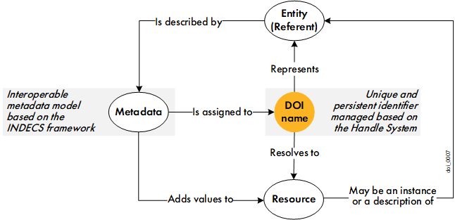
Digital Object Identifier - DOI
Illustration from The DOI Handbook April 2023 (https://doi.org/10.1000/182 identifies the latest current version of the handbook)
Notes:
This figure illustrates the basic principle of the DOI System. Let’s start in the middle. Any entity (digital, physical, or abstract) can be identified by a global unique and persistent identifier called a DOI name. The DOI name can be resolved to a resource, such as a web or internet resource for example a Zenodo record, with metadata describing the entity, a landing page with access to further resources, etc. The resource could also be an instance of the entity it represents. For example, a DOI name representing an article resolves to the web address of the HTML file version of the article.
Metadata must be assigned to each DOI name to describe the entity represented by the DOI name. Metadata interoperability is ensured through basic principles outlined by the DOI Foundation. Metadata is used to provide services to the users: it can be displayed to users to enrich an information resource; it can be used by users to search for a DOI name; etc.

Slide 33


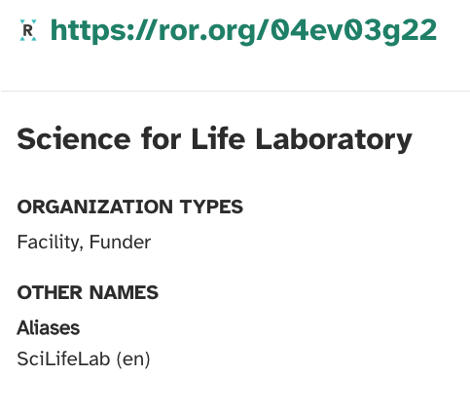
Other examples of PIDs
ORCID - Open Researcher and Contributor ID
persistent identifiers for researchers
takes homonymy into account
add aliases to your profile if your name changes
ORCID stays the same when affiliation changes
The Research Organization Registry
persistent identifiers for research organizations
Notes:
ORCID, which stands for Open Researcher and Contributor ID, is a global, non-profit organisation which provides a unique and persistent identifier free of charge to researchers. Especially if you have a common name, you’ll know how important it is to distinguish homonyms! It is extremely useful to be correctly identified, worldwide. ORCID takes homonymy into account, and the system also allows you to add aliases to your profile in the event that your name changes, making sure that it will be tracked back to you. Another benefit is that your ORCID will stay the same, even when your affiliation changes, ensuring that you get the credit you deserve and helping you keep track of your work. ROR, The Research Organization Registry (ROR.org) is a global, community-led registry of open persistent identifiers for research organizations. ROR makes it easy for anyone or any system to disambiguate institution names and connect research organizations to researchers and research outputs. For example, Science for Life Laboratory is commonly referred to as SciLifeLab. If not directly involved with the organisation one might easily think that these are two different organisations, using the SciLifeLab ROR-id will make it clear they refer to the same organisation.

Slide 34
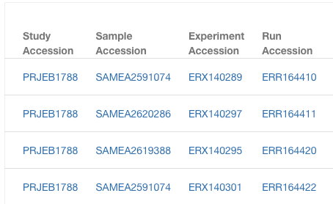
Accession numbers
The European Nucleotide Archive (ENA) assigns accession numbers to digital entities at various levels of granularity.
Notes:
PIDs and accession numbers for Life Sciences data
Many databases and repositories in life sciences work with their own identifier system. As these databases are considered as trustworthy data repositories by many instances, their accession numbers are widely adopted and accepted for use in citations.
The European Nucleotide Archive (ENA) assigns accession numbers to digital entities at various levels of granularity. Example ENA accession numbers are the PRJEB1788 (BioProject) and ERR 164410(Sequence).
Other examples:
The European Genome-Phenome Archive (EGA) assigns IDs to studies and datasets. An example dataset ID is EGAD00000000001.
EMBL-EBI’s BioStudies database links to or manages diverse biological data from EMBL-EBI databases as well as data that do not fit in the structured EMBL-EBI databases. Once data are submitted successfully, an accession number is automatically assigned. Example accession numbers are S-BSST7 (BioStudies), S-BEAD712 (BioImage Archive), E-MTAB-12919 (ArrayExpress).

Slide 35
Benefits of PIDs
uniquely distinguish resources from similar objects (F)
a place to keep the metadata (F)
machine actionable identifiers increase findability (F)
resolves providing a way or information on how to access the object (A)
enhances citability leading to easier reuse (R)
Notes:
The benefits of using unique identifiers are several and by using a public repository to assign a DOI to your training material you benefit from efficient management and accurate tracking, as well as gaining the ability to more easily automate processes and collaborate with partners in your community. Furthermore, DOIs facilitate accurate citation and tracking of outputs and for individuals to get recognised for their works.
F:
- uniquely distinguished from similar objects
- a place to keep the metadata
- machine actionable identifiers increase findability
A: - resolves providing a way or information on how to access the object
I: - NA
R: - enhances citability leading to easier reuse

Slide 36
Licenses
Open Science in the project lifecycle - access & reuse
Notes:
Why they are important
What to think about
How to re-use

Slide 37
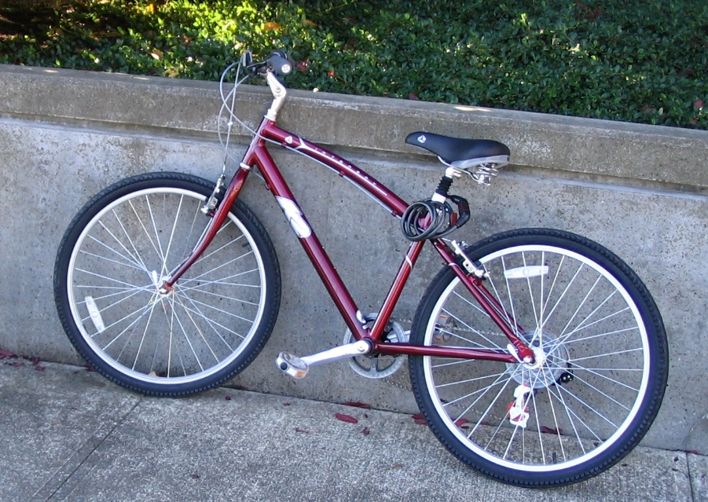
Why license your research output?
Image from Flickr, licensed CC0 (https://flic.kr/p/6kHZ9r)
Open Licenses for Data, Code, and Software Pilot – CC-BY SA – 19.06.2024
Notes:
[Slide and speaker notes from Open Licenses for Data, Code, and Software Pilot – CC-BY SA – 19.06.2024] Imagine that you are walking in the city and you see a bicycle propped against a wall. It’s a very nice bicycle. You would love to take it. It’s exactly what you need. You could make good use of it. But… you’re not sure if you can. Why did the owner leave it here? There is no one around you could ask. What if you take the bicycle and get in trouble? You don’t want to take the risk. So you leave the bicycle and you walk away.

Slide 38
Why license your research output?
FREE
to a good home
Image from Flickr, licensed CC0 (https://flic.kr/p/6kHZ9r)
Open Licenses for Data, Code, and Software Pilot – CC-BY SA – 19.06.2024
Notes:
[Slide from Open Licenses for Data, Code, and Software Pilot – CC-BY SA – 19.06.2024, speaker notes added for the Open Science in the Swedish context 2025-05-05 – 09, url: https://scilifelab-training.github.io/open-science/2505/]
What if there was a sign on the bike saying “FREE to a good home”. Then you might think differently. You know why the owner left it there, and since you could make good use of it you could take it with you.

Slide 39
Why license your research output?
FREE
to a good home
A license is a clear invitation for others to REUSE your research data or software – on your terms.
Image from Flickr, licensed CC0 (https://flic.kr/p/6kHZ9r)
Open Licenses for Data, Code, and Software Pilot – CC-BY SA – 19.06.2024
Notes:
[Slide from Open Licenses for Data, Code, and Software Pilot – CC-BY SA – 19.06.2024, speaker notes added for the Open Science in the Swedish context 2025-05-05 – 09, url: https://scilifelab-training.github.io/open-science/2505/]
So a license is a clear declaration of intended reuse and and invitation for others to reuse your research output - according to the terms you decide on.

Slide 40
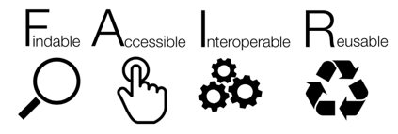
Why license your research output?
FAIR principles for research data 🡪 R1.1. (meta)data are released with a clear and accessible data usage license.
FAIR principles for research software 🡪 R1.1. Software is given a clear and accessible license.
Sources : 1 - 2 - 3 - 4
Open Licenses for Data, Code, and Software Pilot – CC-BY SA – 19.06.2024
Notes:
[Slide from Open Licenses for Data, Code, and Software Pilot – CC-BY SA – 19.06.2024, speaker notes added for the Open Science in the Swedish context 2025-05-05 – 09, url: https://scilifelab-training.github.io/open-science/2505/]
Licences enables reuse and is mentioned in the FAIR principles for research data, software and training materials but could also be applied to presentations, posters, method descriptions etc.
Applying a license is critical to disseminating a research product. A misconception is that a licence is constraining but it’s rather the opposite; without a license, the terms of reuse are unclear and potential users may walk away.

Slide 41
Why license your research output?
Make the property rights clear & access and usability rules evident
Protection of one’s right
More citations
More reuse
Greater impact
Notes:
The primary purpose of licenses are to make the property rights clear & access and usability rules evident. This can also lead to some additional benefits for you as a researchers.
Protection of one’s right
More citations
More reuse
Greater impact

Slide 42
What type of licences have you come across?
Notes:
Ask the participants if they have any examples of licenses they have experienced as a user of someone else’s material or that they have applied on their own materials.

Slide 43

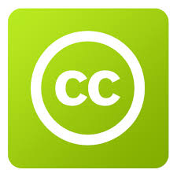









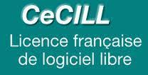




Overview of available open licenses
There are numerous licenses, some of which can be customized to meet specific needs, while others are highly specific.
Open Gouvernement license for public sector information
Etalab license
SPDX Licenses list
European Union Public Licence
Eclipse Public Licence
Italian Open Data License
Open Licenses for Data, Code, and Software Pilot – CC-BY SA – 19.06.2024
Notes:
There are many different licences for different purposes or from different countries and so on. We will not go through all of these but if you’re interested you can check out the SPDX licenses list, which is a list of commonly found licenses and exceptions used in free and open or collaborative software, data, hardware, or documentation.
Point out:
ODC open data commons and the - Open Data Commons Open Database License (ODbL)
GNU and MIT licences
We will start by looking at the Creative common licenses.

Slide 44
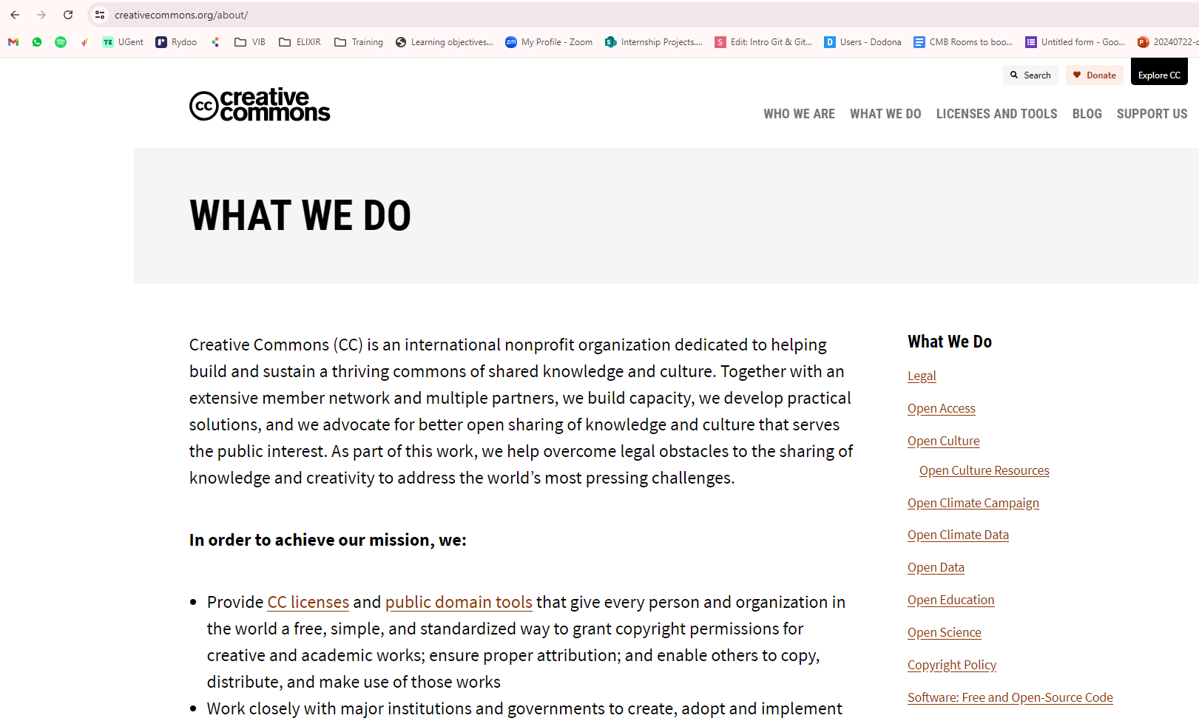
Creative Commons
Originates from session 8 of the The ELIXIR FAIR training material by Design course. CC-BY-NC-SA
Notes:
Creative Commons (CC) is an international non-profit organization founded in 2001, their mission is to empower people to share their creative work and knowledge freely and legally. They are not a legal entity but they have created and are maintaining practical solutions for better sharing. CC provides free and machine readable, standardized copyright licenses and public domain tools that creators can use to grant permissions for others to use their work.

Slide 45
Creative Commons - before licensing
The licenses and CC0 mark cannot be revoked
Updates only apply for “new users”
Only the copyrights holder can apply a CC license
If created in the job , you might not be the holder
Notes:
The licenses and CC0 cannot be revoked. This means once you apply a CC license to your material, anyone who receives it may rely on that license for as long as the material is protected by copyright, even if you later stop distributing it. You must own or control copyright in the work. Only the copyright holder or someone with express permission from the copyright holder can apply a CC license or CC0 to a copyrighted work. If you created a work in the scope of your job, you may not be the holder of the copyright.

Slide 46
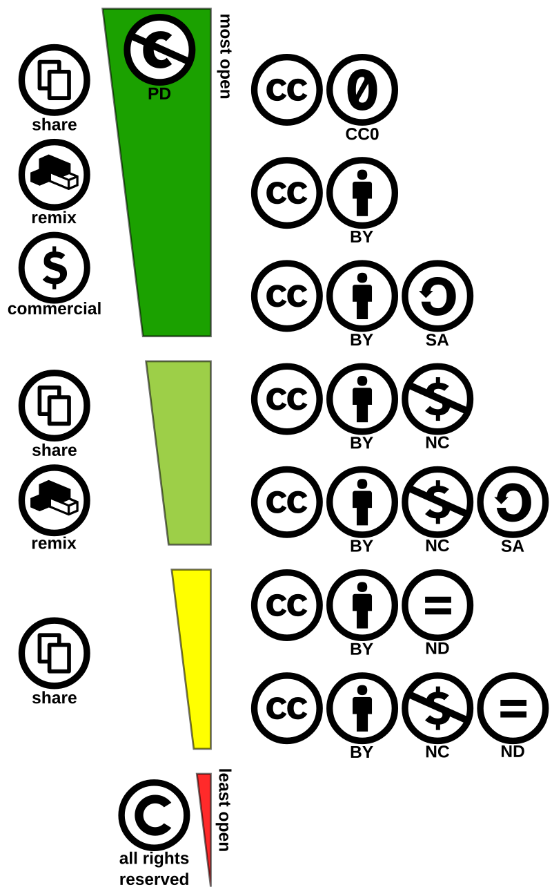

Creative Commons
Core conditions:
Public domain tools:
Attribution
No rights reserved
ShareAlike
No known copyright
PDM
NonCommercial
NoDerivatives
Notes:
Creative commons offer 6 licences based on 4 Core conditions that are combined into the different licences.
The Four Core Conditions:
Attribution (BY): A figure icon (person) - You need to name the original author/creator. In all 6 licences
ShareAlike (SA): A circular arrow icon - If you adapt the work, you must share your modifications under the same or a compatible license.
NonCommercial (NC): A dollar sign with a slash through it icon - You can only use the work for non-commercial purposes.
NoDerivatives (ND): An equals sign icon - You cannot share adaptations or modifications of the work.
In addition, there are two public domain tools
CC0 (Creative Commons Zero): Often represented by the number zero in a circle. It allows creators to dedicate their work to the public domain, waiving all copyright and related rights.
Public Domain Mark: Indicates works that are already in the public domain due to expired copyright.

Slide 47

Creative commons licences
Creative commons license spectrum by Shaddim; original CC license symbols by Creative Commons. CC-BY-SA 4.0
Notes:
Here we see the 6 licences on a spectrum from most open to least open and the public domain markings. For all of the licences attribution is mandatory. And the most open licence allows for sharing, remixin, adapting and building upon for any kind of use including commercial. The difference between CC-BY and CC-BY-SA is that in the latter case, new material created need to be licensed in the same manner. Then follows the same kind of licences but with the additional condition that they cannot be used for commercial purposes. Finally there are 2 license that allows sharing but no adaptations are allowed.
So how do we know which one to choose from?

Slide 48

Mission
coordinate and support the digitalisation of public administration.
responsible for Sweden's digital infrastructure.
to follow up and analyse the digitalisation of society.
to help the government make well-informed decisions.
Notes:
DIGG is a public authority (under the Ministry of Finance) that is responsible for the digitalisation of the public administration. Our assignment is formulated in our instructions and in our regulation letter. We are also steered through direct government assignments, where we can be given the task of investigating an issue or developing a special solution.
The instruction contains four clear overall points that clearly summarises our mission:
We coordinate and support the digitalisation of public administration.
We are responsible for Sweden's digital infrastructure.
We follow up and analyse the digitalisation of society.
We help the government make well-informed decisions.
In the context of the open data directive from 2019, DIGG has come up with recommendations for licences for public authorities

Slide 49
Creative commons licences -recommendations
The Agency for Digital Government (DIGG):
information/data not subject to copyright or IP protection
information/data subject to copyright
authorities should not impose this type of limiting condition or control compliance
Rekommendation om öppna licenser och immaterialrätt | Digg
Creative commons license spectrum by Shaddim; original CC license symbols by Creative Commons. CC-BY-SA 4.0
Notes:
The Agency for Digital Governance has come up with recommendations for
For information and data created by a public authority that is not subject to copyright or other intellectual property protection, the marking PDM or CC0 is recommended. For databases created by a public authority for the exercise of public authority, the marking CC0 is recommended.
The recommendation presupposes that unrestricted further use can take place in accordance with other legislation.
For other information created by a public authority that is subject to copyright protection as a work or performance, the license CC BY 4.0 is recommended. This also presupposes that the authority has acquired sufficient rights or has fully taken over the economic rights from the creator through an agreement.
The authority is advised against using the CC BY-SA license, as the condition that others' processing of such information must be licensed under the same license entails a limitation. Authorities should not impose this type of condition or control compliance.
The DIGG has more extensive recommendations also for software. Unfortunately this is only in Swedish but using a translating tool could make them useful. Please have a look at their website.

Slide 50
Tools for choosing a license
License selector https://ufal.github.io/public-license-selector/
Choose a license https://choosealicense.com/
Creative Commons license chooser https://chooser-beta.creativecommons.org/
Notes:
If you are not to follow the recommendations from DIGG for some reason. There are tools that can help you choose a licence. [Maybe showcase one of them]

Slide 51

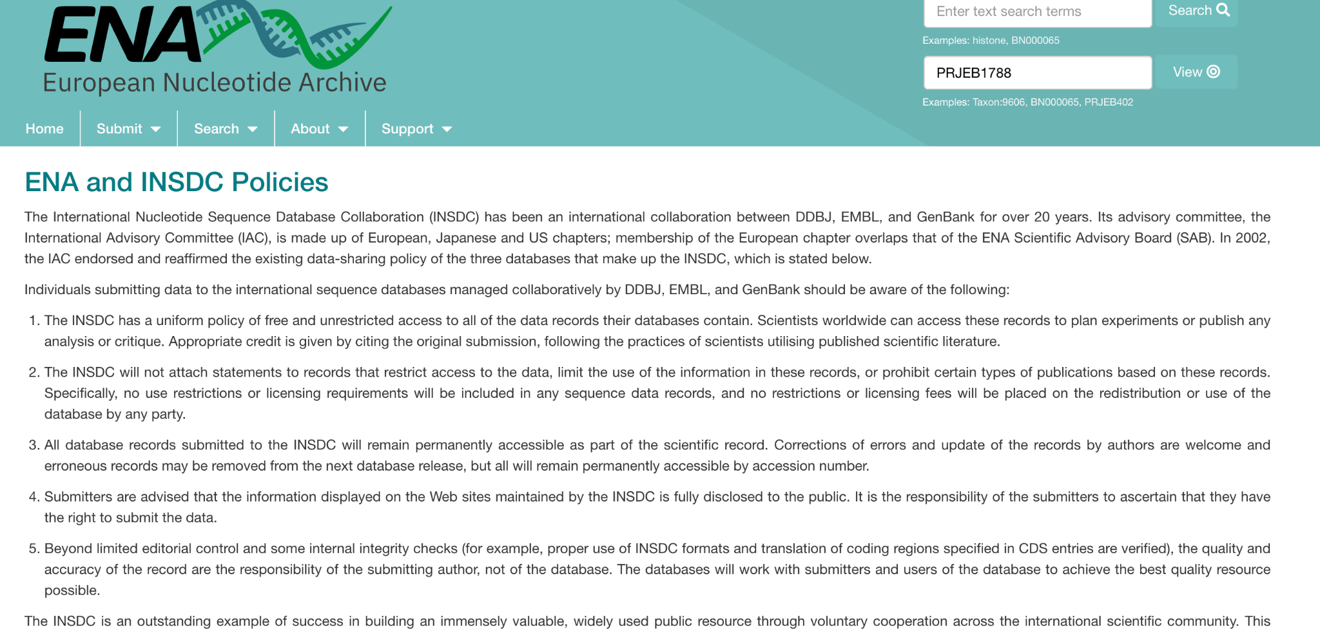
Licences vs Terms of use
Disadvantages:
Not standardised
Not machine readable
Notes:
As we’ve seen earlier when speaking of identifiers, repositories that have been around for some time might have their own solution regarding terms of use that are not standardised licences. One example of this is EMBL-EBI data repositories.
Disadvantages:
Not standardised
Not machine actionable
https://www.science.org/doi/10.1126/science.298.5597.1333b
We will:
Standardise the licences used across EMBL-EBI resources.
Use licences that present the lowest barriers to data reuse. CC0 is preferred over CC-BY. CC0 is most in line with the spirit of the EMBL-EBI Terms of Use.
State the licence explicitly on the resource as a whole and at the record level, in both human and machine-readable formats.
In some cases EMBL-EBI’s Terms of Use may have to be retained (for example, for a data resource that aggregates content with existing multiple licence types).

Slide 52
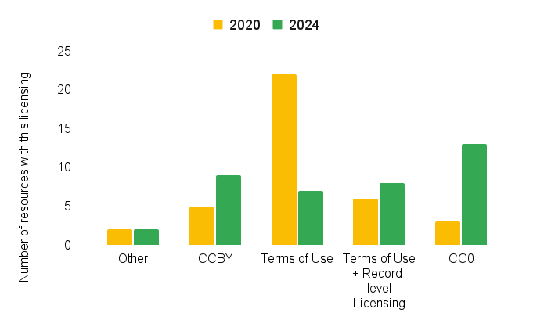
Licences vs Terms of use
Monitoring progress towards standardised licensing
Standardise the licences used across EMBL-EBI resources.
Use licences that present the lowest barriers to data reuse. CC0 is preferred over CC-BY.
State the licence explicitly both on the resource and at the record level.
Plot from EBI https://www.ebi.ac.uk/licencing/
Notes:
In 2021 EMBL-EBI decided to start a transition to adhere to standardised licences instead of custom policies and terms of use. Here we see the progress between 2020 and 2024
https://www.ebi.ac.uk/licencing/
https://www.science.org/doi/10.1126/science.298.5597.1333b
We will:
Standardise the licences used across EMBL-EBI resources.
Use licences that present the lowest barriers to data reuse. CC0 is preferred over CC-BY. CC0 is most in line with the spirit of the EMBL-EBI Terms of Use.
State the licence explicitly on the resource as a whole and at the record level, in both human and machine-readable formats.
In some cases EMBL-EBI’s Terms of Use may have to be retained (for example, for a data resource that aggregates content with existing multiple licence types).

Slide 53
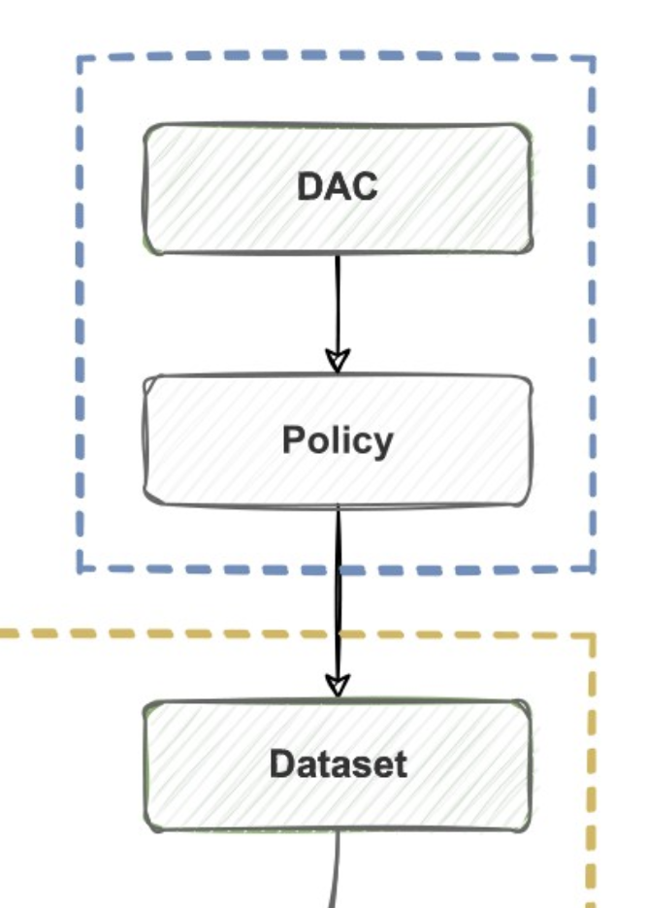
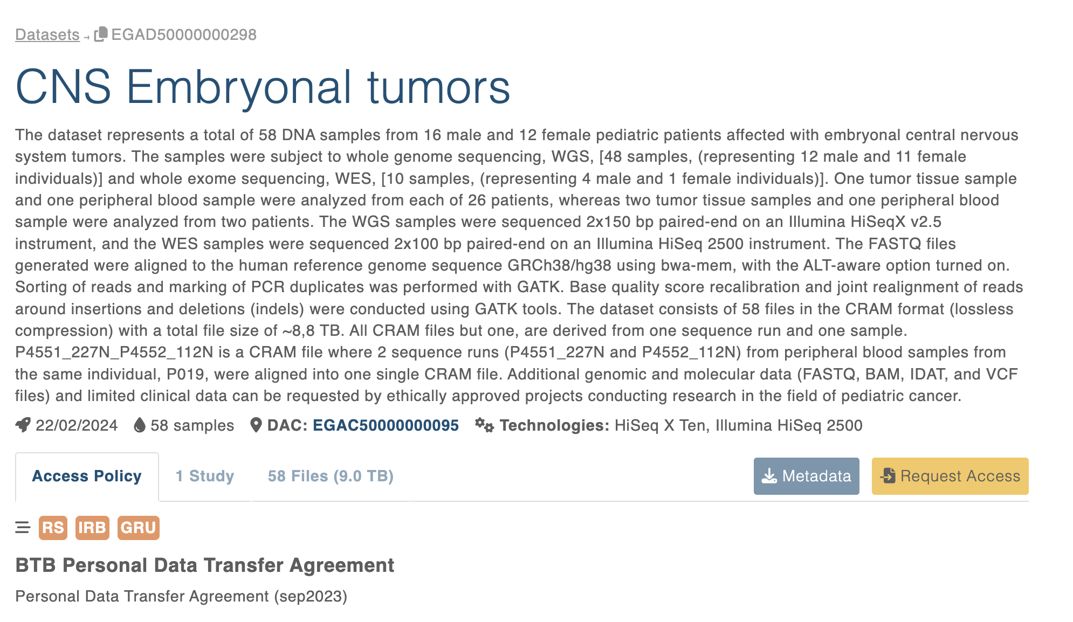
Restricted access: EGA example
Metadata record for EGAD50000000298
https://ega-archive.org/submission/metadata/ega-schema/
Notes:
For repositories with restricted access the Creative commons licenses are not suitable. Often the Terms of use or data access agreements are dataset specific.

Slide 54
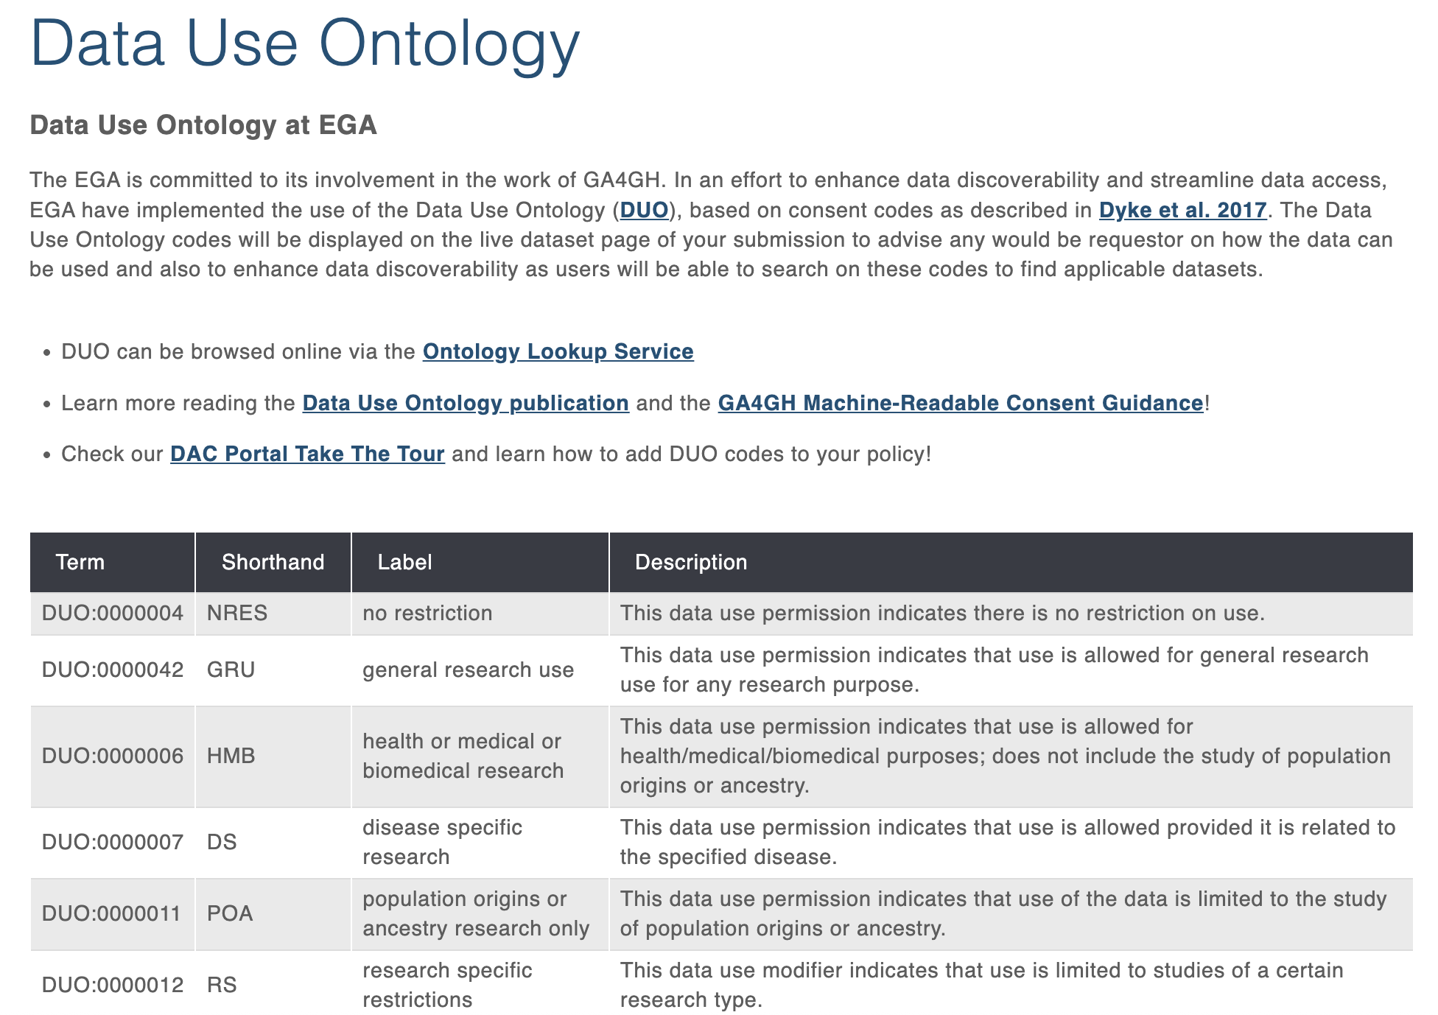
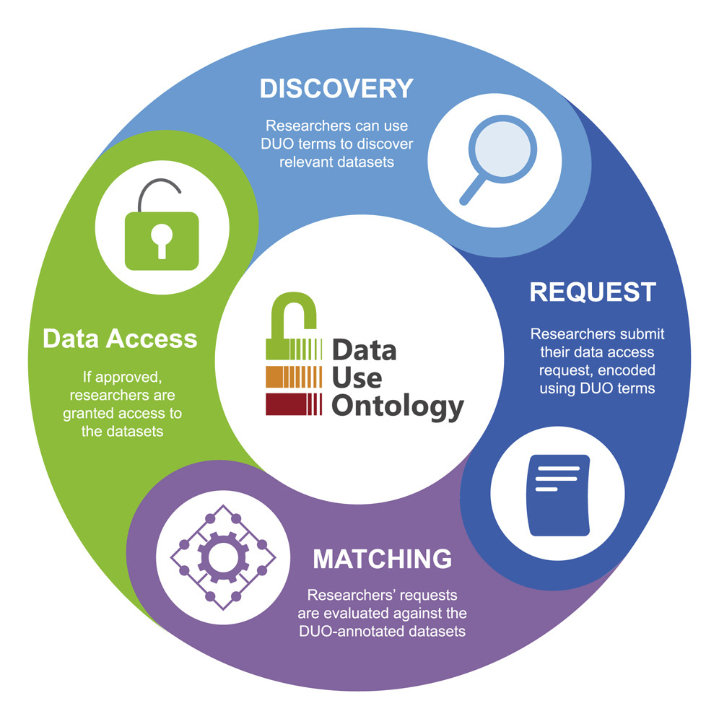
Restricted access: EGA example
Lawson et al., 2021, Cell Genomics 1, https://doi.org/10.1016/j.xgen.2021.100028
https://ega-archive.org/access/data-access-committee/data-use-ontology/
Notes:
In order to standardise and streamline the access conditions a Data use ontology has been implemented. You can apply terms that are machine readable to the dataset to make it easier to find for the prospective reuser.

Slide 55
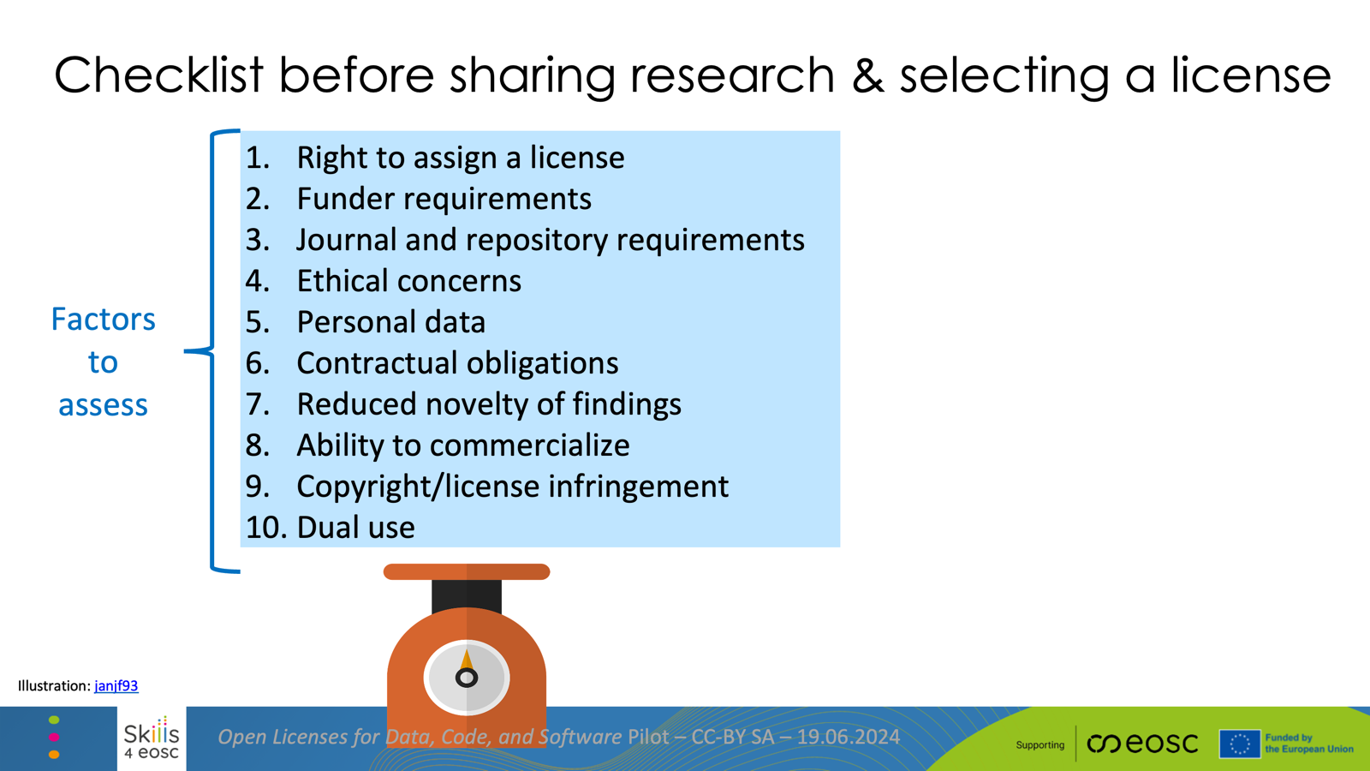
Notes:
When choosing a license for sharing research outpts there are quite a few things to consider and factors to assess.

Slide 56
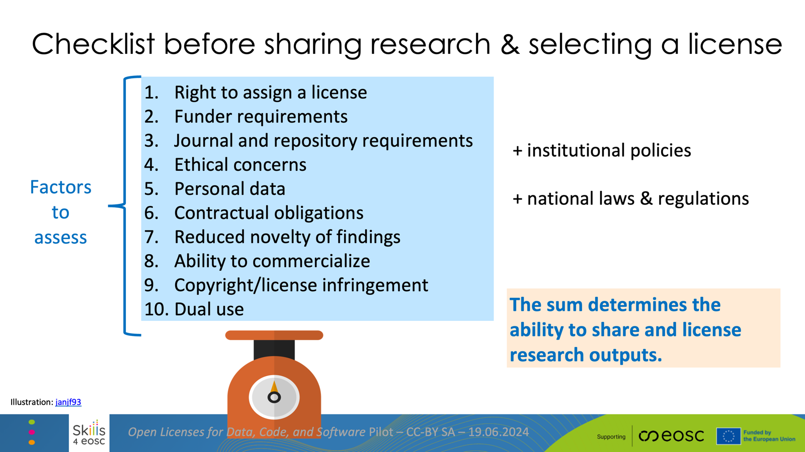
Notes:
On top of this there might be additional institutional policies and national laws and reguations

Slide 57
Lets try this out!
Notes:
Now you will get to try writing a Data Management Plan. There are 2 set of exercises to choose from. The first one will mainly be for those of you who are life scientist. You can try out the tool from SciLifeLab and either create a DMP for a pre-defined scenario in the material or create a DMP for your own project.
The second one is good for everyone so life scientists might also choose that one. It has 2 parts. First, find out if your organisation/institution has a DMP tool or template. Search your intranet, ask your support function or library if you have one etc. Then, use the DMP checklist from SND and reflect over the questions in the checklist. Would they be applicable to you/your project or not.

Slide 58
Getting Your Research Out There: A Hands-On Introduction to Open Sharing with Zenodo Sandbox
https://go.nbis.se/OS26-Zenodo

Slide 59
Reflections
Were some metadata fields difficult to provide an answer to?
Did something surprise you with the metadata requirements in Zenodo?

Slide 60
Repositories are key for share and reuse
Why using repositories?
When to start thinking about repositories?
Notes:
Do you agree or disagree with this statement? Could you give me some reasons for why using repositories is a good idea?
When should we start identifying a repository?

Slide 61
Repositories are key for share and reuse
Why using repositories?
Helps you adhere to the FAIR principles
When to start thinking about repositories?
Early on
File formats
Metadata fields
Lightweight backup
Notes:
Do you agree or disagree with this statement? Could you give me some reasons for why using repositories is a good idea?
When should we start identifying a repository?

Slide 62
Evaluate a repository
Things to check when evaluating:
Are others in the community using it?
Is it easy to navigate / user-friendly?
Is there support / guidance for submission and reuse?
Is it sustainable, i.e. will the repository be around for a while?
Will the datasets obtain persistent identifiers? Is the repository itself FAIR?
What are the usage rights or license options?
Notes:
Evaluate the suitability of a repository
How do you know if a repository is trustworthy? Say that you find a repository that might fit your purposes, how can you evaluate if it is suitable? Apart from accepting your type of data, there are some questions to consider when deciding if a certain repository is suitable or not:
Are others in the community using it? Explore what datasets are already in it.
While exploring it, is it easy to navigate / user-friendly?
Is there support / guidance for submission and reuse?
Is it sustainable, i.e. will the repository be around for a while? Is there a long-term plan for financing the repository, is it managed by a trustworthy group?
Will the datasets obtain persistent identifiers? Is the repository itself FAIR?

Slide 63
Key Points
Rich metadata is the key to scientific reliability and reuse.
No license - no reuse (without asking for permission).
Persistent identifiers allow an object to be identified, verified and located.
Using repositories increases FAIRness and reuse:
Identifying a repository early one helps to formalise metadata from the start.
If possible, use a domain-specific repository since it has maximum reach in the research community.
The research output (data) types determines which domain-specific repository is suitable.

