Slide 1

OPEN EDUCATIONAL RESOURCES (OER)
CC BY 4.0
MATTIAS VON FEILITZEN, 260505

Slide 2
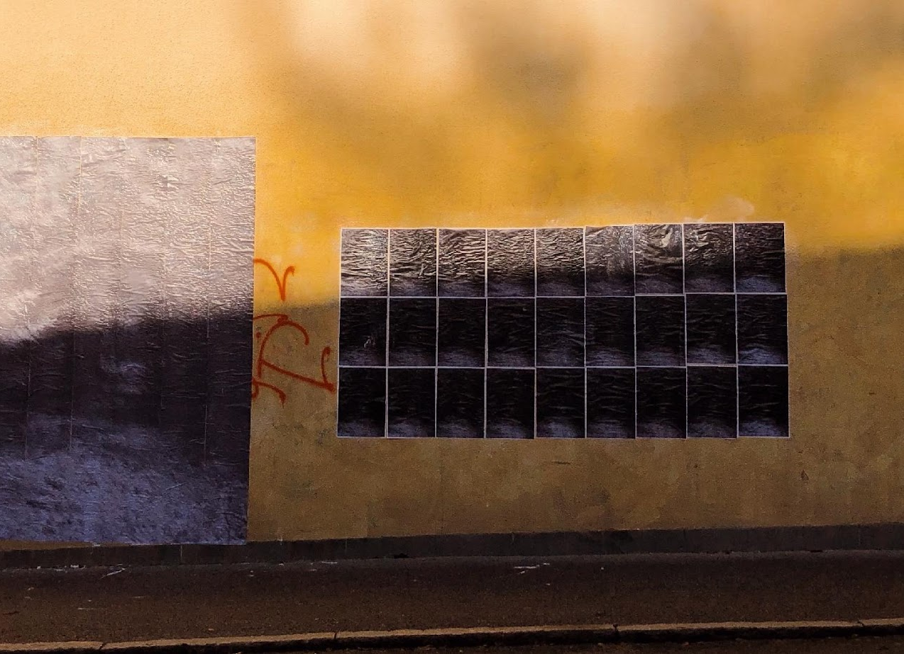
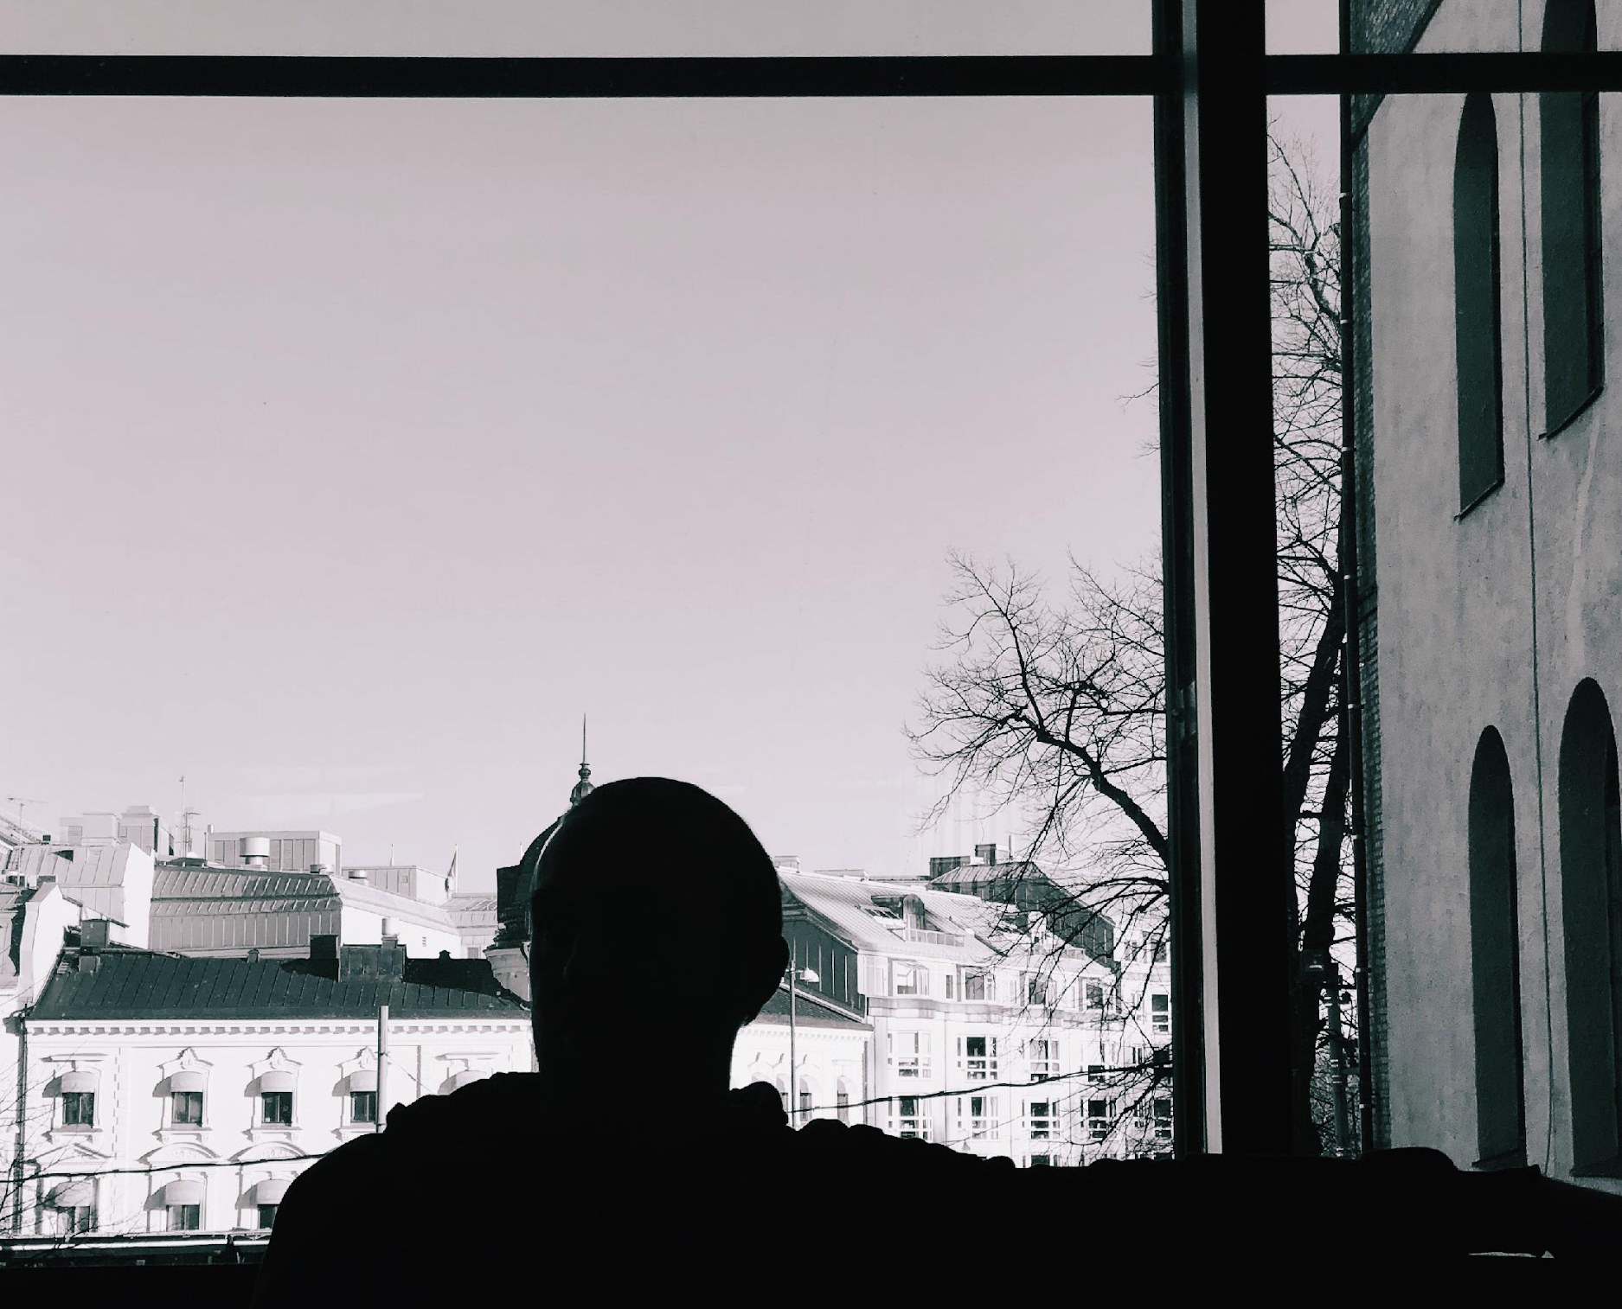
Workshop content
What is OER?
Ideas behind OER
Creative
Com-mons
Finding OER
Sharing OER

Slide 3



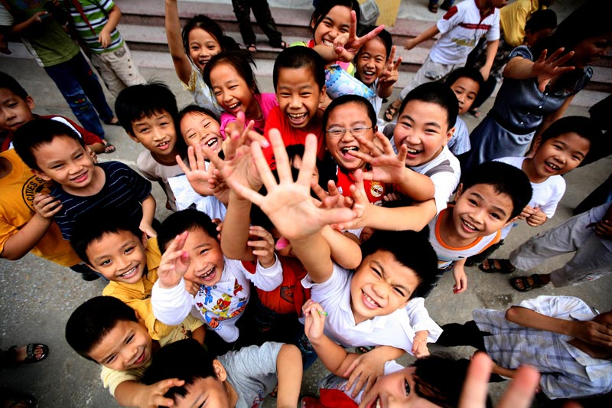
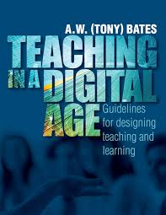
Meighan Avelos
Jonathas Mello
Justin Mott
Tony Bates
Notes:
Global trend linked to education for sustainable development and to learning together from a student-centered perspective.
Open Education (OE) is about removing barriers (such as prerequisite requirements) and increasing accessibility—most often through digital media.
It began as an altruistic initiative driven by dedicated individuals, but has also developed into a research field with its own conferences and journals.
It has been concretized through OER and OT. The focus is on dynamic resources created through a collective process that often includes students and may emphasize tools for reflection.
According to the OECD (2007), Open Educational Resources (OER) are “digital learning resources offered online free of charge and without licensing barriers for teachers, students, and lifelong learners to find, copy, use, remix, and share in teaching, learning, and research.”
OER are not only course components; they can also be entire courses or reference works.

Slide 4
Conceptualising OEP (Cronin & MacLaren, 2018)
OEP ≠ OER. Shift from resources to practices
Multiple definitions. From narrow (OER-focused) to expansive (pedagogy & context)
Core idea: collaboration, co-creation, learner empowerment
Not dependent on OER. Practices can come first
Context matters. Shaped by culture, discipline, institution
Critical dimension. Challenges power, supports equity
OEP = flexible, evolving approach to openness
Notes:
Start by clarifying that OEP ≠ OER.
Emphasize the shift from focusing on content (OER) to focusing on how teaching and learning happen (practices).
Highlight that there is no single definition of OEP.
Explain the spectrum from OER-focused approaches to more expansive views including pedagogy, collaboration, and systems.
Stress the core principles: OEP is about collaboration, students as co-creators, and active participation, not passive consumption.
Point out an important insight: OEP does not require OER. In many cases, open practices emerge first, and only later connect to open resources.
Underscore the importance of context: What “open” means depends on where you are, what you teach, and who your learners are.
It is therefore shaped by local culture, discipline (subject area) and institution.
Introduce the critical perspective: OEP can redistribute power, challenge traditional roles, and support more equitable and inclusive education.
OEP is not a fixed model, but a flexible, evolving way of thinking about openness in education.

Slide 5
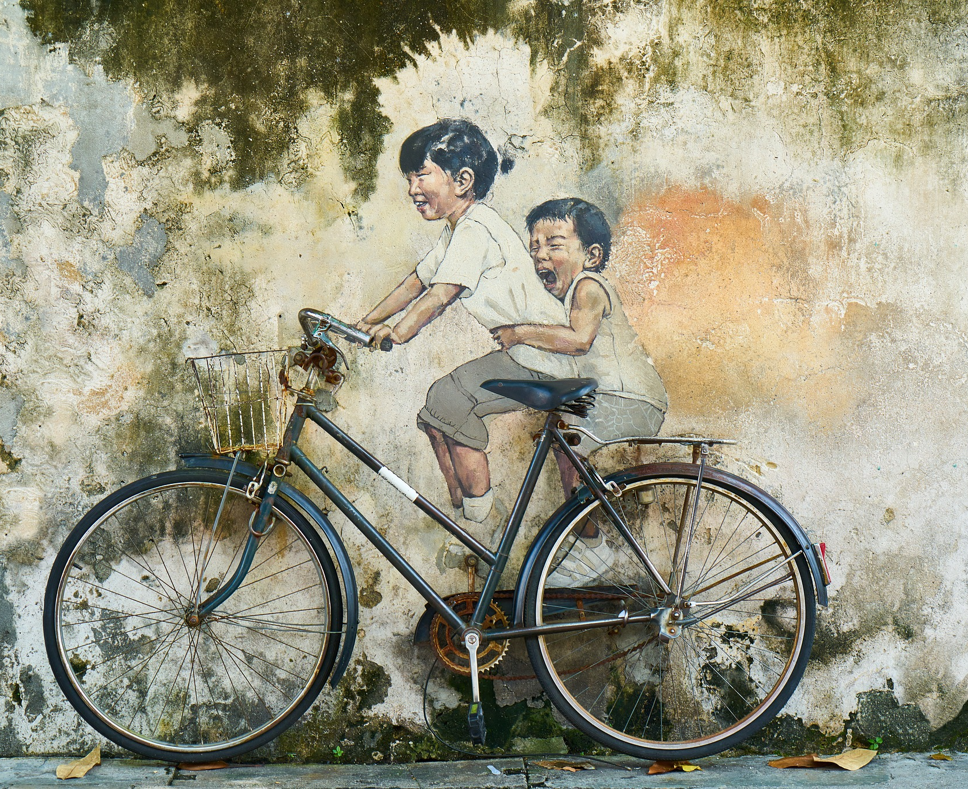

Sharing culture – open practices
Education is a basis for democracy. Also funded by public resources. (Hylén, 2006)
What you share comes back to you refined (Iiyoshy & Kumar, 2008)
Cross-boundary collaboration / engagement with society (Engeström, 2015)
Some argue that it increases robustness, while others claim that quality deteriorates. (Camilleri et al., 2014)
Practice already used in research
EnginAkyurt
NickStarychenko
Notes:
Those who support OER advocate for a participatory culture, based on Web 2.0 and theories of collaborative learning, referred to as Open Educational Practices (OEP).
However, some authors argue that we are still only seeing a sharing culture (Iiyoshi & Kumar, 2008), and that OER in itself does not constitute a new form of learning. Rather, the goal is to transform teaching methods, where new tools are integrated into education and learning takes place through collaborative activities among students and/or between teachers, students, and members of society. The aim is to challenge traditional educational practices in ways that increase equity and justice (Cronin & MacLaren, 2018, previous slide).
Some aspects of open practices and sharing culture
Education is a democratic project that is also funded by public resources. It is therefore entirely reasonable that educational materials and courses are made open and accessible to more people.
Hylén, J. (2006).
From both an individual and a content perspective, sharing is beneficial, as it includes elements of refinement, improvement, and further distribution. There is no need to “start from scratch.” It is also advantageous from a resource perspective.
Iiyoshi, T., & Kumar, M. S. V. (Eds.). (2008).
Quality assurance systems are not formalized in the same way as in other fields (e.g., scientific publishing). This can lead to reduced quality due to a lack of formal review. At the same time, robustness may increase as more people are involved in reviewing, revising, and improving the material.
Camilleri, A. F., Ehlers, U.-D., & Pawlowski, J. (2014).
In research, this is already the way we work: peer review for evaluation, and increasingly also the sharing of both results and data. The Swedish Research Council (VR) requires open access publishing.

Slide 6
Reuse
The 5 R’s of OER
Retain
Revise
Remix
Redistribute

Slide 7
Reuse
Retain
Content can be reused in its unaltered original format
Revise
Remix
Redistribute
Notes:
Reuse - Content can be reused in its unaltered original format - the right to use the content in a wide range of ways (e.g., in a class, in a study group, on a website, in a video)

Slide 8
Reuse
Retain
Copies of content can be retained for personal archives or reference
Revise
Remix
Redistribute
Notes:
Retain - Copies of content can be retained for personal archives or reference - the right to make, own, and control copies of the content (e.g., download, duplicate, store, and manage)

Slide 9
Reuse
Retain
Content can be modified or altered to suit specific needs
Revise
Remix
Redistribute
Notes:
Revise - Content can be modified or altered to suit specific needs - the right to adapt, adjust, modify, or alter the content itself (e.g., translate the content into another language)

Slide 10
Reuse
Retain
Content can be adapted with other similar content to create something new
Revise
Remix
Redistribute
Notes:
Remix - Content can be adapted with other similar content to create something new- the right to combine the original or revised content with other material to create something new (e.g., incorporate the content into a mashup)

Slide 11
Reuse
Retain
Content can be shared with anyone else in its original or altered format
Revise
Remix
Redistribute
Notes:
Redistribute - Content can be shared with anyone else in its original or altered format - the right to share copies of the original content, your revisions, or your remixes with others (e.g., give a copy of the content to a friend)

Slide 12

Notes:
A barrier to sharing cultures and OER has been issues related to copyright. Who actually owns the material that is created, and how may it be used?
Moral rights belong to the creator. Economic rights can be negotiated.
However, this framework is often too blunt and difficult to manage when it comes to enabling sharing. There is a need to allow use, but under certain guidelines or conditions.
This is why Creative Commons was developed.

Slide 13


Slide 14

BY Attribution
SA Share alike
ND No derivatives
NC Non-commercial

Slide 15

ZERO Public domain

Slide 16




grena.nu – Canvas Commons – OER Commons – Wikimedia Commons

Slide 17
Workshop activity
Browse for OER:s in repositories (grena.nu, OER commons, Canvas commons)
Reflect on quality, ease of use, finding resources, etc
OR
Prepare and share your own work as an OER
Reflect on selecting platform and license, metadata, ease of use, etc

