Slide 1
Open Access
for Code and Models
Practical steps for making code and models reusable
Karin Engström, Associate Professor and Domain Specialist in bioinformatics, Lund University
1

Slide 2
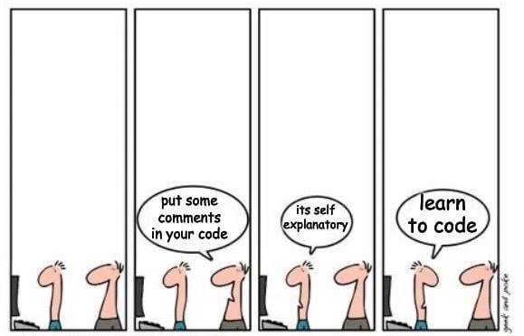
Core idea
Putting code or models online is only the first step
Open Science happens when they are versioned, documented, licensed, and easy to cite or reuse.
These are also key steps toward making them FAIR:
Findable Accessible Interoperable Reusable
https://www.reddit.com/r/ProgrammerHumor/comments/1 22hv4n/when_you_are_tired_of_explaining/

Slide 3
Session outline
60 minutes
1
2
3
4
5
6
7
Learning outcomes
Why open code and models matter
Concepts: code, models, licensing, citation
Hands-on 1: Git basics
Hands-on 2: README and reusable pipelines
Hands-on 3: model documentation
Wrap-up checklist

Slide 4
Hands-on work
Three practical skills to take away
2. Document Write a README that helps others
understand and run code.
3. Share responsibly Identify the minimum documentation needed
for model reuse.
1. Version control (Git) Create a small version-controlled
research code folder.
Focus today: practical minimums, not perfect repositories. Goal: make outputs easier to inspect, cite, and reuse.

Slide 5
“Online” is not the same as “reusable”
Visible, but hard to reuse
Reusable in practice
Files uploaded somewhere
No README
No license
Unclear version
Missing dependencies
No citation or contact info
Versioned repository
README
License
Run instructions
Release or archive
Limitations documented
Difference between visibility and practical openness
3

Slide 6
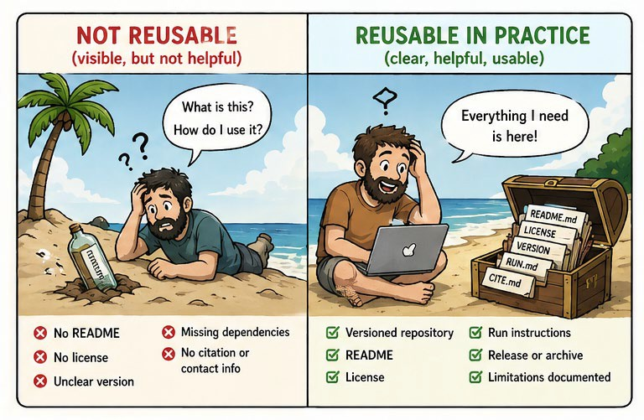
This reduces friction for others — and for your future self
AI generated

Slide 7
What Open Science asks us to do here
Open as possible, closed as necessary
Aim for openness that supports reuse
Why something may not be fully shareable
Personal or sensitive data
Copyrighted training material
API keys or credentials
Proprietary dependencies
Partner or contract restrictions
Make outputs understandable
Make them easier to inspect
Enable reuse where possible
Document what others need to know
Even when full release is impossible, you can often still share metadata, documentation, synthetic examples, or access conditions.
4

Slide 8
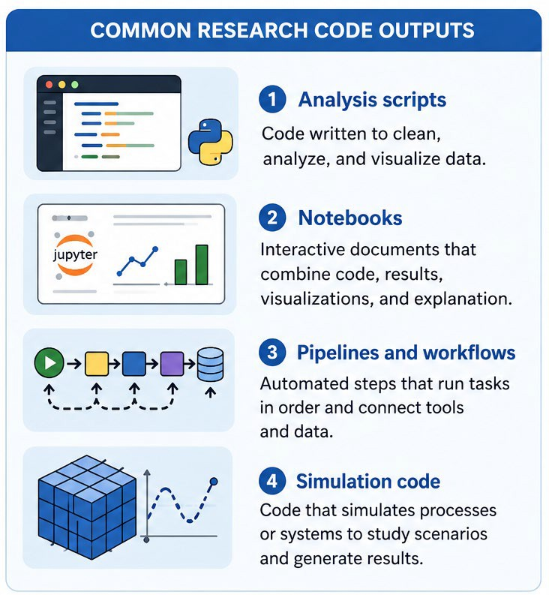
What is code?
Code is a set of instructions that tells a computer how to perform a task (e.g. to run and build a model).
6

Slide 9
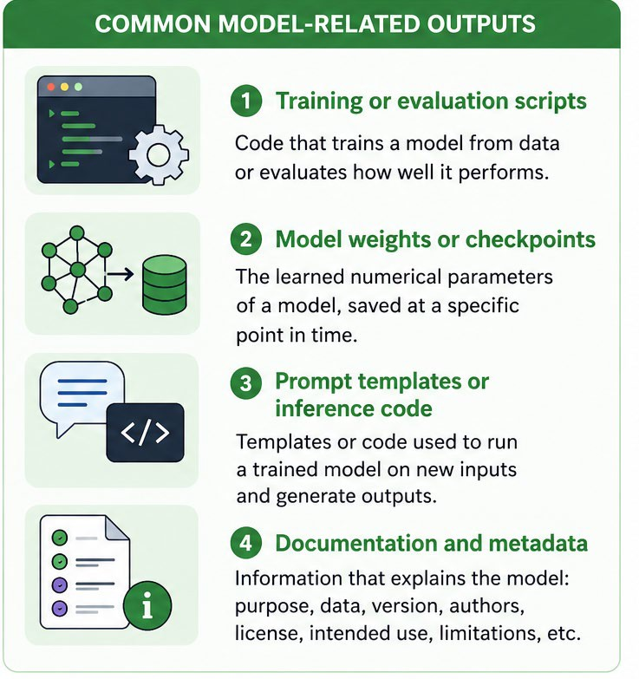
What is a model?
A model is a simplified representation of part of the world, built so we can describe it, explain it, predict outcomes, or simulate processes.
Examples across research
Statistical models
Climate or epidemiological models
Conceptual models in theory-building
Machine learning models
input
model
output
6

Slide 10
Code and models
Code builds and runs models
Models represent patterns or systems
Code → needed to reproduce how the model was created Model → needed to reuse or apply it
Sharing only one is often not enough for open science
6

Slide 11
The minimum shareable code package
project/
├─ README.md
├─ LICENSE
├─ analysis.py
├─ requirements.txt
├─ results/
├─ .gitignore
└─ data/
└─ README.txt
Why each file matters
README.md explains what the project is and how to use it
LICENSE: states reuse conditions
analysis.py contains the example code.
requirements: software dependencies needed
results/ is where outputs may be written
.gitignore: lists files or folders that should not be tracked
data/README.txt explains the data folder, even if data cannot be shared.
8

Slide 12
Sharing and citing code: repository vs archive
A paper needs a stable version, not only the latest state
Development platform
Archive / citation layer
GitHub or GitLab
Note: May be deleted any time by their owner!
Active work
Latest version
Collaboration and issue tracking
Zenodo
Release a specific version
Archive it, ensuring long-term access
Mint a DOI
Cite the exact version used in the paper
“A repository is where the project grows. An archive is where a version becomes part of the scholarly record.”
1
0

Slide 13
Licensing: visible is not the same as reusable
Keep the legal message simple and practical
No license
People can see the code, but reuse is unclear.
Common families to mention
MIT – very permissive: you can use, modify, and share the code freely, as long as you include the original license.
GPL – copyleft: you can use and modify the code, but if you share your version, it must also be open under the same license.
Apache 2.0 – permissive: like MIT, but with additional legal clarity, especially regarding patents.
9

Slide 14
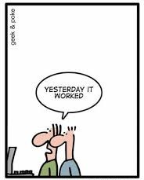
Git and version control

Slide 15
Git and open science - making research more transparent and reusable
Transparency
See what changed, when, and why
•
Reproducibility
Return to the exact version used in a study - avoid “final_final_v3” confusion
Collaboration
Work together without overwriting each other and track contributions clearly
Sharing
Structure your code for others and connect to platforms (GitHub, Zenodo)
Your future self
Understand your own work later!
6

Slide 16
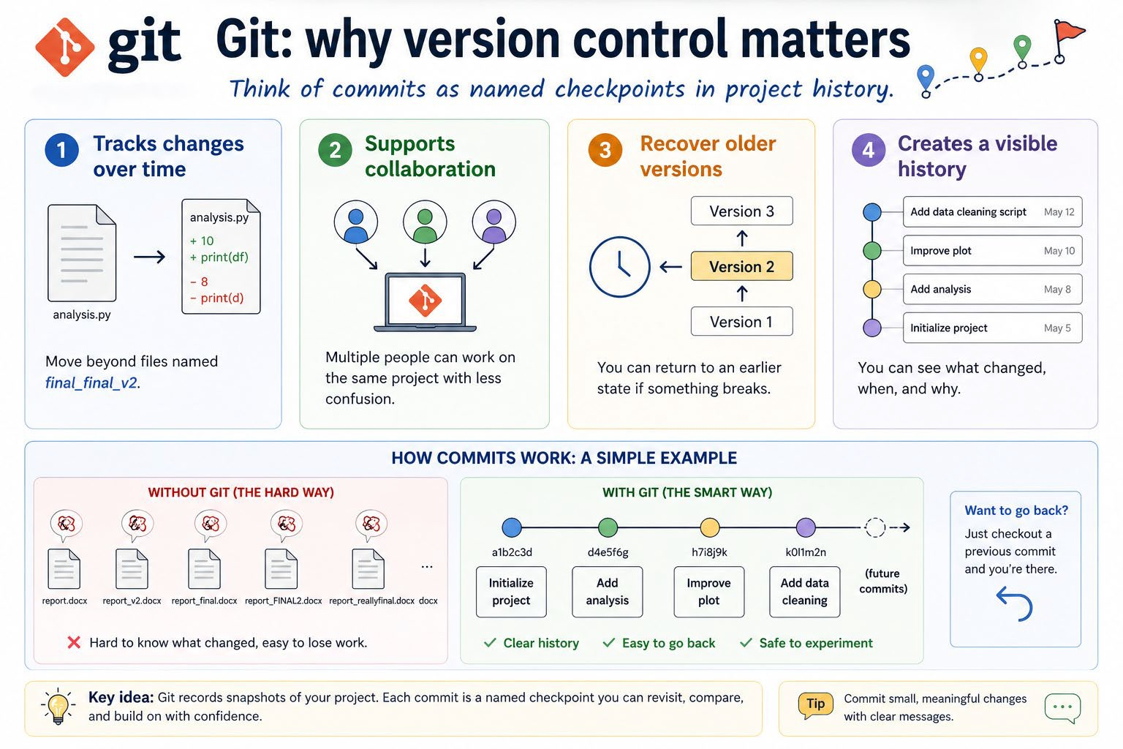
AI
generated

Slide 17
Git and GitHub: what is the difference?
Git = version control tool. GitHub = online hosting platform.
Git
GitHub
A tool for tracking changes in files
Works with any text-based files (R, Python, SPSS etc.)
Works on your own computer
Allows you to save versions through commits
A web platform for hosting Git repositories online
Used for sharing, collaboration, and visibility
Often used to publish code publicly
Builds on Git, but is not the same thing
You can use Git without GitHub, but GitHub usually uses Git.
1
2

Slide 18
Hands-on 1: Git basics
Around 15–20 minutes
What to remember
A repository starts in an ordinary folder
A commit is a named snapshot
Short commit messages explain the change
Versioning begins with a few simple commands
1
3

Slide 19
Link to exercises
http://bit.ly/4dnQYZq

Slide 20
Hands-on 2: Writing a README
If someone reads only one file, it will probably be this one
Example README structure
# Project name
## Short description ## Files included
## How to run
## Dependencies ## Data
## Citation / contact ## License
A good README answers basic questions
What is this project?
What does it do?
How do I run it?
What depends on what?
Is the data included, restricted, synthetic, or available elsewhere?
How should I cite it?
What license applies?
1
4

Slide 21
Hands-on 2: Example README
Fictional project: Campus Coffee Consumption Analysis
1
Project Name
Campus Coffee Consumption Analysis
4
How to run
Install dependencies, data description is available in data/README.txt, then run: python analysis.py
2
Short description
Analyzes coffee habits from a small campus survey.
5
Dependencies
Python 3.10, pandas, matplotlib.
3
Files included
analysis.py, data/README.txt, results/ (generated outputs, ignored).
6
Citation / contact / license
Your Name, 2026. Contact: email@university.se. MIT License.

Slide 22
Link to exercises
http://bit.ly/4dnQYZq

Slide 23
Models are not just files: they need documentation
Purpose
What is this model for? Who is it meant to help?
Data and evaluation
What data was used?
How was the model evaluated?
Limitations
Where can it fail? What is out of scope?
License and use
What may others do with it, and how do they run it?
There are many domain-specific frameworks (such as DOME for ML), but they all focus on the same core questions: purpose, data, evaluation, and limitations.
1
5

Slide 24
Hands-on 3: Documenting models
Around 10 minutes
# Model name
## Version ## Purpose
## Intended use
## Out-of-scope use
## Training/source data ## Evaluation
## Limitations ## License
## How to use
Before sharing code or a model, ask:
Is it versioned? Is it licensed?
Is it documented?
Is it runnable or at least understandable?
Have sensitive files, credentials, and restricted data been excluded?
Is there a stable citation point? Are the limitations clear?
This is essentially a simplified version of what is called a ‘model card’ in machine learning
1
6

Slide 25
Hands-on 3: Example Model Documentation
Fictional model: Coffee Consumption Classifier
1
Version
v1.0 — the documented model release.
2
Purpose
Predict high vs low coffee use from survey answers.
3
Intended use
Teaching and research demonstration of a simple classifier.
4
Out-of-scope use
Not for health advice, profiling, or decisions about individuals.
5
Training/source data
Campus survey of staff and students (n=200); no identifiers included.
6
Evaluation
Tested on held-out survey responses; accuracy around 78%.
7
Limitations
Small dataset, one university context, limited generalizability.
8
License
MIT License for example code and documentation.
9
How to use
Run the prediction function in analysis.py with new survey data.

Slide 26
Link to exercises
http://bit.ly/4dnQYZq

Slide 27
Take-home checklist
Versioned → track changes (Git)
Documented → README + model description Licensed → clear reuse conditions
Runnable → dependencies + simple instructions Citable → release or DOI (e.g. Zenodo) Responsible → no sensitive or restricted data
Open Science is not about sharing everything — it’s about sharing enough for others to understand, run, and reuse your work.

