Slide 1
THE SOM SURVEY AND THE CITIZEN PANEL
OPEN DATA, COLLABORATION AND NOT-SO-OPEN DATA?
TILDA EKSTRÖM & MARCUS WEISSENBILDER

Slide 2




The SOM Institute
An independent research organisation at the University of Gothenburg. Since 1986, we have combined a close relation to survey research with a strong presence in the public debate.

Slide 3
Brief history
Started in 1986 as a collaborative survey project between researchers in political science and media studies
Became a centre at the Faculty of Social Sciences in 2010
Joined together with the Swedish Citizen Panel in 2014
Became a national research infrastructure supported by the Swedish Science Council (VR) in 2018

Slide 4
The purpose of the SOM Institute
Serve as an efficient, high-quality research infrastructure for survey-based data collections in Sweden
Conduct long-term research and analysis on the Swedish societal development
Actively communicate results outside of the university
Conduct research collaborations outside of academia with public agencies
Conduct methodological research and development on survey data collections

Slide 5
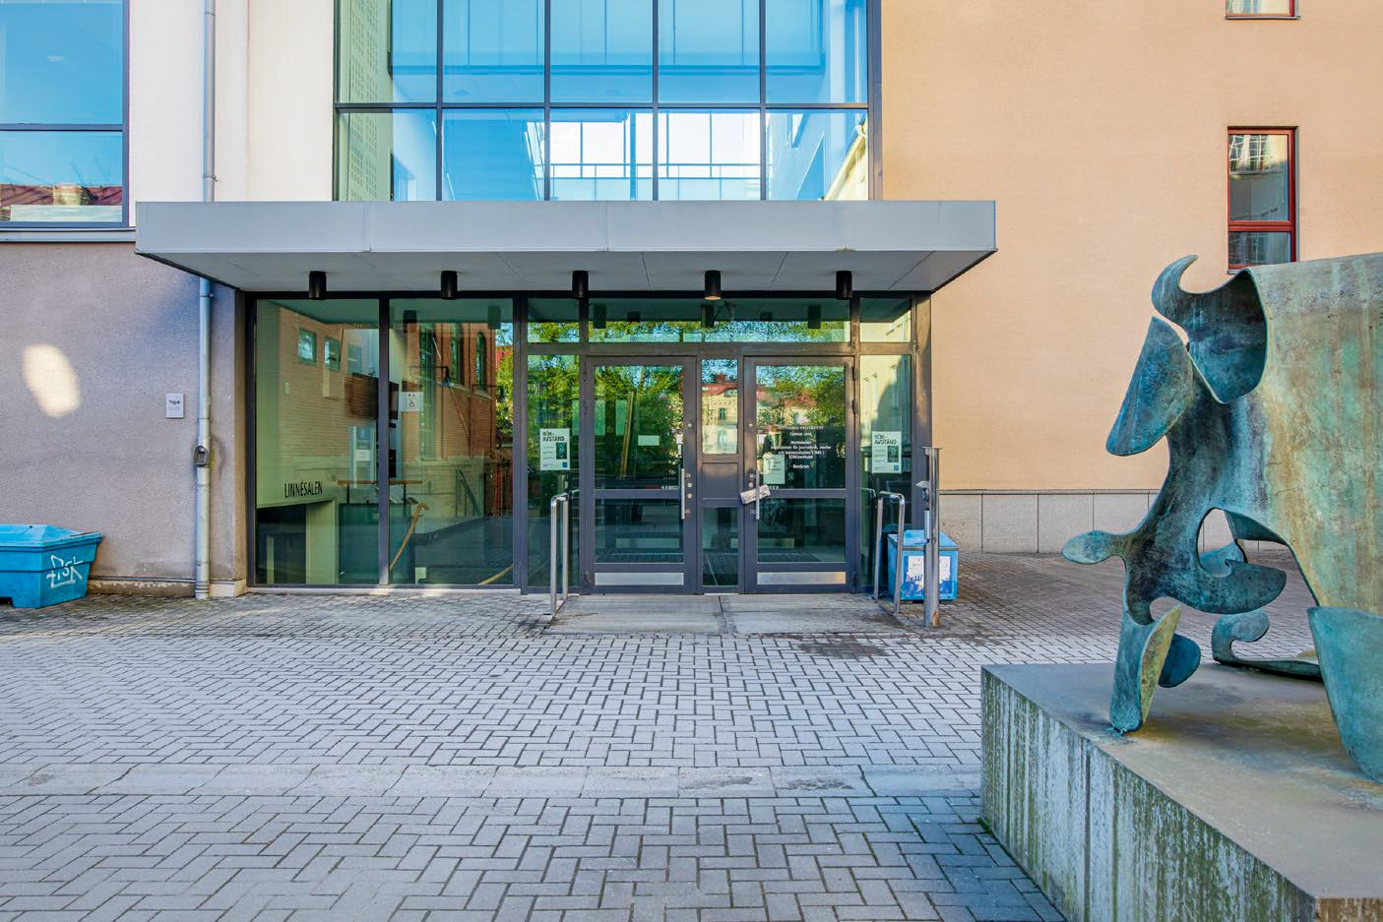
Organisation and staff
In total, 17 employees:
→ Research Director: Annika Bergström
→ 5 Researchers (political science, media,
psychology/economics, survey methodology)
→ 2 Survey managers and 7 Assistant survey
managers
→ 1 Communications officer, 1 Administrator

Slide 6
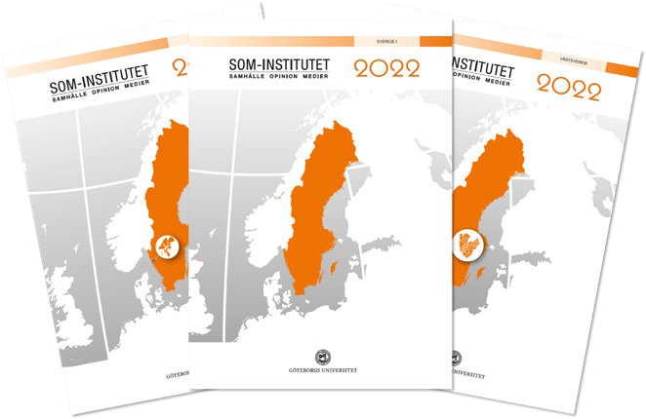

Two main facilities for data collections
The annual SOM surveys
The Swedish Citizen Panel
Large cross-sectional, representative samples of the Swedish population (mainly paper surveys)
Online access panel (strictly web surveys)

Slide 7
Our different types of open/available data
(Collaboration within our surveys and panels)
Secondary datasets for researchers and students
SOM-surveys and the CORE-panel
All of our publications freely available online
Aggregated data available directly and freely online:
https://som-institutet.se/dataanalys
Completely open and transparent methodology:
https://www.gu.se/som-institutet/som-undersokningarna/metod
https://www.gu.se/som-institutet/medborgarpanelen/for-dig-som-forskar
https://www.gu.se/som-institutet/medborgarpanelen/for-dig-som-forskar/panelvagor-och-tekniska-rapporter

Slide 8
The SOM-surveys

Slide 9
How the SOM-surveys are conducted
Yearly national (n=26 250), regional (n=6 000) and local surveys (n=9 000)
A paper questionnaire is delivered to the respondent with an option to respond online
The questionnaires are between 12-16 pages
Five postal reminders, two text messages and reminders via digital mailbox are sent out during the field period (which is 100 days)
Respondents receive a lottery ticket after having sent in their survey
After the field period is ended all direct identifiers/keys are destroyed, so that individuals can’t be identified

Slide 10

Response rate over time in the national SOM survey
1986–2025 (percent)
1986
1987
1988
1989
1990
1991
1992
1993
1994
1995
1996
1997
1998
1999
2000
2001
2002
2003
2004
2005
2006
2007
2008
2009
2010
2011
2012
2013
2014
2015
2016
2017
2018
2019
2020
2021
2022
2023
2024
2025
100
90
80
70
60
68
50
52
40
30
20
10
0

Slide 11
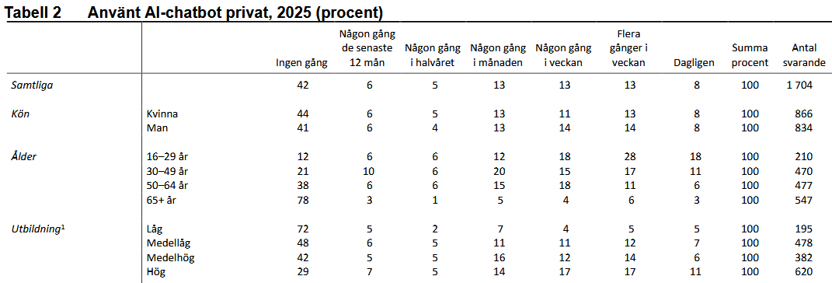
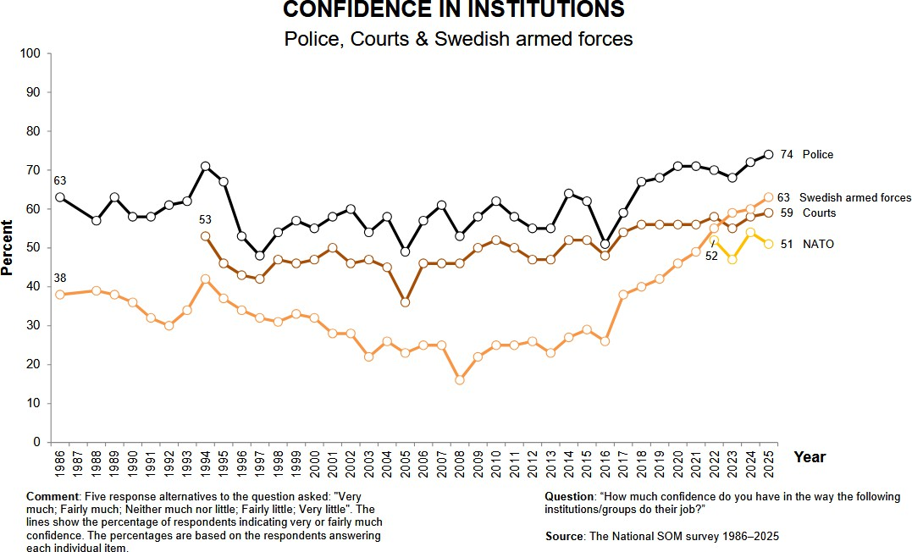
Results from the SOM-surveys
Often in the form of time-series
However also many group comparisons

Slide 12












(Our own) annual output – the SOM surveys
Datasets: 3–5
Book series (anthologies): 1–3 each year
General and/or themed reports : 40+ each year
Notes on survey methodology 2–3 each
Presentations and seminars

Slide 13
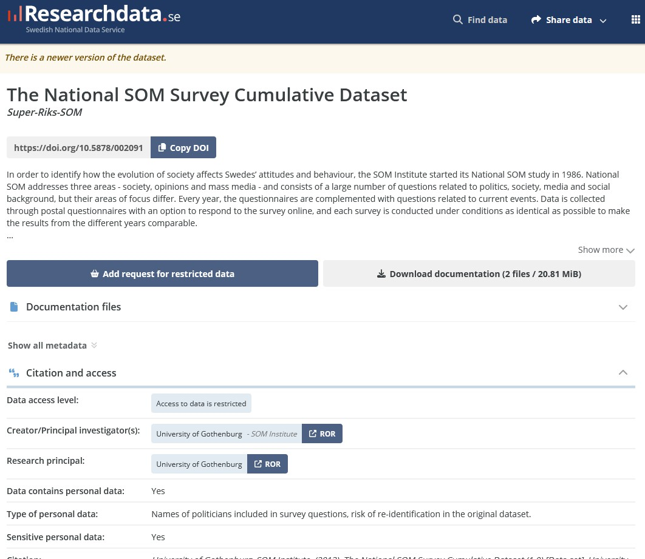
Making data available
From the SOM survey each year:
3-4 datasets from the annual surveys
3 cumulative datasets 1986-
Available for any researcher
Also available for students
Free to request via Researchdata.se

Slide 14
What data is not made available?
While all data from the SOM surveys eventually become freely available to researchers and students there are some restrictions.
Data we collect during e.g. the autumn/winter of 2025 first becomes available in the spring of 2027, giving our collaborating partners a chance to do their own research.
Even as data is made available, for the first five years data is ”reduced”.
Open-ended questions are removed, some geographical variables (such as municipality) and other variables which increase the risk of backwards-identification are also removed or aggregated.
After five years a more complete dataset is added to Researchdata.

Slide 15
Collaboration within the SOM surveys
Researchers can collaborate with SOM to include their own questions in the survey
SOM assists with question wording, as well as questions of scales and other methodological aspects
This type of collaboration is associated with a cost
SOM does however not strive to make any profit, the fee is simply based on the space questions take in our survey and our costs of conducting the survey
See more information here:
https://www.gu.se/en/som-institute/collaboration/collect-data-in-the-som-surveys

Slide 16
Annual output from others using SOM data
Data requested by 150 students for use in student papers
Data requested by on average 30 Ph.D. students per year
Approximately 40 peer reviewed journal articles per year
Several 100 news articles referencing SOM per year

Slide 17
The Swedish Citizen Panel

Slide 18
The Swedish Citizen Panel
Online Access Panel (no other survey modes offered)
Academically administered
Exclusively used for research:
Longitudinal studies
Survey-embedded experiments (including conjoints)
Cross-sectional studies
Recruitment to qualitative studies

Slide 19
The Swedish Citizen Panel
Approximately 70 000 participants aged 16+ living in Sweden
Self-recruited and probability-recruited participants:
Self-recruited: 70%
Probability-recruited: 30%
No economic incentives are offered to participants
The large number of participants enable targeted sampling across socio-demographic groups, professions, opinions and habits
→ Tailored solutions

Slide 20
Waves
We conduct four large omnibus survey waves each year: in February, June, September, and December
Each wave includes several different studies, ranging from survey experiments to cross-sectional studies
In addition to these omnibus waves, separate projects and questionnaires can also be conducted between waves upon request.
Participation rate around 60 percent

Slide 21
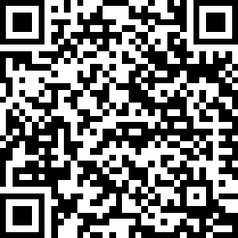
Based on collaboration with other research groups
Researchers may apply to collaborate for a user fee
Cost is estimated based on the type of sample, the length of the questionnaire, and the number of requested completed responses
Feedback on the questionnaire is provided to researchers, including suggested revisions
We offer support with ethical review and data management plans
Technical reports are provided after each data collection
Approximate timeline: About 3 months from application to completed data collection
Approval from the Swedish Ethical Review Authority is required when collecting sensitive personal data
More information about collaboration with the Swedish Citizen Panel

Slide 22
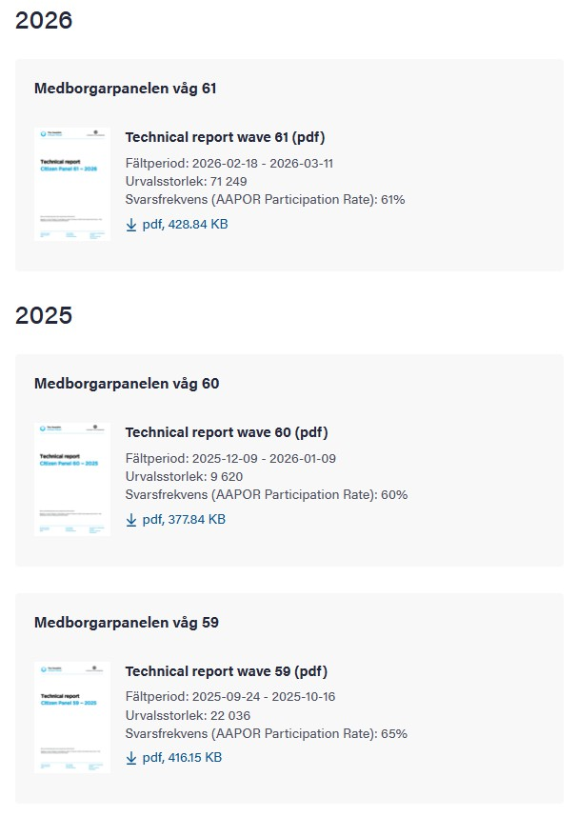
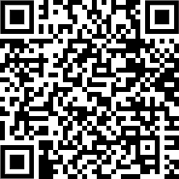
Technical reports for each data collection
https://www.gu.se/som-institutet/medborgarpanelen/for-dig-som-forskar/panelvagor-och-tekniska-rapporter

Slide 23
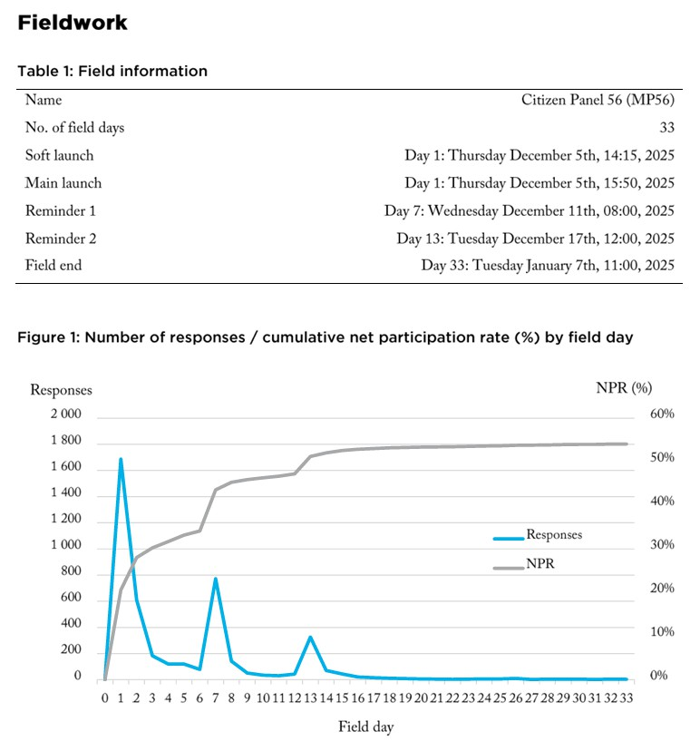
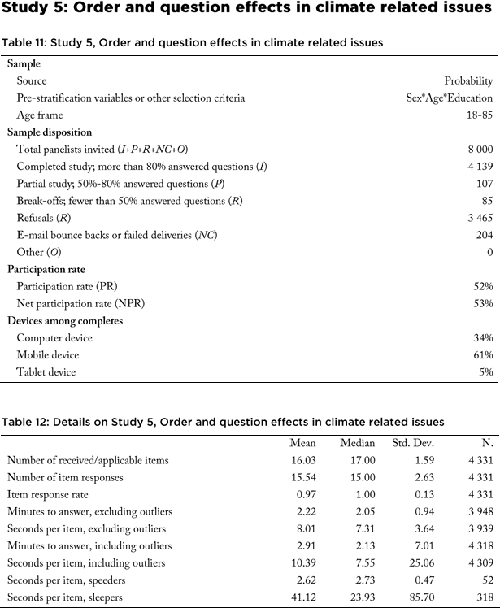
Technical report example
•
https://www.gu.se/sites/default/files/2025-01/TR_SCP_MP56.pdf

Slide 24
The CORE panel
In addition to collaborating research projects, we also have our own longitudinal panel
About 4 000 panelists
Get identical questionnaires once or twice per year
The surveys include a set of societally relevant questions related to: subjective health, media use, political ideology and attitudes, trust in public institutions, social trust, and perceptions of Sweden’s economy
The panel has been active since 2010 (35 waves)
Available for researchers for a fee
Ethical approval from the Swedish Ethical Review Authority is required

Slide 25
Data availability
Data from the Swedish Citizen Panel is only shared with collaborating researchers
The CORE panel is available to researchers for a fee
In general, data are not publicly accessible due to legal restrictions related to the panel structure
We provide legal guidelines for researchers working with our data

Slide 26
Open and transparent research

Slide 27
All methodology and publications freely available online
Our ambition is that everything we do is to be freely and publicly available online.
Everything we do in terms of methodology, field plan, outline of our surveys and reminders, data processing and so on is available on our website
https://www.gu.se/som-institutet/som-undersokningarna/metod
https://www.gu.se/som-institutet/som-undersokningarna/frageformular-och-kodbocker
All of our publications, books, methodological notes, report and more also available for free:
https://www.gu.se/som-institutet/resultat-och-publikationer
https://som-institutet.se/publikationssok
https://www.gu.se/som-institutet/resultat-och-publikationer/metodforskning

Slide 28
Thank you for your attention!
Questions?
Contact: marcus.weissenbilder@som.gu.se

