Slide 1
Research with Sensitive Quantitative Data Gustav Nilsonne, 2026-05-06

Slide 2
Risks and
harms
Benefits

Slide 3
GDPR (General Data Protection Regulation)
Personal data are data that can be attributed to a living natural person by means reasonably likely to be used
Processing of personal data must have a legal basis
Research in the public interest is recommended basis
Processing of sensitive personal data requires ethics approval
Definition of sensitive personal data concerning health is broad and covers clinical data, information derived from the testing or examination of a body part or bodily substance, including from genetic data and biological samples, etc.

Slide 4
Sharing data from humans
Anonymized data can be shared fully openly
Non-anonymized data can be shared through a controlled access model
Offered under ”SND 2.0”
Other options for data that have not been anonymized
Share summary statistics, distributions etc.
Share correlation matrices

Slide 5
Recommendations for consent forms when collecting primary data
Consider phrases like:
”Data will be published openly in the XX repository [link]”
”We will remove all data we think could be used to identify you in the published data set, for example name and date of participation”
Avoid phrases like:
”No-one outside the research group will have access to your data”
”Results will be published only as statistical averages”
”Your data will be stored for ten years”
Example language in English available e.g. at https://open-brain-consent.readthedocs.io/en/master/#

Slide 6
What is re-identification
An attacker combines target data with reference data and achieves matching; data about individuals can then be inferred
Can be deterministic or probabilistic

Slide 7
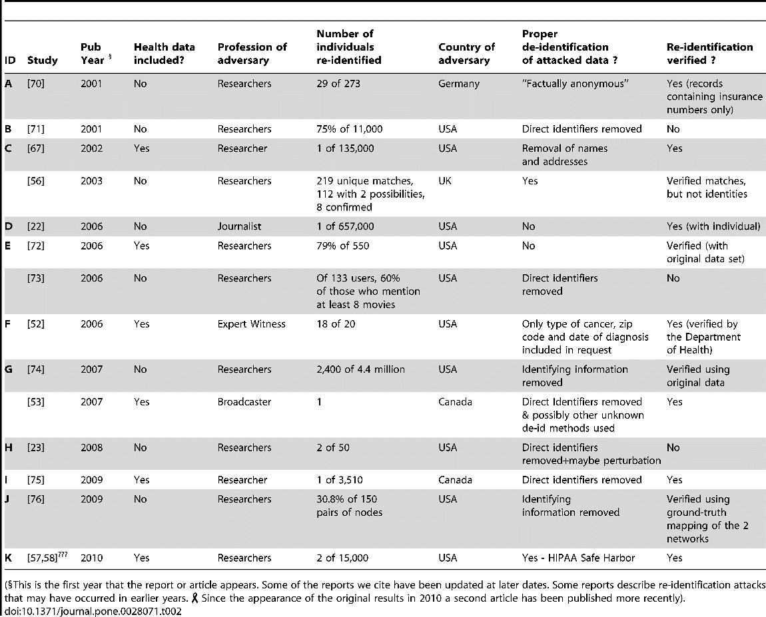
A systematic review on reidentification attacks
Known reidentification attacks on health data at the time (2011) were mainly academic
Success rates were very low in data that were anonymized properly
https://doi.org/10.1371/journal.pone.0126772

Slide 8
Assessing risk of reidentification
Risk depends on likelihood of reidentification and sensitivity of data
Threat models
Self-identification by participant
Targeted reidentification
Mass reidentification
Data uniqueness: can a participant be singled out?
Is there a reference dataset to which data could be matched?
Target population
Reference population

Slide 9
Actions on variables
Aggregation/categorization/binning
Continuous variables can be binned, eg age 21-30 years. May require differently sized bins at top or bottom, eg age 81-
For hierarchical variables, lower levels can be dropped, eg municipality in county
Transformation
Preserves internal relations, eg by subtracting a constant
Combination
Two or more variables can be replaced by a combination of the variables, eg height and weight by BMI
Censoring

Slide 10
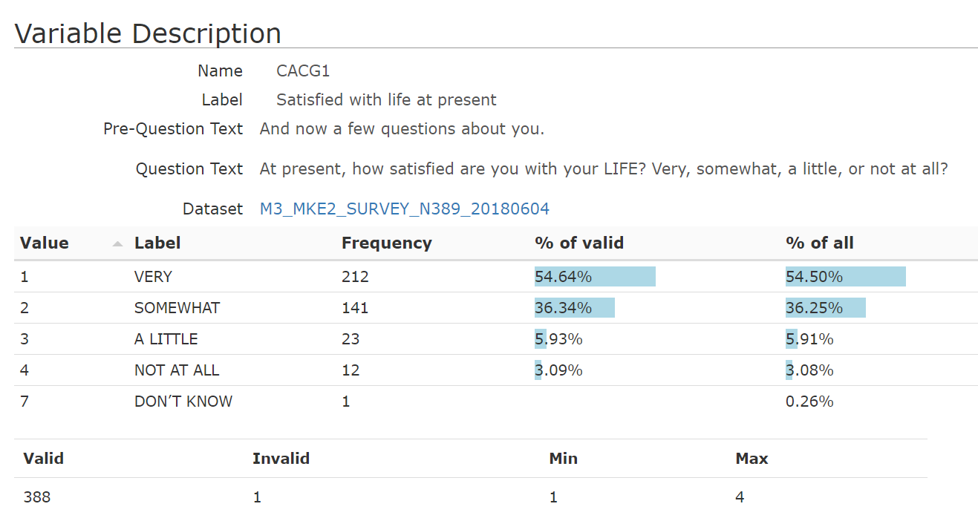
Example: unlinked variable

Slide 11
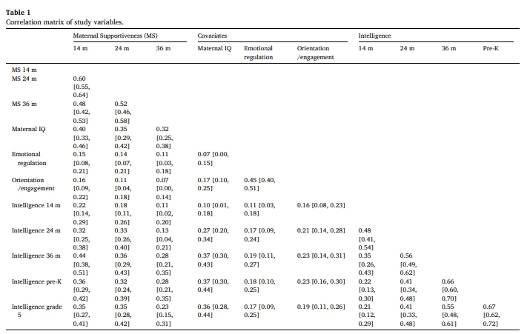
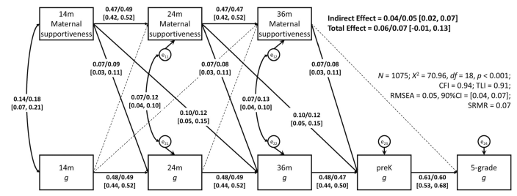
Example: Sharing a correlation matrix
Dunkel et al. 2023, intelligence in children and “maternal supportiveness”

Slide 12
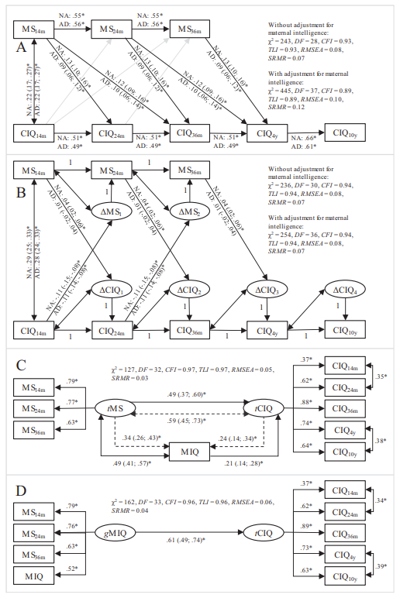
Reanalyses
Sorjonen et al. 2024

Slide 13
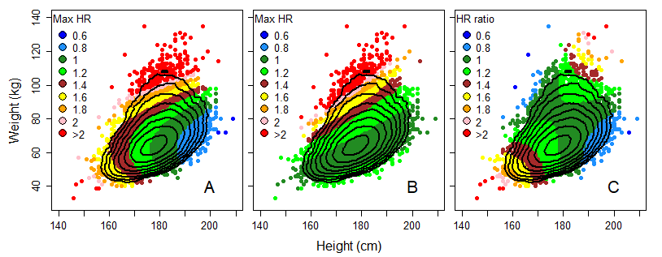
Example: singling out in a bivariate distribution
Decomposed
BMI
Ratio
Sorjonen et al. 2021, http://dx.doi.org/10.1002/osp4.473

Slide 14
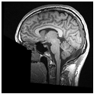
Example: risk mitigation of biometric data
Defacing of MRI images of the head

Slide 15
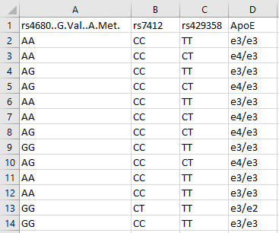
Example: genetic data
Should be assessed case-by-case
Combination of allele frequencies identifying?
Information about health?
APOE genotype – prognostic information not communicated to participants

Slide 16
Thank you!

