Slide 1
Open access to research data.
A short introduction.
David Rayner, SND Training Coordinator
2026-05-06
Notes:
Hi, I’m David Rayner, Training Coordinator at the Swedish National Data Service.
Today I’m going to talk about ”Open access” to reseach data, how it fits into the open science landscape, and some things to keep in mind for you as PhD students and future researchers when you collect or generate research data

Slide 2

Open access to research data is one of the six priority areas within Open Science.
“
Research data that is produced by publicly-funded research should be made accessible according to the principle: "as open as possible, as restricted as necessary".
”
Notes:
Ok, I’m here to talk to you because Open Access to research data is Swedish government policy. It is one of the six priority areas within open science.
The policy states that research data from publicly funded research should be made accessible, following the principle of being as open as possible, as restricted as necessary.

Slide 3
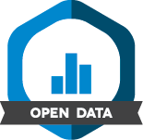
Open access to research data:
It it’s already published, reuse it!
Publish the data that support your results using established research infrastructures.
Publish sensitive data with access restrictions.
Badges to Acknowledge Open Practices
Notes:
But what does ”open access” to research data mean in practice? What do we mean by making data ”accessible”?
In short:
- If someone else has published data and you want to use it, do it! Reusing published research data is NOT plagarism, it’s part of open science!
.- publish the data that support your results whenever you publish a research article, book chapter etc,. Open access to research data DOES NOT mean that you have to make all your data available as soon as you collect them! But when your results are published, the data – the evidence – they should be published too!
Use established research infrastructures such as research data repositories or databases to publish research data, don’t just make it available from a cloud-service or on a web-page.
Not all research data can be made freely available and sharable. Publish sensitive data with access restrictions, and don’t use the fact that your data can’t be made freely available as an excuse for not making a data publication!

Slide 4


Reusing research data.
Notes:
Reusing research data.

Slide 5
Cite the data!
link to the original source
recognizes the contributions of the creators
cite any original research paper that describes the dataset
Sjöstrand, A. & Uppsala University, Department of Archaeology and Ancient history. (2024). List of bones, osteological analysis, Ajvide, Eksta parish, Gotland, Sweden (Version 1) [Data set]. Uppsala University. https://doi.org/10.57804/kb93-d027
Notes:
When you use a dataset, you should always cite your source, the same way you would with a published article. Citing data acknowledges the original source of the data and recognizes the contributions of the creators. It also promotes research reproducibility by making the data easier to find and access.
When citing a dataset, we generally recommend that you also cite any original research paper that describes the dataset. Not only does this acknowledge the efforts of the data creators, but it also provides a link to vital information about how the data were collected or created.
Most journals prefer you to cite data similarly to how you cite research articles. Always check the journal’s instructions to see which citation style to use, and whether there are any special instructions for citing data. A typical APA-style citation for a dataset is formatted as:
Selfridge, A. R., Spencer, B., Shiyam Sundar, L. K., Abdelhafez, Y., Nardo, L., Cherry, S. R., &amp; Badawi, R. D. (2023). Low-Dose CT Images of Healthy Cohort (Healthy-Total-Body-CTs) (Version 2) [Dataset]. The Cancer Imaging Archive. https://doi.org/10.7937/NC7Z-4F76Opens in a new tab
Licences
Acknowledge their contribution, even if cc0
Note that if you use data with cc by or cc 0 in your research, you are allowed to include the data in a new dataset that you publish as evidence for your research results. It’s not plagarism, provided you acknowledge the data source

Slide 6
Publishing research data.
Notes:
Publish the data that support your results using established research infrastructures such as data repositories and databases.

Slide 7
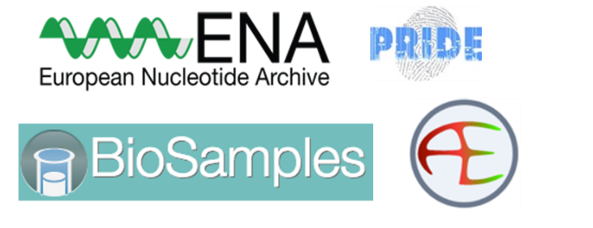



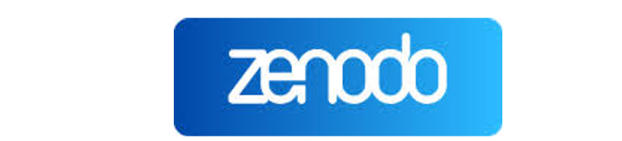


How do you publish research data?
Publish the data on which your research results are based, either in:
a well-know, subject-specific repository/database
a research data repository.
Notes:
So how do you create FAIR research data? The easiest way is to use a data repository or public data archive.
By using these platforms, you enter metadata and receive a permanent identifier, such as a DOI, which allows you to cite your data. The repository takes care of all the other aspects of FAIR!
So, how do you publish data?

Slide 8
Publish data in a research data repository.
Datasets = files + metadata.
For both open and restricted access data.
Trusted repositories employ a manual review process.
Notes:
The best way to make your data accessible is to publish in a research data repository.
Unless the dastaset is very small and self-explanatory, don’t just add your data to a supplement for an article in a journals
Turn it into a stand-alone dataset in a research data repository.
There are research data repositroies both for open and restricte access datasets.
There are subject-specific and generic data repositories.
All repositories require you to describe the dataset with metadata, usually by entering inforjation into a web-form.
Repositories use secure storage, so you don’t need to worry about backups, or what happens to your data when you finish you phd.
A trusted data repository employs a manual review process by authorized staff and ensures long time preservation.
Dataset review is not the same as submitting a research artcicle…

Slide 9
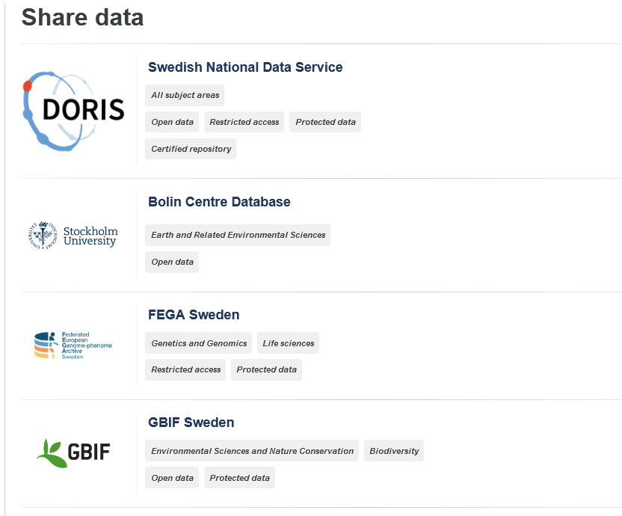

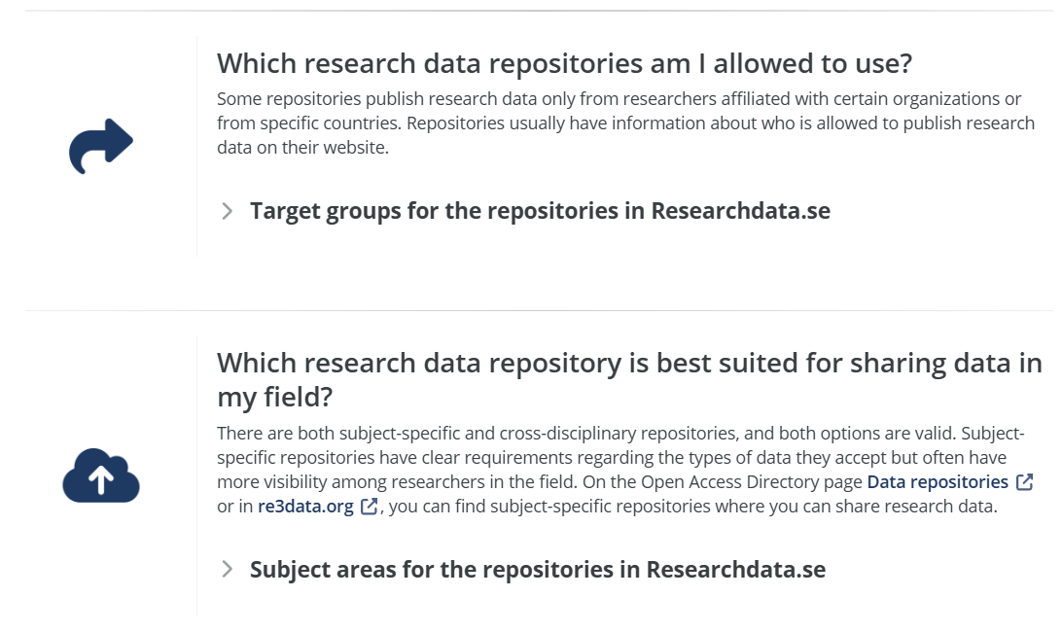
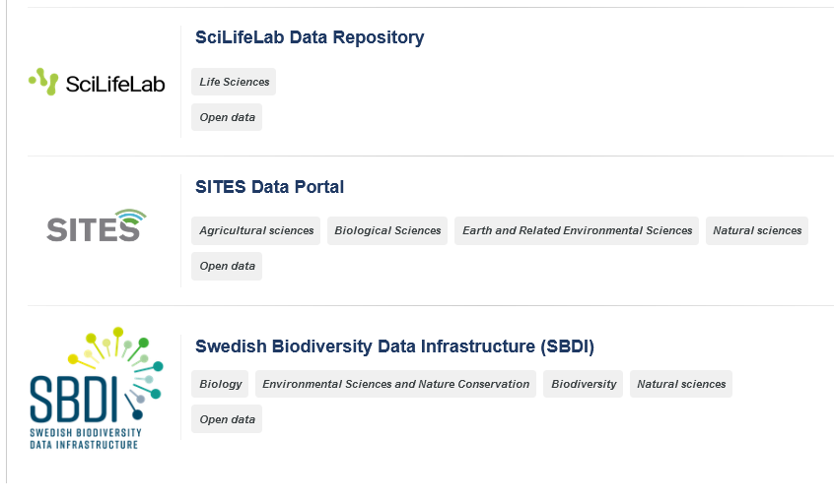

Slide 10
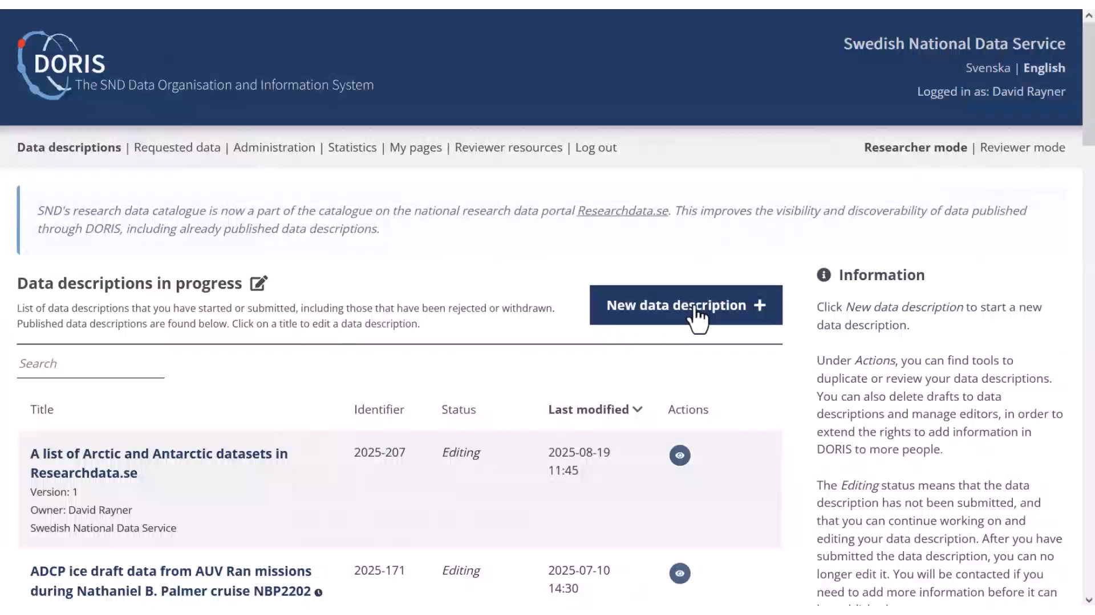

Slide 11

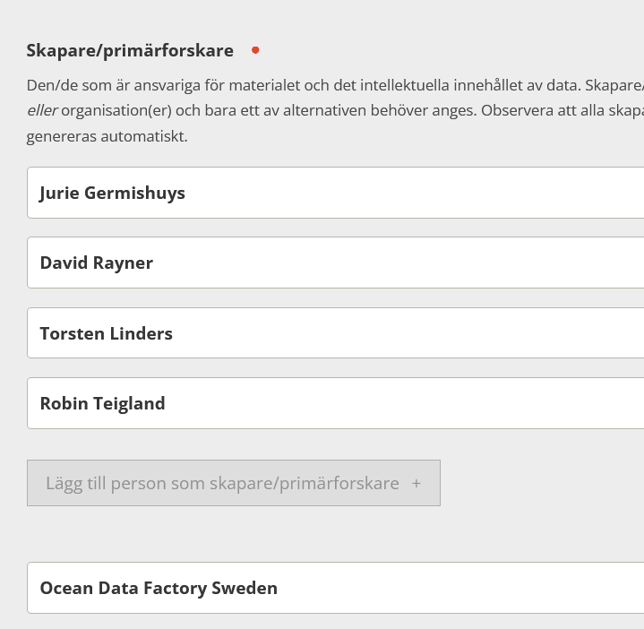
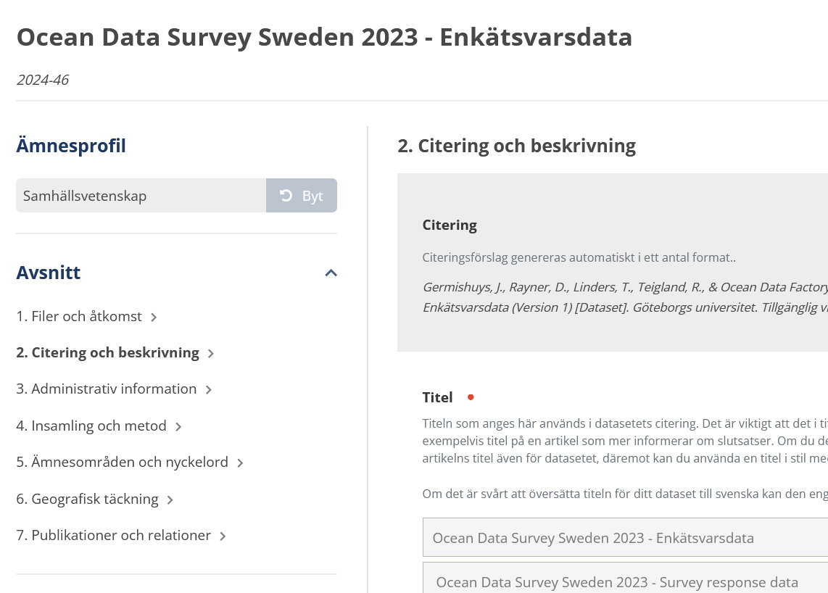
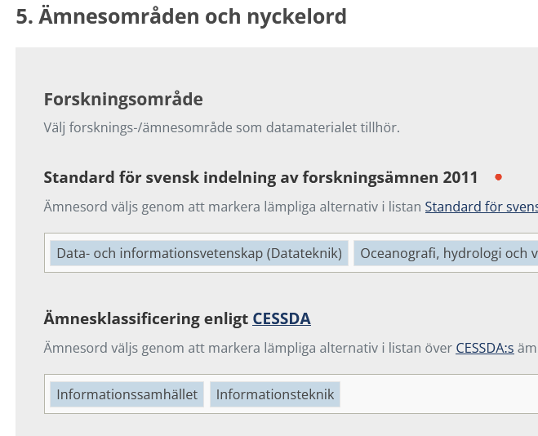
Notes:
This is how the dataset upload form looks. You can choose to use either the Swedish or English version of the upload form, and swap freely between them!

Slide 12
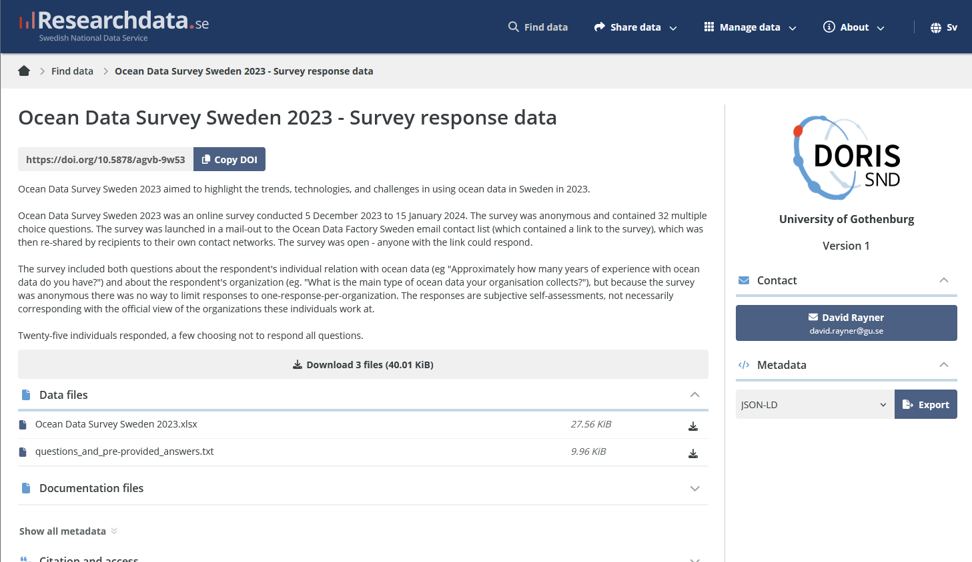
Notes:
.. And this is how the dataset look in the Researchdata.se catalog when it is published!

Slide 13
Publishing in a research data repository.
“What might others want?”
Open/common file formats
Fill in relevant metadata
Provide documentation
Use a license for freely-available data
Cite your dataset – with DOI – in your publication/s
Notes:
As mentioned earlier, if you publish your data using a research data repository, the repository itself takes care of most of the FAIR principles, so you really don't need to know about them!
However, you as a researcher have some responsibility!!
Fristly, think about what data you are sharing – is it data that others might want and be able to reuse? If you have unique data that would be hard to re-create, you might want to share even the raw data so that others can try to re-process it. But in many cases, what other researchers want is pre-processed data that can be reused with minimal effort. You can, of course, publish both raw and processed data if you want!
By "Fill in relevant metadata", I mean actually take the time to describe the data itself, don't just write "This is the data for my paper" as the dataset description!
Publishing your paper open access is important for making research data reusable. This is because research data is often unique and cannot be understood without knowing about the methods used to collect and process the data, and these are usually described in the methods section of the research article. So even if someone can acces the data, the data might be completely unusable if the article is behind a paywall!
Finally, remember to cite your dataset from your research paper, and link to the research paper from the dataset!

Slide 14

What about “as open as possible, as restricted as necessary”?
Notes:
What about “as open as possible, as restricted as necessary”?

Slide 15
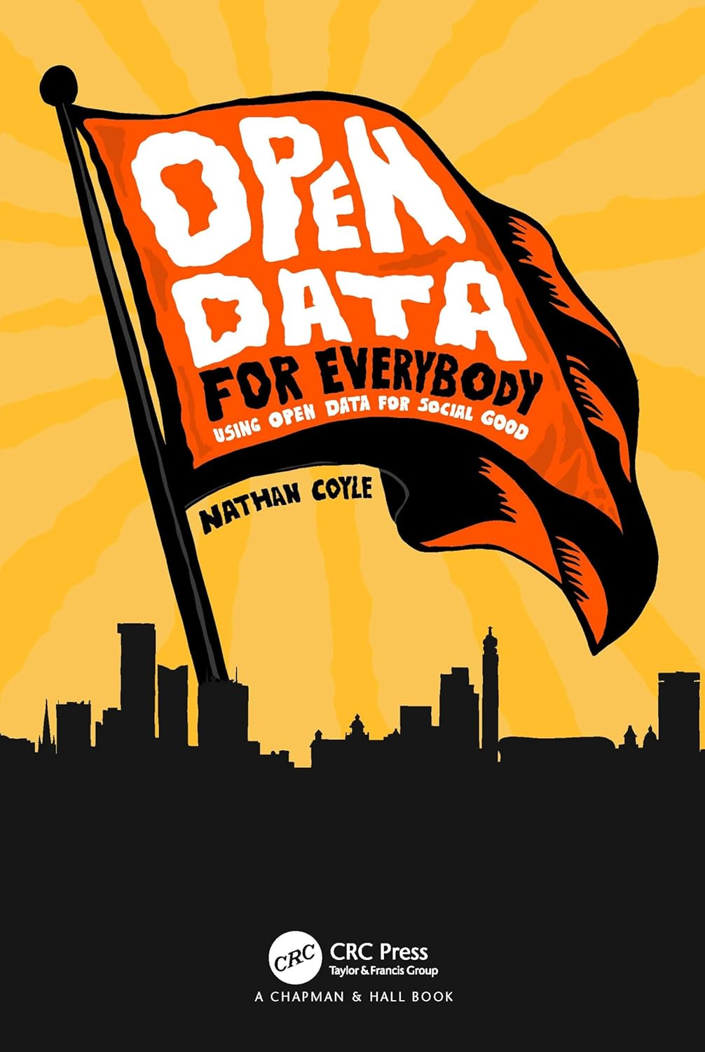
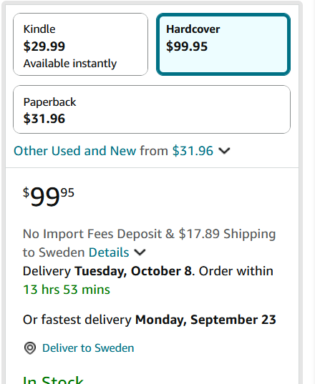
What if I can’t make data openly available? Publish anyway!
Publishing data in a research data repository does NOT imply the data need to be openly (freely) available.
You can publish in a data repository with restricted access!
Notes:
Despite talk of “Open Data”, publishing research data is more like publishing a book.
Publishing implies that a unique, persistent (digital) object has been created.
But just because it is published, doesn’t mean it is freely available.

Slide 16
Publish sensitive data with access restrictions, don’t waste it!
Most research data that cannot be published openly!
Describe dataset, indicate “Restricted Access”
Upload files, get DOI.
Dataset description is public, files not.
Your organization reviews access requests.
Requestor may need to show they have ethical approval.

Slide 17
Most common reasons for protection.
Publish with Restricted access
Personal information
Copyright material
Drone camera images
Sea-floor data
Infrastructure coordinates
Notes:
In addition to openly accessible data, there's also data that can be published with restricted access. Most protected data can be published with restricted access, with the exception of some data with national security implications.
Most often, research data needs protection because it contains personal information.
Such datasets can be published with restricted access.
The procedure is basically the same as with publishing data that will be freely-available.
This means you describe and upload the data files, and you get a DOI.
The dataset description is then published in the research catalog, but the data files are not publicly available.
Access requests are assessed by your organization. In Sweden, data with restricted access can only be disclosed after a secrecy review and may require an ethical permit for access.
Note that publishing with restricted access is not the same as a creating a “metadata-only” catalog post – where the data are described but the research group stores the data on their own system. Publishing with restricted access means the data must be provided to a system that is designed to facilitate access, but access to the data is restricted.

Slide 18
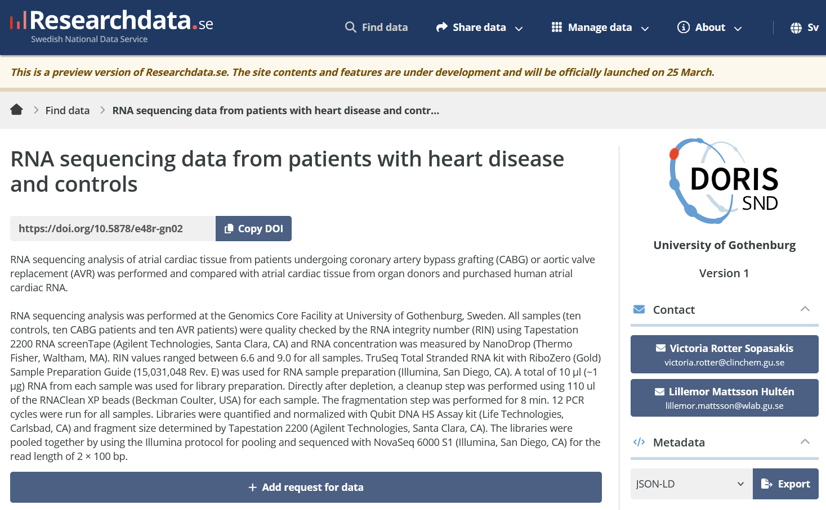
Restricted Access Dataset
Notes:
Here is an example of a dataset with Restricted Access on Researchdata.se
Hmmm… RNA sequences and patient data – this looks like sensitive personal data!
Note that there are no links to the data files, instead there is a "+ Add request for data" button.

Slide 19
Datasets with Personal Information.

Slide 20
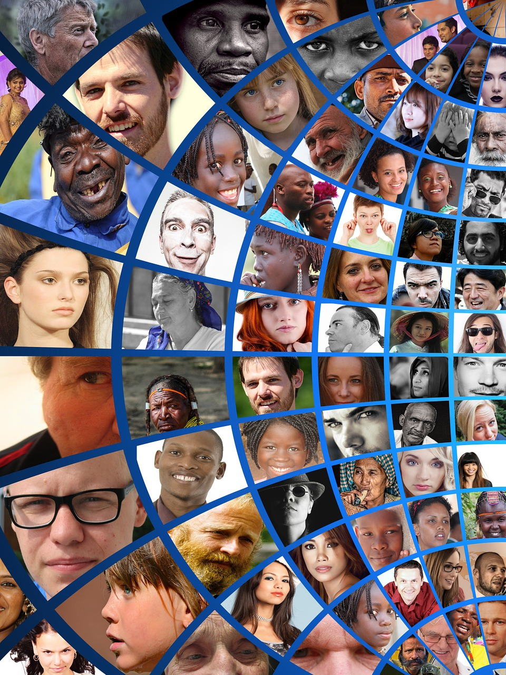
What is personal information?
“information that directly or indirectly refers to a living, identified or identifiable natural person”
Pseudonymized data is personal data!
Regardless whether you as a researcher have the code key or if it is stored securely somewhere else!
“indirectly” could be:
Recorded voice
Photograph where person is identifiable
Registration number of a private car
IP address

Slide 21
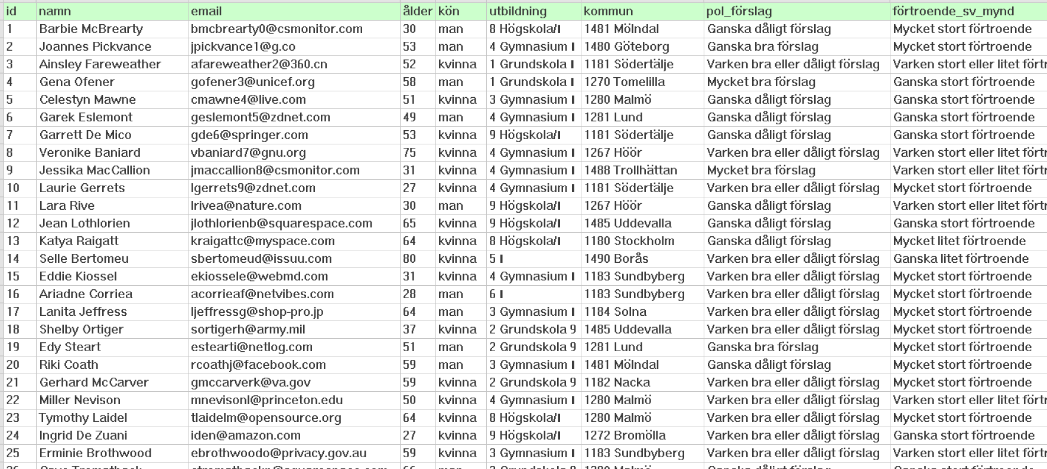
Removing identifiers does NOT anonymize a dataset IF original is retained!
Notes:
The most common misunderstanding about personal data is that you can create and "anonymous copy" of the dataset by removing the identifiers.
Here is a dataset that is personal information, as there are columns with name and email. Note that this is synthetic data, these are not real people!

Slide 22
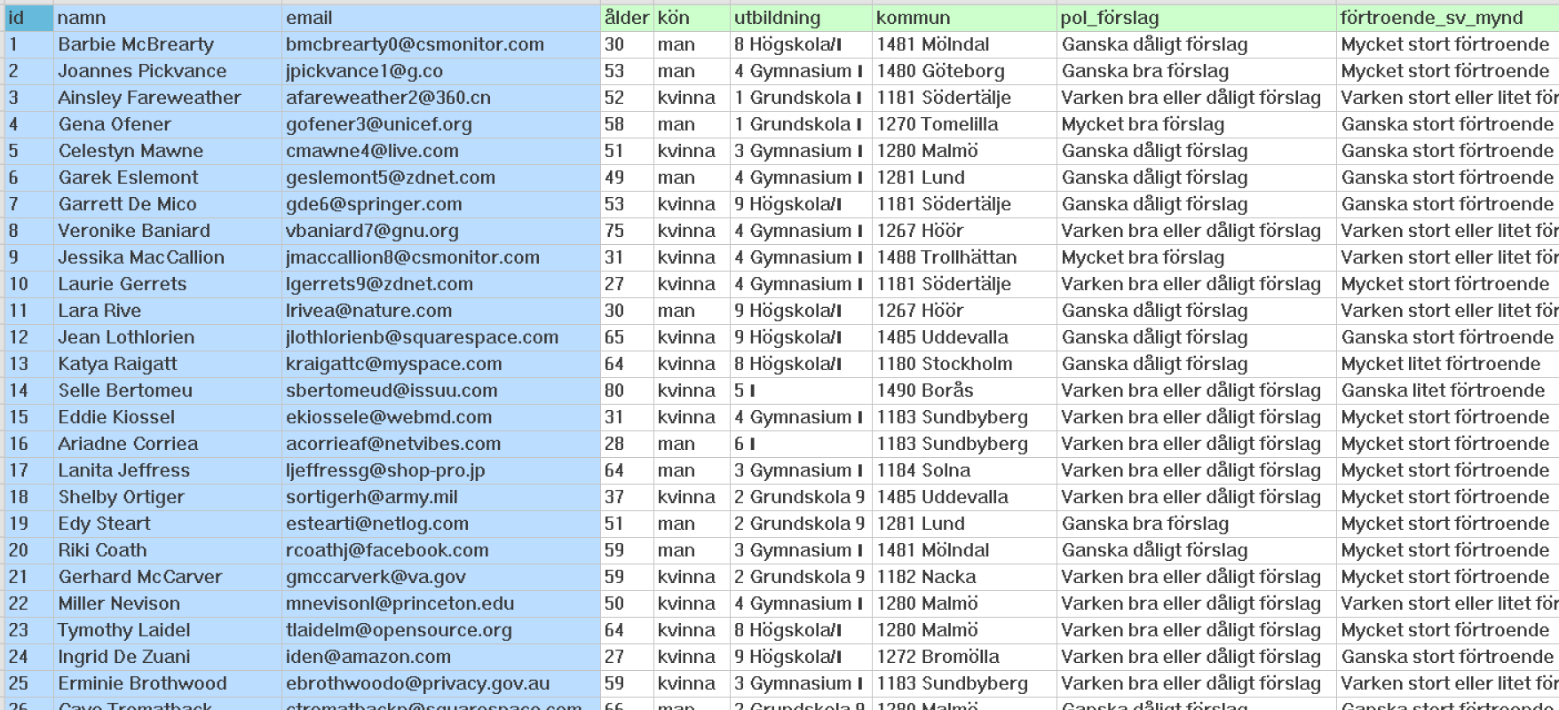
Removing identifiers does NOT anonymize a dataset IF original is retained!
Notes:
You CANNOT create an anonymous copy by using Save-As to create a new file without the id, name and email columns! That is because you can easily cross-reference any row in the new file against the data in the original file and thus find the name and email. And the way the law is interpreted in Sweden, even if you give the copy to someone else who does not have the original dataset, THEIR copy is still personal data as long as YOU have the original!
You could anonymize the dataset by deleting the original. However, this will probably be a breach of archiving laws!
There is no easy solution, so when it comes to publishing data like this, the easiest solution is to create a copy without the identifiers and then publish it with restricted access as personal data anyway.

Slide 23

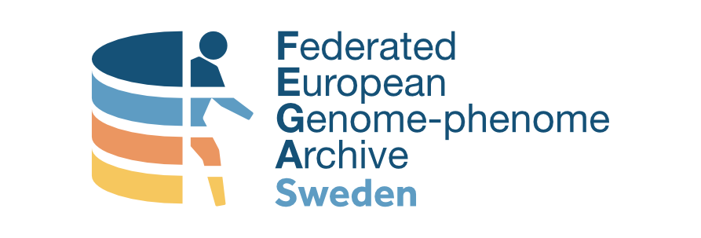

Datasets containing personal information
Can you publish research datasets containing personal information with restricted access?
1. Only use authorized repositories!
2. Not all universities have contracts for this:
List of FEGA Sweden organizations List of DORIS organizations
3. Contact your Data Support unit before publishing data with personal information!
Notes:
Ok, but can YOU publish research data containing personal information?
Some organizations have agreements with SND that allow their researchers describe datasets containing personal data in DORIS and obtain a DOI. If your organization has signed a Personal Data Processing Agreement (or stores the datasets on their own servers), you can publish!
SND has a list of organization with agreements, see
https://snd.gu.se/en/describe-share-data/share-data-step-step/1-preparations/sharing-data-personal-information
FEGA Sweden can also publish sensitive personal data from certain organizations, check https://fega.nbis.se/submission/complying-with-gdpr.html
Before you publish, you should look at the information you provided to the research participants. If you promised (for example) that no-one outside the research group will have access to the data, then you should probably not publish. Note that you should NOT have made such a promise (that no-one outside the research group will have access to the data) because you may be obliged to provide data to third parties under the Swedish freedom of information laws anyway!
It's recommended to contact your data support unit for guidance before publishing any data containing personal information.
Although there are questions and advice to consider, it’s usually possible to share such datasets with restricted access.

Slide 24
Common questions about publishing datasets with Personal Information.

Slide 25
Question: What about “metadata-only” dataset descriptions?
A “metadata-only” dataset description contains structured information about the datataset (eg title, authors, contact details), but…
NO formal data preservation strategy!
Metadata-only is NOT the same as
publishing with restricted access
embargo
closed review
! SND does not encourage (or provide support for) “metadata-only” dataset descriptions!

Slide 26
What about “metadata-only” dataset descriptions?
Why SND does not recommend “metadata-only”
We tried it!
Too often, data could not be obtained when requested.
Publication with “Restricted access” requires data are submitted to a repository.
➔ Ensures that the data are preserved.

Slide 27
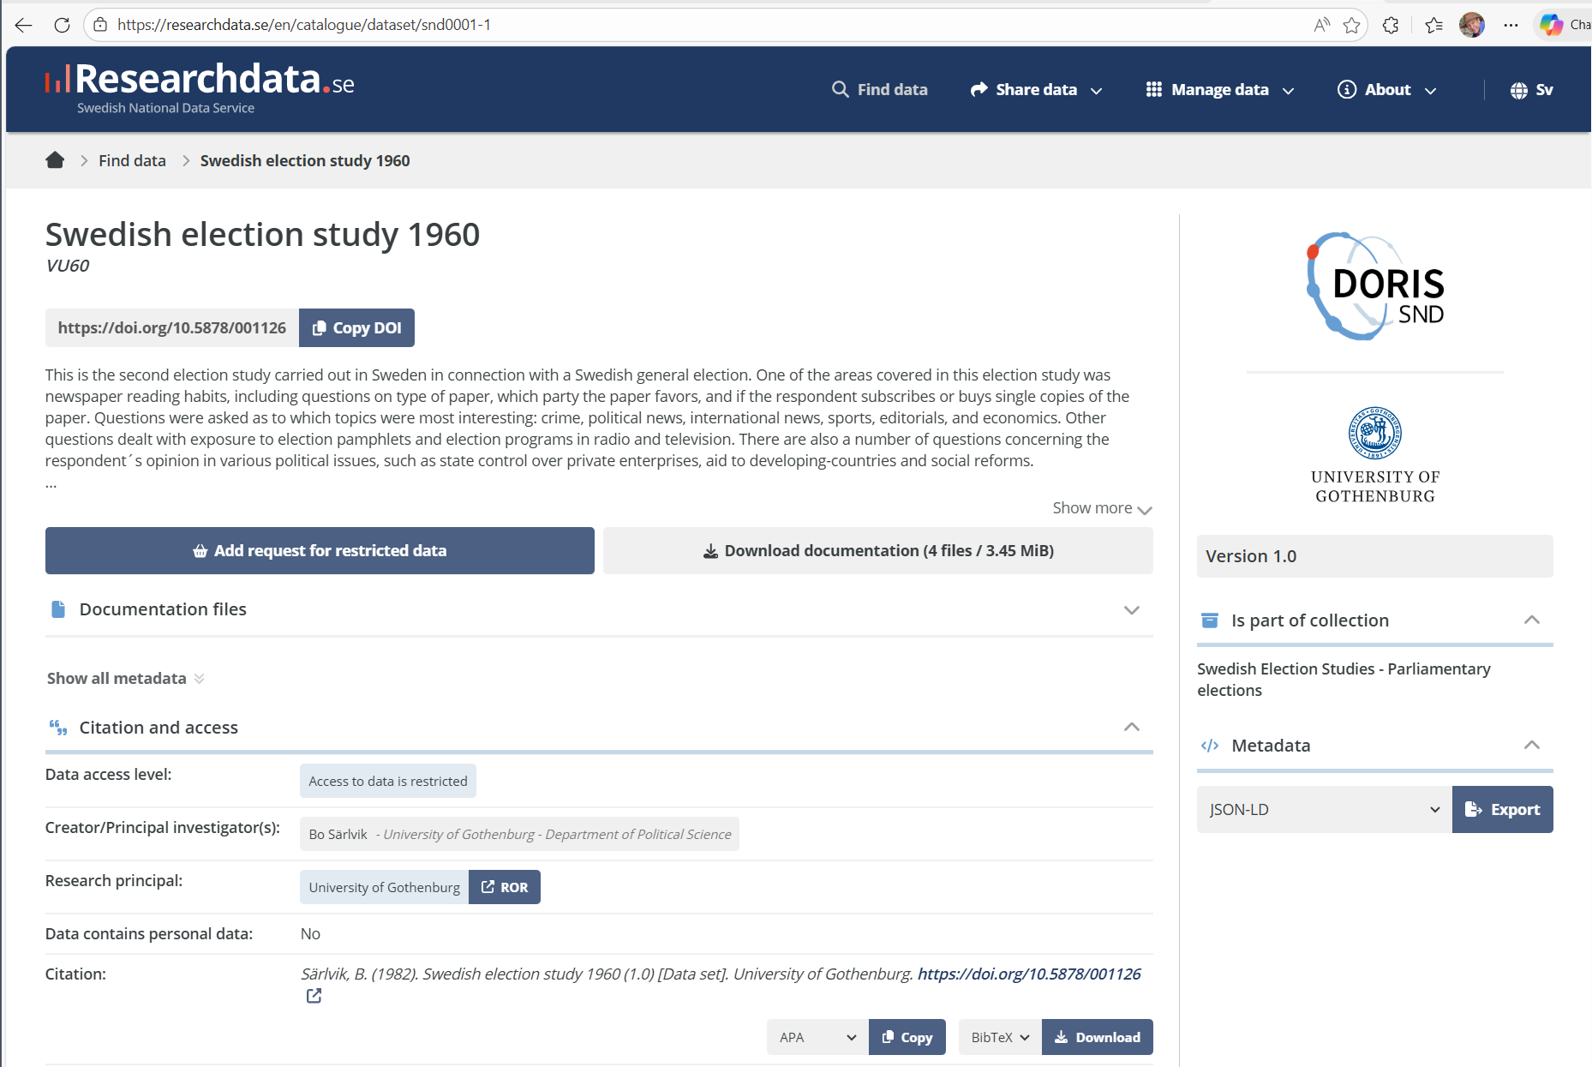
Still available!
Notes:
But data from 1984, in the SND Research Data Catalog, are still available!

Slide 28
Do you need to have mentioned data publication in your ethical review?
No, but there will come a “but...”
In short:
You don’t “give out” data when you publish.
Data is only “given out” only when someone requests it.
Use DORIS and the data stays under the control of your organization.
Only the dataset description (“metadata”) goes to SND.
Requests for data are handled (by your Data Support) under Freedom of Information (Offentlighets- och sekretesslag (2009:400)

Slide 29
Do you need the participant’s consent to publish data?
No, but there will come a “but...”
In short:
Legally, you are only publishing a dataset description, not “using data for a new use”.
Creating a well-documented dataset for preservation is something you should do anyway!
Keep in mind:
Do NOT promise that no-one outside the research group will get access to the data!
Do NOT promise that the data will be destroyed after the results are published!

Slide 30
But! be honest with participants!

Slide 31
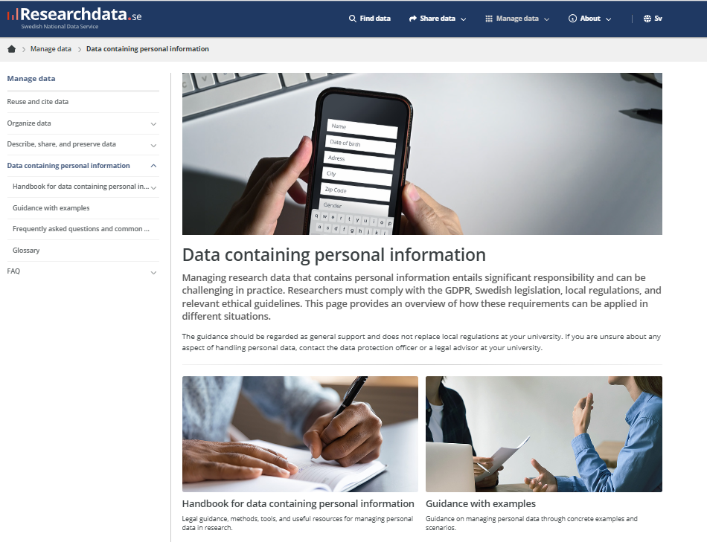

Slide 32
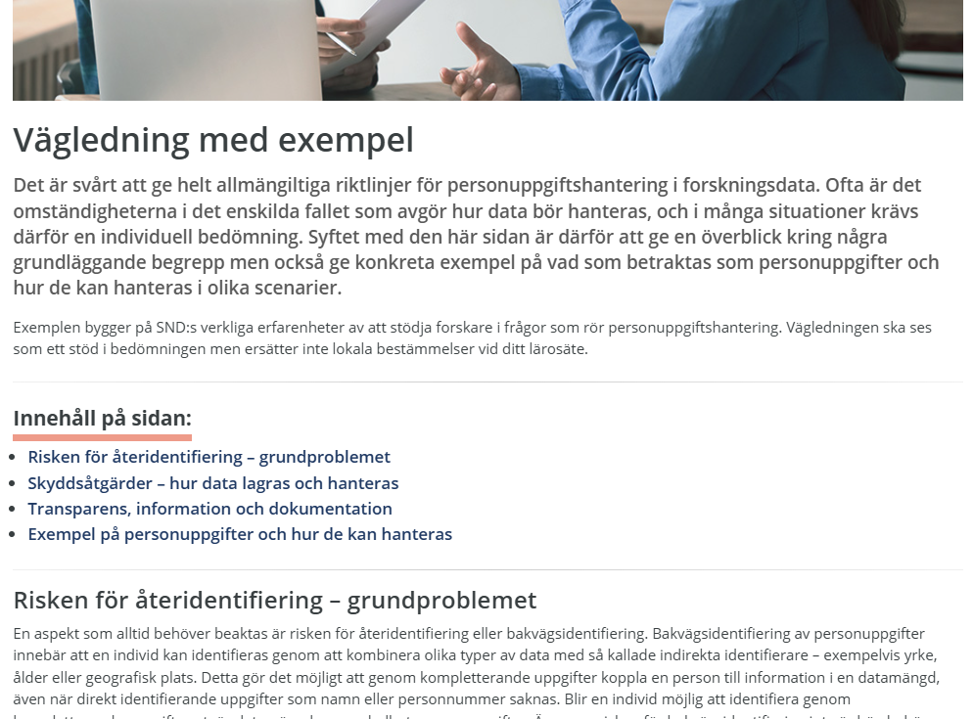
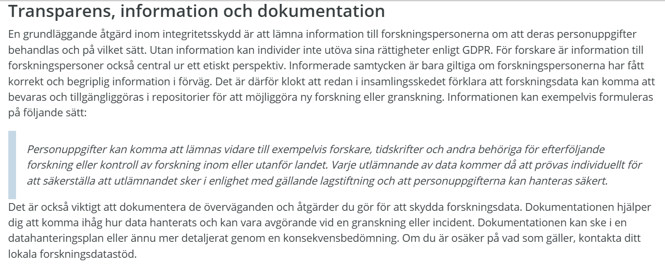
…för att ersätta det vanliga: ”Dina svar och dina resultat kommer att behandlas så att inte obehöriga kan ta del av dem.”

Slide 33

Should you publish the code-key/direct identifiers?
No!
Data reuse rarely requires identifying participants.
and if code-key is required, it can be applied for under Freedom of Information from your organization.
Presence of direct identifiers creates and unnecessary risk for a privacy breach.
Takacs Alexandra on Unsplash

Slide 34

Reducing re-identification risk.
Suppression and masking
Generalization – reduce granularity
Categorizing age into age groups.
Recoding rare categories as “other”
Replacing address with the name of town/municipality/region
Replacing identifiers with random identifiers
Notes:
You can take steps to minimize the risk of reidentification when you publish a dataset containing personal information!
Suppression – remove variables that contribute little to the result but which increase the risk of reidentification.
Masking – mask (replace with a token or code) particular values that increase the risk or reidentification. For example, if age is an important variable but there is only one older person who responded to a survey, you might mask less important variables for that response (eg their education level or postcode).
Generalization – reduce the granularity in the data. You ideally would have thought to do this when you collected the personal information.
Categorizing numerical values in to groups e.g. age groups, rather than age.
Aggregating several rare responses into “other”
Aggregating address information into larger geographical regions.
Sometimes, for example in transcripts, you might need to systematically replace names of people or organizations with alternative, fictional names.

Slide 35

Should you anonymize/reduce the risk of re-identification (in qualitative data) and publish it?
If you want the dataset to be reusable.
Reducing re-identification risk
Reduces the risk to research participants.
Makes the data more reusable (Freedom of Information requests more likely to be approved).
Takes a lot of time.
Consider:
How sensitive is the data?
Are you expecting that the data will be requested/reused?
Is this something you know how to do already?
Is this something you will do often?
Lukas Blazek on Unsplash
Notes:
In short, do a cost-benefit analysis before you start reducing the risk of re-identification!
How sensitive is the data, in terms of the risks to research participants if they are identified?
For sensitive data, you owe it to your research participants to make the effort.

Slide 36
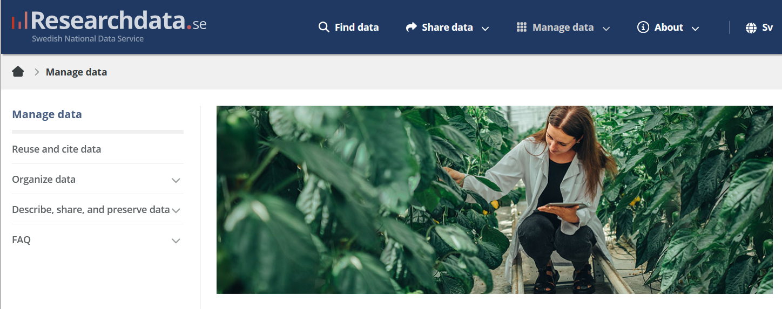

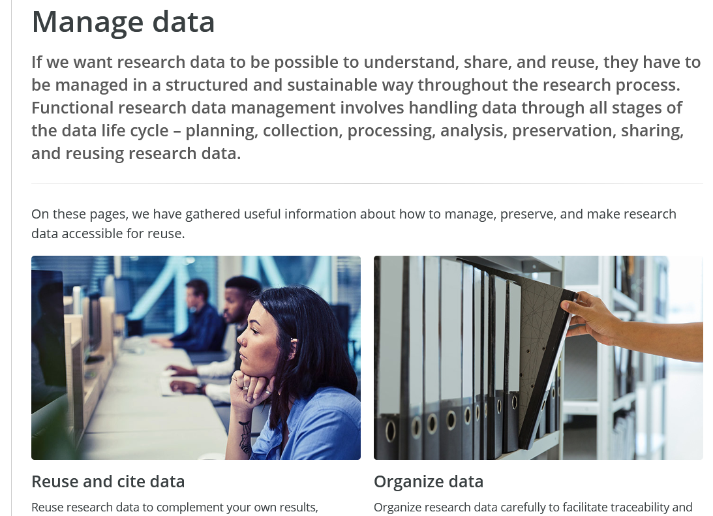
Notes:
SND provides support for research data management and data publishing ! You can find information on the Researchdata.se webpage under “Manage Data”

Slide 37
Good luck!
Notes:
Take home points:
Check whether someone else has already published data you can use before you go and collect it.
Think right from the beginning that you need to publish your data when you publish your results, and plan accordingly
Publish _independent_ data publications with rich metadata and documentation, no matter if your data is open access or restricted in some way.
And don’t forget to cite your own data publications throughout your thesis and articles.
And welcome to the Open Science research community!

