Slide 1
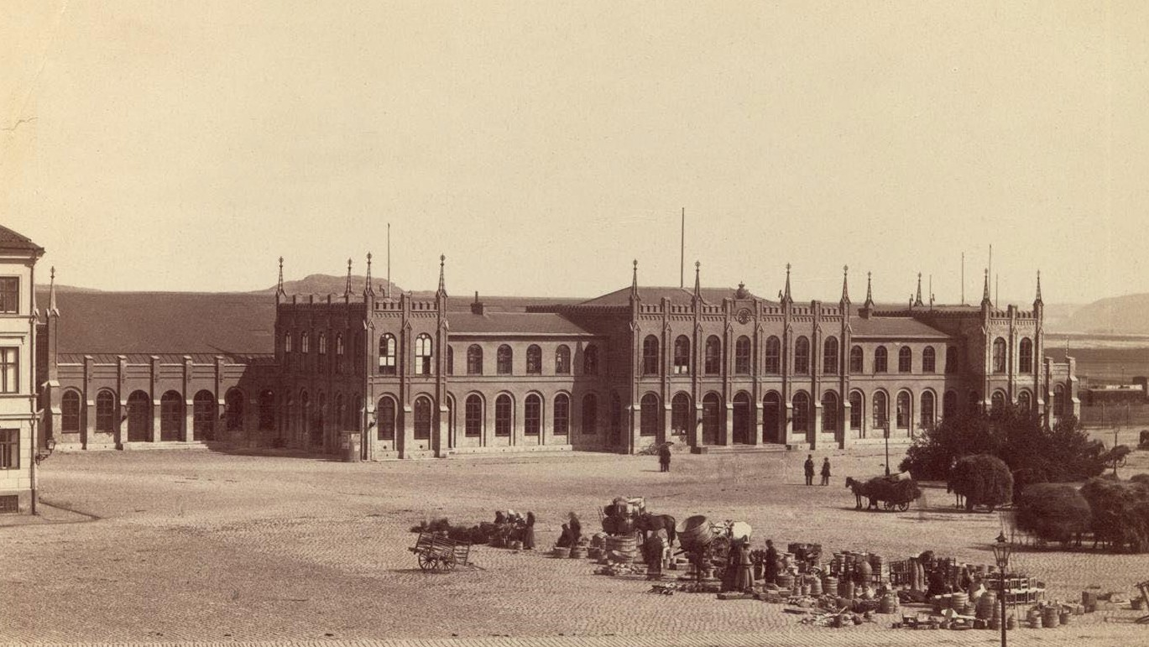


Slide 2

Accessible archives with AI and Citizen science
Karl-Magnus Johansson, The National Archives of Sweden Open Science in the Swedish Context, May 7th 2026

Slide 3
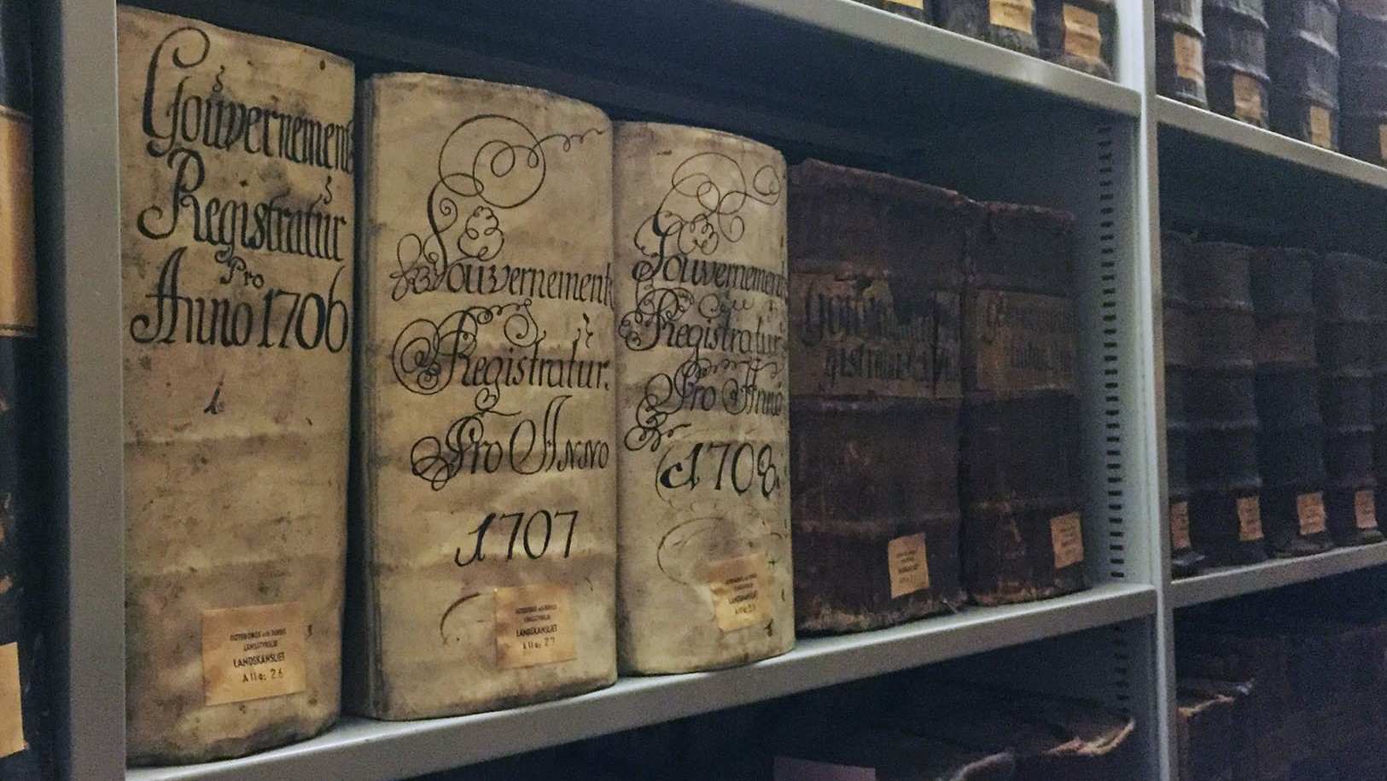

Slide 4
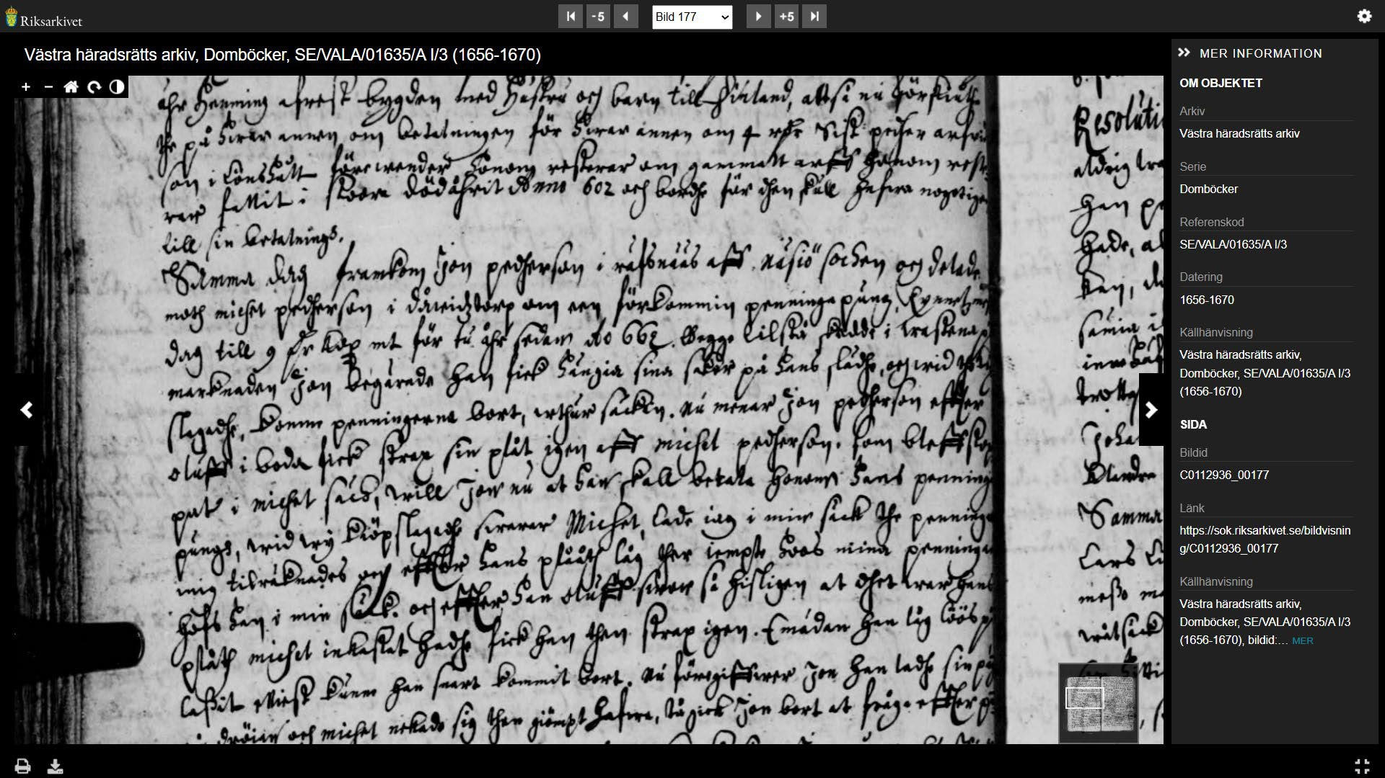
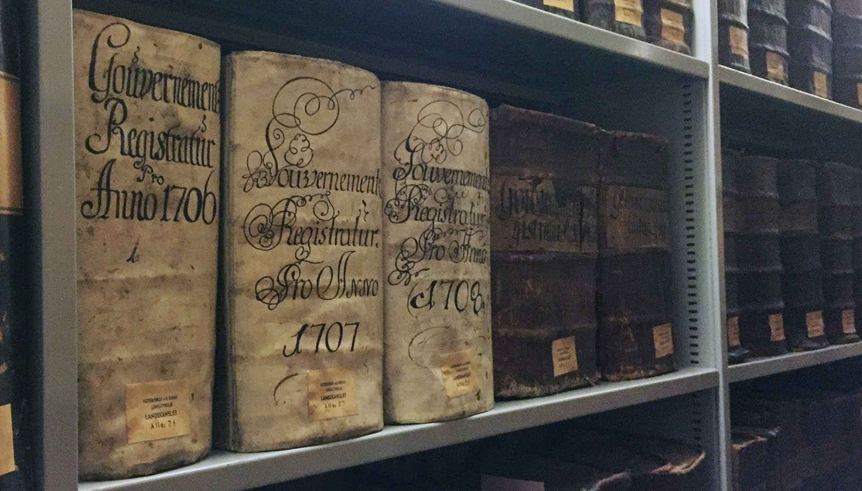

Slide 5
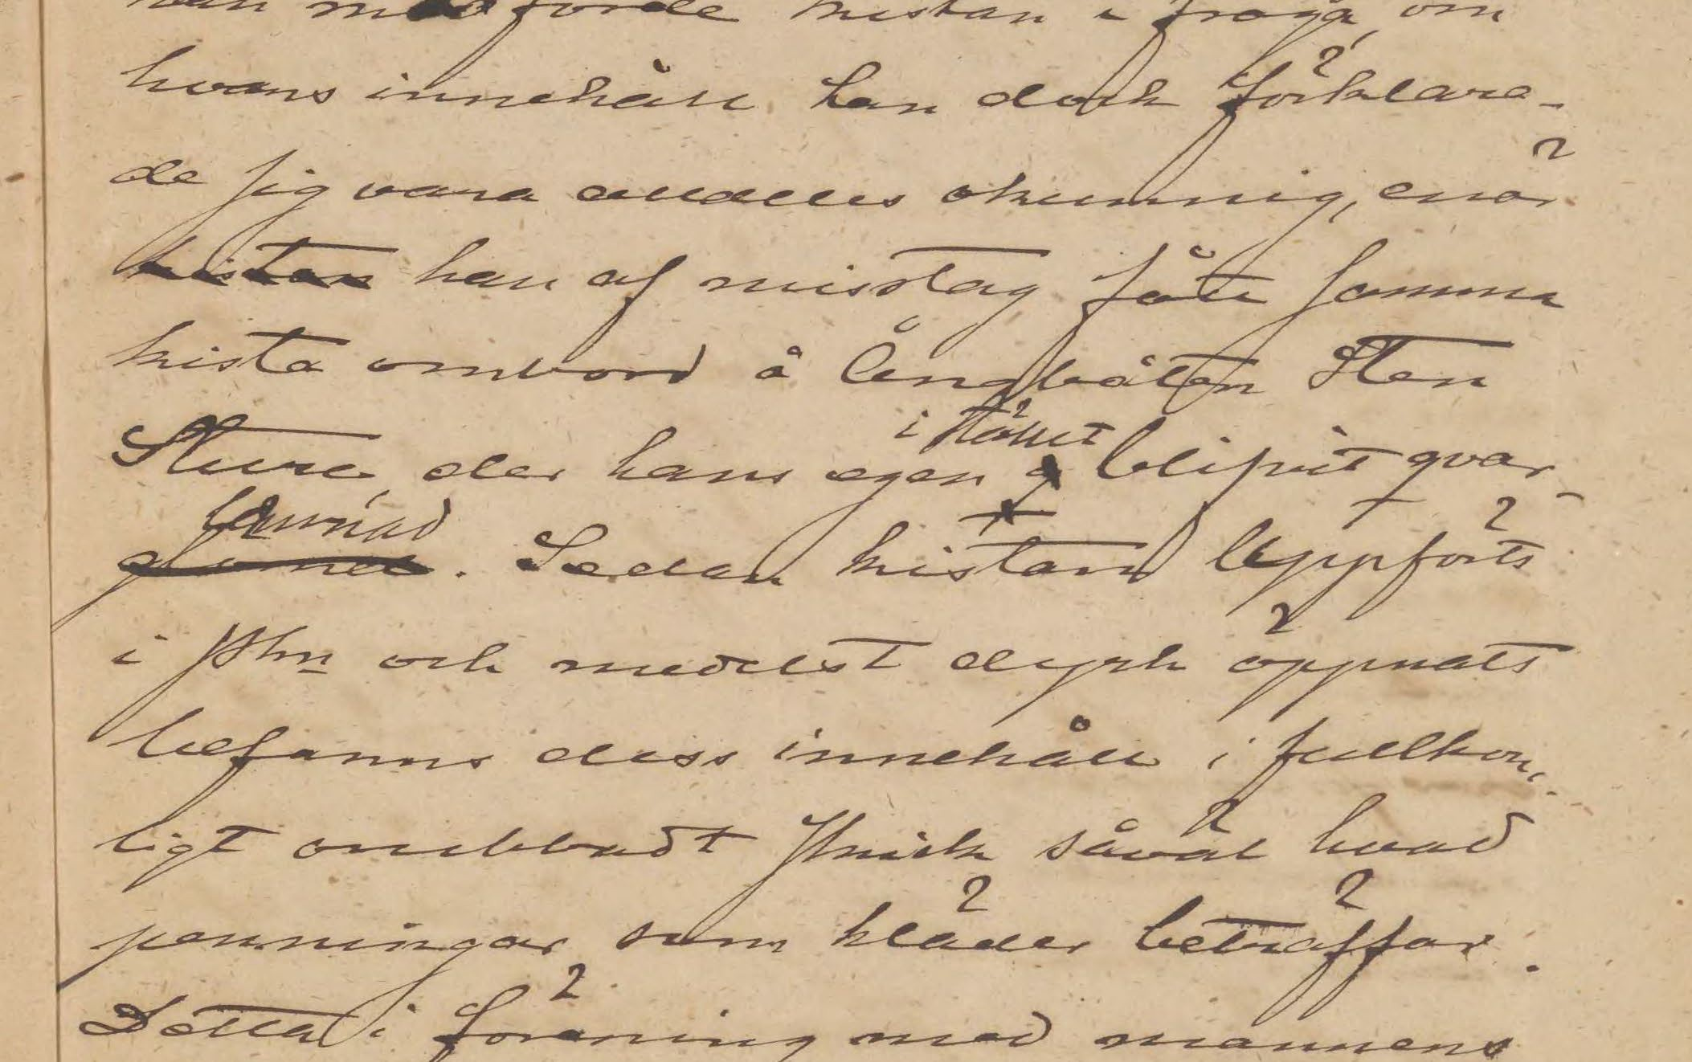

Handwritten Text Recognition (HTR)
Supervised machine learning for automatic transcription of handwritten text from image to text data

Slide 6
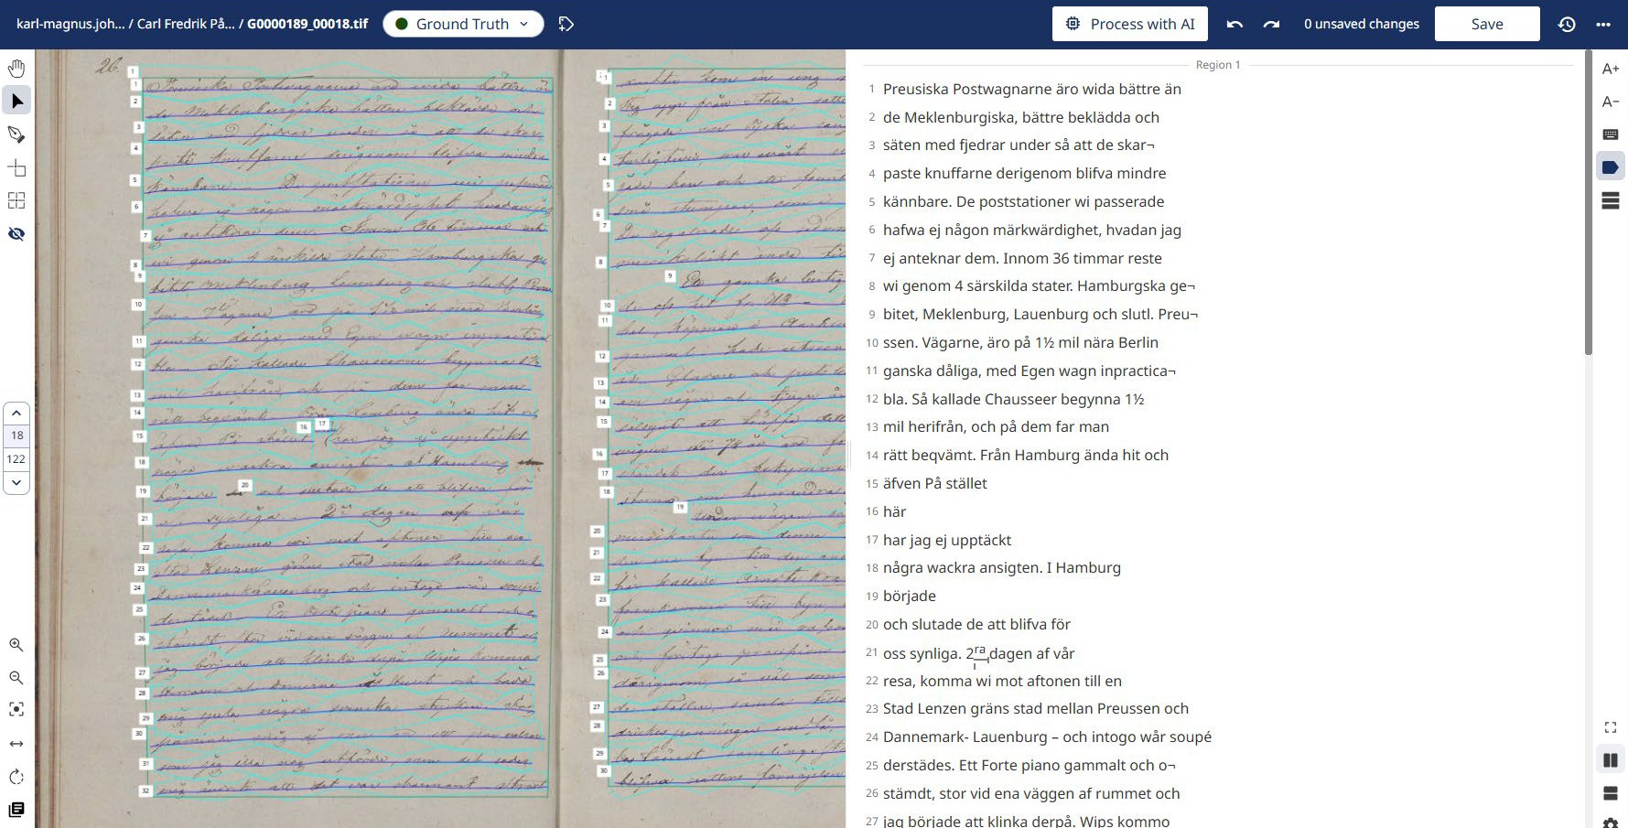

Slide 7
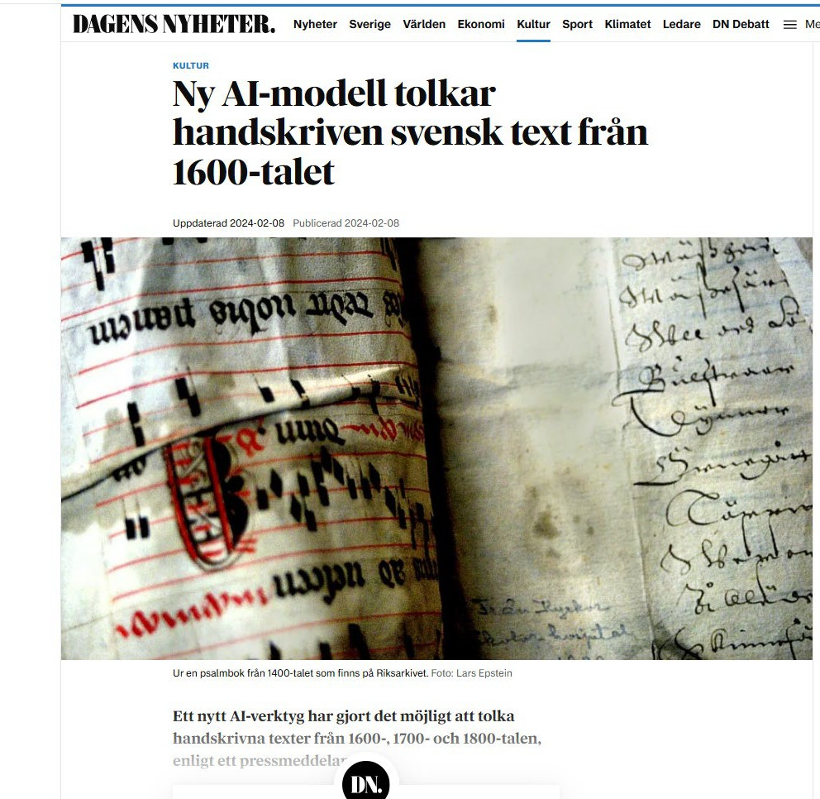
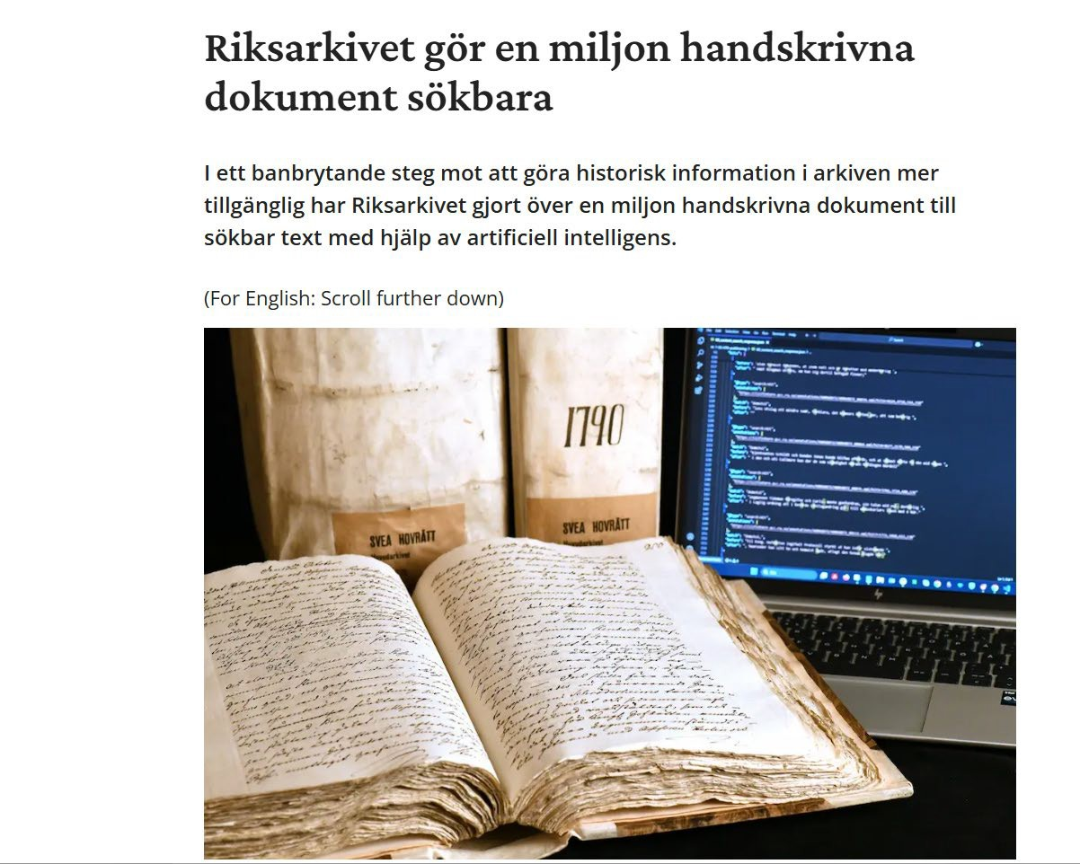

Slide 8
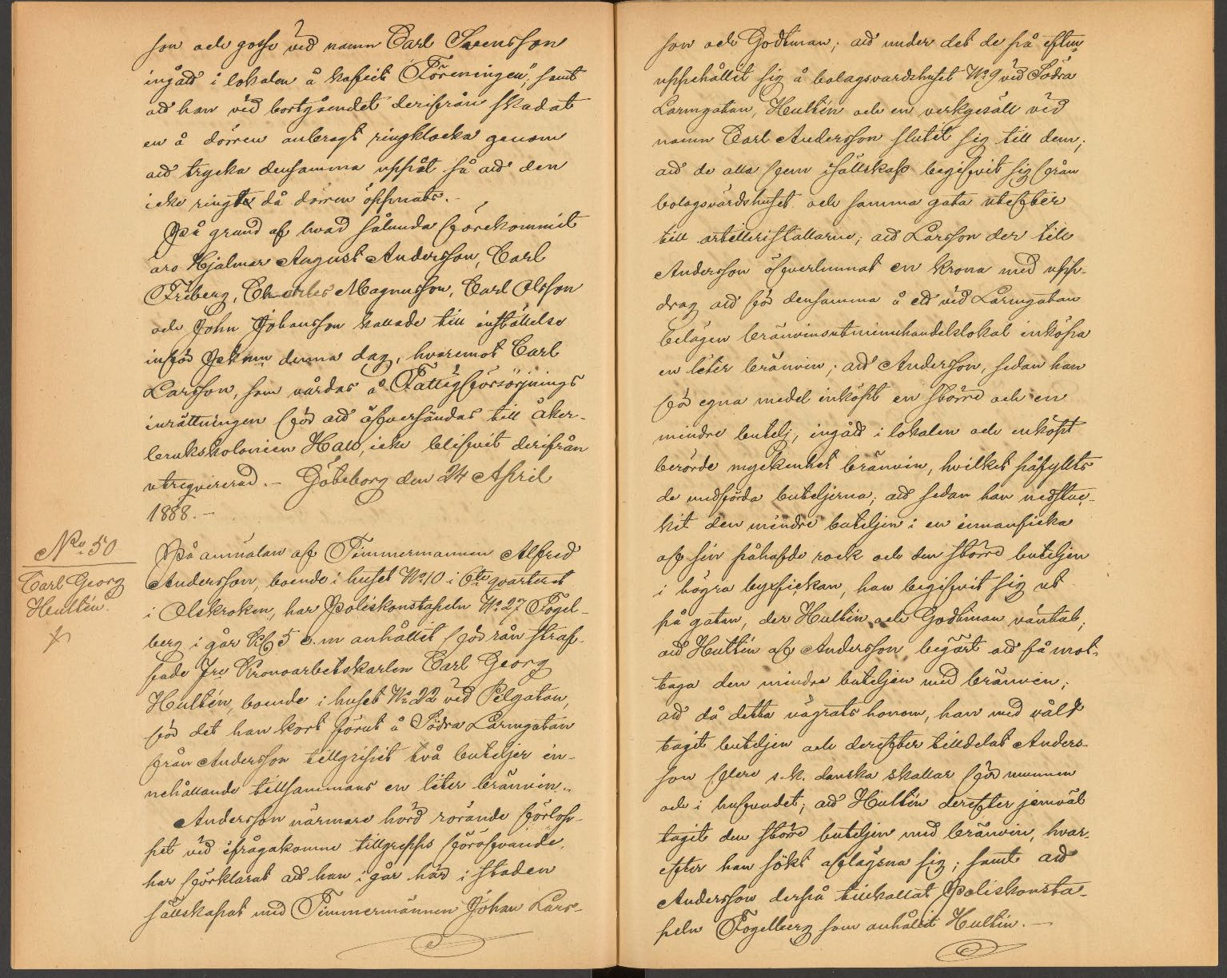
Gothenburg Police, Detective Section
Police reports (1868–1902) and telegram messages (1865–1903)
Appr. 25 000 pages
46 bound volumes
A project in collaboration with GPS400: Center for collaborative visual research, University of Gothenburg

Slide 9
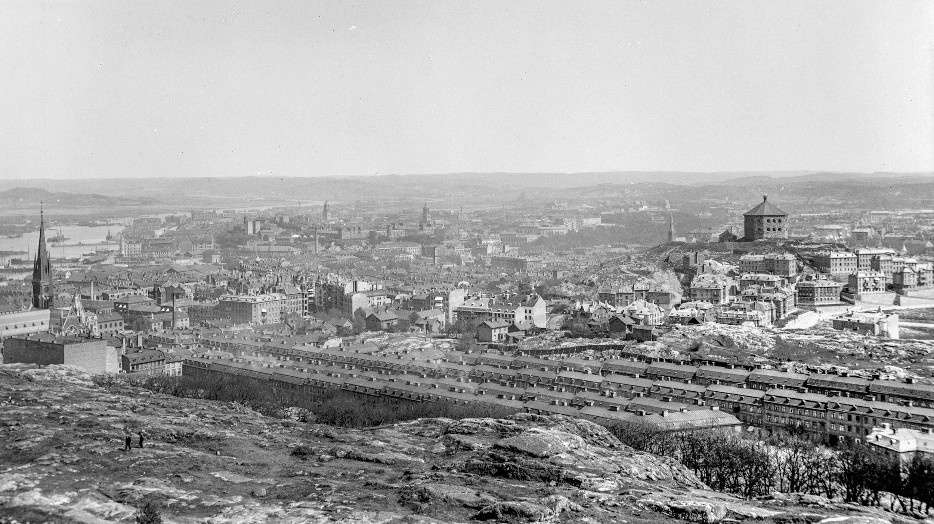

Photo: Axel Leonard Svensson, 1901
(Lena Carlssons bildarkiv, The Swedish National Archives, Gothenburg)

Slide 10
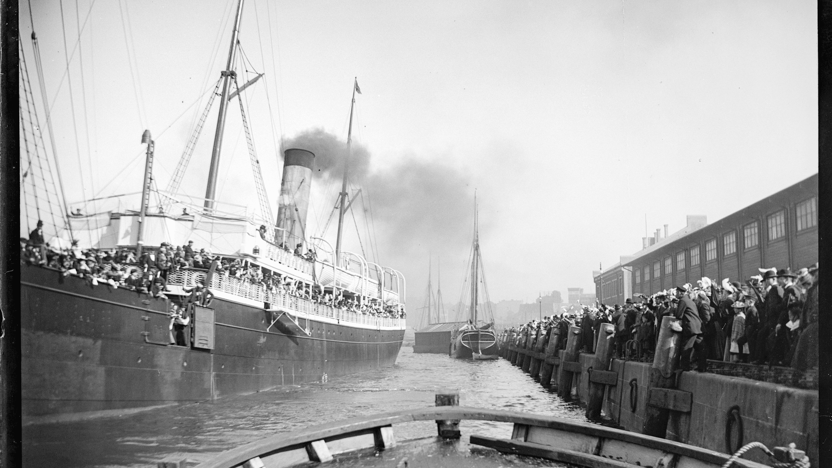
Photo: Axel Leonard Svensson, 1900
(Lena Carlssons bildarkiv, The Swedish National Archives, Gothenburg)

Slide 11
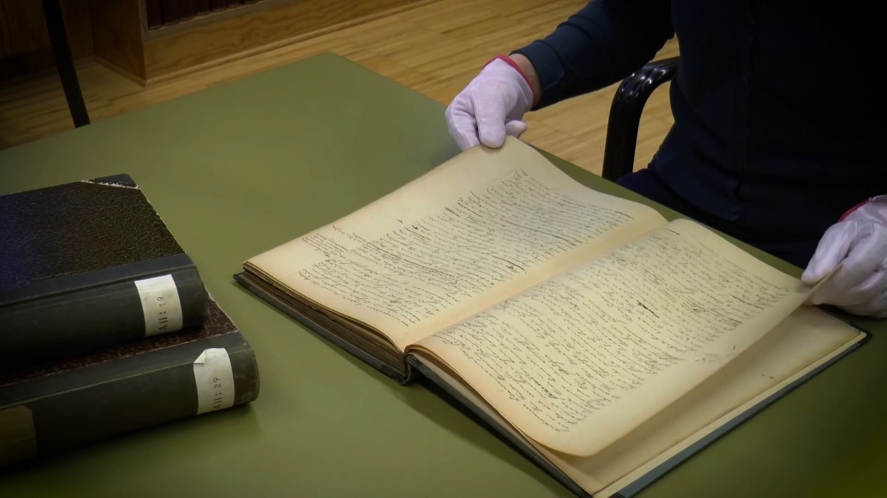

Slide 12
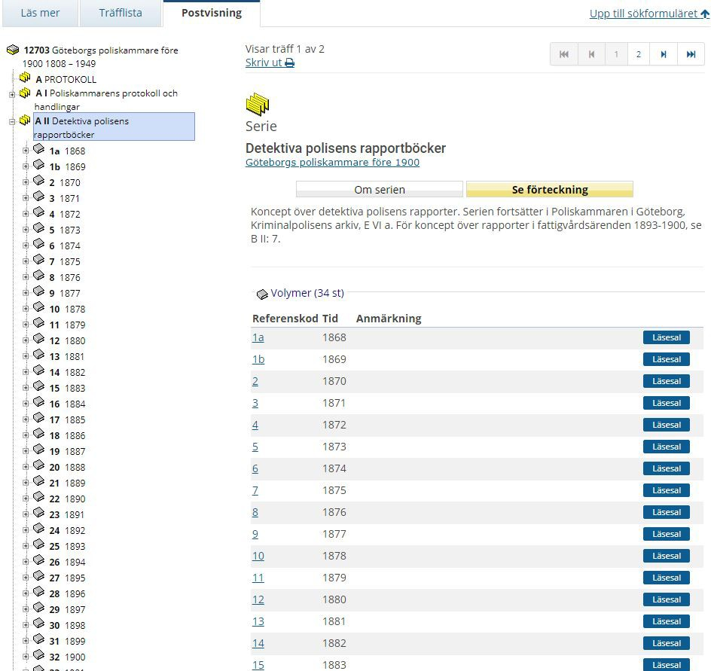

Slide 13
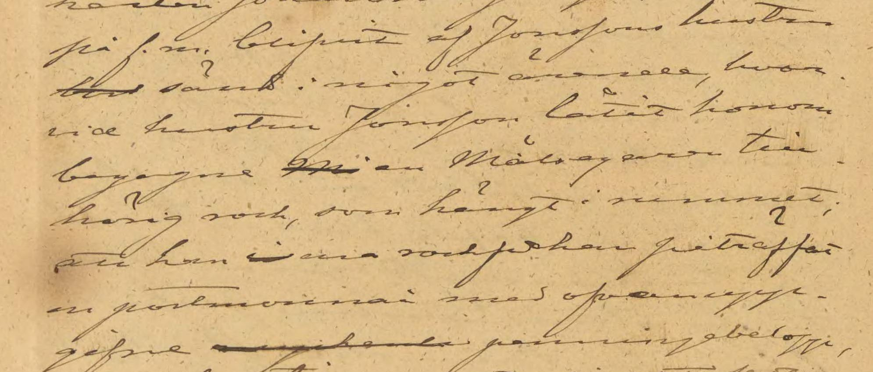
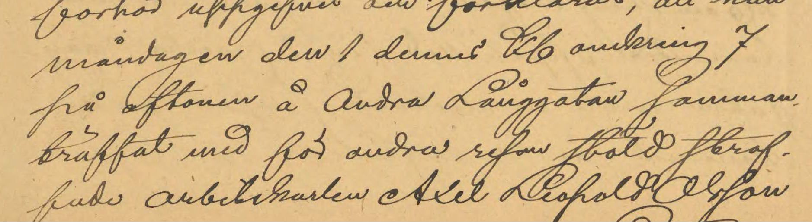
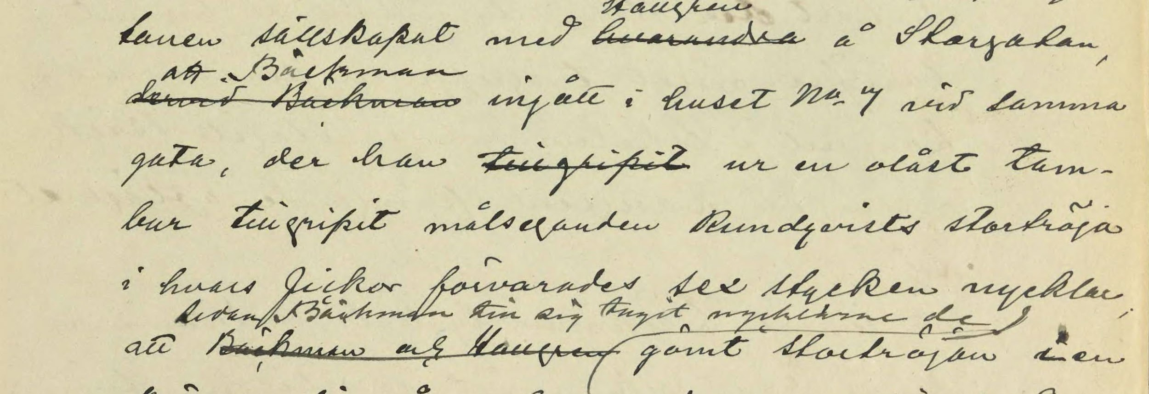
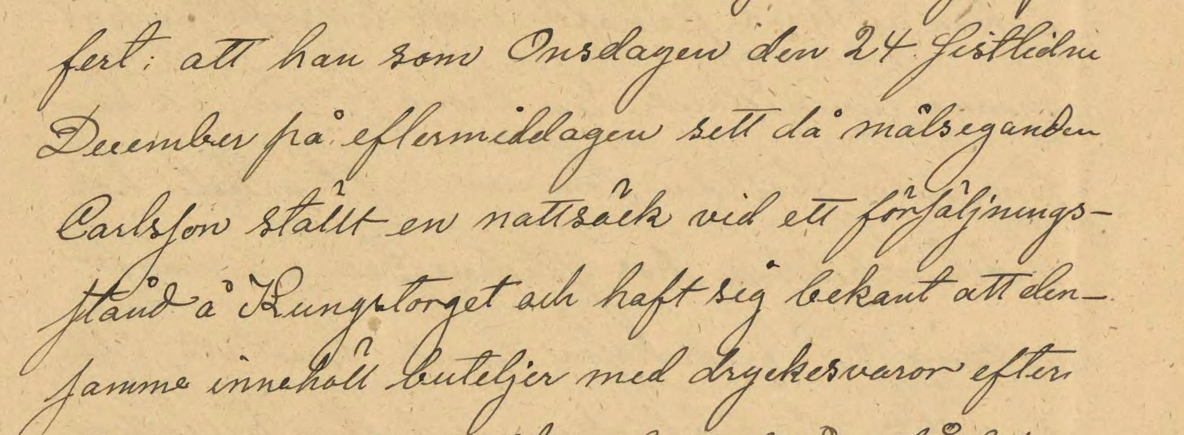
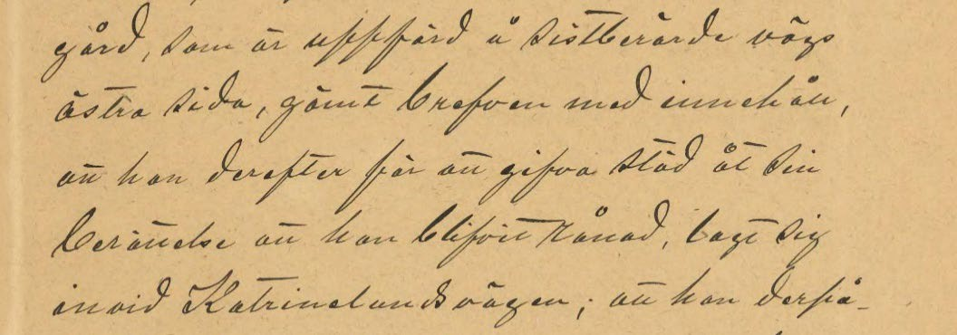
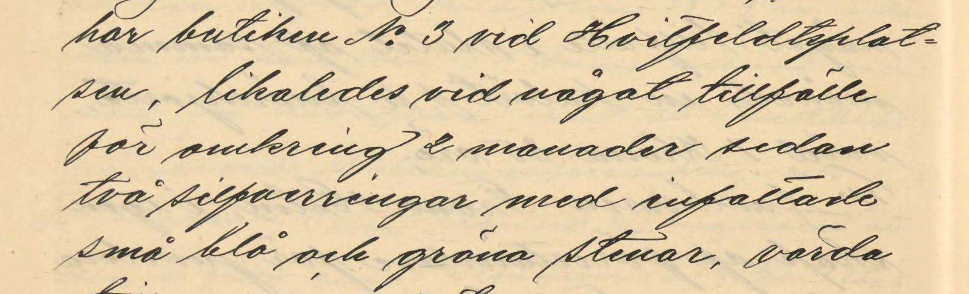

Slide 14
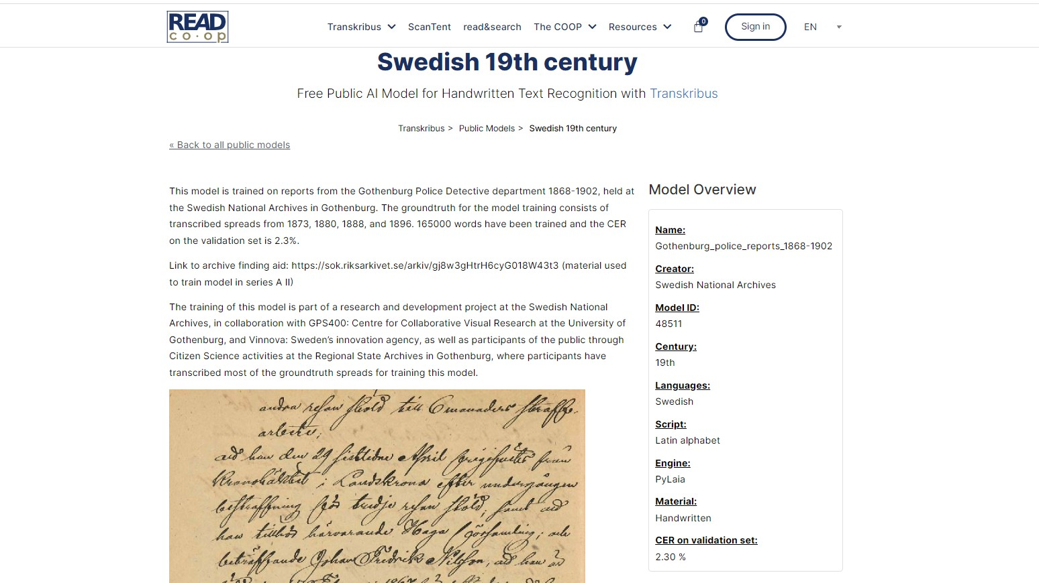

Slide 15
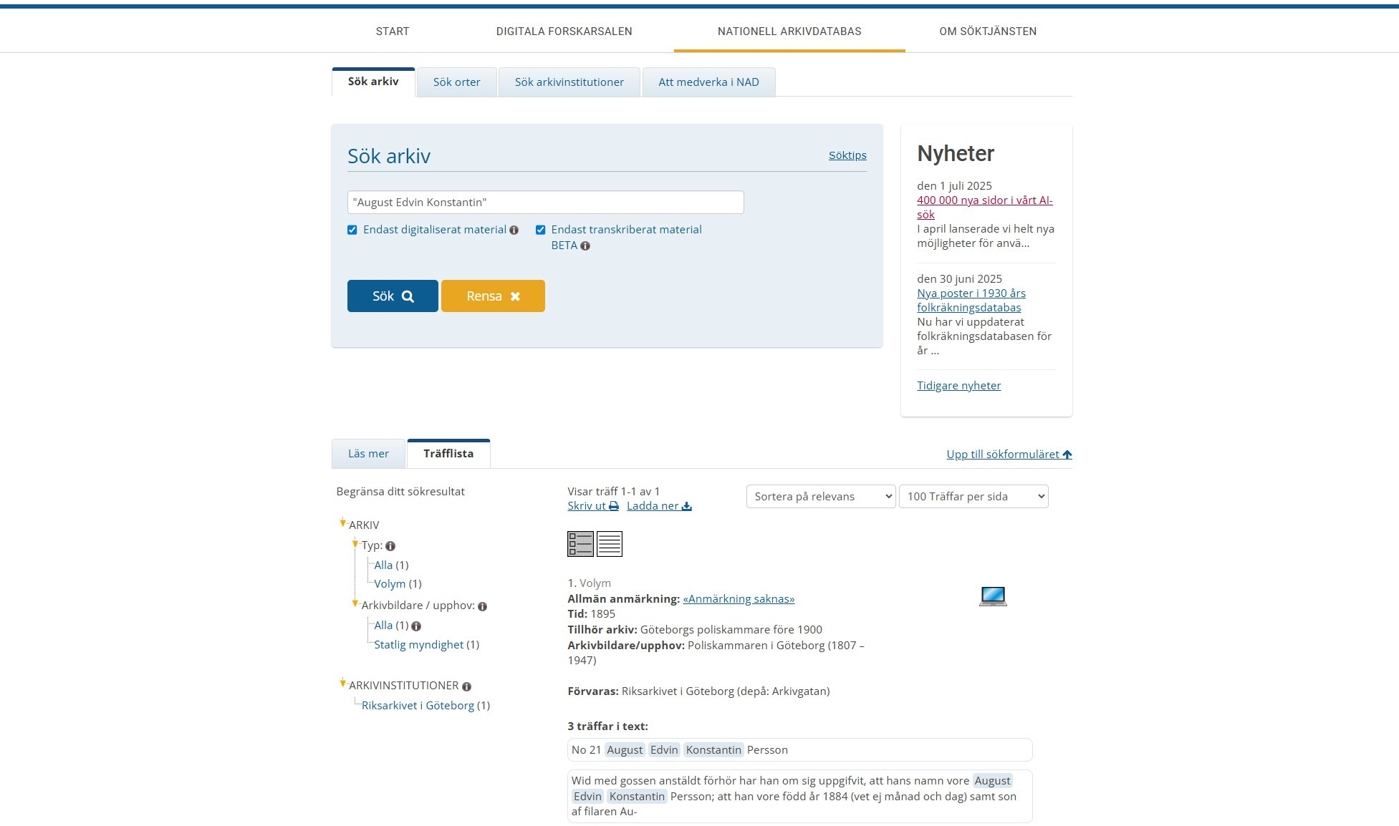

Slide 16
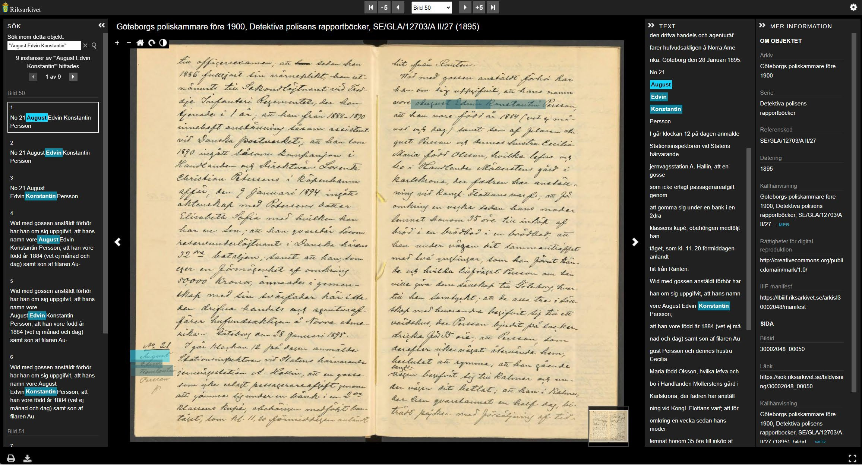

Slide 18
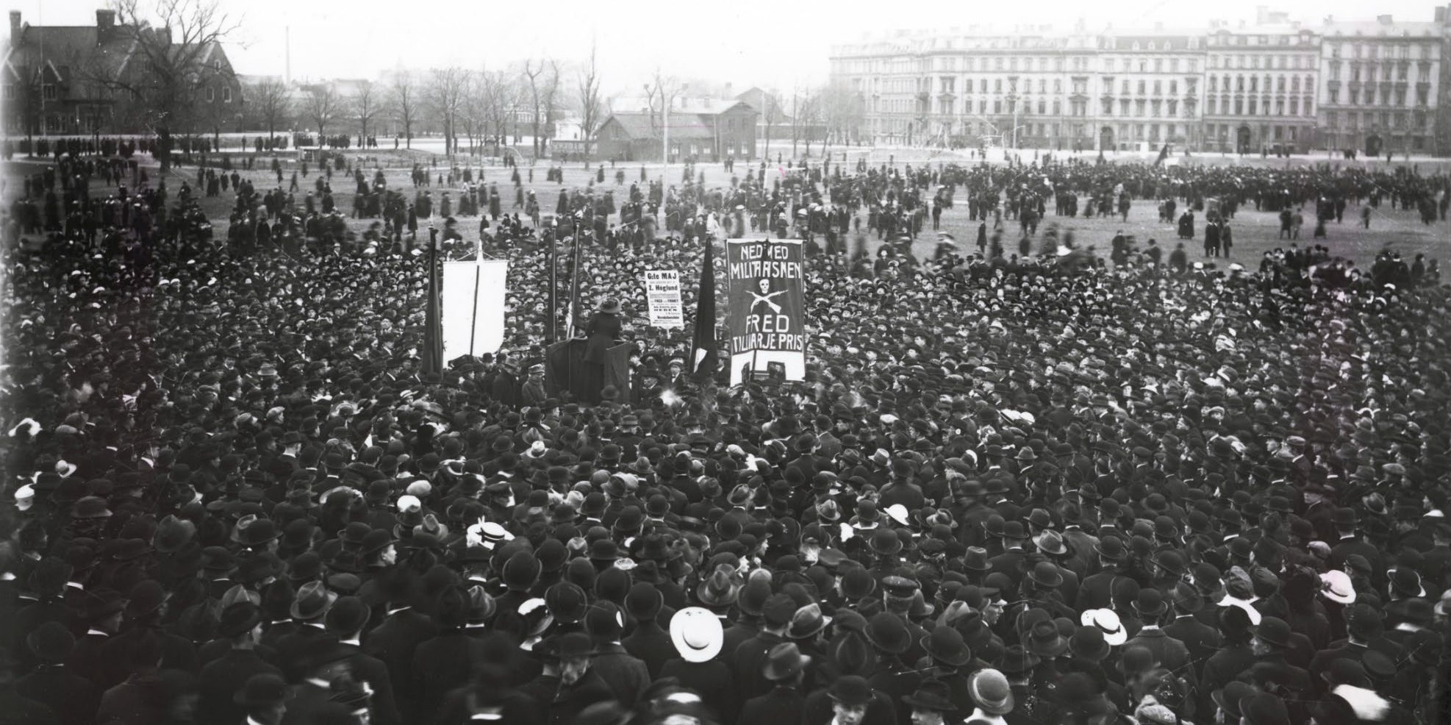
Hungerkravallerna

Slide 19
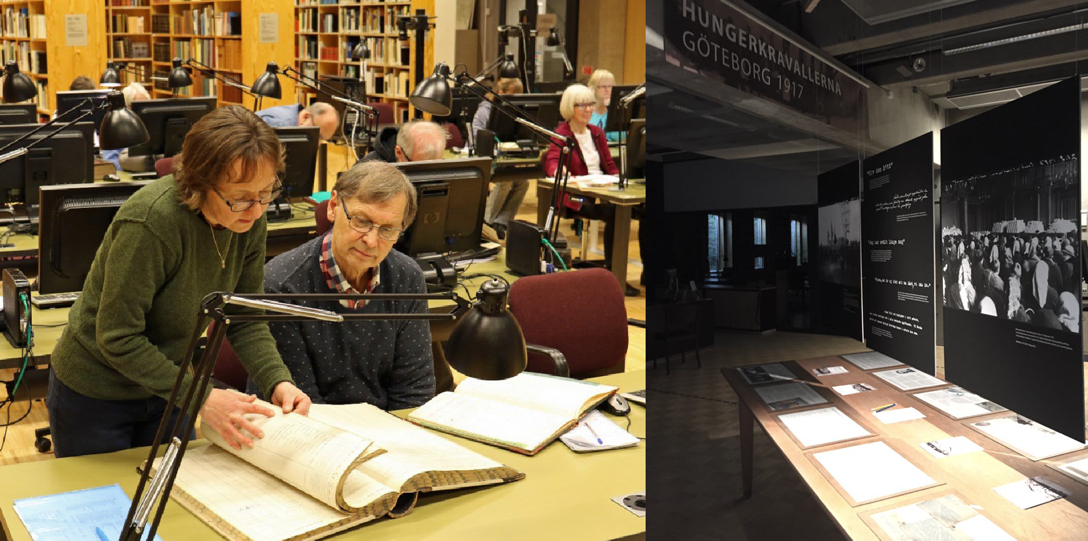
Hungerkravallerna

Slide 20
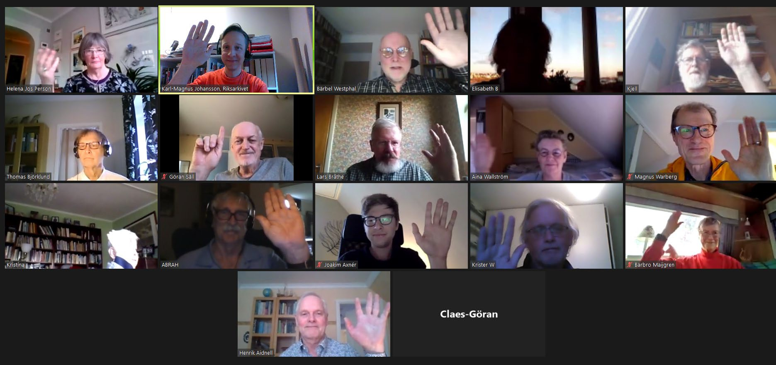

Slide 21
Studying the epistemic culture that developed in the project
Kasperowski, D, Johansson, K-M & Karsvall, O. ”Temporalities and Values in an Epistemic Culture: Citizen Humanities, Local Knowledge and AI-supported Transcription of Archives”, Archives & Manuscripts 2023:2
Kasperowski, D & Johansson, K-M. ”Kulturarvspedagogik genom AI, arkiv och medborgarforskning”, in J. Håkansson et al (red.) Kulturarv som politik och pedagogik, 2025
Kasperowski, D & Johansson, K-M. ”Participants Learning and Open Archives through AI and Citizen Humanities”, Citizen Science: Theory and Practice (coming, 2026)

Slide 22
How do volunteers value their participation?
to contribute for a greater cause
the (local) historical material
multifaceted learning

Slide 23
"The public will benefit greatly from this in the future. Those who are not so used to studying old archives will have a much easier time accessing the material.“
”I am learning so much. I had no idea about some local historical details but the project has given me new perspectives on it. When I am out walking with friends I usually tell them about cases that have taken place in different places we visit. I have almost like guided tours.”

Slide 24
“I tell all my friends: 'I'm doing something really fun', and they get so jealous of me, especially during Covid.”
“Projects like this show just how incredibly much there is to discover [in the archives], so many different topics and so on. The project points you in a direction, and you get some free knowledge, and then you contribute, and you learn […] What I like is that – you might already have an interest, and then you get nudged, and suddenly it becomes interesting, or maybe at first you think “oh well,” but the more you learn, the more interesting it gets!

Slide 25
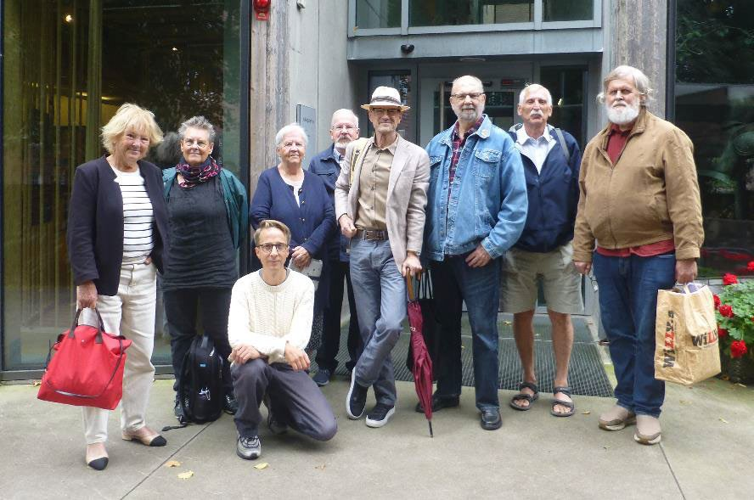
Citizen Science is based on relationships and mutual trust

Slide 26
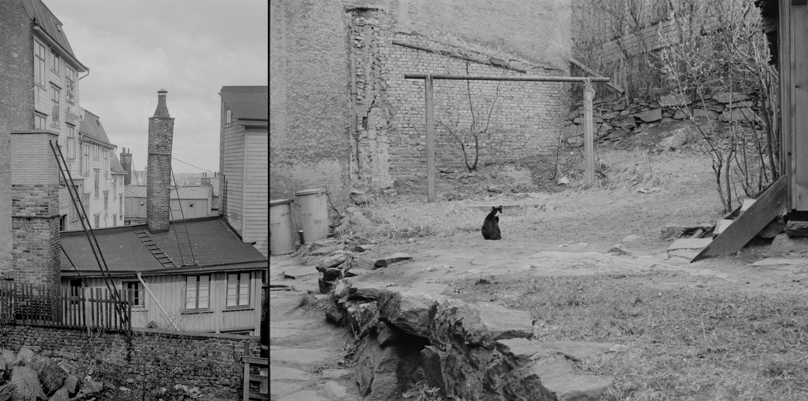
Glöckner, Murre

Slide 27
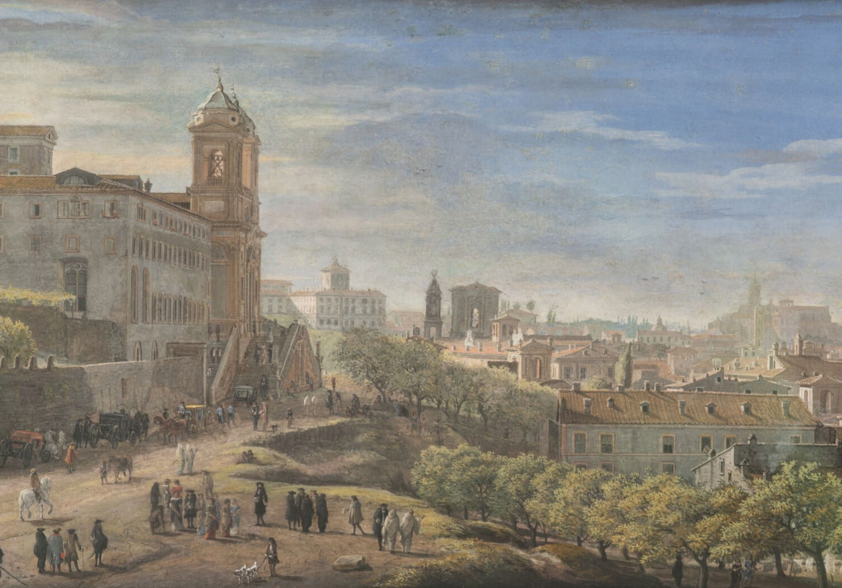
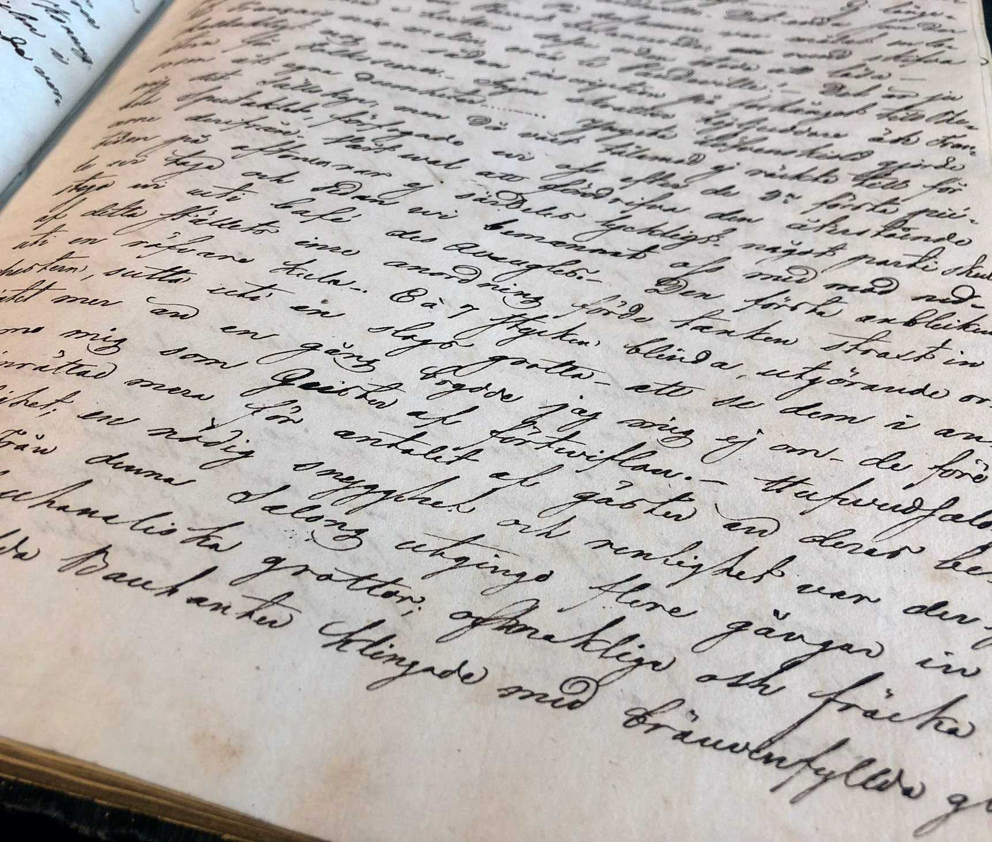

Slide 28
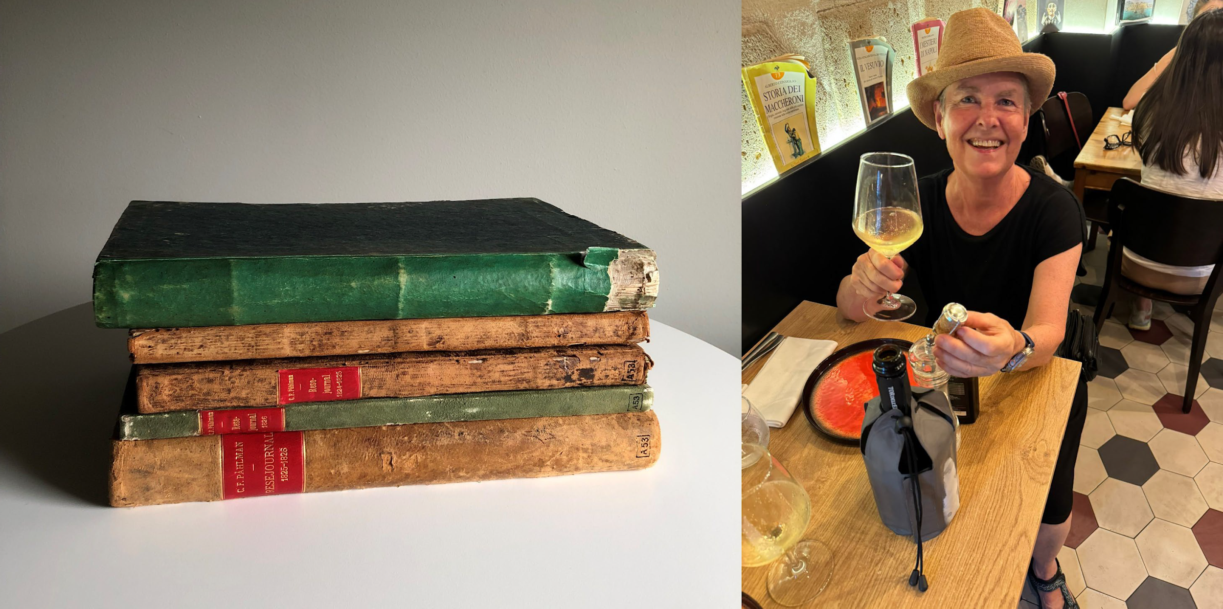

Slide 29
Thank you for listening!
Contact: karl-magnus.johansson@riksarkivet.se

