Slide 1
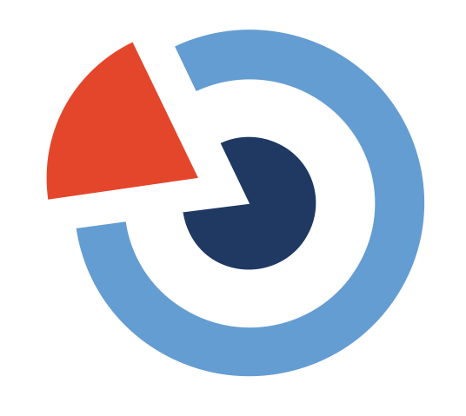
7. Reuse and Communication
Science Communication
Karin Westin Tikkanen
Senior advisor, SND
Chair of Minerva, section for non-fiction writing, Swedish Writers’ Union
karin.tikkanen@snd.se

Slide 2
”Knowledge is like fine wine. The researcher brews it, the scientific paper bottles it, the peer review tastes it, the journal sticks a label on it, and archive systems store it carefully in a cellar. Splendid! Just one small problem: wine is only useful when somebody drinks it. Wine in a bottle does not quench thirst.
Knowledge Translation … opens the bottle, pours the wine into a glass, and serves it.”
(Bennett and Jessani, 2011, p. 1)

Slide 3
This presentation in 5 steps
1. Definition of science communication
2. Different models for science communication
3. Differences between scholarly communication and science communication
4. Principles for (good) science communication
5. Assignment for the Grand Final: the Elevator Pitch!
Swedish National Data Service
3

Slide 4
Science Communication
7. Open Science in the project lifecycle – communicate & involve
< Lat. scientia ”knowledge"
< Lat. com- ”together”, munus ”gift; burden”
⇒ communis ”something shared”
Karin Westin Tikkanen
Senior advisor, SND
Chair of Minerva, section for non-fiction writing, Swedish Writers’ Union
karin.tikkanen@snd.se
SCIENCE COMMUNICATION (or knowledge translation) is the sharing of knowledge and research results with an audicence located outside of the research context.

Slide 5
”THE PUBLIC”
Scientists: The academic community and government. Industry.
Mediators: communicators (including science communicators,
journalists)
Decision-makers: policy makers in government, and scientific and learned institutions.
General public: the three groups above, plus other sectors and
interest groups.
Attentive public: people already interested in (and reasonably well-informed about) science and scientific activities.
Interested public (”lay public”): people interested in but not necessarily well informed about science and technology.

Slide 6
WHY SCIENCE COMMUNICATION?
PAS (public awareness of science) – transmitting positive attitudes toward science (and technology).
PUS/POUS (public understanding of science) – ensuring the public can understand scientific findings.
Open Science considers not only the transmitting of attitudes and understanding but also what benefits people could get from active interaction in and with science.

Slide 7
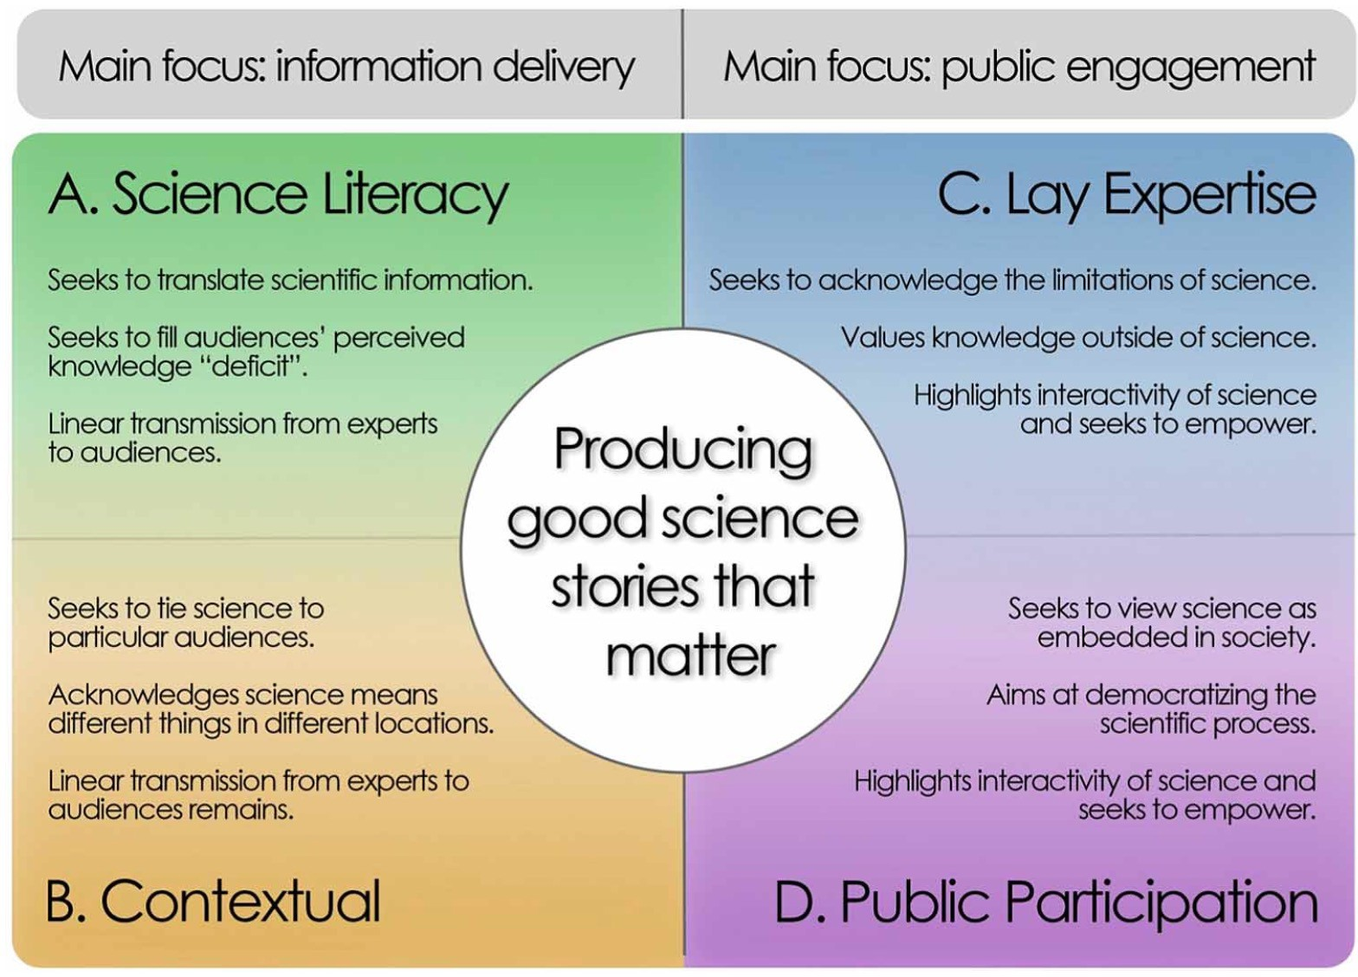
From Secko, David M.; Amend, Elyse & Friday, Terrine (2013). Four models of science journalism,
Journalism Practice 7(1), 62–80. DOI: 10.1080/17512786.2012.691351

Slide 8
SCHOLARLY COMMUNICATION: What do the scholarly community do?
scientific process (primary research)
results are examined (peer-review process)
dissemination (articles and presentations)
SCIENTIFIC LITERACY
SCIENCE COMMUNICATION: What strengthens public understanding of science?
a vocabulary of basic scientific constructs sufficient to read competing news stories in a newspaper or magazine (content)
an understanding of the process or nature of scientific inquiry (process)
some level of understanding of the impact of science and technology on individuals and on society (social factors)

Slide 9
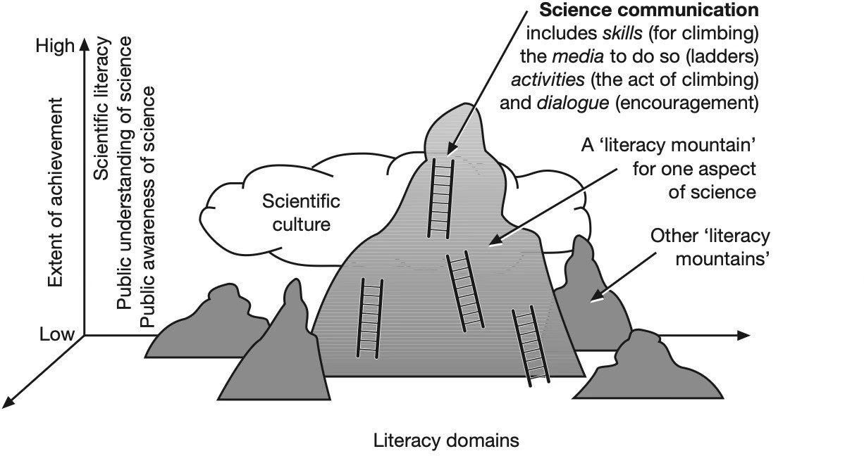
Burns et al. (2003) Science communication: a contemporary definition.
Public Understanding of Science Vol 12(2), p. 193

Slide 10
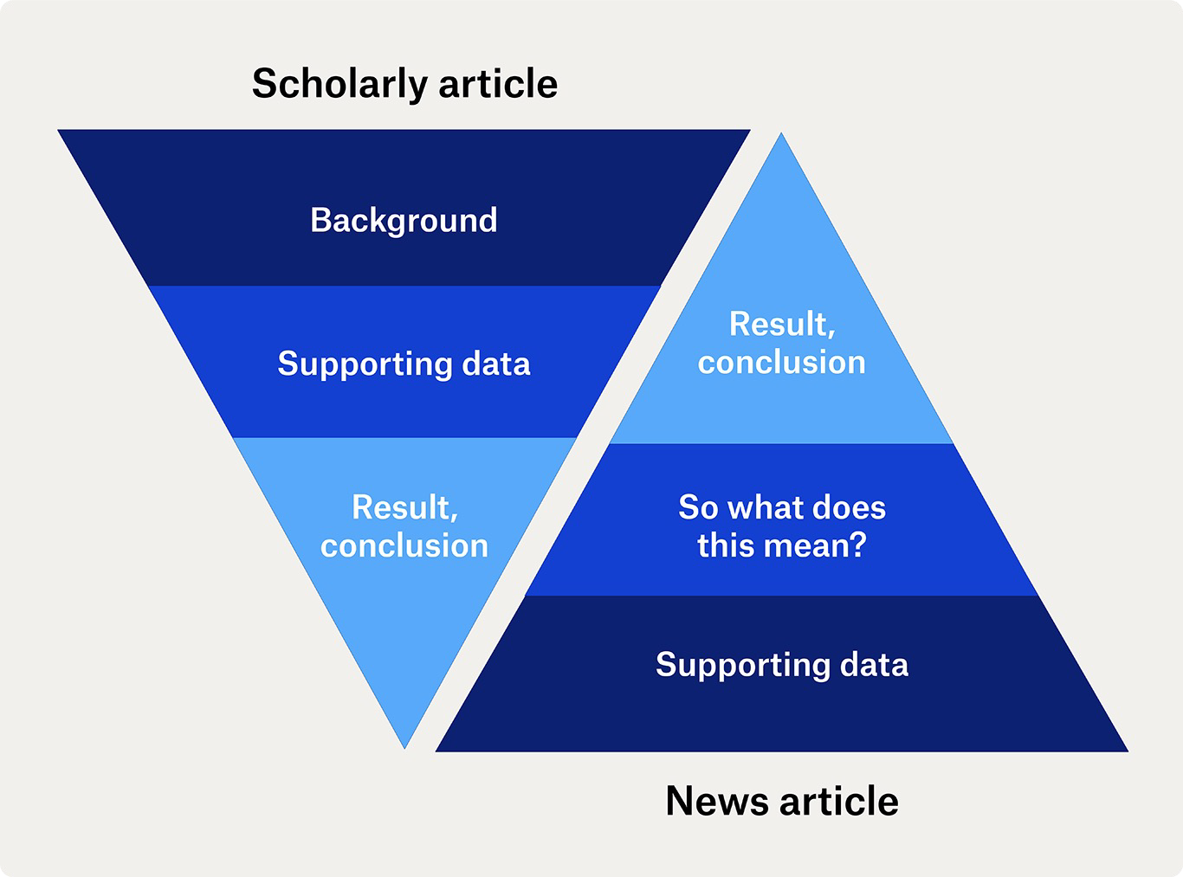
First page
”There is life in space!”
”We are not alone in the universe.”
”The evidence for biological life are two molecules…”
Last page
The difference between a scholarly article and a news article.
Communicating research – tips and advice (VR.se)

Slide 11
Seven principles for science communication (1/3)
Source:https://www.staff.lu.se/research-and-education/research-support/communicate-your-research/principles-research-communication (based on Danske universiteters principper for god forskningskommunikation)
Correctness
The content must be correct and give the target group a correct understanding of the relevant facts about both the results and the research involved.
Relevance
What is relevant for the recipient to know? Provide relevant information about facts and data to ensure that content and conclusions cannot be misinterpreted or overinterpreted. Avoid communicating alarming messages unnecessarily.

Slide 12
Seven principles for science communication (2/3)
Uncertainty
Clarify the uncertainties that relate to the research. Scientific discoveries are associated with varying uncertainty factors depending on method, research design, data or theoretical suppositions. Be clear about any limitations/weaknesses/uncertainties relating to the results and their interpretation.
Scientific status
What is the scientific status of the research? Have the findings been published and reviewed in research publications or are they preliminary results, hypotheses etc.? Is there broad support for the results among researchers, or do the results deviate from the general consensus within the field of research?

Slide 13
Seven principles for science communication (3/3)
Authorship
Who is the author? Researchers often communicate information that stems for other parts of the research world – i.e. information that they have not produced themselves. It should be stated in the communication whether what is presented derives from the researcher’s own research or someone else’s.
Perspective
Is this research or opinion? Is the topic under discussion within the researcher’s own area of expertise or is based on other knowledge? Or is it a point of view that the researcher has?
Transparency
State any vested interests! Be open about funding of the research as well as possible company interests and collaboration partners.

Slide 14
… and don’t forget Open Science!
Use the bridging tools of Open Science and give access to research in order to strengthen epistemic trust.
Cite the article and other sources
Where applicable, provide access to data
Give access to research infrastructure and software, and explain the hardware.
…and so on.

Slide 15
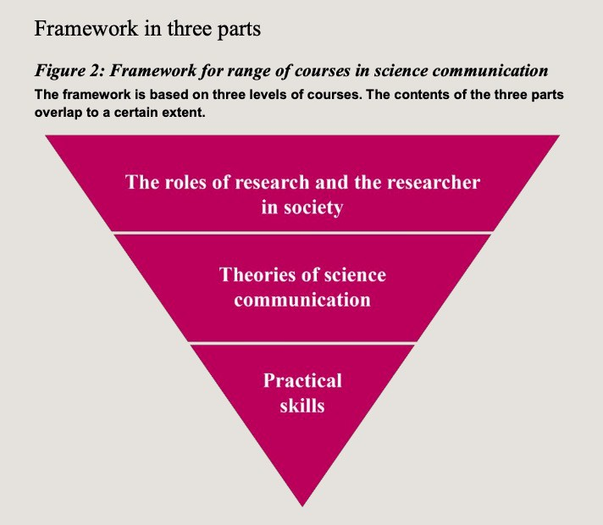
Further reading
Communicating research – tips and advice. VR.se
Framework for courses in science communication. VR.se
Events and websites focusing on science communication. VR.se
Verktygslåda för forskningskommunikation (Swe). V&A
Framework for courses in science communication (VR.se)

Slide 16
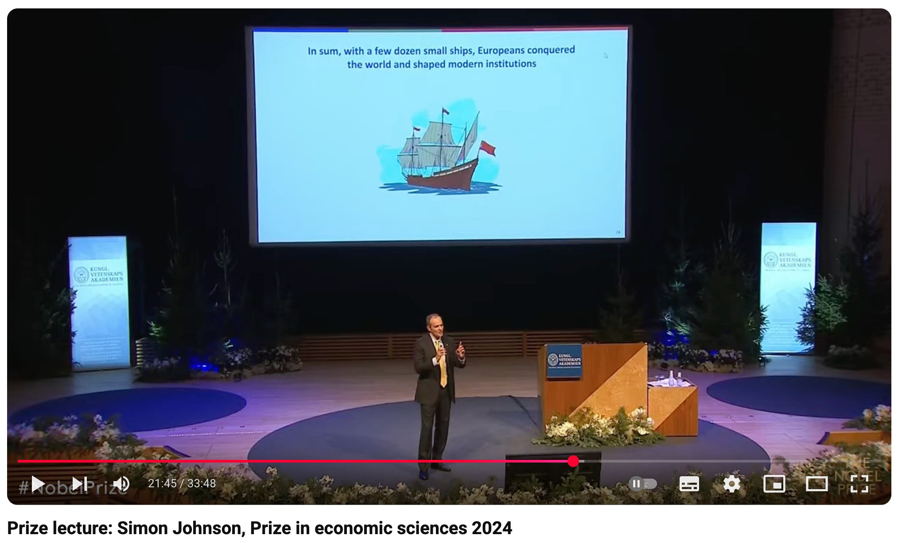
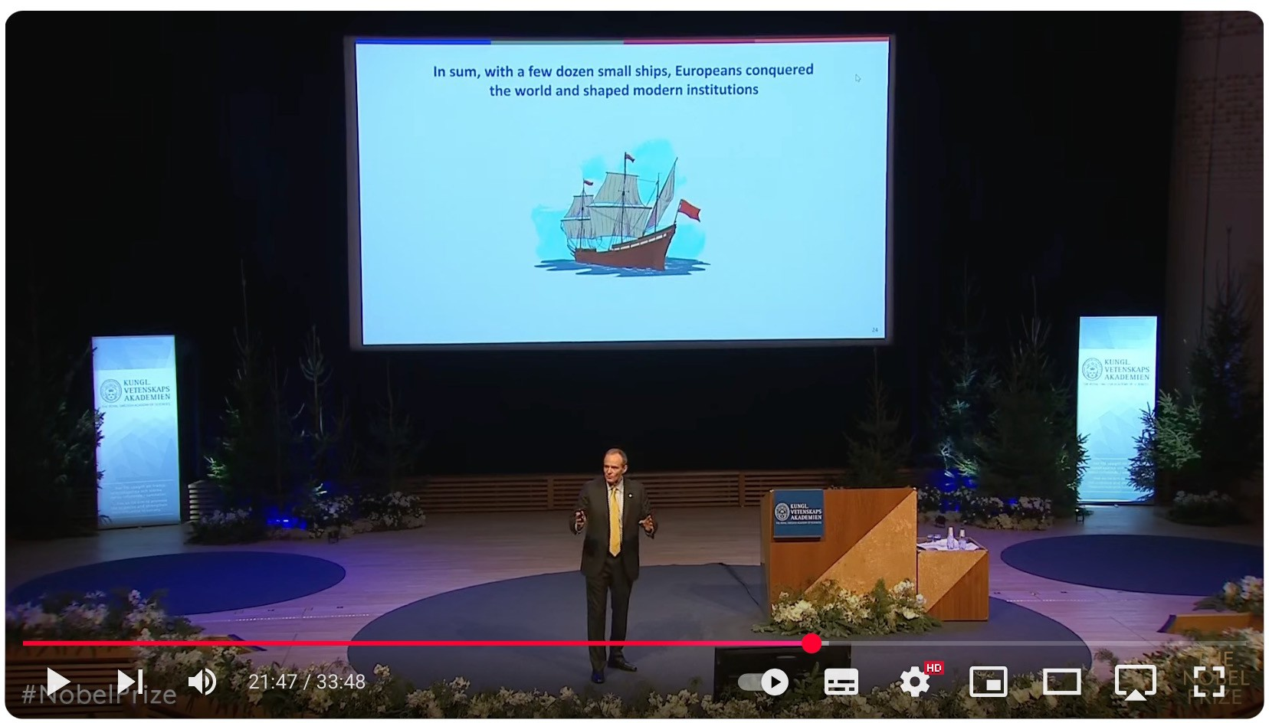
…and watching
E.g. Simon Johnson, The Sveriges Riksbank Prize in Economic Sciences in Memory of Alfred Nobel 2024 (one of three recipients).
Prize lecture, Dec. 8 2024: ”Disease Environments, the Mortality of Europeans, and the Creation of Institutions in the Colonial Era”
https://www.youtube.com/watch?v=iBwuEt3DqoI

Slide 17
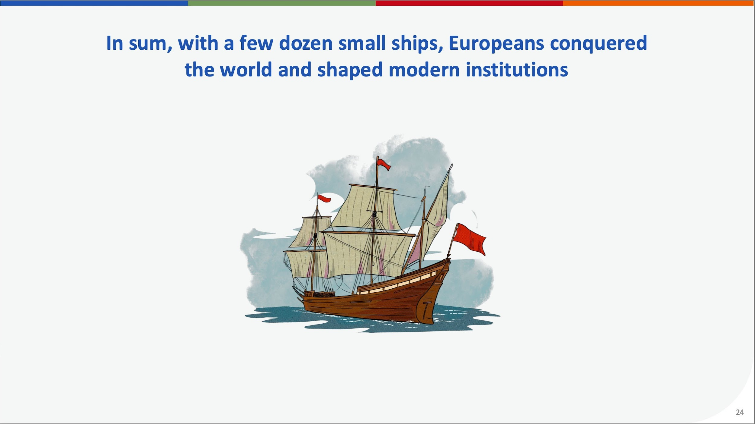
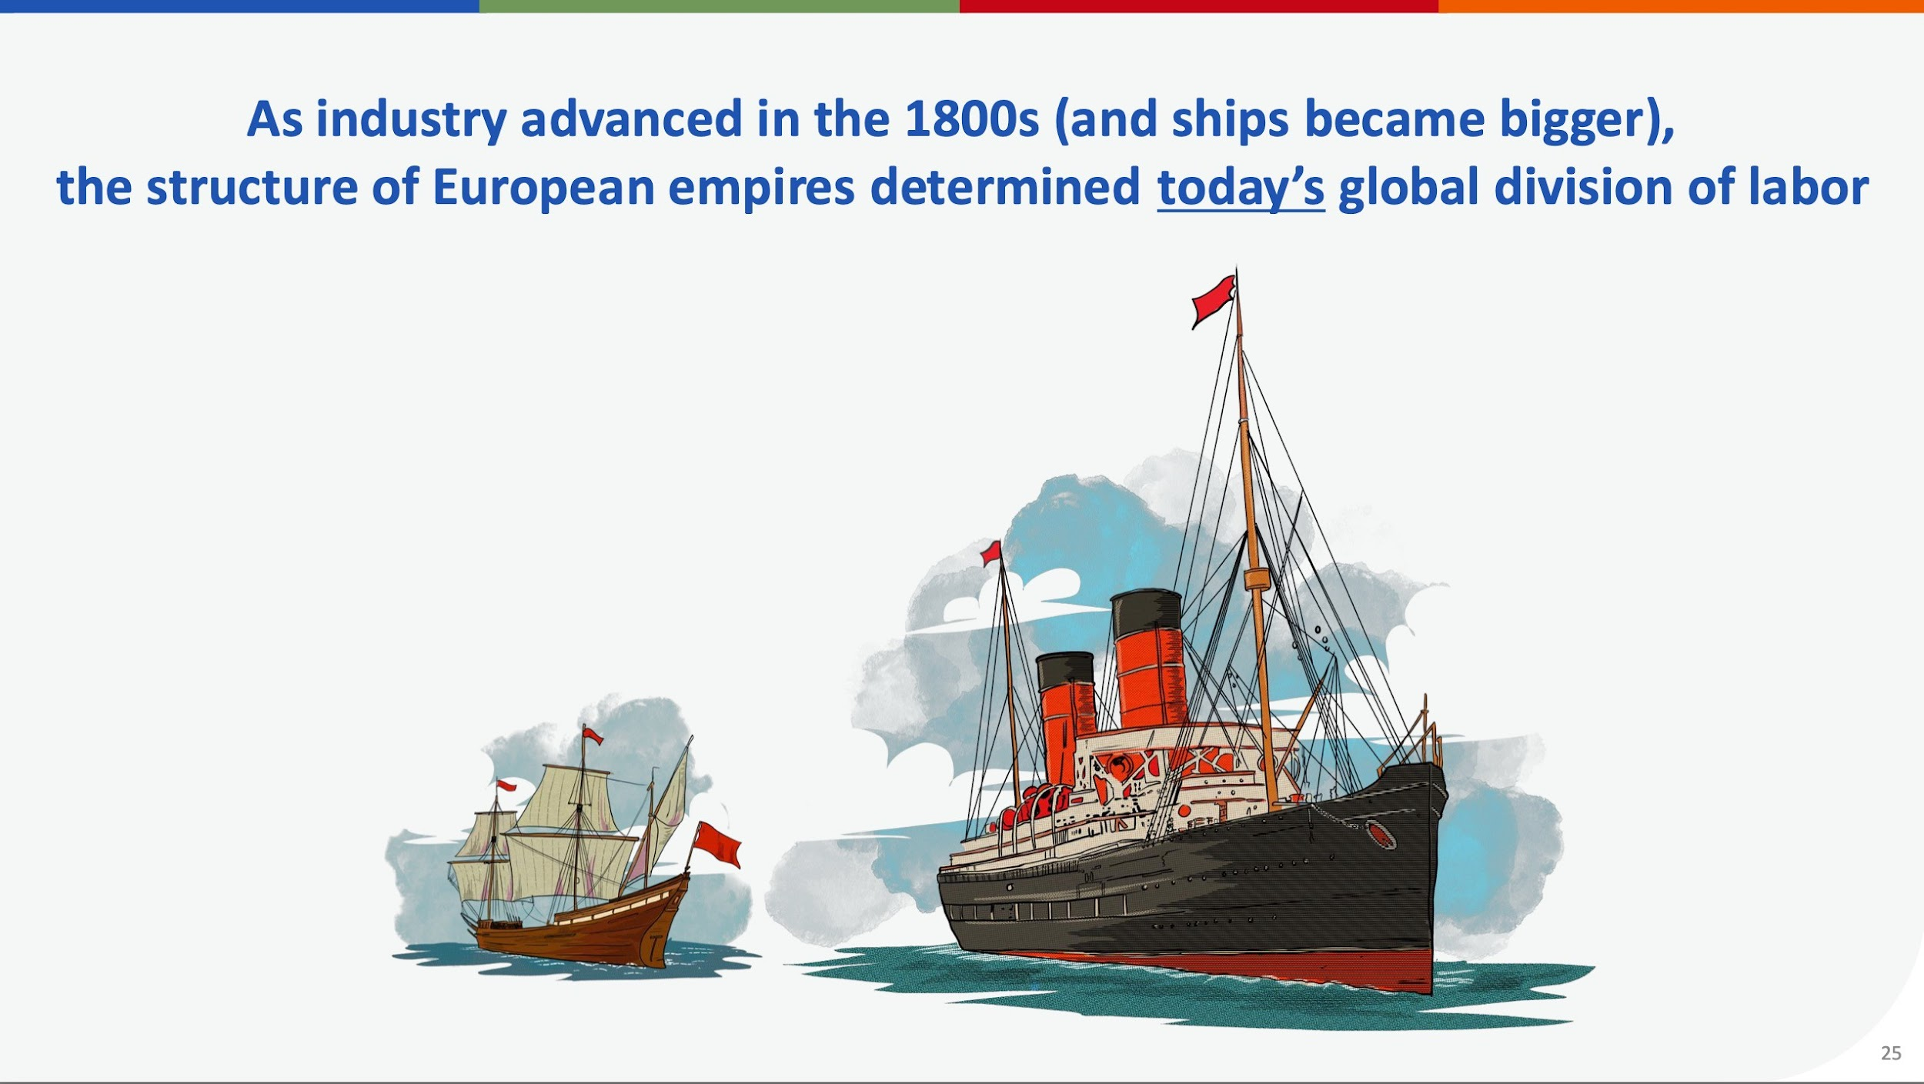

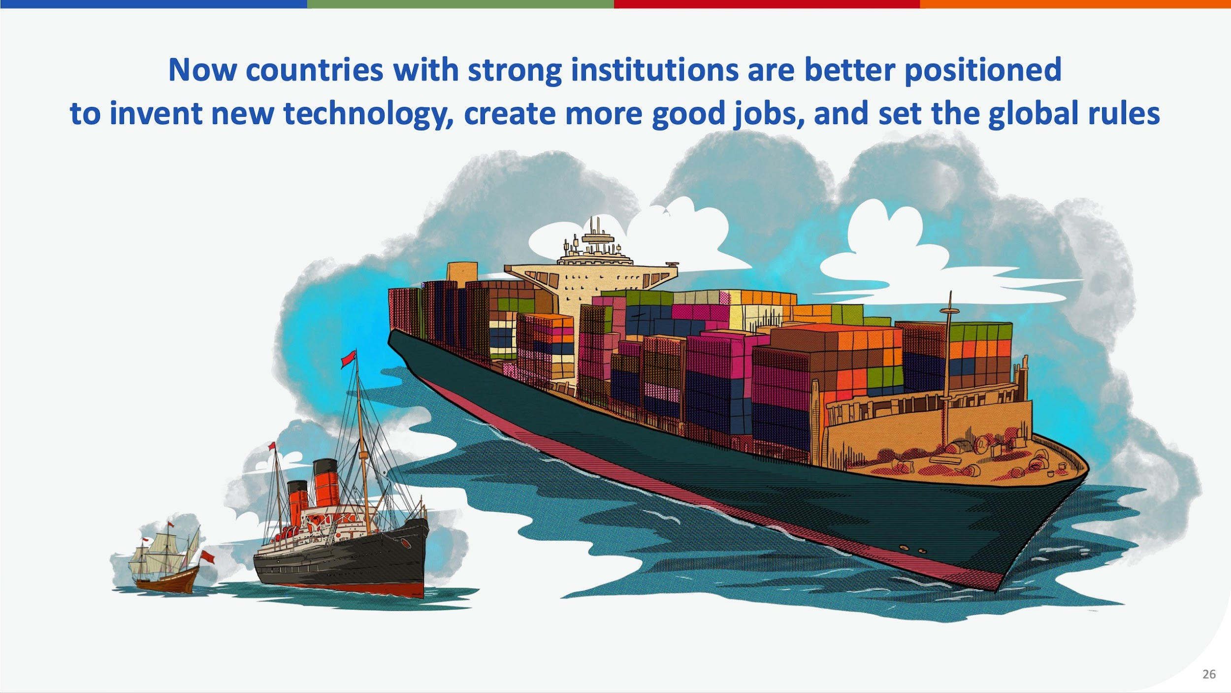
Source: Simon Johnson – Prize lecture. NobelPrize.org. Nobel Prize Outreach (May 2, 2025).

Slide 18
The Elevator Pitch
Create an Elevator Pitch about 1) your own research, or 2) research you are involved with, e.g. at your work place, or 3) research you are very interested in.
Rules:
The pitch should last no longer than 60 seconds, preferably less.
Your audience are an Attentive public, i.e. people already interested in (and reasonably well-informed about) science and scientific activities.
Use simple language, no scientific jargon.
Remember, the Elevator Pitch is the BEGINNING of a conversation. Your task is to make your audience interested enough to ask questions.

Slide 19
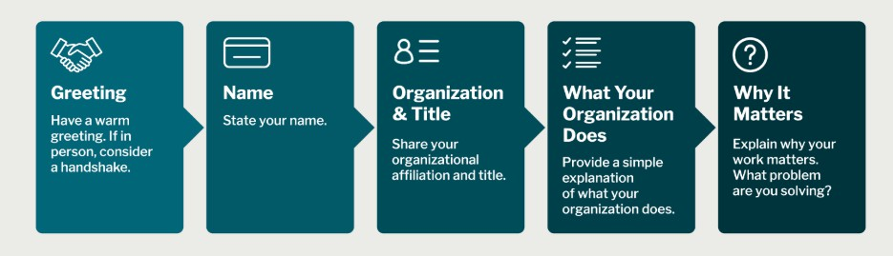
Crafting a strong elevator pitch
The Basic Formula
Greeting: Have a warm greeting. If in person, consider a handshake.
Name: State your name.
Organization and title: Share your organizational affiliation and title.
What your organization does: Provide a simple explanation of the research.
Why it matters: Explain this. What problem are you/your organization solving?
For more advice, see Elevator Pitches (Catalyst.Harvard.edu)

Slide 20
The Pitch Pattern
0-15 sec: Introduce yourself and your idea in a few words
15–35 sec: Expand on the idea with information on the problem it solves or the need it meets.
35–50 sec: Specify what sets you apart from others, and explain why your idea is guaranteed to succeed.
50–60 sec: Repeat the strong point of your idea and leave the door open for questions for more information.

Slide 21
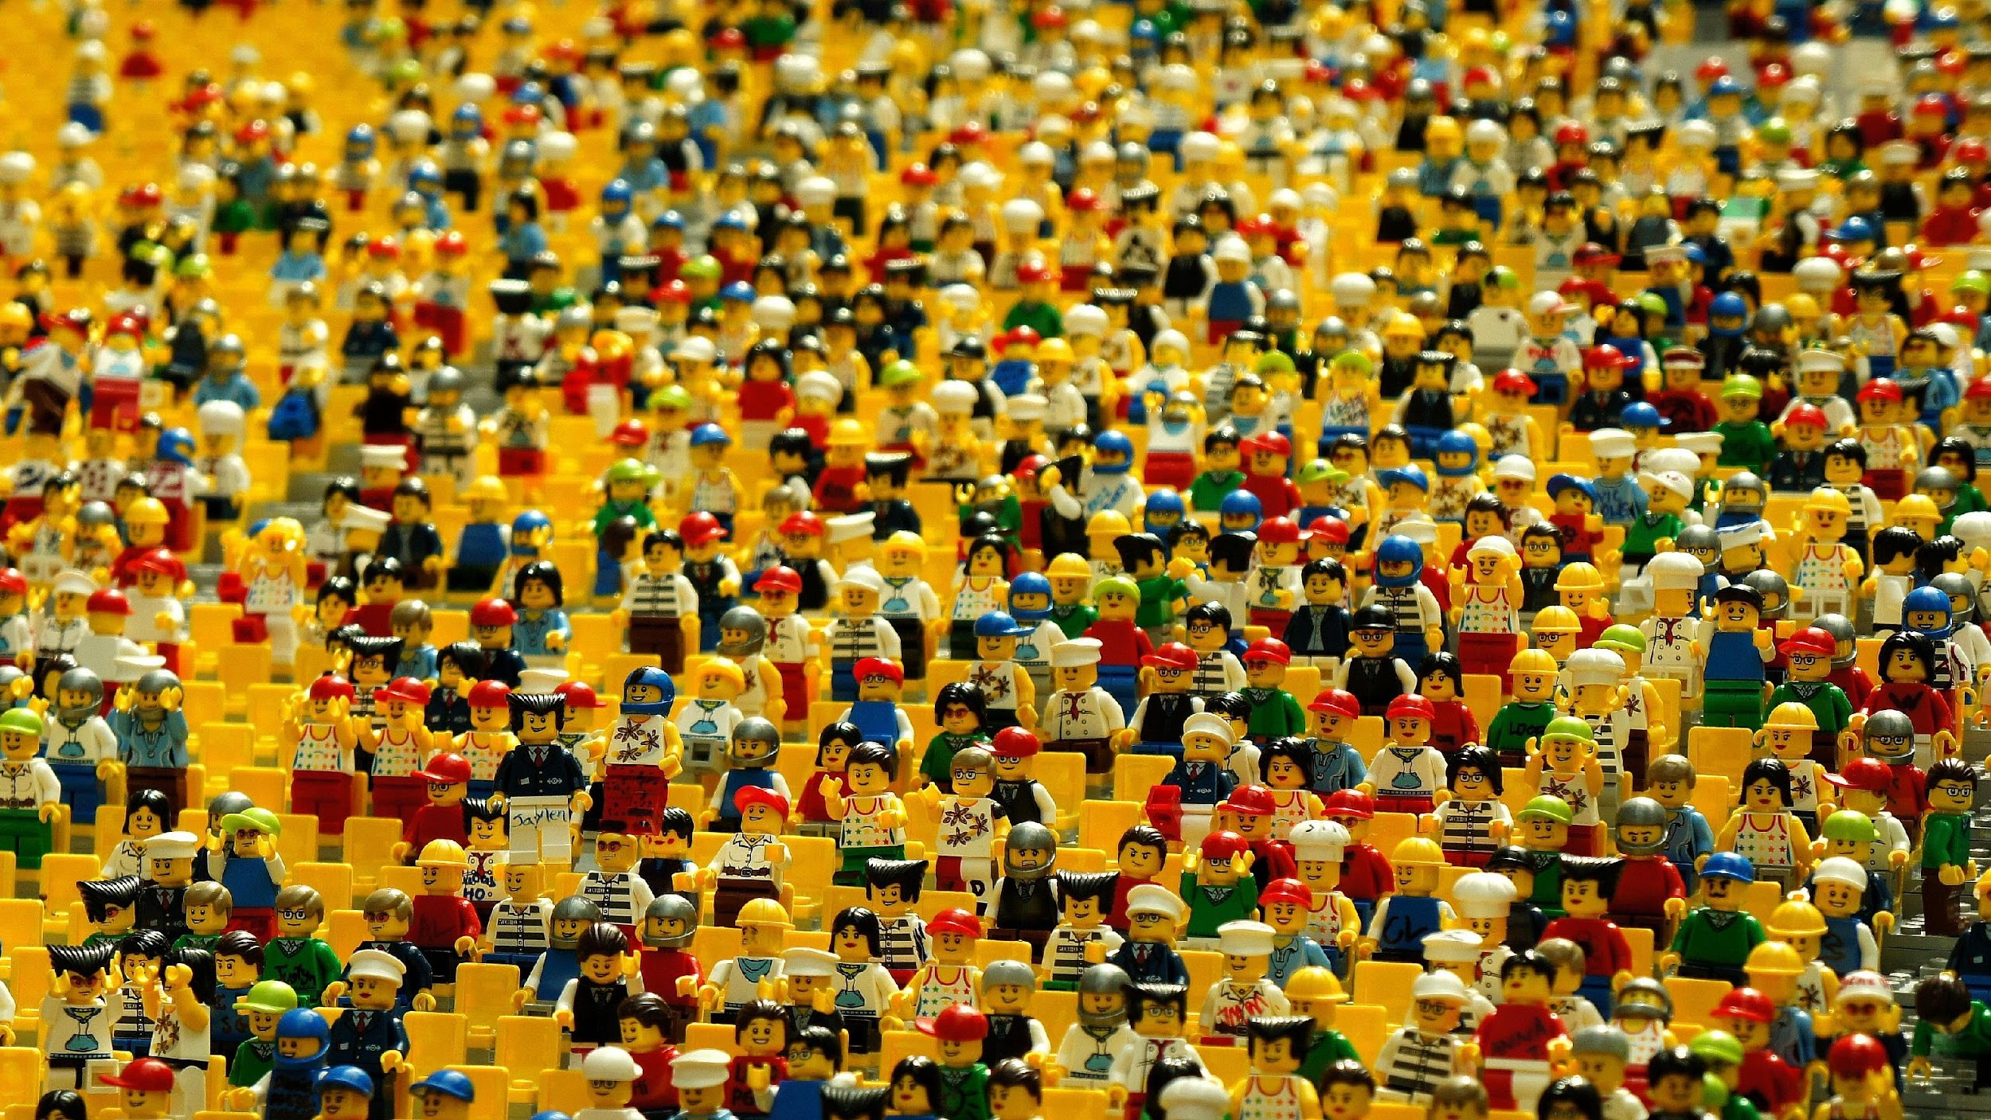
GOOD LUCK!
karin.tikkanen@snd.se

