Slide 1
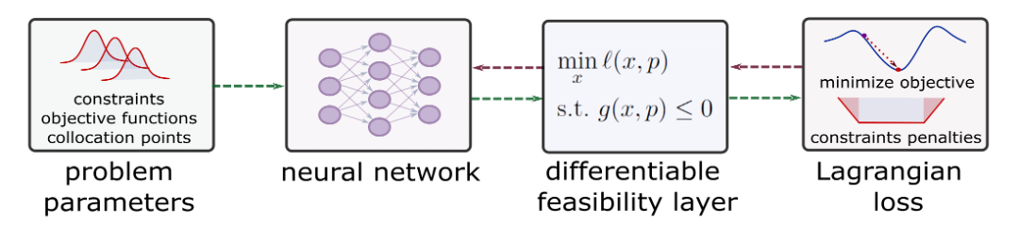
SciML Tutorial: Learning to Optimize (L2O)
Truong X. Nghiem
Associate Professor Department of Electrical and Computer Engineering
Department of Computer Science (secondary)
School of Modeling, Simulation, and Training (secondary)
College of Engineering and Computer Science University of Central Florida
8th Annual Learning for Dynamics & Control Conference University of Southern California, June 17

Slide 2
Objective
The tutorial will show …
What is Learning to Optimize (L2O)? What problem does it solve?
What are major L2O approaches?
Some L2O methods
Demonstrations of two L2O methods for real optimization examples, using Neuromancer and JAX

Slide 3



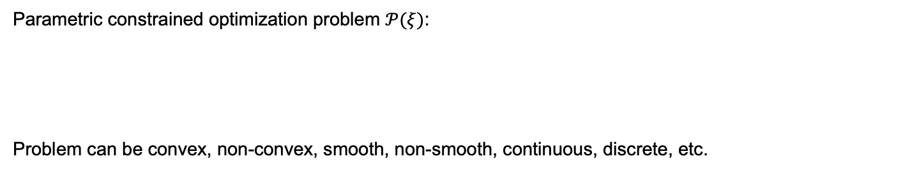



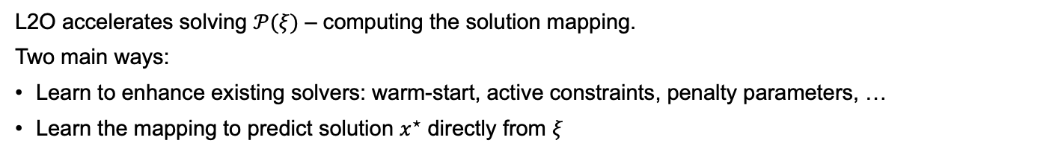
L2O learns to solve parametric optimization
Parametric constrained optimization problem $𝒫(ξ)$:
Problem can be convex, non-convex, smooth, non-smooth, continuous, discrete, etc.
Many applications in control, planning, scheduling, etc.
$ξ∈Ξ$ is instance parameter
Solving $𝒫(ξ)$ for an optimal solution $x^{⋆}$ is essentially a mapping $π^{⋆}:Ξ→X$ that maps $ξ$ to $x^{⋆}$
$$ξ$$
Solve $𝒫(ξ)$
$$x^{⋆}$$
Often computationally expensive, esp. for time-critical applications
L2O accelerates solving $𝒫(ξ)$ – computing the solution mapping.
Two main ways:
Learn to enhance existing solvers: warm-start, active constraints, penalty parameters, …
Learn the mapping to predict solution $x^{⋆}$ directly from $ξ$

Slide 4
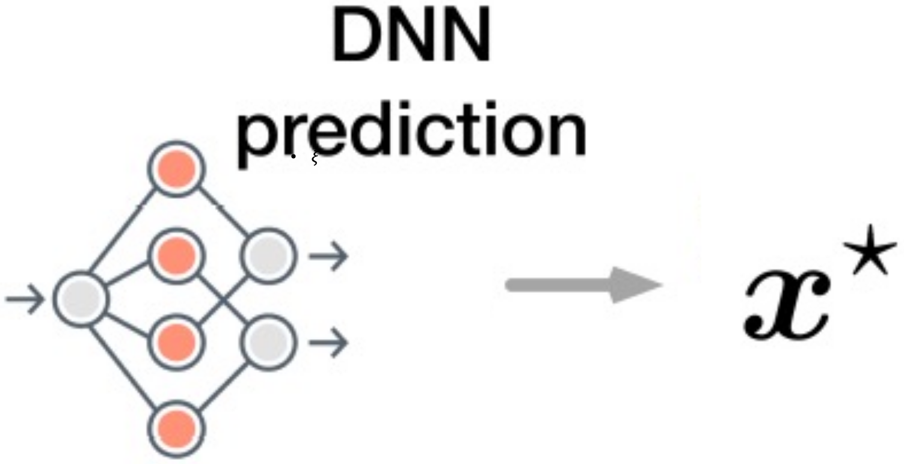
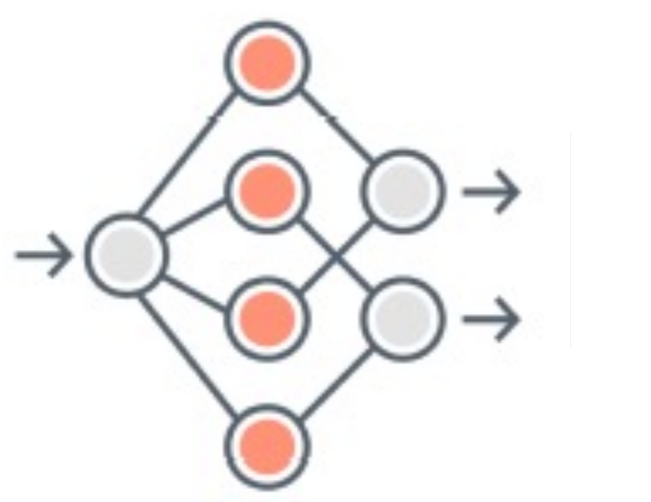
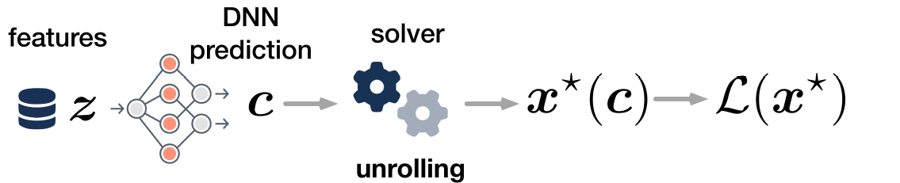

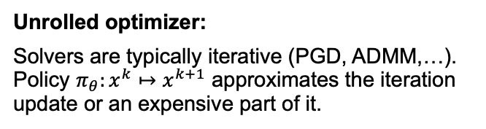

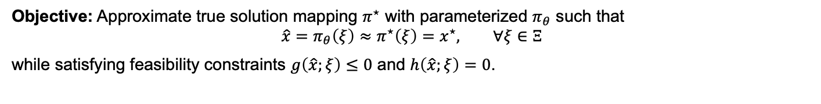

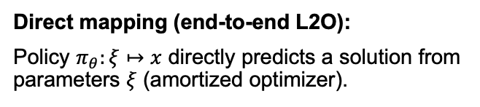





How does L2O learn to solve?
Objective: Approximate true solution mapping $π^{⋆}$ with parameterized $π_{θ}$ such that
$$\hat{x}={π_{θ}\left(ξ\right)≈π}^{⋆}\left(ξ\right)=x^{⋆}, ∀ξ∈Ξ$$
while satisfying feasibility constraints $g\left(\hat{x};ξ\right)≤0$ and $h\left(\hat{x};ξ\right)=0$.
Direct mapping (end-to-end L2O):
Policy $π_{θ}:ξ↦x$ directly predicts a solution from parameters $ξ$ (amortized optimizer).
$$={π_{θ}\left(ξ\right)≈π}^{⋆}\left(ξ\right)$$
$$ξ$$
Unrolled optimizer:
Solvers are typically iterative (PGD, ADMM,…). Policy $π_{θ}:x^{k}↦x^{k+1}$ approximates the iteration update or an expensive part of it.
$$ξ$$
Iteration
$$x^{k}$$
$$x^{K}≈x^{⋆}$$
$$x^{0}$$
$$x^{k}$$
$$x^{k+1}$$
Hybrid design:
Combine direct mapping with an unrolled iterative update/refinement procedure.
J. Kotary et al., Backpropagation of Unrolled Solvers with Folded Optimization, IJCAI, 2023

Slide 5

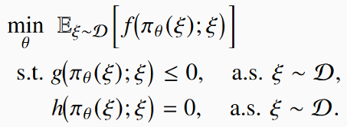
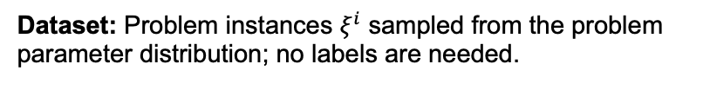
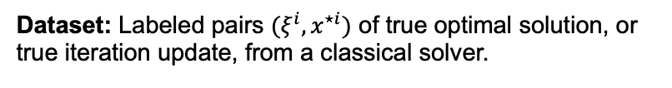
Supervised vs Self-Supervised L2O
Supervised L2O minimizes the expected prediction error w.r.t. optimal solution by classical solver.
Loss function:
Dataset: Labeled pairs $(ξ^{i},x^{⋆i})$ of true optimal solution, or true iteration update, from a classical solver.
Self-supervised L2O minimizes the expected objective subject to constraints.
Loss function:
Dataset: Problem instances $ξ^{i}$ sampled from the problem parameter distribution; no labels are needed.

Slide 6
Differentiable Optimization
Differentiable optimization layers expose the sensitivity of optimization solutions to parameters, enabling end-to-end learning with an optimization problem inside the computation graph.
Two ways of differentiating through optimization program:
Fixed-point differentiation, based on either unrolling iterative solvers (backpropagation through time) or applying the implicit function theorem (IFT) at a fixed point.
KKT-based differentiation, which differentiates the Karush–Kuhn–Tucker (KKT) optimality system directly using IFT.
Brandon Amos, J. Zico Kolter, OptNet: Differentiable Optimization as a Layer in Neural Networks, ICML, 2017
Agrawal, A. and Amos, B. and Barratt, S. and Boyd, S. and Diamond, S. and Kolter, Z., Differentiable Convex Optimization Layers, NeurIPS 2019
James Kotary, My H. Dinh, Ferdinando Fioretto, Backpropagation of Unrolled Solvers with Folded Optimization, IJCAI, 2023
Quill Healey, Parth Nobel, Stephen Boyd, Differentiating Through a Quadratic Cone Program, 2025
https://implicit-layers-tutorial.org/differentiable_optimization/

Slide 7


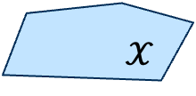

End-to-end L2O: Feasibility
End-to-end (direct mapping) L2O often returns infeasible solution that violates constraints.
Feasibility Restoration Layer restores feasibility by an operator $x^{⋆}=ℱ\left(\hat{x}\right)$ that maps infeasible $\hat{x}∉𝒳$ to a feasible or approximately feasible $x^{⋆}∈𝒳$.
$$\hat{x}$$
$$ξ$$
$𝒳$

Slide 8
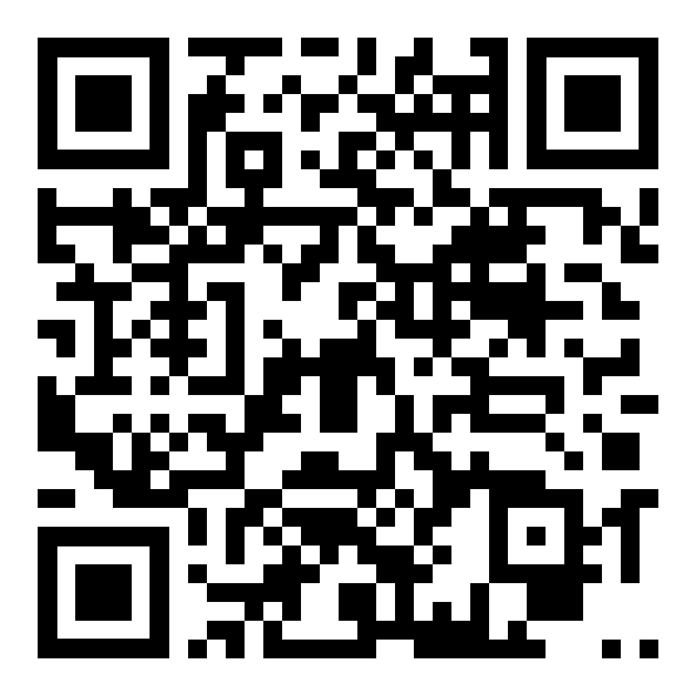
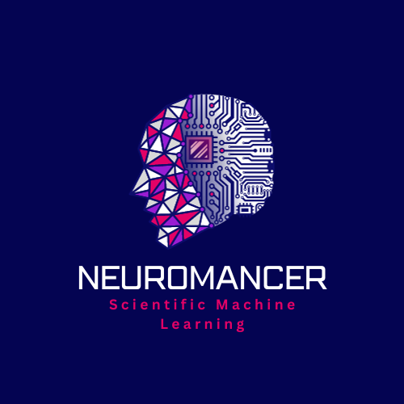
L2O Example in NeuroMANCER SciML Library
https://colab.research.google.com/github/SciML-L4DC2026/SciML-L4DC2026/blob/main/notebooks/L2O/Example_1_DC3/Example_1_DC3.ipynb
sciml-l4dc2026.github.io/SciML-L4DC2026
github.com/pnnl/neuromancer

Slide 9


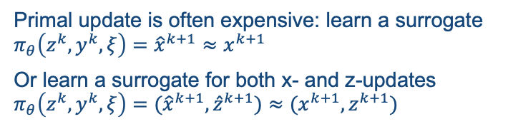
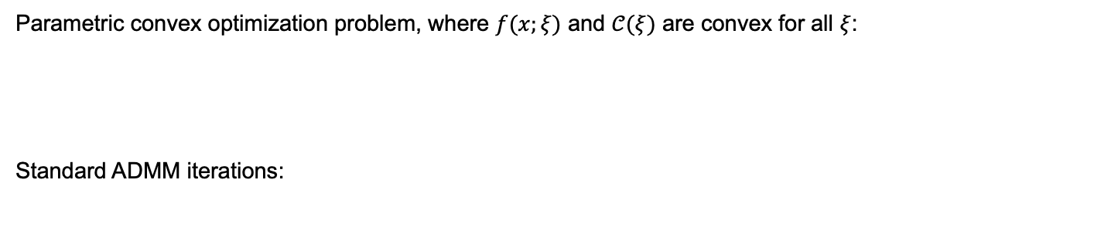



Basic Unrolled L2O for ADMM
Parametric convex optimization problem, where $f(x;ξ)$ and $𝒞(ξ)$ are convex for all $ξ$:
Standard ADMM iterations:
Primal update is often expensive: learn a surrogate $π_{θ}\left(z^{k},y^{k},ξ\right)={\hat{x}}^{k+1}≈x^{k+1}$
Or learn a surrogate for both x- and z-updates $π_{θ}\left(z^{k},y^{k},ξ\right)=({\hat{x}}^{k+1},{\hat{z}}^{k+1})≈(x^{k+1},z^{k+1})$
$$z^{k}$$
$$y^{k}$$
Primal update (x-update)
$$x^{k+1}$$
Advantages:
Learning an update step (proximal operator) is simpler than learning the optimal solution.
Feasibility via z-update
Challenges: convergence, error propagation
ADMM-unrolled L2O:
Auxiliary update (z-update)
$$z^{k+1}$$
Dual update (y-update)
$$y^{k+1}$$

Slide 10

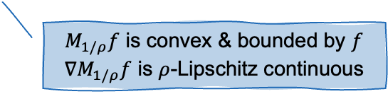
Learning Moreau Envelope Framework (LEAF)
Parametric convex optimization problem:
Primal update in ADMM-unrolled L2O:
vector output, no structure
Moreau envelope = optimal objective:
Learn surrogate $π_{θ}^{M}\left(z\right)≈M_{1/ρ}f(z)$
Scalar output
ICNN to enforce convexity & Lipschitz
Boundedness
$M_{1/ρ}f$ is convex & bounded by $f$
$∇M_{1/ρ}f$ is $ρ$-Lipschitz continuous
B. Nguyen et al., “LEAF: A learning-enabled ADMM framework for accelerated convex optimization,” 2026

Slide 11
Hard-Constrained Unrolled ADMM (HUANet)
Unroll ADMM iterations into NN with KKT optimality conditions, trained with self-supervised learning.
Self-supervised training loss:
Dual estimates for primal KKT optimality conditions
Optimal objective
Primal KKT residuals
T. Tran, et al., “HUANet: Hard-Constrained Unrolled ADMM for Constrained Convex Optimization,” 2026.

Slide 12
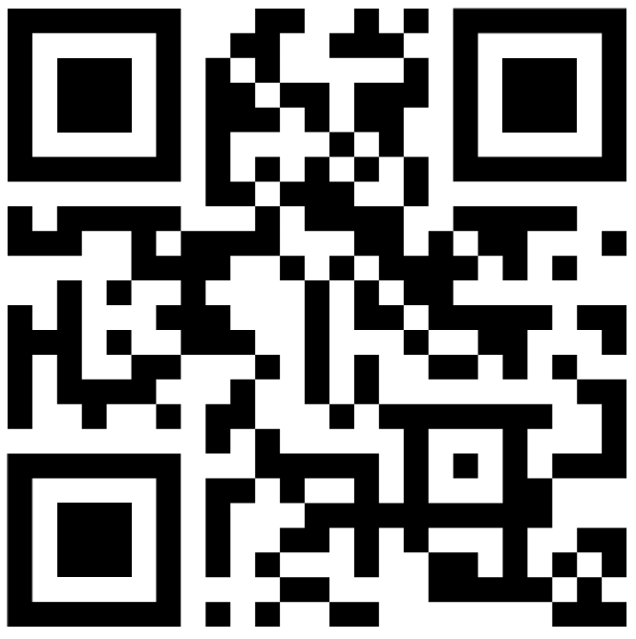
HUANet Example in Python + JAX
https://colab.research.google.com/github/SciML-L4DC2026/SciML-L4DC2026/blob/main/notebooks/L2O/Example_2_HUANet/HUANet_entropy.ipynb

Slide 13
Learning to Optimize (L2O) Summary
L2O via learning entire or part of solving optimization problem
Learns direct mapping to predict solution from parameters, with differentiable feasibility restoration layer.
Unrolls optimizer to learn iteration or an expensive part of it.
Supervise & self-supervised training.
Shifts computational burden offline, enabling fast optimization online.
Challenges
Feasibility & feasibility restoration
Optimality gap
Convergence (for unrolled L2O)
Links:
More L2O examples: https://github.com/pnnl/neuromancer
PIMLXplore: https://pimlxplore.nxtlab.org/
Hiring in SciML!!! nxt@ucf.edu https://nxtlab.org/

