Slide 1
Graph VAE for self-supervised GRN edge inference

Slide 2
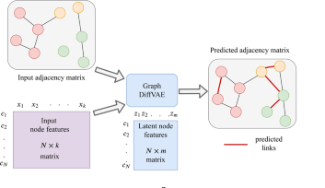
Progress
Changed reLU activation to leaky reLU
Added gradient (norm) clipping
Used all cell expression values as node features (126)
Trained with 25% of known edges
12 hidden layer features, 3 latent space features

Slide 3
Confusion Matrix Training Set
 | Actual: Edge | Actual: No Edge
Predicted: Edge | 549 | 639.194 | 639.743
Predicted: No Edge | 34 | 1.256.352 | 1.256.386
 | 583 | 1.893.797
Accuracy: 66%
FDR: 99,9%
Sensitivity: 94%
Specificity: 66%
Precision: 0,086%

Slide 4
Confusion Matrix Test Set
 | Actual: Edge | Actual: No Edge
Predicted: Edge | 523 | 638.671 | 639.194
Predicted: No Edge | 1.226 | 1.255.126 | 1.256.352
 | 1.749 | 1.893.797
Accuracy: 66%
FDR: 99,9%
Sensitivity: 30%
Specificity: 66%
Precision: 0,082%
Random Guesser with same amount of edges (639.194):
Probability of choosing correct edge: 0,092%
Expected value: 590 edges

Slide 5
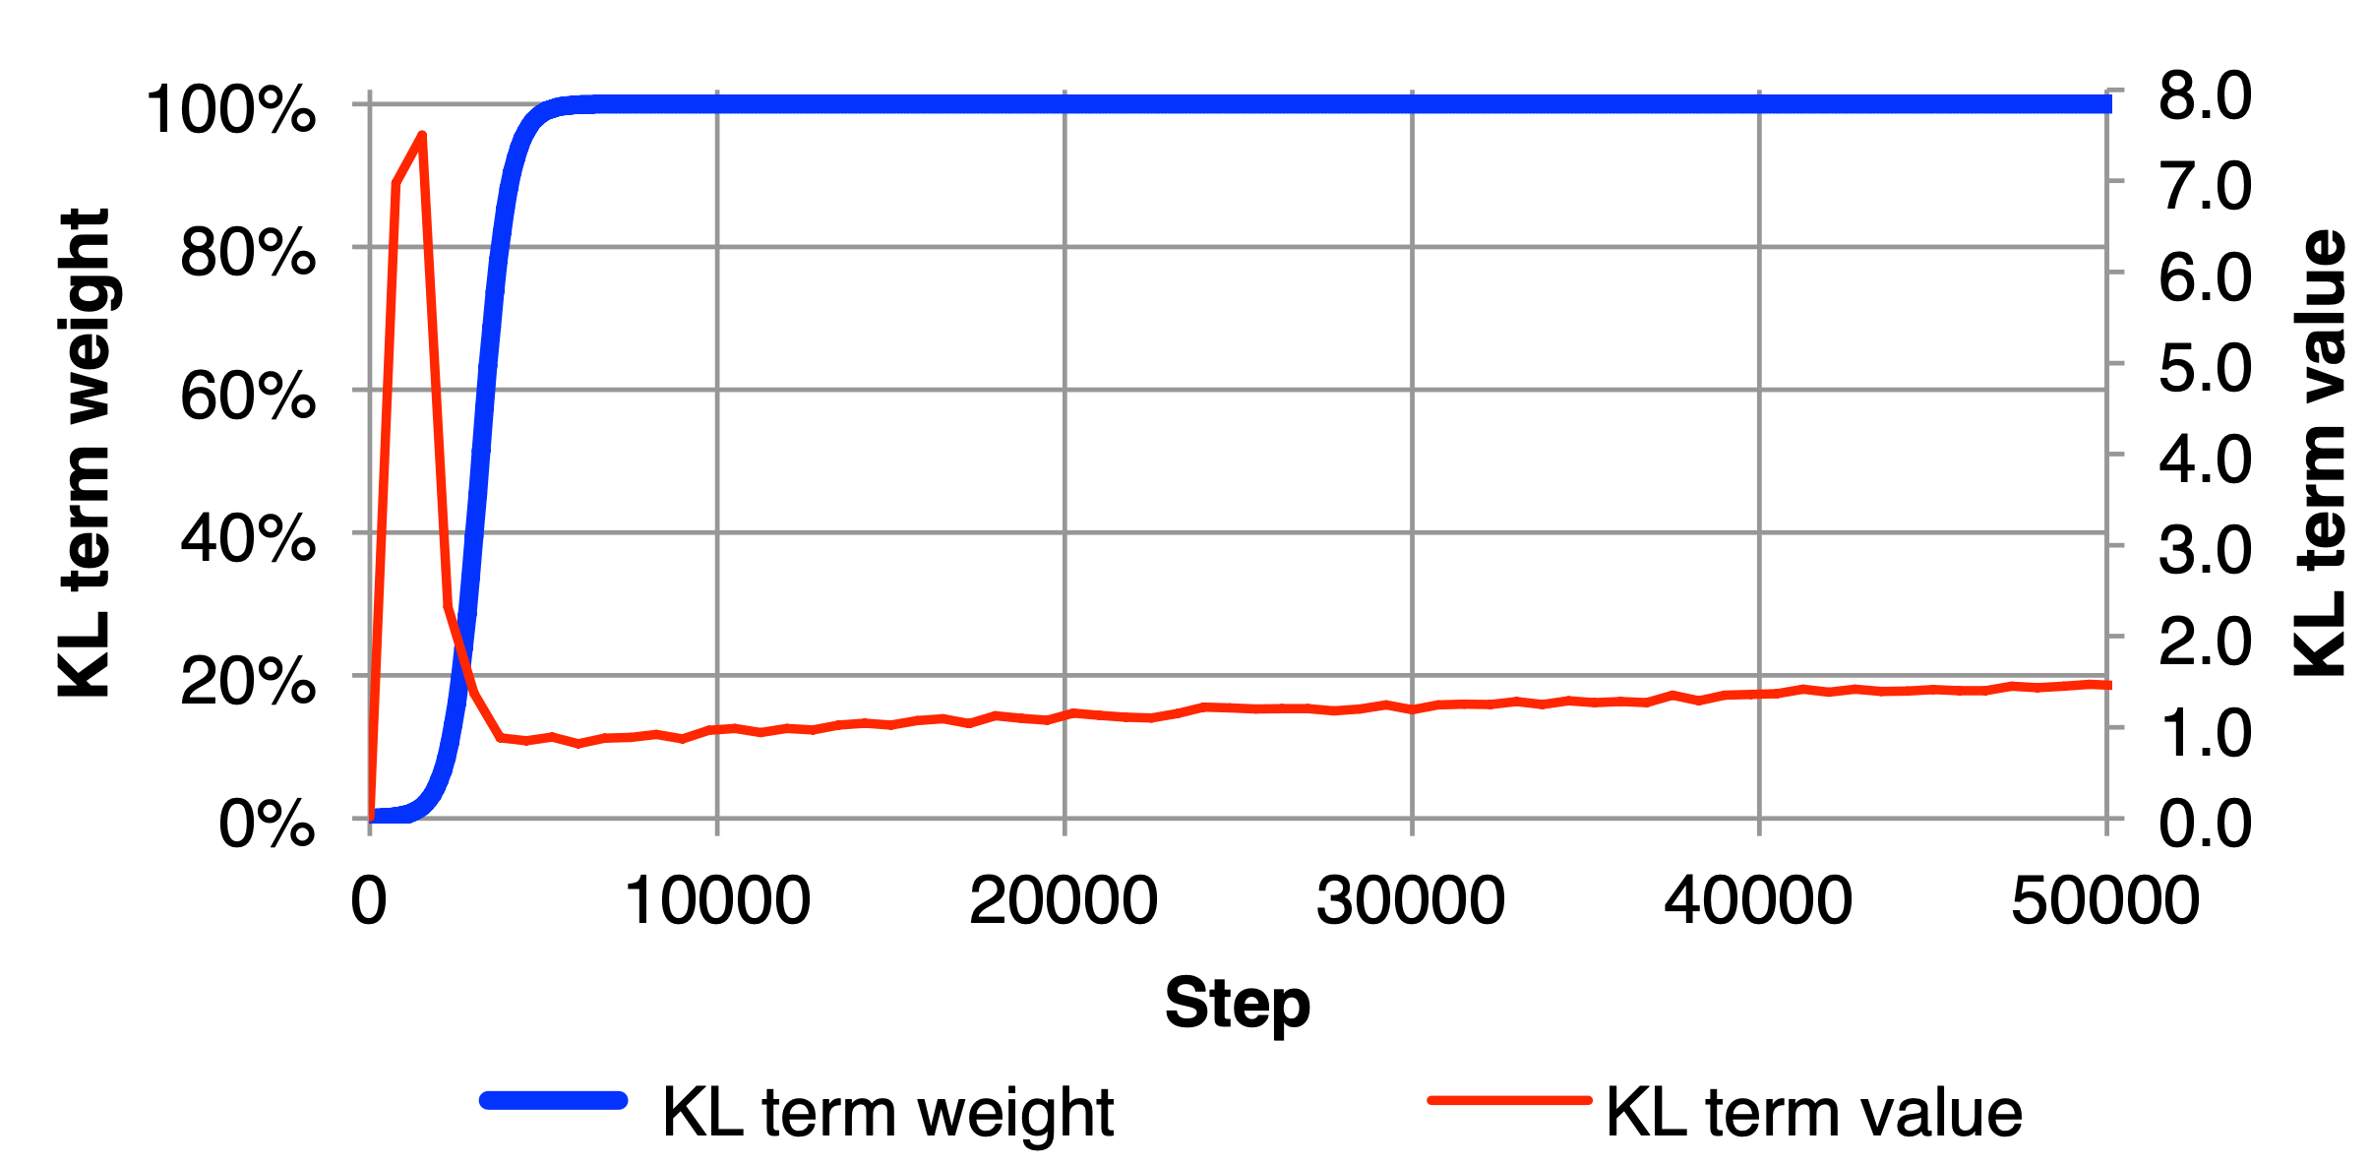
Further changes
Trained with multilabel binary cross entropy loss → almost all predictions around 0.5
Implemented warmup function of KL loss (Sønderby et al 2016, Bowman et al 2016)

Slide 6
Further changes
Stabilized training (reduced exploding gradients by initializing variance layer to 0)
Added option to choose best model during training
Track metrics during training (Total loss / KL loss / Recon loss)
Added evaluation script (AUC)

Slide 7
Without KL loss (training set)
 | Actual: Edge | Actual: No Edge
Predicted: Edge | 583 | 1.364.266
Predicted: No Edge | 0 | 531.280
 | 583 | 1.893.797
Accuracy: 28.05%
FDR: 99,96%
Sensitivity: 100%
Specificity: 28.03%
Precision: 0,04%

Slide 8
Without KL loss (test set)
 | Actual: Edge | Actual: No Edge
Predicted: Edge | 1407 | 1.362.859
Predicted: No Edge | 342 | 530.938
 | 1.749 | 1.893.797
Accuracy: 28.08%
FDR: 99,9%
Sensitivity: 80.45%
Specificity: 28.04%
Precision: 0.1 %
Random Guesser with same amount of edges (1.362.859):
Probability of choosing correct edge: 0,092%
Expected value: 1253 edges

Slide 9
Hyperparameter optimization
Symmetric vs asymmetric adjacency matrix → 2
Binary vs categorical cross entropy vs f1 loss → 3
Diagonal 0 or 1 → 2
Train with different graphs (each cell / subgraphs) or one graph → 3
Nr. of hidden dimensions
Nr. of latent dimensions
% of edges used for training
Learning rate
KL-divergence weigth (+warmup)
Sparsity of input
Node features
Batch size

Slide 10
Ideas
Graph Clustering afterwards?
Incorporate known NOT existing edges
How to deal with unbalanced data set? (No negative edges) → Try to restrict graph topology by including restrictions to loss function? Gao et. al 2019

