Slide 1
Graph VAE for self-supervised GRN edge inference

Slide 2
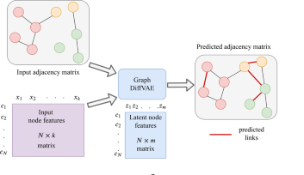
Progress
Changed reLU activation to leaky reLU
Added gradient (norm) clipping
Used all cell expression values as node features (126)
Trained with 25% of known edges
12 hidden layer features, 3 latent space features

Slide 3
Confusion Matrix Training Set
 | Actual: Edge | Actual: No Edge
Predicted: Edge | 549 | 639.194 | 639.743
Predicted: No Edge | 34 | 1.256.352 | 1.256.386
 | 583 | 1.893.797
Accuracy: 66%
FDR: 99,9%
Sensitivity: 94%
Specificity: 66%
Precision: 0,086%

Slide 4
Confusion Matrix Test Set
 | Actual: Edge | Actual: No Edge
Predicted: Edge | 523 | 638.671 | 639.194
Predicted: No Edge | 1.226 | 1.255.126 | 1.256.352
 | 1.749 | 1.893.797
Accuracy: 66%
FDR: 99,9%
Sensitivity: 30%
Specificity: 66%
Precision: 0,082%
Random Guesser with same amount of edges (639.194):
Probability of choosing correct edge: 0,092%
Expected value: 590 edges

Slide 5
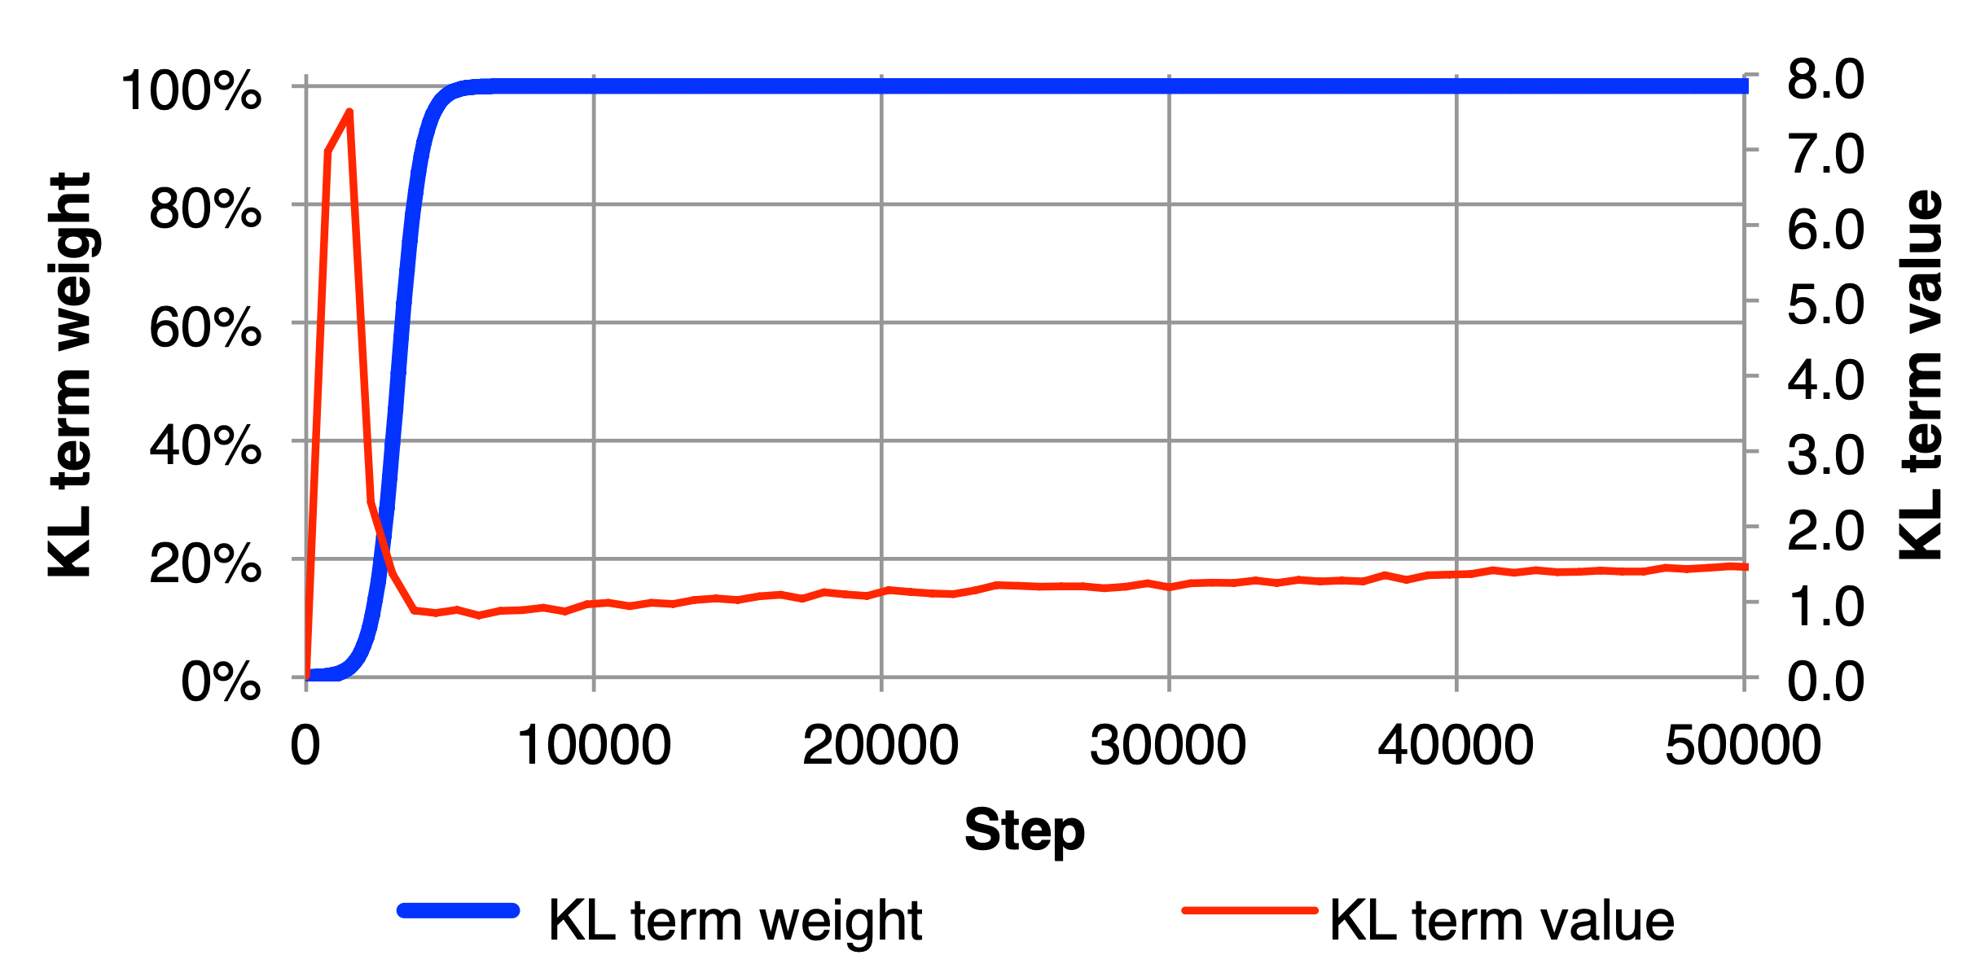
Further changes
Trained with multilabel binary cross entropy loss → almost all predictions around 0.5
Implemented warmup function of KL loss (Sønderby et al 2016, Bowman et al 2016)

Slide 6
Further changes
Stabilized training (reduced exploding gradients by initializing variance layer to 0)
Added option to choose best model during training
Track metrics during training (Total loss / KL loss / Recon loss)
Added evaluation script (AUC)

Slide 7
Without KL loss (training set)
 | Actual: Edge | Actual: No Edge
Predicted: Edge | 583 | 1.364.266
Predicted: No Edge | 0 | 531.280
 | 583 | 1.893.797
Accuracy: 28.05%
FDR: 99,96%
Sensitivity: 100%
Specificity: 28.03%
Precision: 0,04%

Slide 8
Without KL loss (test set)
 | Actual: Edge | Actual: No Edge
Predicted: Edge | 1407 | 1.362.859
Predicted: No Edge | 342 | 530.938
 | 1.749 | 1.893.797
Accuracy: 28.08%
FDR: 99,9%
Sensitivity: 80.45%
Specificity: 28.04%
Precision: 0.1 %
Random Guesser with same amount of edges (1.362.859):
Probability of choosing correct edge: 0,092%
Expected value: 1253 edges

Slide 9
Hyperparameter optimization
Symmetric vs asymmetric adjacency matrix → 2
Binary vs categorical cross entropy vs f1 loss → 3
Diagonal 0 or 1 → 2
Train with different graphs (each cell / subgraphs) or one graph → 3
removal of isolated nodes (Sparsity of input) → 2
Nr. of hidden dimensions
Nr. of hidden layers
Nr. of latent dimensions
% of edges used for training
Learning rate
KL-divergence weigth (+warmup)
Node features
Batch size
Cross validation
Evaluation (directed vs undirected)

Slide 10
Ideas
Graph Clustering afterwards?
Incorporate known NOT existing edges
How to deal with unbalanced data set? (No negative edges) → Try to restrict graph topology by including restrictions to loss function? Gao et. al 2019

