Slide 1
Historic Programming Languages
Fortgeschrittene Programmierkonzepte
Sandro, Toygun, Tufan

Slide 2
Konzept für ein Anfang folgt

Slide 3
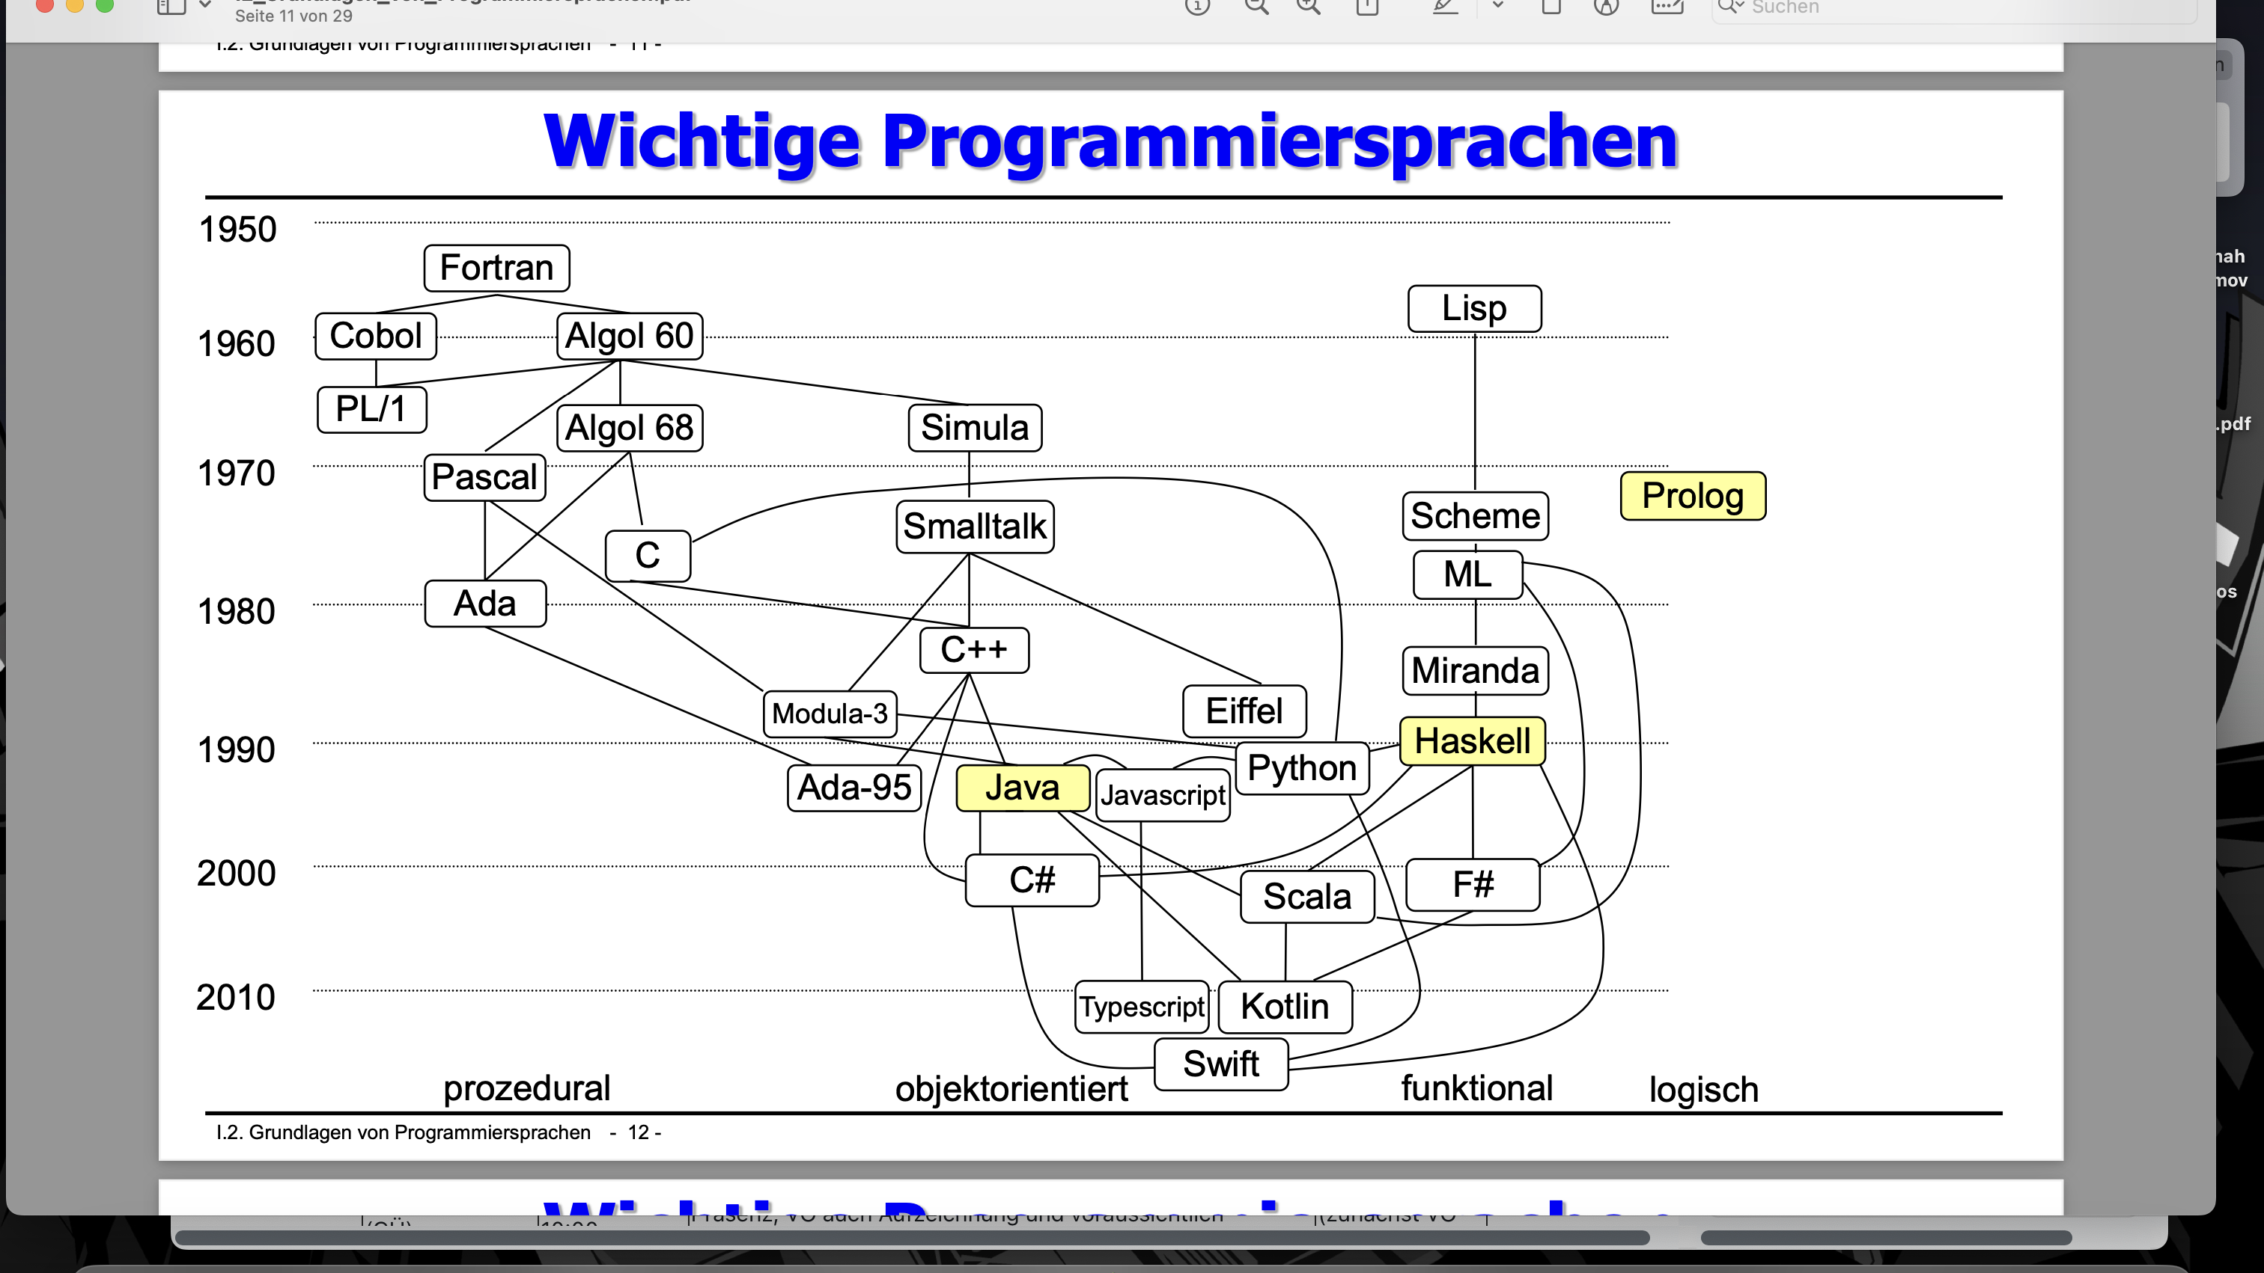
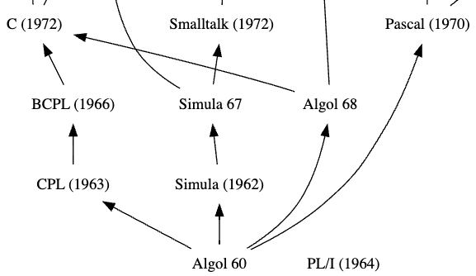

Slide 4
FORTRAN
Notes:
Hi, my name is Sandro and check this out!

Slide 5
FORTRAN (FORmula TRANslation)

Slide 6
FORTRAN
Fortran
Typescript
Java
C#
Python
C
Notes:
What has FORTRAN or also known as Fortran got to do with these programming languages? They all derive from a common ancestor

Slide 7
FORTRAN
Fortran
First version from the 1950s
Multiple newer versions like Fortran 77, 90, 95 or 2003
Latest version in 2018
Next version will be published this year
Files are saved as *.f77, *.f90 etc. or as *.f
Notes:
Since Fortran is still used today, it is still supported. It really is anything, but an old or deprecated programming language. However, we are going to put the main focus on Fortran 90

Slide 8
Invention
Why was it developed?
It was the first High-level programming language
Therefore it was the first, that needed an Compiler
Fortran is a procedural, structured programming language
It should make programming much less difficult
Developed by John W. Backus
Notes:
This increased the readability immensly. Furthermore, the Compiler was aimed at giving the best possible performance

Slide 9
Innovations
Fortran featured many paradigms, which are still found today
Variables and Constants with different data types
Control structures
Subroutines
Operators
(Object oriented programming)
Notes:
declaring and initializing, if then, loops, functions,

Slide 10
Applications
Where can we still find Fortran in today‘s world?
Weather prediction
Medicine
Computational fluid dynamics
Computational chemistry and physics
benchmarking the world‘s fastest supercomputers
Notes:
Fortran is used everywhere, where reliability, stability, and execution speed is crucial.
This implies the following aspects

Slide 11
FORTRAN 90

Slide 12
Syntax

Slide 13
Fortran 90
Syntax
program helloworld
!I am a comment
print *, "Hello World!"
end program helloworld
The compiler ignores me.
Every program has to be inside the program/end program block.
The rest is going to be ignored by the compiler
Line-comments are made with „!“
Output to the console is made with the print command and an asterisk as the first parameter
Capitalization is irrelevant
Notes:
Line comments similar to Java

Slide 14
Fortran 90
Syntax
pRoGRAm helloworld
!I am a comment
PRINT *, "Hello World!"
end pRoGRAm helloworld
The compiler ignores me.
Every program has to be inside the program/end program block.
The rest is going to be ignored by the compiler
Line-comments are made with „!“
Output to the console is made with the print command and an asterisk as the first parameter
Capitalization is irrelevant

Slide 15
Fortran 90
Data Types
Java | Fortran
int | Integer
double | Real
boolean | Logical
char | Character
- | Complex
Notes:
The scentific focus of Fortran becomes clear.

Slide 16
Fortran 90
Variables
program variables
implicit none
integer :: i, j
real :: x
character :: char
logical :: flag
complex :: z
i = 10
char = 'a'
x = 3.14159
flag = .true.
z = (1.0, 2.0)
print *, i, char, x, flag, z
end program variables
Fortran supports automatic type detection
variables must be declared with an „::“
Java‘s initialization of variables is comparable to Fortrans
By giving multiple arguments, Every variable is printed
Notes:
All numbers are real, except for i,j,k,l,m,n, which are integers

Slide 17
Fortran 90
Variables
program variables
implicit none
character(len=4) :: name
read *,name
print *,'Hey, ',name,'!'
end program variables
Strings are realized with characters
Notes:
All numbers are real, except for i,j,k,l,m,n, which are integers

Slide 18
Fortran 90
Variables
program variables
implicit none
character(len=4) :: name
read *,name
print *,'Hey, ',name,'!'
end program variables
Strings are realized with characters
Rick → Hey, Rick!
Johnny → Hey, John!
Tim → Hey, Tim !
Notes:
All numbers are real, except for i,j,k,l,m,n, which are integers

Slide 19
Fortran 90
Operators
Java | Fortran
< | .LT.
<= | .LE.
== | .EQ.
!= | .NE.
>= | .GE.
> | .GT.
Python | Fortran
+ | +
- | -
* | *
/ | /
** | **
+ | //
420 .NE. 69 returns .true.
Fortran hugely impacted modern languages

Slide 20
Fortran 90
Operators
Python | Fortran
and | .AND.
or | .OR.
== | .EQV.
!= | .NEQV.
not | .NOT.
.true. .NEQV. .false. returns .true.

Slide 21
Fortran 90
Control structures
!Fortran:
if ( area .LE. paint) then
print *, 'The area can be painted'
else
print *, 'The area can not be painted'
end if
It is easy to see the similarities between Fortran and Java
The program flow can be easily modified depending on values of variables
//Java:
if (area <= paint) {
System.out.println("The area can be painted");
} else {
System.out.println("The area can not be painted");
}

Slide 22
Fortran 90
Control structures - loops
Fortran
Fortran
integer :: i
do i=1,10
print *, i
end do
integer :: n = 2
do while (n .LE. 100)
print *, n
n = n ** 2
end do
for(int i = 1; i <= 10; i++) {
System.out.println(i);
}
int n = 2;
while (n <= 100) {
System.out.println(n);
n = (int) Math.pow(n, 2);
}
Java
Java

Slide 23
Fortran 90
Paintingproblem
program painting
implicit none
real :: r, pi, area, paint
parameter (pi = 3.141592653589793238462643383279502884197169399375105820974944592307816406286208998628034825342
117067982148086513282306647093844609550582231725359408128481117450284102701938521105559644622948954930381964428
810975665933446128475648233786783165271201909145648566923460348610454326648213393607260249141273724587006606315
588174881520920962829254091715364367892590360011330530548820466521384146951941511609433057270365759591953092186
117381932611793105118548074462379962749567351885752724891227938183011949129833673362440656643086021394946395224
737190702179860943702770539217176293176752384674818467669405132000568127145263560827785771342757789609173637178
721468440901224953430146549585371050792279689258923542019956112129021960864034418159813629774771309960518707211
3499999983729780499 5105973173281609631859502445945534690830264252230825334468503526104287554687311595628638823
537875937519577818577805321712268066130019278766111959092164201989380952572010654858632788659361533818279682303
019520353018529689957736225994138912497217752834791315155748572424541506959508295331168617278558890750983817546
374649393192550604009277016711390098488240128583616035637076601047101819429555961989467678374494482553797747268
471040475346462080466842590694912933136770289891521047521620569660240580381501935112533824300355876402474964732
639141992726042699227967823547816360093417216412199245863150302861829745557067498385054945885869269956909272107
975093029553211653449872027559602364806654991198818347977535663698074265425278625518184175746728909777727938000
816470600161452491921732172147723501414419735685481613611573525521334757418494684385233239073941433345477624168
625189835694855620992192221842725502542568876717904946016534668049886272327917860857843838279679766814541009538
837863609506800642251252051173929848960841284886269456042419652850222106611863067442786220391949450471237137869
609563643719172874677646575739624138908658326459958133904780275900994657640789512694683983525957098258226205224
894077267194782684826014769909026401363944374553050682034962524517493996514314298091906592509372216964615157098
583874105978859597729754989301617539284681382686838689427741559918559252459539594310499725246808459872736446958
486538367362226260991246080512438843904512441365497627807977156914359977001296160894416948685558484063534220722
258284886481584560285060168427394522674676788952521385225499546667278239864565961163548862305774564980355936345
681743241125150760694794510965960940252288797108931456691368672287489405601015033086179286809208747609178249385

Slide 24
Fortran 90
Paintingproblem
program painting
implicit none
real :: r, pi, area, paint
parameter (pi = 3.1415926535897932384626433832795)
print *, 'Enter radius of circle'
read *, r print *, 'Enter Area that can be covered in paint'
read *, paint
area = pi * r**2
if ( area .LE. paint) then
print *, 'The circle can be painted'
else
print *, 'The circle cannot be painted'
end if
end program painting
Output:
Enter radius of circle
5
Enter Area that can be covered in paint
78
The circle cannot be painted!
Output:
Enter radius of circle
5
Enter Area that can be covered in paint
79
The circle can be painted
Notes:
As you can see, in this example, we are making use of data types, variables, input and output, constants, Arithmetical and Relational operators, and Control structures

Slide 25
Fortran 90
Paintingproblem
import java.util.Scanner;
public class Paintingproblem{
public Paintingproblem() {
Scanner scanner = new Scanner(System.in);
System.out.println("Enter the radius of the circle: ");
double radius = scanner.nextDouble();
System.out.println("Enter the amount of paint: ");
double paint = scanner.nextDouble();
double area = Math.PI * Math.pow(radius, 2);
if (paint >= area) {
System.out.println("The area can be painted");
} else {
System.out.println("The area can not be painted");
}
scanner.close();
}
public static void main(String[] args) {
new Paintingproblem();
}
}

Slide 26

Fortran 90
Arrays
program arrays
implicit none
real, dimension(4) :: x
x = (/ 3.141, 2.718, -10.01, 999.9 /)
print *, x(1)
print *, x(5)
end program arrays
(4,4)
Index | Value
1 | 3.141
2 | 2.718
3 | -10.01
4 | 999.9
output1: 1.14100003
output2: 2.85741012E-37

Slide 27
Fortran 90
Functions and Subroutines
program function
real :: my_square
my_square = square(4.0)
print *, my_square
end program function
function square(n)
implicit none
real :: square
real :: n
square = n**2
end function square
intrinsic functions
MIN(5, -2, 64, 0) → -2
MAX(6.4, 18.0, -1.5, 9.99) → -1.5

Slide 28
Fortran 90
Functions and Subroutines
program subroutines
implicit none
integer :: age = 20
call print_age(age)
end program subroutines
subroutine print_age(age)
integer :: age
print *, "I am ", age, " years old."
end subroutine print_age

Slide 29
ALGOL
(algorithmic language)

Slide 30
Was noch work in progress ist
Sorry
Einleitung in das Thema ist nur ein Konzept bis jetzt
Der History/Innovations/Area of application Teil ist unfertig/ausbaufähig
Kleinigkeiten und Feinheiten

Slide 31
ALGOL
What’s that?
ALGOL
ALGOL 58
ALGOL 68
First version of ALGOL
Numerical computing
Block structure
Much more complex
User- defined data types
ALGOL 60
More powerful
Flexible
Very influential
Recursion
Multi-dimensional arrays

Slide 32
ALGOL 60

Slide 33
ALGOL 60
History
ALGOL 60
Developed by an international comitee
Designed for mathematical computing in mind
Expressive and powerful
Simula (1962)
PL/1 (1964)
ALGOL 68
Pascal (1970)

Slide 34
ALGOL 60
Innovations
ALGOL 60
Recursion
Lexical scoping
Nested block structures
Semicolons as statement terminators
Clearer syntax, better to learn
Simula (1962)
PL/1 (1964)
ALGOL 68
Pascal (1970)

Slide 35
ALGOL 60
Areas of application
ALGOL 60
Algorithm development
Clear and concise
Scientific and engineering calculations
Simula (1962)
PL/1 (1964)
ALGOL 68
Pascal (1970)

Slide 36
Syntax

Slide 37
Code blocks
Syntax
begin
integer A, X;
real Z;
boolean Z;
Z := 2.5;
Code blocks defined with begin/end
Data types: integer, real, boolean
Operators: +, -, *, /, ÷, ↑
A := 5;
X := 8;
outinteger(1, A + X);
outinteger(1, A * X);
outinteger(1, Z / A);
outinteger(1, X ÷ A);
outinteger(1, X ↑ A);
end
Output: 8
40
0.5
1
32768

Slide 38
Lexical Scoping
Syntax
begin
integer A, X;
A := 5;
Scope of variable determined by position in code/which block
Can be accessed within block and any block nested within
Incorporated in Java, Python, JavaScript
X := 8;
comment outer X;
begin
integer X, Y;
X := 5;
comment inner X assigned here;
Y := 10;
end
outinteger(1,X);
Y := 12;
comment error! Y not defined in outer scope;
end
Output: 8

Slide 39
Arrays
Syntax
begin
procedure arrayproc(n); value n; integer n;
begin
Every array declared with one data type
real array by default
array[start:end]
integer array x[0:n-1];
x[0]:=10;
x[1]:=11;
x[2]:=12;
≠ Java
x[3]:=13;
outstring(1,“Value at index 2: ");
outinteger(1,x[2]);
end
integer n := 4;
arrayproc(n)
end
Output: Value at index 2: 12

Slide 40
Control structures
Syntax
If-then-else
For loops
integer i, j;
integer i, j;
i := 1;
FOR i:=1 STEP 1 UNTIL 5 DO
j := 8;
begin
IF i=1 THEN outinteger(1,“I“);
FOR J:=1 STEP 1 UNTIL i DO
outstring(1,“ * ");
IF i<j THEN outstring(1,“I<j“)
end
ELSE outstring(1,“i>=j“);
Output: *
**
***
****
*****
Output: 1 i<j

Slide 41
Running example

Slide 42
Example
Circle problem
begin
procedure circleAreaProblem(radius,area); real area; radius;
real pi := 3.14159;
begin
real circleArea := pi * radius * radius;
if circleArea <= area then
outstring(1, "The circle can be painted“)
else
outstring(1, "The circle cannot be painted“)
end
circleAreaProblem(5, 75);
circleAreaProblem(5, 79);
end
Output: The circle cannot be painted
The circle can be painted

Slide 43
What did ALGOL do 60 good?

Slide 44
Goods
ALGOL 60
It has recursion
Block structure
Lexical scoping
Clean and consistent syntax
Used in modern languages like Java

Slide 45
Bads
ALGOL 60
No build in I/O facilities
Limited set of data types
No object-oriented programming
Lack of standardization
Hard to write with complex data structures
Less suited for large scale programms

Slide 46
Conclusion

Slide 47
Conclusion
ALGOL 60
Goods
Bads
Legacy Language
It has recursion
Block structure
Lexical scoping
Clean and consistent syntax
No build in I/O facilities
Limited set of data types
No object-oriented programming

Slide 48
Lisp (List Processing)

Slide 49
TODOS and whats missing in the Lisp section
Innovations/Application/Conclusion slides need improvement
Comparison with Haskell not 100% finished

Slide 50
Lisp
What is Lisp?
Lisp
Origin
Influence
1958 John McCarthy
2nd high-level language
Mathmetical notation
Pioneer
Dialects: Scheme, Clojure
Languages: Python, Haskell
General
Multi-pardigm
Funtional
Dynamic
Homoiconic

Slide 51
Innovations

Slide 52
Lisp
Innovations
S-expressions
Macros
Garbage Collection
Recursion
Dynamic Typing
Higher-order functions

Slide 53
Application

Slide 54
Application
Lisp
AI: Lisp-Machines had GUI and IDE
Boeing and Airbus use Common Lisp
Software package Piano
AutoCAD implemented in AutoLisp
MTU Aero Engines applies AllegroCL
Clojure in Wallmart data management system (+5000)

Slide 55
Syntax

Slide 56
Lisp
Syntax
S-expression
Control Structures
Syntax
Lists
Functions
Variables

Slide 57
S-expressions

Slide 58
S-expressions
Syntax
Operator
Arguments
Lisp: “Lots of Irritating Superfluous Parentheses”
Prefix Notation
(+ 6 9)
Parentheses

Slide 59
S-expressions
Syntax
Lisp: “Lots of Irritating Superfluous Parentheses”
Prefix Notation
Every expression gets evaluated
(+ (* 2 3) 9)
(+ 6 9)
15

Slide 60
S-expressions
Syntax
Lisp: “Lots of Irritating Superfluous Parentheses”
Prefix Notation
Every expression gets evaluated
Basic building blocks
Atoms: numbers, string of numbers and characters
Lists
Valid
Invalid
73842
*name*
Number#21
(hello
666number
Hi world

Slide 61
Lists

Slide 62
Lists
Syntax
Haskell
Lisp
[]
[1,2,3]
1 : 2 : 3 : []
nil
(1 2 3)
(cons 1 (cons 2 (cons 3 nil)))

Slide 63
Lists
Haskell
Lisp
[]
[1,2,3]
1 : 2 : 3 : []
nil
(1 2 3)
(cons 1 (cons 2 (cons 3 nil)))
head [1,2,3] = 1
tail [1,2,3] = [2,3]
(car '(1 2 3)) = 1
(cdr '(1 2 3)) = (2 3)

Slide 64
Lists
Syntax
Cons-Cell
Cons-Cell
nil
1
2
3

Slide 65
Lists
Syntax
car
cdr
nil
1
2
3

Slide 66
Variables

Slide 67
Variables
Syntax
(defvar number#78 78)
(defvar number#12)
(setq number#12 12)
(let ((four 4) (five 5))
(write (+ four five))
(defconstant giesl 1)
Declaration and initialization
Only declaration
Set/Change variable and local variable
Local variables
Constants

Slide 68
Code Example
Circle-Paint Program
circle :: IO()
circle = do
putStrLn "Enter radius of circle: "
input1 <- getLine
putStrLn "Enter how much paint you have: "
input2 <- getLine
let rad = (read input1)
let paint = (read input2)
let area = (rad*rad*pi)
if area <= paint then putStrLn "The circle CAN be painted!"
else putStrLn "The circle CAN NOT be painted!"
Haskell
Get Input from user:
Radius of circle
How much paint
Output if there is enough paint

Slide 69
Code Example
Circle-Paint Program
Lisp
(defvar rad)
(defvar paint)
(defvar area)

Slide 70
Functions

Slide 71


Functions
Syntax
Function name
Parameters
Macro “defun”
(defun pow (x y)
(if (= y 0)
1
(* x (pow x(- y 1)))
)
)

Slide 72
Code Example
Circle-Paint Program
Lisp
(defvar rad)
(defvar paint)
(defvar area)
(defun circle ()
)

Slide 73



Code Example
Circle-Paint Program
(defun circle ()
(terpri)
(setq rad (read))
(setq paint (read))
(setq area (* PI rad rad))
)
Lisp

Slide 74
Functions
Operators
Comparison
Operations
Logical Operations
Arithmetic Operations
(= 3 4) = NIL
(/= 3 4) = T
(< 3 4) = T
(> 3 4) = NIL
(=< 3 4) = T
(=> 3 4) = NIL
(max 3 4) = 4
(min 3 4) = 3
(and nil t) = NIL
(and 7 8) = 8
(and t t) = T
(or 7 nil) = 7
(or t nil) = T
(or nil nil) = NIL
(not nil) = T
(not T) = NIL
(+ 6 3) = 9
(- 6 3) = 3
(* 6 3) = 18
(/ 6 3) = 2
(mod 6 3) = 0
(incf 6 3) = 9
(decf 6 3) = 3

Slide 75
Control structures

Slide 76
Control structures
Haskell
if condition then action1
else action2
Decision making
If-then-else statement
cond: for multiple test-action clauses
when: if-then
case
Lisp
(if (condition)
(action1)
(action2))
(cond (test1 action1)
(test2 action2)
...
(testN actionN))
(when (condition) (action))

Slide 77



Code Example
Circle-Paint Program
(defun circle ()
(terpri)
(setq rad (read))
(setq paint (read))
(setq area (* PI rad rad)
(if (<= area paint)
()
())
)
Lisp

Slide 78
Control structures
Loops
(setq a 0)
(loop
(setq a (+ a 1))
(write a)
(terpri)
(when (> a 9) (return a))
)
loop
loop for
Output: 1
2
3
4
5
6
7
8
9
10
(loop for a from 1 to 10
do (print a)
)

Slide 79
Control structures
Loops
(loop for a from 1 to 10
do (print a)
)
loop
loop for
do, dotimes, dolist
(loop for x in '(Toygun Sandro Tufan)
do (format t "~s~%" x)
)
Output: TOYGUN
SANDRO
TUFAN

Slide 80






Code Example
Circle-Paint Program
Output:
Enter radius of circle:
5
Enter how much paint you have:
78
The circle CAN NOT be painted!
Lisp
(defun circle ()
(terpri)
(write-line "Enter radius of circle: ")
(setq rad (read))
(format t "Enter how much paint you have: ~%")
(setq paint (read))
(setq area (* PI rad rad))
(if (<= area paint)
(format t "The circle CAN be painted!~%")
(format t "The circle CAN NOT be painted!~%")))
Output:
Enter radius of circle:
5
Enter how much paint you have:
79
The circle CAN be painted!

Slide 81





Code Example
Circle-Paint Program
circle :: IO()
circle = do
putStrLn "Enter radius of circle: "
input1 <- getLine
putStrLn "Enter how much paint you have: "
input2 <- getLine
let rad = (read input1)
let paint = (read input2)
let area = (rad*rad*pi)
if area <= paint then putStrLn "The circle CAN be painted!"
else putStrLn "The circle CAN NOT be painted!"
Haskell

Slide 82
circle :: IO()
circle = do
putStrLn "Enter radius of circle: "
input1 <- getLine
putStrLn "Enter how much paint you have: "
input2 <- getLine
let rad = (read input1)
let paint = (read input2)
let area = (rad*rad*pi)
if area <= paint then putStrLn "The circle CAN be painted!"
else putStrLn "The circle CAN NOT be painted!"
Haskell
(defun circle ()
(terpri)
(write-line "Enter radius of circle: ")
(setq rad (read))
(format t "Enter how much paint you have: ~%")
(setq paint (read))
(setq area (* PI rad rad))
(if (<= area paint)
(format t "The circle CAN be painted with ~D m2 of paint!~%" paint )
(format t "The circle CAN NOT be painted!~%")))
Lisp

Slide 83
Conclusion

Slide 84
Conclusion
Lisp
S-expressions work well with AI
Macros and other features make it a “programmable programming language”
Many dialects
Original Lisp general-purpose
Dialects often domain-specific
AI, CAD, CAM, GUI etc.

