Slide 1
Overview
Environment
Fisheries
Resilience checklist
Resilience tools
A bunch of text explaining how to use the tool.

Slide 2
Overview
Environment
Fisheries
Resilience checklist
Resilience tools
Select a country: Brazil
Sea surface temperature
Map now
Map difference in 2050 under RCP 2.6
Map difference in 2050 under RCP 8.5
Projected trends under all RCPs
Aragonite saturation
Map now
Map difference in 2050 under RCP 2.6
Map difference in 2050 under RCP 8.5
Projected trends under all RCPs
Dissolved oxygen
Map now
Map difference in 2050 under RCP 2.6
Map difference in 2050 under RCP 8.5
Projected trends under all RCPs
Habitat coverage
Map of habitat type
The EEZ is:
X% coral reef
X% kelp forest
X% soft bottom
X% rocky reef
Coral reef photo
Coral reefs are affected by climate change…
Kelp forest photo
Kelp forests are affected by climate change…

Slide 3
Overview
Environment
Fisheries
Resilience checklist
Resilience tools
Select a country: Brazil
Importance of fisheries
Time series of catch by commercial group
Projected impact of climate change
Time series of projected MSY change by RCP and commercial group
Projected impact of climate-adaptive management
Time series of projected MSY change by RCP and commercial group
Table of stocks projected to enter of exit EEZ under RCP
FishPath guidance on data collection priorities?

Slide 4
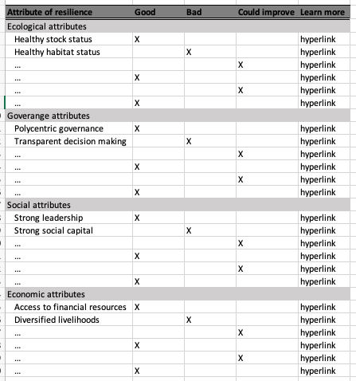
Overview
Environment
Fisheries
Resilience checklist
Resilience tools
Select a country: Brazil
Generate list of potential resilience enhancing actions

Slide 5
Overview
Environment
Fisheries
Resilience checklist
Resilience tools
Select a country: Brazil
Attribute | Action | Example
…. | …. | ….
…. | …. | ….
…. | …. | ….
…. | …. | ….
…. | …. | ….
…. | …. | ….
…. | …. | ….
…. | …. | ….
…. | …. | ….
…. | …. | ….
…. | …. | ….

