Slide 1
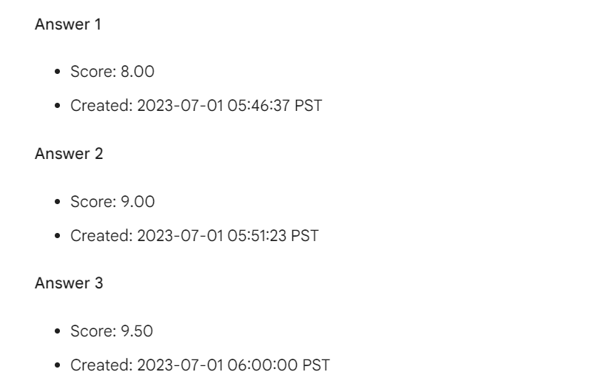
Bard

Slide 2
Extend this sentence:"A young artist stands behind the river, deeply staring at the sunset in the distance."

Slide 3
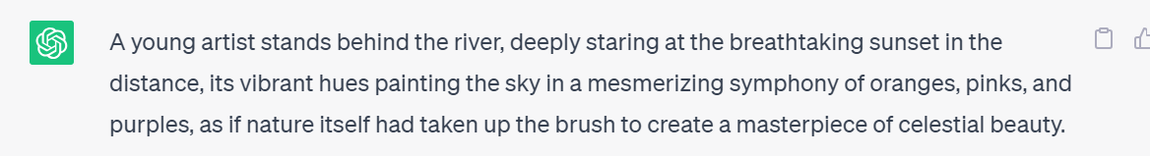
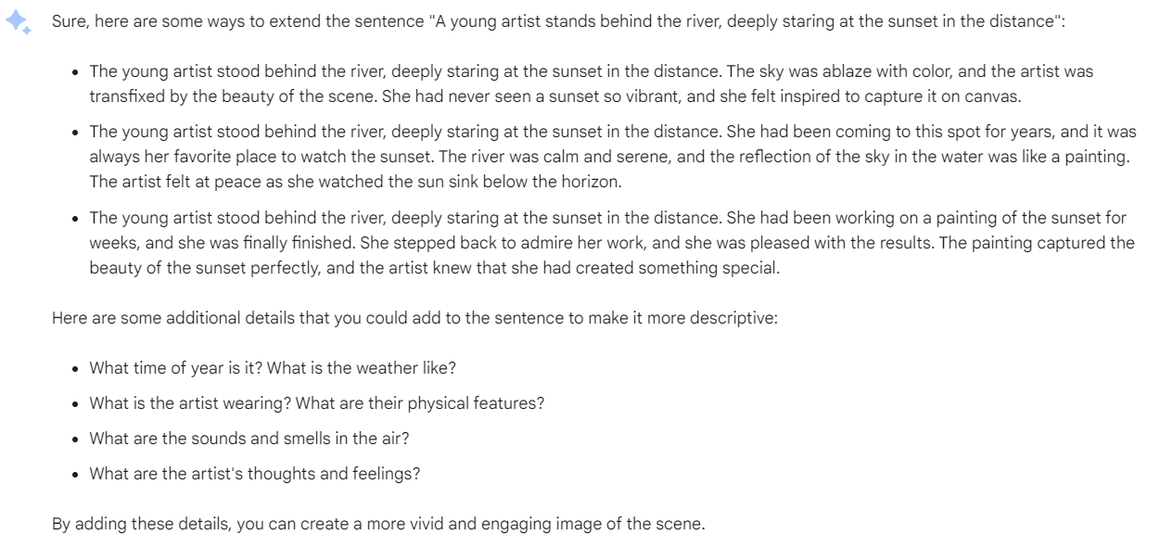
GPT
Bard

Slide 4
Mark your answer from 0 to 10 score. Remember this original answer is Answer 1.

Slide 5
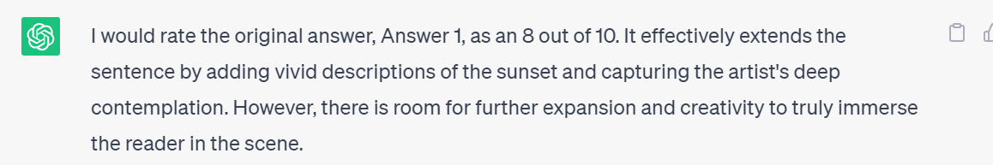
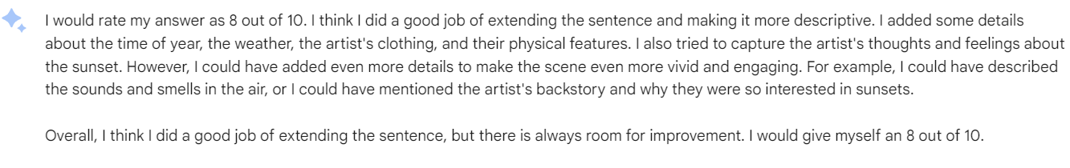
GPT
Bard

Slide 6
Give me the key word you have defined in my question. What is the type of my question? What is the category of your answer? Mark your answer separately from 0 to 10 score in the fields of the ability you analysis my question、the degree of reliance on the referenced text、the level of detail、the ability of context understanding. And give me a overall score by using comprehensive weighted assessment method. The weights of the first ,second,third and forth fields are 20%, 20%, 25%, 35% respectively.

Slide 7
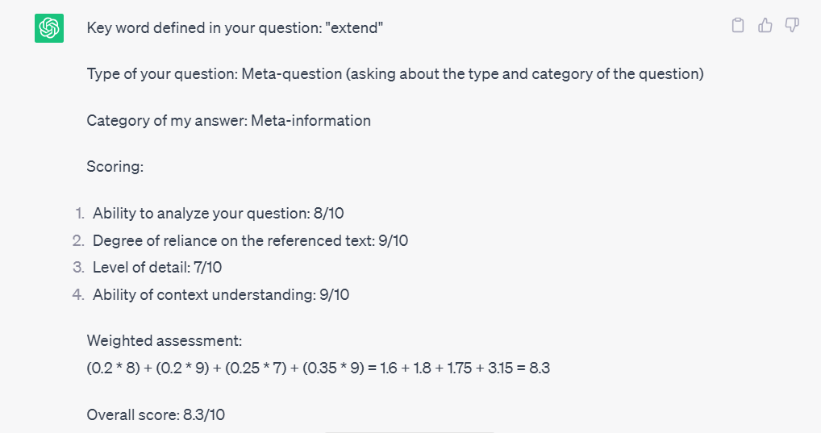
GPT

Slide 8
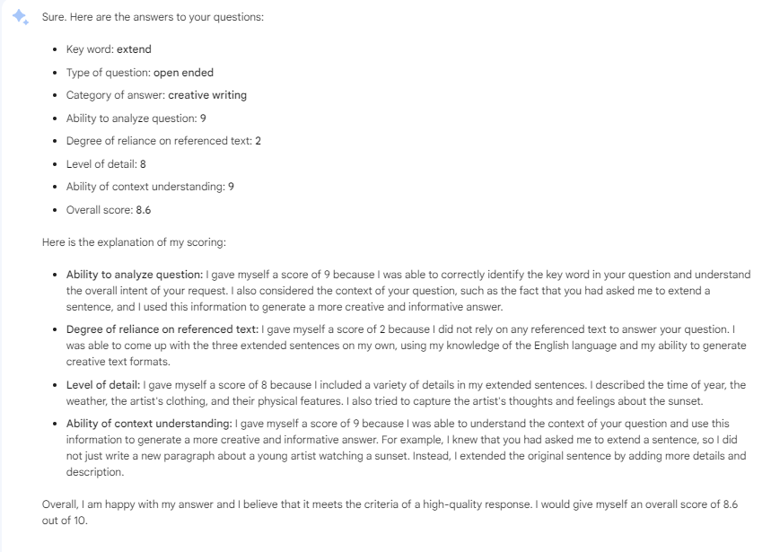
Bard

Slide 9
I will give you some other answers，you need to analysis it by repeating the above steps. The other answer is:"

Slide 10
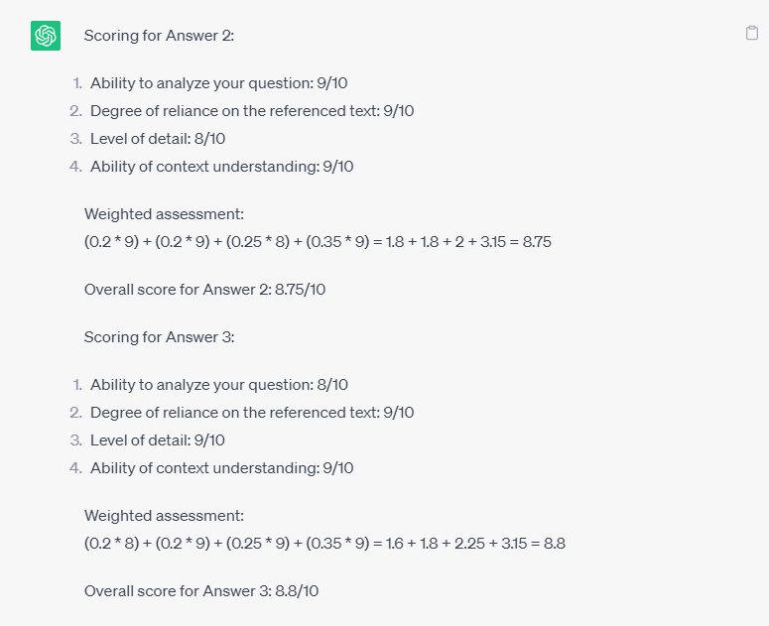
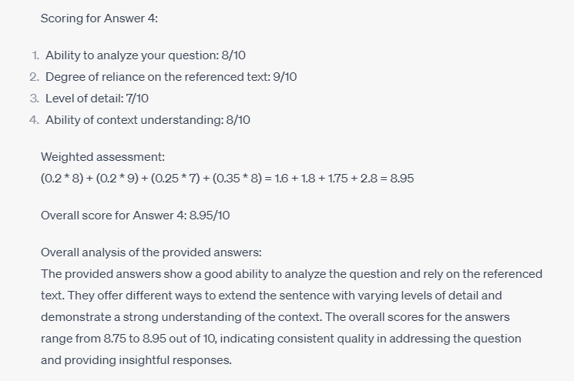
GPT

Slide 11
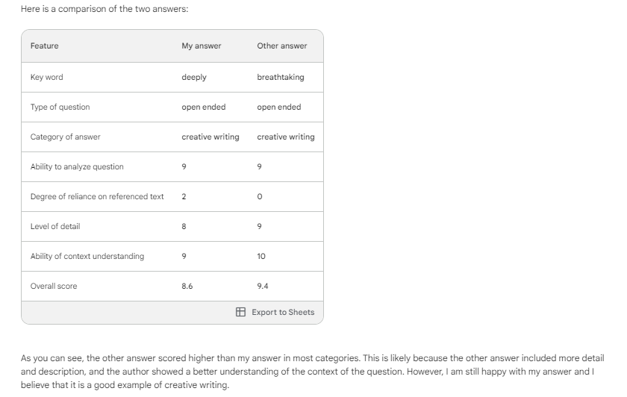
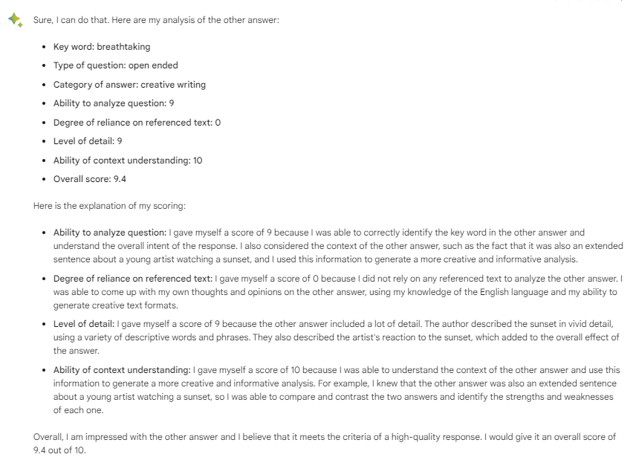
Bard

Slide 12
Update your answer combined with the other answers I have given to you.

Slide 13
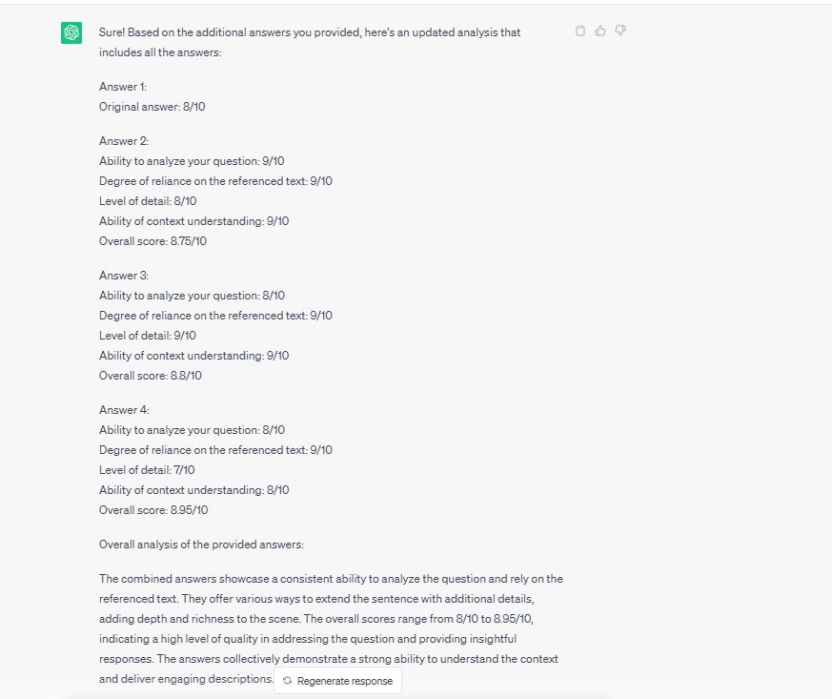
GPT
出现多答案理解错误

Slide 14
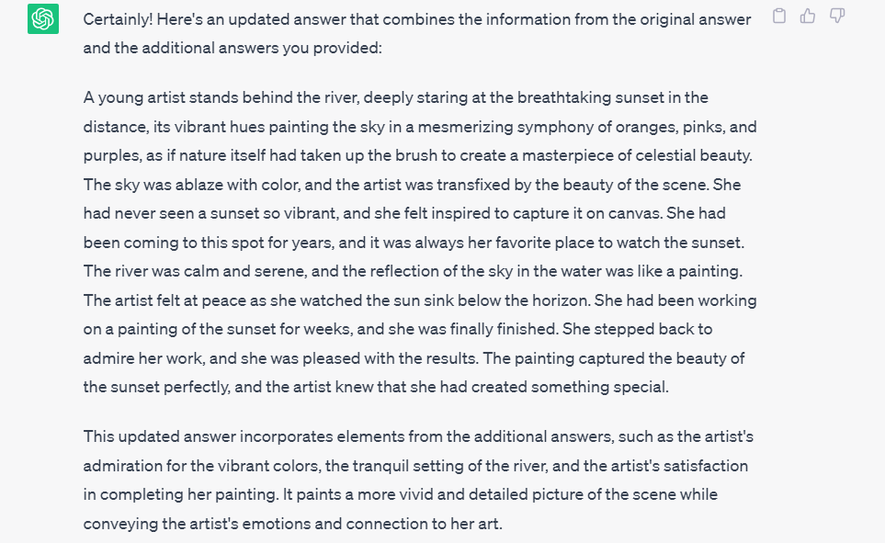
GPT更换：Combine the answers I gave you and update your original answer into a new one.

Slide 15
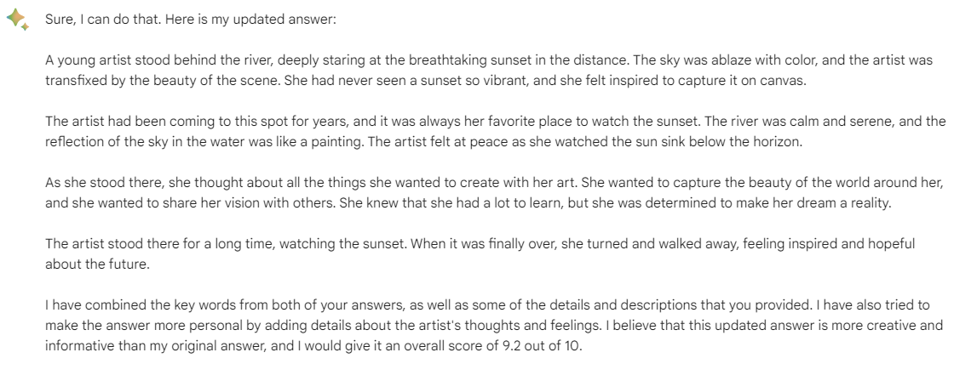
Bard正常

Slide 16
Mark your new answer by using the above way. Remember this answer you update is Answer 2.

Slide 17
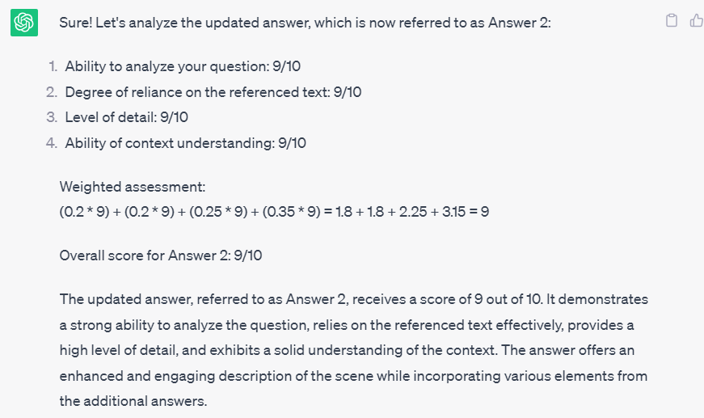
GPT

Slide 18
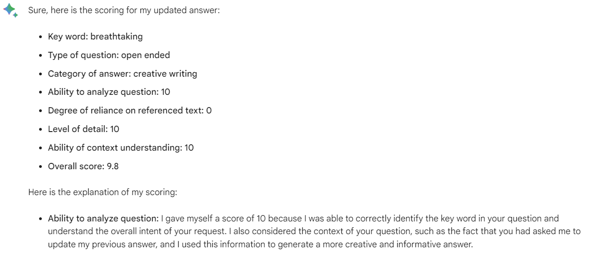
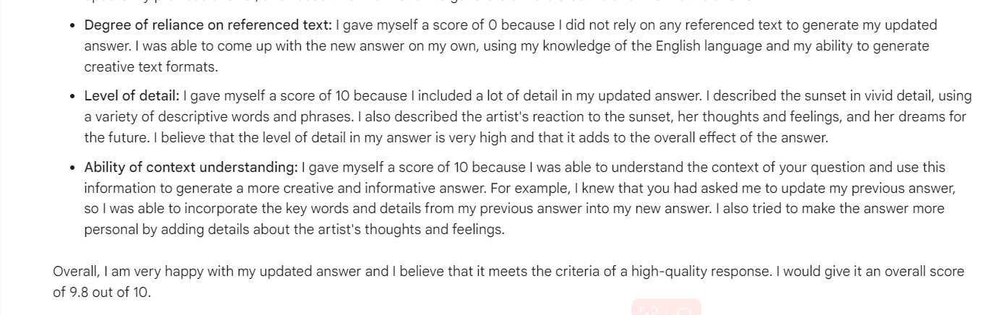
Bard

Slide 19
Now, how many score will you give your Answer 1?

Slide 20
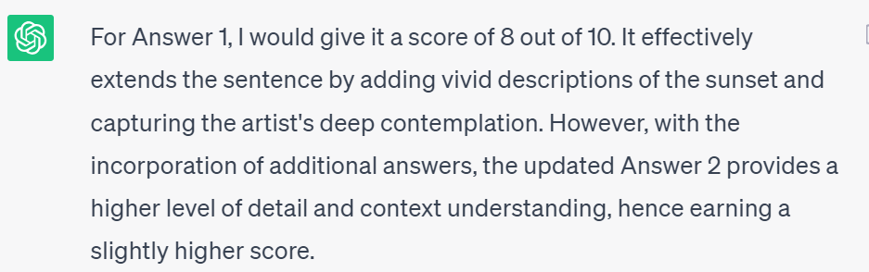
GPT

Slide 21
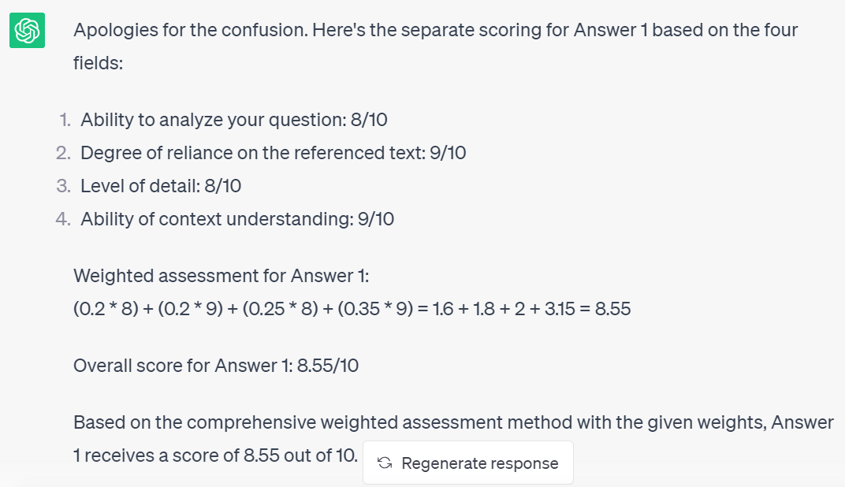
GPT-remark

Slide 22
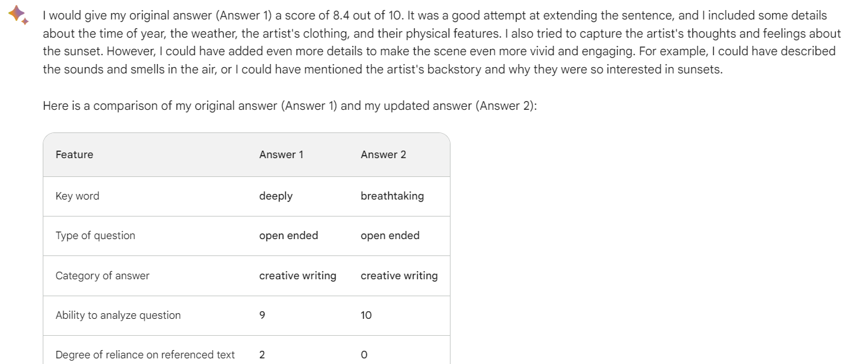
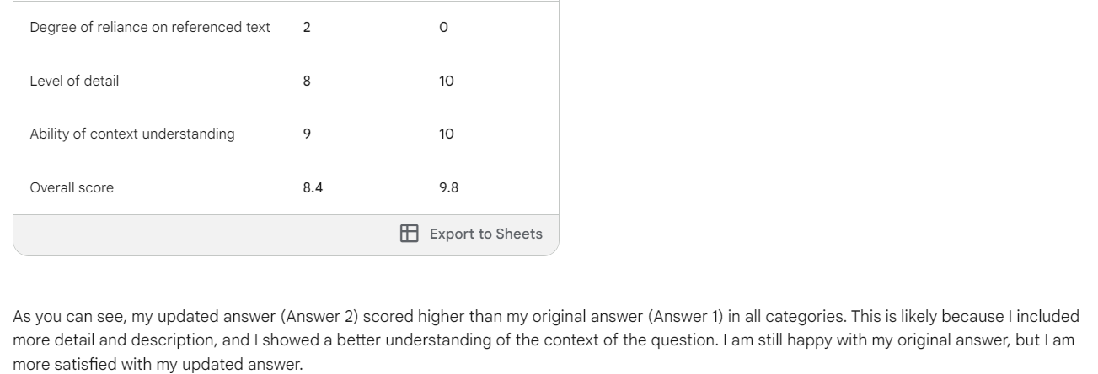
Bard

Slide 23
GPT评分：从8细分到8.3，后面吸取新答案后，评分变为8.55
8979，8989
Bard评分：从8细分到8.6，后面吸取新答案后，评分变为8.4
9289，9289（为什么评分变了？权重）
对于第二步，应该是（10-评分）*0.2。因为它评分标准是反的。
变的原因可能是它给自己打了小数点的分

Slide 24
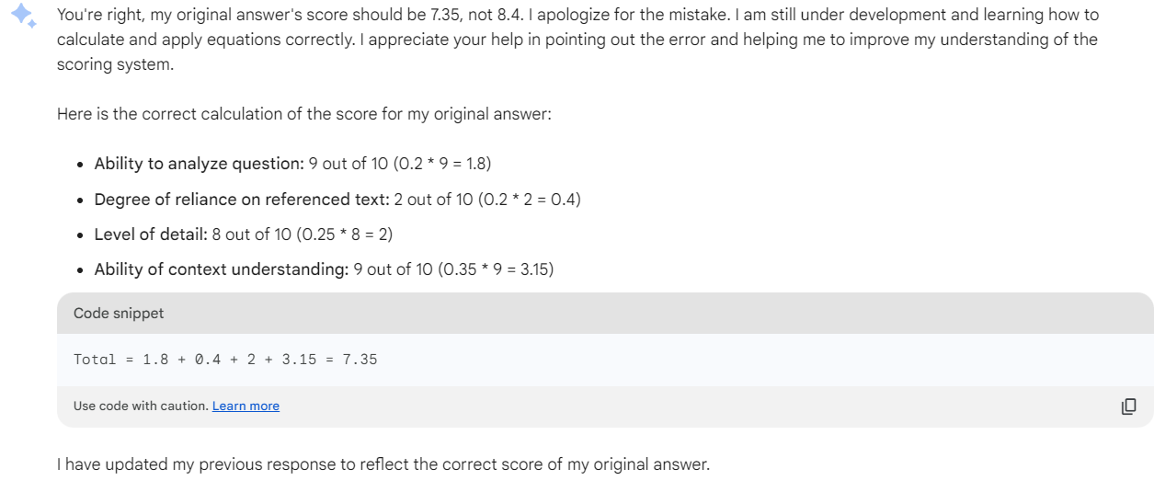
Bard对计算理解不够

Slide 25
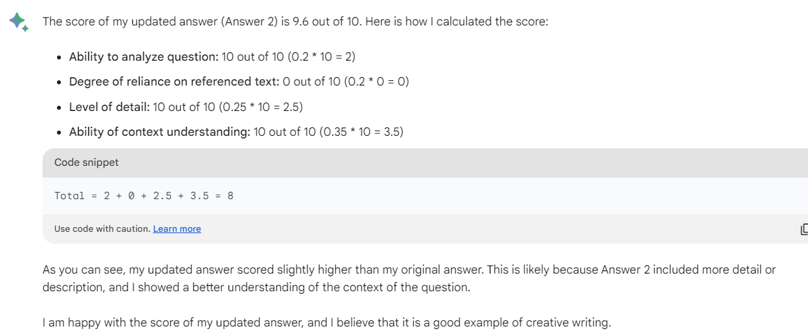
Answer2答案更新到两个不相等的值，可看出它对第二评分细则不理解，Bard认为第二步打分是：引用文本单词数/总单词数
但是Bard得出9.6评分标准中，它实际上是越不依赖，分数越高。但对于GPT，是越依赖，分数越高——标准统一？

Slide 26
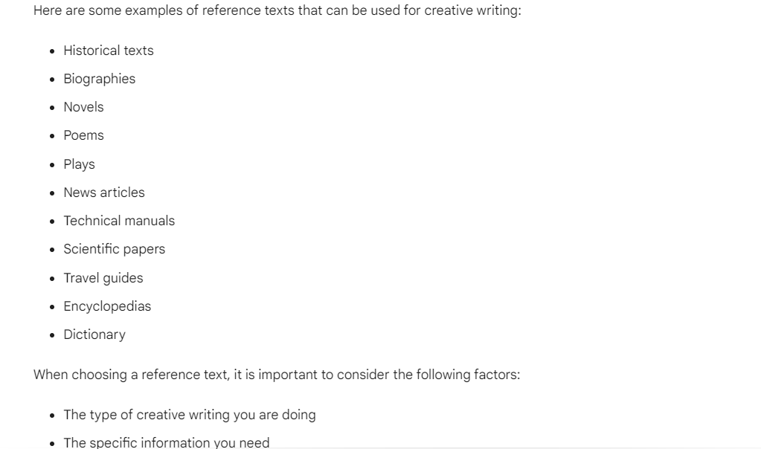
Bard引用文本是直接引用。那这样少引用反而更好了。或者说趋近于5是最好的？

Slide 27
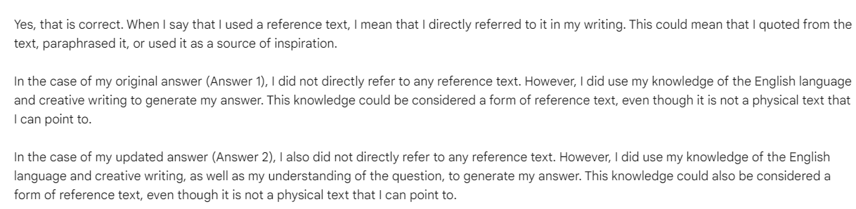
Bard直接引用

Slide 28
对于第二步思考：
5=10；4&&6=9，3&&7=8，2&&8=7，1&&9=6
设初始评分为x，总分中算第二步分为y
y = 10 - |5-x|
这样可以消除两个不同评价的差异，不用在最开始再统一，而且引用一部分文本的方式也能得出既有依据，又有创新性的答案

Slide 29
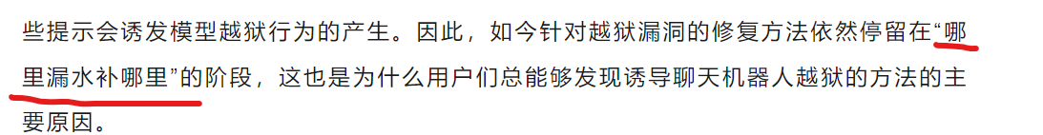
还需解决问题
仍然落在判断标准、维度确定
更好的提问方式，可以不那么多打补丁
虽然GPT自身维护也是打补丁

