Slide 1

AMSTERDAM SCIENCE PARK
STUDY GROUP
A vibrant community that fosters Open Science practices related to data analysis and programming for the natural sciences
Faculty of Sciences (FNWI), University of Amsterdam
https://www.scienceparkstudygroup.info/

Slide 2

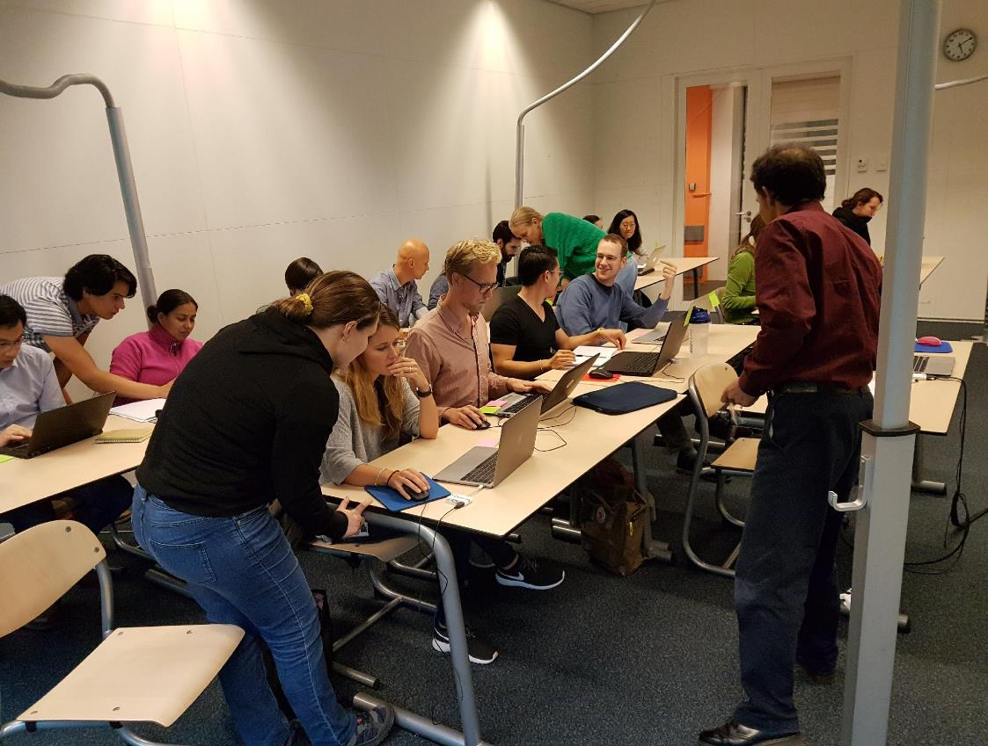
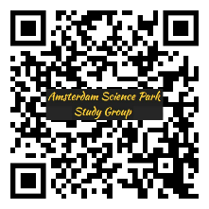
GOALS OF THE STUDY GROUP
Support students (undergraduate to post-graduate) and early career researchers in the Faculty of Science
Empower and provide a safe environment for learning data analysis and programming
Share good data science practices
Promote Open Science

Slide 3
GOALS OF THE STUDY GROUP
Support students (undergraduate to post-graduate) and early career researchers in the Faculty of Science
Empower and provide a safe environment for learning data analysis and programming
Share good data science practices
Promote Open Science

Slide 4
GOALS OF THE STUDY GROUP
Support students (undergraduate to post-graduate) and early career researchers in the Faculty of Science
Empower and provide a safe environment for learning data analysis and programming
Share good data science practices
Promote Open Science

Slide 5
GOALS OF THE STUDY GROUP
Support students (undergraduate to post-graduate) and early career researchers in the Faculty of Science
Empower and provide a safe environment for learning data analysis and programming
Share good data science practices
Promote Open Science

Slide 6



OUR DREAM TEAM (board members)
The Study Group is formed by an interdisciplinary team from multiple natural science domains:
ecology
molecular science
biostatistics
microscopy
geoscience
Together we constitute a pool of experts capable of addressing diverse questions from statistics to software development, from genomics to microscopy.
To join the Study Group, a member nominates its successor.
Tijs Bliek (Technician)
Like Fokkens (Post-doctoral fellow)
Marc Galland (Data scientist)
Joachim Goedhart (Assistant Professor)
Johannes de Groeve (Data Manager)
Huub Hoefsloot (Associate Professor)
Evelien Jongepier (Bioinformatician)
Frans van der Kloet (Research Assistant)
Stacy Shinneman (Geoinformatician)
Images: Flaticon.com

Slide 7






STUDY GROUP HISTORY
Stage 1
community formation
(2017 – 2019)
Stage 2
maturing phase
(2019 – present)
Stage 3
Self-sustainable stage
(future)
Our community building model is fully explained in:
Stevens et al. (2018) Building a local community of practice in scientific programming for life scientists.
PLOS Biology 16(11): e2005561.
First training workshops (n = 2)
16 Co-working sessions
2 Carpentries Instructors trained
1 publication in PLoS Biology
Website creation
Community advertisement
Recruitment of 8 board members
4 Carpentries training workshops
NWO Team Science Award (2020)
Summer school
Board members recruit other
members and contributors
NWO Open Science Fund

Slide 8

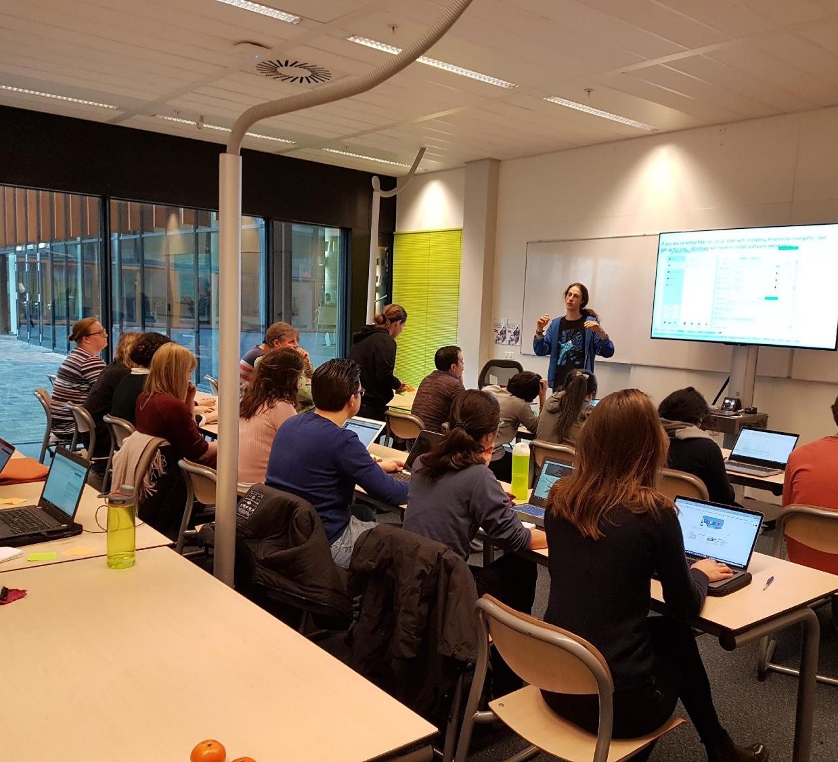
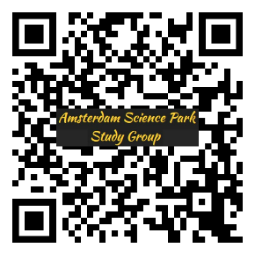

ACHIEVEMENTS
Carpentry workshops organized
2 days each
Themes: Python, R, geospatial data, genomics, etc.
Other events
16 co-working events (“Hacky Hours”)
40 one-hour lessons
Slack workspace for questions
Snakemake day
NWO Team Science Award (2020)
10k€ to expand our activities
First official recognition

Slide 9
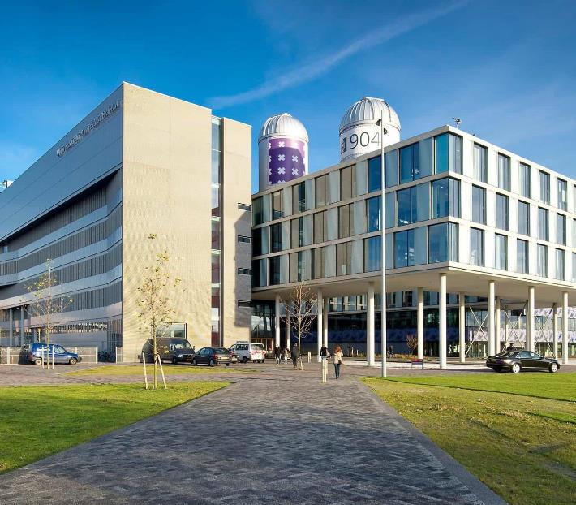


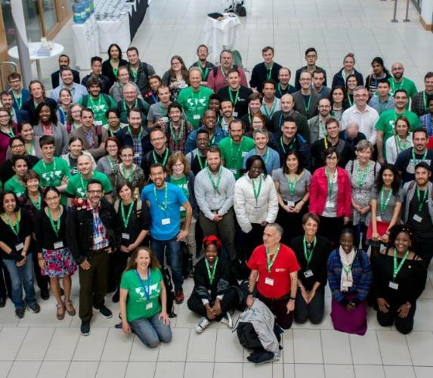
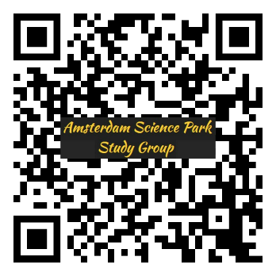
THE FUTURE
Act as a liaison between domains
Interfacing external expertise with local needs
Facilitate working relationships between natural scientists and data scientists
Organise a code Summer Camp
2 weeks for ~30 participants,
All board members involved
Content customized to the needs of the researchers
Become a member of the Carpentries Foundation
Increase the pool of local instructors
Incorporate most recent Carpentries lessons
Network with other European instructors
https://www.scienceparkstudygroup.info/

