Slide 1
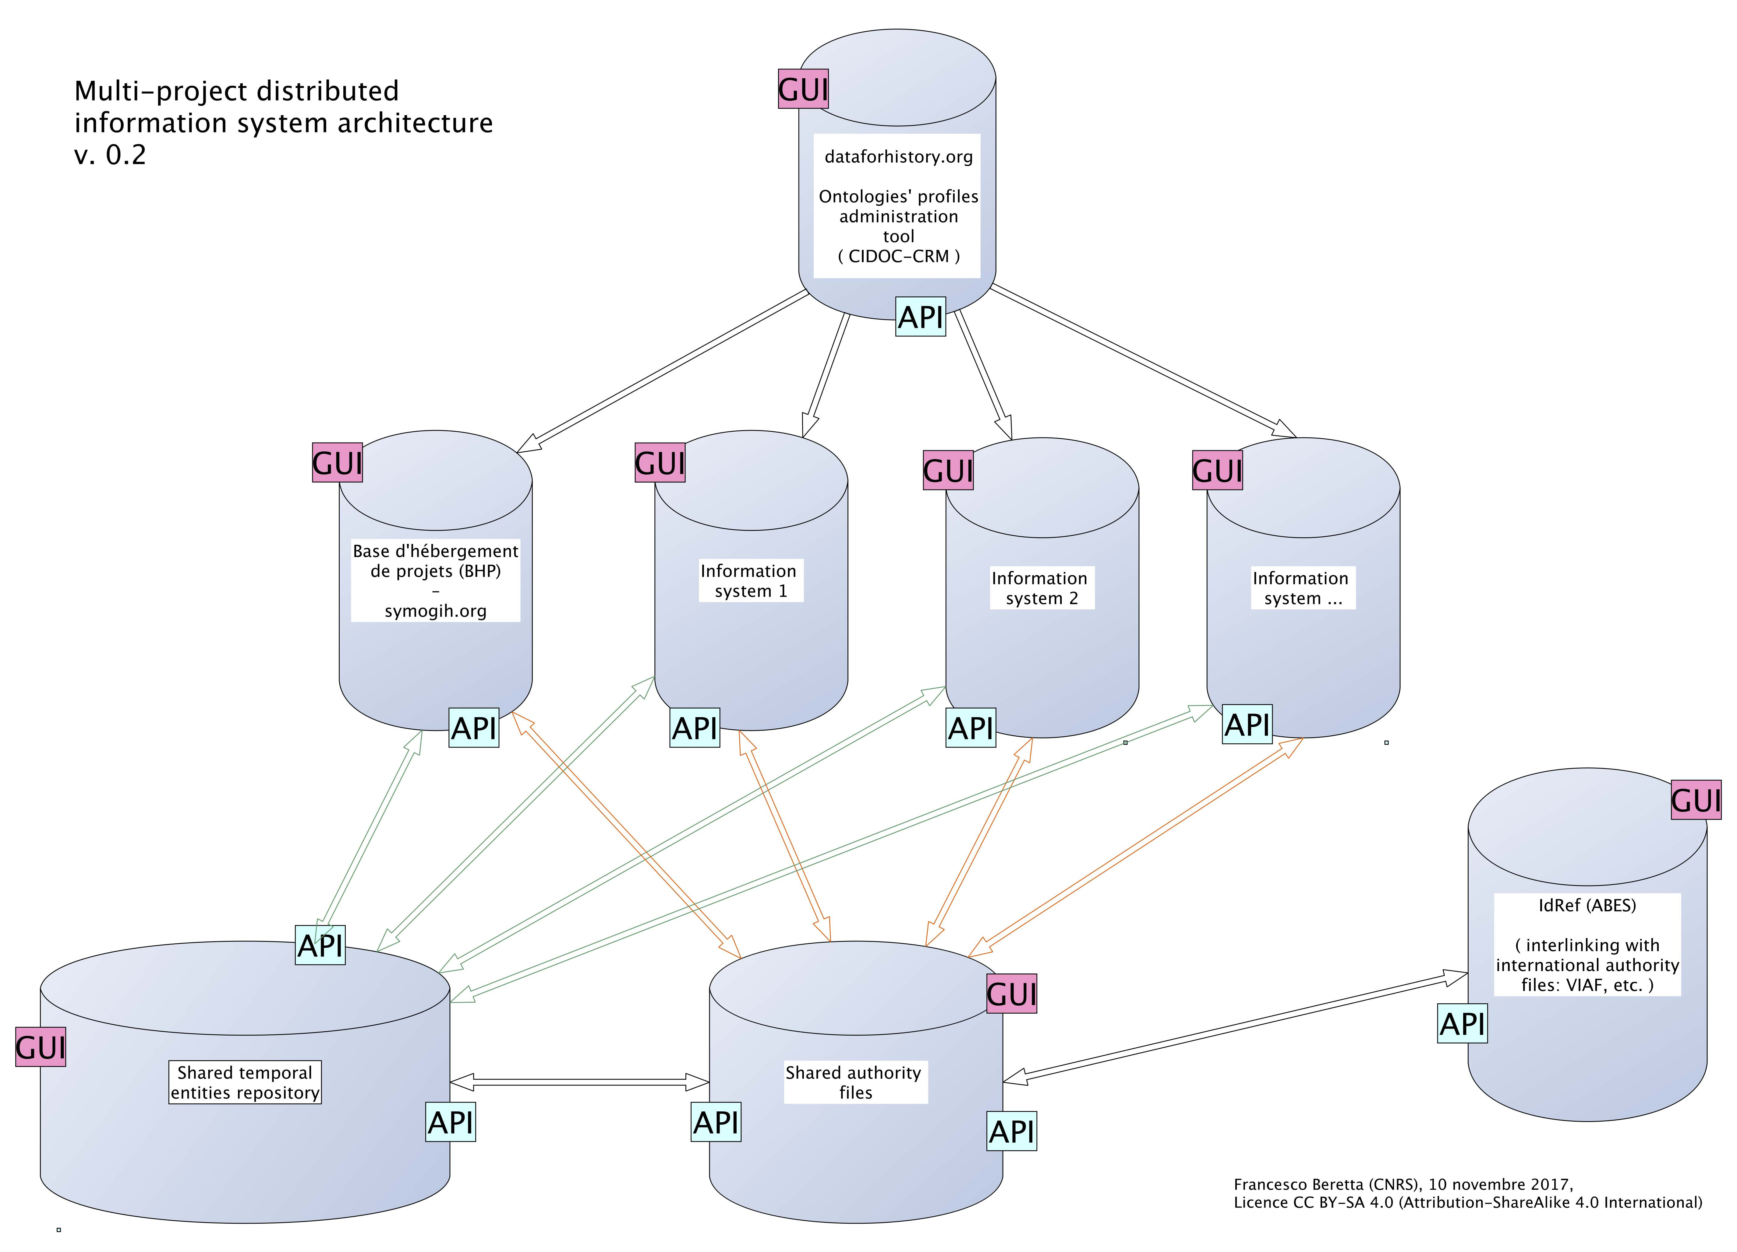
dataforhistory.org
FAIR

Slide 2
TeEn1
Pers
Place
TSpan1
TSpan3
SoCh
TSpan2
Pers
TeEn2
Statement1
Source1

Slide 3
TSpan2
TSpan2

Slide 4
Name
Type
Location
(geo-referenced)
Class
1, 1
0, n
1, n
name
type
locate
0, n
classify
0, n
1, n
1, 1
1,1
Place
0, n
instantiate
0, n
Concrete form
0, n
0, n
Geometry
represent
0, n
exists
during
0, n
Time span

