Slide 1
2018 DL Lab1 Neural network training process
TA: Chun-Hsien, Li
Advisor: Tian-Sheuan, Chang

Slide 2
Objective
Get familiar with python
Understand how neural networks works
Understand how to use backpropagation and gradient descent to train a neural networks
Understand neural networks training process
Build a neural networks model for the classification problem

Slide 3
Tasks
Implement the following layers as a python function(both forward and backward propagation)
Inner-product layer (10%)
Activation layer (20%)
Sigmoid function (10%)
Rectified function (10%)
Loss function (20%)
Softmax with cross entropy (10%)
L2 loss (squared error) (10%)
Build neural networks to solves the Fashion MNIST classification problem
Discuss activation and loss function issue (20% , 1 page A4 in pdf)
Plot iteration accuracy curves of the neural networks (10%)
Performance (Upload results to Kaggle) (20%)
Design your own NN (cannot use convolutional layer)

Slide 4
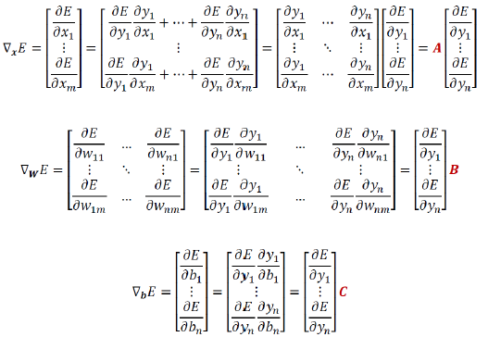
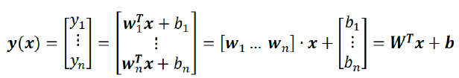
Inner-product layer
Forward-propagation
Backward-propagation
Please find the matrices 𝐀, 𝑩 and 𝐂

Slide 5
Inner-product layer
Backward-propagation
Please find the matrices 𝐀, 𝑩 and 𝐂

Slide 6
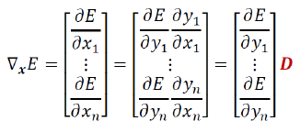
Activation layer – Sigmoid function
Forward-propagation
Backward-propagation
Please find the matrix 𝑫

Slide 7
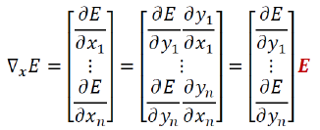
Activation layer – Rectified function
Forward-propagation
Backward-propagation
Please find the matrix 𝑬

Slide 8

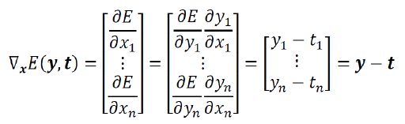
Softmax with cross entropy
Forward-propagation
Backward-propagation

Slide 9

L2 loss
Function

Slide 10
One hidden-layer neural networks
Softmax
L2 loss

Slide 11
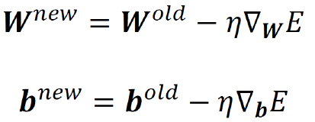
Gradient Descent
In the neural networks, there are only the inner-product layers have parameters to be optimized
Using gradient descent to optimized parameters in inner-production layers

Slide 12
Cross validation

Slide 13
Coding detail – Layer Details
Implement the following .ipynb file
ID_DL_Softmax.ipynb
Neural network with softmax
ID_DL_L2loss.ipynb
Neural network with L2 loss
ID_DL_BestNN.ipynb
Neural network with L2 loss
.ipynb is a ipython notebook file
Almost the same as python but easier and clear to understand
Open .ipynb file
srun --gres=gpu:1 --x11=first -u jupyter notebook
System requirement
Python 2.7 / 3.4
Numpy
Matplotlib

Slide 14
Coding detail – Training and Testing
For propagation of the neural networks layer
InnerProduct_ForProp
InnerProduct_BackProp
L2Loss_BackProp
Softmax_ForProp
Softmax_BackProp
Sigmoid_ForProp
Sigmoid_BackProp
Rectified_ForProp
Rectified_BackProp
Implement whole training and testing process
Including cross-validation

Slide 15
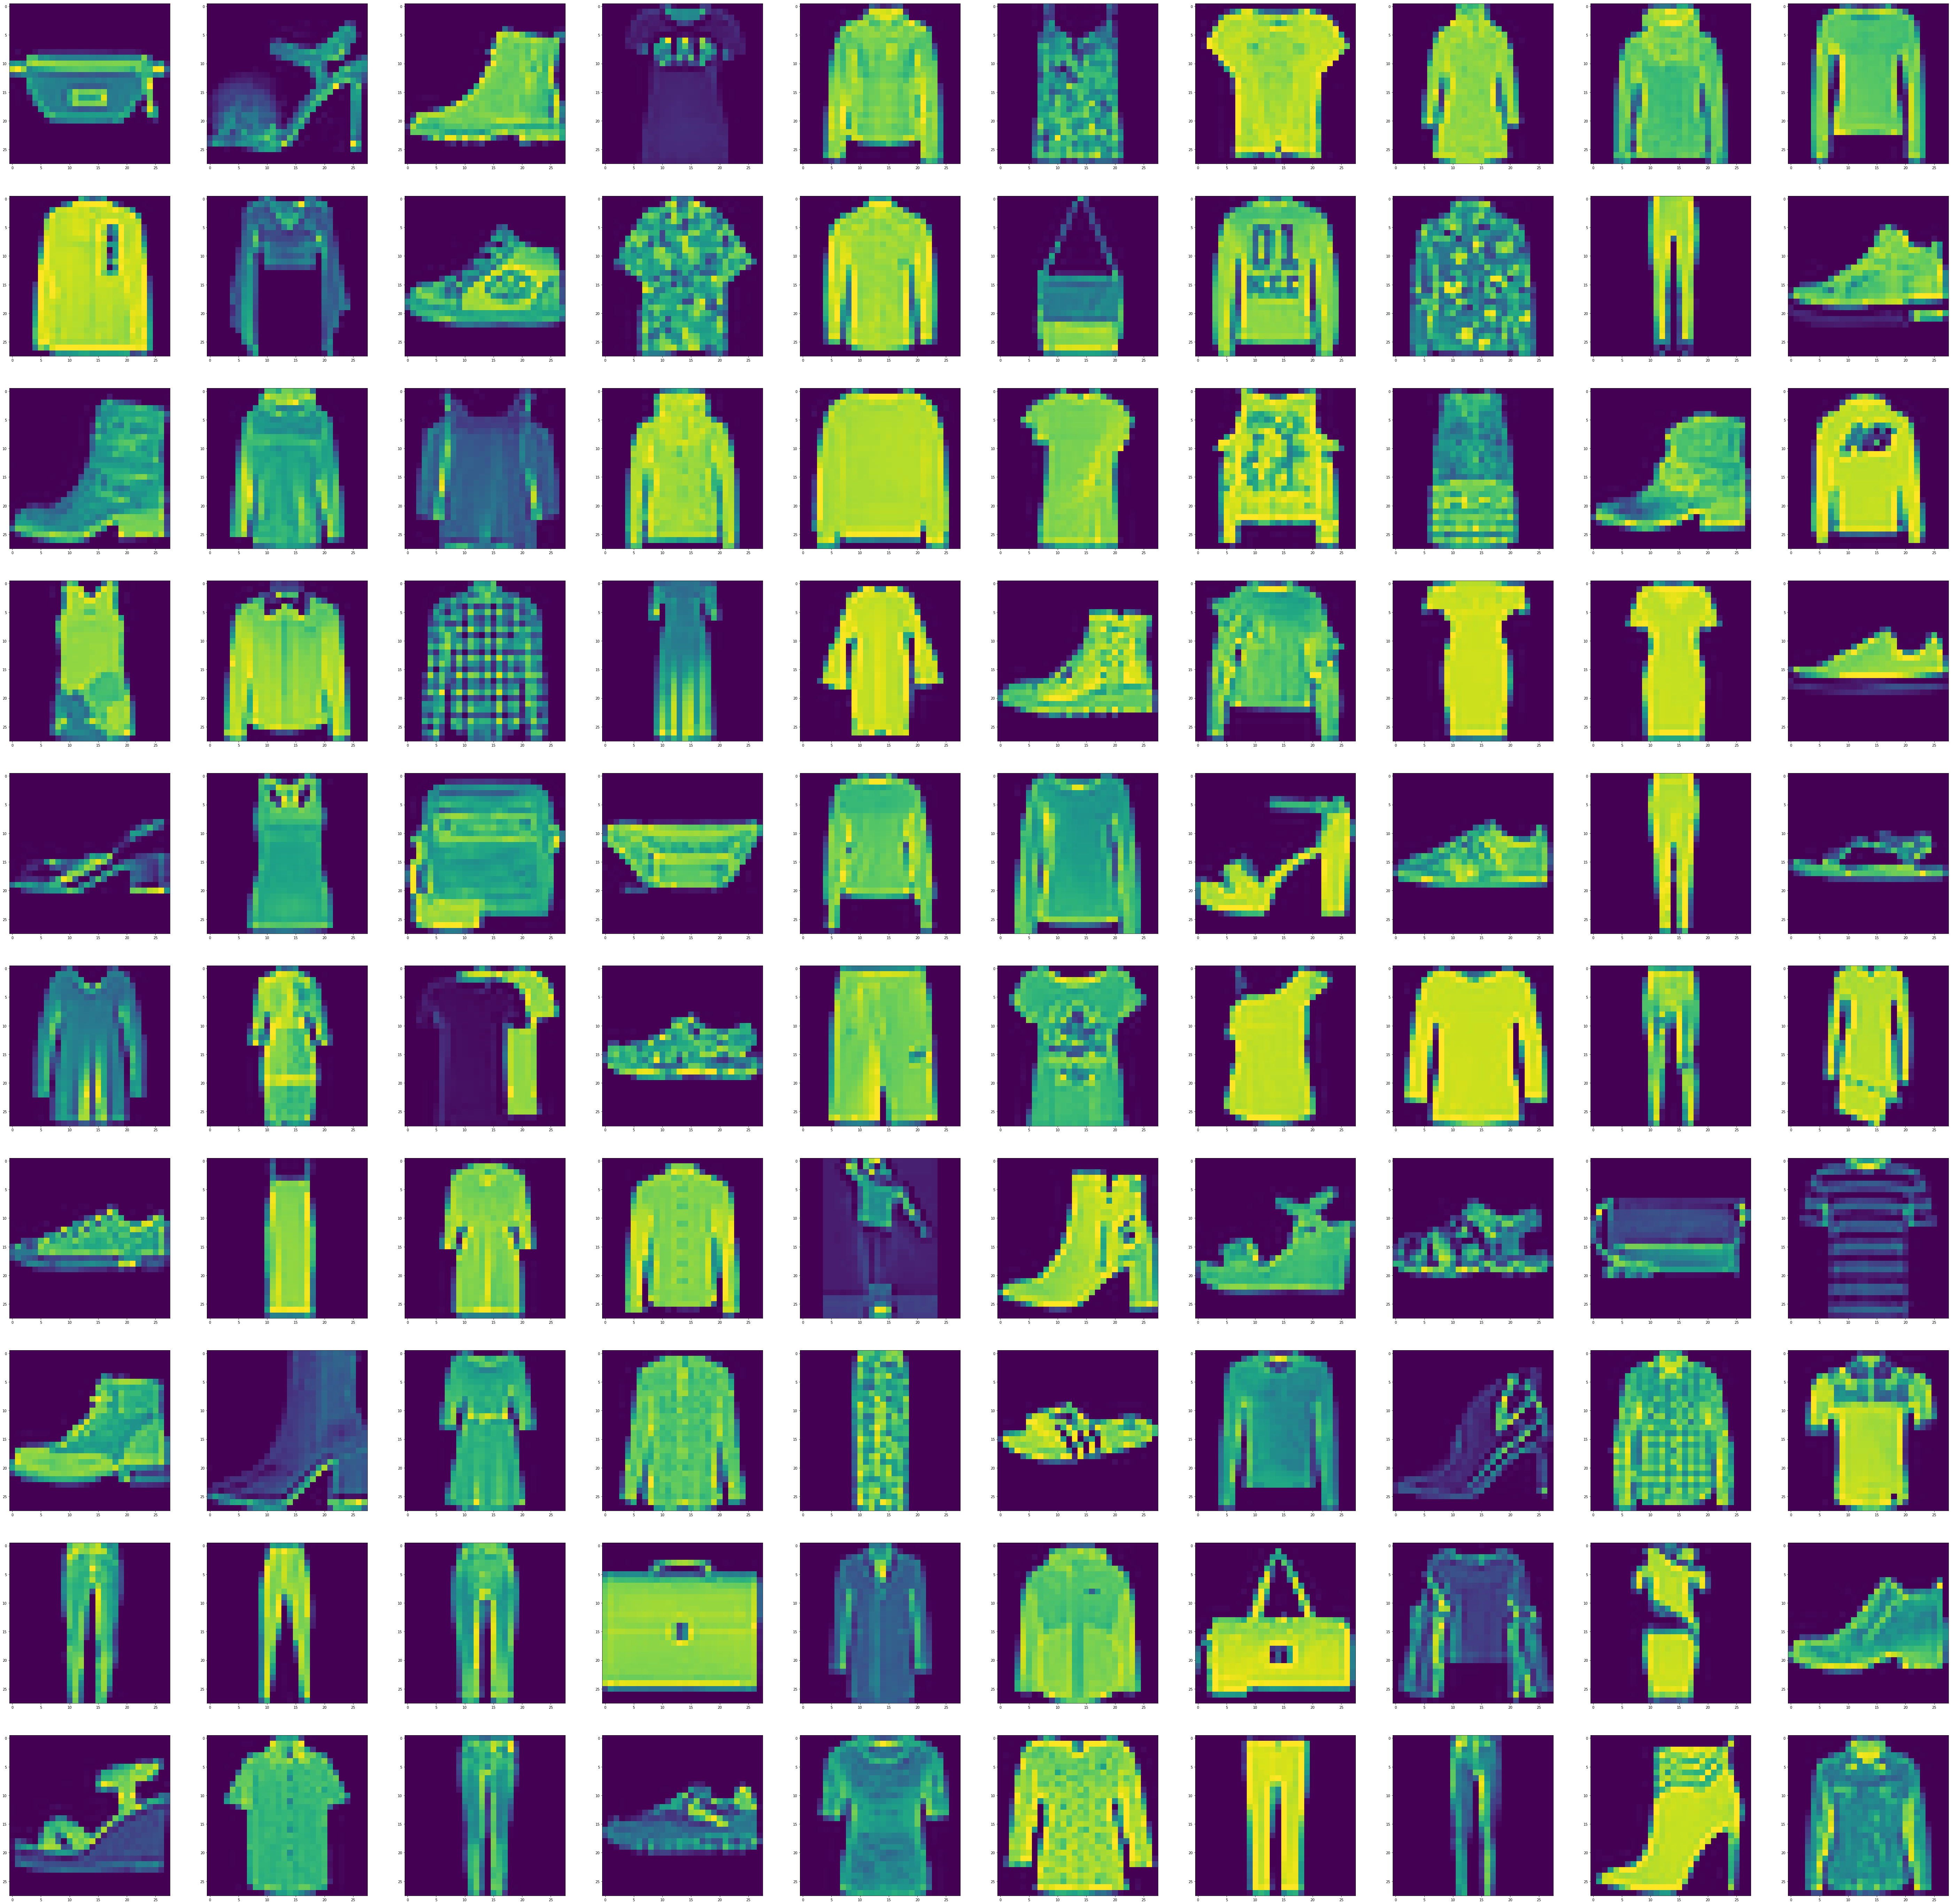
Coding detail - Dataset
Fashion MNIST
Fashion-MNIST is a dataset of Zalando's article images—consisting of a training set of 60,000 examples and a test set of 10,000 examples.
Each example is a 28x28 grayscale image, associated with a label from 10 classes.
Parser of Fashion MNIST is already done for you by
fashion-mnist_test_data.csv
fashion-mnist_train_data.csv
fashion-mnist_train_label.csv
Run the block “Prepare all the data” in the .ipynb files
Data will put into “train_data_img”、 “valid_data_img”、 “test_data_img”
Labels will put into “train_data_lab”、 “valid_data_lab”

Slide 16
Upload to E3
These two .ipynb file and .pdf file (50%)
ID_DL_Softmax.ipynb
ID_DL_L2loss.ipynb
ID_Report.pdf
ID_Report.pdf (20%+10%)
Discuss different activation function (5%)
Discuss different loss function (5%)
Describe the structure of your best NNs (5%)
Discuss what the optimization you do (5%)
Write down the table format like right side
Iteration accuracy curves (10%)
Notice!!!
Change ID to your ID_number
Don’t compress all the files
Item | Accuracy
Benchmark: NN*1+L2 loss | 60%
Add 2 hidden layers | 70%
Change loss to softmax | 85%
Initial the weight by random normal | 92%
…etc. | ???

Slide 17
Download the files and upload the results to Kaggle
Download the files
fashion-mnist_test_data.csv
fashion-mnist_train_data.csv
fashion-mnist_train_label.csv
ID_DL_L2loss.ipynb
ID_DL_Softmax.ipynb
All the loading data functions are already written down in the .ipynb file
Upload the .csv result file
DL_LAB1_prediction_ID.csv
Use the convert function block in the .ipynb file
Prepare your output data (10000,10)
Rename that to fit the function input

Slide 18

Kaggle-Account creating
Address: https://www.kaggle.com/

Slide 19
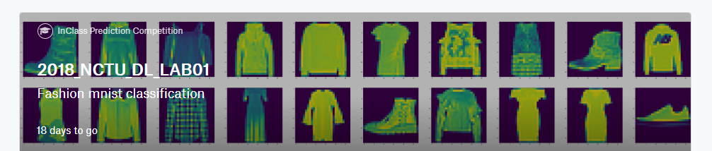
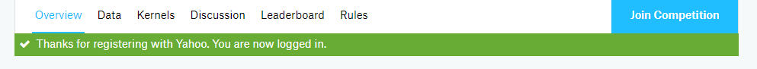
Kaggle-Join the private competitions
Use private URL: https://www.kaggle.com/t/403063f827794b43a320066bcf61888e

Slide 20
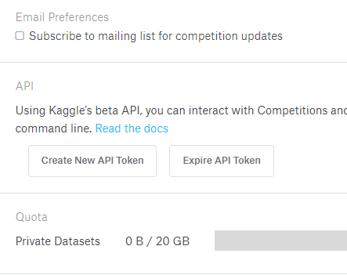
Use kaggle to download the data
Go to “My Account”
Find the “API”
Download the kaggle.json
Use SFTP Upload the file to “~/.kaggle”
Download instruction
srun kaggle competitions download -c 2018-nctu-dl-lab01
File will download to “~/.kaggle”
Unzip the .zip file and move that to your own folder
unzip FileName.zip
Don’t press the “Expire API Token” after you already set the environment or you need to re-run the steps

Slide 21
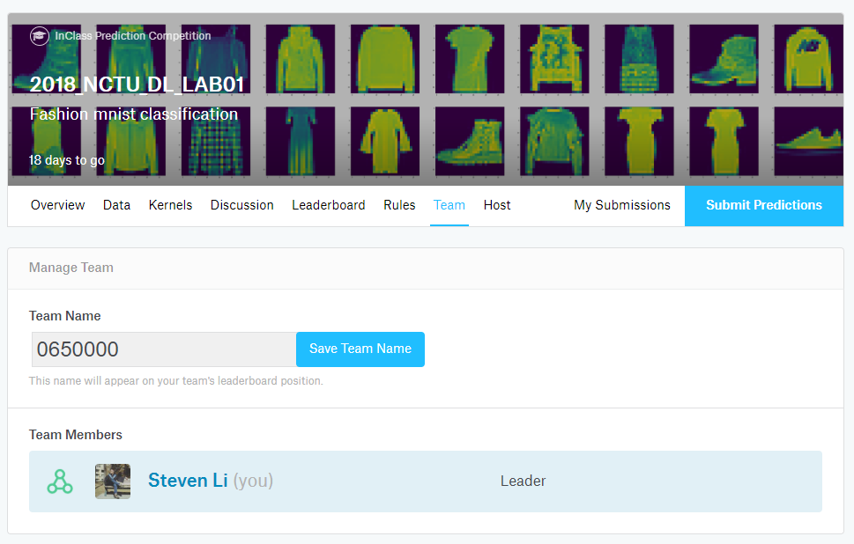
Notice!!!
Change your team name to your ID
If TA can not find your ID, the grade will be “0”
You only have 20 times maximum daily submissions

Slide 22
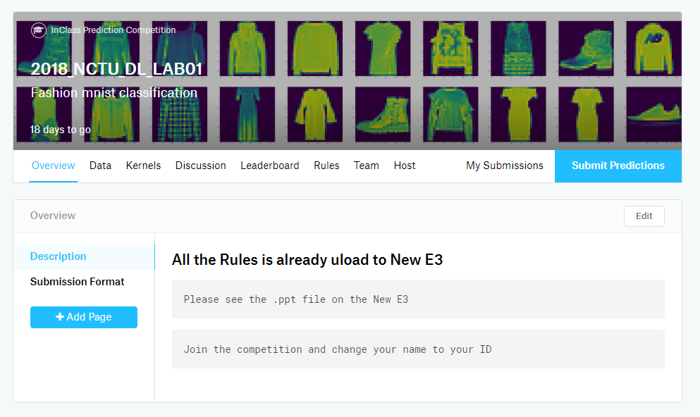
Use Kaggle to submit your result
You need to submit the result to the Kaggle
The result need to follow the format file
.csv file
Label rules
Label | Description
0 | T-shirt/top
1 | Trouser
2 | Pullover
3 | Dress
4 | Coat
5 | Sandal
6 | Shirt
7 | Sneaker
8 | Bag
9 | Ankle boot

Slide 23
Competitions rules (20%)
Accuracy
Acc. < 80% : Grade = 0 point
80% <= Acc. <81%: Grade = 1 point
81% <= Acc. <82%: Grade = 2 points
…
98% <= Acc. <99%: Grade = 19 points
99% <= Acc. <=100%: Grade = 20 points

